Slide 1
NATO NMW COE
Drifting mines: still a threat?
Cdr (OF-4) BEL N Filip CLAUWAERT
Director NATO NMW COE

Slide 2
AGENDA
What is a COE?
What is a drifting Mine
History
Legislation
Detection – Neutralization
Conclusion – Way ahead

Slide 3
CENTRES OF EXCELLENCE
A COE is a multi-nationally or nationally established and sponsored entity, which offers recognized expertise and experience within a defined subject matter area to the benefit of the Alliance within the four pillars of NATO COE’s program....
...A COE is not a part of the NATO Command Structure or of other NATO entities

Slide 4









THE 4 PILLARS
Education
and Training
Concept Development
and Experimentation
Analysis and
Lessons Learned
Doctrine Development and Standards

Slide 5
Program of Work(POW)
Future Naval Mine Warfare Concept 2040+
Exercise REPMUS in Portugal: Robotic Experimentation and Prototyping exercise using Maritime Uncrewed Systems

Slide 6
What is a drifting mine
Floating Mine. A mine visible on the surface of the water. It can be either a Drifting Mine, a Free Mine or a Watching Mine.
  Drifting Mine. An intentionally deployed buoyant or neutrally buoyant mine, able to move under the influence of wind, waves, current or tide.
  Free Mine. A moored mine whose mooring has parted or been cut.
It is possible for a Drifting Mine or Free Mine to be partially buoyant and therefore not be visible from the surface and able to move with the current or tide.

Slide 7
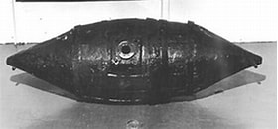
History
16th century in Imperial China
Independence War 1777 “Battle of the Kegs”
Crimean War 1853-1856
US Civil War 1863-1866
Russo-Japanese War 1904-1905
…

Slide 8
Legal framework
International conventions and laws’charters:
  1. The 1907 Hague VIII Convention;
  2. The 1949 Geneva Convention;
  3. The 1982 UN Convention on the Law of the Sea (UNCLOS- 82)
  4. The 1995 “San Remo Manual” on International Law Applicable to Armed Conflicts at Sea.

Slide 9
Legal framework
“Free-floating mines (drifting mines) are forbidden unless they are directed against a military objective and they become harmless within an hour after control over the mine is lost”

Slide 10
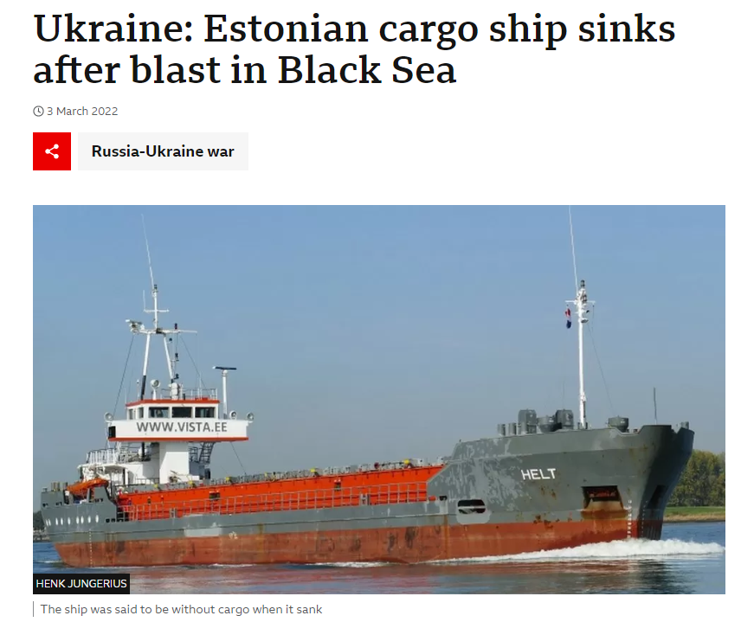
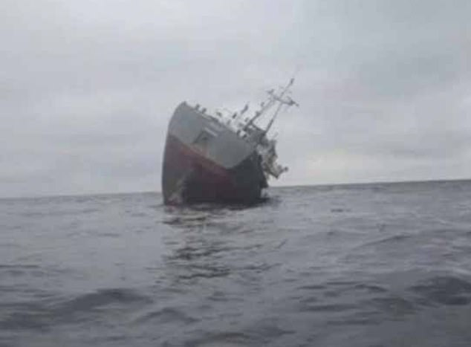
Drifting Mines: still a threat?

Slide 11
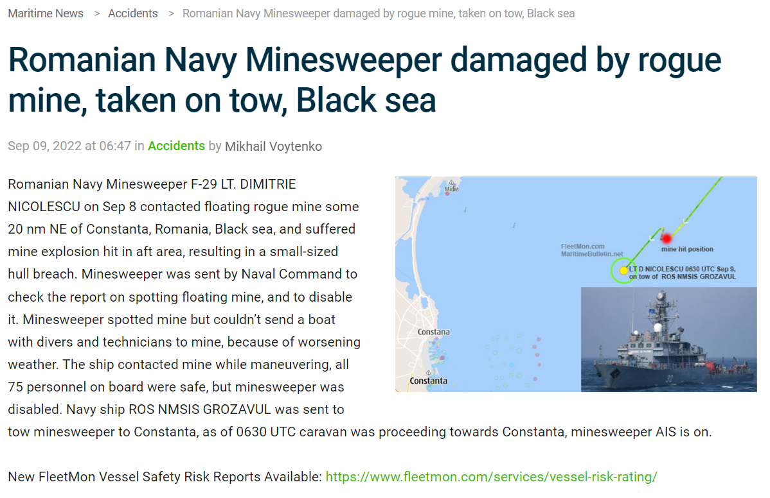
Drifting Mines: still a threat?

Slide 12
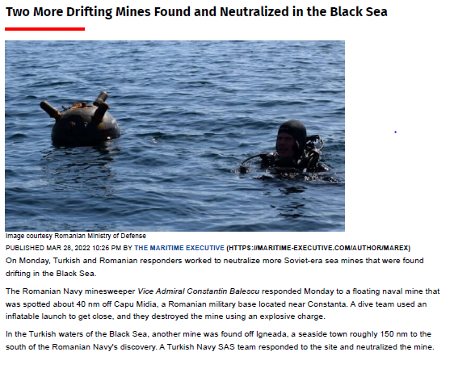
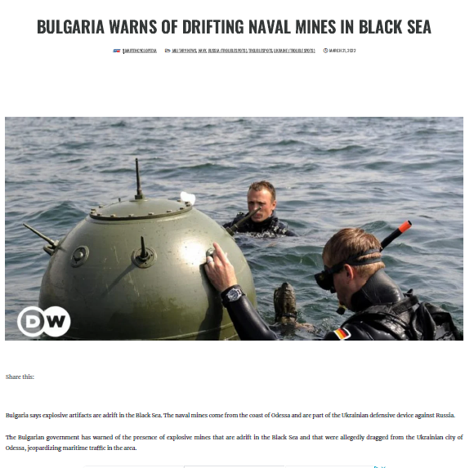
Drifting Mines: still a threat?

Slide 13
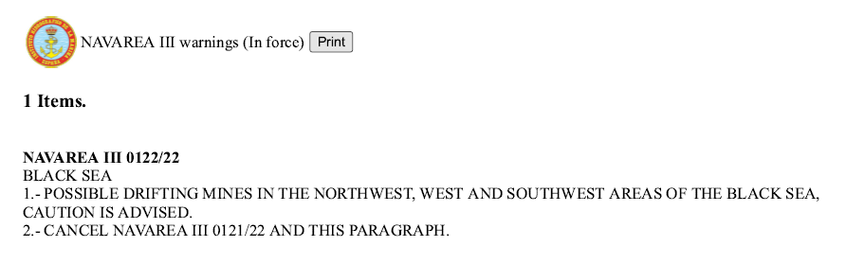
Drifting Mines: still a threat?
Drifting Black Sea mines put fishermen at risk – DW – 04/27/2023

Slide 14
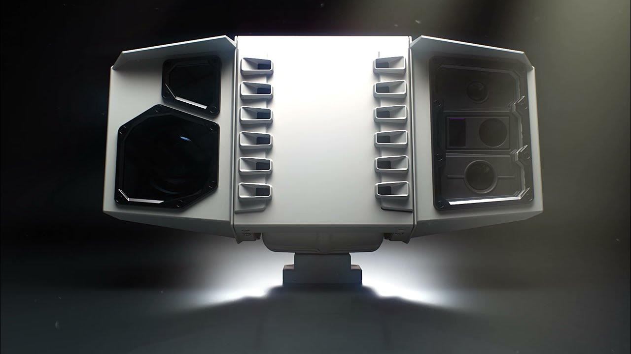
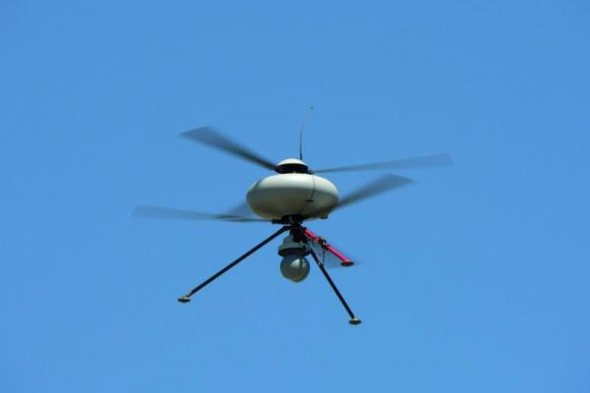

Detection
Eyeball Mk-1
Aerial detection
EO(Electro-optic)
LIDAR(Light Detection And Ranging)
…
OSCAR (FRA)
ECA VTOL IT180 UAV (FRA)
Cobra(USA)
MILSAR(TUR)

Slide 15
Neutralization
EOD Divers
Machine gun
Autonomous Underwater Vehicle(AUV)
…

Slide 16
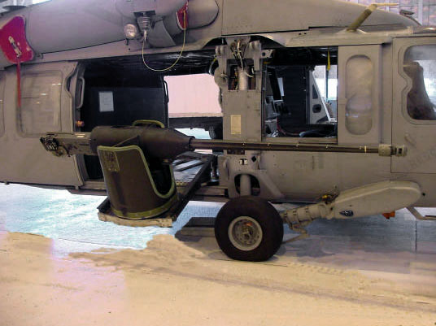
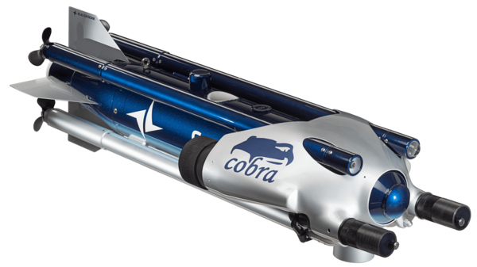
Neutralization
COBRA SeaFox (DEU)
Rapid Airborne Mine Clearance system (RAMICS) (USA)
AN/ASQ-235 Airborne Mine Neutralization System (USA)
BAE Archerfish (GBR)

Slide 17
Neutralization
Seagull USV(Israel)
OTO Hitrole (Italy)

Slide 18
Conclusion/Way ahead
Al current systems have limitations due to meteorological factors
Nations/Industry/Academici have to continue to investigate how to tackle the challenge of Drifting Mines
Protection of Critical infrastructure e.g. Oil/Gas rigs

Slide 19
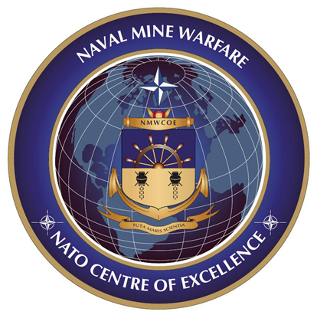
NATO NMW COE
QUESTIONS
?
Filip Clauwaert
CDR (OF-4) BEL NAVY
Director NATO NMW COE
nmwcoe-DIR@mil.be (UNCLAS)
nmw-coe@mil.be (UNCLAS COE collective mail)
nmwcoe@joint.mil.be (NSWAN)

