Slide 1

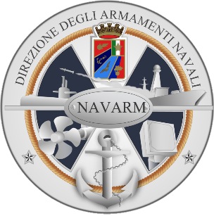

Secretariat General of Defence / National Armaments Directorate
Special and Diving Operation
Submarine Rescue Ship
SDO-SuRS
Cdr Emanuele DE MINICIS
Head of International Cooperations Service
Notes:
1

Slide 2
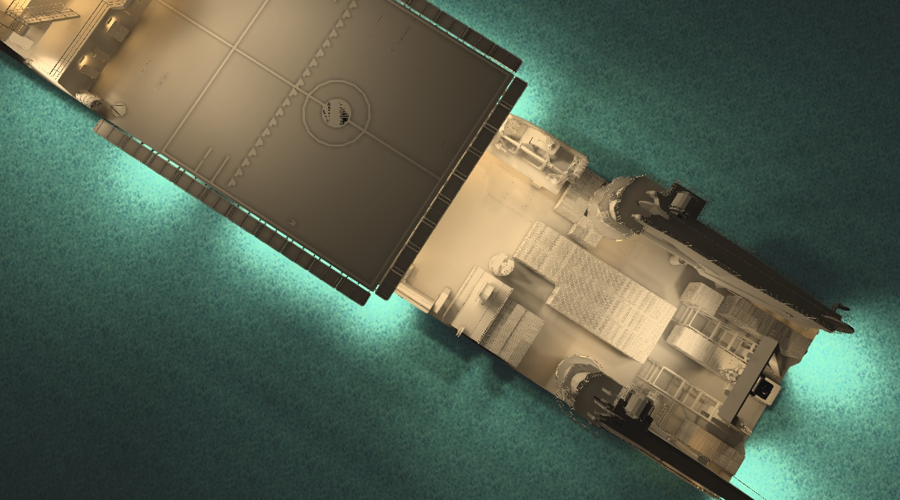
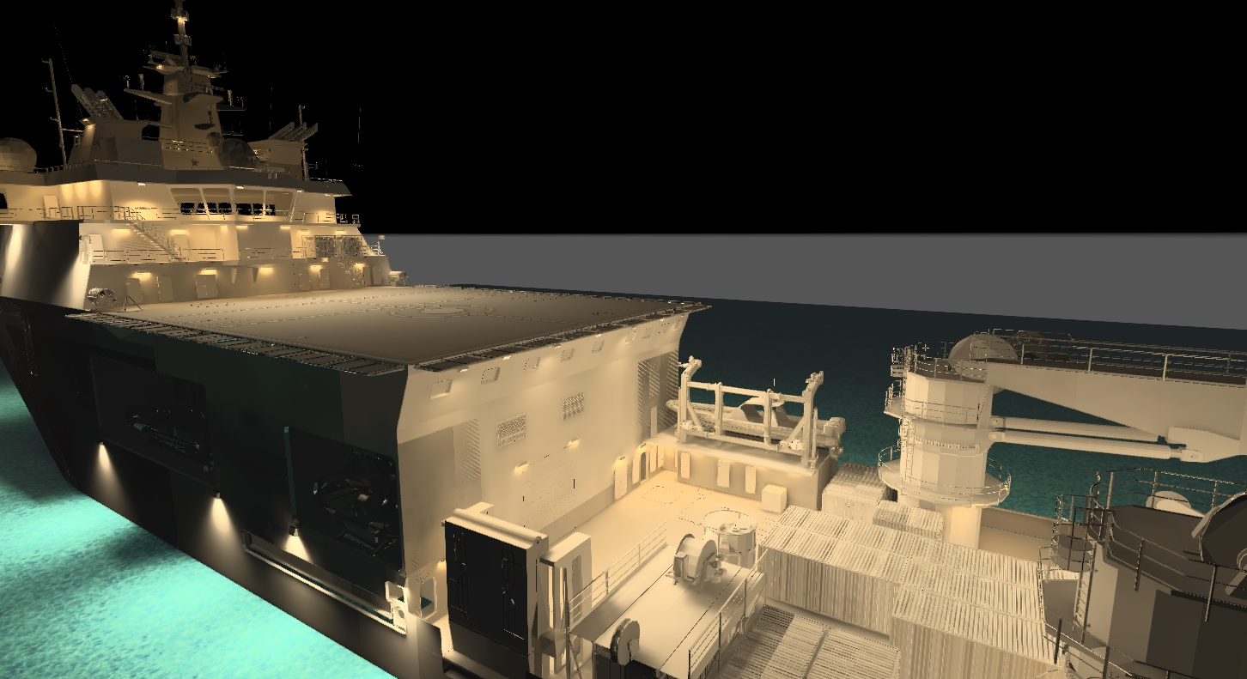
AGENDA
Mission
Special operations
Diving Operations
Submarine Rescue assets
Conclusion

Slide 3
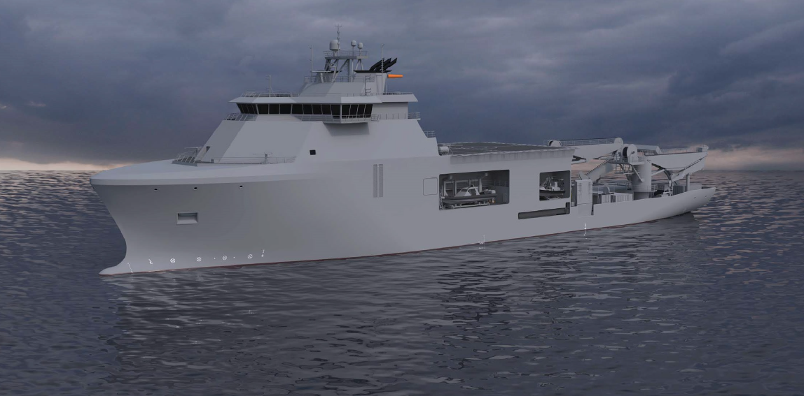
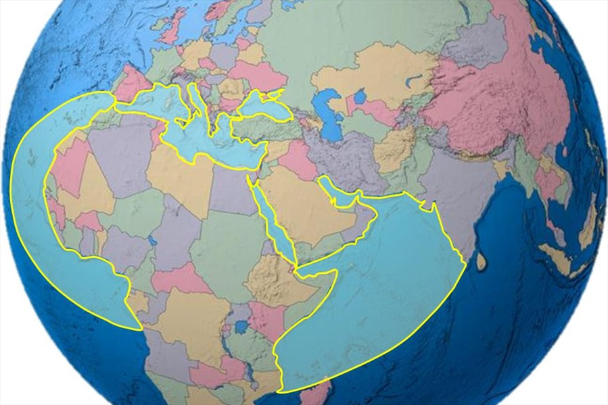
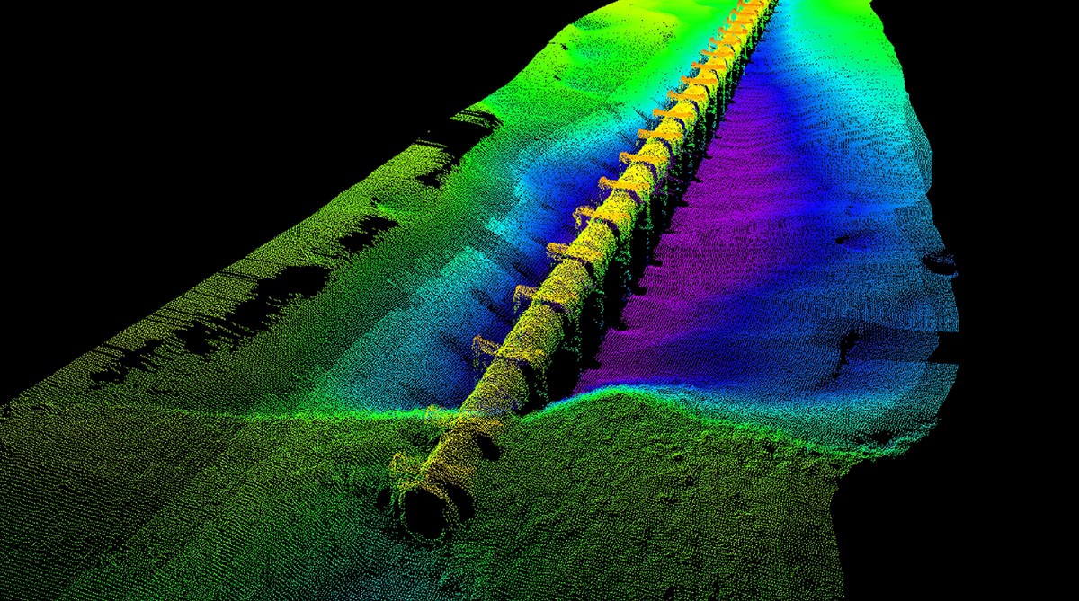
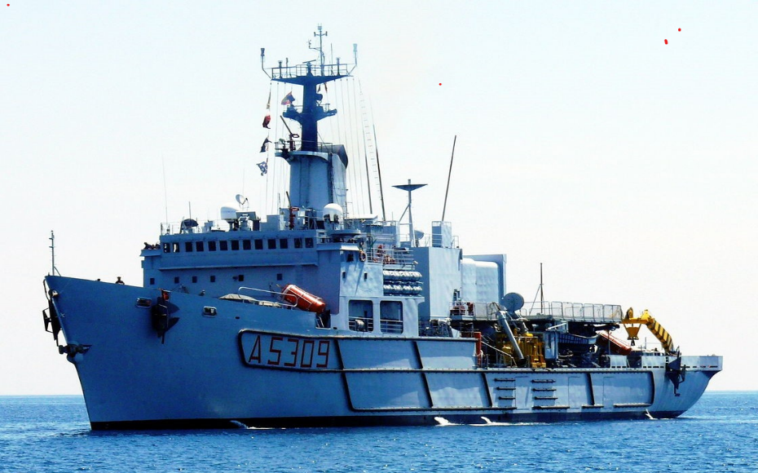
MISSION

Slide 4
MISSION
Support Unit for the Diving Operations Group (GOS) of the Italian Navy for Diving Operation (DO);
Support Unit for operational/training activities, with an underwater/amphibious connotation, of Special Forces (GOI) for Special Operation (SO);
Capability to carry on operative and training activities for distressed submarines (Submarine Rescue Ship - SuRS) up to the NATO standards deep (600 m);
Complex Command for Special Forces operations up to JSOCC (Joint Special Operation Component Command) level.

Slide 5
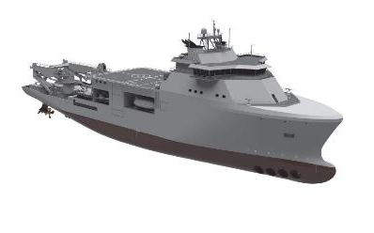




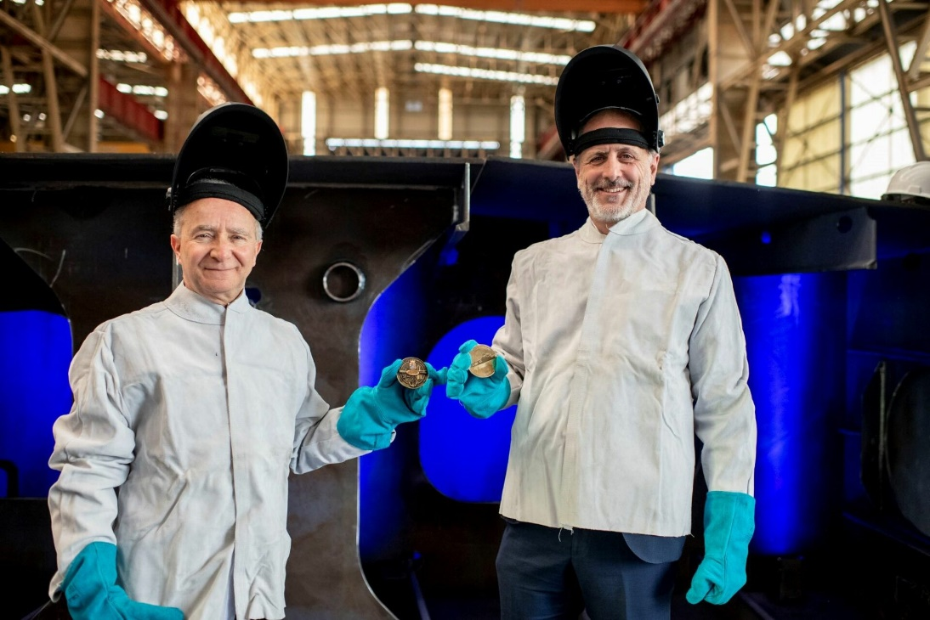
PROGRAMME LAYDOWN
2033
2026
End of Temporary Support
2024
Delivery
Apr 2023
Launch
Dec 2021
Keel Laying
Contract signed

Slide 6
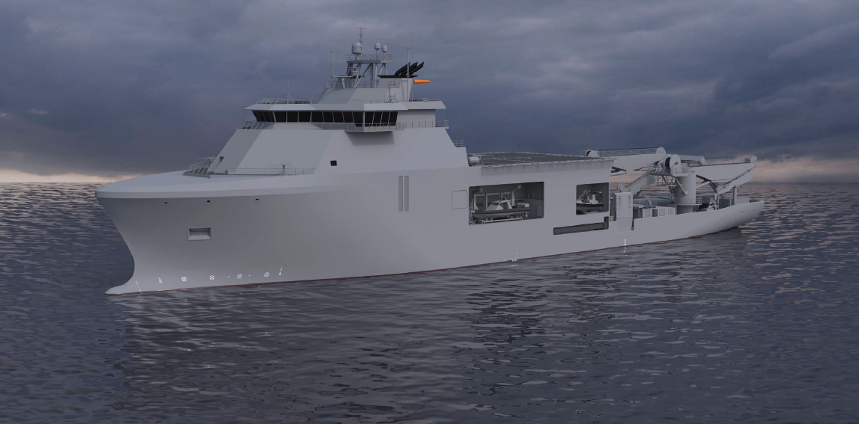
SHIP OVERVIEW
Dimensions
Δ 12000 t
L 128,5 m
B 24 m
Working deck 40 x 24 m
Propulsions
Full Electric (6 x 2,5MW DDGG +
2 x 5MW pods + 3 x 1,5 MW thrusters)
V_{max} 17 kts
Range 5000 nm @ 16 kts
DPS: IMO DP3
Accomodations
Crew 120
Accomodations 200
Capability
Submarine Rescue up to 600 m
MED NATO Role 2B
Diving ops up to 300 m
Spec Ops support + JSOCC
Rescue ship
Submarine Rescue Vehicle con LARS
VoO for NSRS e SDRS
Submarine Rescue Chamber
Insufflation system for DISSUB
Decompression chambers for 60 persons
Diving
2 ADS suite + LARS
AHC off shore 100 t @ 15 m
AHC off shore 40 t @ 15 m
Working+watching ROVs
Integrated diving system with moonpool

Slide 7
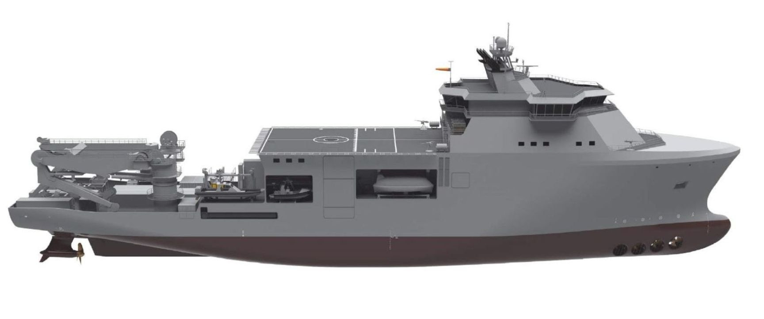


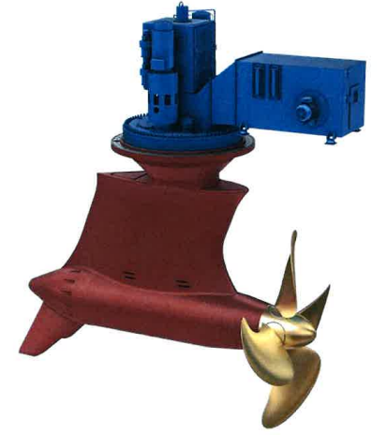
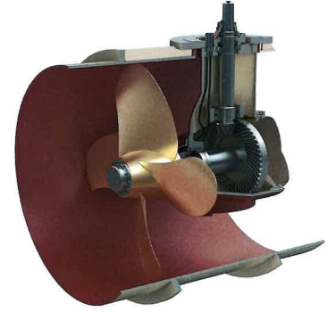
PROPULSION
COMF-NOISE-A
COMF-VIB-A
GREENPLUS
POD SYSTEM
TUNNEL THRUSTER
DP3
2 x 5,5 MW
KONGSBERG PULLING POD 1380-O/M
3 x 1,5 MW
KONGSBERG TT2650 DPN FP
6 x 2,6 MW
WARTSILA 8L26

Slide 8
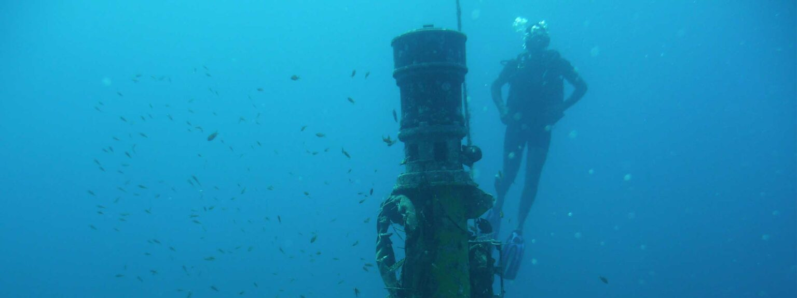
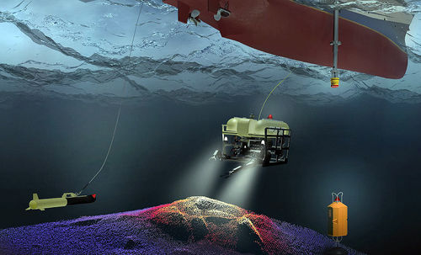
electroacoustic sensors

Slide 9
UTC ROOM
mariottiyard.it

Slide 10
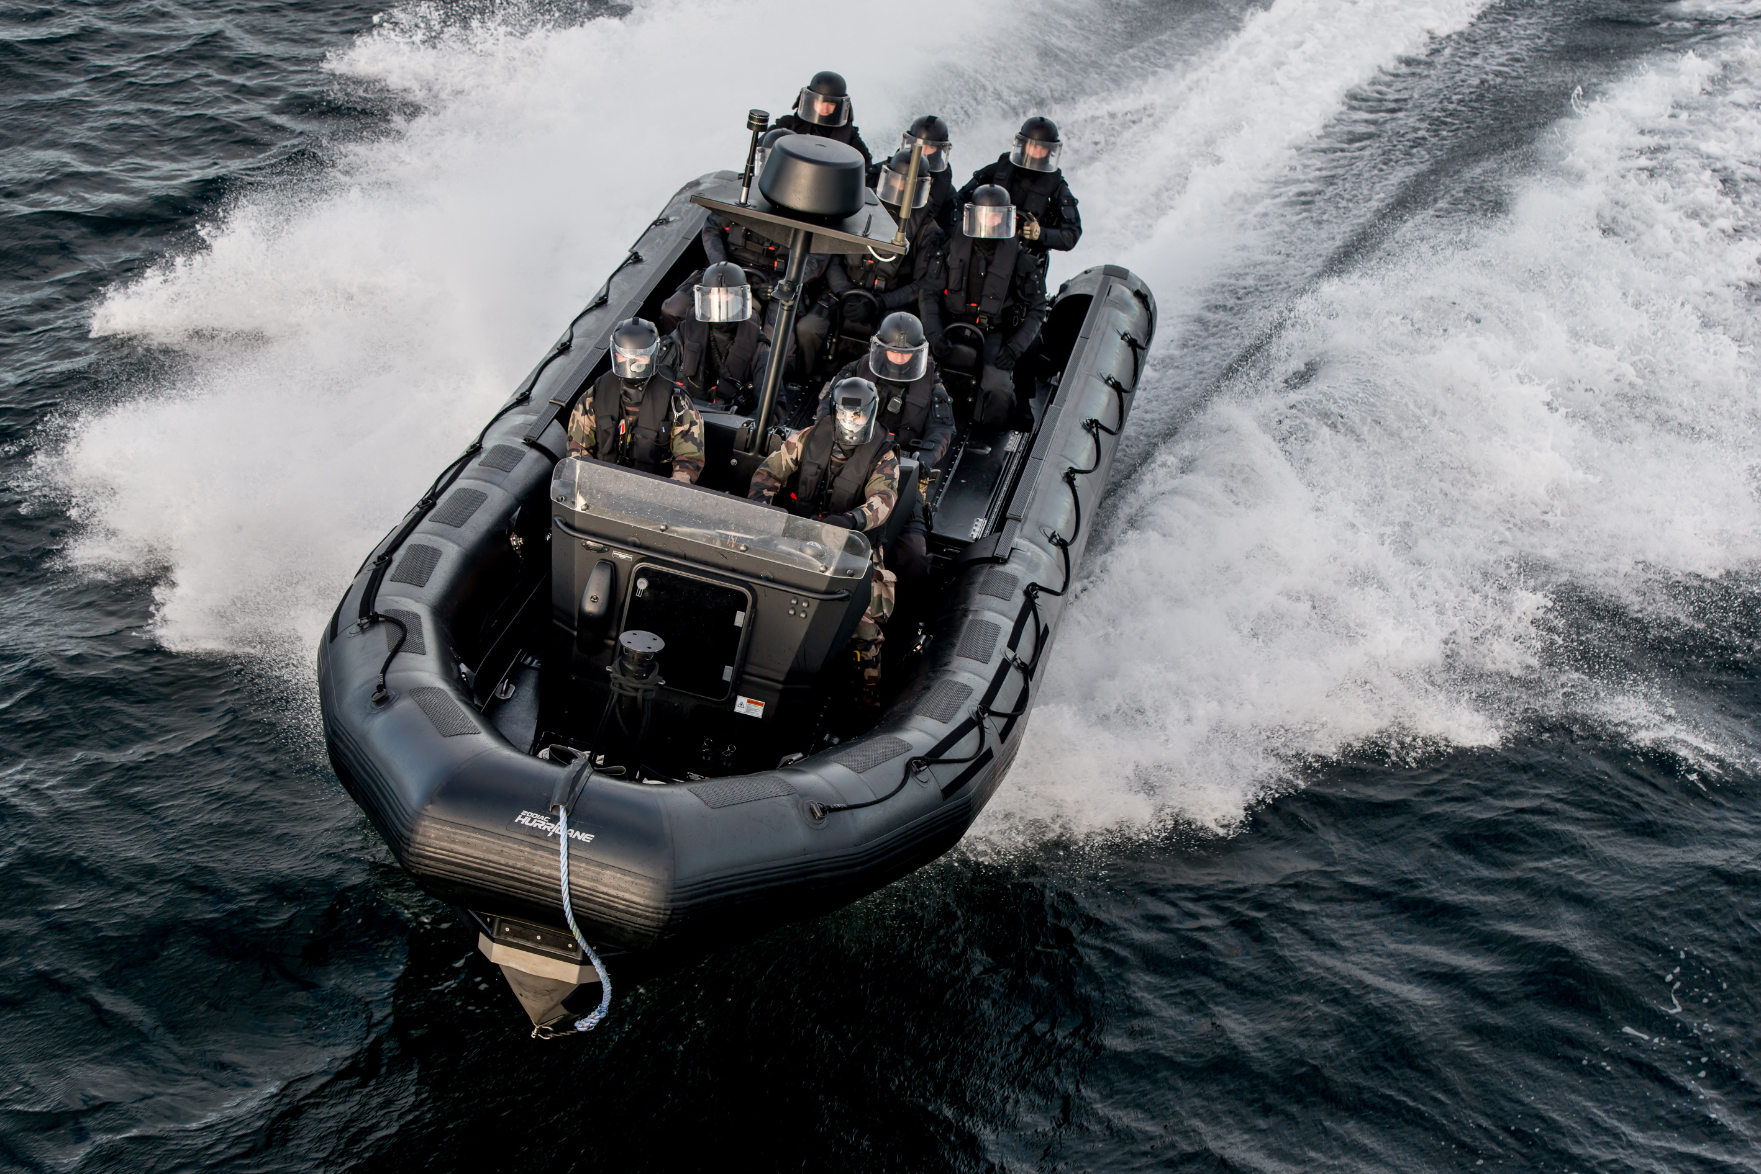
SPECIAL OPERATIONS (SO)
The Unit will have the capability to operate as a Special Forces Command Unit up to Task Group level and to transport and deploy vehicles and special assets on Working Deck e.g.:
RHIB model Hurricane or similar
ISO Container assets

Slide 11
DIVING OPERATIONS (DO)
The Unit may be deployed in shallow and deep-waters search operations, in the context of Homeland Security i.e.:
oil pipeline and oil/gas terminals surveillance operations;
anti-terrorism/sabotage function;
search operations for dangerous wrecks, recovery from the seabed and retrieval of sites at high environmental risk..

Slide 12
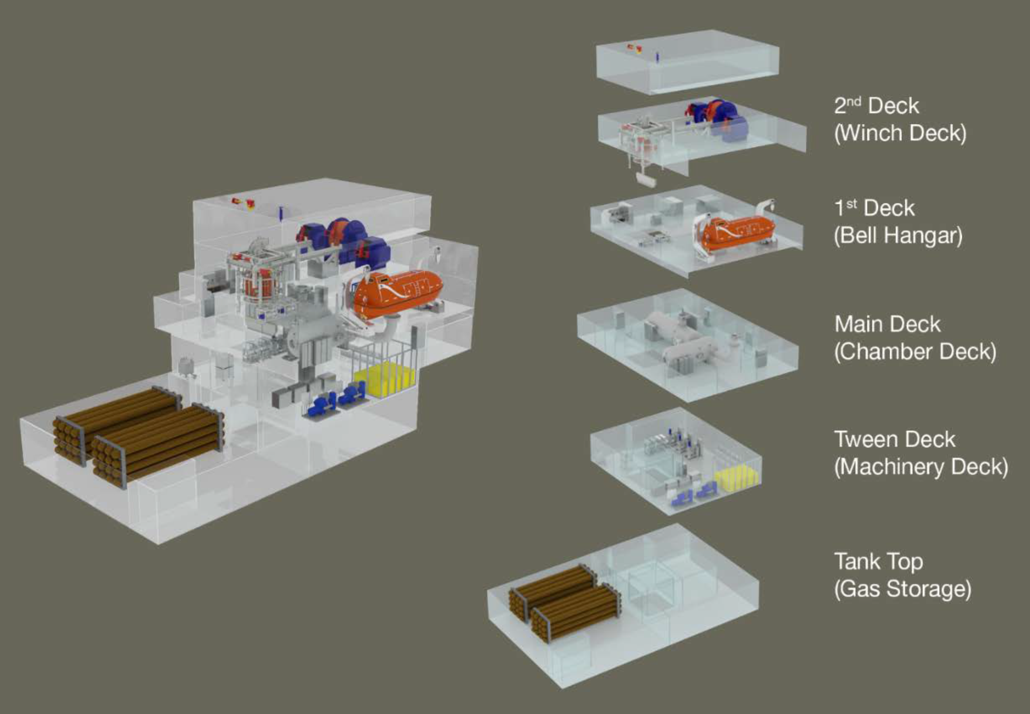
DIVING OPERATIONS (DO)
SAT DIVING SYSTEM
Hyperbaric Chambers 2 X 6
DIVING BELL (SDC) & LARS da Moonpool
Hyperbaric Life Boat (12 + 4 people)
Dive Control Panel
SDC Analysis Panel
Gas Storage 32 x 2.8 m³ 200 bar cylinders

Slide 13
DIVING OPERATIONS (DO)
Diving Control room

Slide 14
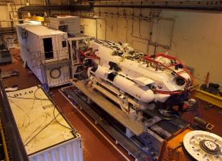
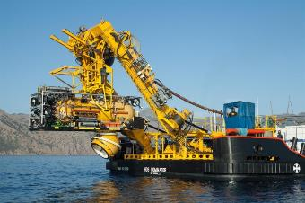
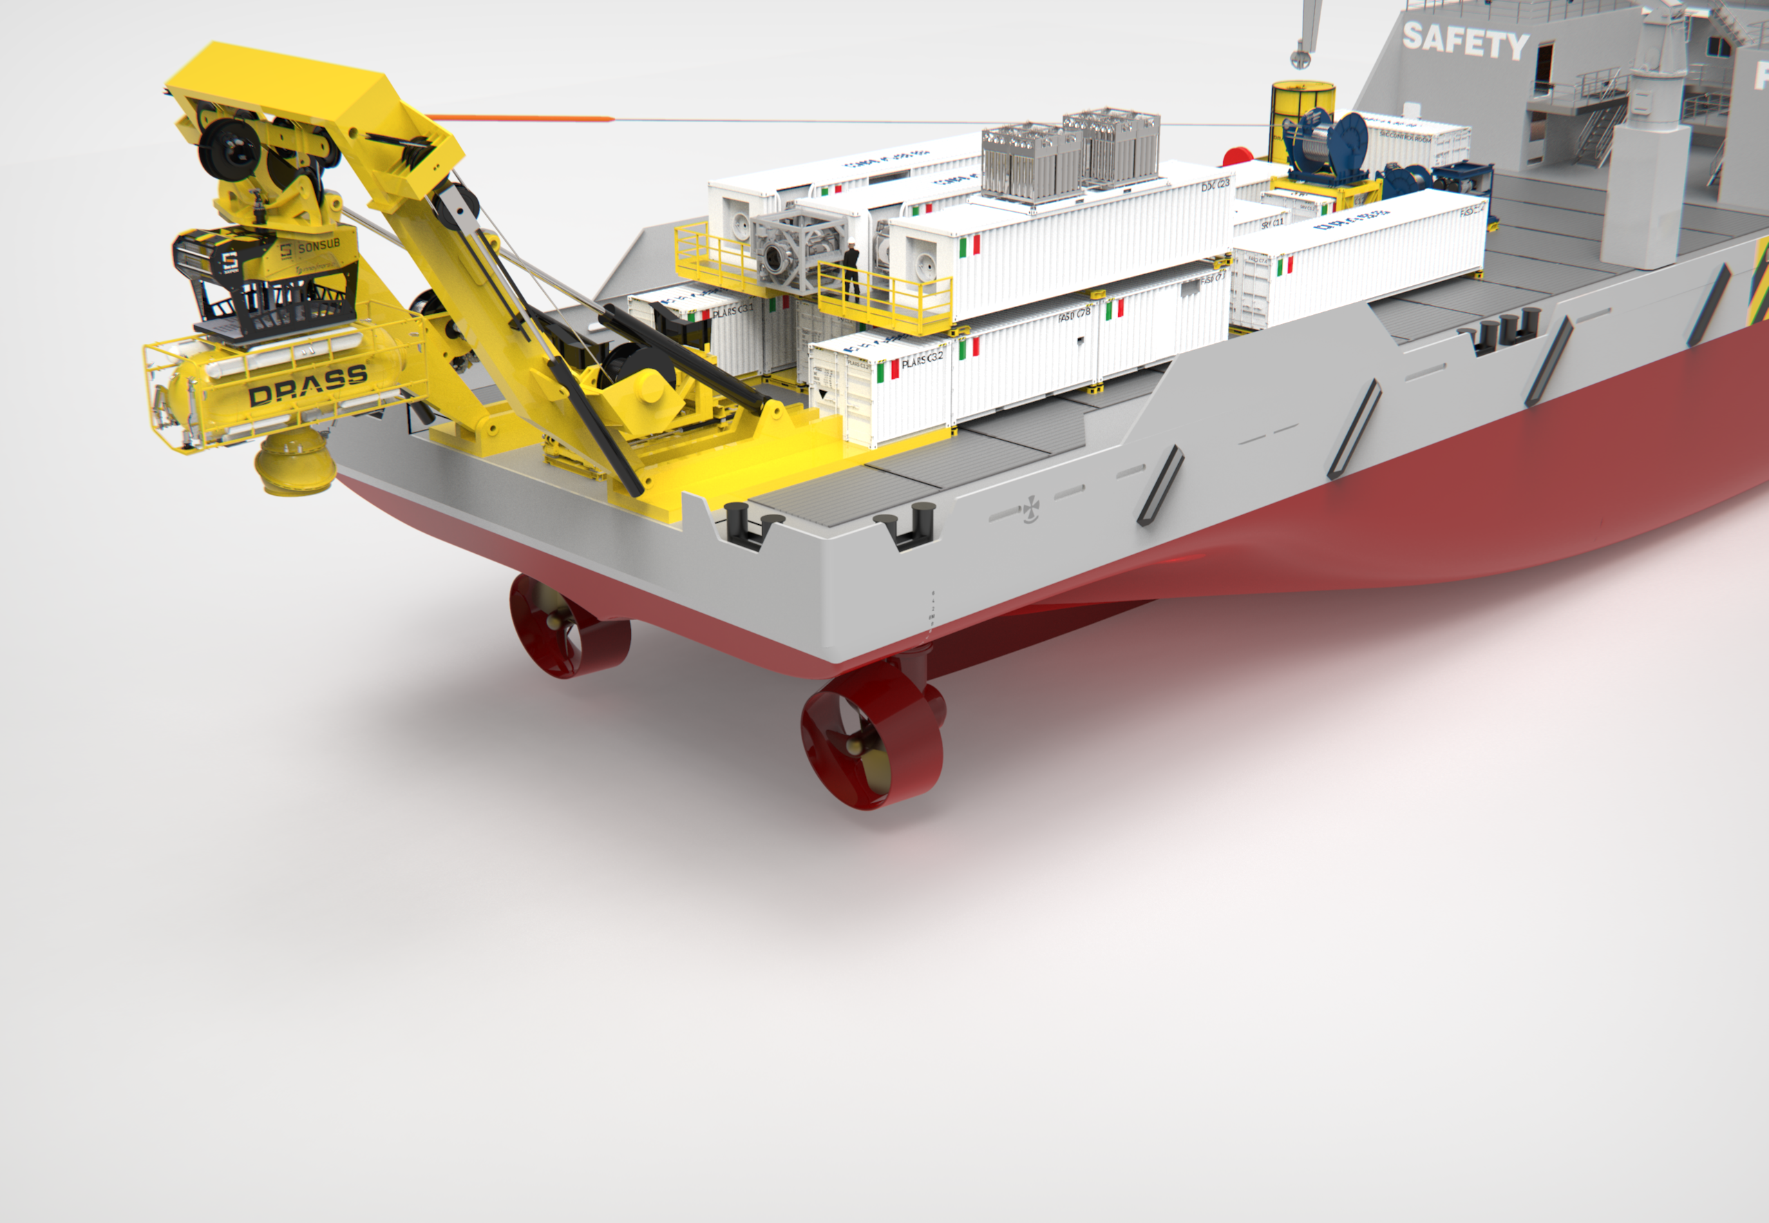
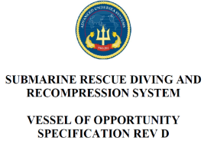

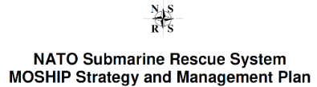
SUBMARINE RESCUE SHIP (SuRS)
Submarine Assistance Ventilation
Equipment Rescue (SAVER)
Notes:
14

Slide 15
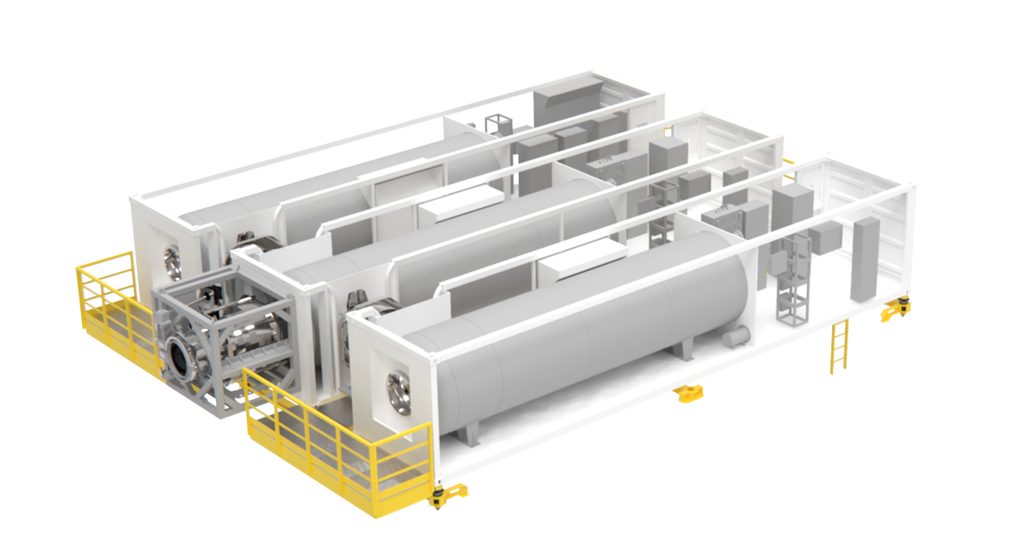
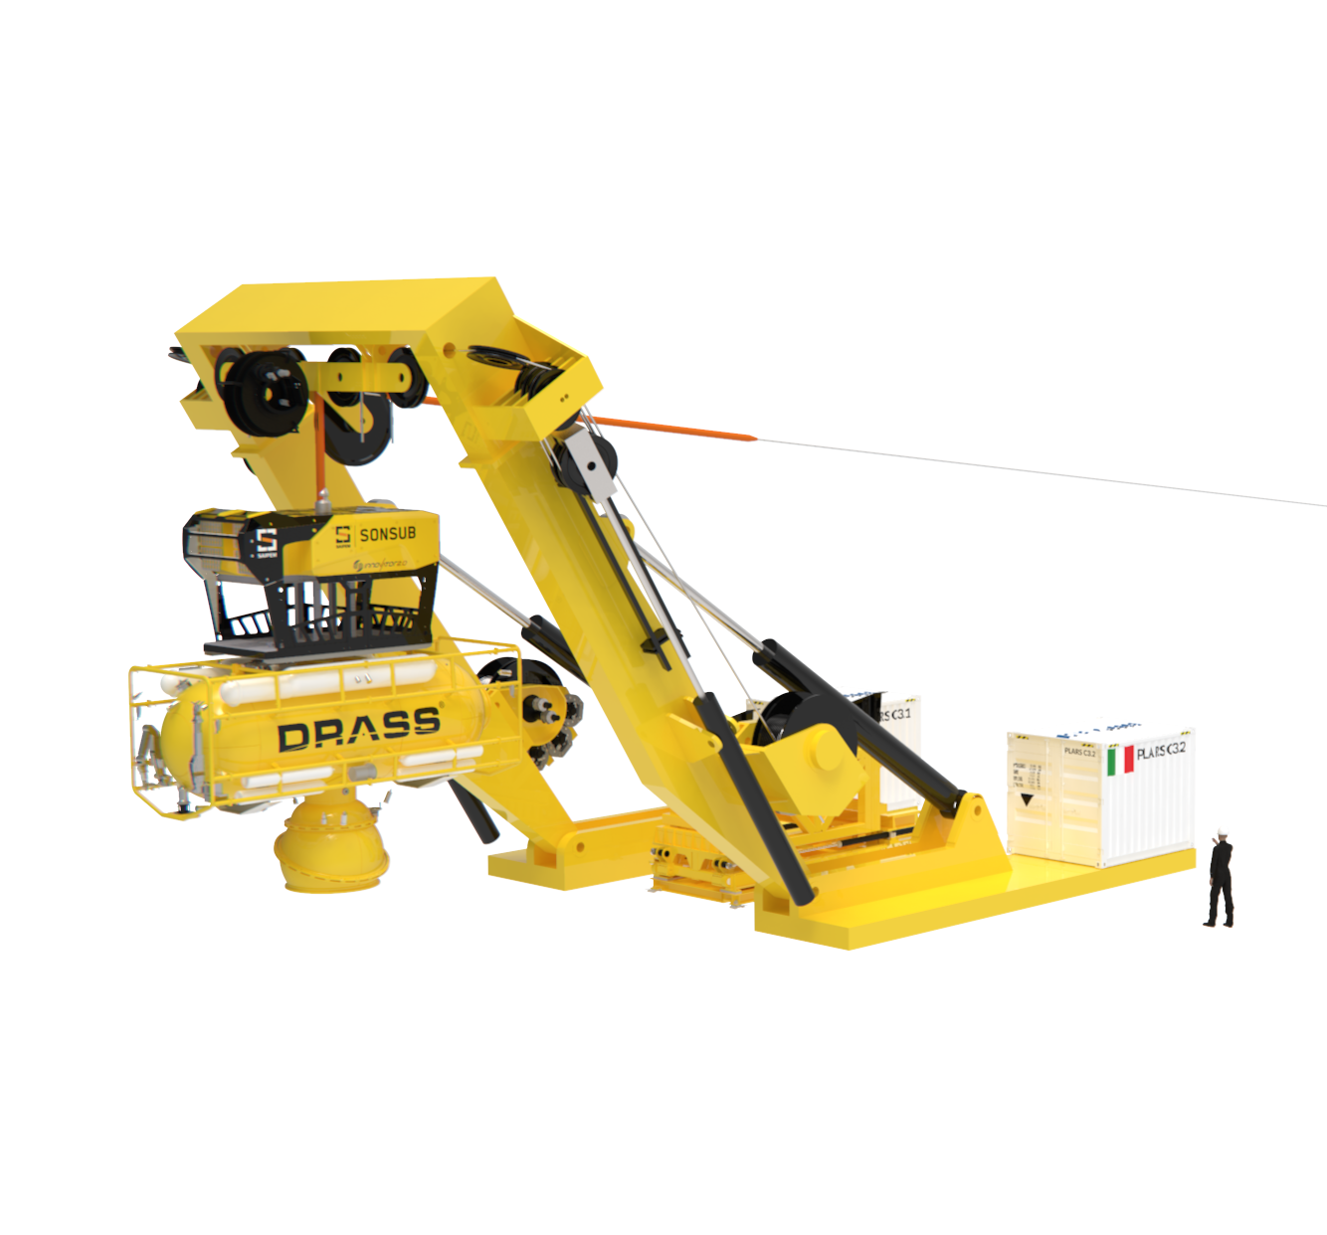
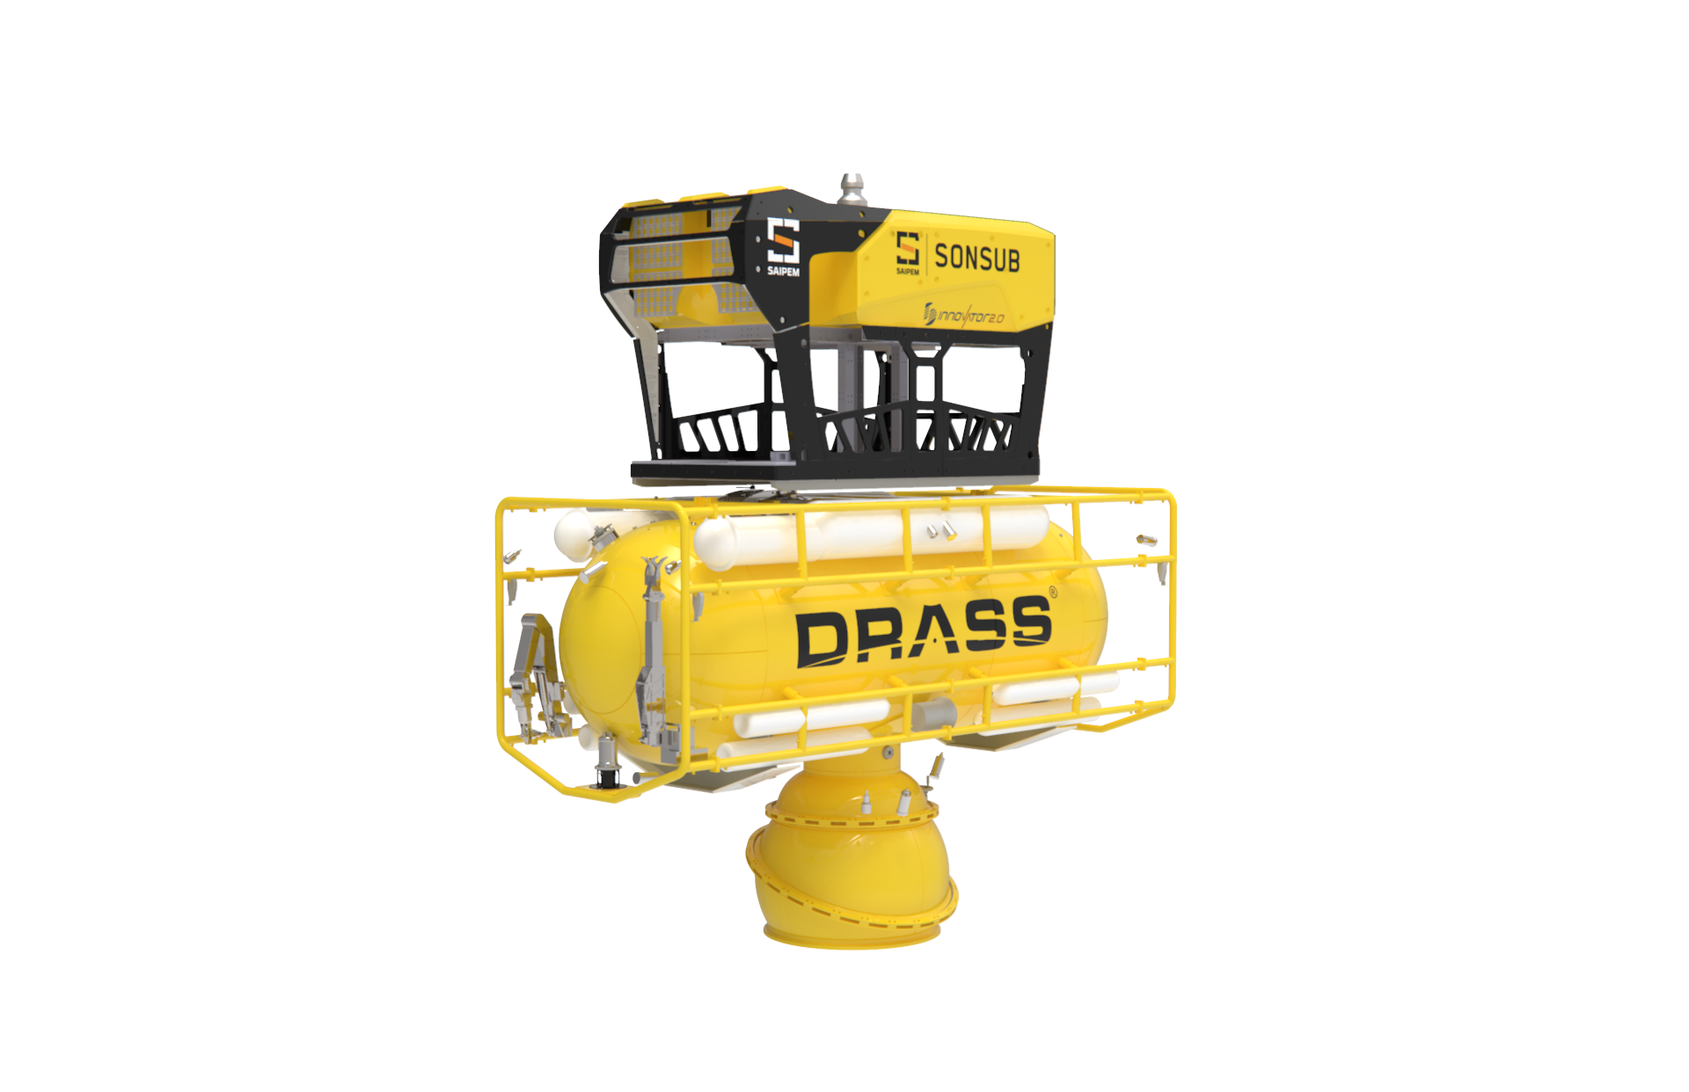
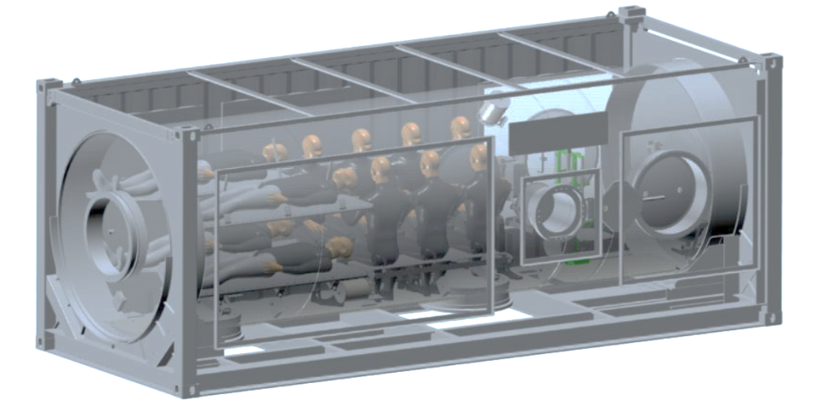
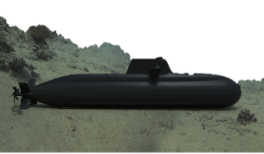
DEPLOYABLE SUBMARINE RESCUE ASSETS
Portable Launch and Recovery System (PLARS)
Deck Decompression Chambers (DDC)
Submarine Rescue Vehicle (SRV)

Slide 16
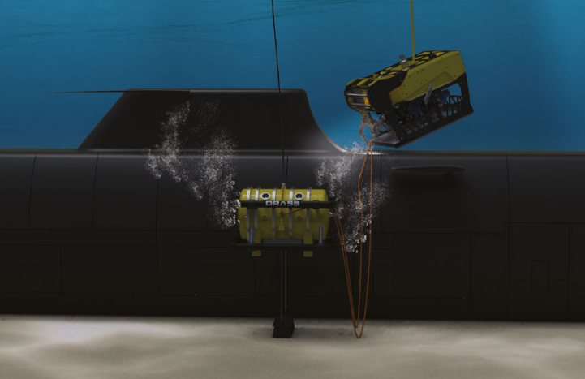
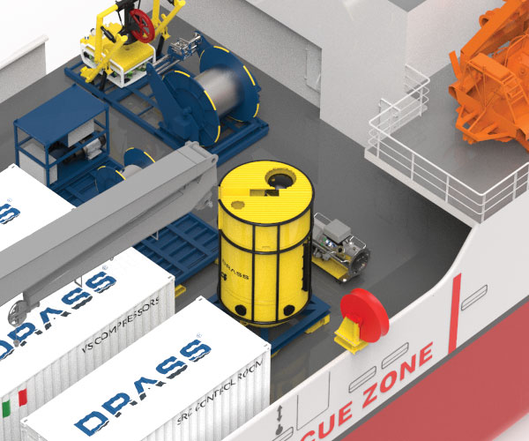
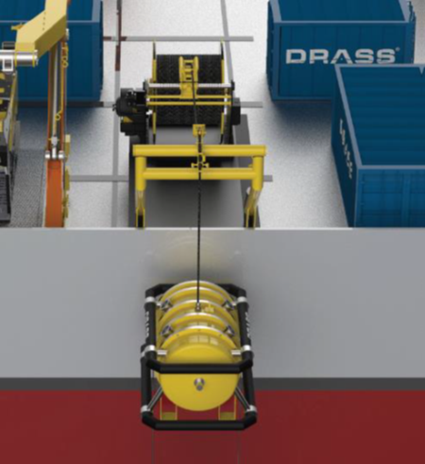
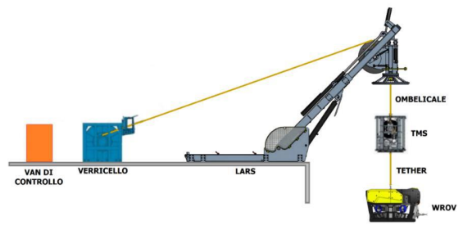
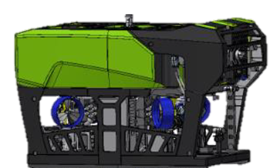
DEPLOYABLE SUBMARINE RESCUE ASSETS
SUBMARINE VENTILATION SYSTEM (SVS)
SUBMARINE RESCUE CHAMBER (SRC)
WROV with LARS
WROV

Slide 17
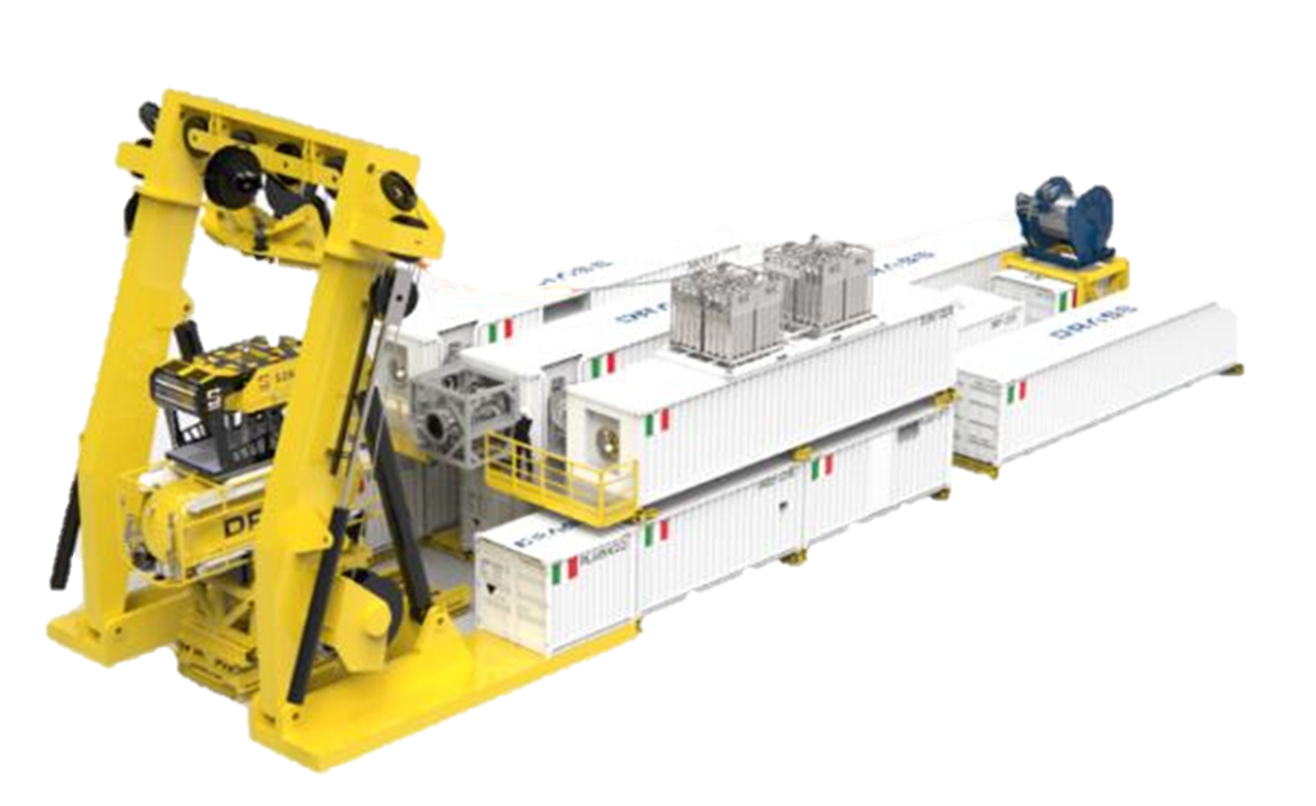
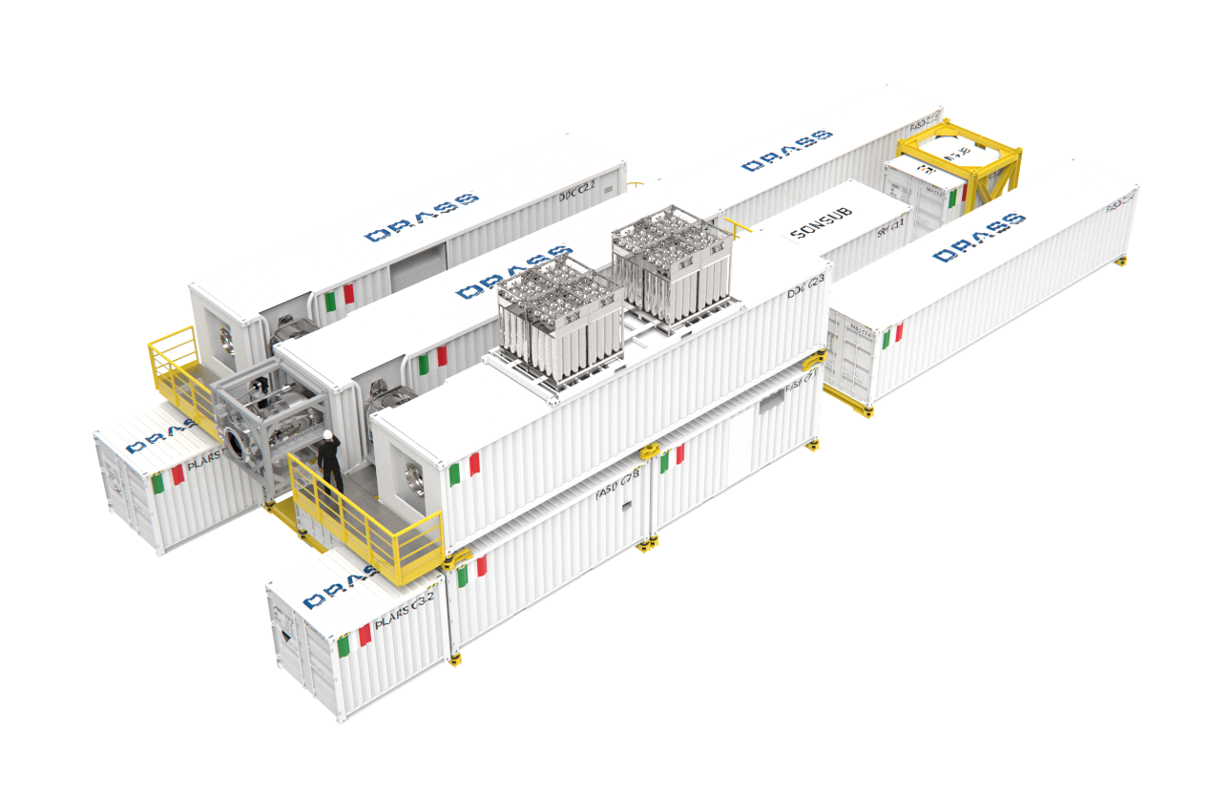
FASD - FAST AUXILIARY SYSTEMS DEPLOY
ISO Standard Containers (10, 20, 40 feet)
Auxiliary System (Breathable air and mix gas)
Diesel electric power station
Electric distribution system
Operation monitoring Central Unit
Total ISO container 10 + 1 Air module
10
1
9
1
6
8
3
5
7
2
4
1
MODULAR concept

Slide 18
CONCLUSION
State-of-the-art in UW capabilities
High value of interoperability and deployability
Full spectrum Hub in UW domain
Fostering Multinational cooperation

Slide 19
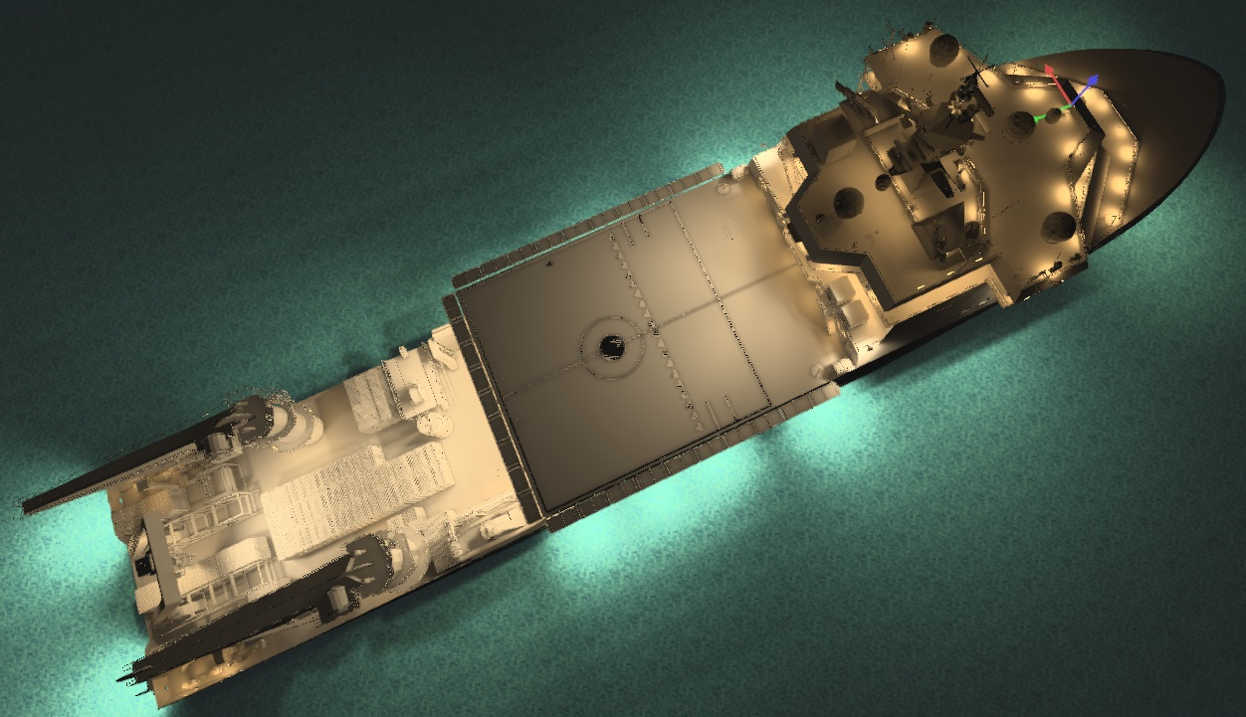
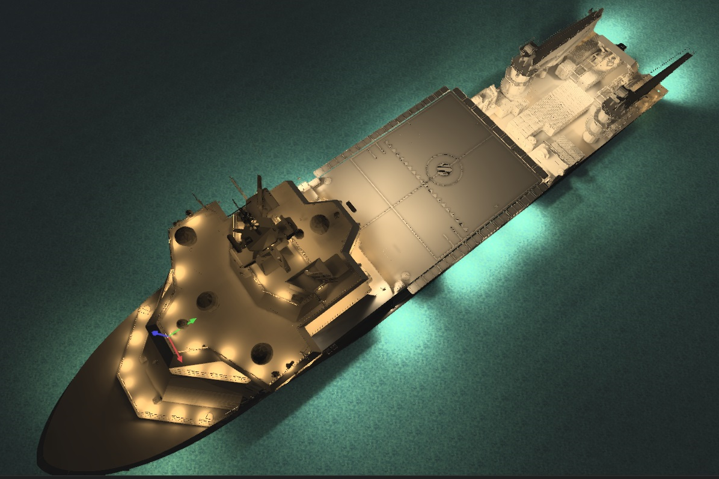
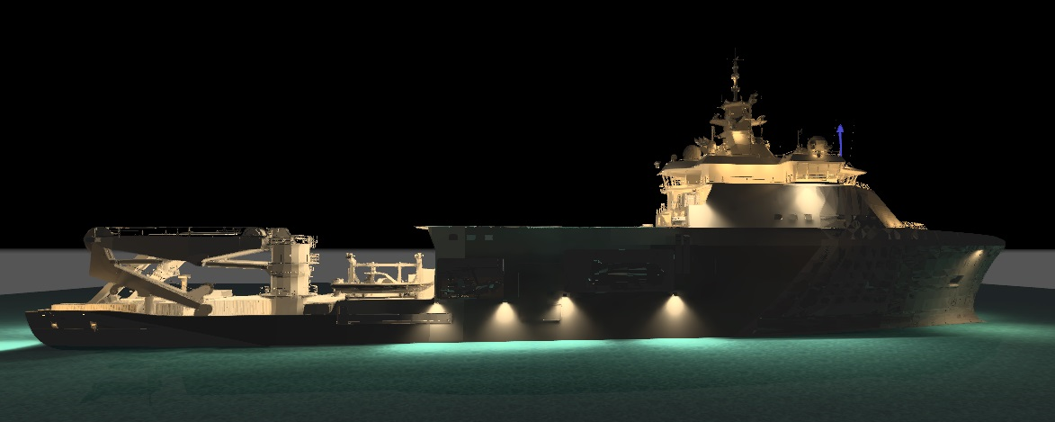
Secretariat General of Defence / National Armaments Directorate
THANK YOU FOR YOUR KIND ATTENTION
Cdr Emanuele DE MINICIS
Head of International Cooperations Service
email: r1coordcs@navarm.difesa.it

Slide 20
Secretariat General of Defence / National Armaments Directorate
Special and Diving Operation
Submarine Rescue Ship
SDO-SuRS
Cdr Emanuele DE MINICIS
Head of International Cooperations Service
Notes:
20

