Slide 1
Integrating beyond traditional ASW Platforms
Chris Wardman
General Dynamics Mission Systems

Slide 2
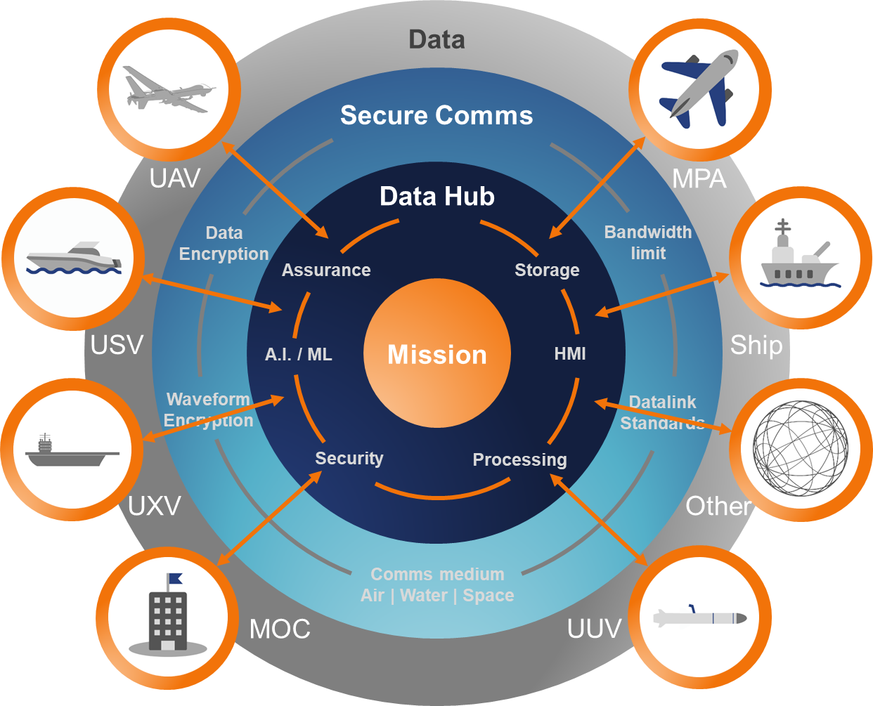
Introduction
Open Architecture Sonar Integration Suite (OASIS)
Previous talk entitled: “Realising a Future Maritime Force for Distributed Undersea Warfare” – CNE 2022.
ASW technology development is happening at pace through Autonomy, ML and AI.
Platform development will help unlock development of hybrid integrated capabilities.
Data capacities limit raw data ingestion – indicating at the edge processing requirements.
Data frameworks and central digital backbones provide the key to providing capability at scale.
Distributed ASW demonstrated at REPMUS’22.
Seamlessly integrate distributed assets for increased mass

Slide 3
Integrating beyond traditional ASW Platforms
Delivering data and how modularity, autonomy and data fusion supports
Modular mission packages enabling the multi-mission.
Maximising efficiencies with distributed technology and processing at the edge.
Bolstering existing platforms with scaled acoustic systems.
  Integration of data, information and situation awareness across the digital backbone.
Multiple Nodes connected at the Edge
Accelerating the ASW Kill Chain – faster acquisition, better real-time decision making, increasing coverage.

Slide 4
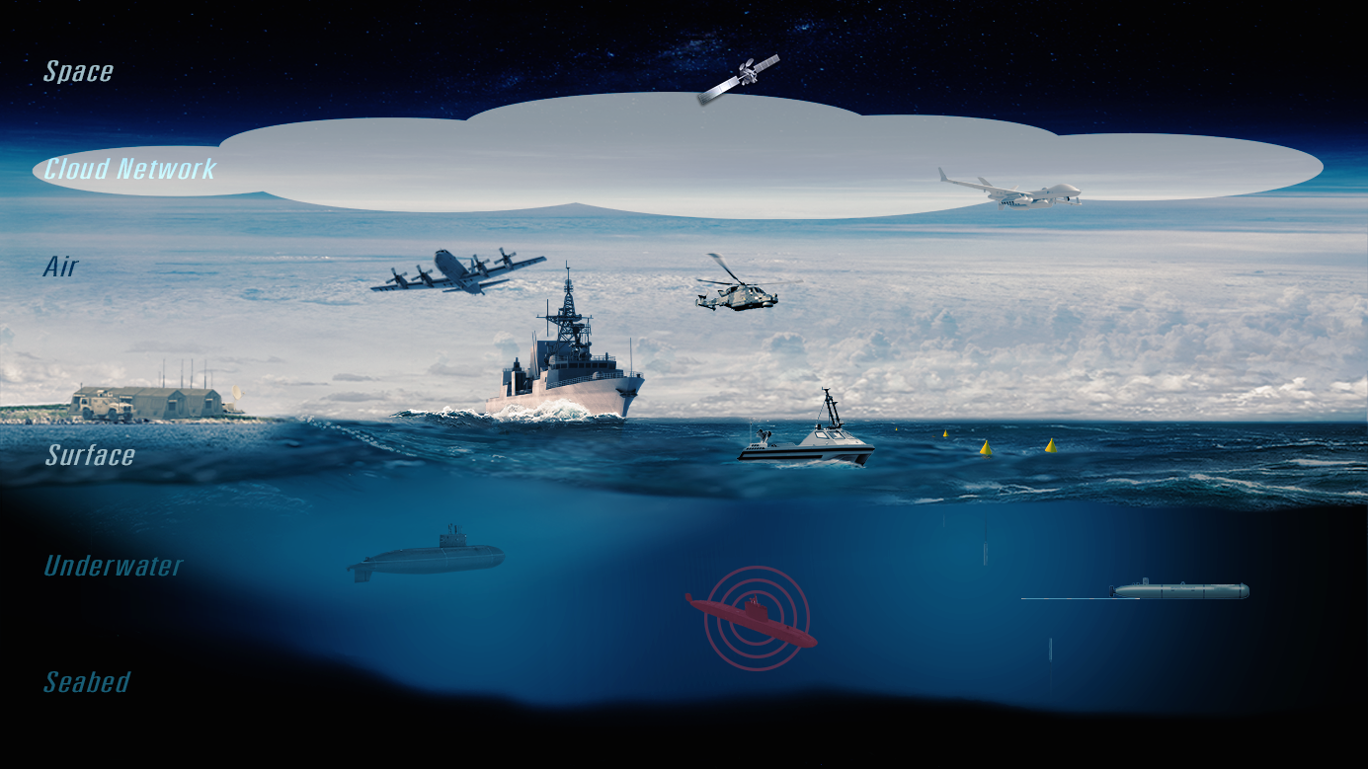
Incremental enhancements show benefits of potential uncrewed capabilities alongside crewed systems

Slide 5
Implementation of Additional Multi-Nodes
Consideration for the successful integration into the ASW Network
Processing at the Edge
  Raw data bandwidths for remote sensors cannot be implemented each and every time.
  Multiple nodes / sensors / data generators result in excessive data.
  Trust in algorithms / ML / AI on board.
Use Organic Capabilities
  Minimal data / information presents benefits when using organic secure links.
  Utilisation of existing organic networks saves time, cost, assurance.
  Allows for scalable ASW uplift through life.
Size Weight Power (SWaP)
  SWaP optimised design to accommodate vehicles with lower volume capacity.
  Reduced power demand through efficient processing techniques.
  Maximise use of COTS elements and common shared / networked processing.

Slide 6
Operational Benefits for Multi-Node Approach
Ultimate flexibility in approach with high-speed acquisition rate
ASW Situation Awareness
Near-real time updates, live ACINT tactical picture.
Data Assurance
Adaptable Mission Flexibility
Multi-nodes. Hybrid multi-mission. Adaptable.
Range Extension
Use of Existing, Secure Datalinks.
Less reliance on core platforms. Cost effective.
Mission replanning for optimised efficiency gains.
Data assured from sensor to effector.
Select nodes against mission objectives.
Core platform focus on core objectives, removing nugatory work.

Slide 7
Integrated ASW Solutions
Integration of digital nodes with OASIS
Modular ASW Capability
UYS-506 Sonobuoy Processor
ARIES PMA Tool
Modular Towed-Reelable Active Passive (TRAPS).
ISO-based solution with integrated OASIS on board.
Distributed ASW for Off-board Operations.
Mission Replay System utilising 3rd party data.
Faster than real-time processing for mission handoff.
Advanced Sonobuoy Processing Capability.
Scalable Acoustic Options
Initial installation
(HMS, TRAPS).
Additional capability added through-life. All-integrated solution.
Apply these to support Hybrid operations using a mix of crewed / uncrewed systems.

Slide 8
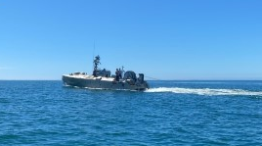
Modular ASW capability
Towed-Reelable Active Passive (TRAPS)
Multiple configuration design Active and Passive Towed Array System.
Single cable deployment.
Processing on board at the edge.
Roll-off / Roll-on ISO container design.
On board, high efficiency processing suitable for:
  Traditional Platforms.
  Modular Platforms.
  Non-traditional Platforms such as OPVs, Corvettes & USV’s.
Modular ASW, Multiple nodes, Flexible platforms

Slide 9
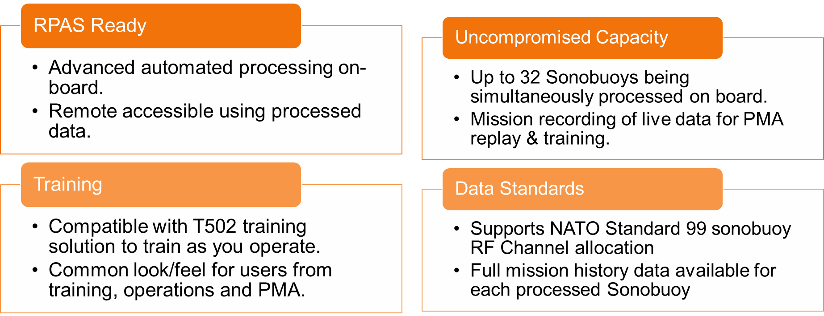
UYS-506 – Distributed Acoustic Systems
Advanced Sonar Processing System for Distributed ASW
Aligned with Acoustic Intelligence Management System (database) and ARIES

Slide 10
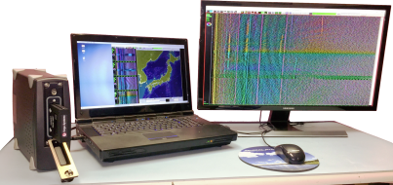
ARIES
Acoustic Replay & Intelligence Exploitation System (ARIES)
Post Mission Analysis System
Features
  Fast data extraction
  Data analysis and archiving
  Sophisticated mission reconstruction tools
  Portable and secure cloud versions available
Mission Analysis and Exploitation
  Use real data to re-train against real world scenarios
  Mission replay up to 20X allowing crew exchange
  All in common format – standard GDMS look and feel
Speed up the cycle of crew handover, ensures no loss in information and gives operators a head start during operations.

Slide 11
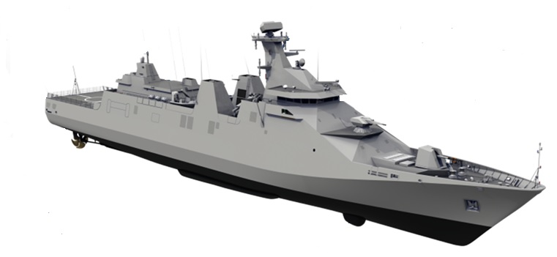
Scaled Modular Acoustic Options
All-integrated ASW suite – scalable against time, threat and budget
NATO Standard Sonobuoy Processing
System
Acoustic Decoy and
Sonobuoy Launcher
Towed Variable Depth Sonar
Combat Information Center (CIC)
-OASIS central processing Hub
-CMS Interface
-Digital Backbone for ASW sensor integration
XBT/XSV Probe
Launcher System
Multi Frequency
Depth Sounder
Integrated Sonar Processing Room
Hull Mounted Sonar, Protective Dome & Underwater Telephone
Align ASW capability against platform, budget and need

Slide 12


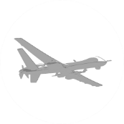


Summary
GDMS Sonar Systems – ‘Accelerating the Mission’
Faster Edge Processing removes need for high-speed connectivity to enable use of organic systems.
Resilient Design within DDIL environments, recording/synching until comms recovery.
UYS-506 enables RPAS/UAV persistence, freeing up specialist crew.
Integrated digital backbone (OASIS) facilitates multi-nodal connectivity for scale to suit mission, threat and budget.
Shared ACINT in near-real time accelerates mission lifecycle.

Slide 13
The key questions
In the context of: “Integrating beyond traditional ASW Platforms”
What are the current blockers to large scale exploitation of Maritime Uncrewed Systems (MUS) by Defence?
  Adoption is slow. Budget, automation, modular platforms (T32) having more focus.
  Suggest that implementation will be, as suggested here, on an incremental basis.
What can Defence do to accelerate the operational exploitation of MUS?
  Look at ways of demonstrating value, savings and improvements.
  Adoption of MBSE / Digital Twins to prove minor and major factors.
What can Industry do to increase the operational maturity MUS?
  Now factors such a data assurance, edge processing, zero trust are being adopted to ensure and assure implementation quicker.
  Data assurance is critical and should be investigated alongside experimentation.
  It is up to industry to continue the creation of data guards, edge processing, open systems to enable wider integration and collaboration.

Slide 14
Come and see the NEW! UYS-506
being demonstrated at #D44
On stand we have:
Chris Wardman – Sonar Systems
Gavin Green – Avionics and Air Systems
Steven Horne – Air-Based Acoustics
chris.wardman@gd-ms.uk
https://www.linkedin.com/in/chris-wardman-1b919822/
https://gdmissionsystems.ca/newsroom/news-releases

