Slide 1
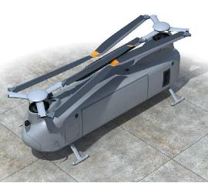
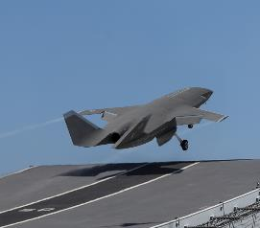
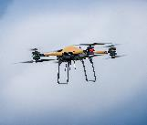
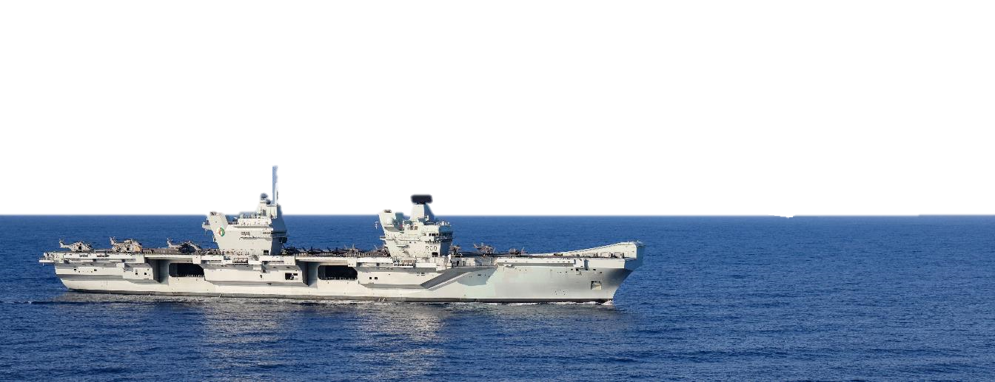
FUTURE MARITIME AVIATION FORCE
Maritime Uncrewed Air Systems Development

Slide 2
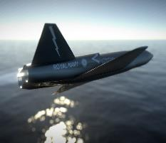
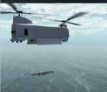
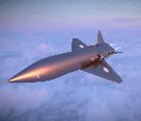
The Challenge
The Vision
Lack of Mass - F35 mass will not reach level required to resource both QEC with full Combat Air potential. Me2 overcommitted elsewhere.
MUAS will:
Developing Un-crewed Platforms - The question is not “if” the Naval force will prioritize and leverage un-crewed platforms and systems, but how quickly and efficiently, in resource constrained environments.
Unlock the full potential of QEC
Extract maximum operational agility in a coherent and integrated way.
Increased capacity through automation - We must free up warfighter capabilities for critical operations, by automating routine/repetitive tasks.
Improve persistence and scalability; enhancing effectiveness from sub-threshold to major warfighting.
Environmental Complexities - We must operate in complex and contested areas all the while reducing the risk to life, force and mission.
Programme Intent:
Vast Scale - We must increase our range, endurance and persistence in order to build advantage. This is scalable beyond human operator limitations
Gather evidence to inform choices available to Defence at the next Integrated Review (IR25).
Ability to Command - We must enable faster, scalable, and distributed decision-making, putting PWOs at the apex of command
Present options for early introduction to Service of air systems and Aircraft Launch/Recovery Equipment.
Gather Evidence
Setup required enablers
Deliver concept demonstration to ‘open up’ QEC deck (2024).
MUAS Concept Demonstrator
IR25
FMAF
‘Sweat the metal’ of QEC by adding mass o the Carrier Air Wings.
Coherence with DEV and FGEN
Demonstrating the potential to
increase mass and enhance lethality
with complimentary uncrewed capabilities and enablers.
Understand full Potential
Study Capabilities

Slide 3
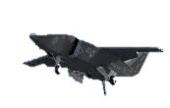
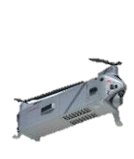
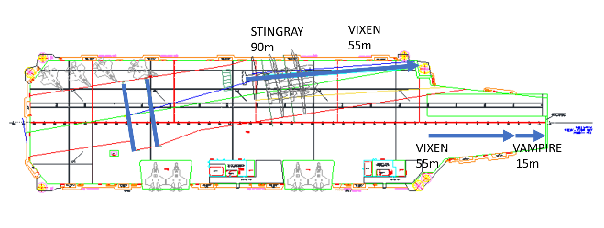
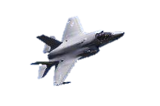
How do we get there?
Complimentary Capabilities
Enablers
VIXEN
Payloads - Common payloads across air vehicles and standards setting for payloads
Commercial advantage: Multiple payload providers to ‘plug in’ to the MUAS FMAF air system architecture. Eg, VIXEN programme requires an AEW radar
QEC-based multi-role capability
AEW contribution to PWAS, or
c500kg modular payloads including cargo and communications.
Digital - Open digital infrastructure that integrates and adopts uncrewed capabilities at speed and scale. Crewed-Uncrewed Teaming (CUC-T) to enable transition of uncrewed support to crewed operations to independent uncrewed operations as capabilities mature.
VAMPIRE
QEC based Decoy and adversary emulator
Light strike fighter performance
Potential for spiral development to include payloads such as CEMA, ISR & Comms
Crewed-Uncrewed
Teaming (CUC-T)
STRATCOM
Multi-Domain
Integration (MDI)
Royal Navy
Naval Strike
Network (NSN)
ARK ROYAL - QEC Aircraft Launch & Recovery Equipment
PROTEUS
Complements current crewed RW systems in the delivery of ASW, ISR, AEW and cargo transportation
c500 kg modular payload (common with VIXEN)
PANTHER
Provides a low cost, agile, light lift capability to CS
Significant decrease to cost and RTL associated with transfer of low weight low volume stores between units
Requirement
Enables operation of high performance Uncrewed strike and support systems. Potential to enable operation of FW crewed aircraft (e.g. F/A-18E, F-35C, Rafale)
Ramp launch to be demonstrated initially, with subsequent assessment once recovery systems are in place to enable full integration can be evidenced.
Launch
Recovery
Flexible Tactical Uncrewed Air System (FTUAS)
Enables rapid deployment of FW assets held at Alert in order to conduct a range of missions.
Weight and cost implications of MUAS minimised, reducing through-life capability cost.
Necessary for the operation of a wider range of crewed and uncrewed aircraft
Enables closer operation with allies and partners including alignment with the UK/US SOI on carrier cooperation. VIXEN will depend this for recovery to QEC.
FTUAS UCR will provide an ISR capability in the KIPION JOA with required persistence to meet current threats from 2023-2025.
Ability to find, fix, track and assess maritime surface entities. Complements crewed RW assets in the provision of situational awareness

Slide 5
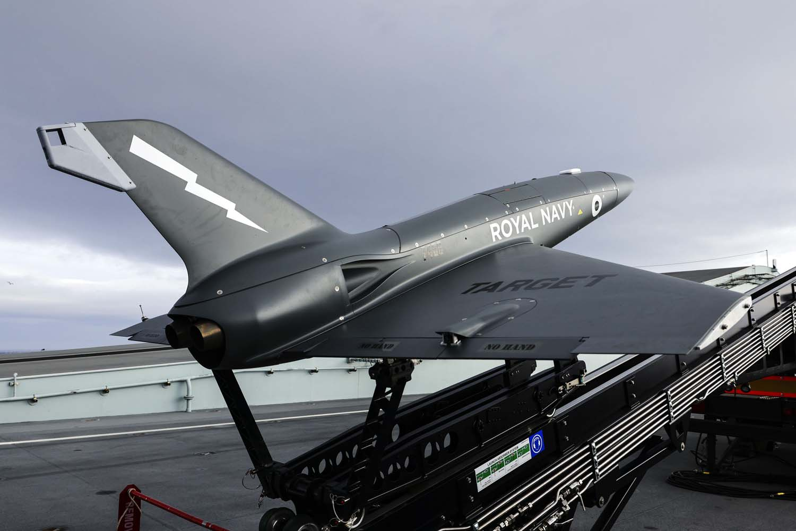
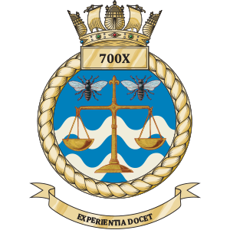
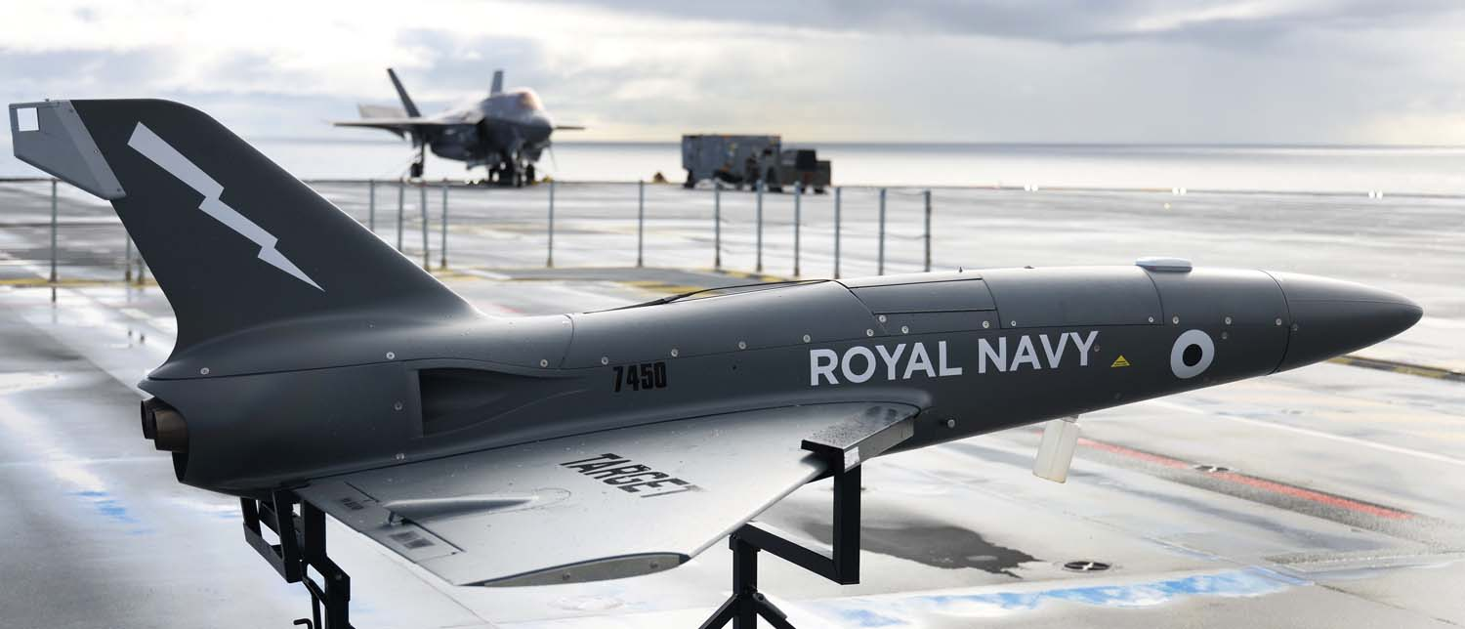
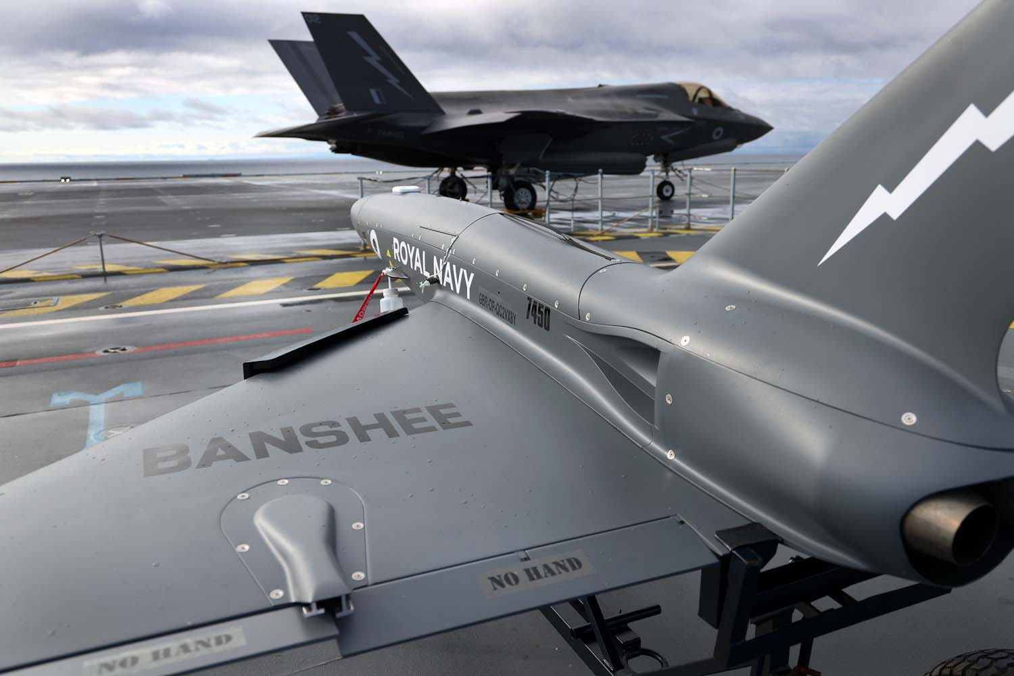
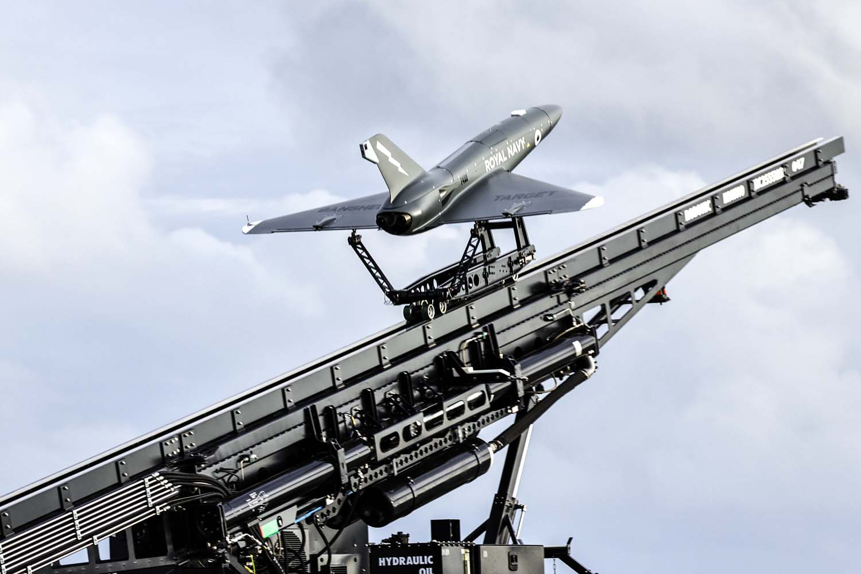
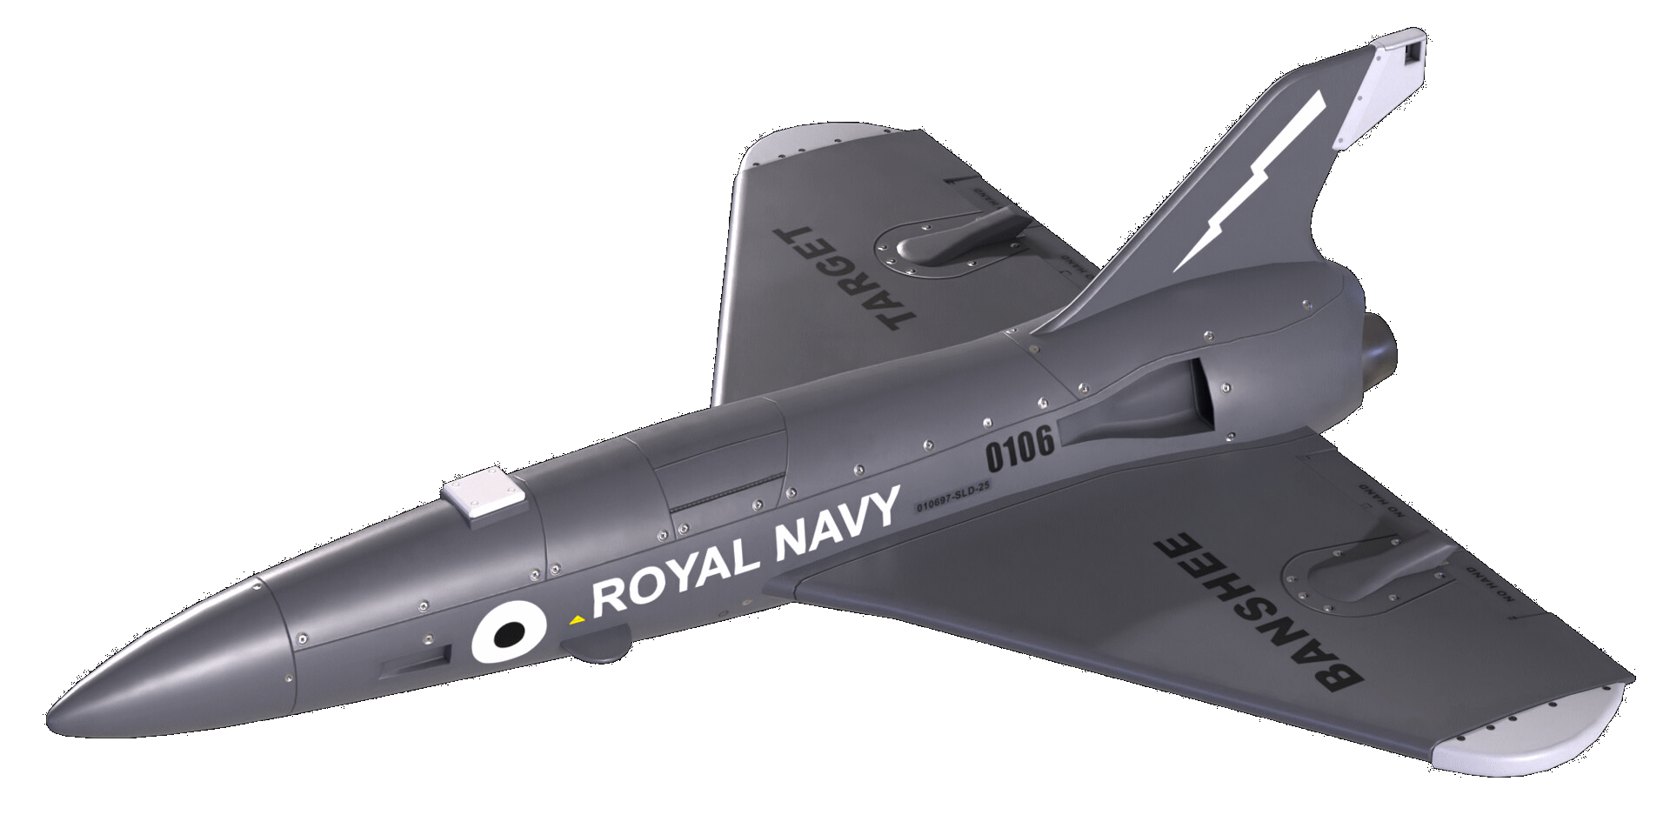
Project Vampire is a low cost fixed wing fast jet uncrewed air system which is part of a spiral development project within the Maritime Uncrewed Air Systems programme (MUASP). It is developing a deployable threat simulator for air defence training, and to provide a trial platform to practically deliver sensors and effectors, integration for the Naval Strike Network (NSN) and build evidence for Integrated Review (IR25).
PROJECT VAMPIRE
Next Steps:
Scale capability
Integrate new payloads
Align with S&T Research Pg activities

Slide 6
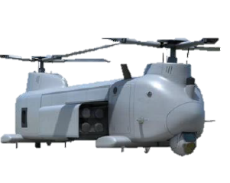
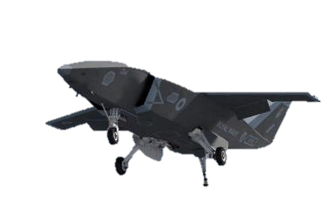
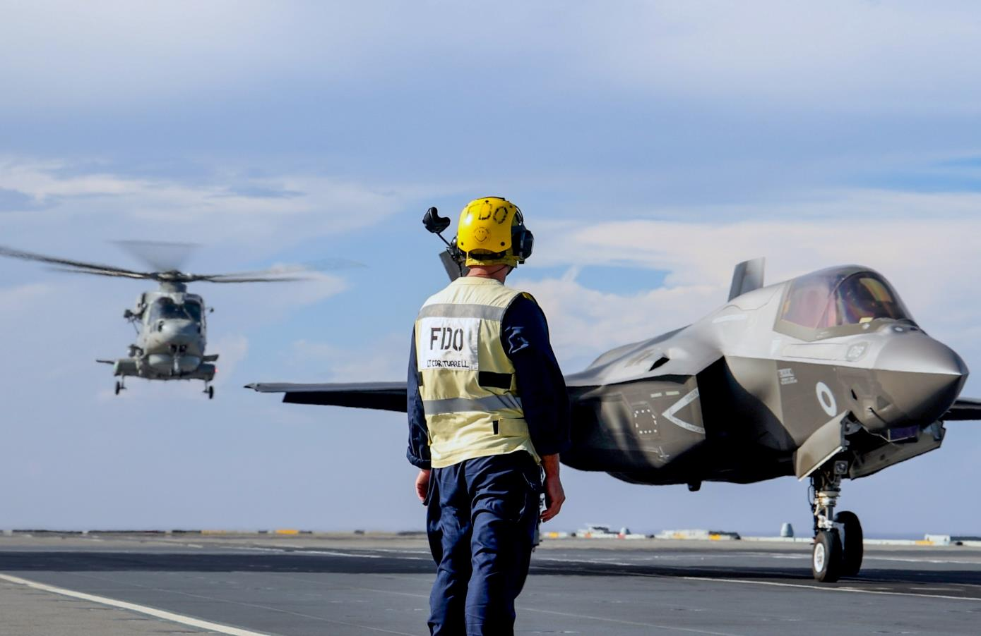
What do we stand to gain?
The ability for NC to assess the performance of MUAS to deliver defence strategic outcomes and allow the decision space to inform future investment opportunities.
Fully appreciate the impact of Ark Royal capability to enable optimised UAS and coalition FW operations.
An understanding of how to optimise critical on- board spaces to deliver effect efficiently.
An opportunity to yield UK prosperity as part of the Defence Industrial Strategy.
FINANCIAL
VALUE
Confirming the RN commitment to Emerging and Disruptive Technologies, demonstrating leadership, innovation and collaboration amongst Allies
in the field of maritime UAS.
Understand the potential of MUAS to enhance Carrier Air Wing (CVW) mass and provide Defence with choices for investment through future spending rounds.
Widening our military options for enhancing our National Security and potentially providing flexibility and offering greater sovereign choice in the delivery of Operational Effect .
STAKEHOLDER
Maximising the availability of crewed assets for Defence core outputs.
Prosperity agenda benefits for UK Industry.

