Slide 1
The NATO Defence Innovation Accelerator for the North Atlantic
Event: Combined Naval Event 2023
Presenter: Cynthia Shaw
VERSION
May 2023

Slide 2
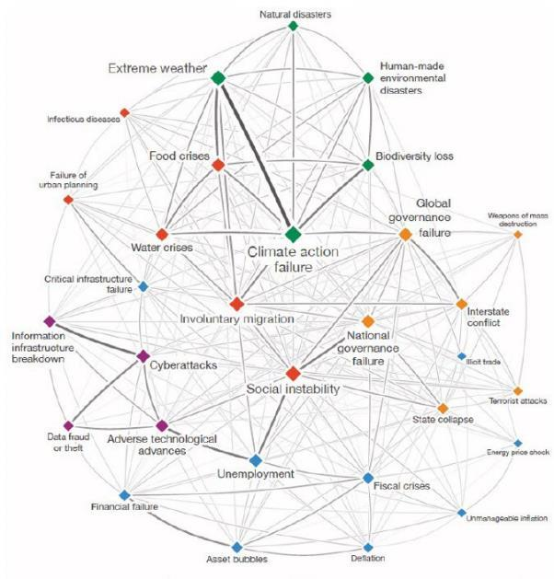
Holistic Defence : The Problem Space
Insecurity is driven by complex, inter- related global challenges, e.g. environmental changes, scarcity of resources, economic instability, hostile threats from state and non-state actors
Understanding and tackling these challenges requires world-leading science and technology

Slide 3
Defence & Security and Innovators - the Gap
Defence is viewed as inaccessible and complex
Innovators are unsure of where to start and who can help
Government rules and regulations viewed as cumbersome
Difficulties in accessing end-user customers to better understand their problems and receive feedback
The result: innovators ignore or are frustrated by the defence and security market, losing interest as commercial revenue streams take off

Slide 4
Role for NATO
Innovators
To address the complex inter-related challenges, there’s a need for a resilient Allied innovation ecosystem that:
Develops and adopts new technologies at the pace of relevance
Fosters stronger innovation partnerships between government, industry and academia
Grows the network of innovation centres Alliance-wide
Reduces the barriers to financing in order to create a sustainable innovation base
Industry
Government
Academia
Capital
Adapted from Dr Phil Budden & Prof Fiona Murray:
MIT’s Stakeholder Framework for Building & Accelerating Innovation Ecosystems

Slide 5
“
Uniting disruptors to shape a peaceful future
”
DIANA is instructed to accelerate civil-military emerging and disruptive technological solutions -particularly dual-use ones - to critical transatlantic defense and security challenges, leveraging existing elements from NATO nations and NATO bodies and guided by relevant NATO Strategies and Frameworks.
NATO DIANA Mission Statement

Slide 6
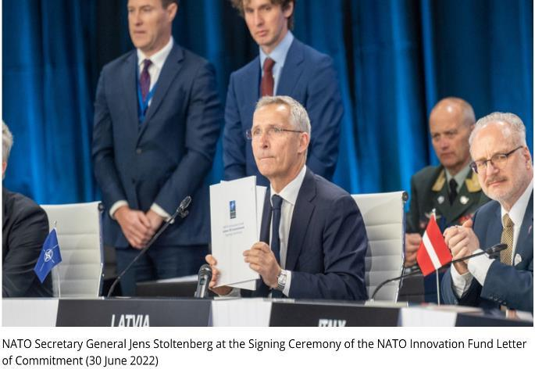
NATO Innovation Fund
The NIF complements DIANA
Will invest EUR €1 billion in early-stage start-ups developing emerging and disruptive technologies
15 year timeframe
Provides option for further investment in companies that have been through the DIANA accelerator programme

Slide 7
Emerging and Disruptive Technologies
Space
Artificial Intelligence
Energy & Propulsion
Data
Autonomy
Quantum-enabled Technology
Biotechnology
Hypersonic technologies
Novel Materials & Manufacturing
9 technology priorities
DIANA’s focus on TRLs 4-7
The technologies are ‘dual-use’ in nature – can address societal challenges as well as defence needs

Slide 8
Core Features of DIANA
Technical Challenges
Rapid Adoption Service
Allied Capital Community
Accelerator Programme
Award of non-dilutive grant; strengthen business viability of companies; product-market fit in defence and security
Competitive calls for proposals addressing critical Alliance needs
Pathways for follow-on contracts and capability development
Access to trusted investors and sources of capital
Innovation Network
Access to state of the art testing facilities at DIANA’s Alliance-wide network of affiliated accelerator sites and test-centres; access to operational end-users

Slide 9
Challenge and Accelerator Programme
Strategic Direction Development
DIANA gathers critical defence and security needs from NATO stakeholders and develops Challenge problems biennially
Challenge Call for Proposals
Innovators from NATO-member nations invited to propose emerging and disruptive, dual-use solutions
Programme Implementation
Two-phase demonstration and maturation Challenge programme includes Grant funding, Accelerator programme, Test Centre access, Mentoring, Investor network and pathways to Allied markets

Slide 10
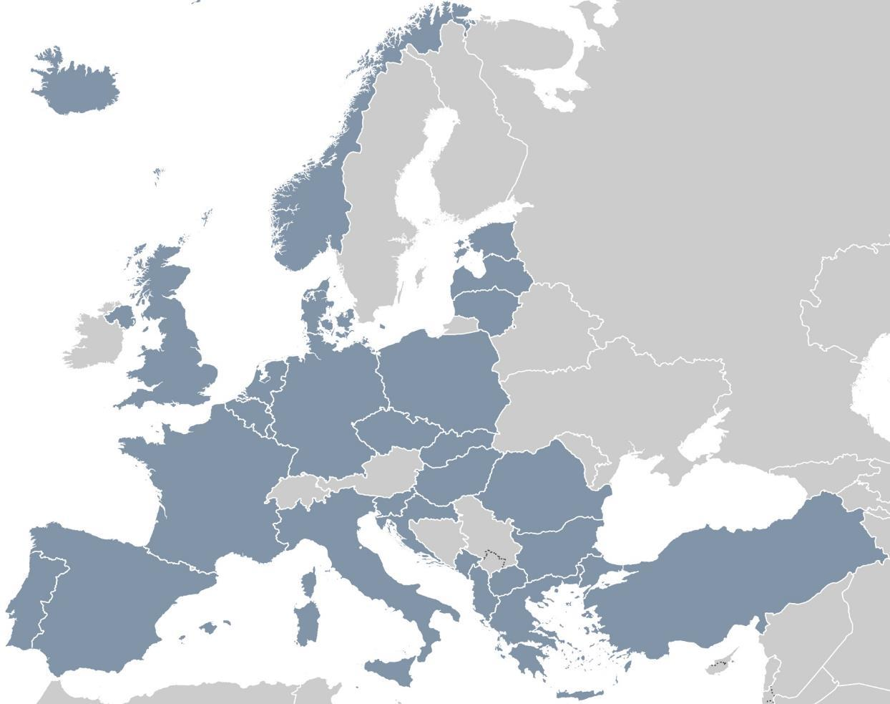
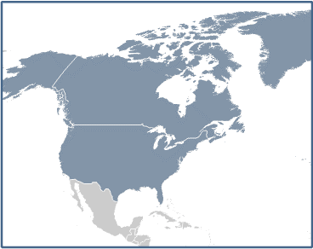
DIANA Network: Accelerator Sites (March 2023)
Key
Regional Offices
Niels Bohr Institute/ BioInnovation Institute BII Copenhagen
quantum-enabled technology, biotechnology
Regional Hub
Tallinn Science Park Tehnopol
Startup Wise Guys / Tartu Science Park
AI, cyber, space, greentech (energy and propulsion)
Test Centres
Accelerators
PN MAC Seattle
AI, next generation communications, robotics, pharmaceuticals, aerospace, biotechnology
CzechInvest Prague
AI, space, greentech (energy and propulsion), CERN related (data and computing)
WSL Wallonia & Brussels
AI, data, autonomy, cyber, biotechnology, aerospace (space), micro/nanotechnology (novel materials), greentech (energy and propulsion)
Odtü Teknokent Ankara biotechnology, energy and propulsion, novel materials and other deep tech programmes
Mass Challenge Boston
aerospace, biotechnologies, space technologies, undersea technologies
France intends to facilitate access to French accelerator sites drawn from across the French innovation sector.
idD Portugal Defence Lisbon
data and computing, biotechnology, novel materials, renewable energies (energy and propulsion)
Demokritos Athens
AI, data, autonomy, nanotechnology (novel materials), biotechnology
FORTH Heraklion
OGR / Plug and Play Turin aerospace (space)
05/24/2023 | PAGE 10

Slide 11
DIANA Network: Test Centre Sites (March 2023)
GERMANY – 9 sites
AI, data, autonomy, space, quantum, hypersonics, secure communications, energy and propulsion, semiconductors
ESTONIA – 6 sites
AI, data, autonomy, cyber, robotics, space, quantum, biotechnologies, novel materials, manufacturing, unmanned vehicles, aerospace
DENMARK – 4 sites
quantum, nanotechnologies, novel materials, optics, laser, metrology
Key
Regional Offices
NETHERLANDS – 2 sites
AI, robotics, autonomous systems, novel materials, energy, quantum
LATVIA
AI, data, communication technology
Regional Hub
NORWAY
data, autonomy, robotics
Test Centres
LITHUANIA – 6 sites
AI, data, autonomy, cyber, greentech, biotechnology, space, novel materials, energy and propulsion
Accelerators
BELGIUM – 14 sites
AI, autonomy, hypersonics, manufacturing, cyber, nanoelectronics, ICT
POLAND – 7 sites
AI, data, autonomy, CBRN, cyber, communication technology, quantum
UNITED KINGDOM
operational testing
SLOVAKIA – 6 sites
AI, data, autonomy, robotics, cyber, space, aerospace, biotechnology
HUNGARY – 2 sites
AI, autonomy, cyber
FRANCE – 10 sites
AI, autonomy, quantum, biotechnologies, energy and propulsion, novel materials, advanced manufacturing, hypersonics, space
ROMANIA – 2 sites
AI, hypersonics
Test Centres in the United States
across all emerging and disruptive technology areas
BULGARIA – 3 sites
AI, data, autonomy
SPAIN – 5 sites
AI, maritime, neurotechnology, 5G, quantum communications, energy
TURKEY – 2 sites
AI, data, autonomy, computing, cyber, biotechnology, space, hypersonics, quantum
ITALY – 2 sites
data, maritime, ISR, air, space, materials
SLOVENIA – 3 Sites
AI, 5G, cybersecurity, critical infrastructure
GREECE – 4 sites
AI, data, autonomy, space, quantum, biotechnology, novel materials and manufacturing
PORTUGAL
AI, data, autonomy, novel materials
05/24/2023 | PAGE 11

Slide 12
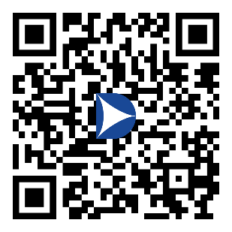
Connect and Register with Us
Read more on the DIANA website
www.diana.nato.int
Follow DIANA on LinkedIn
https://www.linkedin.com/company/nato-diana
Register on the DIANA portal for notifications of Challenge Launch
www.nato-diana.org

Slide 13
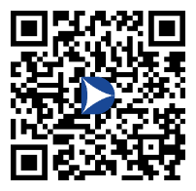
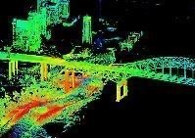
Strategic Direction Focus 2023
EDT solutions that ensure energy is at all times available and sufficient to sustain NATO’s missions and operations. Solutions should allow Allies to better prepare for, minimise, adapt to and recover from anticipated and unanticipated energy disruptions.
EDT solutions that support the detection and systematic observation of physical and digital domains to enable, for example, situational awareness and forecasting.
EDT solutions for protected, reliable collection-through-dissemination of relevant data and ensure that the resultant data-derived information can be trusted.
Sensing and Surveillance
Energy Resilience
Secure Information Sharing

Slide 14
Questions?
cynthia.shaw@diana.nato.int
+32 478 672576

