Slide 1

Preparing the sustainment underwater warfare systems program for future complex scenarios
Johan Wahren, Project Manager Underwater Warfare Weapon Systems

Slide 2
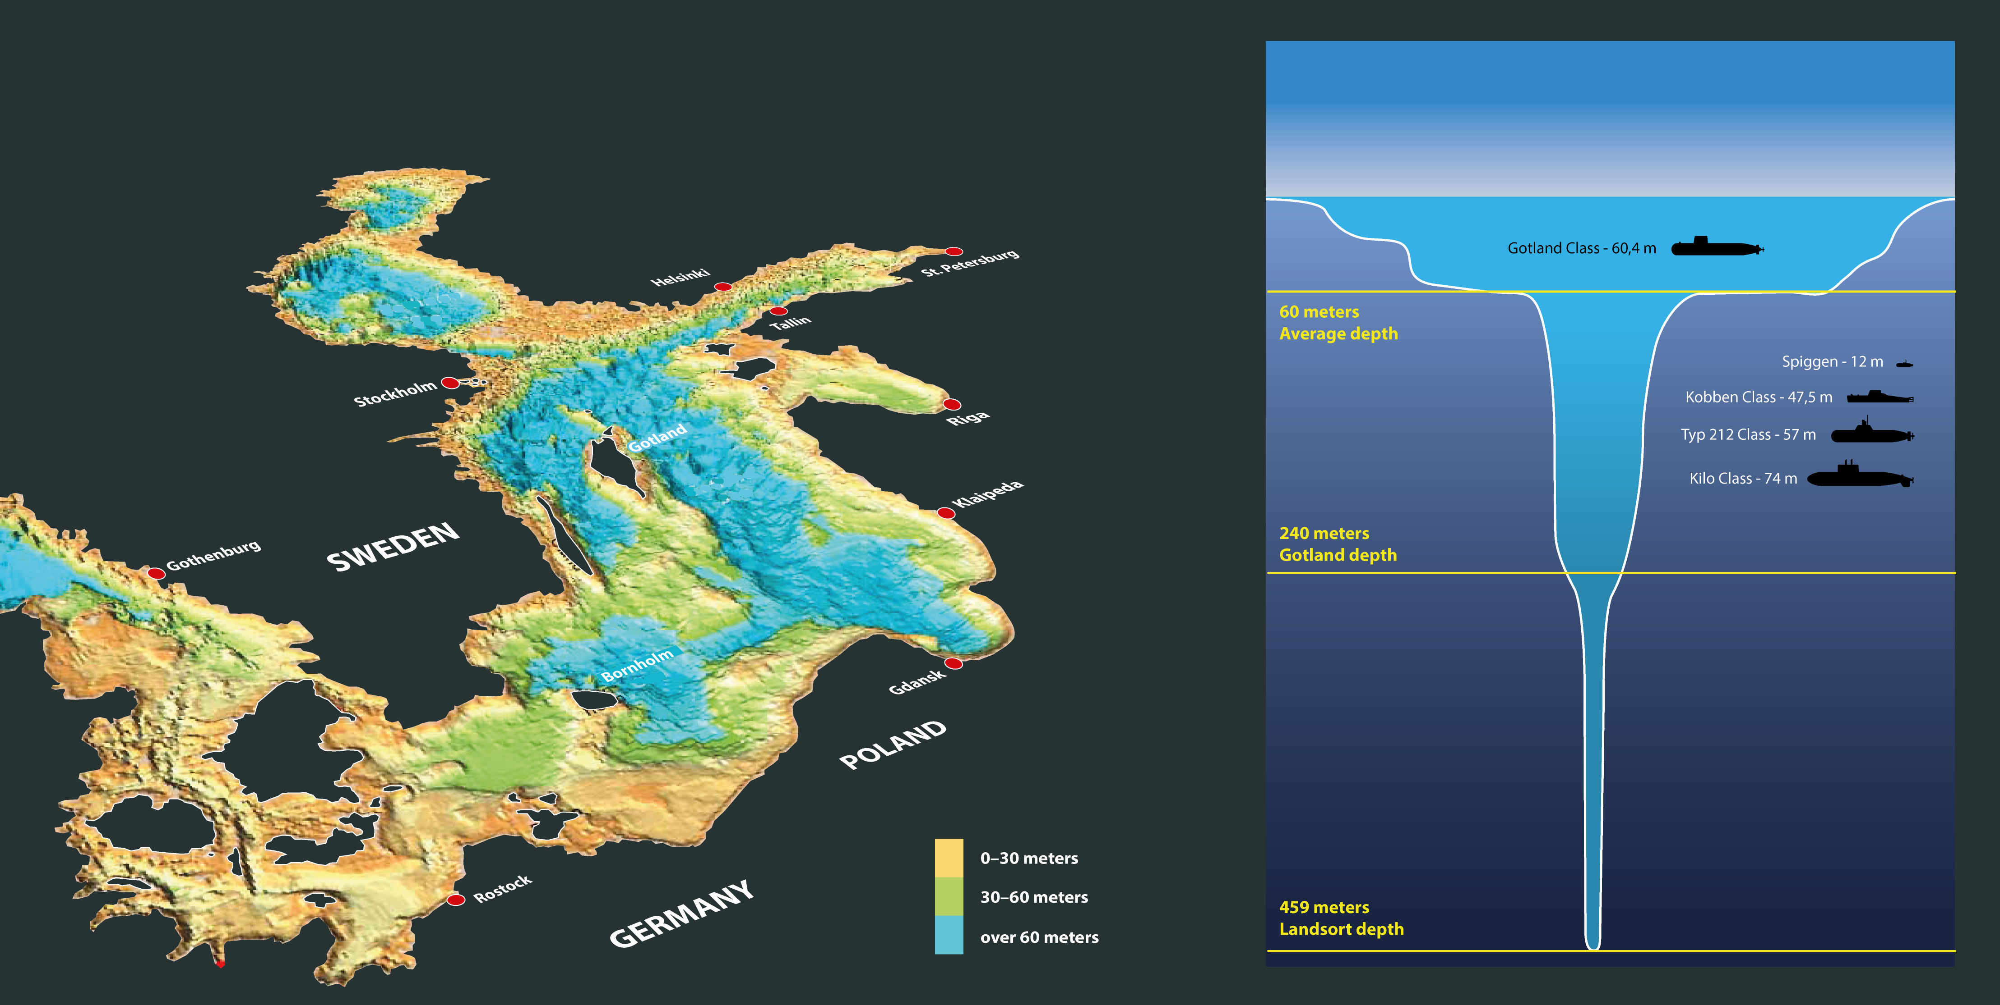
Underwater topography of the Baltic Sea
Submarines that normally operate
in the Baltic Sea

Slide 3
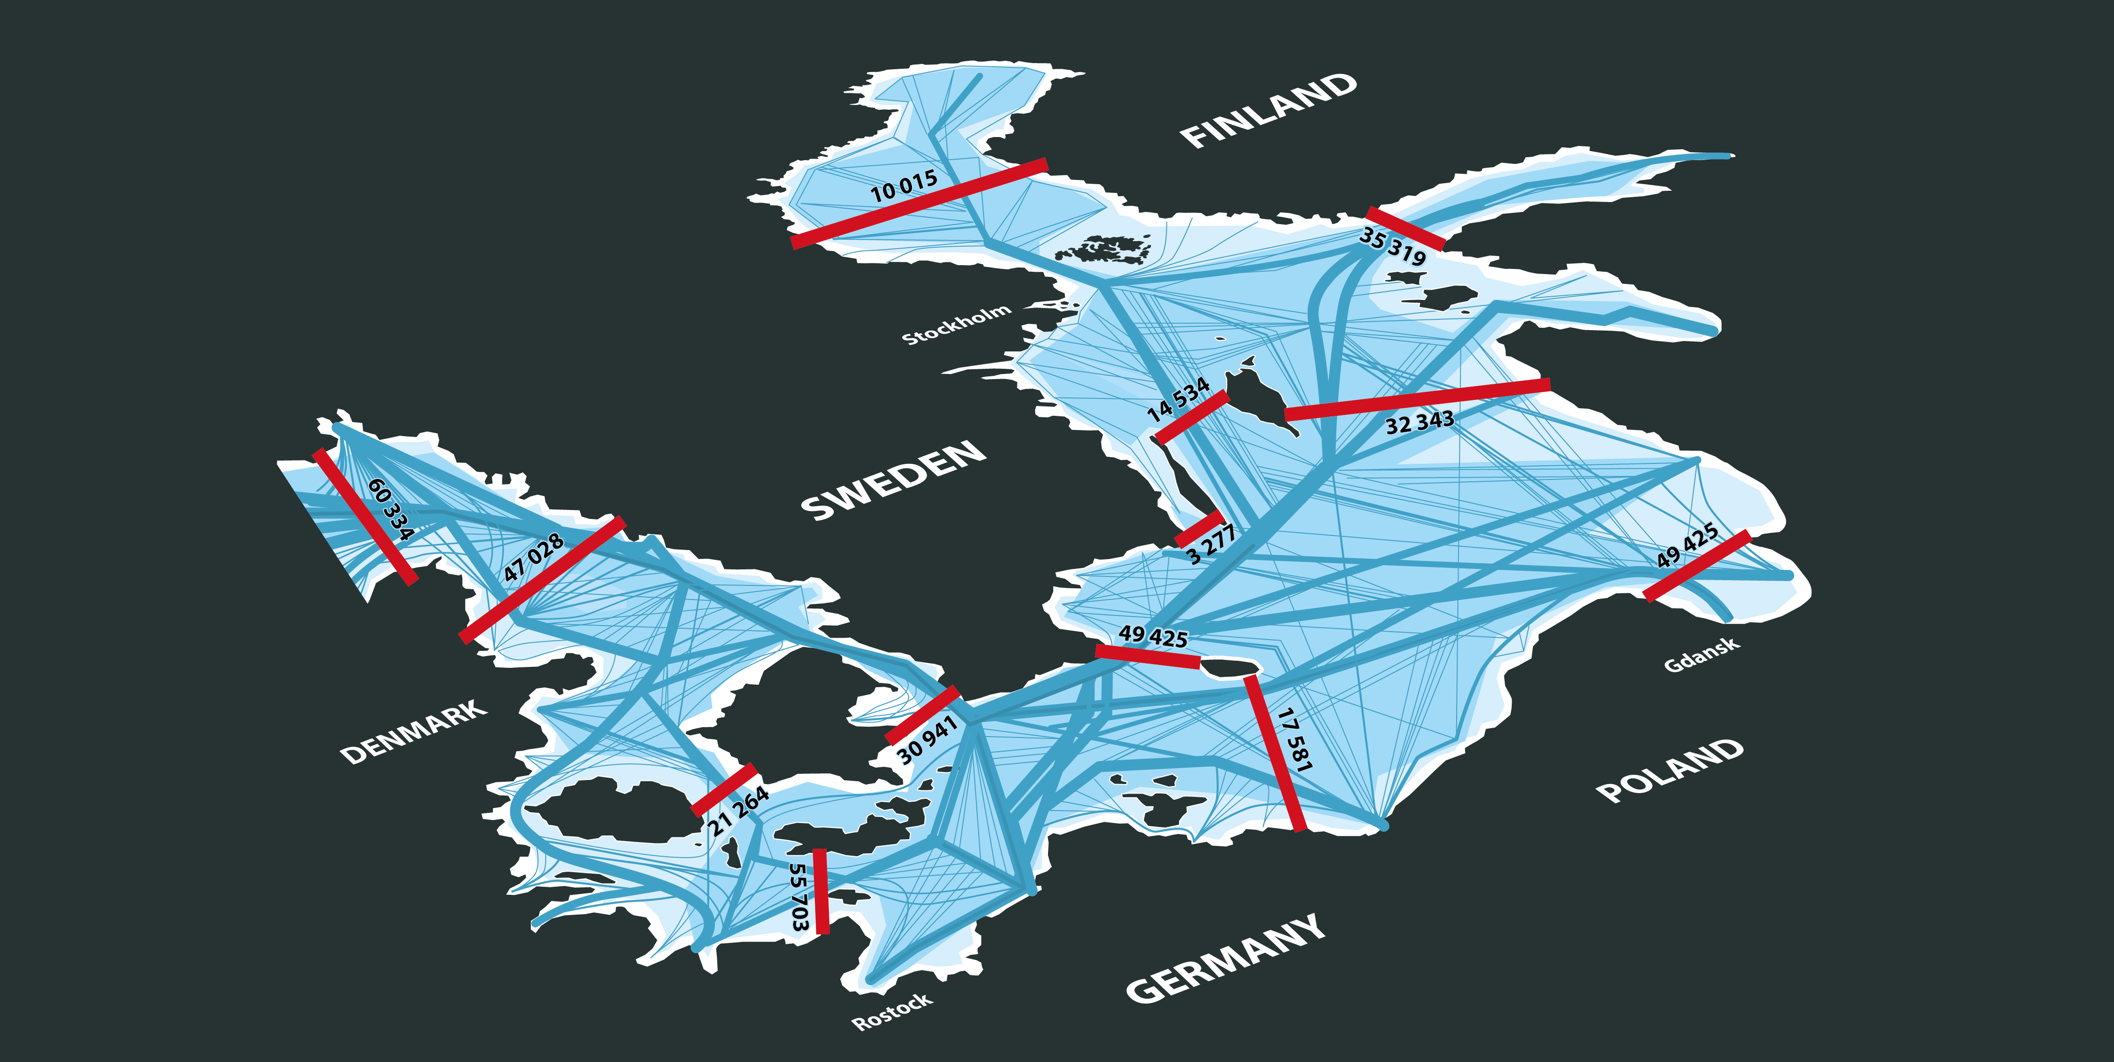
Sea traffic intensity
Passages of vessels equipped with
AIS-transponder in 2015

Slide 4
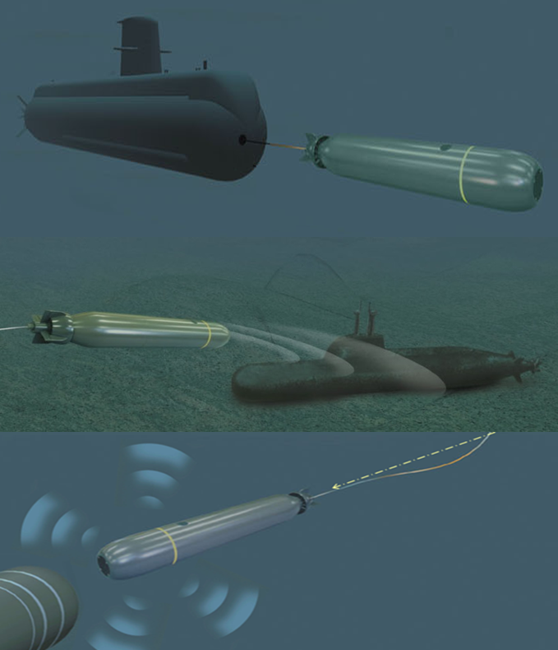
Torpedo System 47 (TS47)
A new generation Lightweight Torpedo System for:
  Anti Submarine Warfare – ASW (primarily)
  Anti Surface Ship Warfare – ASuW (secondarily)
  Torpedo defense
Key functionality:
  Shallow water operations (Baltic sea)
  Complex scenarios
  Low speed capability
  Communication capability
  A modular design to accommodate future upgrades and new functionalities
  Adaptation to international missions
Torpedo 47 in progress to replace the currently operational
Torpedo 45.

Slide 5
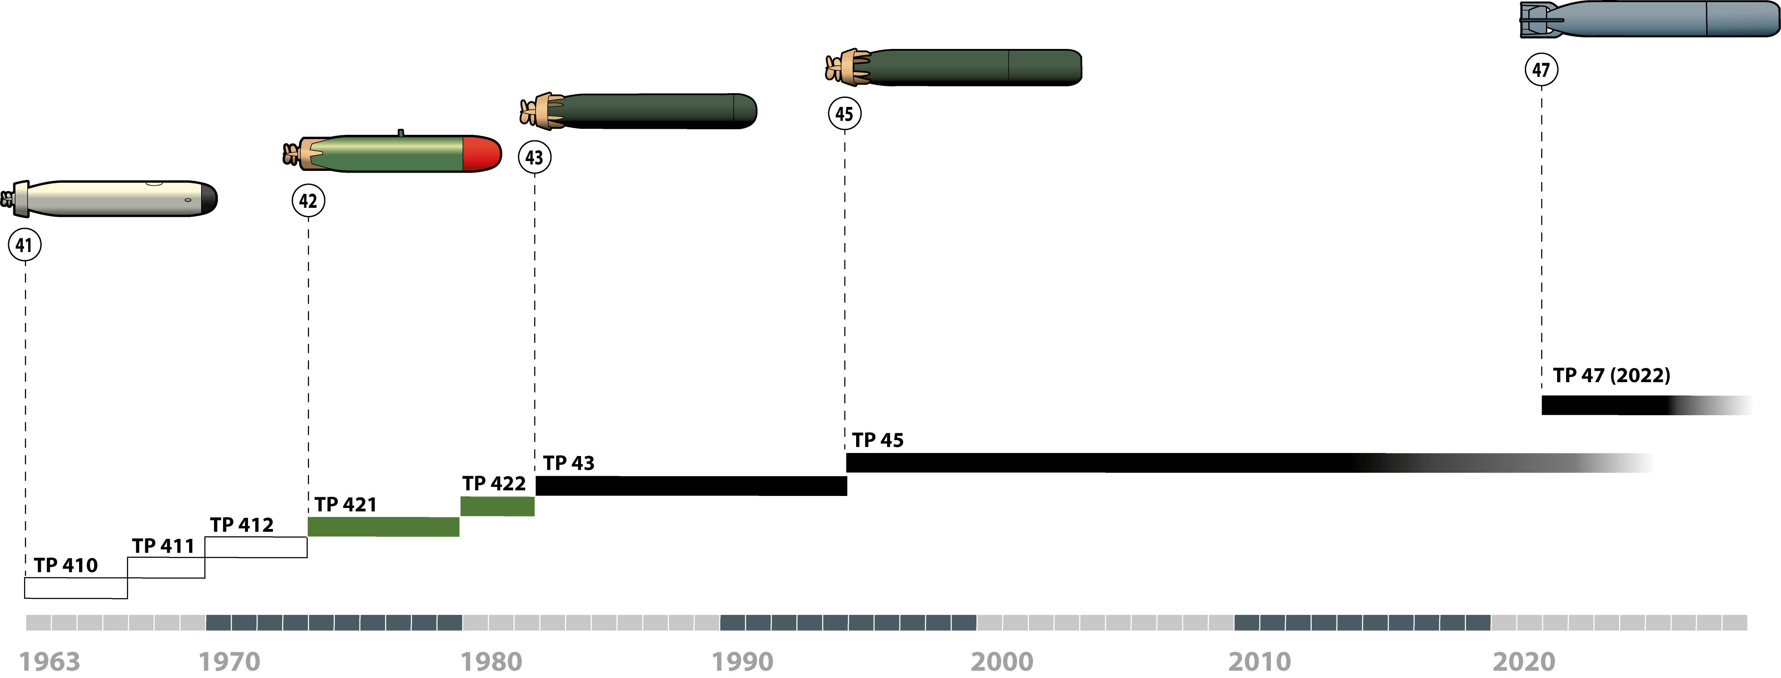
Swedish LWT history Timeline 1963–

Slide 6
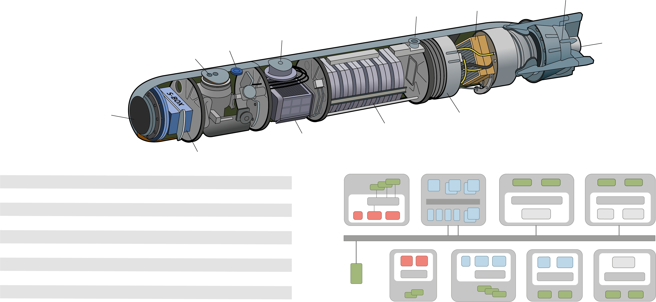
Torped 47 – design principles and performance
Motor &
Controller
Stator/Rotor/Duct
Conector
Recovery
System
Tracking
Light
LLS
Servos/
Rudders
FLS
Wire/Fibre Magazine
Battery
Computer &
Electronics
FLS electronics
Dimensions
Weight
Speed
Endurance
Battery
Propulsion
Homing system
Warhead
Communication
400 mm x 2850 mm
Ca 340 kg
10- to ≥35 kts Prepared for≥45+ kts
≥ 20 km (>1h) Prepared for ≥ 50 km
LiFePO4, >100 recharging
Electronic DC-motor / Pumpjet
Active & Passive (Fully Digital) Prepared for HF
IM compliant, omni-directional, PBX
Galvanic wire, Prepared for Optical fiber

Slide 7
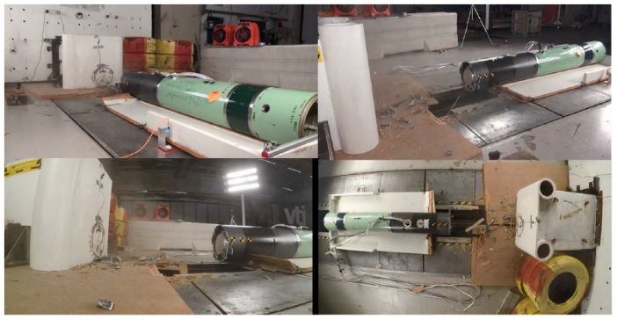

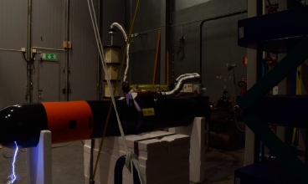
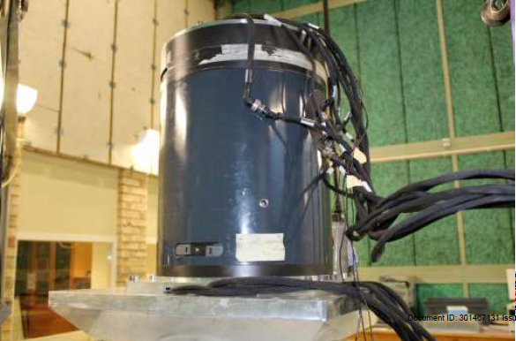
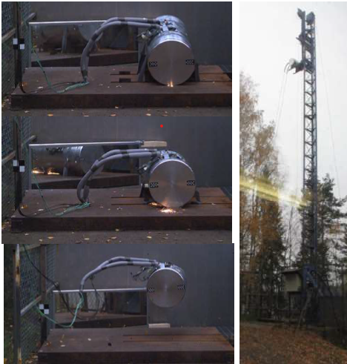
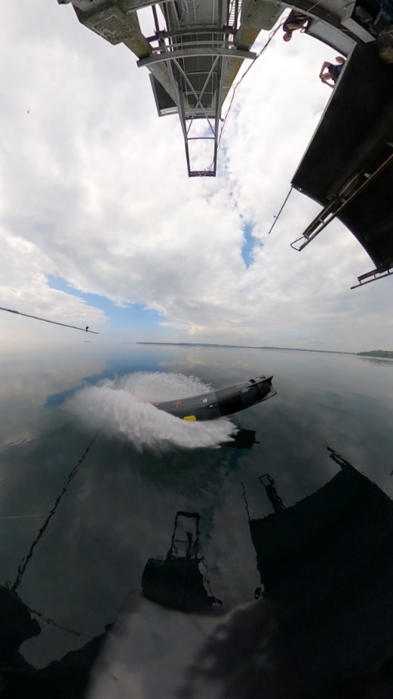
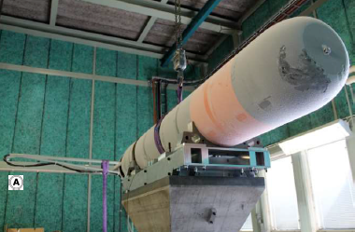
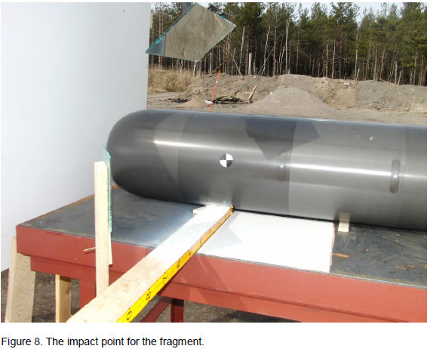
Verification of Requirements
Impact
HESD
Vibration
Droptest
Helo-droptest
Climate
IM

Slide 8
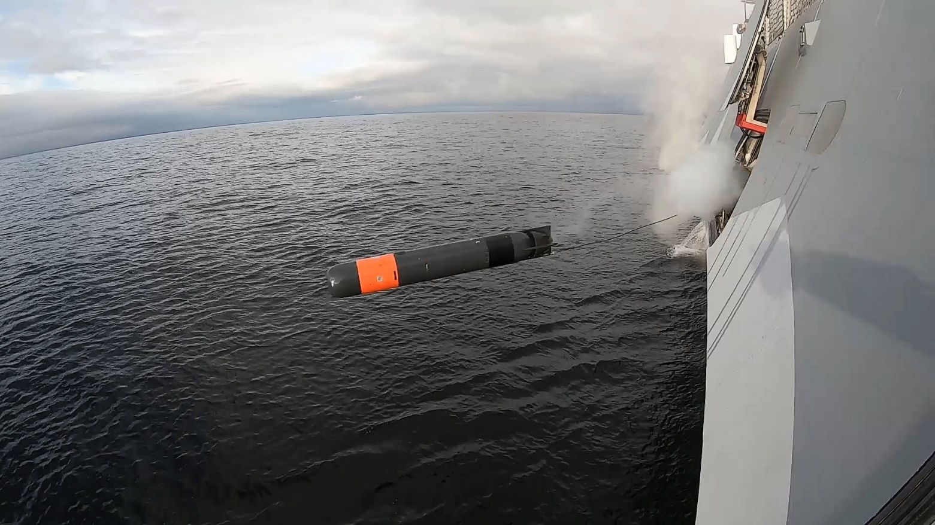
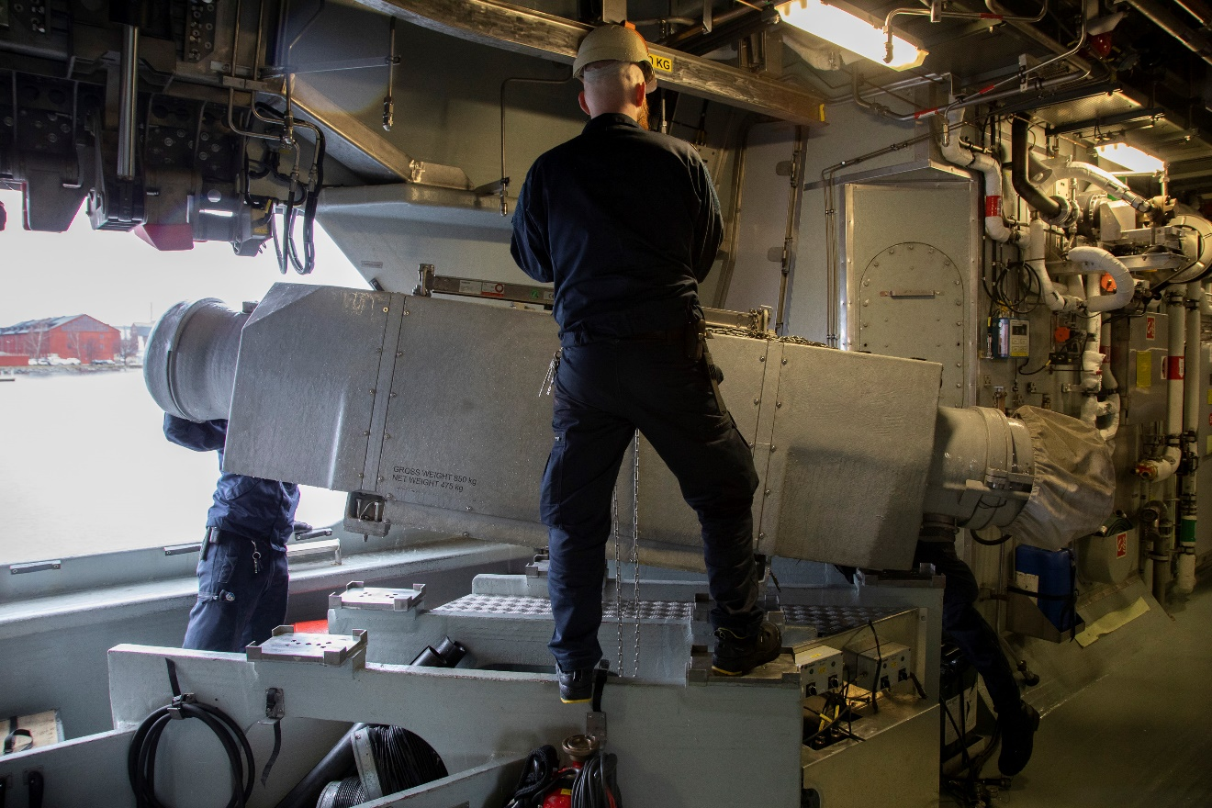
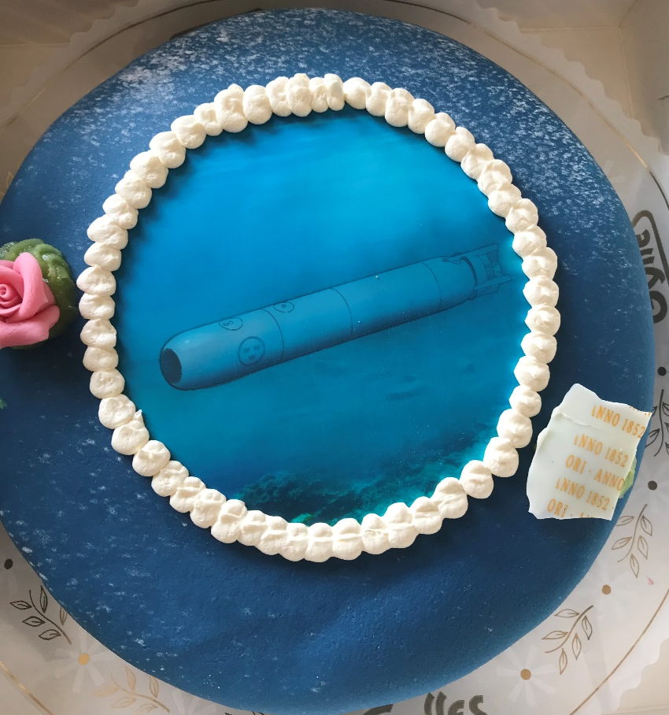
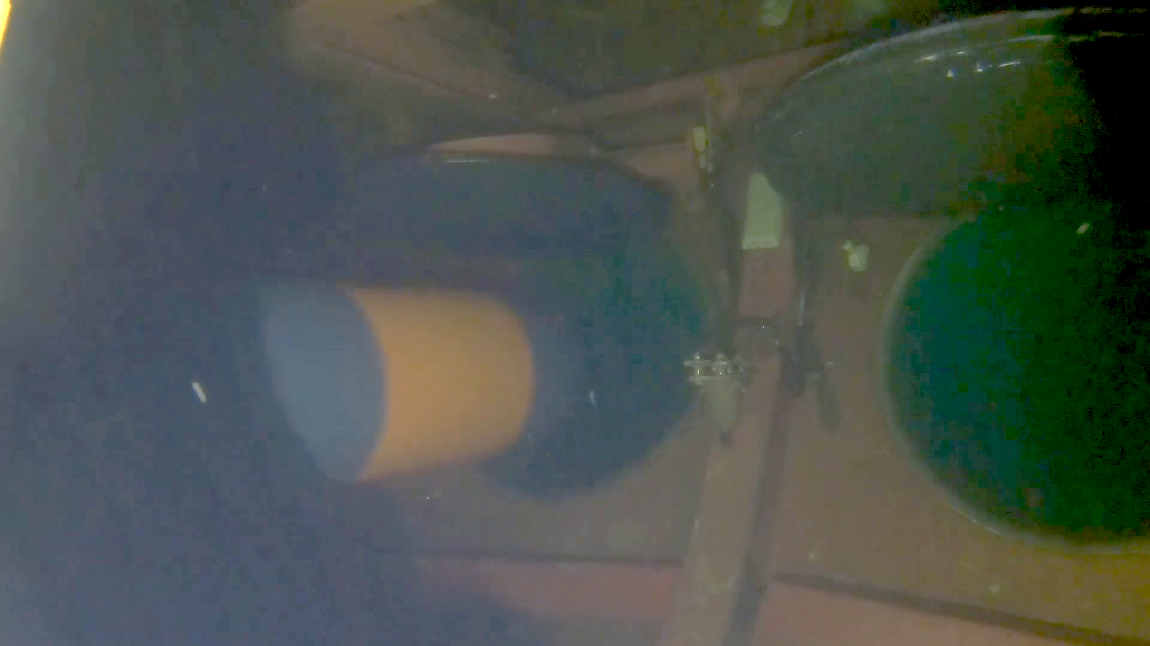
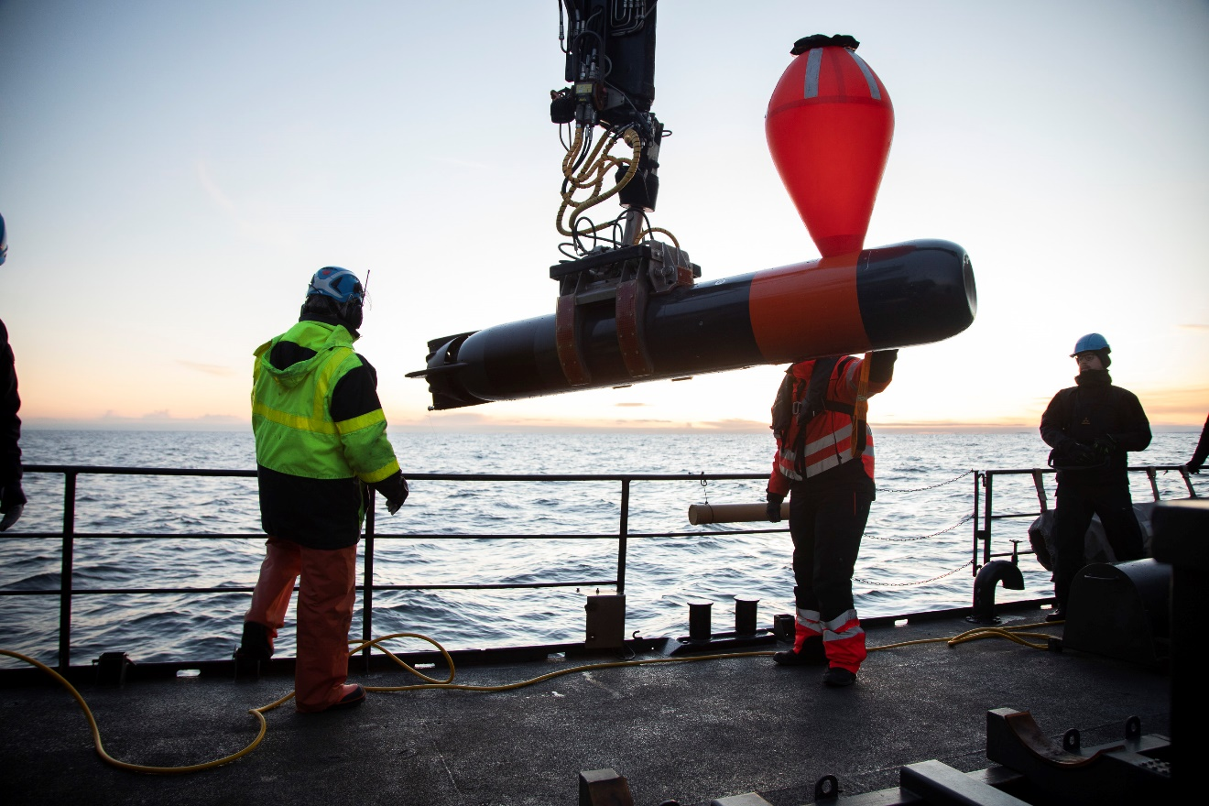
Sea trials
“Sjölöken”
SAT

Slide 9
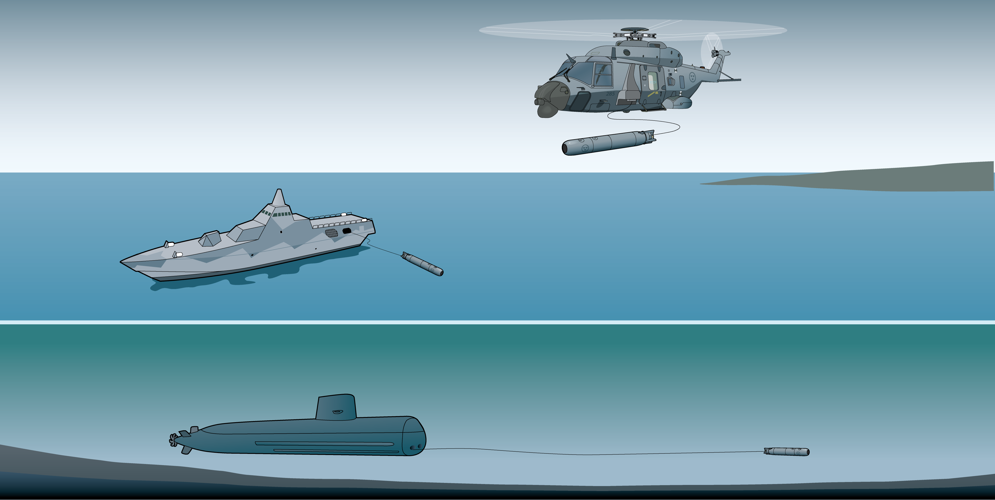
Overview of launching platform types
Helicopter 14F (prepared for)
(ASW Configuration)
Use own sensors or relayed information to locate and track target.
Launch torpedo 47 with wire guidance hovering or as fire and forget.
Visby Class Corvette, Gävle Class Corvette
Use own sensors or relayed information to locate and track target.
Launch torpedo 47 with wire guidance or as fire and forget.
Gotland Class Submarine (In future Blekinge Class Submarine)
Use own sensors to locate and track target.
Launch torpedo 47 with wire guidance or as fire and forget.

Slide 10
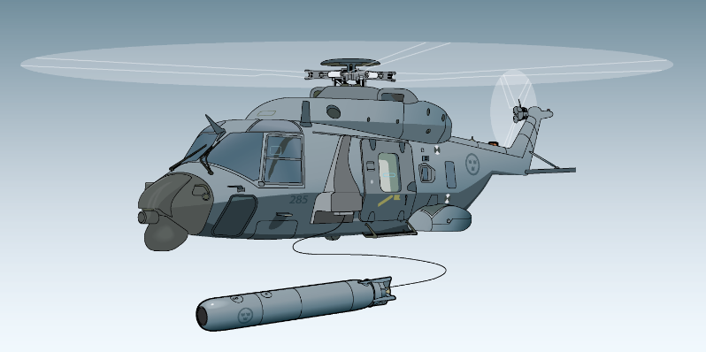
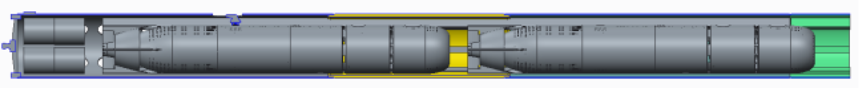

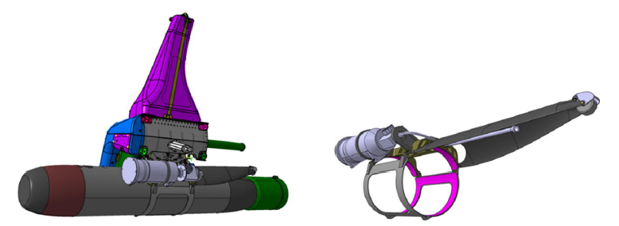
Torpedsystem 47 – Coming phases
Helo
Integration Ub Blekinge (53 cm tub => 40 cm)
ASV/USV
UAV
Future

Slide 11
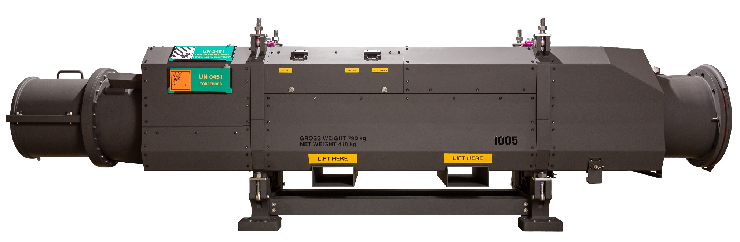
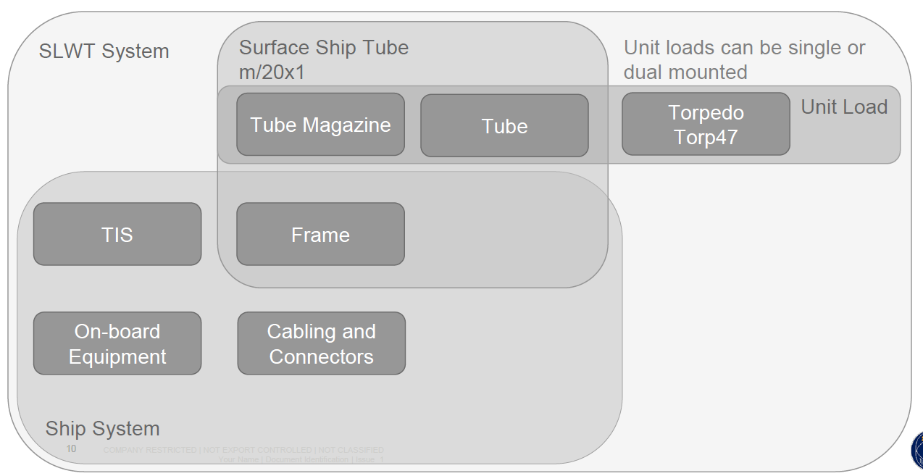
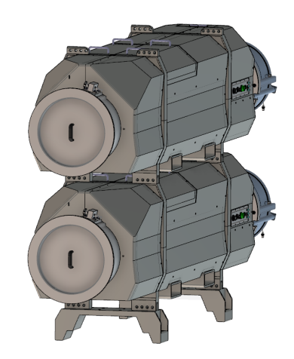
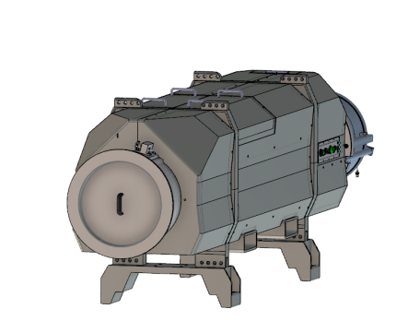
New Surface Tubes
Replace todays tub m/8502
Unit load

Slide 12
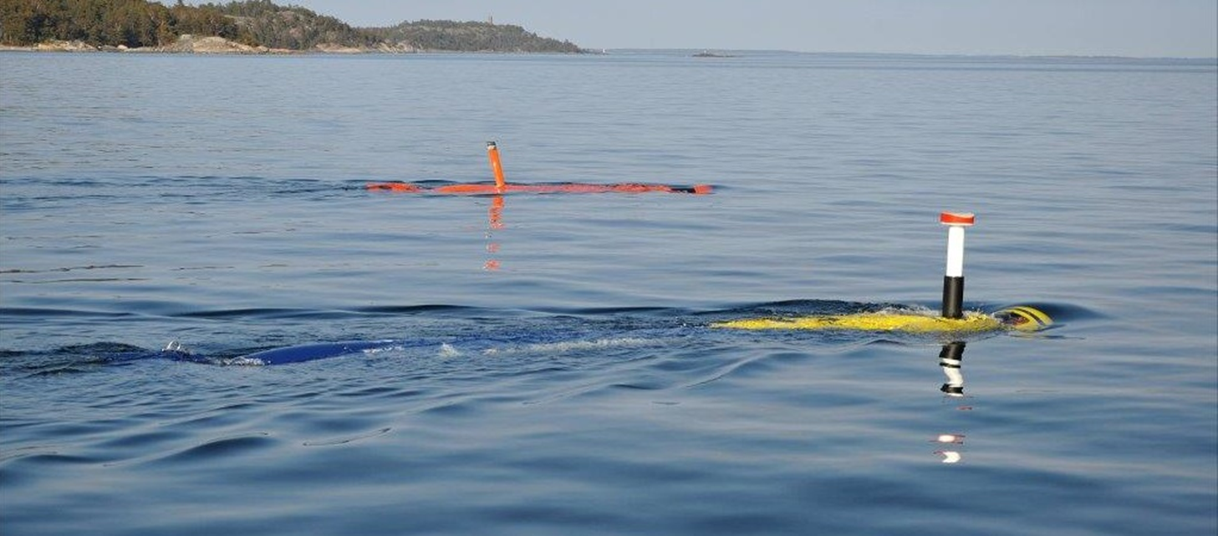
System AUV 62

Slide 13
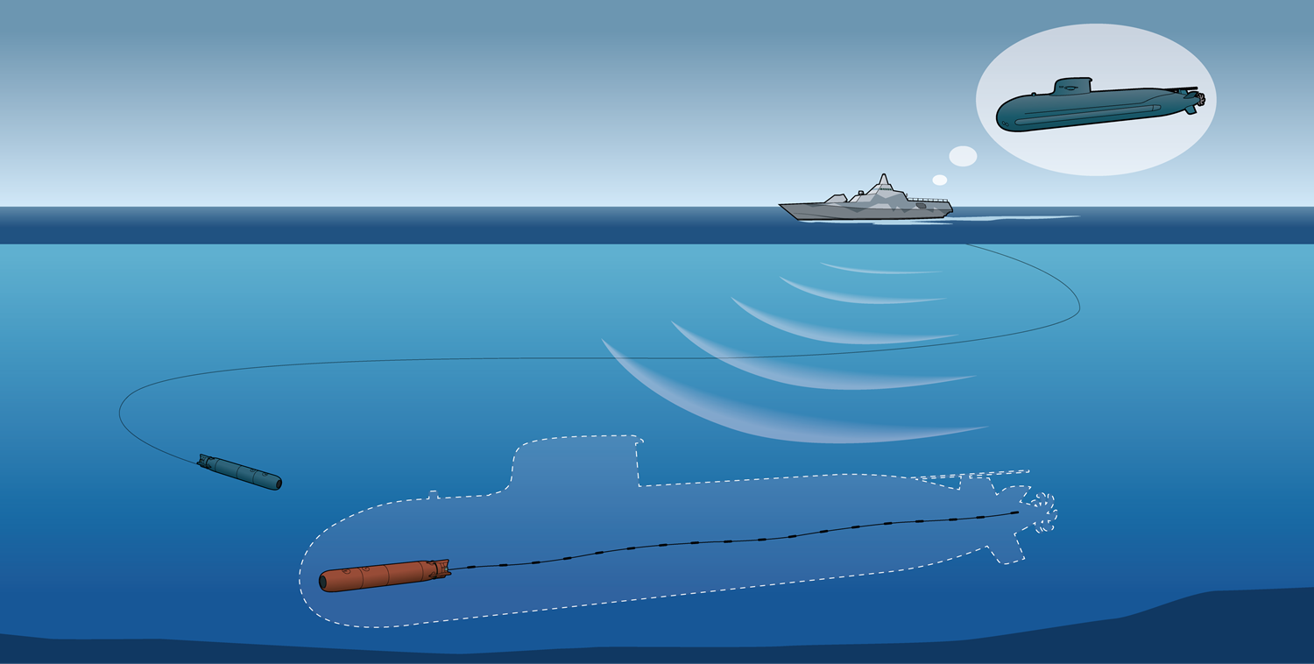
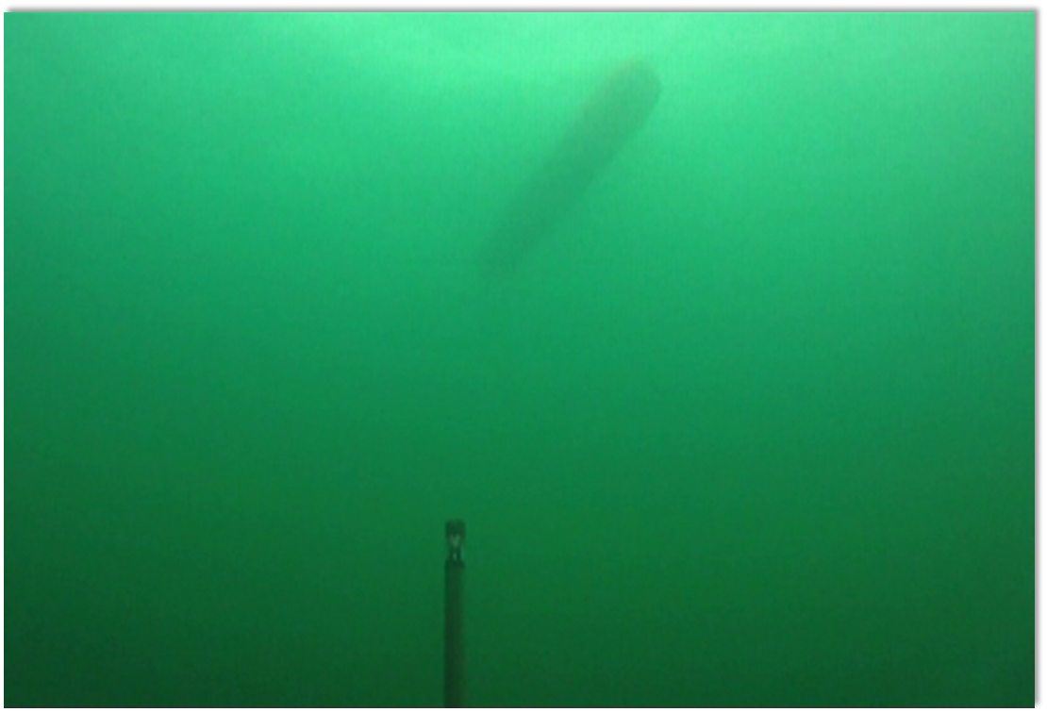
AUV 62-AT: Autonomous acoustic target system for ASW training

Slide 14
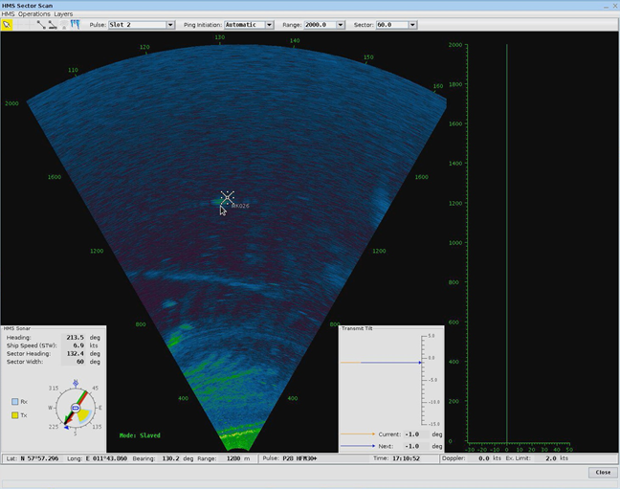
AUV 62-AT
AUV62-AT can handle multiple units simultaneously
Entire chain locate/track/attack can be trained
Joint actions can be trained, such as ship/ship or ship/helicopter cooperation.
AUV62-AT can also be used as target during exercises

Slide 15
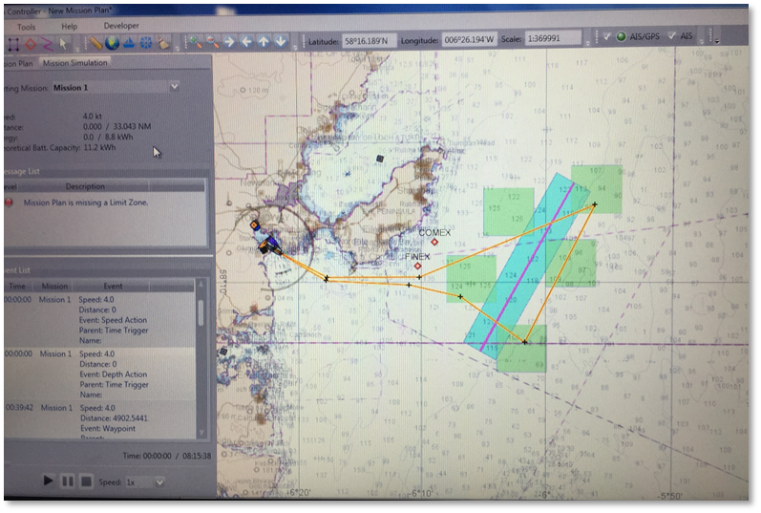
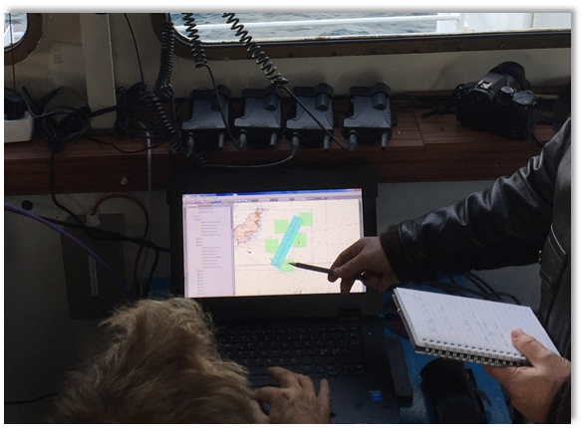
AUV 62-AT
Flexible planning – adapt on the go
Preparation of routes and active/passive signals
Real time position prediction in mission planning system with overlay functions such as charts and AIS data.
On board evaluation possible for rapid feedback during excersice
Advanced evaluation possible through combined data processing

Slide 16
AUV 62-MR: Autonomous mine reconnaissance system
System overview

Slide 17
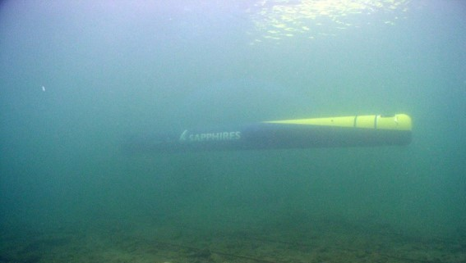

AUV 62-MR
Payload for Mine Reconnaissance
  On-board Synthetic Aperture Sonar (SAS) Processing
  On-board CAD/CAC Processing
  Dual Multi-element Interferometric Side-looking Sonar
  On-board and Bathymetric Focused Multi-beam processing for REA
  On-board Optical sensor processing for Target Identification
  High surface coverage capability with full resolution – entire city of Farnborough (Approx 20km²) in 6h
  Platform integration or COOP capability

Slide 18
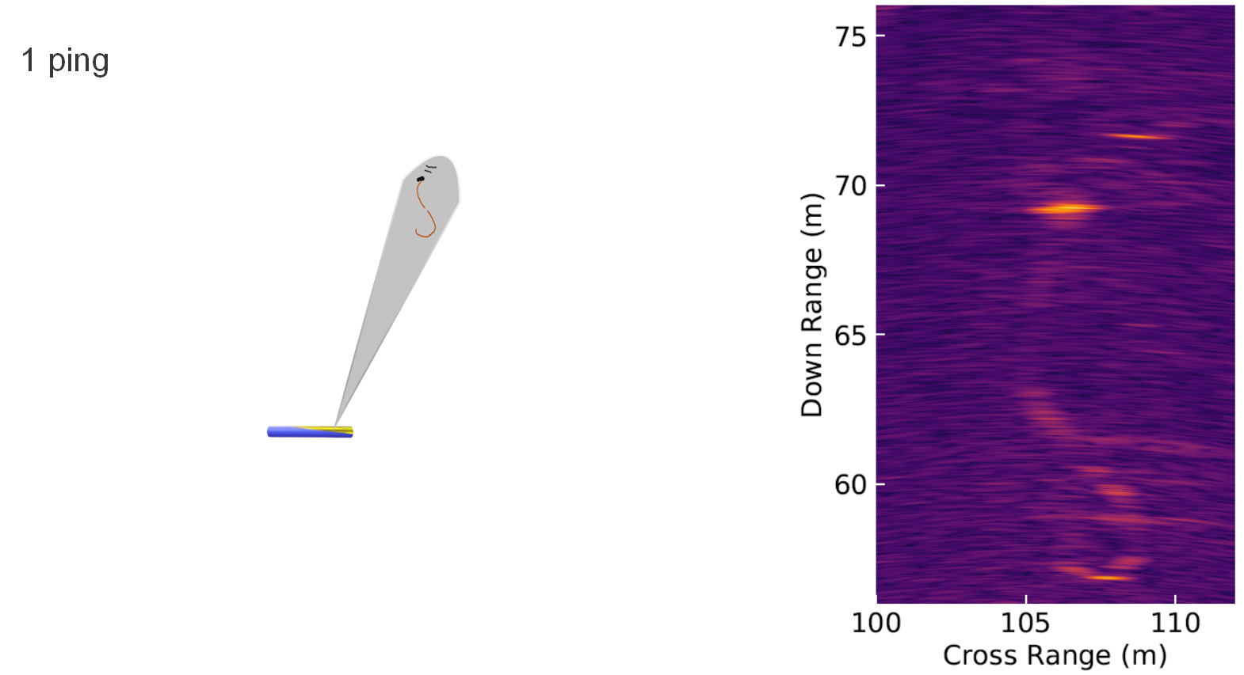


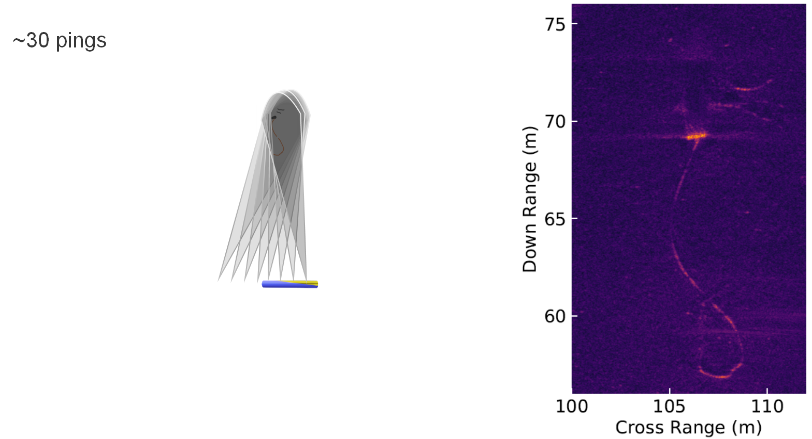
SAS image generation
Photos/images by Saab

Slide 19
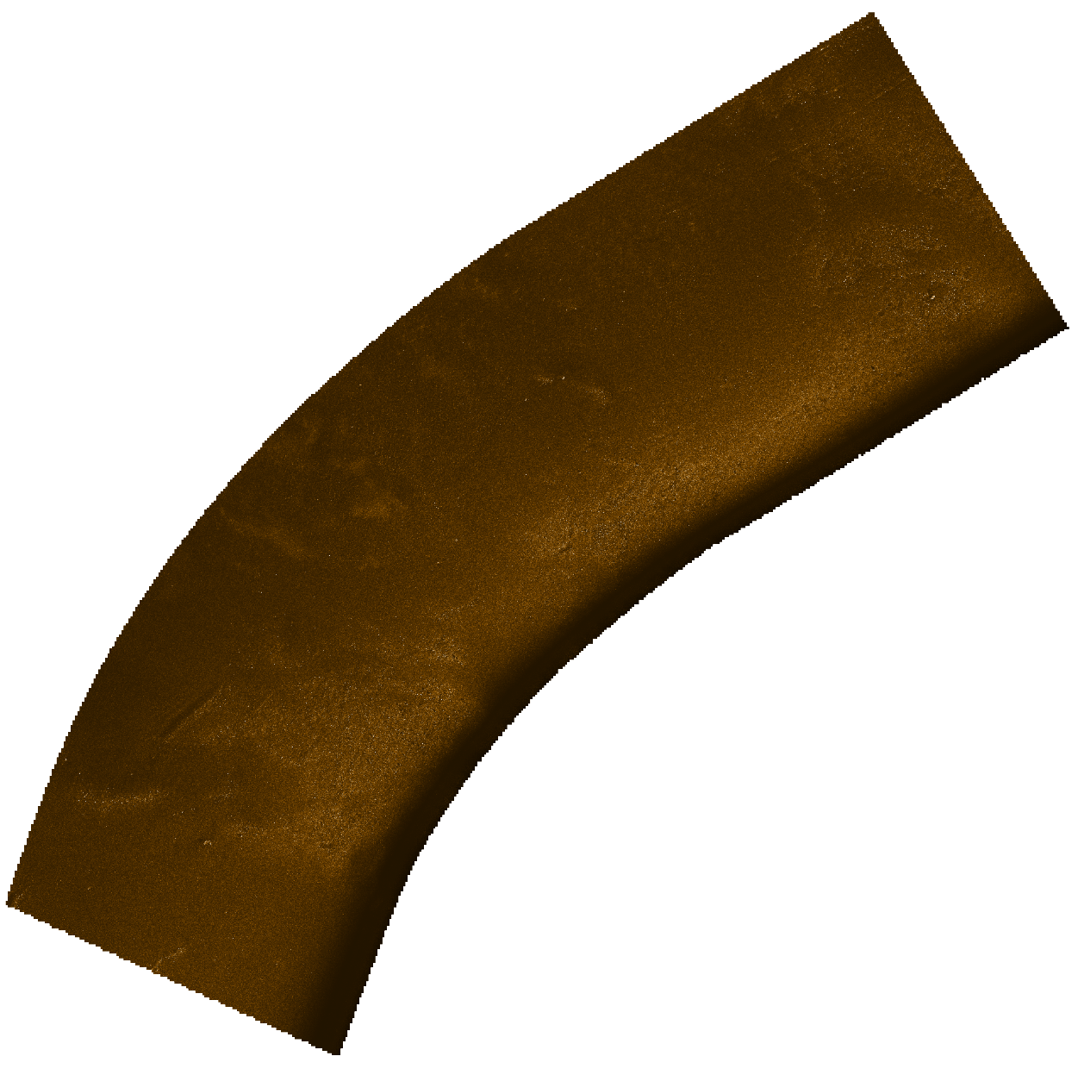
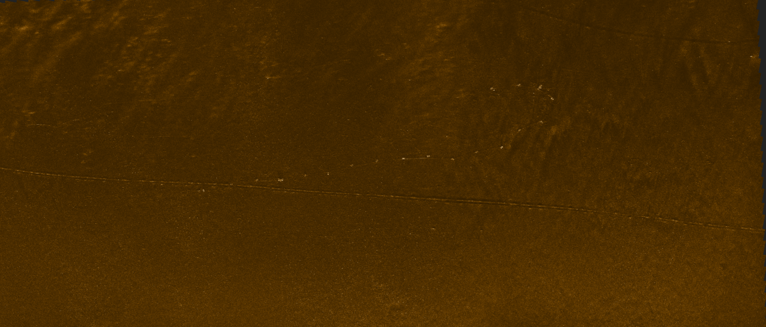
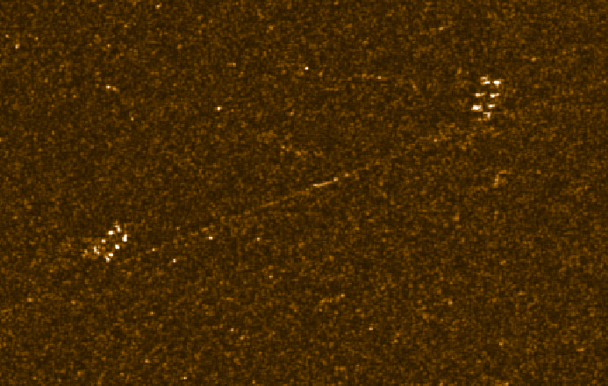
SAS Images - examples
Photos/images by Saab

Slide 20
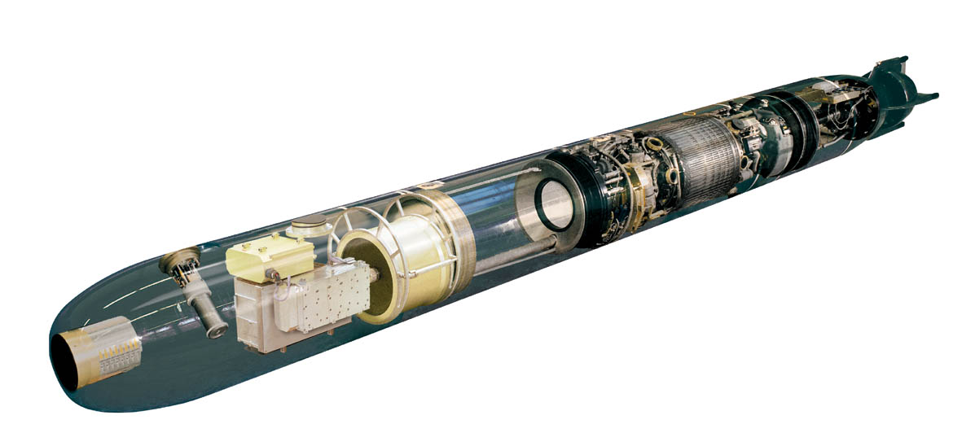
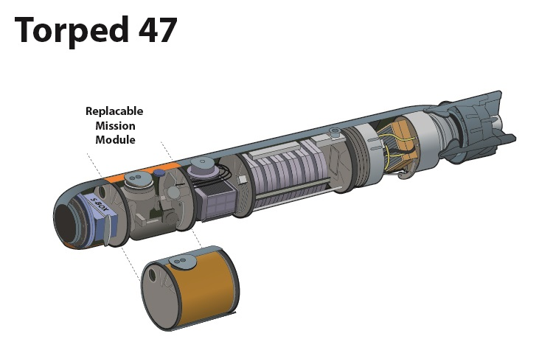
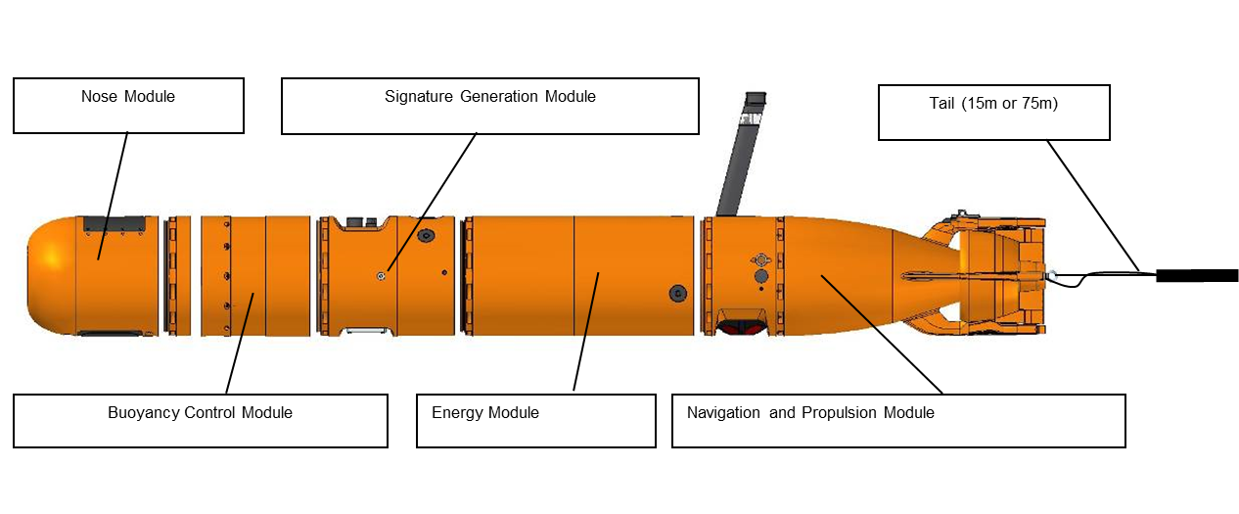
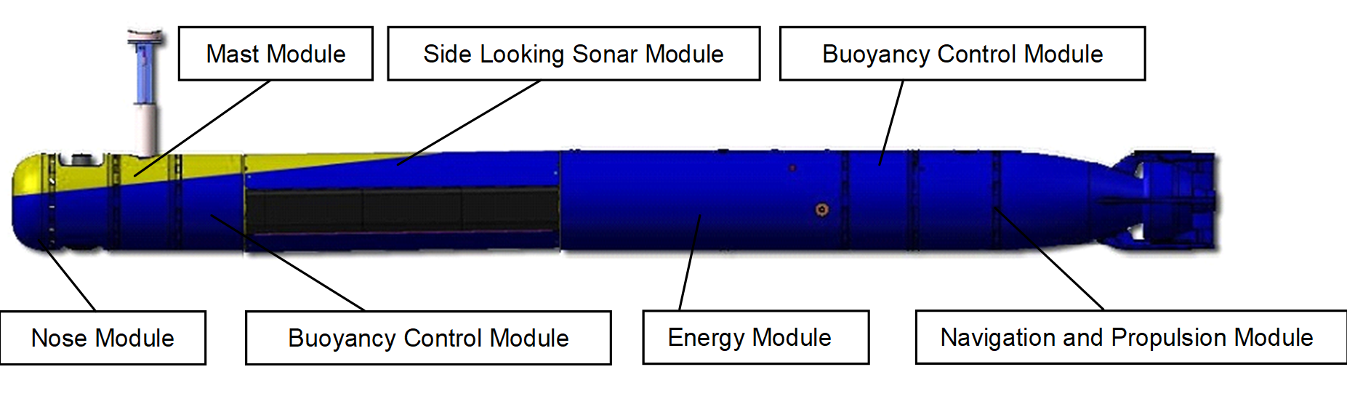
Modular design – Technical platform
Torped 62
AUV62
Notes:
Istället för COTS så är vår styrka teknisk plattform, modularitet och utbytbarhet. Återanvändbarhet mellan produkter så som Torpeder, minor och obemannade farkoster

Slide 21
Modular design –Technical platform
2016
2017
2018
2019
2020
2021
2022
2023
2024
2025
2026
Torped 45
Torped 47
Torped 47
Torped 62
Torped 62
Torped 62
AUV47
AUV62
AUV62
AUV62
MS2
Ers F42
SubRov
SubRov
TIS
TorpG SIM

Slide 22
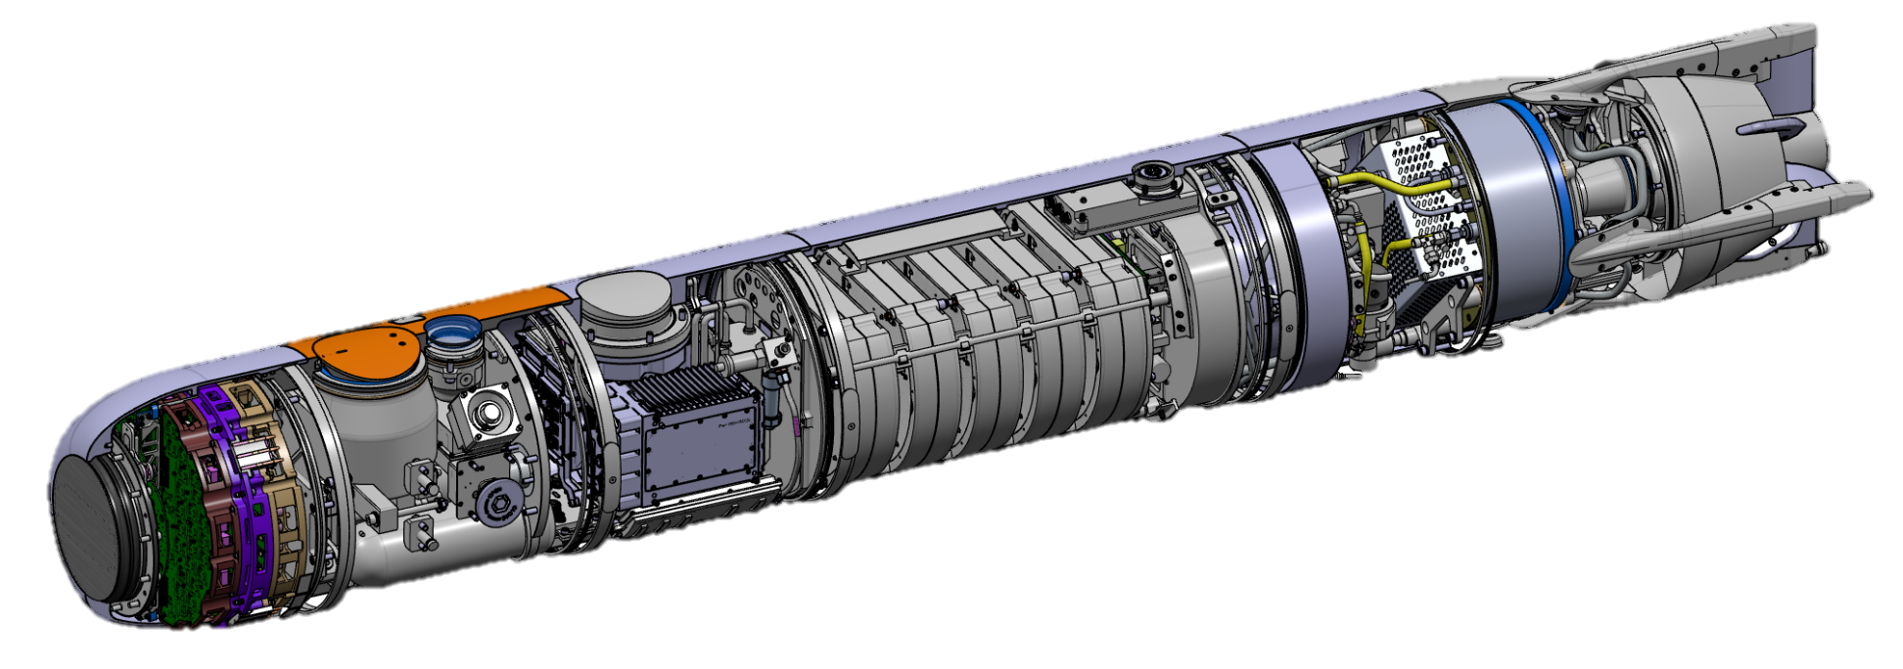
Technical Platform
Propulsion and Pump Jet
Studie Propulsion SP45
Wire Comm Modem
Torpedo 62 ZoKiTS
Lock and Back Connector
Torpedo 45
LLS Electronics
Torpedo 62 ZoKiTS
Rudder Servo Arrangement
Torpedo 62
LLS Front End
Torpedo 62 ZoKiTS
Motor System Design
AUV62
FLS Front End
DEMÅN
Wire Comm Hardware
Torpedo 45
Energy System Design
AUV62
FLS Electronics
DEMÅN
Behaviors and Functions
Torpedo 45 / Torpedo 62
Navigation System
AUV62
Software Architecture
SDS / AUV62

Slide 23


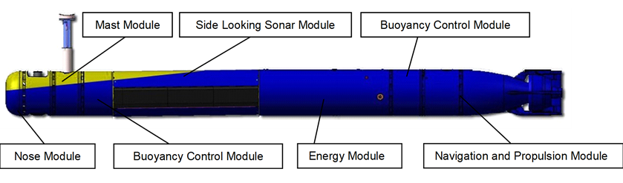
Technical Platform
Handles short technical lifetime of components as it allows for “Rapid COTS insertion"
Allows upgrades and development during lifecycle
Recyclability between different products – “Common shared Components & Subsystems”
Logistics, software and knowledge are also crucial for the technical platform
Future

Slide 24
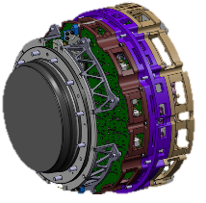
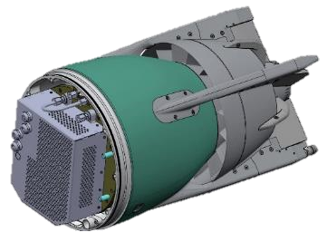
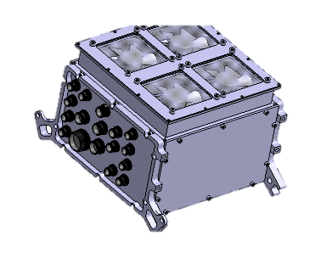
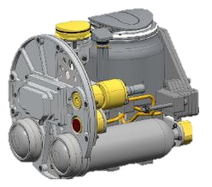
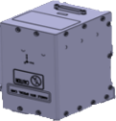
Technical Platform
Overall Torpedo Architectures (HW and SW)
Homing System (MS5)
Propulsion System Modelling and Design
Various System Components and Solutions
IMU IO-Unit Recovery System

Slide 25
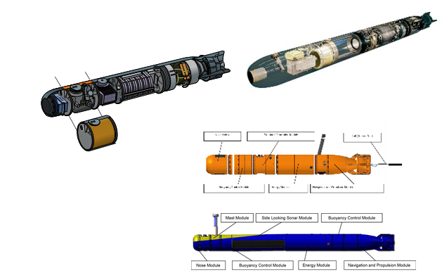
Summary
Non-complex platform adaptation for rapid integration is a key feature for the systems in the technical platform concept
System adaptation for operative environment and tactics
Weapon- and sensor system integration on multiple platforms on surface, in air and under water
Train as you fight
Cost effective and avaliable operator training and platform cooperation training

Slide 26
Thank you for listening!

