Slide 1
Monetizing the Telco Edge: From Infrastructure to API-Driven Revenue
Dragon’s Den: Unlocking New Revenue Streams
Capacity Europe
October 2025

Slide 2
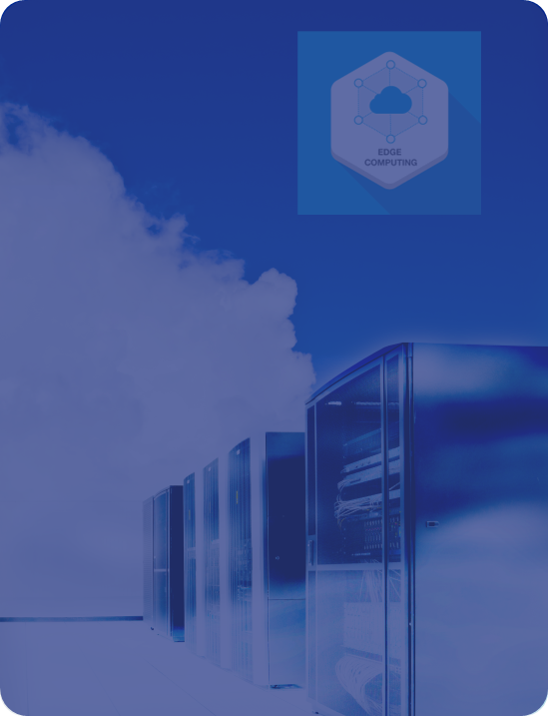
We’re one step close to the Edge
It’s time to show that the Network is as relevant as data centers are when delivering Enterprise services.
Telcos have been stuck monetizing connectivity (bits and bytes) while hyperscalers monetized the application layer (APIs). The revenue gap has been widening for years.
Edge Cloud (MEC) was the missing link. It's the only asset Telcos can own that offers the low-latency, sovereignty, and security required by next-gen enterprise applications
From now on, a blueprint exists to turn this infrastructure into a billable service platform.

Slide 3
Under the IPCEI-CIS tailwind
MWC 2025
Edge Cloud national networks are being built in Europe, Telefónica will offer the first commercial service.
Telefonica’s Edge Cloud architecture includes an Operator Platform based on Nearby Computing’s edge orchestration framework. Special features like Smart App Allocation have been designed.
The Edge Computing service will be ready for federation with other national or international edge nodes, to expose all available resources to enterprise customers.
Nearby Computing has recently published the first reference implementation of the East-West Federation API following OPG’s definition.

Slide 4

Enterprises are ready for Edge
To unlock interest in Edge proximity services, data sovereignty, security, and reliable broadband access are the key catalysts.
Plenty of industrial use cases not eligible for the Cloud. Telcos, through their Edge service, can be the partner that enterprises are looking for.
On-Prem and Telco Edge resources can be seamlessly combined via federation of private and public (telco) orchestrators, using the same OPG API.
Flexibility, customer freedom, etc, will be key to get long-term engagement from developers and ITOps managers.

Slide 5
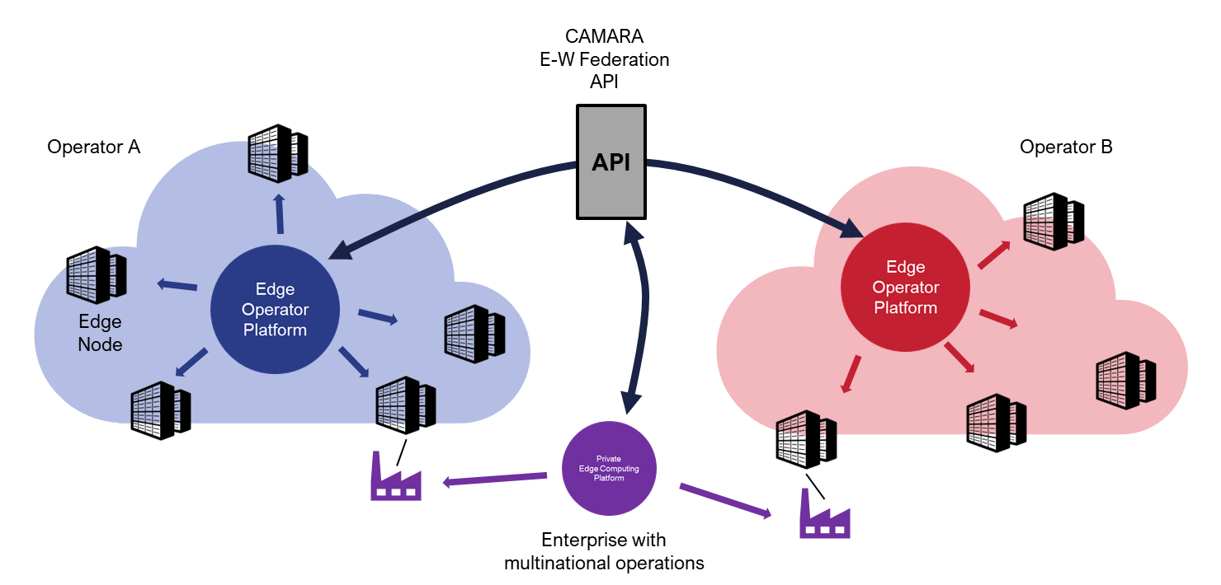
The Edge is a raising wave
Edge Cloud monetization is achieved not through hardware, but through API standardization and Edge Orchestration.
All Telcos are invited to actively adopt the OPG API standards and leverage existing deployment platforms to accelerate interoperability.
The revenue is not in the Edge server; but in the capacity to combine the Infrastructure with the Network and leverage the joint capillarity to eventually deliver an unbeatable service.
LIVE DEMOS AVAILABLE AT MWC 2026

Slide 6
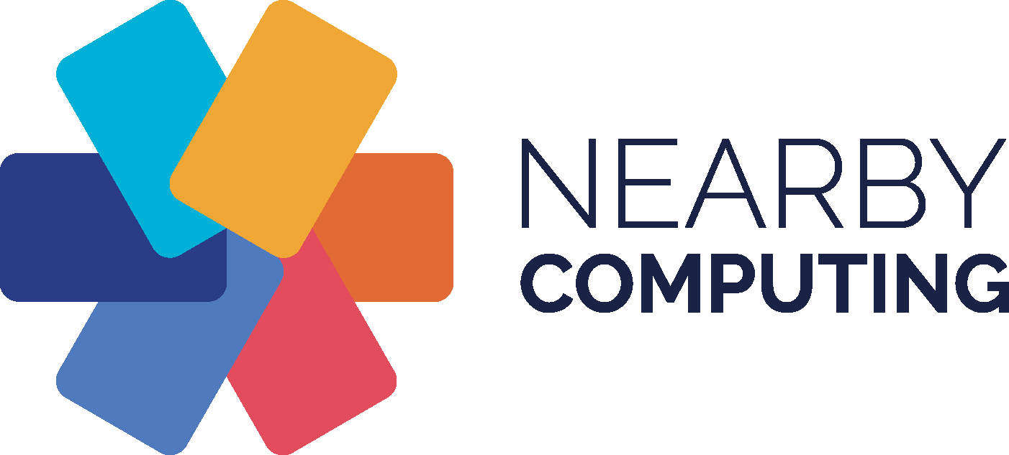
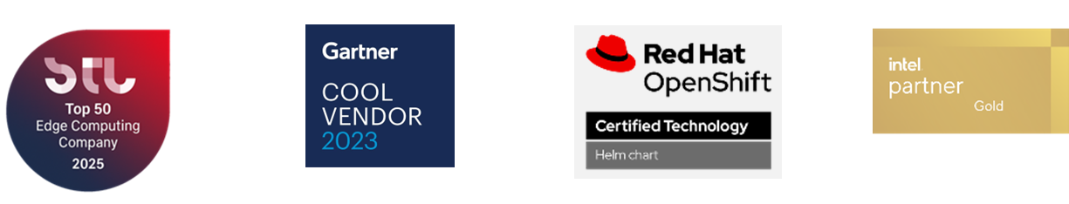
THANK YOU
www.nearbycomputing.com

