Slide 1


Unlocking Trapped Value
In Fiber
Tim Ziemer, Co-Founder / CRO
October 23, 2025

Slide 2

ITW May 2025
“Ecosystems are the key; Part of the core value”
“Many want seamless interoperability between carriers (this has always been an issue)”
“Seen success with overlays; not so much with Federation”
“Focus on end to end service”
“Simple for end users, must be agile”
“Everything must be automated”
“Global CSPas are only ‘Global’ because they know how to partner effectively”
“Enable products above the network level”
”No Proof-points to what happened in interoperability during failure”
Notes:
MaiaEdge exists because connecting private fiber shouldn’t take weeks, mountains of paperwork, or endless site visits. Today, even with all the new fiber being built, tapping into that capacity is still full of slow, manual processes and missed opportunities.
MaiaEdge turns underutilized fiber into instant, sellable private paths, so providers can deliver connectivity at the speed customers expect—ready to sell, ready to scale, anywhere.

Slide 3






OUR TEAM
INVENTED SESSION BORDER CONTROLLERS
Acme Packet used by 90% of the global 100 Carriers and largest Enterprises
INVENTED SECURE VECTOR ROUTING
128 Technology largest acquisition in history of Juniper; routing technology for MIST
ANDY ORY Executive Chairman
PATRICK MELAMPY
CFO & Board member
ABILASH MENON
CEO & Co-Founder
TIMOTHY ZIEMER CRO & Co-Founder
Acme Packet, Oracle
128 Technology, Juniper
Acme Packet, Oracle
128 Technology, Juniper
Cisco, 128 Technology, Juniper
Acme Packet, Oracle
128 Technology, Juniper
Notes:
"Before I tell you why we built MaiaEdge, I want to take a moment to talk about the people behind it. Because if you’re going to trust a new platform, you need to know who’s building it and what we’ve done before.
Andy Ory and Patrick MeLampy are both serial entrepreneurs — and when I say serial, I mean every telecom company they’ve started has gone on to redefine its space.
Andy’s first company was Priority Call Management, way back in the 1990s. This was the company that made pre-paid calling cards possible. Remember those? It wasn’t glamorous, but it was a foundational innovation — and it proved that Andy and Pat had the ability to see where telecom was going before the rest of the market caught up.
After that, they founded Acme Packet, and that’s when I joined them in 2002 to run sales. At the time, we were building what became known as Session Border Controllers — though in the early days we didn’t even know what to call it. Was it a voice firewall? A new kind of gateway? Either way, it turned out to be critical. When SBC acquired AT&T and the SBC name stuck, it was Acme’s SBCs that enabled the migration of global telecom networks to IP while maintaining security and scale.
We went on to become the dominant SBC provider to more than 90% of the world’s largest carriers. If your phone ever worked the way you expected it to, chances are Acme Packet had something to do with it. Oracle eventually acquired the company for $2.2 billion in 2013.
But we weren’t done yet. By 2014, Andy and Pat got the band back together and launched 128 Technology. This time, they brought in Abilash Menon, who had been leading MPLS product management at Cisco. Together, we built Secure Vector Routing — a radically different approach to networking that combined security, efficiency, and performance without the overhead of tunnels.
And it worked. 128T got deployed across the U.S. Department of Defense, and massive enterprises like CVS with over 10,000 locations and Advance Auto Parts with 5,000 locations.Eventually, Juniper acquired 128T, making it their largest-ever acquisition. Juniper integrated it into Mist, and since then Juniper has been the fastest-growing enterprise networking vendor in the world. 128T is now running in major environments like SWIFT with 30,000 locations, AIG, T-Mobile retail stores, and many, many others.
That brings us here. After 128T’s success, Abilash came to us with a new idea. He said: ‘What if we give service providers — you — the ability to be the on- and off-ramps to the internet’s big middle? What if we productize the edge in a way that makes your networks directly consumable, instantly?’
We were all in. And we’ve been heads-down building MaiaEdge ever since.

Slide 4
OUR VISION
Instant Private Connectivity, Anywhere.
From underutilized fiber to instant private paths — ready to sell, ready to scale.
Notes:
MaiaEdge exists because connecting private fiber shouldn’t take weeks, mountains of paperwork, or endless site visits. Today, even with all the new fiber being built, tapping into that capacity is still full of slow, manual processes and missed opportunities.
MaiaEdge turns underutilized fiber into instant, sellable private paths, so providers can deliver connectivity at the speed customers expect—ready to sell, ready to scale, anywhere.

Slide 5

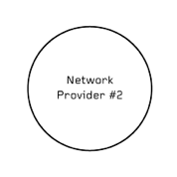

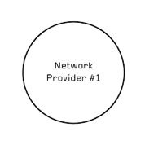









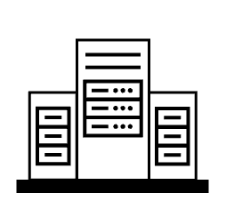
EVOLUTION OF THE NNI
Provisioning cycles may take up to 6 months
Cross-connect requests and manual LOAs need dedicated resources
Service activations require:
On-site work
Multiple device shipments
Complex, error-prone configurations
Standard Ethernet NNI
Notes:
Refined bullets (optional – Tim feel free to delete)
Provisioning cycles can take months
Manual LOAs + cross-connect requests eat resources
On-site work + multiple shipments
Complex, error-prone configurations
Speaker Notes:
You know, for years we’ve watched as all the fiber plant out there—billions in investment—sits as isolated islands of value. There’s incredible potential trapped inside those networks, but turning capacity into services is still a heavy lift. Everything is locked up behind layers of manual process and expensive, complicated routers—just like Voice over IP was back in the 2000s.
Let’s be honest: if a network operator on the east coast wants to connect their colo to one on the west side—even just to another building across town—the process is anything but simple. The first hurdle is just figuring out if a circuit is even available. And if there is, chances are those fibers meet in a “meet-me room” at someone else’s facility. Which means, right away, extra cross-connect fees, forms, delays. That’s not the end of it.
Now you’re negotiating—by hand—across core networks, sorting out which ports to dedicate, wrangling with multiple providers. Every step is manual. Every port, every agreement, a new round of emails and meetings and paperwork. Then you need on-site work—technicians rolling trucks, patch panels getting touched, letters of agreement traded back and forth. It’s a process full of friction…and that’s if everything goes according to plan.
And while all this is happening? Your customer is waiting—impatiently—because they want service now. If you called that customer and said, “Your circuit will be live tomorrow, do you want to start paying tomorrow?”—the answer is always yes. But you can’t deliver, so every day you’re stuck in this drag-out process, is a day you’re not collecting revenue, and your customer is looking somewhere else for a faster answer.
That’s the problem we’re here to solve.

Slide 6




EVOLUTION OF THE NNI
Many Fiber providers don’t offer these services today
First-mile and last-mile challenges
Multiple relationship issues: Who owns the customer?
dualportals/ contracts without API integration
Standard Ethernet NNI >>> IP Based And Cloud Native NNI
Notes:
Refined bullets
Growing demand, but not universally available from fiber providers
First- and last-mile challenges remain
Multiple contracts, dual portals, and limited API integration
Add slide to reiterate the challenges?
Activating connectivity is too slow, too complex, and too fragmented
Delays = lost opportunities
Resources are tied up in manual processes
struggle to deliver what customers now expect instantly
Speaker Notes:
NaaS / Netowrk Fabrics are fantastic at the middle. It gives instant interconnect between data centers and clouds, elastic bandwidth, and standardized turn‑up—so once both ends are on‑net, DCI happens in minutes instead of months.
But the edges still grind. The first mile into the fabric and the last mile out require availability checks, LOAs, cross‑connects, port assignments, MMR patching, and truck rolls—physical steps that drive delay and OpEx while the virtual path in the middle is ready to go.
There’s also a dual‑relationship problem. Traditional NaaS often asks the operator’s customer to accept third‑party terms and work a separate portal, raising “who owns the customer” issues; API integrations exist, but most teams lack the resources to build and maintain them, which tends to favor only the largest players.
Another way to think about it: sovereignty. Fiber operators want to keep commercial control, brand control, and workflow control—own the customer, own the SLA, own the experience—without surrendering the edge to someone else’s portal or process. Solve first/last mile and the dual‑relationship tension, and operators maintain sovereignty while delivering true on‑demand connectivity end‑to‑end.

Slide 7



Normalized
Automated
Sovereign
Visibility End to End
Secure
Notes:
Imagine private connectivity that appears the moment it’s needed. Imagine no LOAs to chase, no meet‑me room roulette, no trucks in the parking lot—just clean, protocol‑free bandwidth that turns on like a light switch, across town or across the country.
Imagine every mile of fiber already in the ground becoming a product—spare strands and latent ports instantly quotable and instantly turned up, monetized in minutes instead of months.
Imagine operations that scale without adding headcount—one install, API‑driven services after that, logical cross‑connects instead of manual patching, full visibility and control without the provisioning circus.
That’s the world the MaiaEdge platform is built to enable: instant private connectivity, anywhere—ready to sell, ready to scale.

Slide 8
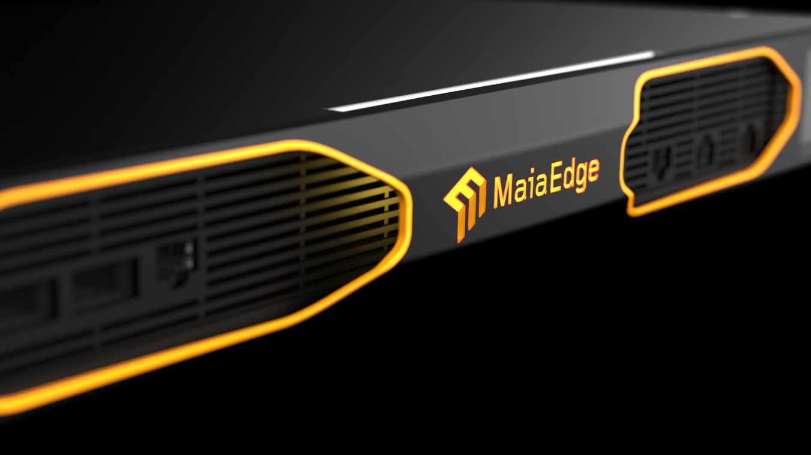
Notes:
Here it is—the hero. The MaiaEdge appliance is the single install that turns any on‑net building into an on‑demand edge. Once it’s in, services stop being projects and start being products—ordered, priced, and turned up in minutes, not weeks.
One device, many private paths. After the initial fiber and device install, every new circuit is software‑defined and API‑driven—no routing stacks to manage, no repeat truck rolls.

Slide 9


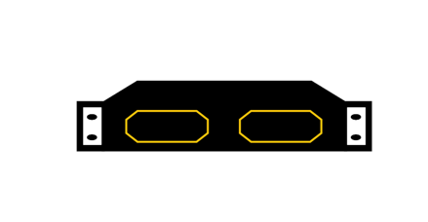
INSTANT PRIVATE CONNECTIONS
Infrastructure-as-a-service push-button easy and hardwire simple.
PATH BORDER CONTROLER
Dual 100 Gbps Interfaces
Merges Layer 2 and 3 functionality
Plug and Play Network Edge
PATH COMPUTATION ENGINE
Carrier Neutral NNI Engine
Cloud-Native Orchestration
Real-time Path Computation
Analytics
Multi-Tennant
End-to-End
AI-driven insights
Notes:
Here is where it gets real.
MaiaEdge is two parts working as one: the Path Border Controller at the edge and the Path Computation Engine in the cloud—instant private connections, push‑button easy, hardwire simple.
PBC: appliance with dual 100G ports; blends Layer 2 simplicity with Layer 3 awareness to deliver clean, protocol‑free bandwidth without per‑site routing stacks; one install, then zero‑touch for subsequent services—no repeat truck rolls.
PCE: cloud‑native control plane that computes paths in real time, enforces policies and business rules, and exposes simple APIs for instant turn‑up; analytics provide customer and end‑to‑end views with AI‑driven insights for capacity, pricing, and sellable paths.
Together: PBC + PCE turn spare fiber into sellable products—quote, order, and activate in minutes, not weeks.

Slide 10



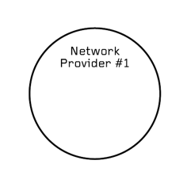
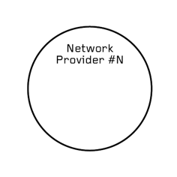

EVOLUTION OF THE NNI
DIRECT INTERNET ACCESS
PCE
PCE
Automated
End to End Visibility
Secure
Standard Ethernet NNI >>> IP Based And Cloud Native NNI >>>>>> MaiaEdge

Slide 11


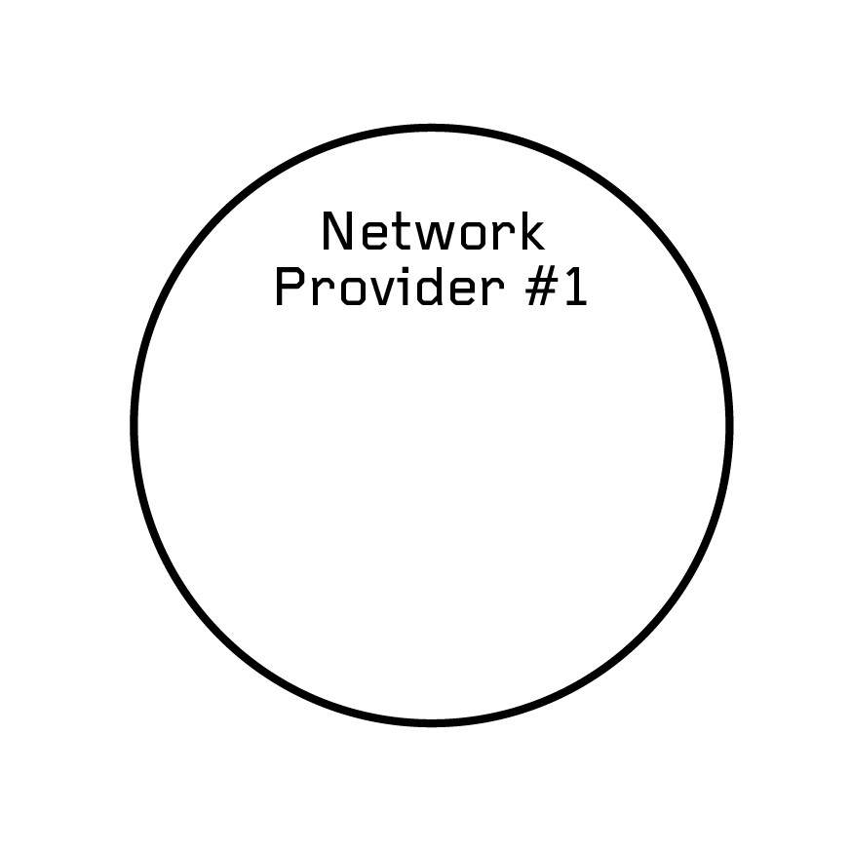
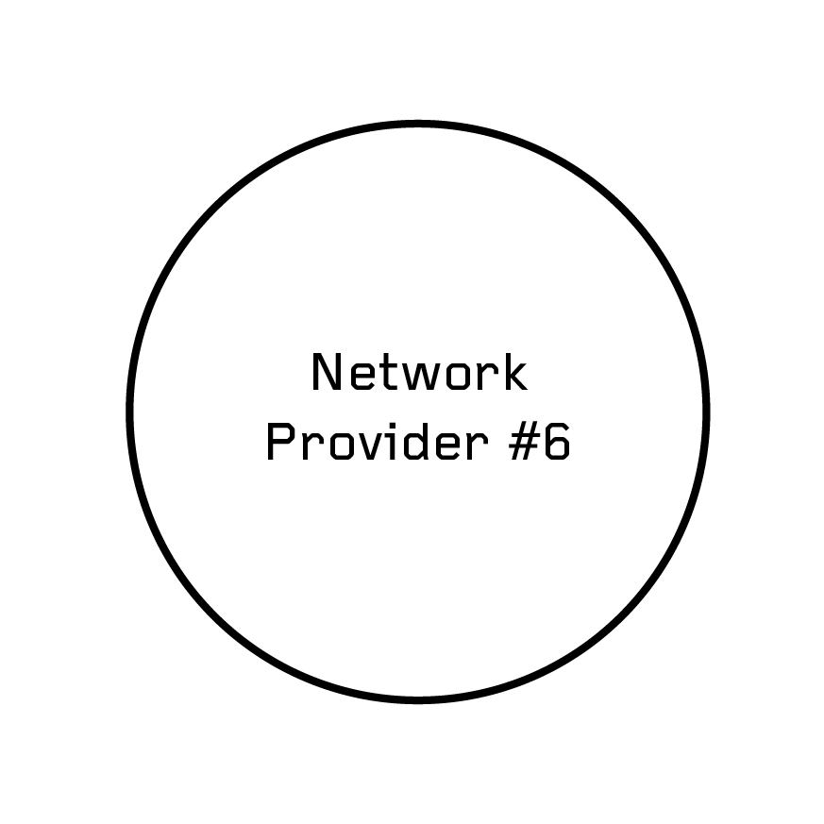





SERVICE NNI
Sovereign
PCE
PCE
DIRECT INTERNET ACCESS
Notes:
Benefit Bullets:
Faster time to revenue: Activate private connections in minutes instead of weeks/months.
SEliminate truck rolls, manual LOAs, and complex provisioning
Increase revenue: Monetize underused fiber and capacity without adding hardware or headcount.

Slide 12


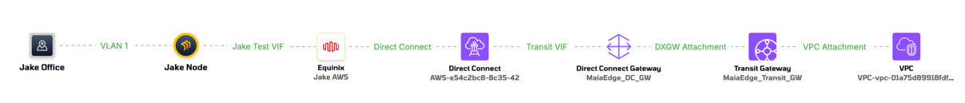
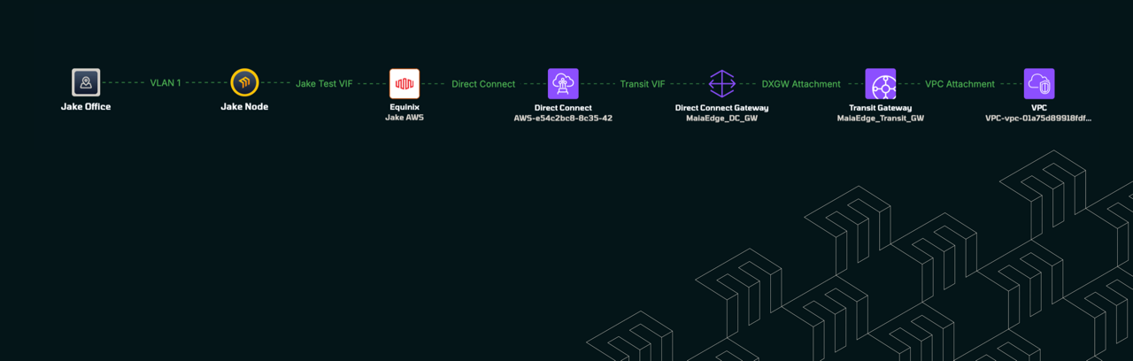
VISIBILITY
Notes:
Photo with poor resolution vs. photo with high res

Slide 13
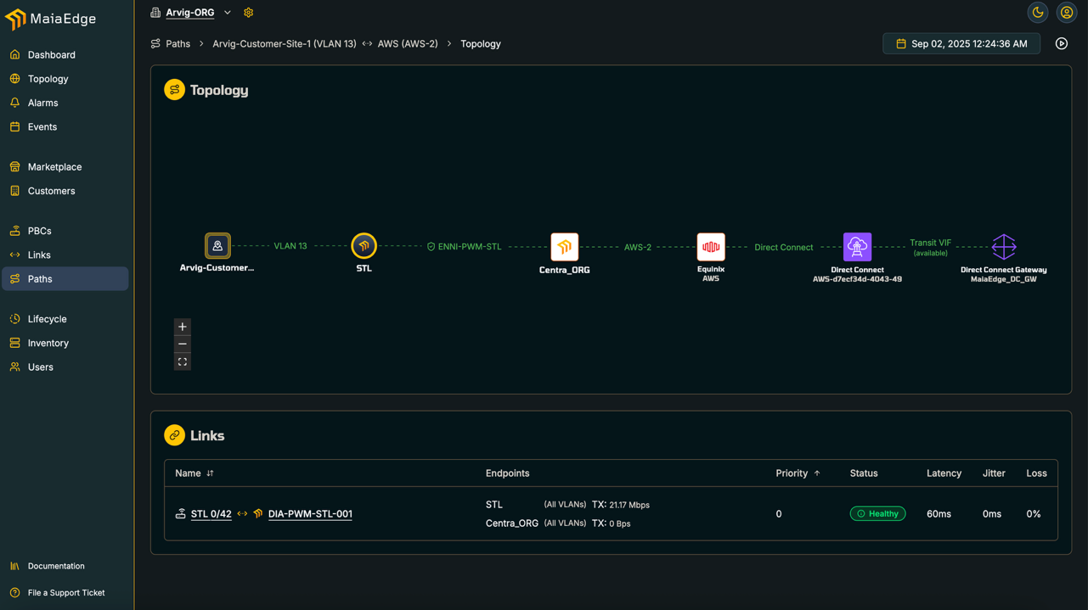

Slide 14
Frictionless Sales:
Connectbase Integration

Slide 15
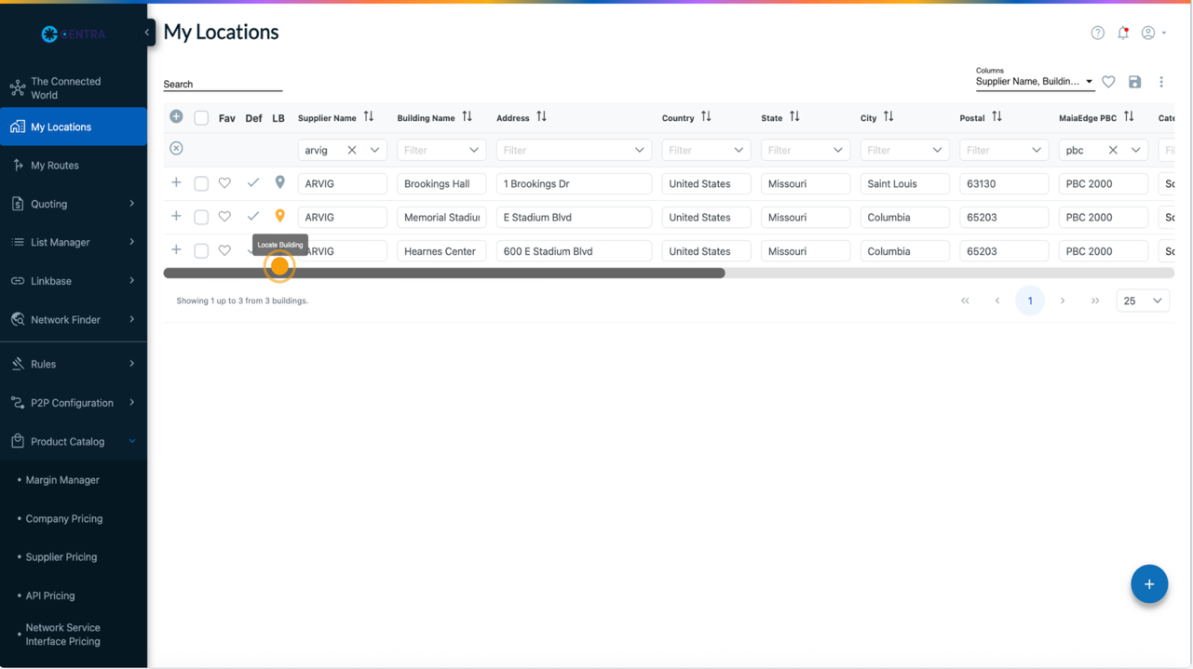

Slide 16

WHO IS THIS FOR
FIBER OPERATORS
COLOCATION / DATA CENTERS
VIRTUAL/ NON-FIBER PROVIDERS (VNOs, MSPs)
Monetize dark/underused strands with on-demand private paths and per-tenant VLAN slices.
Turn spare metro rings and interconnects into recurring revenue without changing core routing.
Offer tenant-to-tenant and tenant-to-cloud paths in minutes—“fabric in a box” with deterministic L2 slices.
Replace manual cross-connect workflows with API-driven logical cross-connects and SLA visibility.
Stich POPs, leased lines, DIA and third party fabrics into one controllable end to end service.
Expand reach and launch differentiated Services (voice, security, cloud) without owning fiber.
Notes:
Here is where it gets real.
MaiaEdge is two parts working as one: the Path Border Controller at the edge and the Path Computation Engine in the cloud—instant private connections, push‑button easy, hardwire simple.
PBC: appliance with dual 100G ports; blends Layer 2 simplicity with Layer 3 awareness to deliver clean, protocol‑free bandwidth without per‑site routing stacks; one install, then zero‑touch for subsequent services—no repeat truck rolls.
PCE: cloud‑native control plane that computes paths in real time, enforces policies and business rules, and exposes simple APIs for instant turn‑up; analytics provide customer and end‑to‑end views with AI‑driven insights for capacity, pricing, and sellable paths.
Together: PBC + PCE turn spare fiber into sellable products—quote, order, and activate in minutes, not weeks.

Slide 17
Thank You

Slide 18
Back Up

Slide 19
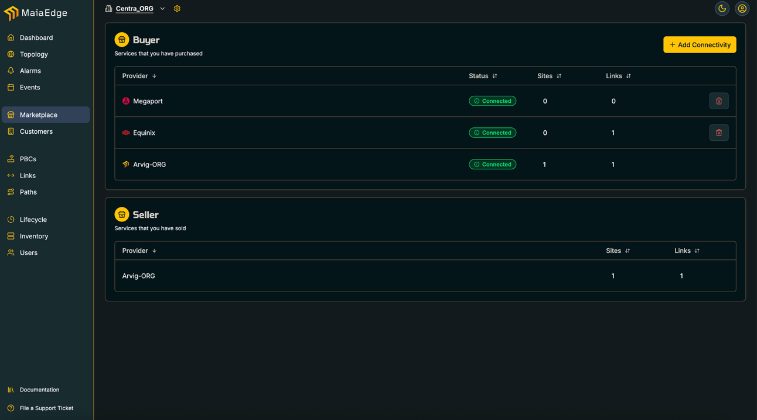

Slide 20
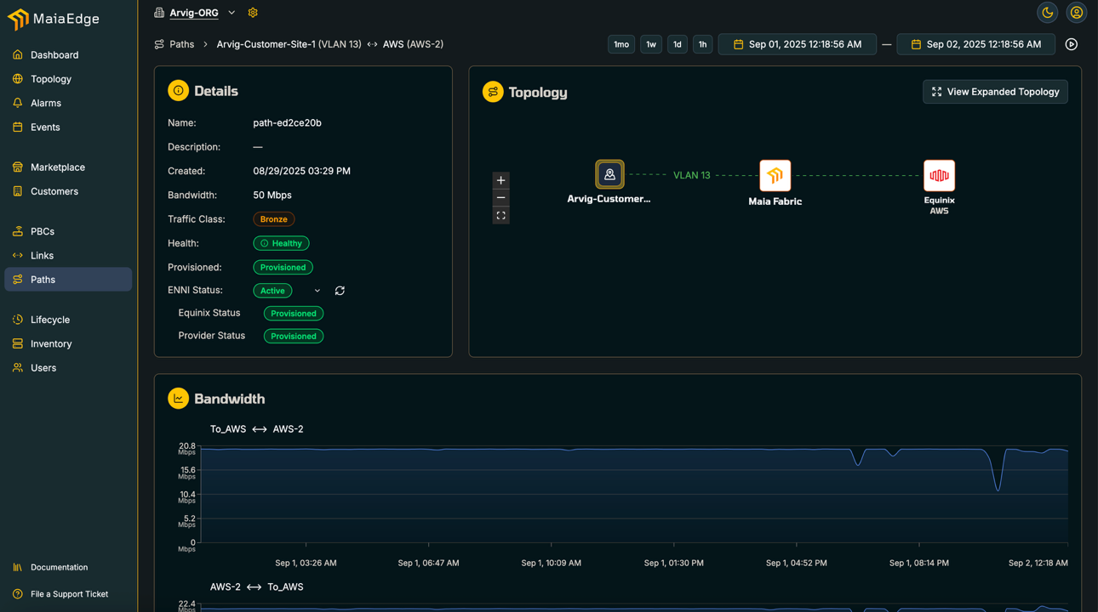

Slide 22
See how your customer feels…

Slide 23
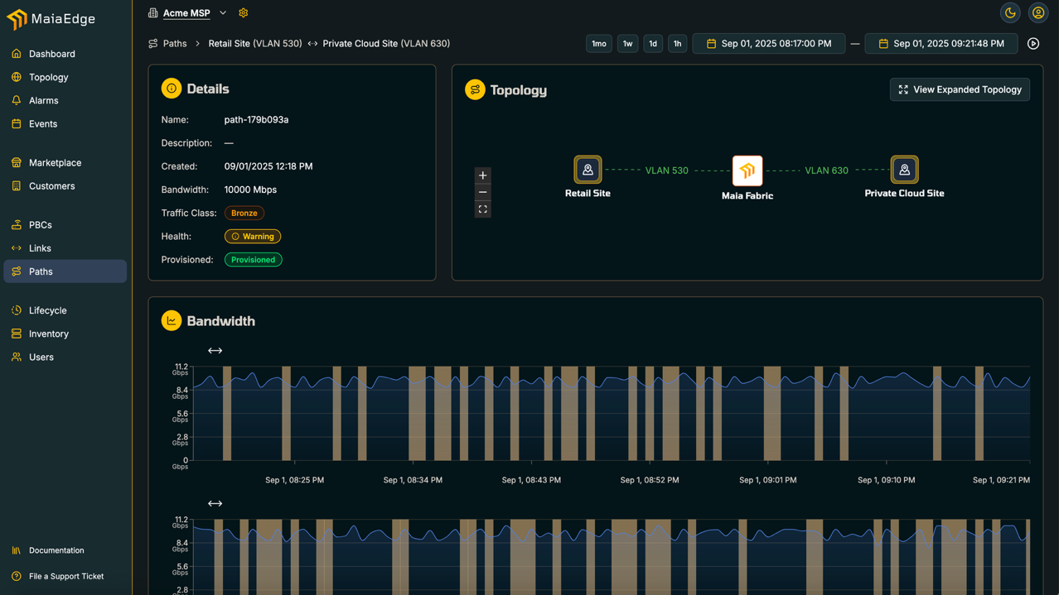

Slide 24
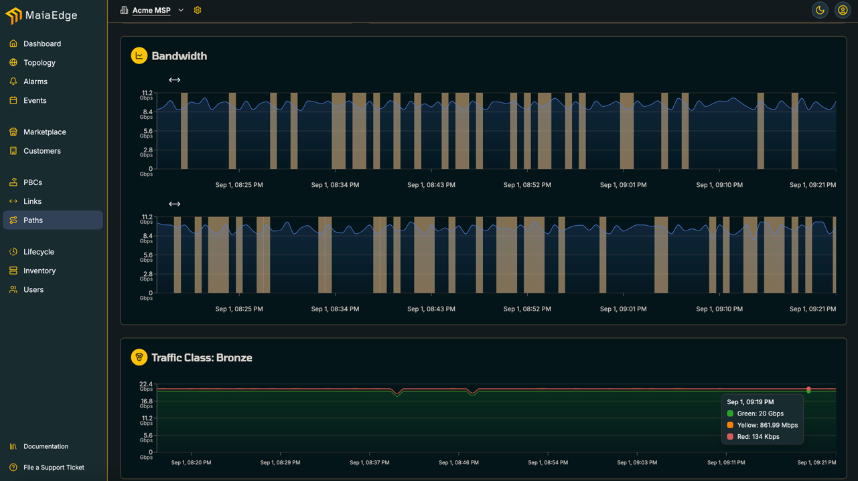

Slide 25
