Slide 1
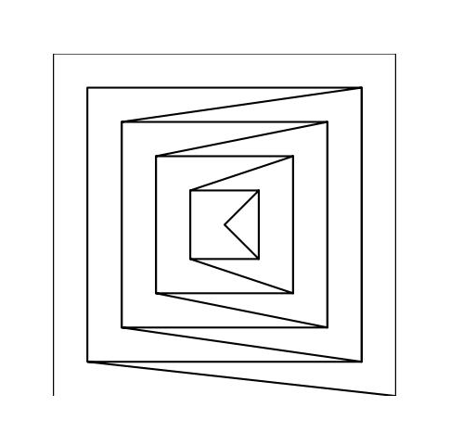
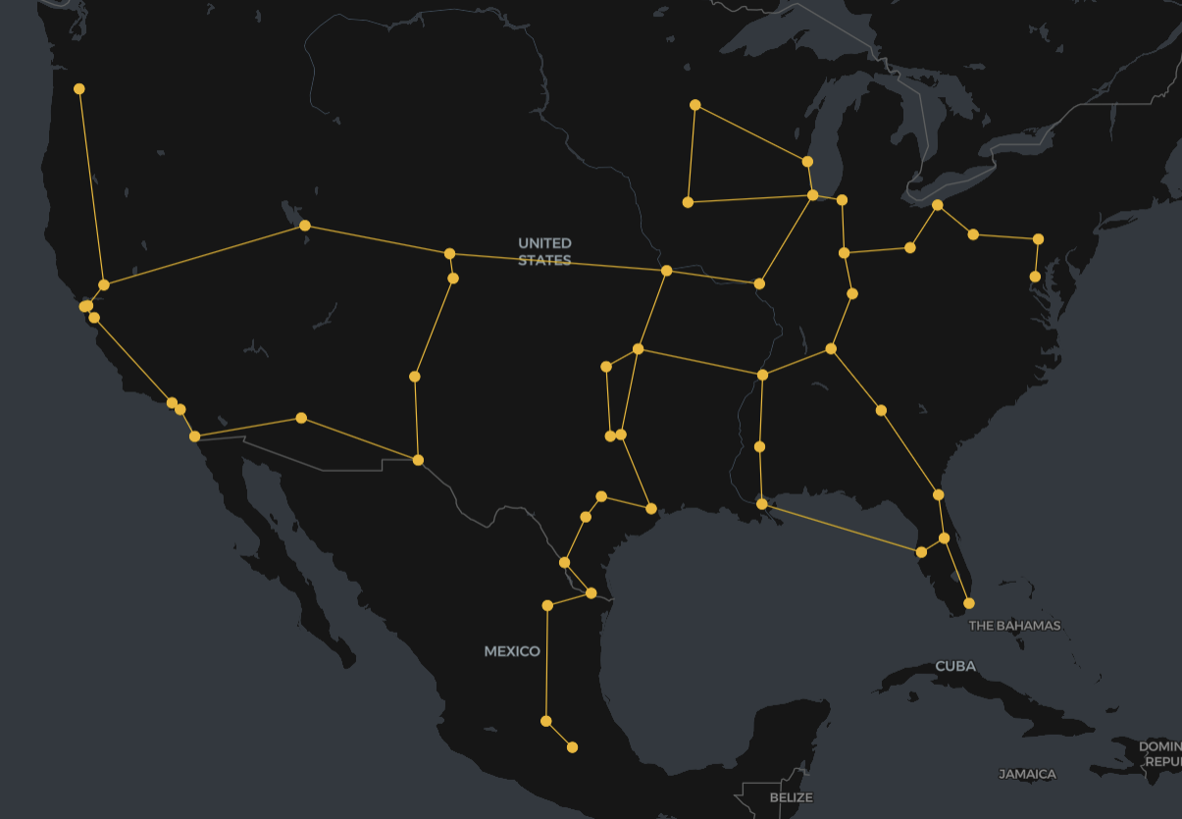
Resilient Backbone Network Design
A new approach to planning networks that are flexible, efficient and built for change
Leigh Maidment
October 2025
Notes:
Good afternoon everybody — today I’d like to share a new approach to backbone network planning that’s designed for the realities of the AI era.
Networks today need to be flexible, efficient, and inherently resilient — and that requires rethinking how we design them.

Slide 2
Why this matters now
Every network operator today is under pressure
AI and cloud workloads are reshaping traffic patterns — backbone networks struggle to keep up.
Backbone planning typically still relies on static traffic forecasts and siloed IP & optical teams.
The result: networks that are overbuilt in some places, congested in others and often fragile under failure.
We’re developing a new backbone design approach that directly addresses these issues — and we’re looking for proof-of-concept partners to validate it.
© 2025 Pozibl Pty Ltd
Notes:
Every network operator today is under pressure — AI and cloud workloads are reshaping traffic patterns and backbone networks are struggling to keep up.
We still typically design optical and IP layers separately, based on traffic forecasts that are often outdated the moment they’re created.
The result? A network where some links are overloaded, others sit idle, and soften fragile under failure.
Today I’m going to introduce a backbone network planning approach that tackles these inefficiencies head-on. And we’re seeking proof-of-concept partners who may be interested in exploring the benefits of the approach.

Slide 3
Three Ideas
Design IP + Optical together — eliminate inefficiency between layers
A different kind of traffic model — plan for uncertainty, not yesterday’s forecast
Built in Resilience — efficiency that holds up under failure
© 2025 Pozibl Pty Ltd
Notes:
The approach rests on three simple but powerful ideas:
First, design IP and optical together, not in separate silos. Second, replace static forecasts with a more flexible traffic model. Third, make resilience an outcome of the design itself — not an afterthought.
Let’s look at each of these.

Slide 4

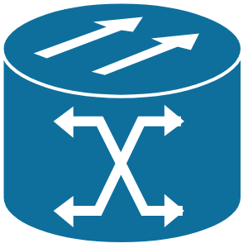
Joint IP + Optical Design — One step, one optimization
Traditionally, optical and IP networks are planned separately — fibre capacity first, IP demand later — creating mismatches that can lead to overbuild or congestion.
What if we design the IP and optical layers together in a single step?
Our approach generates an optimized design that aligns both layers simultaneously — so fibre paths, wavelengths, and router capacities all fit together coherently from the start.
We remove the handoff gap — instead of two separate designs that both overshoot to be safe, we build one coordinated design that uses capacity efficiently.
IP Layer
router
capacity: Tbps
Optical Layer
Optical switch
capacity: fiber pairs
© 2025 Pozibl Pty Ltd
Notes:
Traditionally, the optical and IP networks are planned separately — design the fibre capacity first, and then provision for the IP demand. Unsurprisingly this disjointed approach can result in mismatches, potentially leading to excessive overbuild, or worse, congestion.
What if instead we design the IP and optical layers together in a single step?
we can remove this handoff gap — instead of two separate designs that both overshoot to be safe, we build one coordinated design that uses capacity efficiently.

Slide 5
A different kind of traffic model
Planners typically have to forecast the expected demand between every pair of sites in the network.
AI models have come to aid in this process, however, they fundamentally assume that tomorrow's traffic patterns will be similar in distribution to yesterday’s.
When traffic can shift daily between data centres how accurate are the forecasts?
When a new POP comes online, existing traffic patterns are distorted.
When NaaS connections come and go, on what basis can reasonable traffic assumptions be made?
What if instead we only need to define how much traffic can enter (ingress) and exit (egress) each site in the network?
Align network capacity with other services available at the site (ie: compute and storage). Remove the need to reforecast every traffic pair.
© 2025 Pozibl Pty Ltd
Notes:
Second, what if we consider a different kind of traffic model?
Typically, traffic expectations are input to the design process in the form of a traffic matrix - this is an array of expected demand between every pair of sites in the network being designed.
Estimating this traffic matrix is becoming increasingly complex. And though AI models have come to aid in this process, they fundamentally assume that tomorrow's traffic patterns will be similar in distribution to yesterday’s.
When traffic can shift daily between data centres how accurate are the forecasts?
When a new POP comes online, existing traffic patterns are distorted.
When NaaS connections come and go, on what basis can reasonable traffic assumptions be made?
What if instead of predicting every site-to-site flow, we need only specify how much traffic is required to enter and exit each site?
We remove the need to constantly reforecast every traffic pair. Importantly, we can align the dimensioning of network capacity naturally with the dimensioning of other services at the site, such as compute and storage

Slide 6
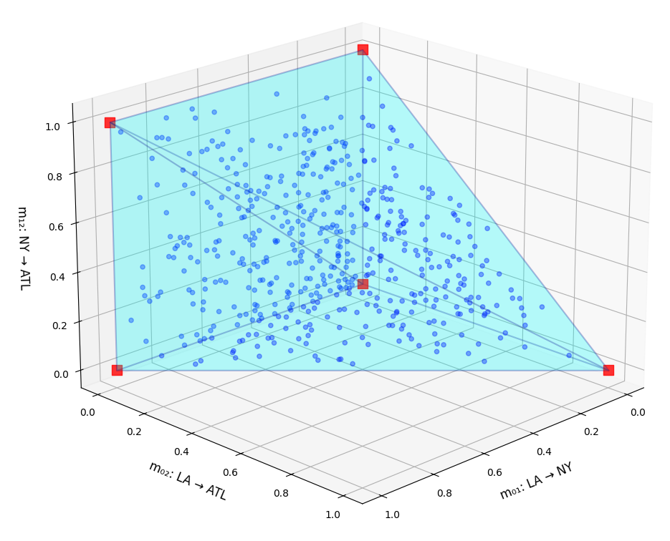
Traffic Envelope
Single sampled traffic matrix:
Specifying ingress and egress for each site defines a traffic envelope a bounded space that contains many possible traffic matrices.
Designing to this envelope makes the network inherently more flexible to change — whether it’s a failure, a new customer, or a service shifting between POPs.
Provisioning in this way leaves headroom to absorb unexpected surges on particular links.
=> the resulting design naturally absorbs traffic uncertainty.
 | LA | NY | ATL
LA | 0 | 0.6 | 0.4
NY | 0.8 | 0 | 0.2
ATL | 0.2 | 0.3 | 0
© 2025 Pozibl Pty Ltd
Notes:
By specifying ingress and egress for each site we are effectively defining a traffic envelope — a bounded space that contains many possible traffic matrices.
Designing to this envelope essentially means designing for many, many traffic matrices at once. This is in contrast to typical methods that take in a single traffic matrix only.
With reference to the diagram, imagine the actual traffic profile moving around from point-to-point within the (blue) design envelope - this for example could be due to a failure, a new significant customer, or a cloud workload shifting from one site to another.
Whatever the reason, intuitively a design provisioned in this way can naturally accept a lot of traffic uncertainty. The network is inherently flexible.

Slide 7
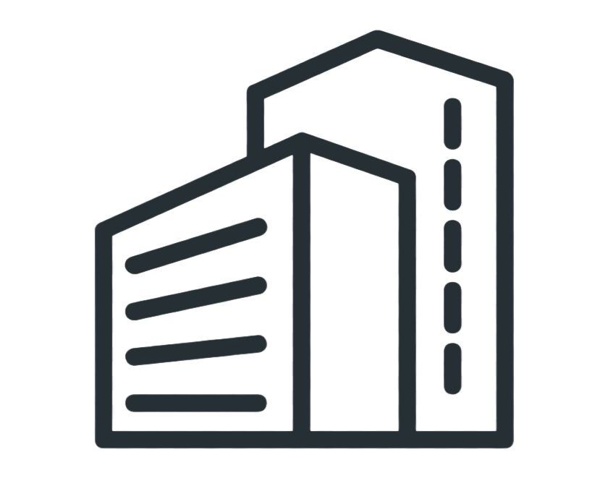
Multiplexing Gain
There’s another key benefit: statistical multiplexing gain.
When we plan based on aggregate ingress/egress instead of hundreds of pairwise flows, we can capture the natural smoothing that happens in real traffic.
This recognises the fact that links sharing the same source or sink are unlikely to hit their peak simultaneously.
We can plan we can plan for a lower total capacity without impacting performance
A Meta study* analysing traffic on their production backbone network indicated a gain of 10-15% in peak demand, and 20-25% for average peak.
Peak sum < 3 Tbps
A
1 Tbps
B
1 Tbps
C
1 Tbps
Sum of link peaks (A + B + C) = 3 Tbps
* Capacity-Efficient and Uncertainty-Resilient Backbone Network Planning with Hose, 2021, S. S. Ahuja et al
© 2025 Pozibl Pty Ltd
Notes:
There’s another key benefit to using ingress/egress traffic as input => statistical multiplexing gain.
In simple terms, this means you don’t need to provision full capacity everywhere. Think of carpooling — when people travel at different times, you need fewer cars to move the same number of passengers.
Similarly, links sharing the same source or destination are unlikely to peak at the same time, so we can plan for a lower total capacity without impacting performance.
In the upper-right diagram, for a site with three outbound legs each at 1 Tbps peak, the planned egress capacity would be less than 3 Tbps.
A study from meta on their production backbone reported a 20-25% reduction in average peak traffic.

Slide 8
Built-in Resilience
Failure Mode 1
Failures are inevitable — fibres get cut, transponders fail
There are a few options on how to handle them:
Ignore and react: hope for the best and accept performance degradation when it happens → under-provisioned and risky.
Overbuild and patch: simulate failures and add capacity after the fact → expensive and inefficient.
Design for resilience from the start: plan with failures in the model itself
Our approach simultaneously searches for the optimal set of IP and optical paths so that every traffic pattern within the traffic envelope can be supported under every failure scenario
Failure Mode N
© 2025 Pozibl Pty Ltd
Notes:
The third idea relates to how we can mitigate the inevitable occurrence of failures in the network. Fibres get cut, active equipment can fall over.
One option could be to ignore and hope for the best and accept the performance hit when a failure occurs. This is obviously risky and likely not a good strategy.
What is more typical is that additional link-wise capacity is added in an uncoordinated manner based on simulations performed after the network topology has been set. This often results in a suboptimal (ie: more expensive) design.
Our suggestion is to incorporate expected failure modes into the design process from the start.
The goal is then to find the optimal set of IP and optical paths such that every traffic pattern within the desired traffic envelope can be supported under every failure scenario.
This is precisely what we have done…

Slide 9
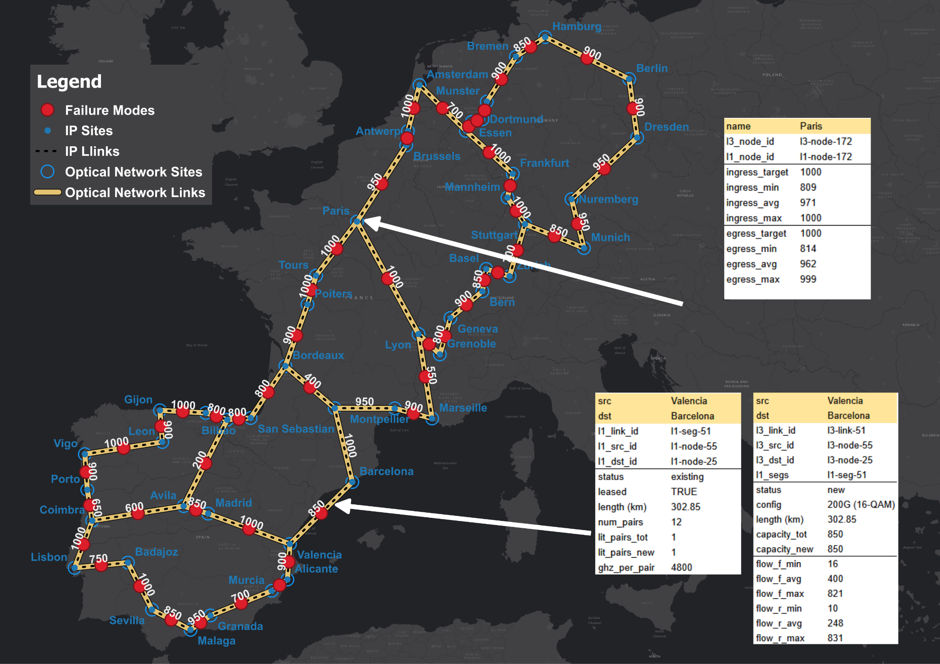
Where Are We At
Working design engine is complete.
Current state:
Scalable approach to generation of IP + Optical design
Stable capacity under multiple failure scenarios
Balanced link utilization (no clear overbuilds)
Traffic flexibility through traffic envelope model
Roadmap to further scalability
© 2025 Pozibl Pty Ltd
Notes:
We’ve built a working prototype that generates joint IP+optical designs directly from available fibre routes, ingress/egress envelopes and failure scenarios.
The outputs include optical capacities, IP link capacities and router capacities — all guaranteed to meet the traffic requirement under each failure mode by design.
It is scalable, with a clear roadmap on how to extend scalability even further.

Slide 10
Seeking Proof-of-Concept Partners
We’re currently seeking proof-of-concept partners to validate:
Cost Benefit - Validate multiplexing gains and quantify CAPEX/OPEX savings versus current methods
Resilience - Demonstrate robustness under realistic traffic dynamics and failure scenarios
Efficiency - Quantify time savings in producing backbone plans across short and long-term horizons
Integration - Prove seamless fit with existing workflows and planning systems
We’ve built a scalable optimization engine — now we’d like to prove its value with real operator data.
© 2025 Pozibl Pty Ltd
Notes:
This brings me to the purpose of me presenting this today
I’m seeking proof-of-concept partners who are interested in validating the approach.
Some of the key proof points include:
Validating the cost benefits, in particular comparing against current design methods
Demonstrating the improved resilience under realistic traffic dynamics and failure scenarios
Quantifying design time efficiency gains
Integration into existing workflows and processes
In short, we’d like to prove its value with real operator data and share the benefits

