Slide 1
Edge AI: Has telco edge finally found its place?
George Glanville, Senior Analyst – george.glanville@stlpartners.com
23 October 2025

Slide 2

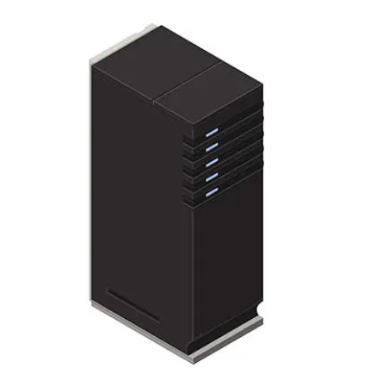
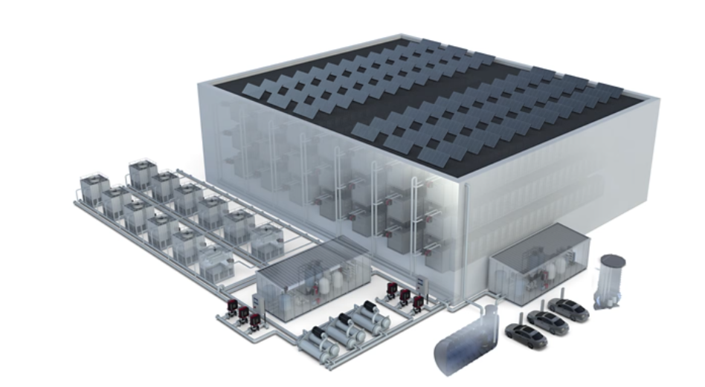
How STL Partners examines the edge computing ecosystem
EDGE COMPUTING
ON-DEVICE
ON-PREMISE
NETWORK
REGIONAL
HYPERSCALE
Sensor, camera, robot, drone
Servers, IoT gateway, on-prem data centre, uCPE
Telco sites and central offices
Regional data centres, internet exchanges
Hyperscale data centres and campuses
On device
<1km
<100km
<1000km
>1000km
<1ms
2ms
<20ms
<50ms
>80ms
<1KW
<0.5MW
0.5-5MW
2-10MW
10MW+
END CUSTOMER LATENCY
COMPUTE CAPACITY
Notes:
Latency is the most readily referenced benefit but there’s many others – data sovereignty, cost reductions, configuration flexibility & access to the data centre for this

Slide 3














There were several early movers in the network edge market
Service now retired
Service now retired

Slide 4












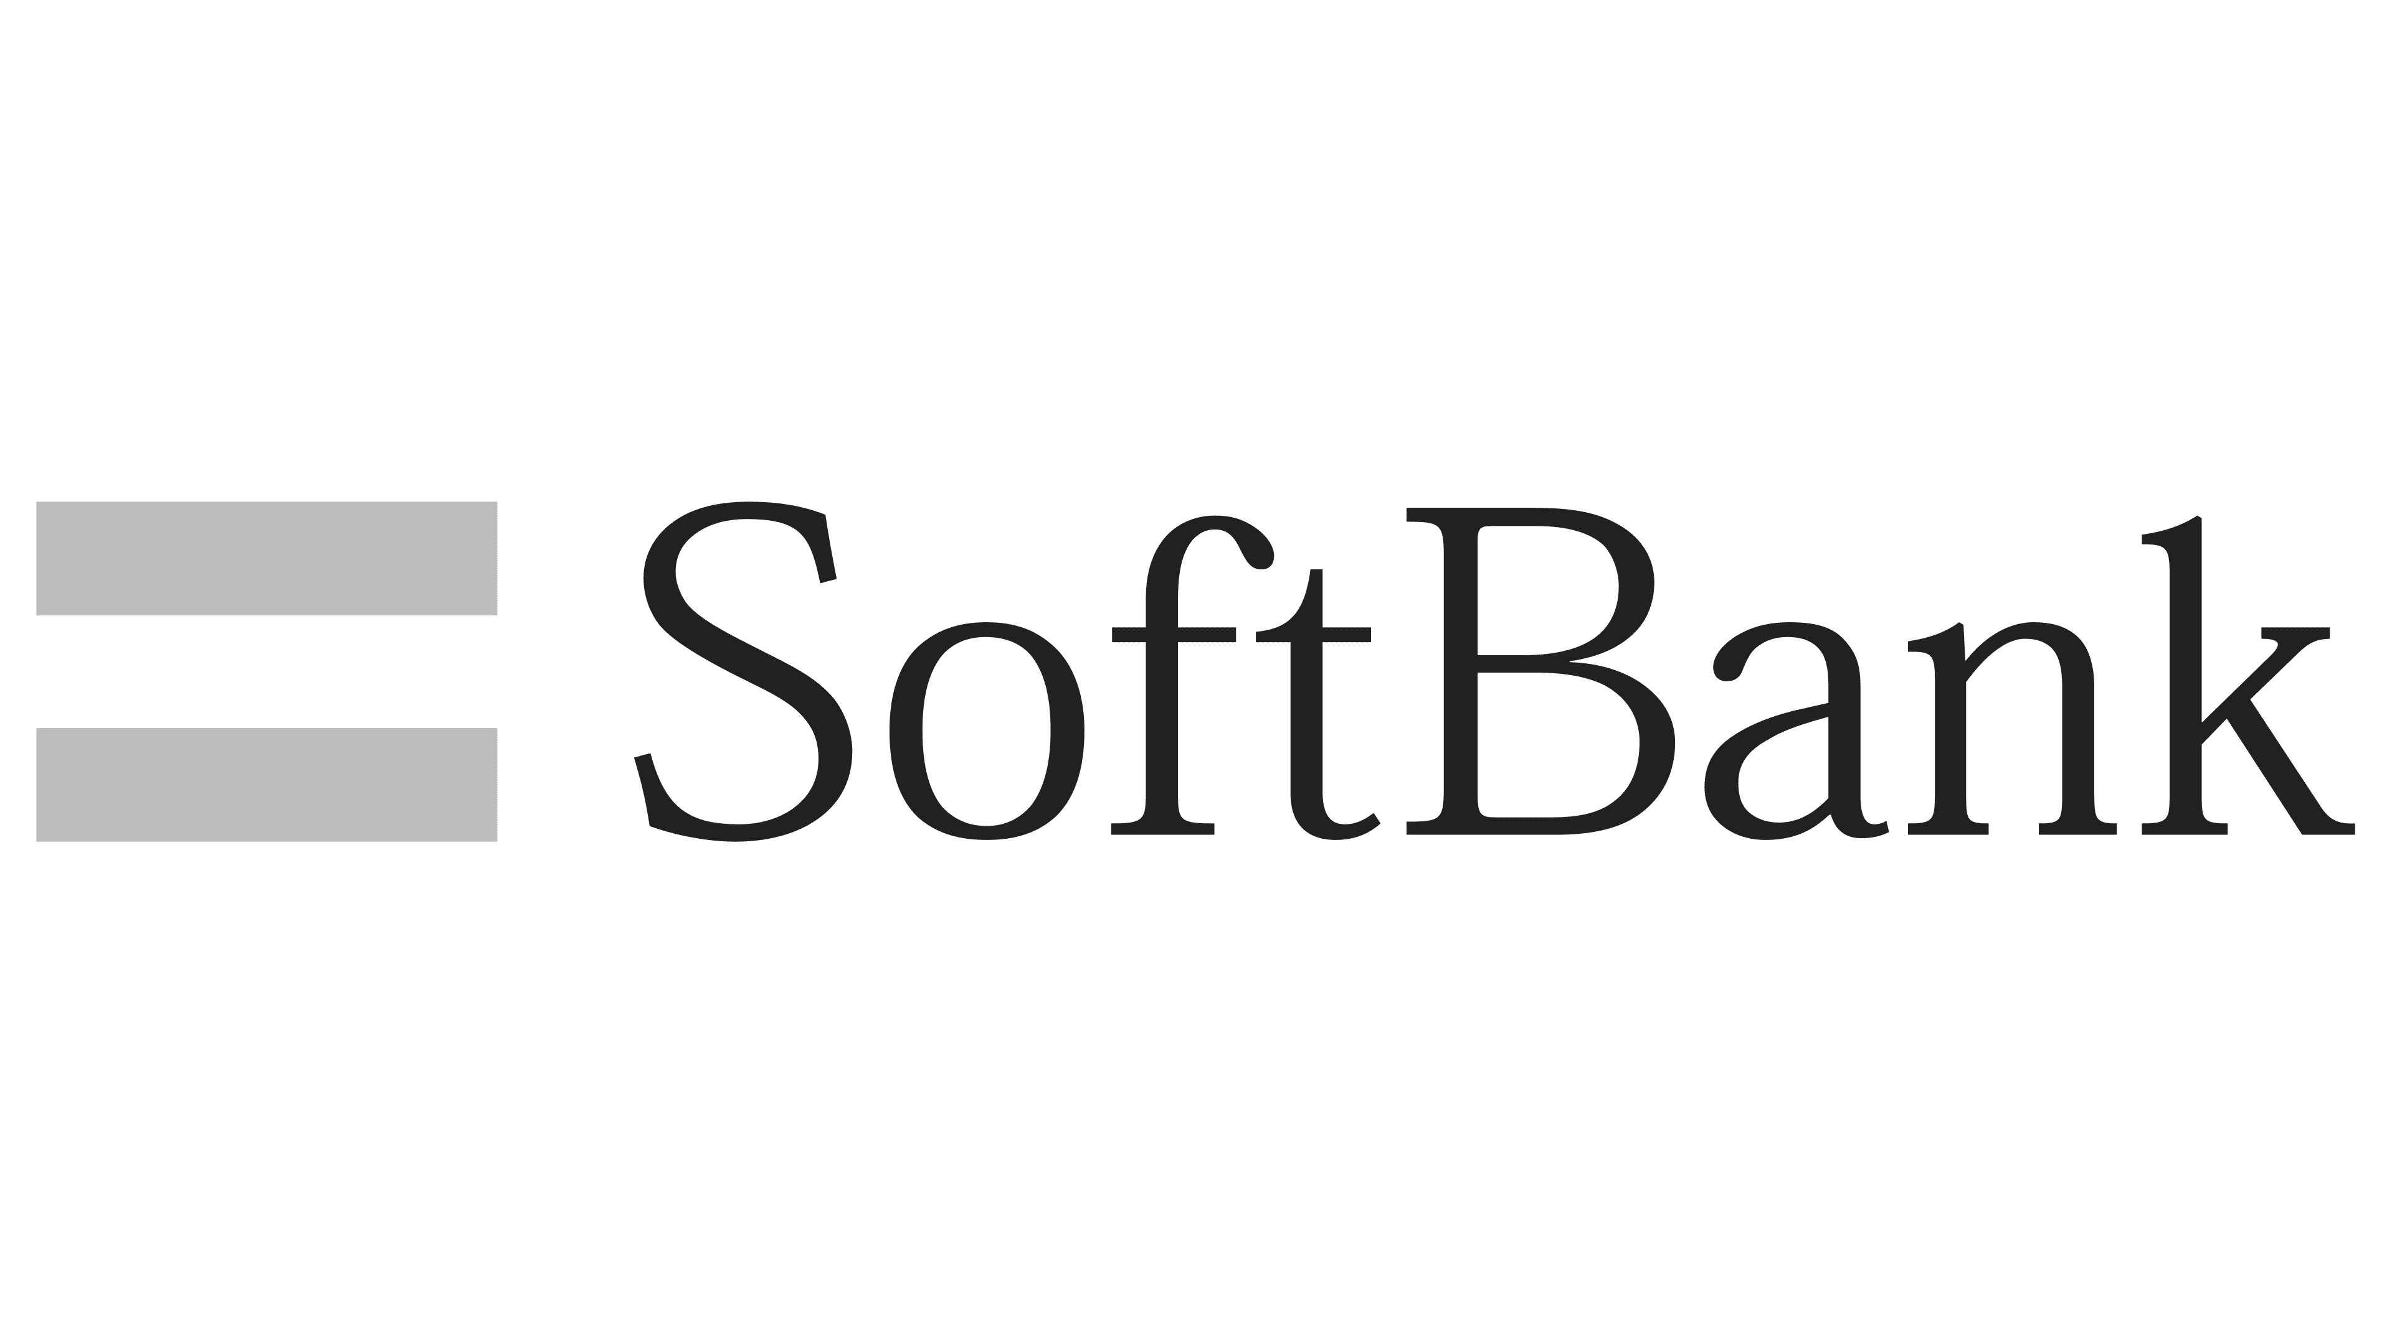











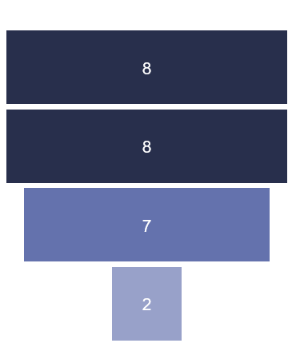
However, the market had entered the trough of disillusionment in recent years, forcing some early entrants to exit or deprioritise
Public announcements slowed in 2024…
…and existing rollouts have scaled slowly
Number of publicly announced commercial
network edge services by year
Number of network edge sites (selected telcos)
CoxEdge retired
2021
2022
2023
2024
Both edge zones retired

Slide 5






These early movers were constrained by a lack of clear commercial differentiation and end customer
Six key reasons fuelling this early difficulty in monetising the network edge
1
2
3
4
5
6
No “killer”
use case to differentiate with
Over expectation of enterprise appetite for latency
Inexperience in selling cloud-like services
Cost premium of network edge services
The absence of a federated edge-cloud fabric
Lack of multi-carrier connectivity

Slide 6





AI has rekindled enthusiasm in the network edge opportunity
What?
Where?
Training
Inference
On-device
At the edge
In the cloud
Notes:
At the edge = on premise or at the distributed edge

Slide 7






Industries will leverage edge computing to support AI workloads when certain characteristics are required
Filtering, structuring, and parsing large amounts of device data
Inferencing on high-bandwidth datasets
Model finetuning on locally specific data
Model training on proprietary or highly sensitive data
Inferencing in mission-critical and limited connectivity scenarios
Situations where real-time decision making is required

Slide 8




The inferencing opportunity has encouraged new network edge service launches

Slide 9
…will 2026 be the year network edge finally scales?

