Slide 1
TANESCO 5TH TANZANIA ENERGY
COOPERATION SUMMIT
Private Sector Participation in Energy
Eng. Gissima Nyamo-Hanga
Managing Director
TANESCO
31st January 2024

Slide 2
WHAT WE DO
TANSMISSION
GENERATION
CORE
FUNCTIONS
OPERATION
DISTRIBUTION
What does this mean for the private sector?
TANESCO is now Capable of fulfilling its financial obligation to partners
Can service its loans from financial Institutions

Slide 3
GENERATION
AS OF 31st DECEMBER 2023
Maximum Demand 1,482 MW
Total Installed Capacity (On Grid) 1,889.84 MW
Energy Sources/Mix
Natural Gas 1,193.82MW
Hydro 601.60 MW
Diesel 83.93MW
Biomass 10.5 MW
Off- grid stations total capacity 33.05MW
Construction of JNHPP – 2,115MW ongoing

Slide 4
TRANSMISSION
AS OF 31st DECEMBER 2023
High Voltage Transmission Lines:
6,837km of 400/220/132/66kV
Grid Substations:
64 Substations of 400/220kV; 220/132kV; 220/33kV; 132/33kV and 66/33kV
Grid Control Centre
1 at Ubungo DSM

Slide 5
DISTRIBUTION
AS OF 31st DECEMBER 2023
Household: 4,656,821
National Connectivity: 55%
Access Rate: 78.4 %
Total MV LINES: 173,425 km
33kV lines :56,485 km
11kV lines : 12,221 km
LV lines : 104,719 km

Slide 6
OPERATIONS
AS OF 31st DECEMBER 2023
Staff: 12,000
Regional Offices: 29
Districts: 132
Clusters : 835
Annual Revenues: $1 billion
Balance Sheet: $ 8 billion

Slide 7
GENERATION HIGHLIGHTS > 2023
Increase Installed Capacity
5GW by 2025
>10GW By 2035
Regional Integration
Fully integrated to EAPP & SAPP by 2025
Net Exporter by 2033
Private Partnership
PPPs & IPPs in Renewables and Gas Fired

Slide 8
TRANSMISSION HIGHLIGHTS > 2023
Improve Reliability & Security of Power Supply by Strengthening the Country’s Backbone by completing all 4 ring-circuits at 400kV
Evacuate power from new & existing generation facilities to grid network through 132kV; 220kV and 400kV transmission lines
Engage Private Partnerships (IPTs) to evacuate power to high - profit customers like Industries, Mines etc.

Slide 9
DISTRIBUTION HIGHLIGHTS > 2023
Restore & Maintain Distribution Network to world class level by 2030.
Implement 5-phased Distribution Network & Reinforcement Plan (US$ 2.8 million)
Expand National Access
92% by 2025,
100% by 2035
Improve National Connectivity
50% by 2025
> 70% by 2035

Slide 10
OPERATIONS HIGHLIGHTS > 2023
Strengthen Corporate Governance & Institutional Capacity
Operations:
Revenues = up 7% YoY
Profit up = 20% YoY
Operating margins = 6%
Clear Creditors book of $537 Mil
Positive Cash Flow
Efficiency
Automation of Systems
Roll-Out Smart Meters
Operate vehicle fleet by Electricity (EVs)n

Slide 11
SHORT TERM PLAN 2023/2024 - 2025/2026

Slide 12
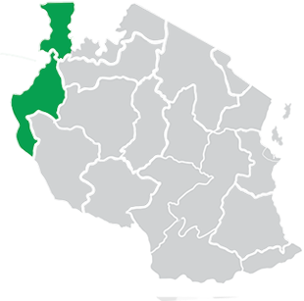
GENERATION PROJECTS SHORT TERM:2023/24 – 2025/2026
Potential Sources of Energy to Increase Installed Capacity Up To 5 GW by 2026
ENCLAVE A - 44MW
Rusumo Hydro – 27MW
Kigoma Diesel - 12MW
Solawazi Solar – 5MW
Existing Plants

Slide 13
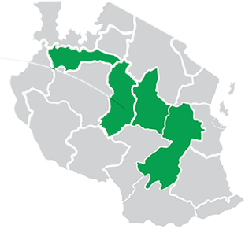
GENERATION PROJECTS SHORT TERM:2023/24 – 2025/2026
Potential Sources of Energy to Increase Installed Capacity Up To 5 GW by 2026
ENCLAVE B - 439MW
Kishapu Solar – 150MW
Zuzu Diesel – 5MW
Kidatu Hydro 204MW
Mtera Hydro – 80MW
Existing Plant
Under Construction

Slide 14
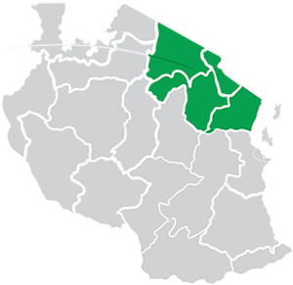
GENERATION PROJECTS SHORT TERM:2023/24 – 2025/2026
Potential Sources of Energy to Increase Installed Capacity Up To 5 GW by 2026
ENCLAVE C - 147MW
Nyumba ya Mungu Hydro – 8MW
Same Solar - 50MW
Hale Hydro - 21MW
New Pangani Hydro – 68MW
Existing Plant
Under Construction

Slide 15
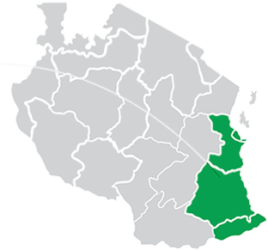
GENERATION PROJECTS SHORT TERM: 2023/24 – 2025/2026
Potential Sources of Energy to Increase Installed Capacity Up To 5 GW by 2026
ENCLAVE D - 3,268 MW
JHNPP Hydro – 2,115MW
Ubungo 1 Gas – 102MW
Tegeta Gas – 45MW
Ubungo 2 Gas – 129MW
Songas Gas – 189MW
Ubungo 3 Gas – 113MW
Kinyerezi 1 Gas – 335MW
Kinyerezi 2 Gas – 240MW
Existing Plant
Under Construction

Slide 16
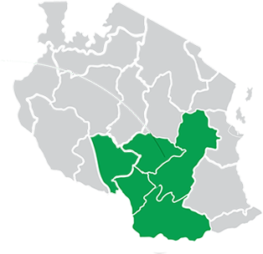
GENERATION PROJECTS SHORT TERM:2023/24 – 2025/2026
Potential Sources of Energy to Increase Installed Capacity Up To 5 GW by 2026
ENCLAVE E - 440MW
Sinotan Wind - 100MW
T-Resources Wind - 60MW
Kihansi Hydro - 180MW
Total Enre Isimani Solar - 100MW
Existing Plant
Under Construction

Slide 17
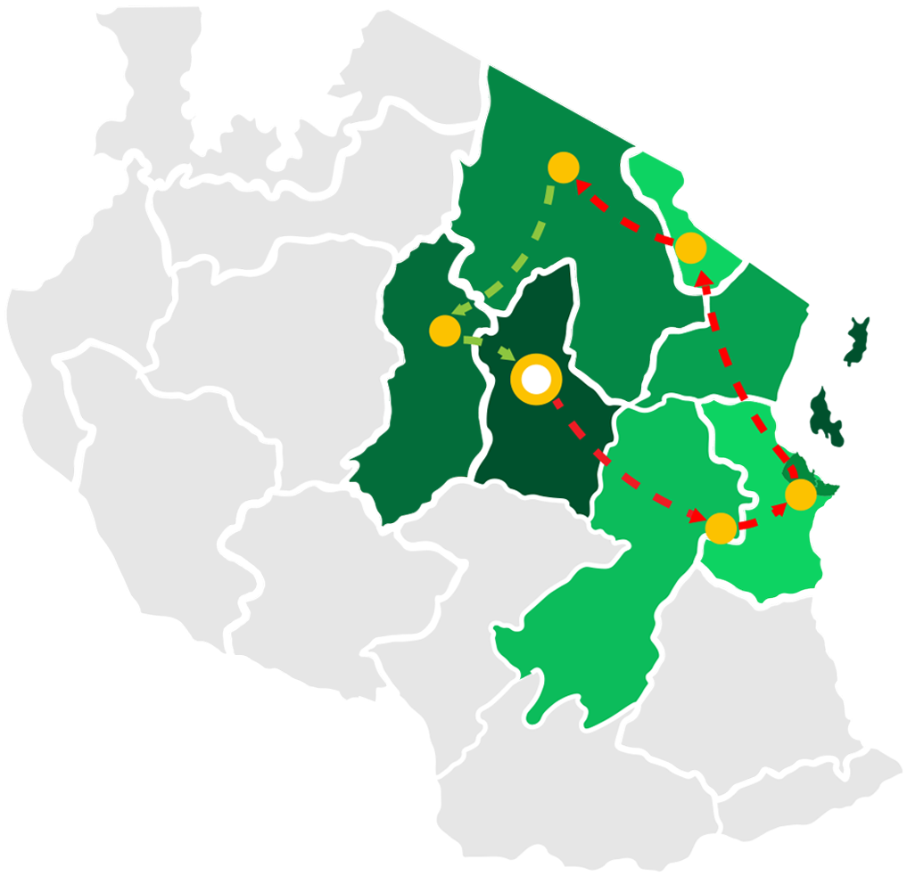
TRANSMISSION PROJECTS SHORT TERM: 2023 - 2026
400kV RING 1
Dodoma (Zuzu) – Chalinze – Kinyerezi - Segera – Same - Lemugur (Arusha) – Singida – Zuzu
Existing TL
Under Construction TL
Under FS/No Funds

Slide 18
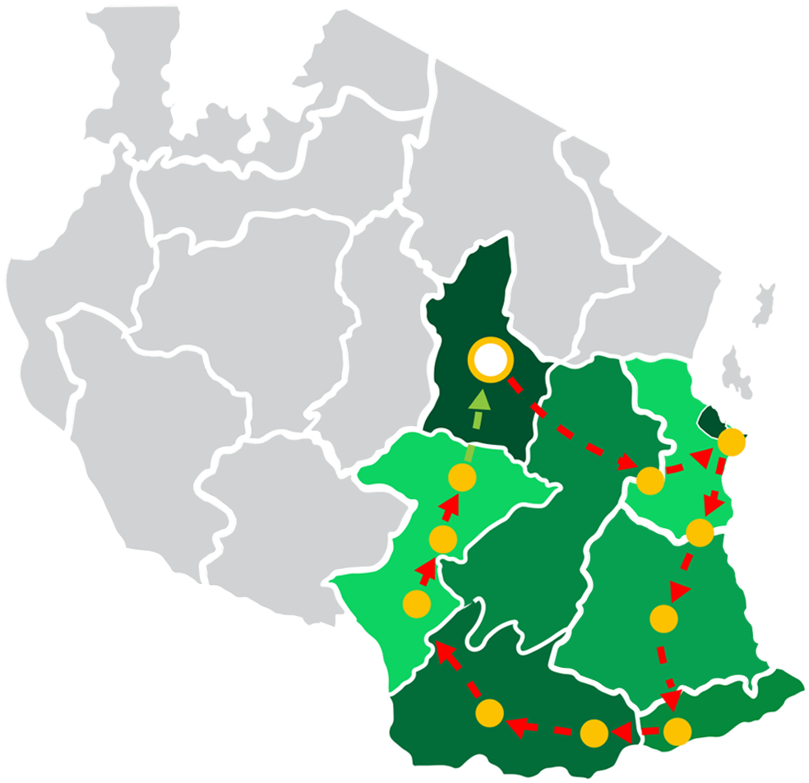
TRANSMISSION PROJECTS SHORT TERM: 2023 - 2026
400kV RING 2:
Dodoma (Zuzu) – Chalinze - Kinyerezi – Mkuranga – Somanga - Mtwara – Tunduru –Songea – Makambako –
Iringa (Kisada) - Iringa (Tegamenda) - Zuzu
Existing TL
Under Construction
Under FS/No Funds

Slide 19
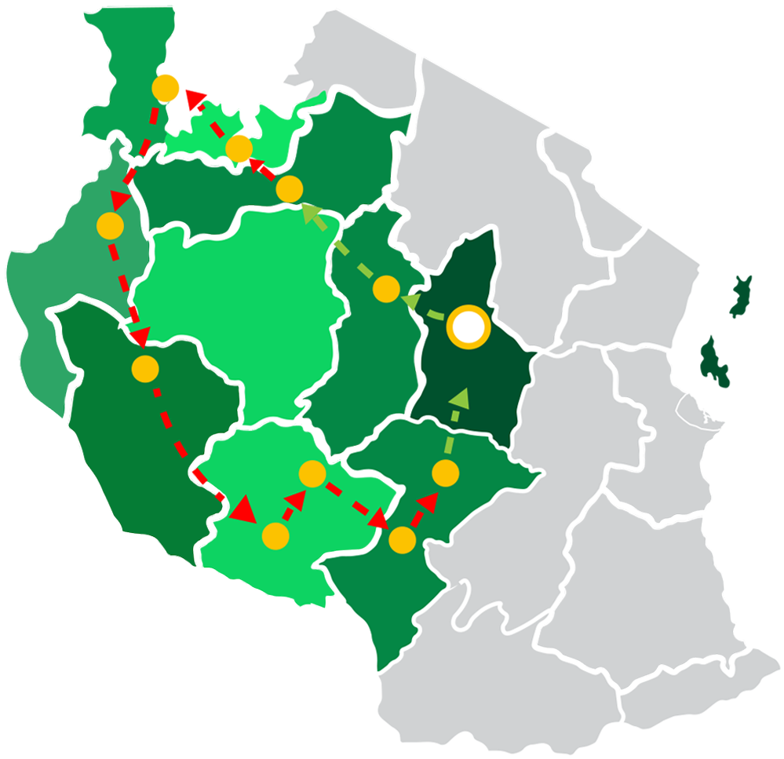
TRANSMISSION PROJECTS SHORT TERM: 2023 - 2026
400kV RING 3
Dodoma (Zuzu) – Singida -
- Shinyanga - Nyakanazi – Kigoma – Rukwa – Tunduma - Mbeya (Iganjo) – Iringa (Kisada) - Iringa (Tagamenda) - Zuzu
Existing TL
Under Construction

Slide 20
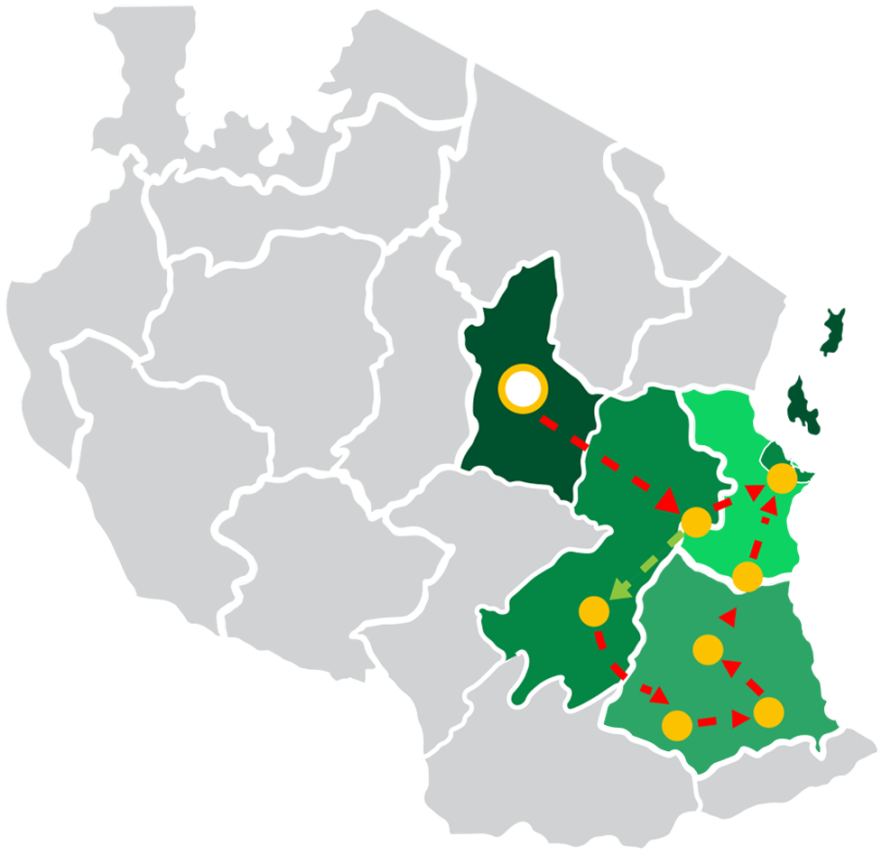
TRANSMISSION PROJECTS SHORT TERM: 2023 - 2026
400kV RING 4
Dodoma (Zuzu) – Chalinze – Kinyerezi – Mkuranga -
Kibiti – Likongo – Somanga – JNHPP - Chalinze
Under Development/ Existing
With Feas.Study /No Funding
Under FS/No Funds

Slide 21
MID TERM PLAN 2026 - 2035

Slide 22
GENERATION PROJECTS MID TERM:2026/27 – 2034/2035
Potential Sources of Energy to Increase Installed Capacity To >10 GW by 2035
ENCLAVE A – 171.5MW
Nsongezi Hydro - 35MW
Malagarasi Hydro – 49.5MW
Kakono Hydro 87MW
With Feas. Study and Funding
Without Feas. Study/No Funding

Slide 23
GENERATION PROJECTS MID TERM:2026/27 – 2034/2035
Potential Sources of Energy to Increase Installed Capacity To >10 GW by 2035
Ikungi Solar - 100MW
Total Energy Wind - 100MW
Manyoni II Solar - 100MW
Ikungi II Solar - 100MW
Manyoni Wind - 200MW
Iringa Solar – 100MW
Makambako Wind 2 - 100MW
Kidunda Hydro - 20MW
Kisaki Geothermal – 30MW
Kisima Solar – 78MW
Ibadakuli Geothermal - 5MW
Zuzu Solar 2 - 50MW
Singida 1 Wind -200MW
Solar Zuzu – 60MW
Singida Wind 2 - 100MW
Manyoni Wind2 - 200MW
Kishapu and Kanawa – 300MW
ENCLAVE B – 1,843MW
With Feas.Study /No Funding
Without Feas. Study/No Funding

Slide 24
GENERATION PROJECTS MID TERM:2026/27 – 2034/2035
Potential Sources of Energy to Increase Installed Capacity To >10 GW by 2035
ENCLAVE C - 420MW
Meru Geothermal – 10MW
Natron Geothermal - 60MW
Monduli Wind - 350MW
Without Feas. Study/No Funding

Slide 25
GENERATION PROJECTS MID TERM:2026/27 – 2034/2035
Potential Sources of Energy to Increase Installed Capacity To >10 GW by 2035
Somanga Fungu PPP Gas -320MW
Kinyerezi 4 - 450MW
Somanga Sumitomo Gas - 600MW
Somanga Fungu Astra Gas - 350MW
Mtwara JICA Gas - 300MW
Kinyerezi 3 - 600MW
Kisaki Geothermal - 30MW
Mkuranga NSSF Gas - 300MW
Louthol Geothermal - 10MW
Mtwara II Gas - 300 MW
Somanga Kilwa Energy Gas – 318MW
ENCLAVE D- 3,578 MW
With Feas.Study /No Funding
Without Feas. Study/No Funding

Slide 26
GENERATION PROJECTS MID TERM:2026/27 – 2034/2035
Potential Sources of Energy to Increase Installed Capacity To >10 GW by 2035
ENCLAVE E – 3,997MW
Ruhudji Hydro - 358MW; Rumakali Hydro – 222MW
Kikonge Hydro 300MW; Songwe Manoro Hydro - 88MW; Mbeya Geothermal - 200MW; Upper Kihansi Hydro - 120MW; Mnyera Pumbwe Hydro - 122MW
Rukwa Thermal – 300MW; Songwe River Basin - 180MW; Mbeya Kibo Thermal - 300MW
Songwe III Geothermal - 10MW; Kiejo Mbaka III Geothermal - 30MW; Mpanga Hydro - 160MW
Songwe Sofre Hydro - 29MW; Mnyera Kisingo Hydro - 119MW; Ngaka I Thermal- 200MW; Mnyera Kwanini Hydro - 144MW; Masigira Hydro - 118MW; Mchuchuma I Thermal - 600MW;
Ngozi II Geothermal - 30MW;
Kiwira I Thermal - 200MW; Kiejo Mbaka II Geothermal - 20MW; Songwe II Geothermal - 10MW
Mnyera Myera Hydro - 137MW
With Feas.Study /
No Funding
Without Feas. Study/
No Funding

Slide 27
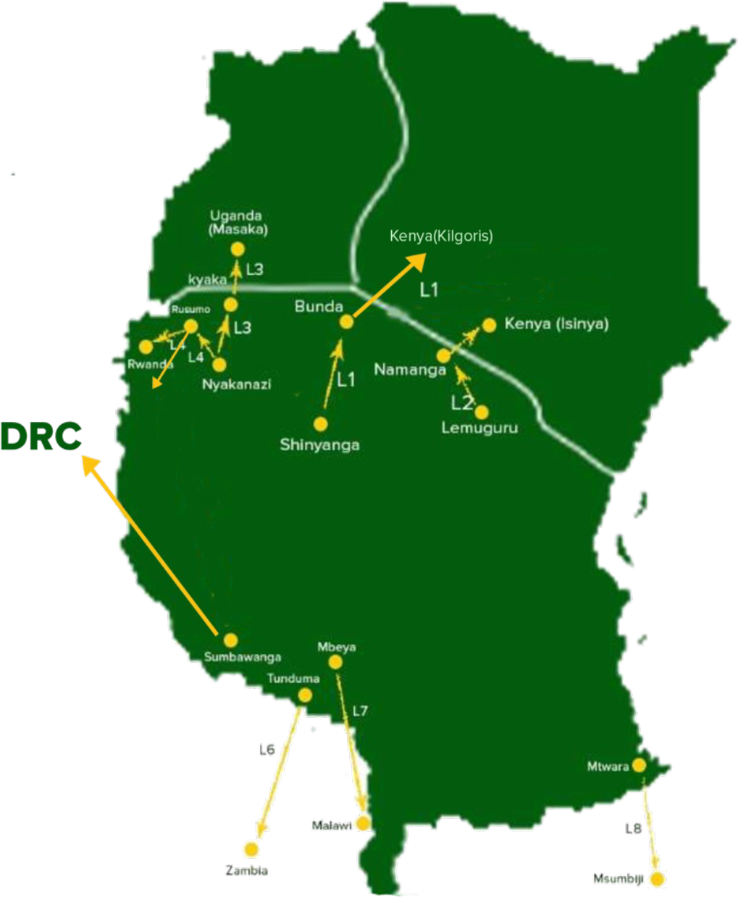
TRANSMISSION HORIZON: REGIONAL INTERCONNECTION 2023-2035
Regional Interconnection to EAPP + SAPP
Line 1 – Shinyanga >> Bunda >> Kenya (Kilgoris)
Line 2 – Lemugur >> Namanga >> Kenya (Isinya)
Line 3 – Nyakanazi >> Kyaka >> Uganda (Masaka)
Line 4 – Nyakanazi >> Rusumo >> Rwanda>> Burundi
Line 5 – Sumbawanga >> DRC
Line 6 – Tunduma >> Zambia (Kasama)
Line 7 – Mbeya (Igonja) >> Malawi
Line 8 – Tanzania >> Mozambique
No Feas. Study /No Funding
With Feas.Study/No Funding
Under Construction

Slide 28
PRIVATE SECTOR PARTICIPATION
PPP power generation opportunities in Tanzania include a wide range of projects areas including:
Solar; Manyoni, Same and Zuzu
Wind; Makambako, Ikungi, Singida
Hydropower; Songwe River, Mnyera River, Mpanga River
Gas; Mkuranga NSSF, Somanga fungu PPP
Geothermal; Ngozi phase I, Kienjo Mbaka phase I, Songwe

Slide 29
PRIVATE SECTOR PARTICIPATION
IPP power generation opportunities in Tanzania include a wide range of projects areas including:
Solar along Dodoma, Singida, Tabora, Shinyanga, Kilimanjaro Regions
Wind along Iringa, Njombe, Singida, Manyara, Arusha Regions
Hydropower along Morogoro, Njombe, Iringa, Rukwa, Ruvuma Regions

Slide 30
PRIVATE SECTOR PARTICIPATION
IPP power generation opportunities in Tanzania include a wide range of projects areas including:
Gas Fired along DSM, Coast, Lindi, Mtwara Regions
Geothermal - Various Sites
Nuclear
Small Power Producers (SPPs) projects in:
Solar -
Wind -
Min-Hydropower

Slide 31
FUNDING MODALITY TANESCO INVESTMENT PLAN
2024-2025
 | $60M
 | $10M
 | $70M
 | $306M
 | $783 M
OWN-GoT
GRANT
ECA/ CONCESSION
COMMERCIAL
PPP/IPP/DFI

Slide 32
FUNDING MODALITY TANESCO INVESTMENT
PLAN 2026-2035
 | $35M
 | $12M
 | $282M
 | $682 M
 | $20 B
OWN-GoT
GRANT
ECA/
CONCESSION
COMMERCIAL
PPP/IPP/DFI

Slide 33
RECOMMENDATIONS
How we should move forward…
Encourage Private Sector participation in power generation through:
IPP
PPP

Slide 34
THANK YOU

