Slide 2
IBC Accelerator
Programme 2026
Crystal Clear
Measuring Dialogue Intelligibility in Media

Slide 3
Crystal Clear
Measuring Dialogue Intelligibility in Media

Slide 4
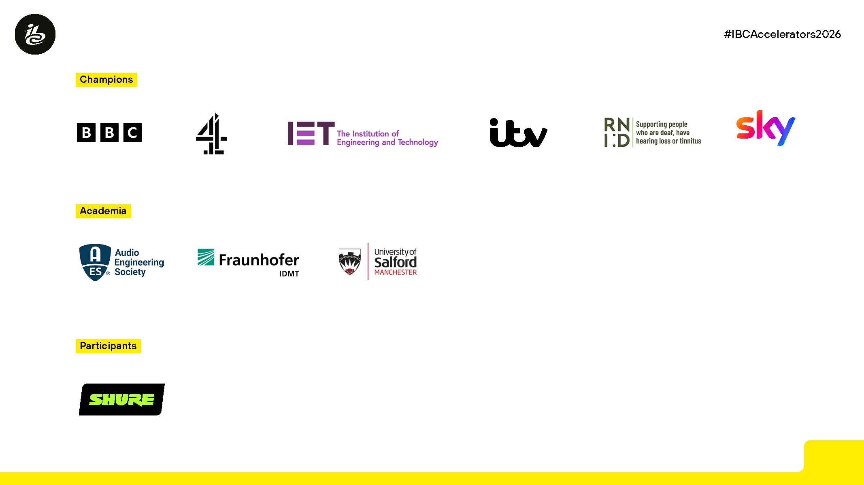
Summary
The Problem
The industry lacks a practical and standardised way to measure dialogue intelligibility. Intelligibility issues often remain undetected until audience complaints are received.
The Research
300 listeners rated real broadcast clips while objective measurements were analysed and compared against human perception.
The Innovation
A hybrid quality-control workflow combining automated analysis with structured human assessment.
The PoC
Integration of intelligibility measurements into a real broadcaster workflow to identify and review only potentially problematic programme segments.
The Vision
Make intelligibility a measurable, manageable and operational part of media quality across the industry.

Slide 5
Summary
The Problem
The industry lacks a practical and standardised way to measure dialogue intelligibility. Intelligibility issues often remain undetected until audience complaints are received.
The Research
300 listeners rated real broadcast clips while objective measurements were analysed and compared against human perception.
The Innovation
A hybrid quality-control workflow combining automated analysis with structured human assessment.
The PoC
Integration of intelligibility measurements into a real broadcaster workflow to identify and review only potentially problematic programme segments.
The Vision
Make intelligibility a measurable, manageable and operational part of media quality across the industry.

Slide 6
The Problem Statement
Audiences frequently struggle to understand dialogue in television and streamed content.
Existing quality control focuses mainly on audibility and technical compliance, rather than whether speech can actually be understood.
  EBU QC catalogue defines only a subjective “golden ears” audibility test
  Subjective listening checks are difficult to scale and can be inconsistent
The industry has no agreed intelligibility measurement method or accepted thresholds.
Crystal Clear establishes a hybrid assessment framework that combines objective measurement with structured human judgement, while respecting creative intent.

Slide 7
The Vision - Accessibility
1 in 3 people in the UK are deaf, have hearing loss or tinnitus.*
Crystal Clear aims to make dialogue intelligibility visible, measurable, and actionable, helping ensure that great content is accessible to everyone.
We believe Crystal Clear represents a significant step towards establishing an industry-wide framework for accessible and inclusive audio quality assessment.
By incorporating the listening experiences of hard-of-hearing audiences into objective assessment methods, Crystal Clear lays the foundation for more accessible and inclusive audio quality standards.
*source https://rnid.org.uk/what-we-do/data-and-evidence/deafness-and-hearing-loss-prevalence/

Slide 8
The Vision - Benefits Across The Industry
Producers
Earlier visibility of intelligibility issues.
Objective feedback during production and post-production.
Supports creative decisions rather than replacing them.
Broadcasters & Publishers
Identify issues before transmission/publication.
Reduce reliance on subjective full-programme listening tests.
More consistent QC processes across suppliers and content types.
Reduction in dialogue-related audience complaints.

Slide 9
The Vision - Benefits Across The Industry
QC Process
Faster and more efficient workflows.
Objective evidence available alongside professional judgement.
Technology Vendors
Opportunity to integrate common intelligibility measurements into QC tools and platforms.
Could provide interoperability between measurement systems and workflow products.

Slide 10
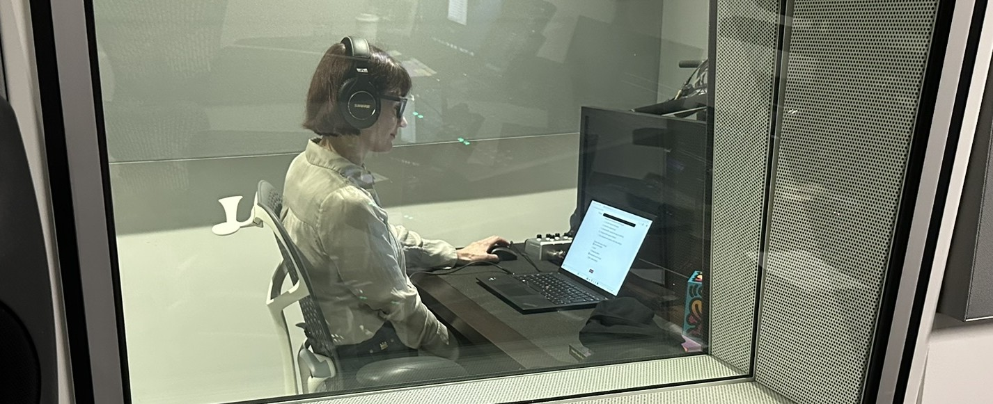

The Research
A large-scale in person and online listening study compared human perception with
objective measurements using actual broadcast content. Listening effort ratings from both
hard-of-hearing and normal-hearing audiences were compared against a range of
machine-based measurements to identify the approaches that best reflect audience
experience
The in-person study was concluded using headphones from

Slide 11

The Research - Phase 1 – Preparation
Human Assessment Framework
Definition of a simplified 5-point listening effort scale (Mappable to existing research methodologies)
Designed for both audience studies and operational QC use
Potential foundation for a practical human review scale within broadcaster workflows
Measurement Framework
Review of existing intelligibility-related measurement approaches
Evaluation of available objective measurement tools and algorithms
Selection of candidate measures for further investigation
Identification of measures suitable for broadcaster workflows
Research incentives were sponsored by
and

Slide 12
The Research - Phase 2 – Listening Experiment
Content Selection
60 short clips selected from actual broadcast content
Range of intelligibility conditions (bandpass, drama, reality)
Designed to represent realistic audience listening challenges
Human Listening Study
150 Normal-hearing and 150 hard-of-hearing volunteers
Listening effort ratings collected using a simplified 5-point scale
Volunteers used headphones or hearing devices at home or in the controlled environment
Objective Measurements
All clips analysed using selected intelligibility-related algorithms
Measurements compared against human listening results
Research incentives were sponsored by
and

Slide 13
The Research - Phase 3 – Analysis
Correlation Analysis
Comparison of human listening effort ratings with objective measurements
Ranked a wide range of machine models by their correlation with human listening effort ratings
Threshold Investigation
Exploration of practical intelligibility threshold(s)
Identification of measurement ranges associated with increased listening effort
Assessment of differences between hard-of-hearing and normal-hearing groups
Research incentives were sponsored by
and

Slide 14
The Innovation
1. Intelligibility as a Measurable QC Parameter
Today, broadcast QC largely measures technical compliance.
Crystal Clear treats dialogue intelligibility as a measurable quality attribute.
Establishes objective metrics and thresholds linked to human perception.
2. Hybrid QC model for producers and publishers QC
Combines automated analysis with structured human assessment.
Machines identify potentially problematic segments.
Humans make the final editorial and quality judgement
Does not compromise creative freedom

Slide 15
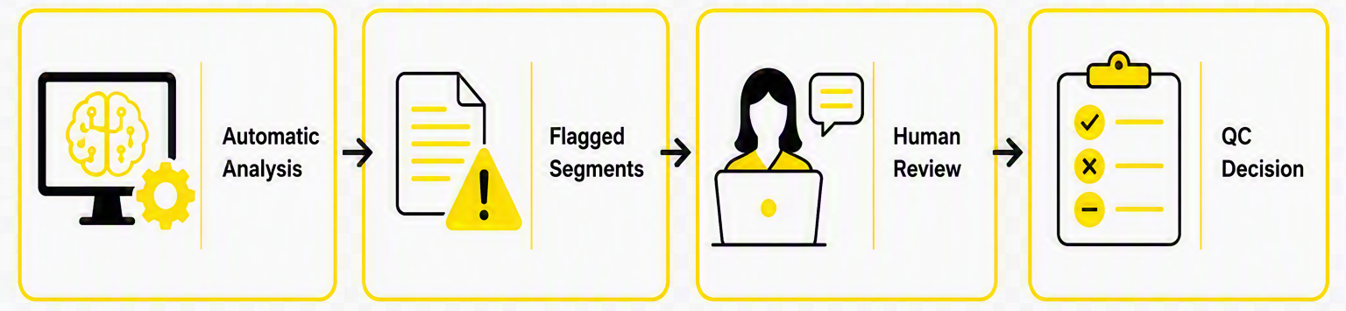
The Innovation (continued...)
3. Scalable Review Process
Instead of reviewing an entire programme, reviewers focus only on areas identified by the system, reducing manual effort while maintaining quality.
4. Practical Workflow Integration
Designed for integration into existing production and publishing workflows.
QC can be applied to production process or as part of delivery.
Supports operational use rather than remaining a research exercise.

Slide 16
The Proof of Concept
Integration to a real broadcaster workflow
Lightweight integration into Channel 4's Media Services environment.
Incoming programme content is automatically analysed after ingest
Nugen implementation based on the Fraunhofer LEAP model.
Measurements identify segments where dialogue intelligibility may be questionable.
Timecoded measurement results are associated with the programme asset in Channel 4’s BRAHMA AI asset management.
Targeted review the highlighted clips

Slide 17
The Focus of the Project
Crystal Clear focuses on what content producers and publishers can control: the intelligibility of dialogue within the content itself.
It does not attempt to address external factors such as transmission, reproduction systems, or listening conditions
Our research intentionally reduced the variables related to these external factors where possible -This enabled clearer conclusions to be drawn and reduced the size/duration of the required listening experiment

Slide 18
Crystal Clear
The Research Results

Slide 19
The Experiment Summary
Dialogue "intelligibility" (widest sense) is a multi-facetted issue in broadcast media
An improved Quality Control (QC) test that is machine-based with human-in- the-loop review is required
300 normal- and hard-of-hearing participants rated listening effort for 60 short clips chosen from Channel 4 and BBC dramas and documentaries
Their ratings were correlated with dozens of potential machine-based measures of speech intelligibility (or similar, e.g. signal-to-noise ratio)
Speech-to-text (STT) model-based measures produced the strongest correlations with listener ratings, but many other measures performed well
Further research is required to determine a useful measurement threshold for QC, potentially using a combination of different measures

Slide 20
The Problem with “Intelligibility”
    Audibility refers to physically being able to perceive (hear) the sound.
    Speech intelligibility is a measure of the correct identification of words in a sentence.
    Comprehension refers to understanding the dialogue.
    Listening effort can affect intelligibility and comprehension, but not audibility – trying harder does not make the sound louder.
    “Intelligibility” has been used in broadcast media to
    cover all issues with dialogue. This conflates loudness (with well-established measures) with comprehension (more difficult to measure and improve).
AUDIBILITY:
Can the sound be heard?
INTELLIGIBILITY:
Can the words be identified?
COMPREHENSION:
Can the dialogue be understood?

Slide 21
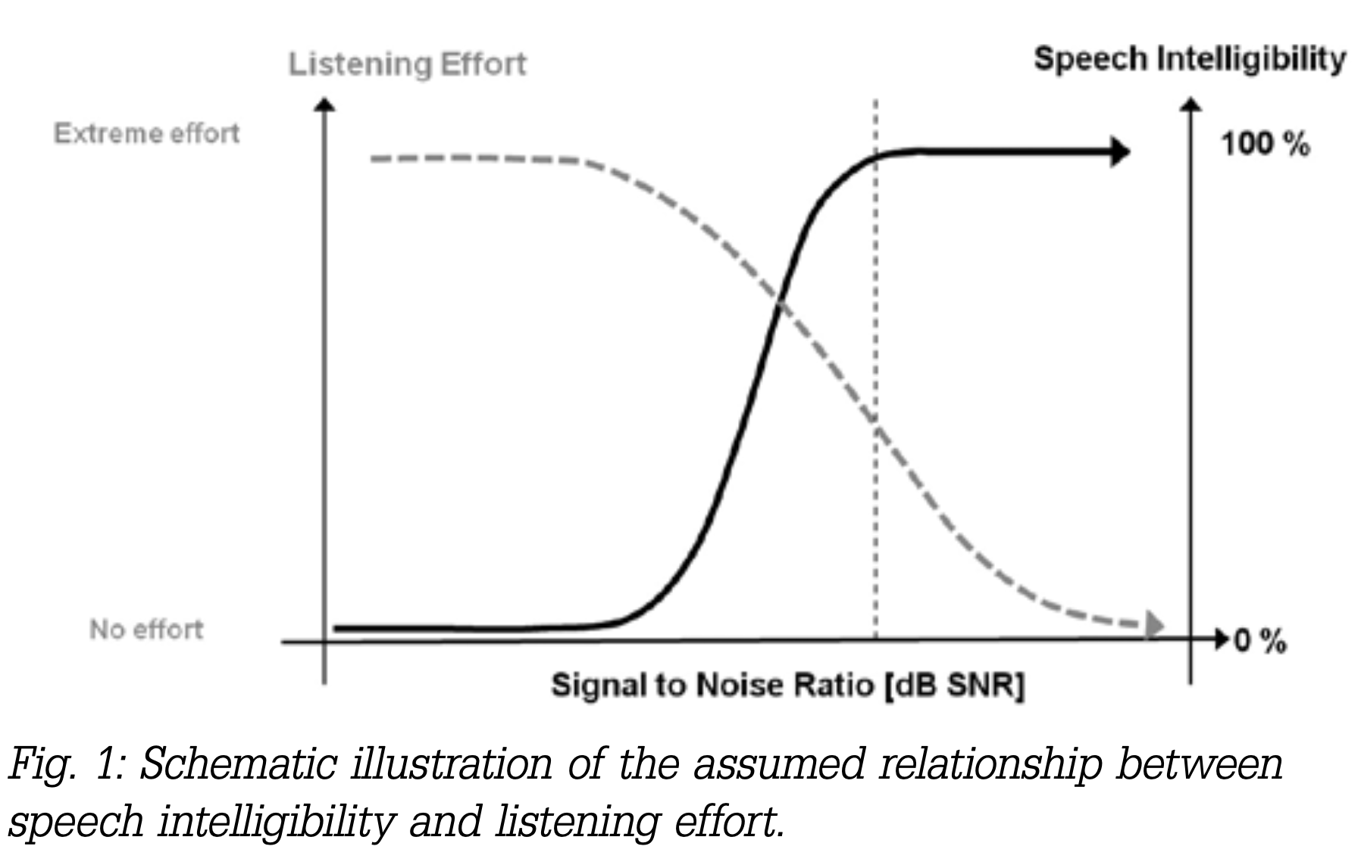
What is Listening Effort, and Why Do We Care?
    Most broadcast media content is intelligible, but the effort required to understand it can vary
    Therefore, Pichora-Fuller et al. (2016) has defined listening effort as: “The deliberate allocation of mental resources to overcome obstacles in goal pursuit when carrying out a task, with listening effort applying more specifically when tasks involve listening."
    Increased listening effort = more fatigue and audience complaints
    Complaints = stop watching
Diagram reproduced from Klink et al. (2012) and altered, "Measuring listening effort in the field of audiology – a literature review of methods, part 1". Listeners may "give up" intelligibility drops too low (i.e. listeners "give up") (red dashed line)

Slide 22
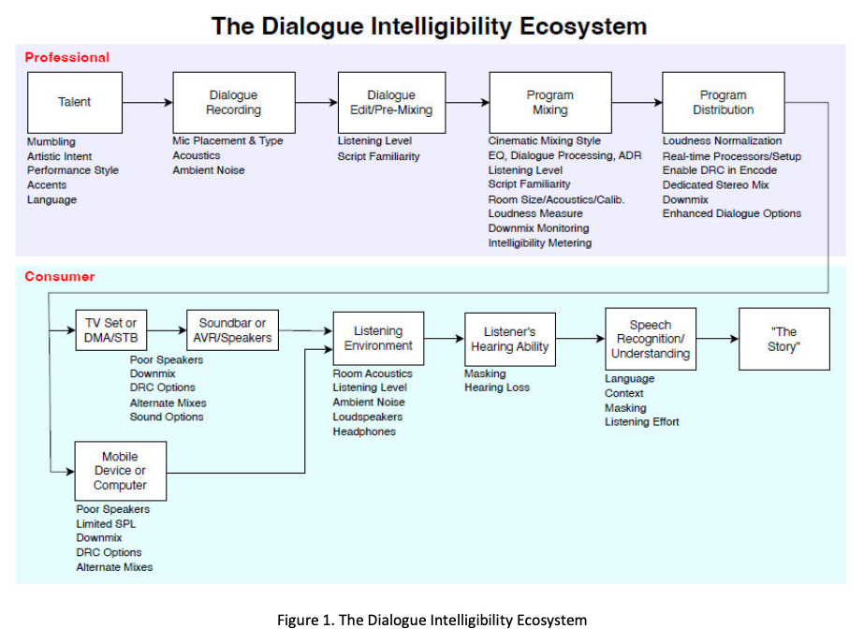
Listening Effort as a Quality Control Test
Last broadcaster “checkpoint” before distribution
    Crystal Clear aims to produce a Quality Control (QC) “traffic light” test for dialogue (Green for ”good”, amber for “needs attention”, and red for “bad”)
    Intelligibility is mostly high in media
    Listening effort is considered a more sensitive listener/audience measure
    Therefore, the research focused mainly on listening effort for QC
Experiment focused on listening effort
Diagram reproduced from AES report TD1009 “Improving Dialogue Intelligibility in Media”, 2025

Slide 23
Requirements for a QC measure
Objective (e.g. automated, machine-based detection with human-in-the-loop review)
Non-intrusive (e.g. no dialogue-only reference available at distribution point)
  Real-time or offline
  Consider computational costs
Shown to correlate well with listening effort for both Hard-of-Hearing (HoH) and Normal Hearing (NH) listeners using mixes taken from broadcast media (e.g. not artificially created)

Slide 24
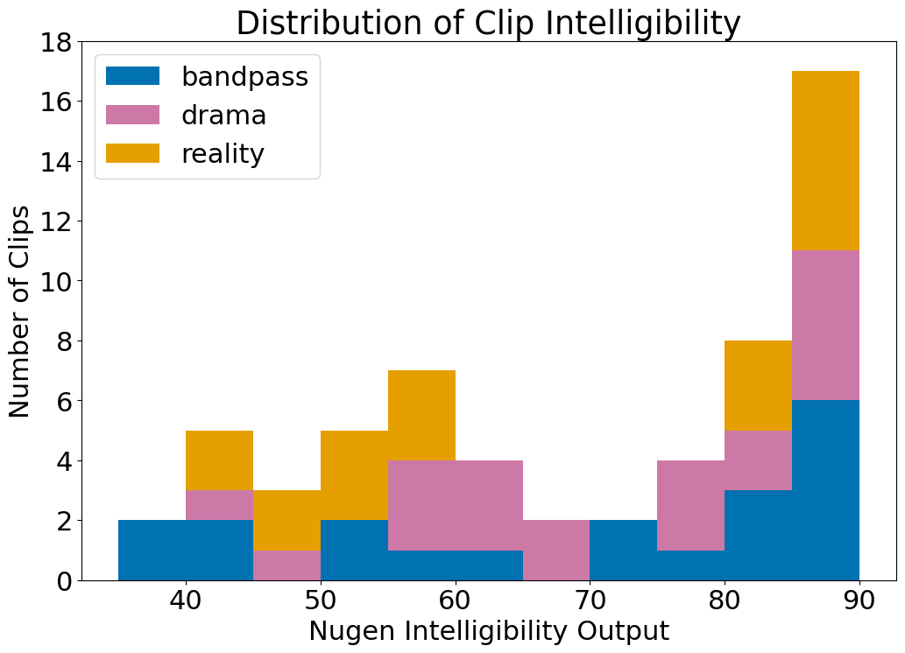
Listening Experiment – Clips
Used the Nugen DialogCheck plug-in to measure hundreds of clips, mostly from Channel 4 programmes
All but one had received complaints about the audio
Genres like sports and feature films not included due to copyright
Subset of 60 short (avg. 8 sec) clips selected manually:
    30 x clips (Nugen output < 75)
    30 x clips (Nugen output > 75)
    Using custom DialogCheck settings and based on previous research
A split distribution (at 75) was used to give the best chance of finding a clear QC threshold

Slide 25
Listening Experiment – Clip Selection
All clips were normalized to -23 LUFS to reduce loudness offset.
Signal-to-noise ratios (SNRs) are unchanged
Three loosely defined conditions (<75 only) identified by manual review:
Bandpass – low-bandwidth speech (e.g., archive audio from early 60’s)
Reality/Documentary – difficult recording environments (e.g., hospitals)
Drama – emotional or whispered speech
The >75 clips were chosen from the same programmes as the <75 clips
This partially controlled for the effect of programme
A successful QC measure should identify issues within a programme

Slide 26
Listening Experiment – Machine Models
We ranked various models by their correlation to human ratings of listening effort.
A version of the LEAP model of listening effort (Fraunhofer IDMT)
    Incorporated into Nugen (as DialogCheck), Telos Alliance, RTW, Steinberg (Nuendo), and Junger audio products
Automatic speech recognition (ASR) confidence values Speech-to-text (STT) models
e.g. Whisper (Open AI) & wav2vec2 (Meta) - Used in previous research (e.g. Clarity Challenges, claritychallenge.org)
Many other non-intrusive objective measures
e.g. non-intrusive STOI &PESQ, NISQA, SQAST, SQUIM, etc)

Slide 27
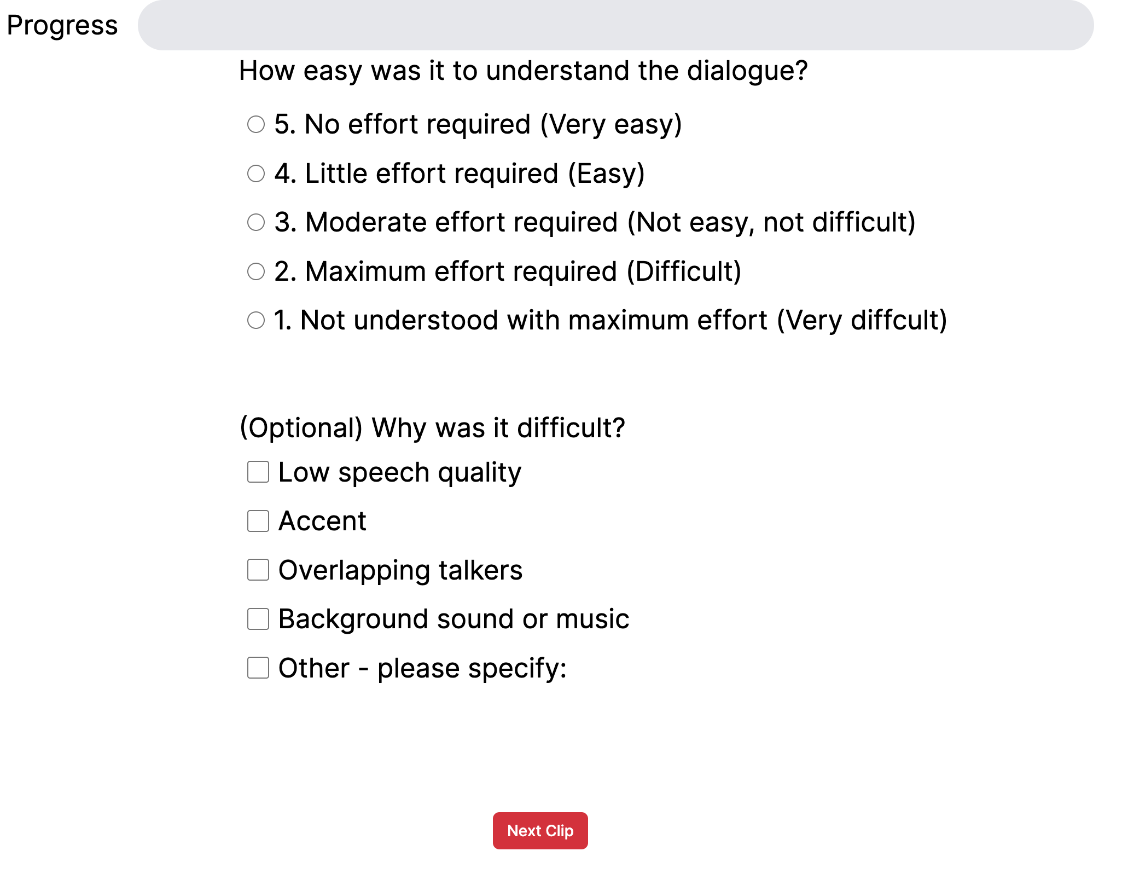
Listening Experiment – Procedure
300 (150 hard-of-hearing, HoH) participants took part in an online experiment
Normal-hearing (NH) participants used headphones
Hard-of-hearing used their usual playback device (e.g. bluetooth-paired hearing aid, device speakers)
Participants rated the listening effort required for each clip, and why it was difficult (optional)

Slide 28
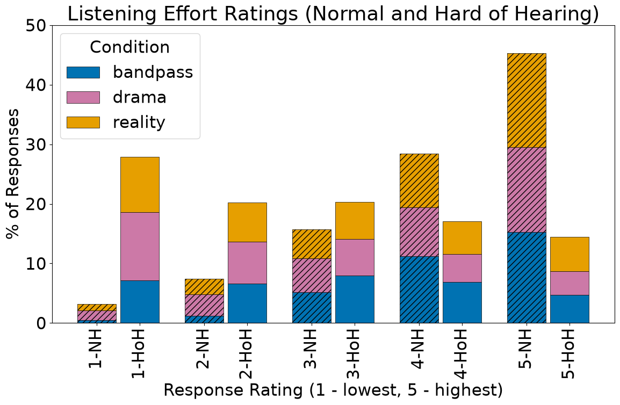
Listening Experiment – Results
Hard of Hearing (HoH) listeners rated clips ~1.5 pts more difficult than normal hearing (NH)
Most NH ratings 4 or above
Most HoH ratings 3 or below
Ratings by condition were evenly spread

Slide 29
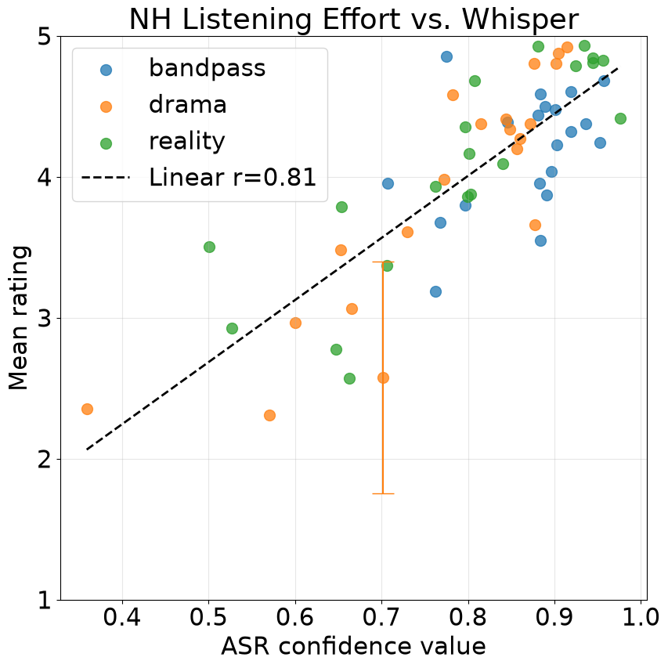
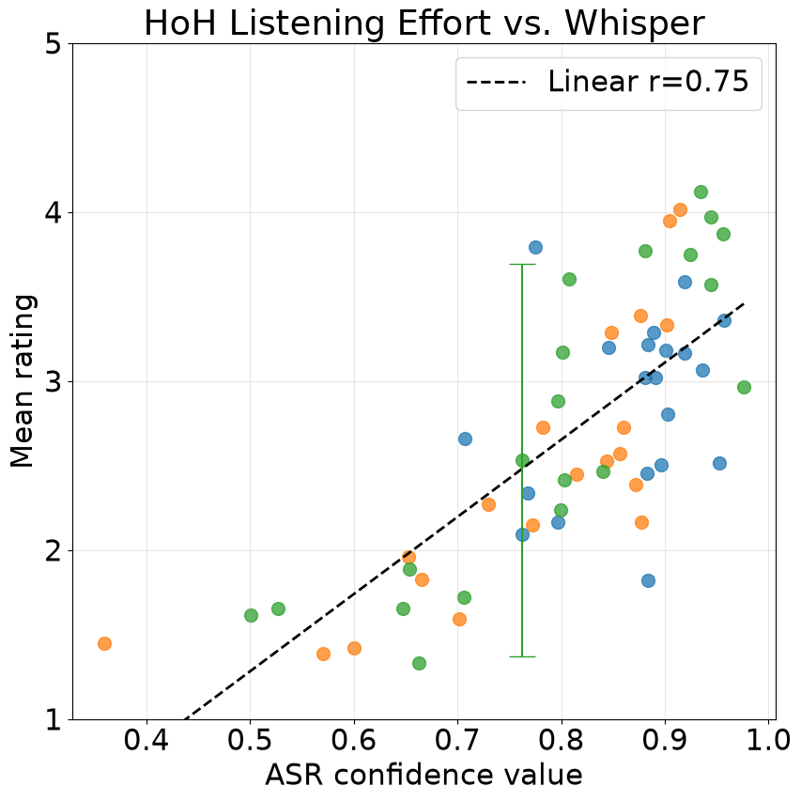
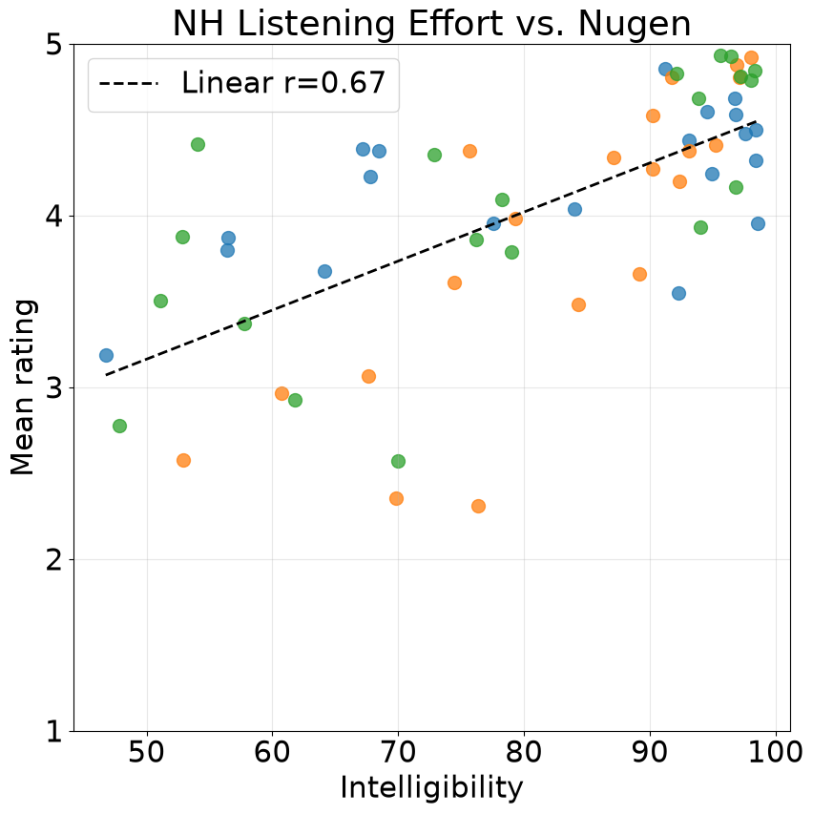
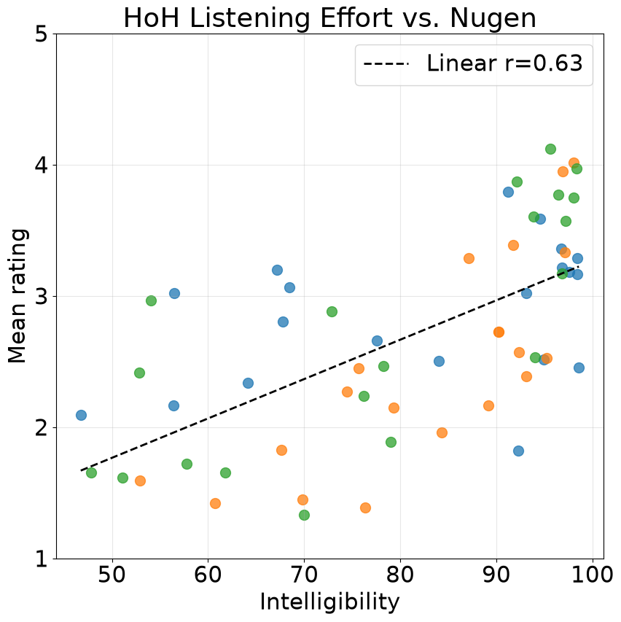
Correlations
HoH listeners rated clips 1.5 points (on listening effort scale) lower than NH listeners
Whisper correlated more strongly than Fraunhofer/Nugen
It is difficult to define a specific threshold for “poor” clips using either measure
High objective values do not guarantee low listening effort
    But low values can be used to highlight audio for additional human review
NH and HoH (columns) listener ratings (y-axis) against Nugen and Whisper (rows) ASR confidence measurements (x-axis)

Slide 30
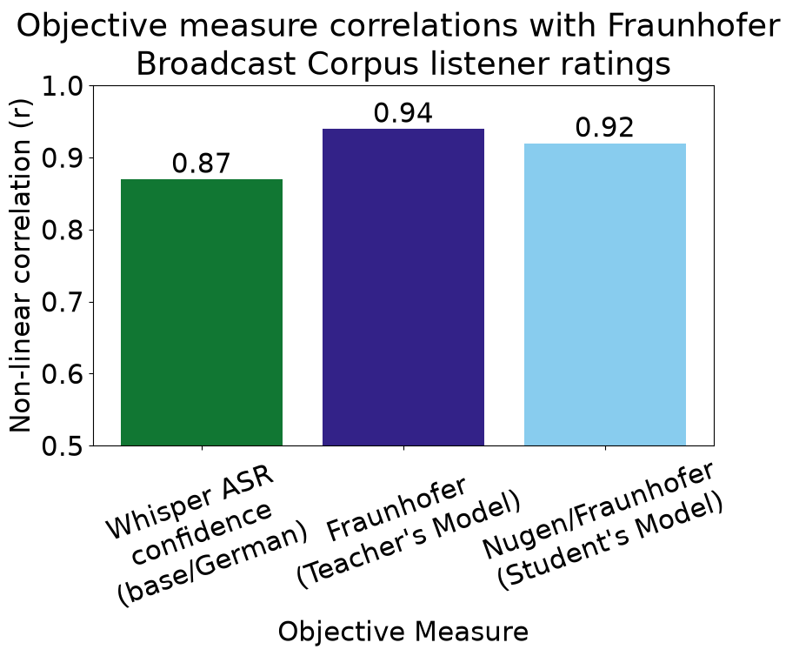
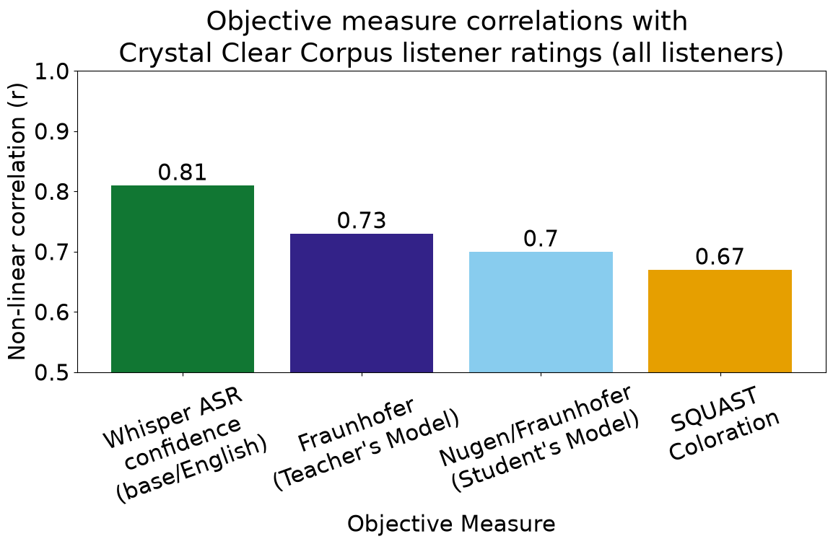
Correlation Comparison
~100 measures, correlations = ~0.1 - 0.85
Speech-to-text (STT) ASR confidence values correlated best with Crystal Clear corpus (60 English clips)
Fraunhofer's models correlated best using a broadcast corpus (400 German clips)
However, STT models are:
  larger (~2 orders magnitude more parameters)
  trained on much larger (often unknown) corpuses

Slide 31
Important Considerations
Crucially, DialogCheck is clearly modelling the perception of phonemes
  STT automatic speech recognition (ASR) confidence values may not have a perceptual basis
The EU AI act may prevent the use of the Whisper model and others like it
Model | Training data (speech) | Data source | Model size (parameters)
DialogCheck | ~8k hrs. word-labeled | Purchased dataset | 458.3k
Whisper (Tiny) | ~680k hours labeled | Unknown | 39 million
wav2vec2 (base) | ~53k hours unlabeled | Libri-Light (LibriVox) | ~95 million

Slide 32
Conclusions
Listening effort ratings are higher overall for hard-of-hearing than normal-hearing listeners
The ratings correlate moderately with several objective measures, including
Fraunhofer IDMT/Nugen and speech-to-text (STT) based models
It is difficult to set clear “traffic light” thresholds based on these results
        The best correlations were moderate-to-strong
        This was partially due to a lack of very difficult audio clips in the corpus, which is representative of broadcast media more widely
There is potential to use objective measures as an automatic “flagging” system for poor dialogue, but only with subsequent human review

Slide 33




Crystal Clear
The PoC Results

Slide 34
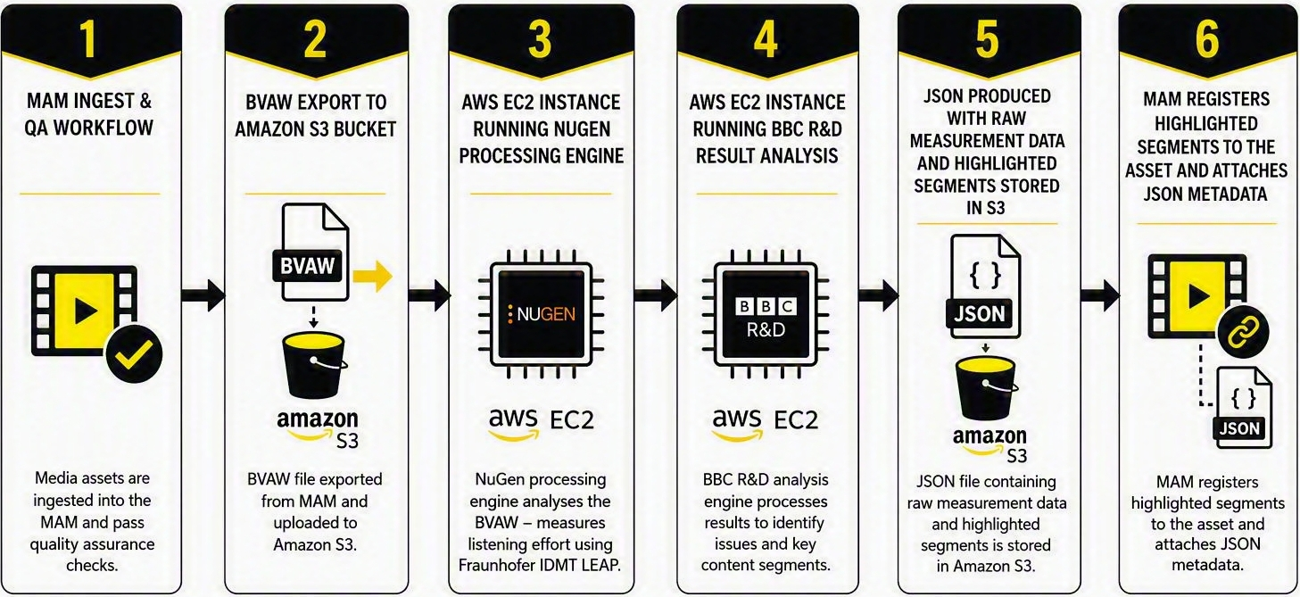
The POC results - Integration Design

Slide 35
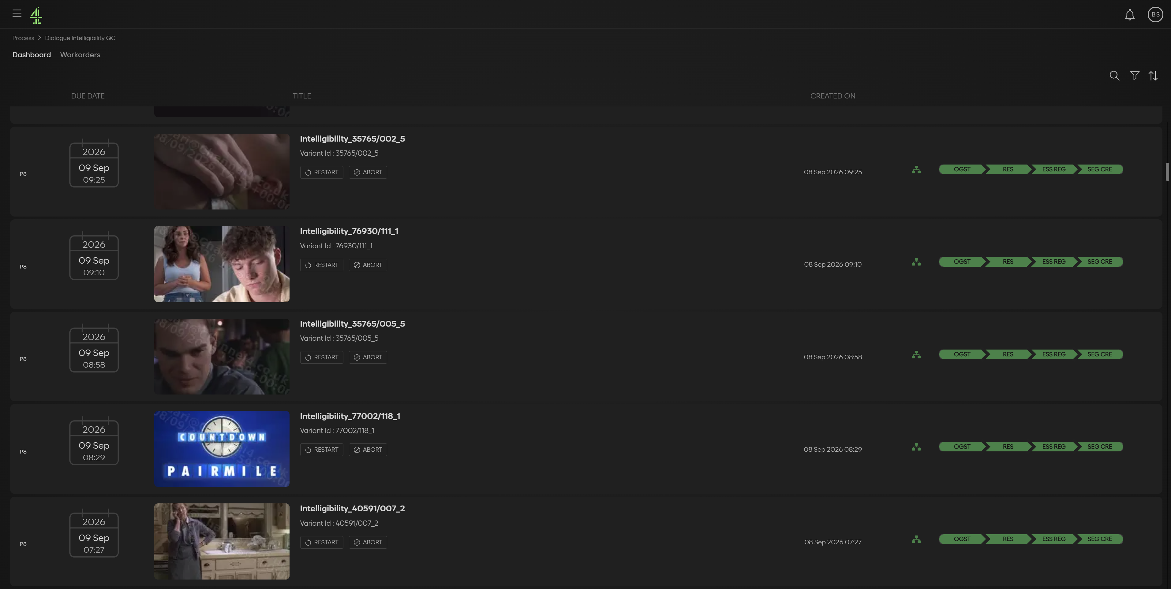
The POC results - Workflow dashboard in

Slide 36
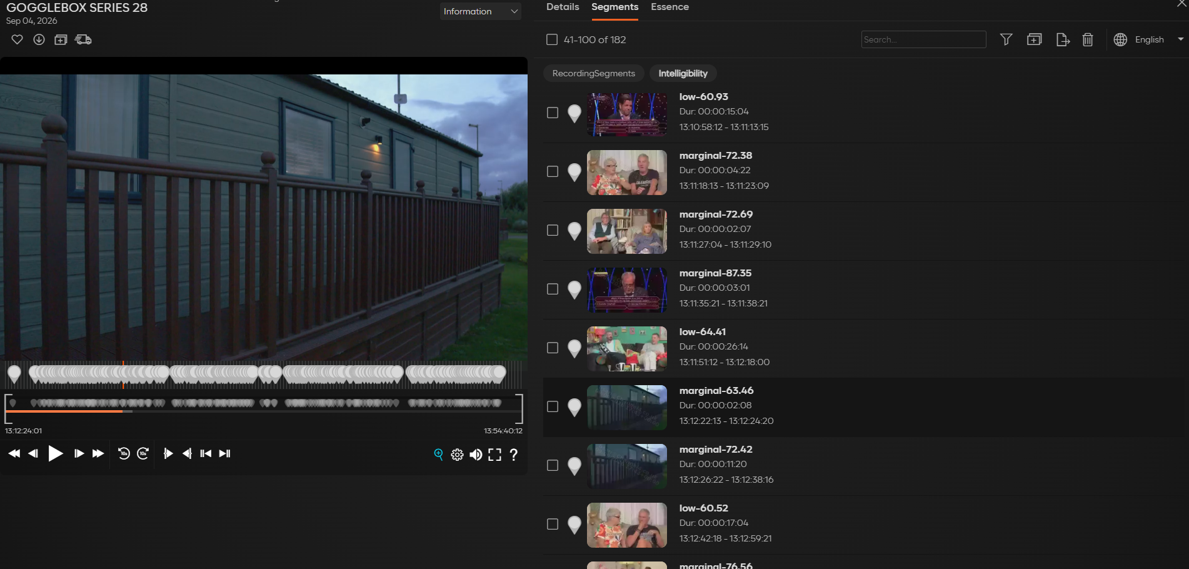
The POC results - Asset view in

Slide 37
The POC results - Areas Investigated
  Segment Length
  Segment duration should be user-filterable
  Reviewers can understand flagged issues, but pre-roll and post-roll would improve context
  Approximately 5 seconds of pre-roll and post-roll is practical for operational QC
  Threshold Application
  Proposed thresholds identify relevant content within the limitations of the models used
  Too many segments are currently highlighted, requiring UI-based filtering
  A single threshold may not work consistently across all programme genres and content types
  Workflow Suitability
  The approach can be integrated into existing broadcaster workflows
  It has the potential to provide useful guidance without unnecessary operational overhead
  The current POC implementation requires further refinement

Slide 38
Crystal Clear
The Achievements of the Project

Slide 39
The Achievements of the Project
  1. Subjective evidence collected
  Collected listening-effort assessments from 300 participants, including people with normal hearing and hearing loss, using 60 broadcast clips
  2. Objective measurement models assessed
  Evaluated candidate measurement approaches against the subjective listening data to understand how effectively automated models reflect audience experience.
  3. Broadcast content measurement pipeline developed
  Created an automated process for analysing programme audio, retaining raw measurements and identifying potentially problematic time-coded segments.

Slide 40
The Achievements of the Project
4. Proof of concept implemented​
Integrated automated intelligibility analysis into a broadcaster’s media asset management and quality-assurance workflow, allowing highlighted segments and measurement metadata to be registered against the asset.​
5. Hybrid human-in-the-loop workflow ​
Combined machine-based analysis with targeted human review, enabling reviewers to focus on system-flagged segments rather than listening to complete programmes. ​
6. Foundation created for industry alignment​
Established research evidence, an operational PoC and shared recommendations that could support future intelligibility thresholds, delivery specifications and wider standardisation. ​
Crystal Clear has moved dialogue intelligibility from a largely subjective concern towards a measurable, testable and operationally manageable component of media quality.​

Slide 41
Crystal Clear
The Team

Slide 42
The Team
Channel 4: Balazs Sari, Robert James, Manju Sundaram, Dr. Cara Hirst, Dr. Sue Farrell, Jesse Milverton, Steve Belford, Andy Bell, Maheen Choonara, Kirsty Walker, Jonathan Penny, Holly Fairweather, Fiona Lomax, Tamara Ballard, Roshan Alex, Ian Barrett, Lucy Antoniou, Rebecca Hollister, Andrew James
BBC: Dr. Alan Archer-Boyd, Andrew Dunne, Dr. Matt Paradis
Fraunhofer IDMT: Johanna Baumgartner-Krone, Prof. Dr. Jan Rennies-Hochmuth, Christian Rollwage, Dr. Rainer Huber
Sky: Ashley Ross
IBC: Keran Boyd, Octavia Lily
IET: Ian Nock, Ted Laverty, Sean Jones
AES: Richard Friedel, David Bialik, Robert Bleidt, Dr. Scott Norcross
Amazon: Dr. Scott Isabelle
Shure: Ian Davis, Jack Drury
RNID: Dr. Lauren Ward, Laura Marples
ITV: Matt Simpson
Nugen: Dr. Paul Tapper, Charles Blessing
University of Salford: Dr. Ben Shirley
BRAHMA AI: Madhankumar Thangavel, Atul Saxena, James Macmillan, Kavipriya, ⁠Diwakar Reddy, ⁠Sushma L, ⁠Jinoy Jairaj
Telos Alliance: Kirsten Smith, Markus Hintz, Graham Tudball, Costa Nikols

Slide 43












Special Thanks To:

Slide 44

Link the AES paper: Improving Dialogue Intelligibility in Media

