Slide 1
IBC Accelerator
Programme 2026
Network Control
Your Connection, Your Choice

Slide 2
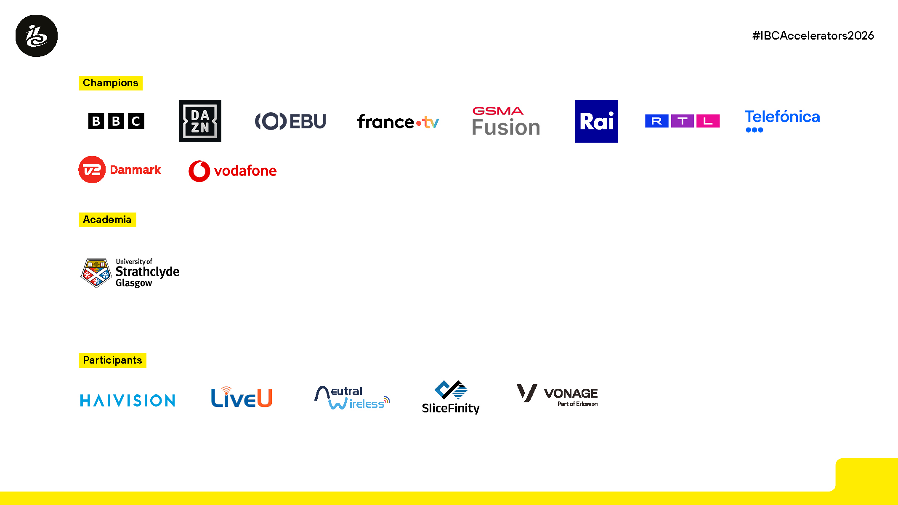
Logos placeholder

Slide 3

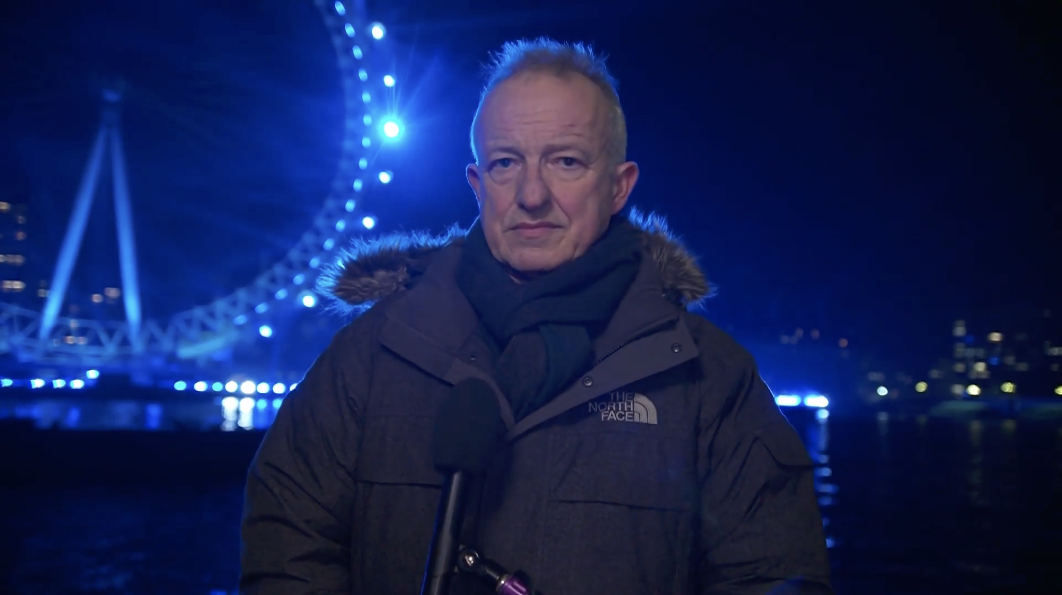
Motivation & Objectives
Broadcasters now regularly use public 4G/5G as an
alternative to satellite
Any network can become congested especially in high demand environments – public, private, slices
Open APIs necessary for adoption
Quality on Demand (QoD) provides dynamic control allowing live production to guarantee resources in real-time on a live network
→ Accelerate awareness, adoption and availability
Explore how programmable network resources (QoD) can support live production workflows
  More than just video workflows
Facilitate collaboration between broadcasters and operators
→ Showcase reliable 5G for broadcast production

Slide 4
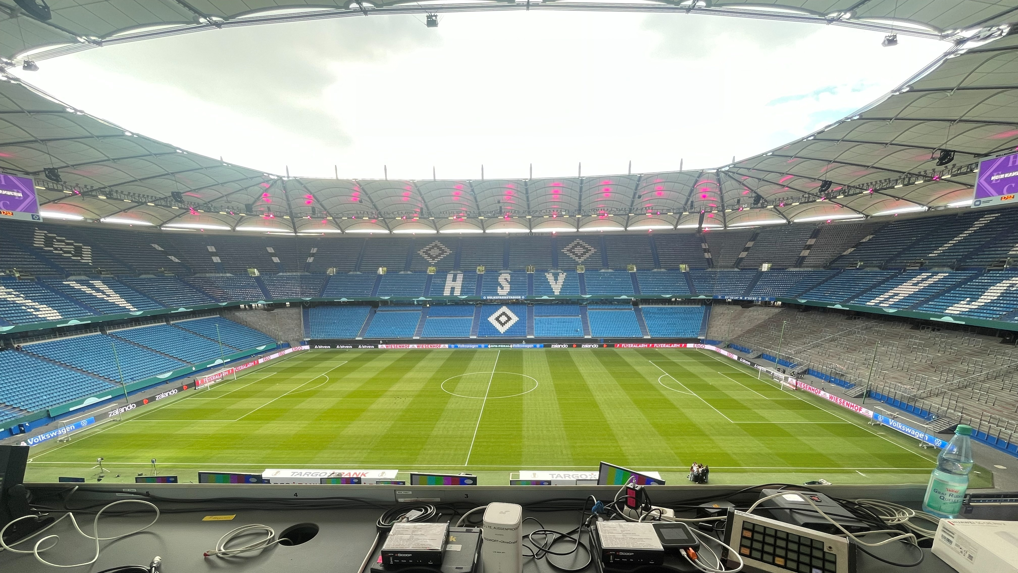
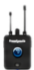

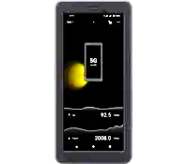
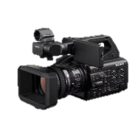
Proof of Concept
A test of QoD with real production workflows, on live public networks, in a real-world environment
DFB-Pokal football match in Hamburg with 45,000+ people inside the stadium
Intercom
500 kbps GBR
    Successfully delivered intercom where best-effort failed
    Peak congestion average traffic
    → QoD 365 kbps vs. 73 kbps best effort
    Stable commentary transmission where best-effort failed
    → 127 packets lost vs. 2,316 packets lost (18x better)
    Working with operator and platforms to understand unstable performance on 2 Mbps GBR profile
    Successfully used a portal created by SliceFinity to schedule Vonage QoD from the Remote Production Centre
Commentary
512 kbps GBR
Mobile Journalist
2 Mbps GBR
Return Video
Live Contribution
2 Mbps GBR
Live Video
8 Mbps slice

Slide 5
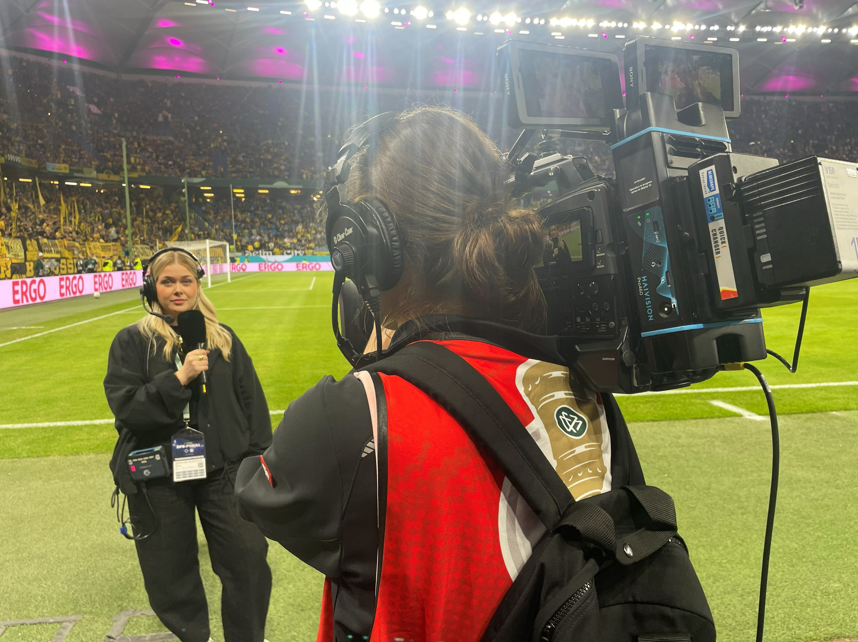
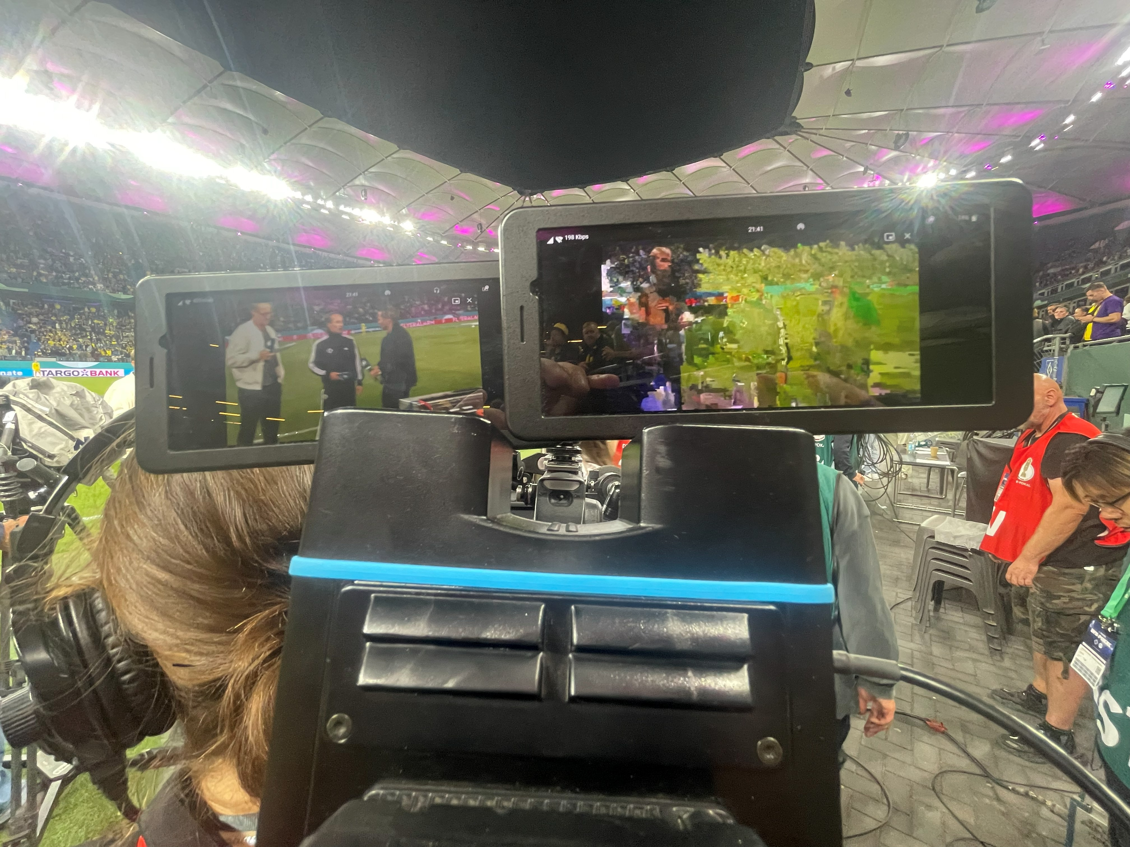
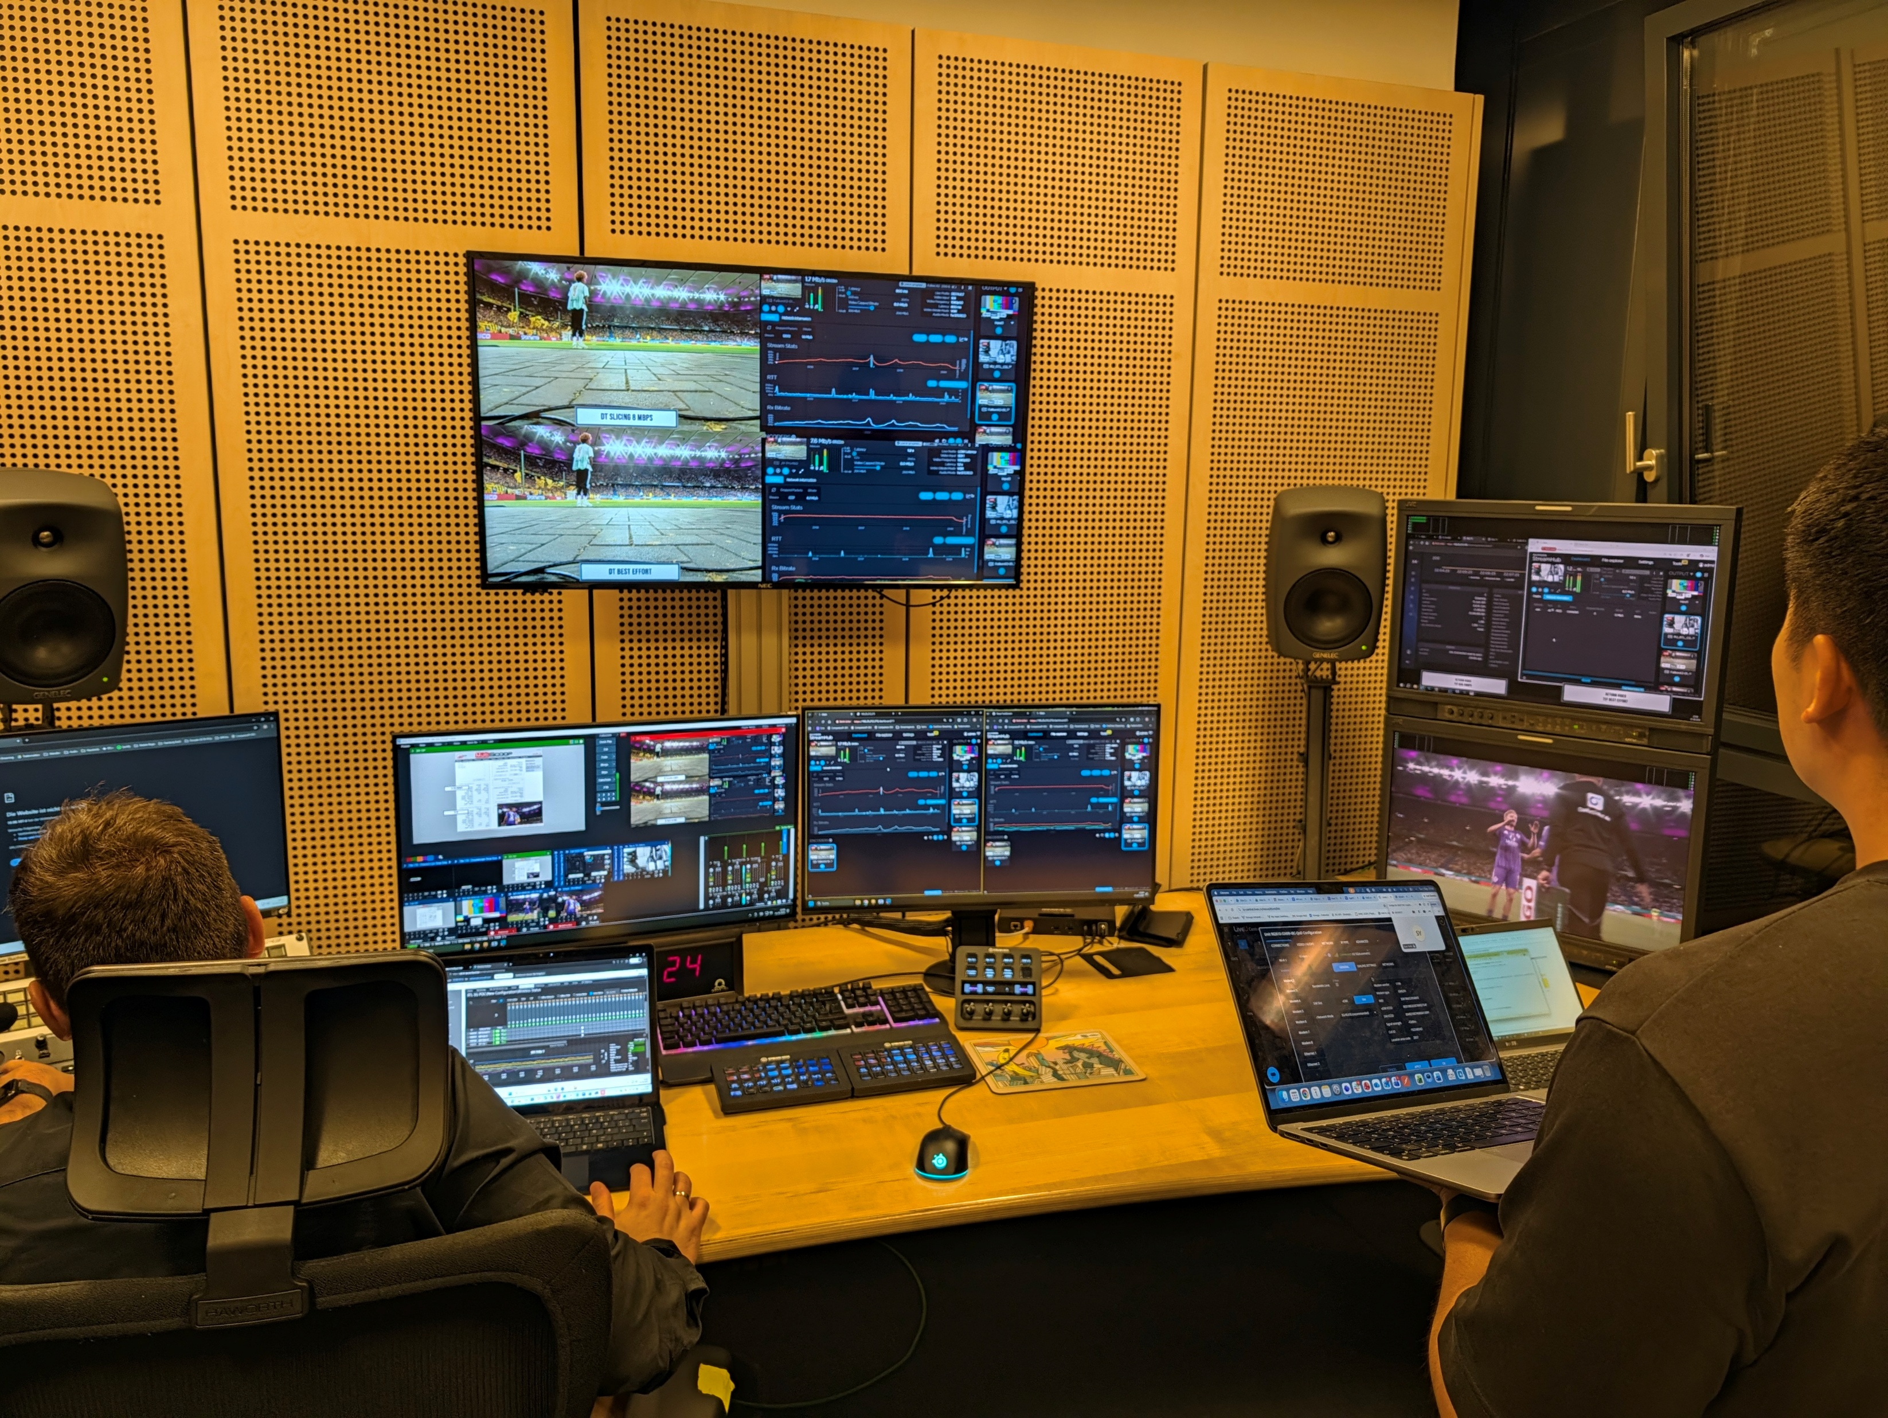
Key Learnings & Impact
    Facilitated communication between broadcasters and operators
    Accelerated implementation and integration of QoD to address genuine challenges
    Validated on live networks at a real live production
    TL;DR
    Demonstrated interaction with live public networks to dynamically request guaranteed resources, controlled by third-party remote devices in the production gallery
    → Where next? .
    Wider operator/service availability
    More broadcast profiles and integrations
    More APIs: QoS booking, network insights
    BYOE – Bring Your Own Event for testing!
    → When something just works, it is easy to overlook the achievement
    → IBC Show .
    Live demo of QoD on private network
    Strong interest from broadcasters, ecosystem vendors, and operators
    Will be showcased at MWC27

