Slide 1

The International Centre
Site Induction
Construction Design & Management 2015

Slide 2
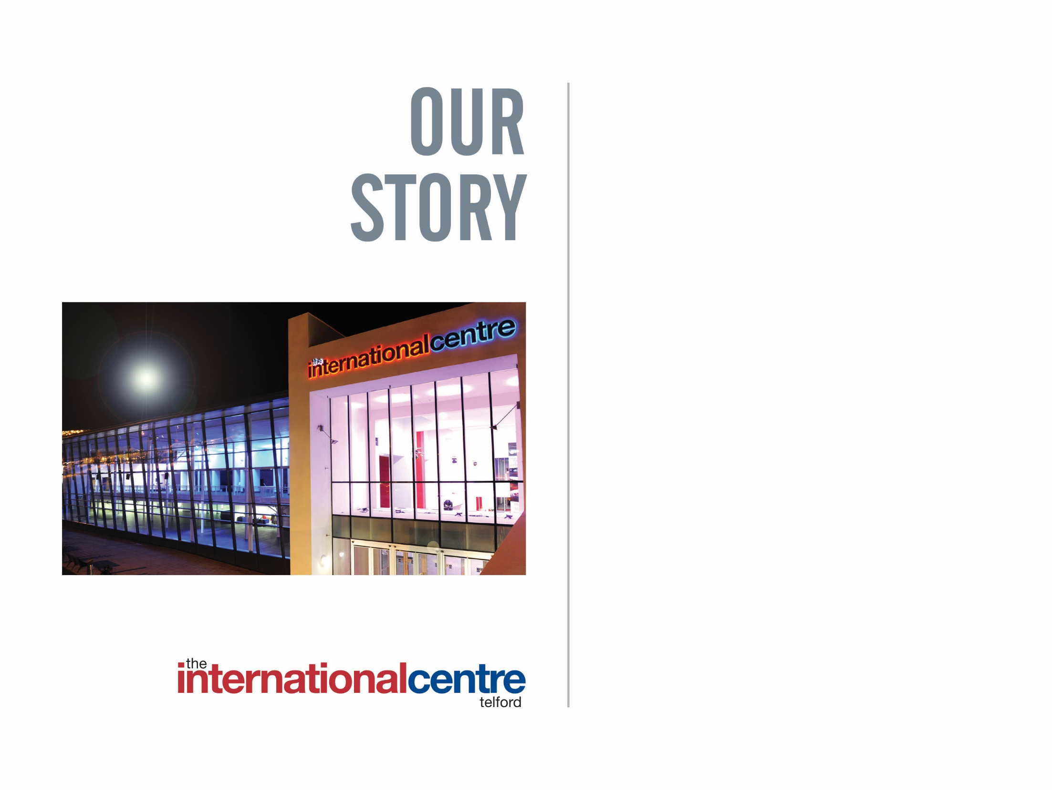
Contents
Introduction
Emergency Evacuation Procedure
Traffic Management Procedure
Welfare Facilities on site:-
Toilets
Catering facilities
First Aid
Smoking
PPE
Build / Breakdown Procedures

Slide 3

Site Induction
It is essential that anyone working in and around any CDM site within The International Centre (TIC) participates in this induction. This includes all organisers, exhibitors, contractors and TIC staff.
It is important whilst working at TIC that you are aware of safety rules and procedures that are in place
All of your contractors and employees are required to read this document prior to working at or around The International Centre

Slide 4
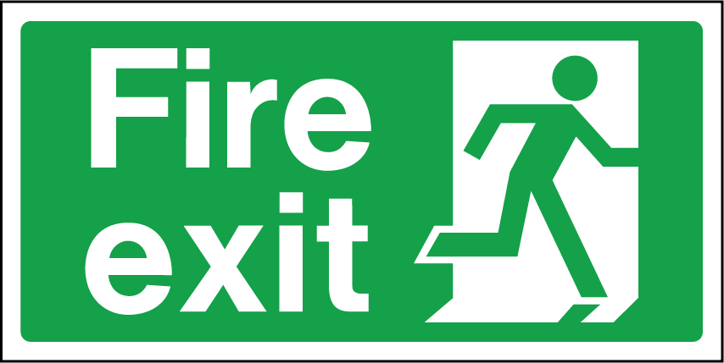
Emergency Evacuation Procedure
Please ensure that you are familiar with your nearest Emergency Exits
If you discover a FIRE raise the alarm immediately via the nearest ‘Break Glass’ or by informing a member of staff or Duty Manager
Fire extinguishers & break glasses are located next to each Fire Exit within the Halls

Slide 5
Emergency Evacuation Procedure
In the event of an Emergency Activation you will hear the following automated message:-
‘ATTENTION, ATTENTION, AN EMERGENCY SITUATION EXISTS WITHIN THE BUILDING, PLEASE LEAVE VIA THE NEAREST AVAILABLE EXIT’
On hearing this message, please leave the Building IMMEDIATELY by the nearest exit in a calm and orderly manner
DO NOT use the lifts or attempt to take anything with you.
Move well away from the building to the marked assembly points ‘A’, ‘B’, ‘C’ & D on the car parks as directed by TIC staff
DO NOT attempt to return to the building until the ‘all clear’ has been given by either TIC’s Fire Evacuation Controller or The Chief Fire Officer

Slide 6
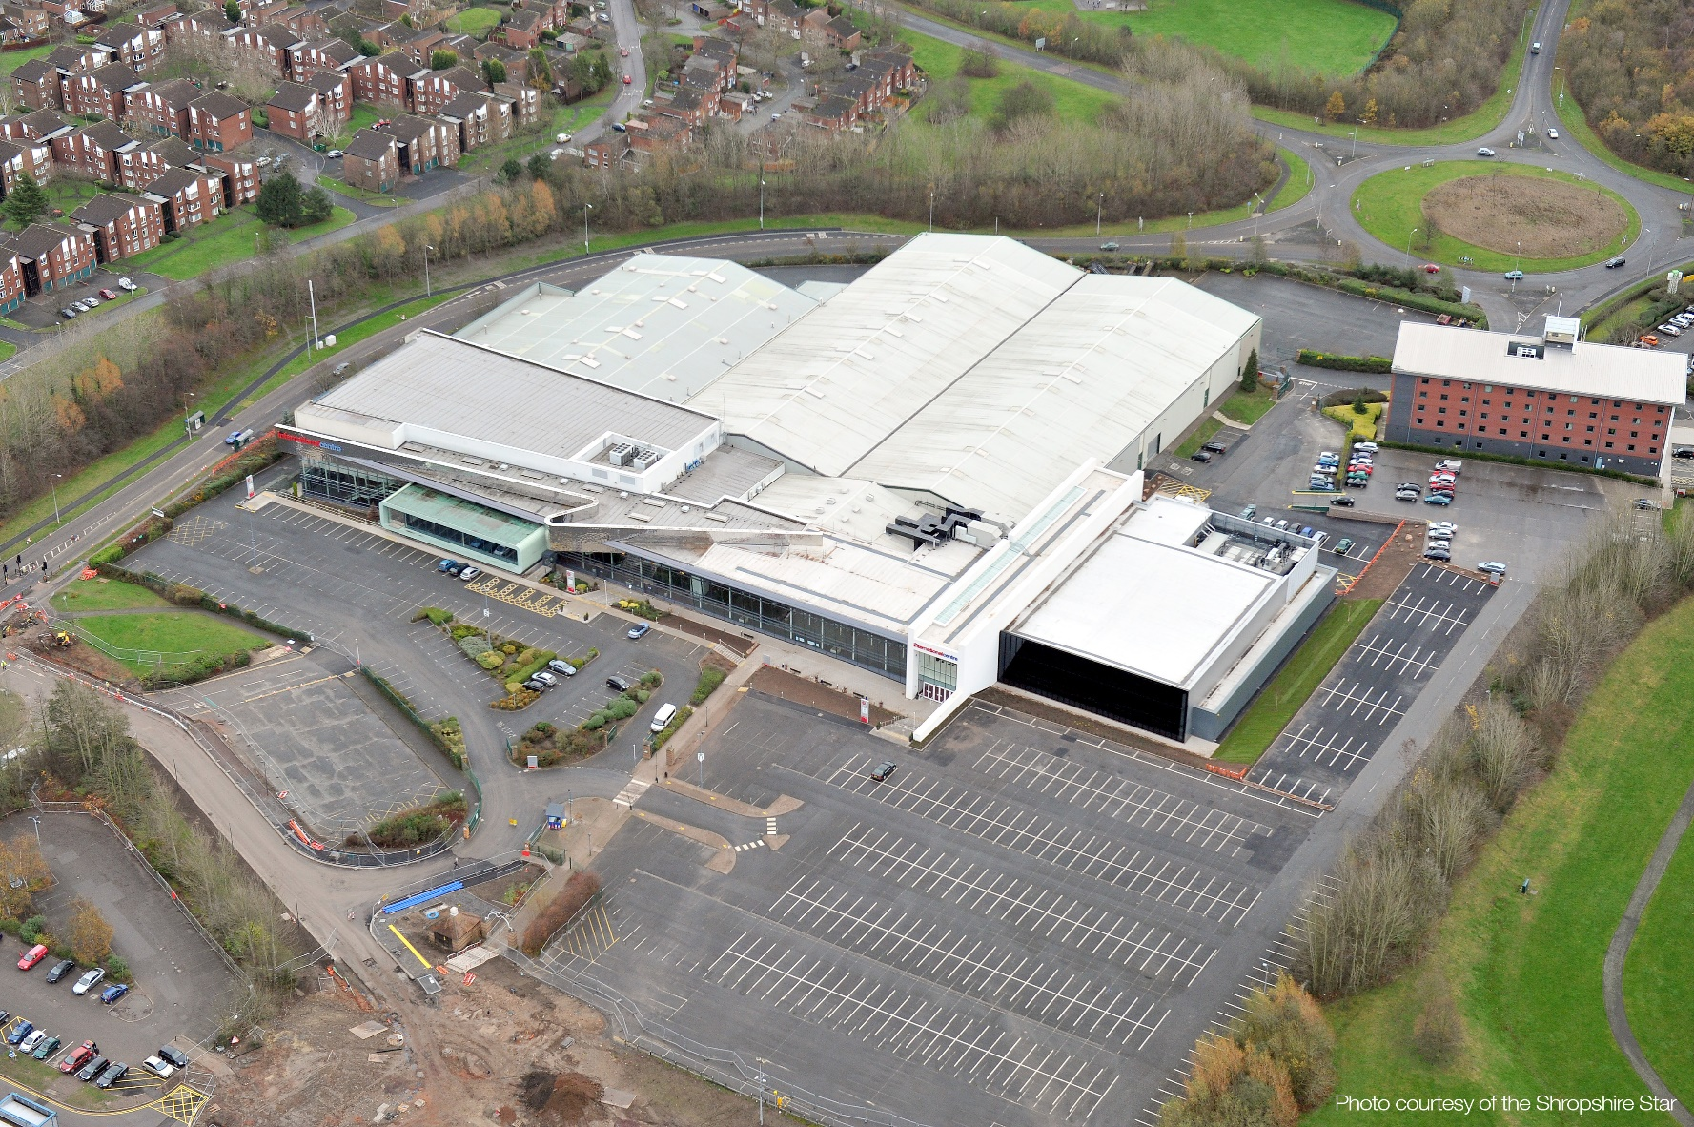
Emergency Muster Points
D
C
A
B

Slide 7


Welfare Facilities
Toilets
Toilets are located in:
Lower and upper concourse areas
Within Halls 2 & 3 (see site plan)
Food & Beverages
Available to purchase from the following:-
Reception (drinking water) - Lower Concourse
Costa Coffee - Lower Concourse (open times subject to event)
Vending Machines - Lower Concourse and Hall 2 Foyer

Slide 8

Welfare Facilities
First Aid
In the event of requiring first aid treatment you can:-
Contact a member of security who will radio a first aider
Contact the Duty manager on 07790346741
Visit Reception – Lower Concourse
When requesting First Aid you must state
The location of the incident
What the injury / illness is or appears to be
Name and age of person injured or ill
All accidents, incidents and near misses must be reported to the venue

Slide 9

Venue Site Plan – Ground Floor
Vending
Machines
Vending
Machines
Main Reception

Slide 10
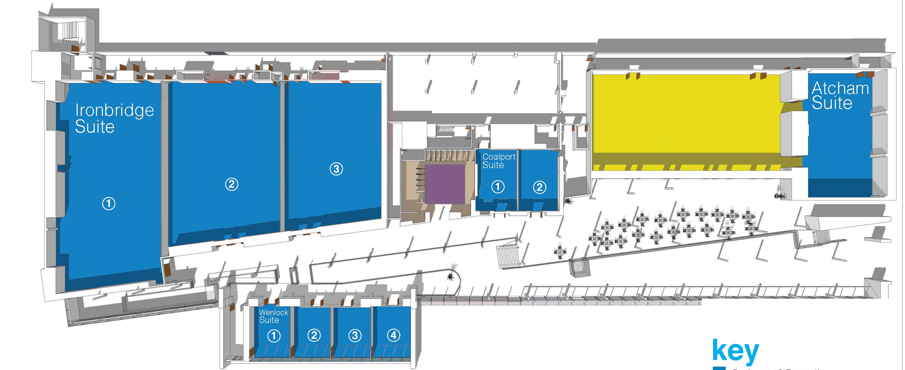
Venue Site Plan – First Floor

Slide 11
Site Traffic Rules
Loading / Unloading During Events
Report to the Gate House on Arrival and follow instructions and directions given by Security Personnel
Vehicles entering the TIC grounds must conform to speed limits and road signs
Do not park on double yellow lines or hatched areas
Do not park of pavements or pedestrian walkways as this may obstruct pedestrians
Slow down when approaching junctions, narrow roadways and in areas of congestion
Avoid obstructing points of access or exit
When a pass system is in operation always display your pass in the vehicle
A queuing system for loading / unloading on occasions will be in operation

Slide 12
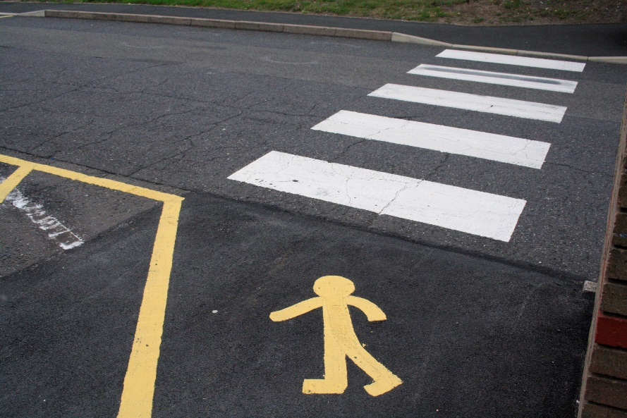
Site Traffic Rules
Loading / Unloading During Events
Adhere to times allocated for loading / unloading given to you by Security personnel If you experience difficulties and cannot complete your loading / unloading on time then please inform a member of Security who may be able to extend your time
A ‘One Way’ system on occasions will be in operation. Follow instruction and directions given by Security at this time
Once you have unloaded your vehicle you will be directed to a car park
Request Banksman assistance from Security personnel before reversing your vehicle if over 7.5 tonnes
All pedestrians please be aware of
vehicles loading and unloading and
moving / reversing vehicles including
forklifts. Always use designated
pedestrian walkways
Vehicles parked in unauthorised areas
may be removed by TIC

Slide 13
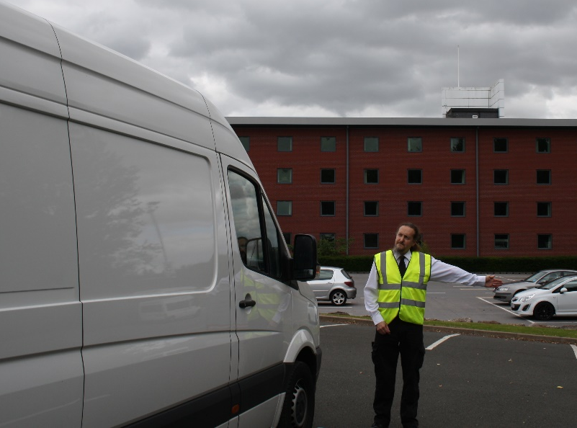
Site Traffic Rules
Always adhere to the speed limits which are identified on road signage around the site (5 MPH)
Please report any dangerous activity to the Duty Manager on 07790346741 where required
Information
We will always strive to assist drivers in getting on and offsite and quickly as possible. Processes are designed to speed up the build / breakdown in an efficient and safe manner. Please be patient and follow instructions given to you by Security Personnel.
TIC will monitor and review procedures and make amendments when and where required

Slide 14
Internal Vehicle Movement Procedure
Vehicle access to Halls at is restricted to achieve maximum efficiency and safety.
This procedure must be agreed by the Event Manager and the Event organiser before the procedure is implemented. No vehicles are to be allowed into the halls without prior agreement.
Drivers must follow instructions from TIC Security personnel before entering the hall
Dedicated stewards dressed in high visibility clothing will walk in front of vehicles taking drivers to the pre-arranged designated plot within the building
All vehicles must display hazard-warning lights during movements and be restricted to a speed not exceeding the walking pace of the steward directing them
No more than two moving vehicles will be allowed in any one hall at any time *
Drivers must not move vehicles within the halls until a designated Steward is available
A one way system may be in operation
*This rule may be altered at the discretion of the Security Manager only and subject to the event Risk Assessment.

Slide 15
Internal Vehicle Movement Procedure
Reversing is not allowed without a trained Banksman present. This will need to be requested from Security personnel
Engines must be switched off once at a standstill
No vehicles can enter the hall during break down until ALL members of the public and children under 16 years have exited from the hall and it is safe to do so
Exhibitors wishing to carry their items without bringing vehicles into the hall will be encouraged to do so
Vehicles will not be allowed into the hall until everything is packed and ready to load
Vehicle movement is not allowed during the open hours of the event
Anyone found not to be following this procedure may be asked to leave site.
This procedure is designed to speed up the build / breakdown in an efficient and safe manner. Please be patient and follow instructions given to you by Security Personnel. TIC will monitor and review procedures and make amendments when and where required.

Slide 16
Breakdown Procedures
Familiarise yourself with the breakdown procedures and timings as issued from the event organiser. This is key to ensuring the understanding of arrangement and co-operation in maintaining a safe environment.
It is essential that breakdown does not commence until all visitors have left the halls and the all clear is given.

Slide 17
Breakdown Procedures
TIC Site Rules
Please also be aware of site rules, ensuring that this information is passed on to all contractors and exhibitors working at the TIC.
No persons under the age of 16 are permitted in the exhibition Halls during these periods
No vehicles will be allowed to load / unload or enter / exit the venue until
authorised by a member of the venue security team
3. No large items i.e. pop-up stands or trolleys may be taken through any of the main
public entrances. All equipment must exit the building via the fire exit doors/ roller
doors at the rear and side of the Halls
4. Stands must not be broken down until all public are clear from the hall
Fire doors/ roller doors at the side and rear of the halls will not be opened until the
venue security team are happy that the area is clear of general public, and the
Event Manager gives approval to do so.

Slide 18

Smoking
TIC in a No Smoking Venue. This includes e-cigarettes
Smoking is permitted in the designated smoking area adjacent to Hall 1

Slide 19
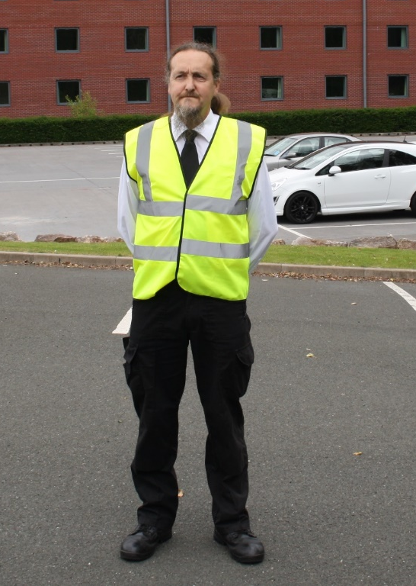
Site Rules
During all event builds and breakdowns ALL staff,
organisers and contractors are required to wear
hi vis clothing.
Hi vis vests are available to purchase from TIC reception,
however it is advisable to bring your own
It is advisable to wear safety shoes within the CDM site
Fire routes must be kept clear from obstruction at all times
No hot works can take place without a hot works permit being issued
Any person suspected to be under the influence of drugs or alcohol will be ejected
Only persons who have received suitable training are permitted to operate plant or machinery (including fork lift trucks)

Slide 20
Thank you for
your co-operation

