Slide 1


How to better valorise sustainable proteins and their by-products?
Frédéric BAUDOUIN

Slide 2
Who are we?
The first open European R&D platform dedicated to the extraction and transformation of sustainable proteins (plant-based, insects, micro-algae, yeast, precision fermentation…)
30 employees, 800 m² pilot plant facility / 170 m² lab, ~ 20 m€ investment to date
Mission: Support ingredient producers and food manufacturers in their R&D
Since 2013: 700+ customers, 6 patents
Amiens, France

Slide 3


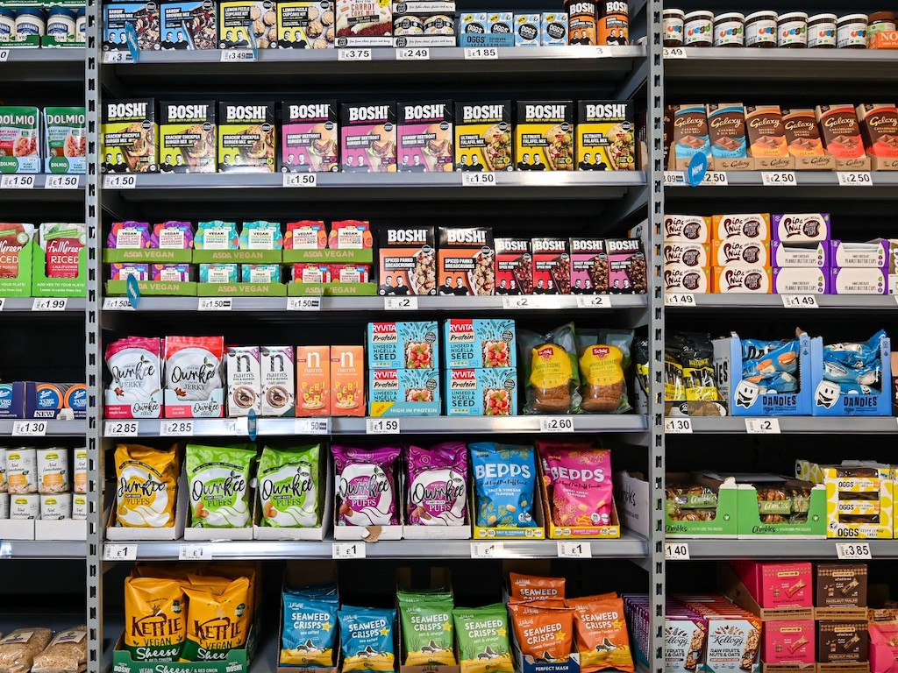
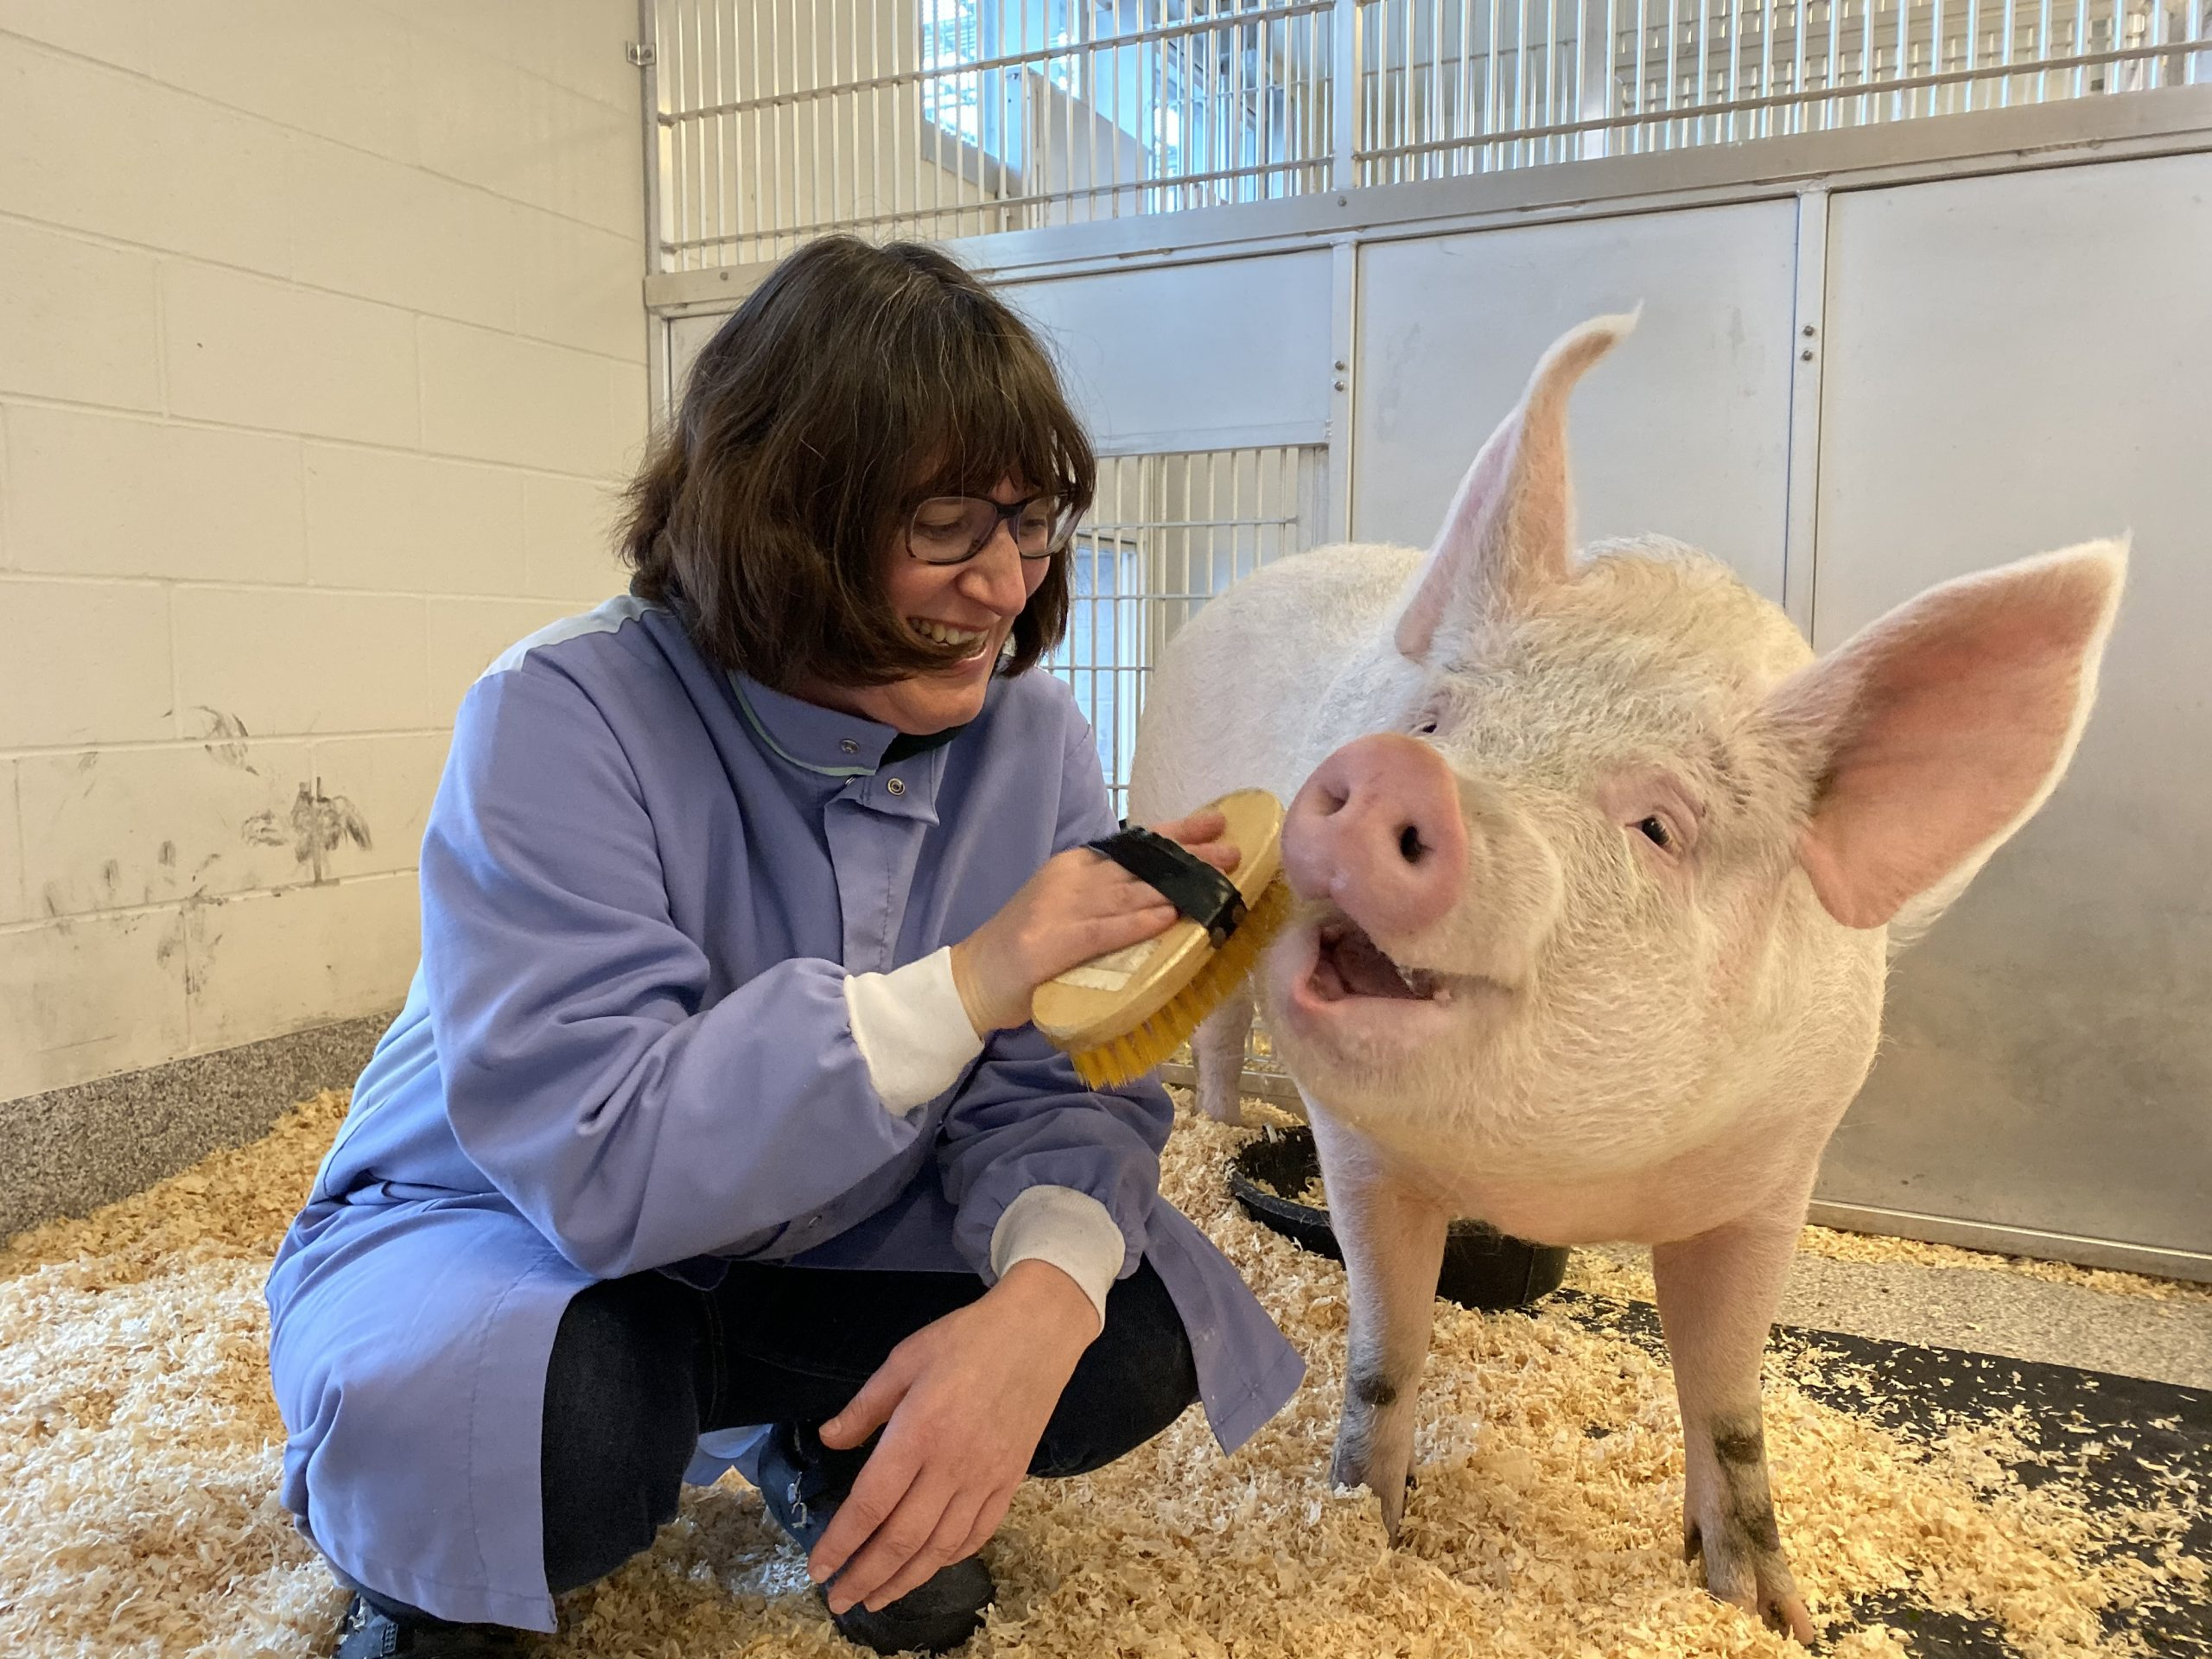

Successes and current challenges of the sustainable protein market
Why sustainable proteins?
Feed growing population
Reduce CO2 emissions and land uses
Develop a new market
Animal welfare
Cheaper alternatives
What has been achieved in the last 10 years?
Development of novel extraction and transformation processes
Dozens of new factories in B2B / B2C
Significant growth of dairy alternatives and high-protein market
Price parity with meat in some areas
Offer > demand: how can we increase sustainable protein consumption?
“Ultra-processed” controversy
How to further improve quality, cost and environmental quality?
How can we do even better?

Slide 4



Case study – Production of pulse protein concentrates
100
Grain
Dehulling
15%
Hulls
15
Only 5-10% of initial grain used for food transition
How can we increase the proportion of protein concentrate in human food?
How can we valorise by-products in human food?
85%
Kernel
85
Air-fractionation
67%
Starch concentrate
57
70%
Feed, petfood
20
33%
Protein concentrate
28
Human
8
30%

Slide 5
Case study – wet processes
Pulse protein isolates
Plant-based milk
Grain
Grain
Dehulling
Hulls
Dehulling
Hulls
Alkaline extraction
Starch
Hot grinding
Acid precipitation
Molasse
(albumins, sugars)
Decantation
Okara
Protein Isolate
Plant-based milk

Slide 6
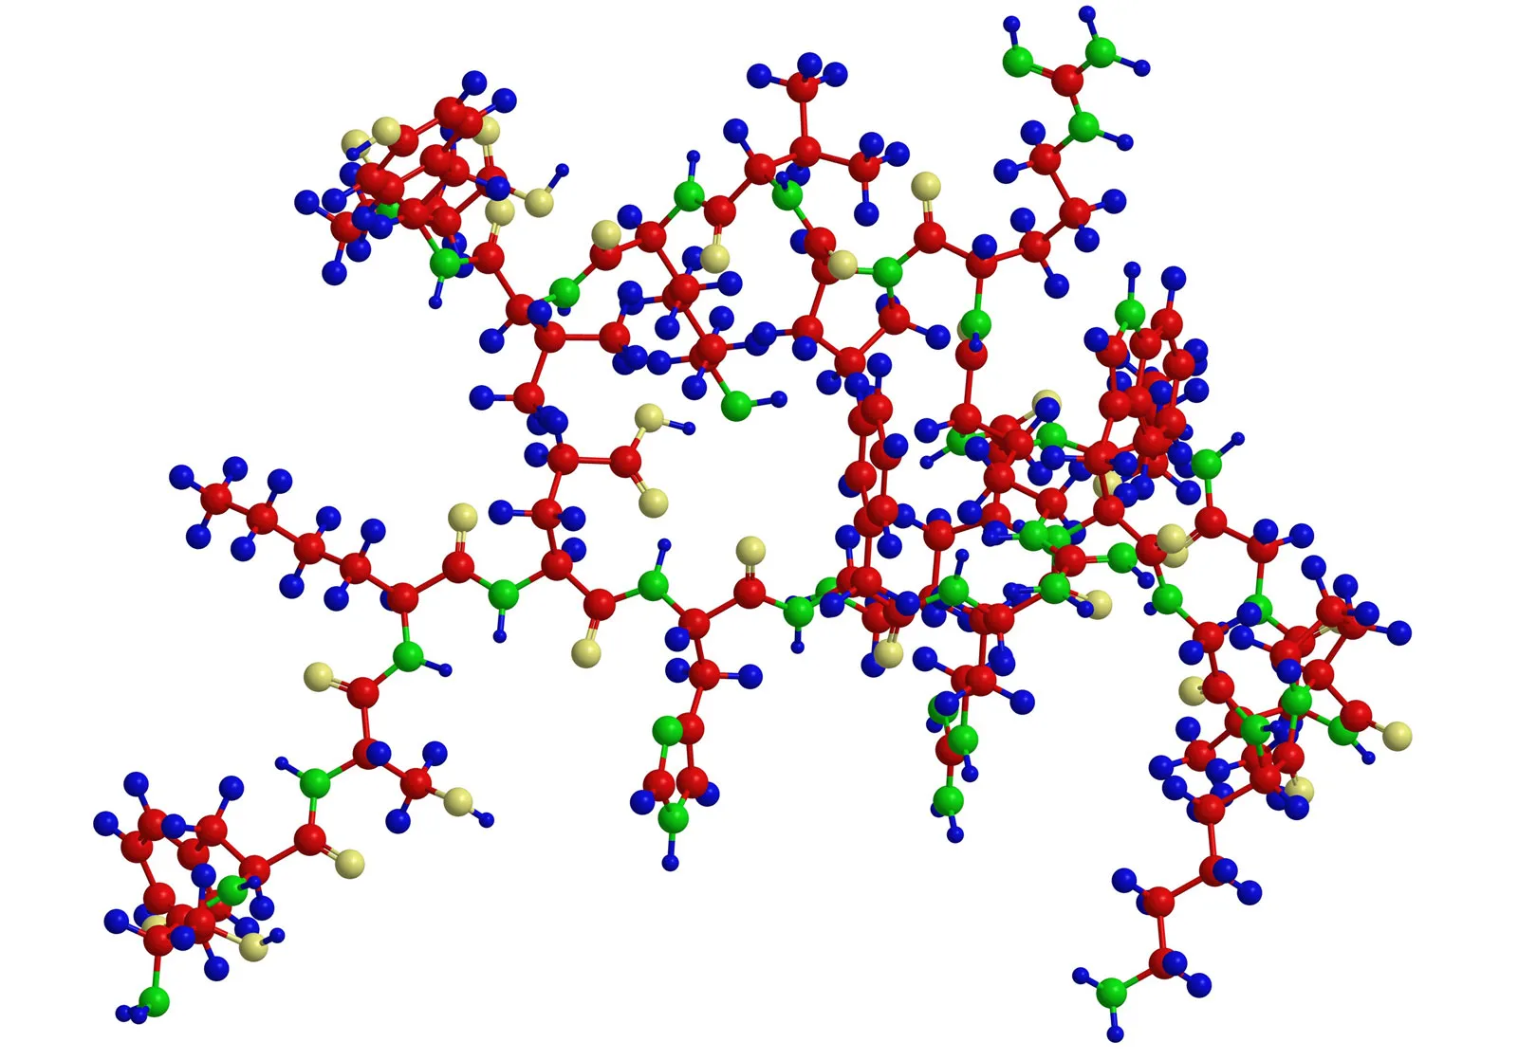
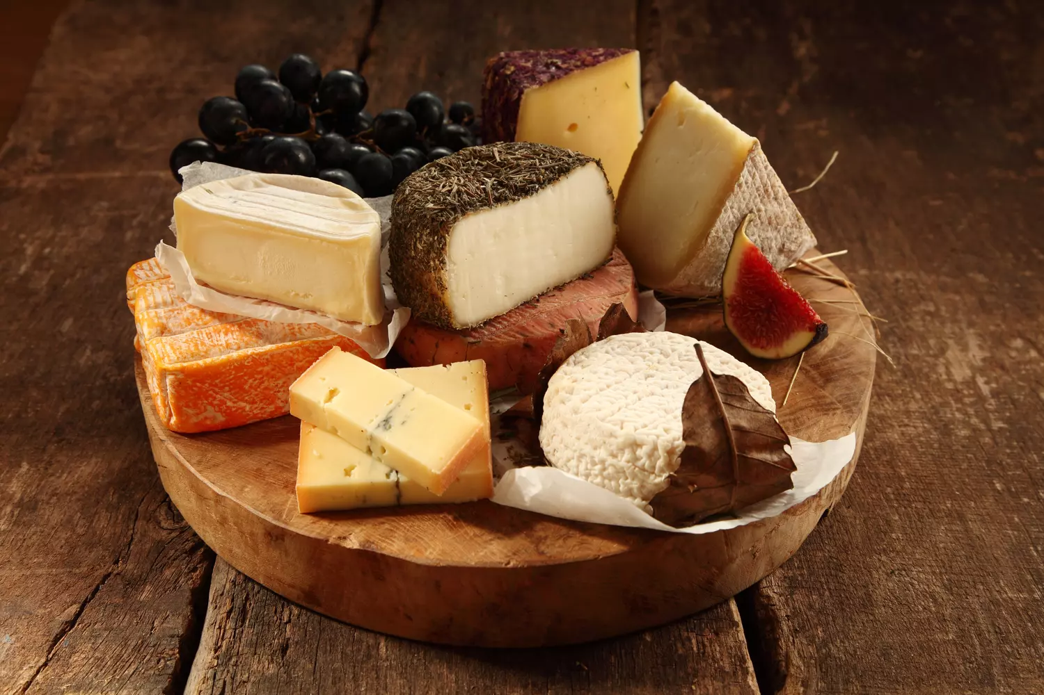

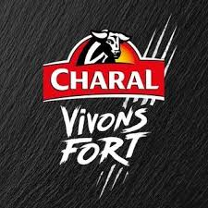

Implications of protein-centric vision
Valorisation of non-protein components of resource (plant, yeast, waste) not integrated early in the project in process definition, economic and environmental balance
Marketing bias: animals not consumed just for protein
★ Nutrition
★ Organoleptics
★ Convenience
We must fulfil all the reasons we eat animal-based foods, and not just providing the protein
How can we both valorise a bigger part of the grain and bring benefits similar to animal-based foods?
Why do we eat animal-based foods?
★ Beliefs
★ Social experience

Slide 7
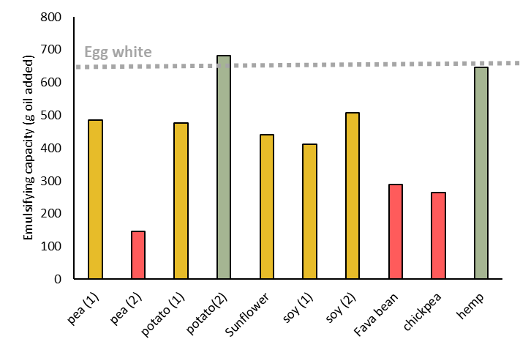
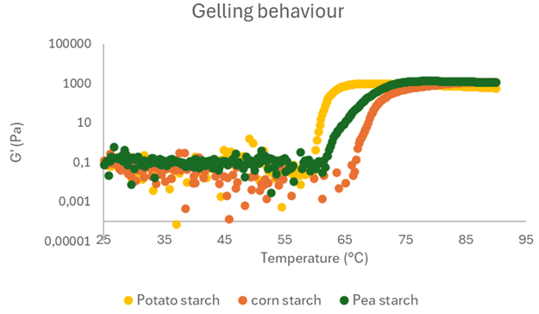
Plant-based molecules are valuable
A diversity of molecules, with a large range of functional properties
Protein
Starch
Fibers
Sugars
Structure made of …
Nutrition benefits …
Differ in …
Functional uses:
Aminoacid chains
Essential a. a.
4 levels of structure
Gel / emulsion / foam
Glucose polymers
Long energy release
Amylose / amylopectin
Viscosity, Gelling
Polysaccharides
Microbiota, intestin
Cellulose, pectin,…
Viscosity, gelling
Oses
Probiotics, digestion
digestibility
Prebiotics, fermentation
Protein emulsifying capacity
Starch gelling behaviour
With strong differences between resources

Slide 8
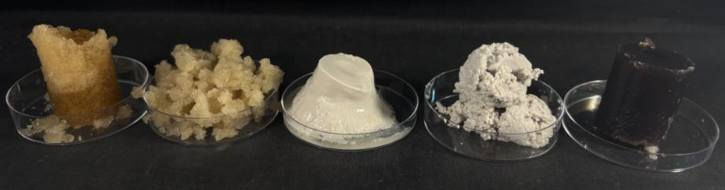
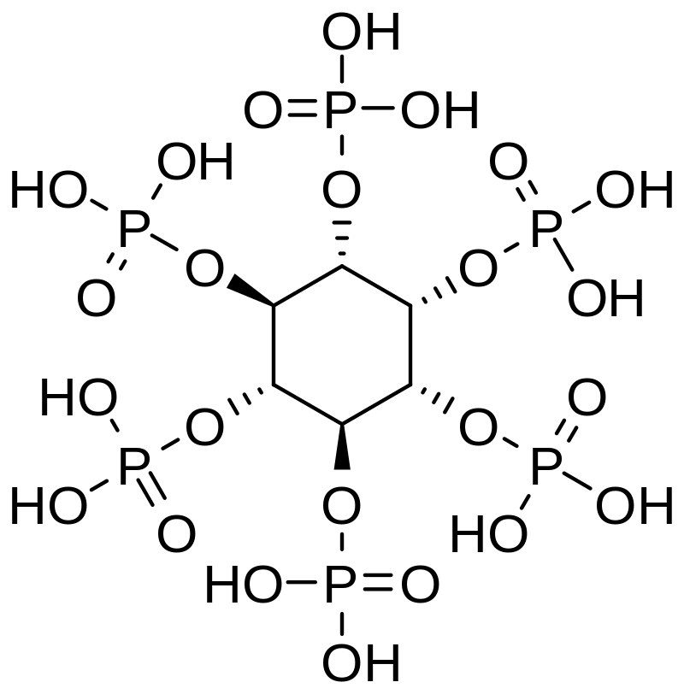
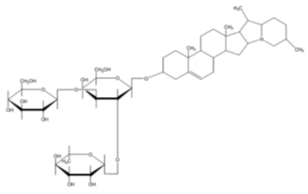
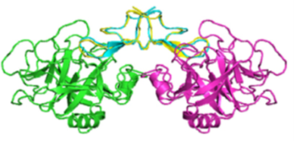
Plant-based molecules are valuable
Still a lot to be discovered
Physico-chemical behaviour of novel sources still largely unexplored, which limit their applications
Thermal behaviour of a plant albumin, different pH
Phytic acid
Saponins
Enzymes
What about minor components?
And others…

Slide 9
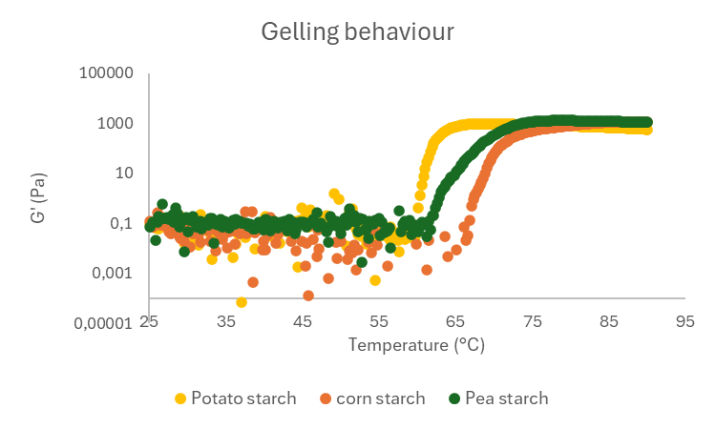
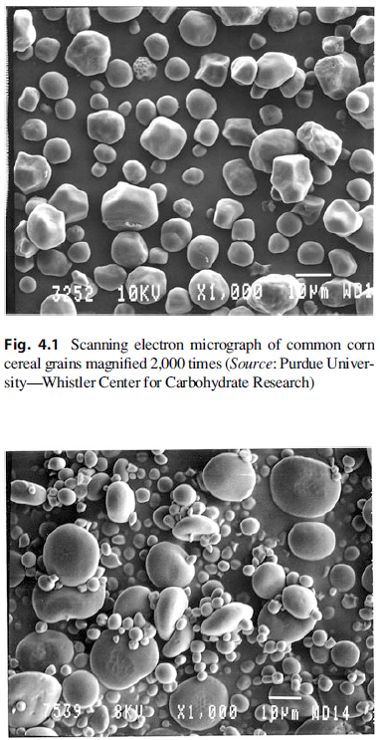
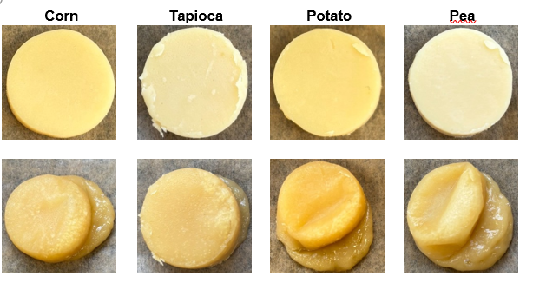
Case study – valorisation of pulse starch into cheddar-like
Difference in composition and morphology
Differences in functional properties
Starches from each resource intrinsically different one from another (here: texture and melting)
Opportunity to develop different applications
Benefits: organoleptics
Raw
After heating
Difference in applications (cheese analogues)

Slide 10
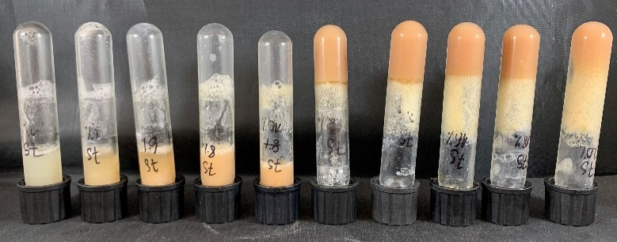
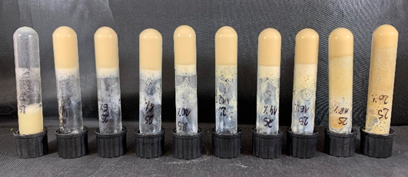
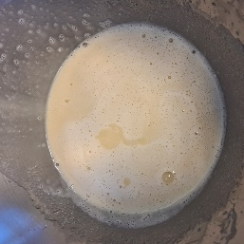
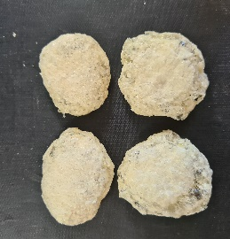
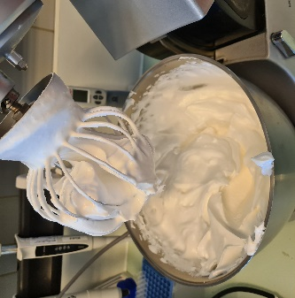
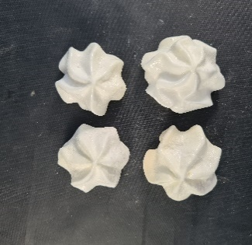
Case study – valorisation of albumins
Pea globulins Pea albumins
By-product from protein isolate production, needs additional (and quite complex!) process to be purified
Very different structure and physicochemical properties from conventional pea protein: smaller size, very soluble, often enzymes
Gels at 12% concentration
Gels at 4% concentration
(identical to egg white)
Pea globulins Pea albumins
Very different functionality from conventional pea proteins (globulins)
Benefits:  organoleptics (foaming, gelling)
Little foaming properties
Good foaming properties

Slide 11
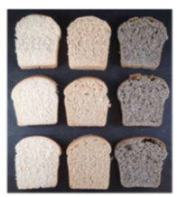
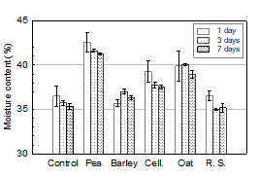
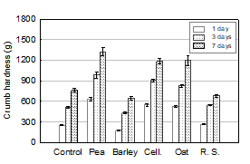
Case study – valorisation of fibres
Produced in large amounts for flour, protein concentrate and isolates
Blend of complex molecules (cellulose, hemicellulose, lignin, pectin, arabinoxylan…), soluble or insoluble
Deficiency in western diet
Impact on crumb structure
Impact on bread appearance
Impact in applications depend on fibre composition and physical properties (size, shape)
Benefits:  nutrition and health;  organoleptics
Impact on water retention
Impact on crumb texture

Slide 12
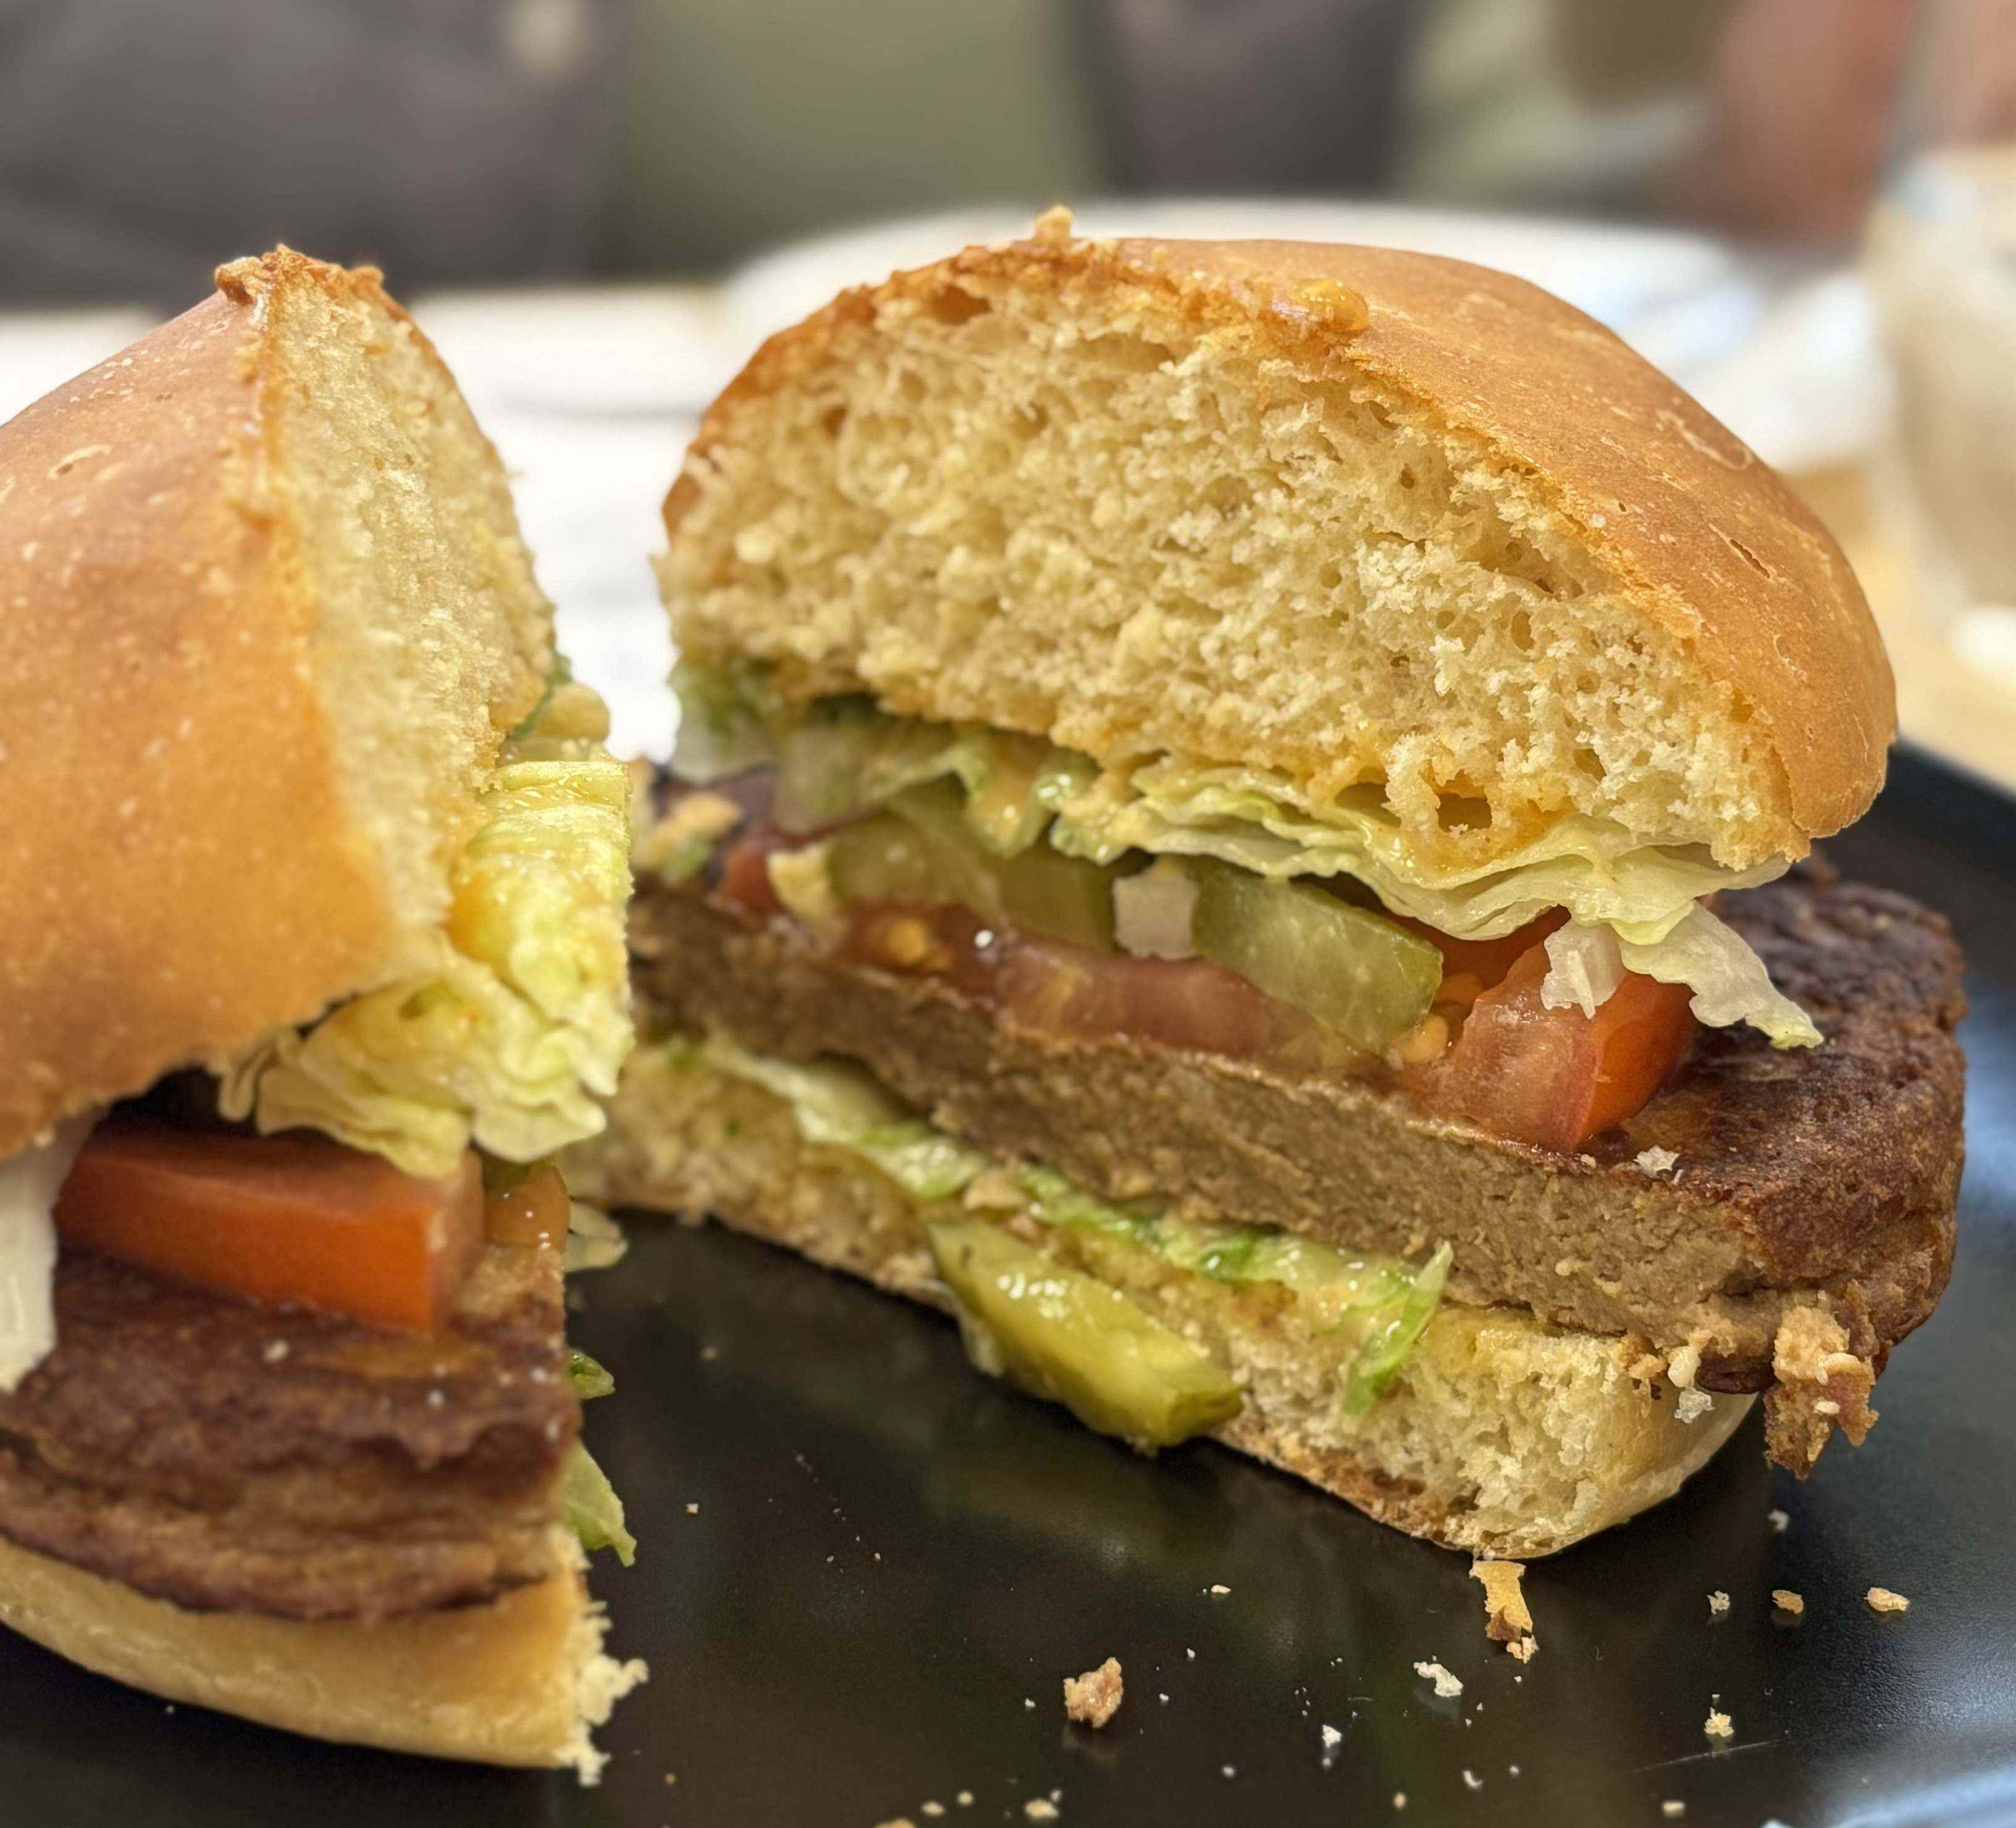
Recombination of fractionated molecules
Bread: enrichment in pea fibre: better nutrition, water retention
Cheese: enrichment in pea starch concentrate; better meltability
Burger: use of a blend of pea protein concentrate and pea protein isolate for production of textured pea protein; partial use of pea albumins as binder
Sauce: use of pea protein concentrate – protein fraction provides emulsification and residual pea starch provides a thicker texture and stability
“IMPROVE” pea burger
Benefits:  organoleptics,  nutrition,  convenience,  social aspect

Slide 13
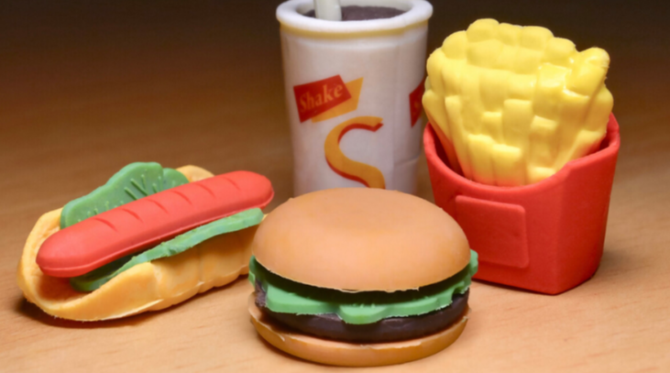

Strategy 2 – valorising the whole grain
Limit of fractionation / recombination strategy
Limit of unprocessed grain
“ultra-processed products to replace meat in school canteens: this is not food, this is chemistry”
RMC (French television), 05/04/2023
Pulses are long to prepare
⬆ Convenience; ⬆ organoleptics; ⬇ beliefs
⬇ Convenience
How to facilitate the consumption of whole grains?

Slide 14
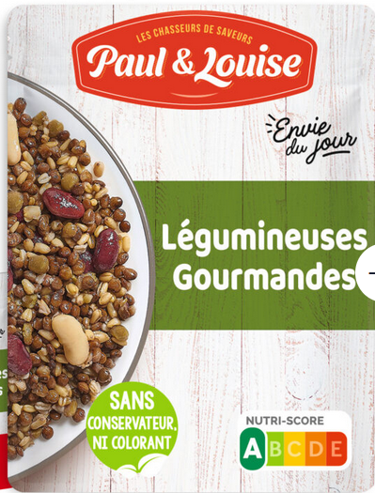
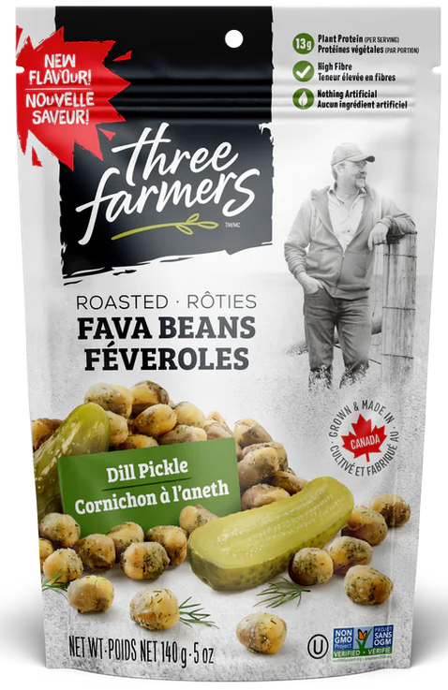
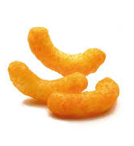
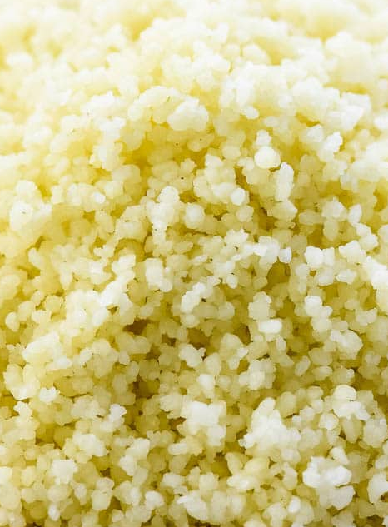
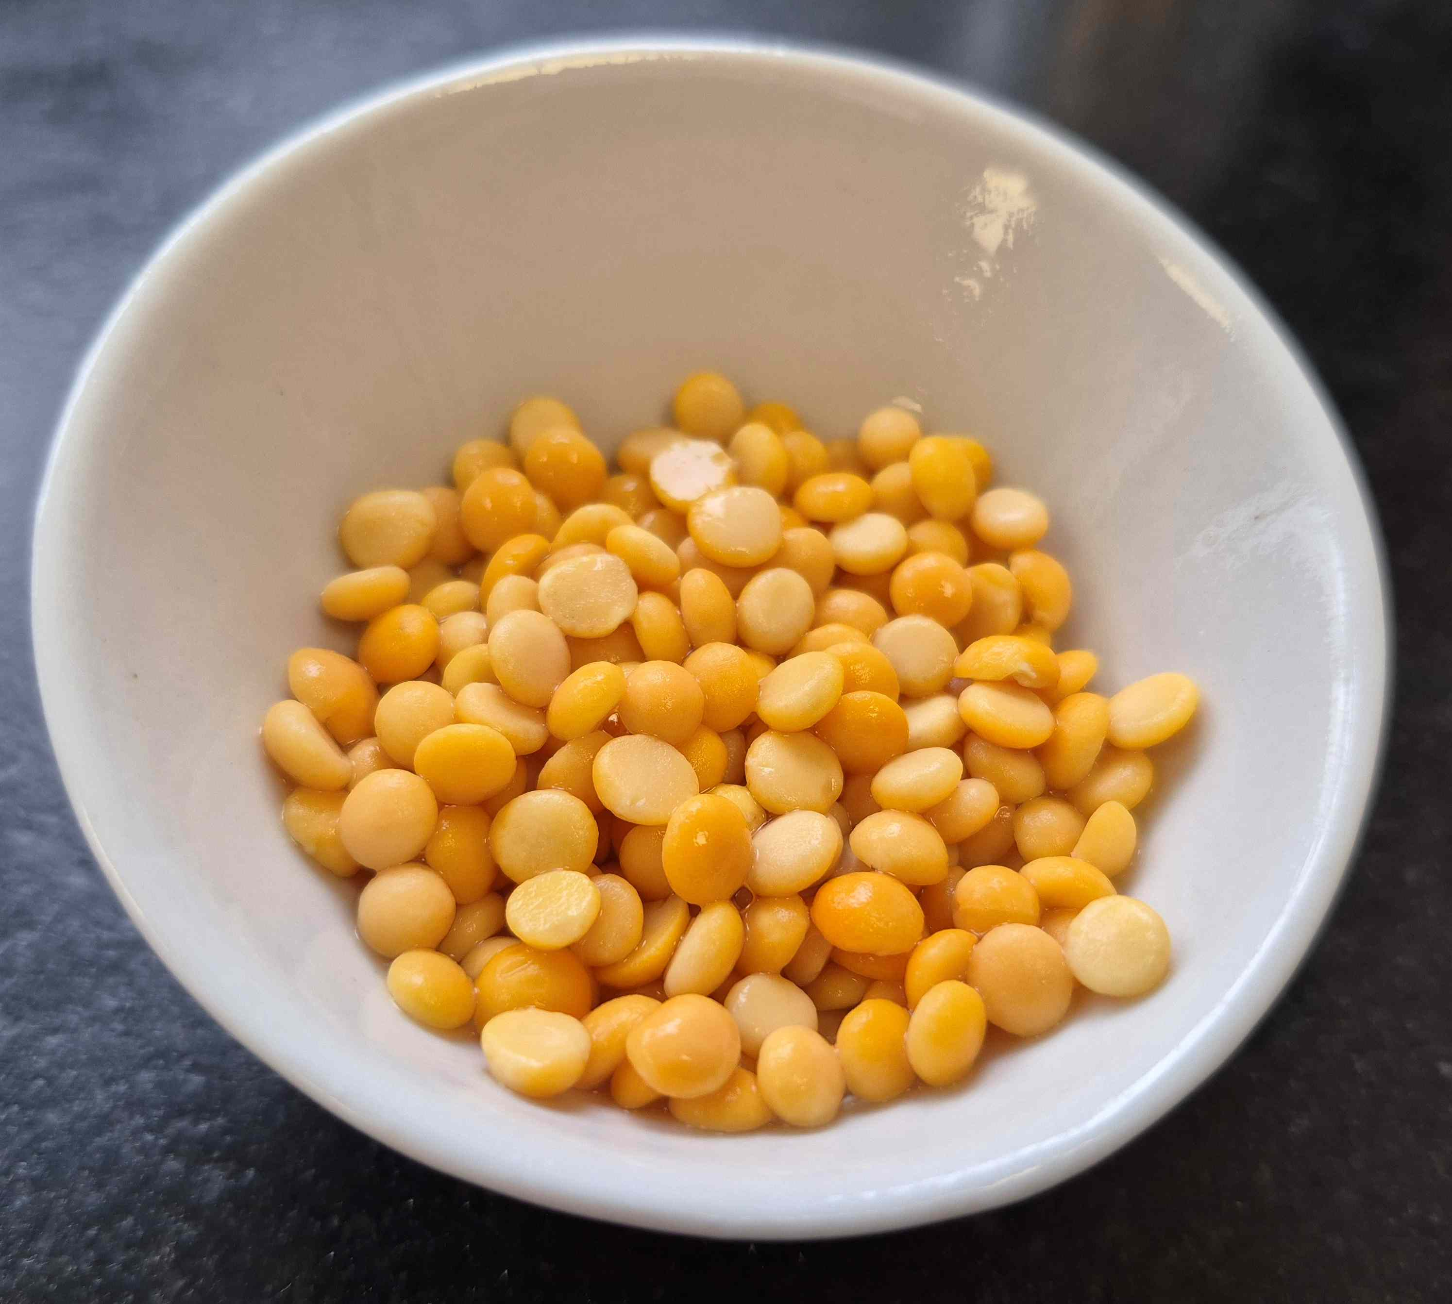
Some product concepts
Using novel technics to facilitate pulse consumption
2 min microwavable pulses
Pulse snacks
Pulse snacks
Pre-cooking
Aseptic filling
Toasting
Air fractionation
Extrusion
⬆ convenience, ⬆ nutrition, ⬆ organoleptics
⬆ convenience, ⬆ nutrition, ⬆ organoleptics, ⬆ social experience
⬆ convenience, ⬆ nutrition, ⬆ organoleptics, ⬆ social experience
Pulse pearls
Pulse couscous
Dehulling
Milling
Agglomeration
Abrasion
Pre-cooking
⬆ convenience, ⬆ nutrition, ⬆ organoleptics
⬆ convenience, ⬆ nutrition, ⬆ organoleptics

Slide 15
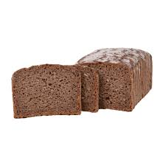
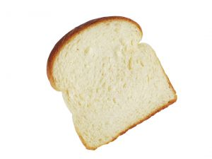
A third way – milder fractionation
Major difference between modern and traditional transformation processes: degree of purity of ingredients (sugar, oil, protein, starch…)
Elimination of some valuable phytonutrients
Need high CAPEX / OPEX, use of water and energy
Simplicity for formulation
Formulation goal:
25% protein,
20% lipid,
15% sugar
With purified ingredients:
A: 100% protein, 0% lipids, 0% sugar
B: 0% protein, 100% lipids, 0% sugar
C: 0% protein, 0% lipids, 100% sugar
Solution is easy
%A: 25%
%B: 20%
%C: 15%

Slide 16
A third way – milder fractionation
Major difference between modern and traditional transformation processes: degree of purity of ingredients (sugar, oil, protein, starch…)
Elimination of some valuable phytonutrients
Need high CAPEX / OPEX, use of water and energy
Simplicity for formulation
Formulation goal:
25% protein,
20% lipid,
15% sugar
With less purified ingredients:
A: 55% protein, 12% lipids, 15% sugar
B: 8% protein, 80% lipids, 5% sugar
C: 15% protein, 6% lipids, 60% sugar
Solution is more complicated
%A: 39%
%B: 18%
%C: 13%
But the solution exists

Slide 17
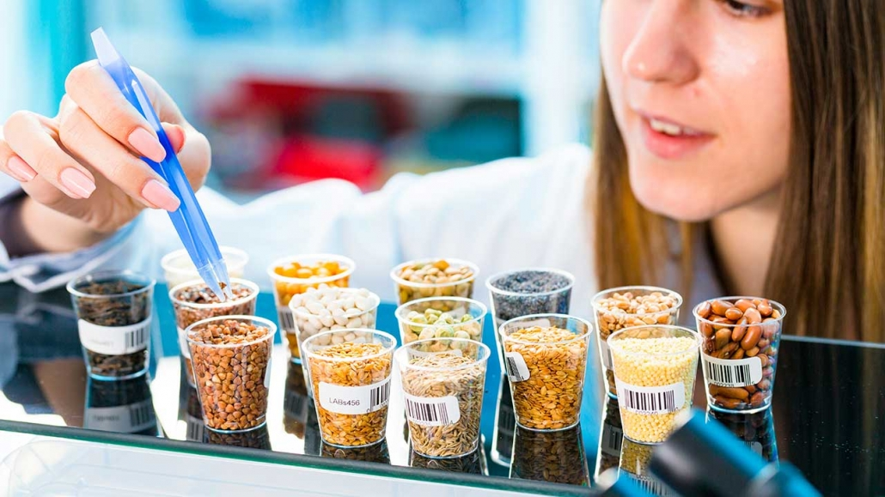
Promoting less refined ingredients in formulation
Transposition to the ‘’real world’’ of formulation:
less purified ingredients may contain undesired off-flavours, colours, textures, viscosity… making formulation more difficult
Less purified ingredients also brings distinct advantages:
« contaminants » may replace additives in the recipe, bring nutritional benefits, have a much lower cost and a much better environmental balance
Only viable if ingredients producers and food manufacturers are ready to change practices

Slide 18
Key takeaways
Current sustainable protein ecosystem focusses on animal protein substitution
Protein intake is not the only reason we consume animals; we also like its organoleptics, convenience, social experience, among others
Non-proteins components of plants are diverse in physicochemical properties and can bring significant benefits to vegetarian options like texture, organoleptics or convenience
They can be incorporated by different strategies: fractionation / reconstitution, whole grain transformation, or mild fractionation
For all strategies, the better knowledge of their physicochemical properties and clever use of technology is key to produce a good quality product

Slide 19
Thank you for your attention!
Technical enquiries:
frederic.baudouin@improve-innov.com
Commercial enquiries :
commercial@improve-innov.com

