Slide 1

The UK’s leading-low carbon innovation congress
SPEAKER PRE-EVENT HANDBOOK

Slide 2
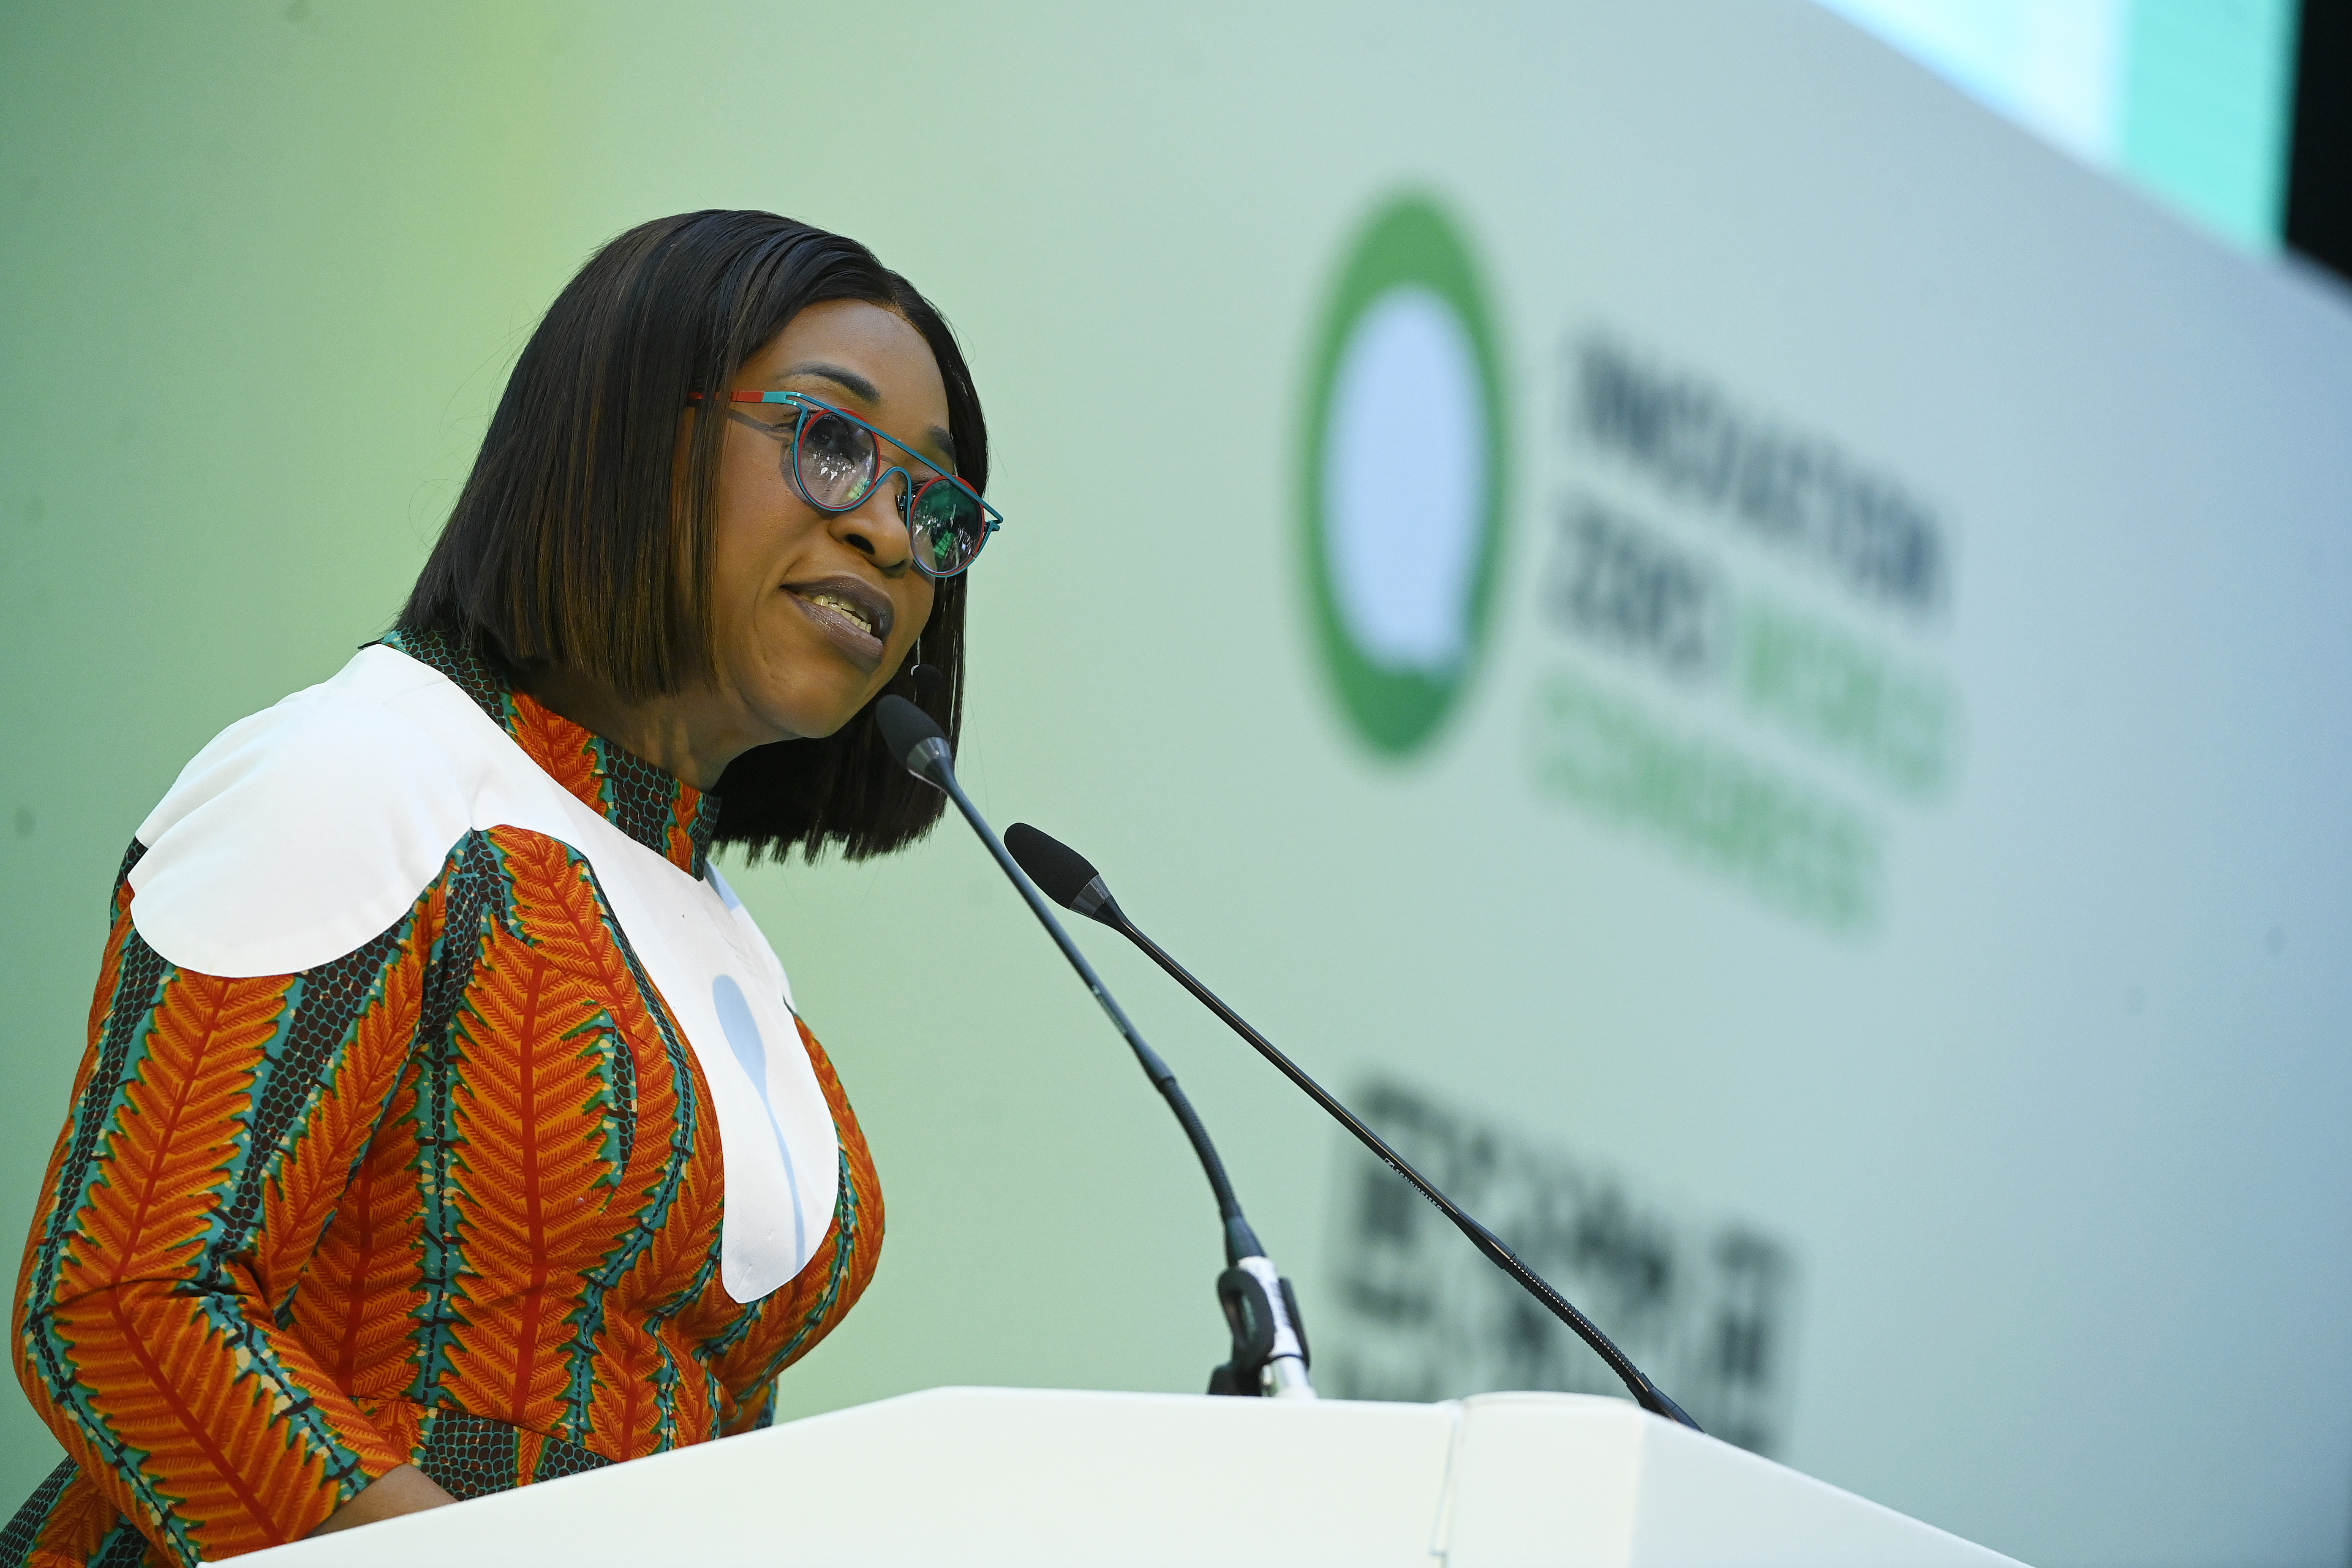
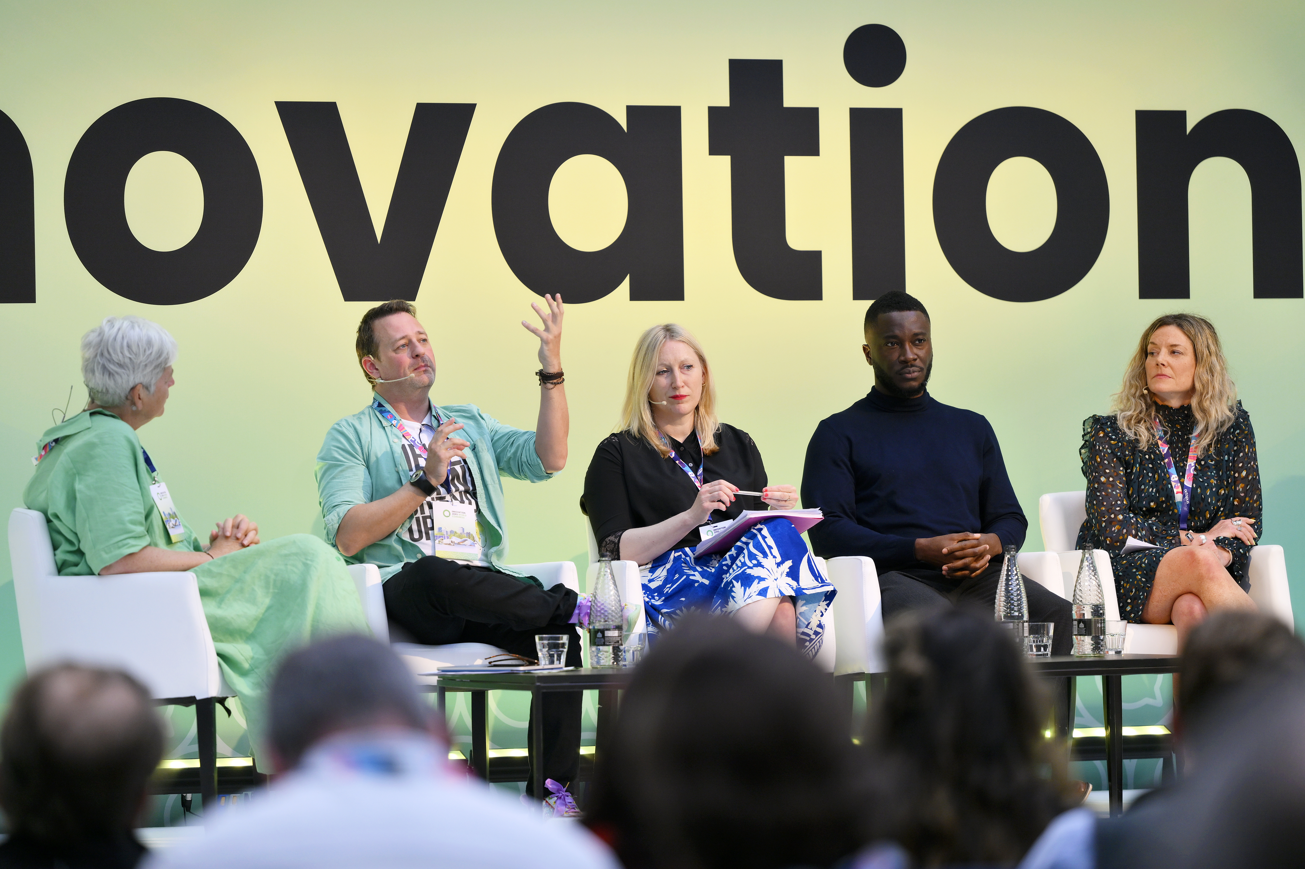
WELCOME!
We are excited to welcome you to the Olympia for the upcoming edition of Innovation Zero World.
The following handbook has been compiled to help you spread the word about your involvement as a speaker, and ensure you have a smooth and successful experience at the event.
If you need any assistance along the way, the Event Team is on hand to help. Please contact enquiries@innovationzero.com

Slide 3
WHAT WE SUPPLY TO OUR SPEAKERS
We supply speakers with the following assets – but if you’d like anything more bespoke, please do ask!
Speaker social media announcement card
Suggested copy to use on socials and in emails
Our logo and brand guidelines for any bespoke assets you wish to create
Email signature graphics

Slide 4




MARKETING COPY FOR PROMOTIONAL PURPOSES
For any outgoing communications with your network, please ensure that you share this unique link.
Social Media:
@_InnovationZero Innovation_Zero @_innovationzero InnovationZero / IZWorld26
*Note: please make sure to tag us in any social posts that you put out.
Event Tagline: The UK’s leading low-carbon innovation congress
Event Theme: Powering the future economy

Slide 5
EXAMPLE SOCIAL MEDIA COPY
General (Don't forget to add the unique tracking link to your posts).
Innovation Zero World Congress returns to Olympia London on 28–29 April 2026, convening 7,500+ senior decision-makers across energy, infrastructure, industry, finance and policy. Join the organisations delivering a low-carbon future economy. Register now >> #InnovationZero#IZWorld26
Innovation Zero World Congress 2026 brings together innovators, investors, policymakers and corporate buyers to accelerate the delivery of a low-carbon future economy. Taking place at Olympia London, 28–29 April 2026. Register here >> #IZWorld26
Exhibitor & Audience Focus
Innovation Zero World Congress 2026 will welcome 300+ solution providers showcasing technologies and systems enabling a low-carbon future economy. 7,500+ senior leaders from the public and private sectors will attend to explore deployment, investment and partnership opportunities. Register here >> #InnovationZero #IZWorld26
Programme/Speaker Focus
300+ industry leaders and experts will take to the stage at Innovation Zero World Congress 2026, sharing practical insights on energy systems, infrastructure delivery, industrial transformation and finance - and how these come together to deliver a low-carbon future economy. View the full speaker programme here >>
I'm delighted to announce that I will be joining the [FORUM NAME] session, "[Session Title]" at #InnovationZero World 2026 (28–29 April)

Slide 6
EXAMPLE COPY FOR GUEST INVITATIONS
I'm pleased to offer you a complimentary guest pass to join me at Innovation Zero World Congress 2026 at Olympia London on 28–29 April. The pass provides access to all content forums, the exhibition and networking areas, bringing together policymakers, investors and industry leaders working to accelerate the transition to a low-carbon future.
I'd be delighted for you to join me at Innovation Zero World Congress 2026 as my guest. Your complimentary guest pass will give you full access to the content theatres, show floor and networking areas at Olympia London on 28–29 April. This is a great opportunity to connect with the organisations delivering the low-carbon transition in practice.
I'm pleased to share a complimentary guest pass for Innovation Zero World Congress 2026 (28–29 April, Olympia London). The pass includes access to all content theatres, the exhibition and networking areas.

Slide 7
EVENT DETAILS
(For larger comms, e.g. emails)
Name: Innovation Zero World Congress 2026
When / Where: 28th & 29th April 2026 / Olympia London
Event Description
Innovation Zero World, the UK's leading low-carbon innovation congress, will return to Olympia London for its fourth edition on the 28th and 29th of April 2026.
Our mission? To accelerate the delivery of a low-carbon future economy by connecting innovators, investors, policymakers and industry leaders to turn ambition into real-world action.
In 2026, Innovation Zero World Congress will convene 7,500+ senior stakeholders, 300+ speakers and 300+ solution providers, creating a focused environment for partnership-building, deployment and decision-making.
You can register as my guest here.

Slide 8
CARDS, BANNERS AND LOGOS CAN BE DOWNLOADED VIA THIS LINK
These digital assets can be used across:
Email signatures
Promotional emails and newsletters
Websites
Social channels
If you require graphics in specific dimensions or formats, drop us a message at enquiries@innovationzero.com

Slide 9


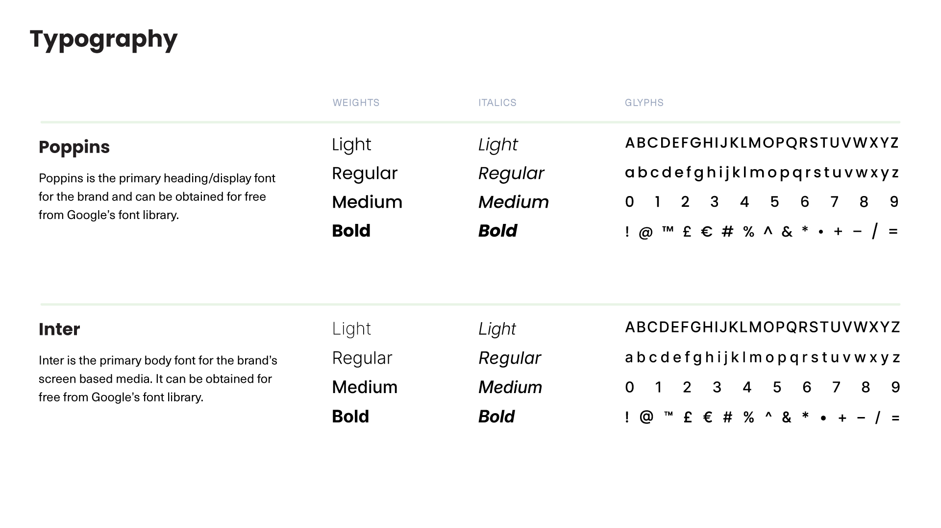
INNOVATION ZERO BRAND GUIDELINES

Slide 10
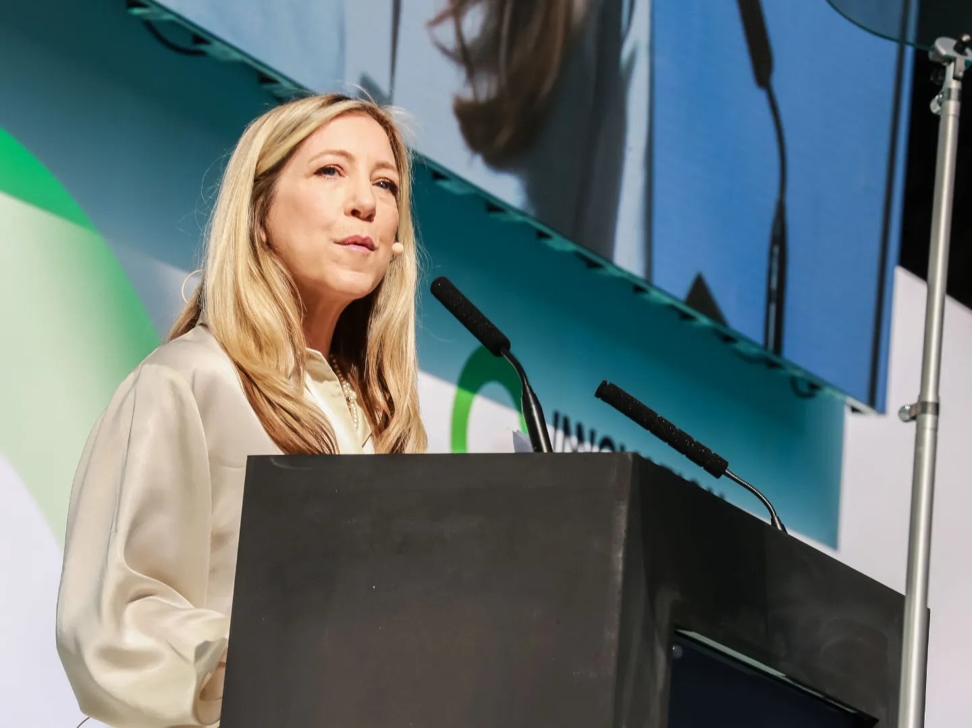
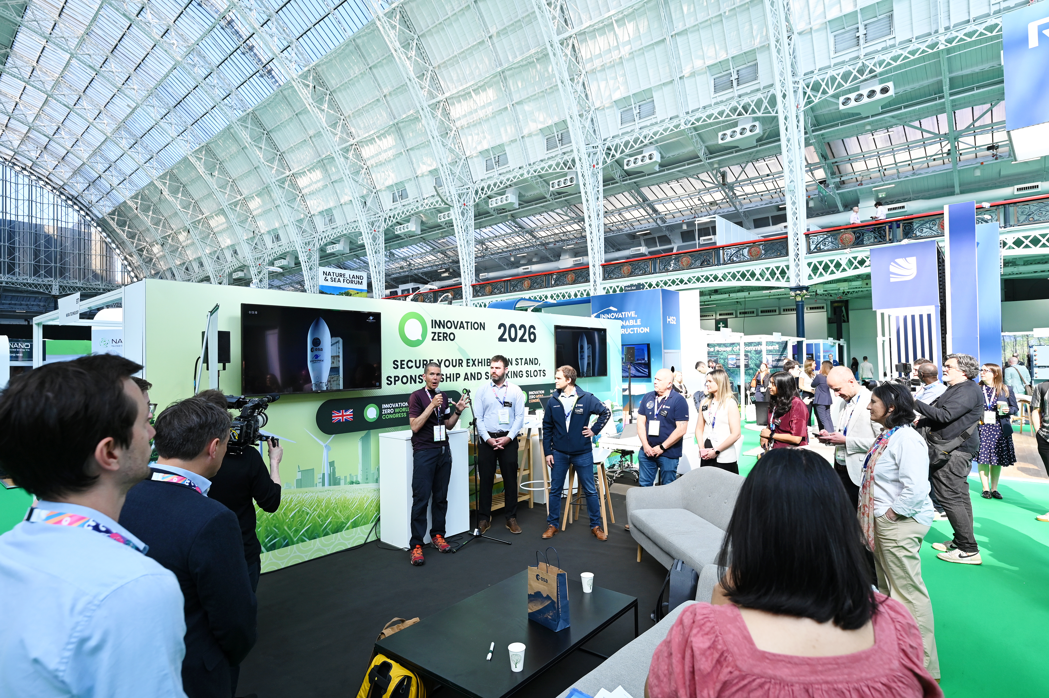
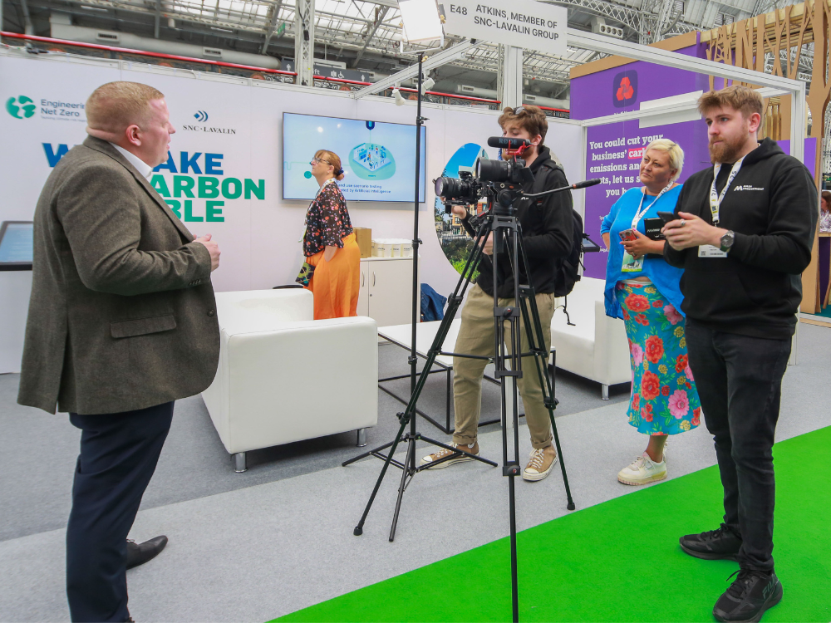
JOURNALISTS & PR AGENCY
Our Communications Partner, Madano, is a specialist energy and net zero agency and is available to support you if have any news or announcements to promote or are launching a new product or initiative at the event. They will be engaging with journalists ahead of the event and coordinating media interviews and our press room. Please contact InnovationZero@Madano.com by 31 March to discuss how our PR team can support you and so can consider including your information as part of our event amplification. This can include:
Spokesperson quote in our Innovation Zero World press releases distributed to UK national and trade media
Inclusion of your press release in our event press packs, which will be shared with media attendees in advance
Depending on the announcement, it could be used for media interviews with select journalists at the event

Slide 11
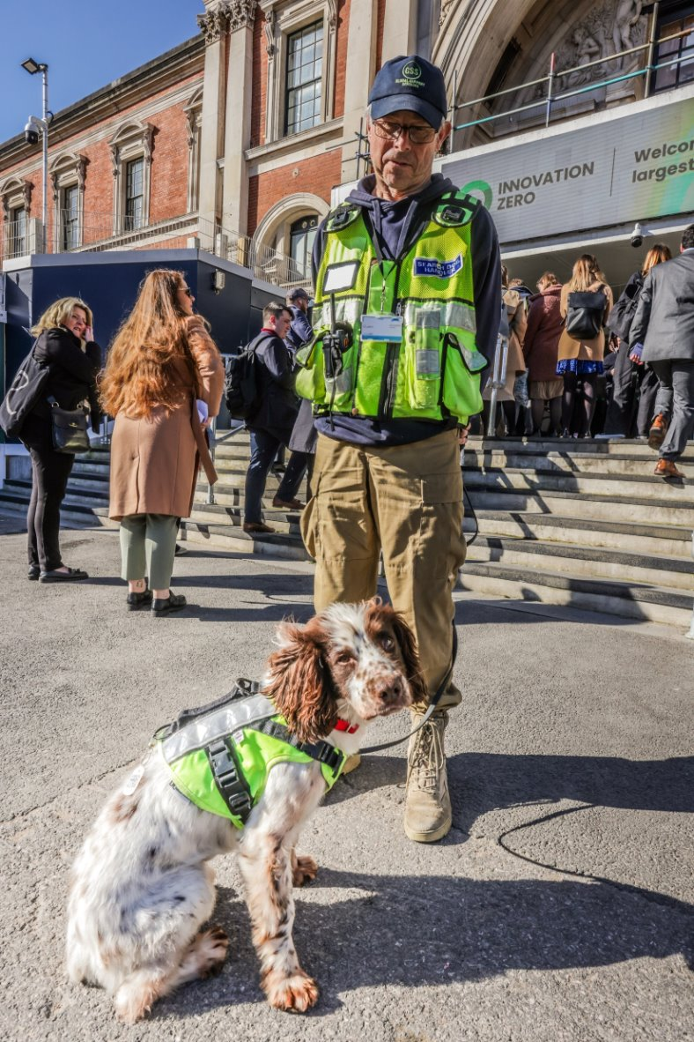
LOGISTICS
Upon arrival at the venue, please allow 30 minutes to complete security checks and collect your badge. There will be a designated Speaker Registration Desk for you to use.
Please check in at the Speakers’ Lounge at least 1 hour before your session time. You are free to use the facilities in our speaker lounge at any time during your visit to the show.
We will contact you if you have not checked in to the Speakers’ Lounge 45 minutes before your session is due to start.
30 minutes prior to your session, please make your way to your Theatre where you will meet with the Room Manager and our AV team, and be prepped to start (including mic set up).
As a speaker, you have full access to the event and are welcome to stay beyond your session to enjoy the rest of the event.

Slide 12
KEY CONTACTS, DATES & DEADLINES
Contacts
Speaker Management Team: speakers@innovationzero.com
Event Operations: eventoperations@innovationzero.com
PR & Media: innovationzero@madano.com
General Enquiries: enquiries@innovationzero.com
Dates & Deadlines
Speaker Webinar Briefing: 3rd March
Session Preparation Call: w/c 16th March to w/c 20th April
*Presentation Submission: 23rd April at 17:00 BST
Post-Event Feedback Submission: 8th May
*If you are unsure whether your session requires a presentation, please reach out to the Speaker Management Team.

Slide 13
TRANSPORT & ACCOMMODATION
Travelling from outside of London?
If you're planning on staying overnight for the event, you can find preferential rates for hotels in the area here, courtesy of our Accommodation Partner, Event Express.
Transport Links
Nearest Tube
Kensington (Olympia): Overground and Southern Rail Services (2-minute walk)
West Kensington: District Line (10-minute walk)
High Street Kensington: Circle and District Lines (12-minute walk)
Airport Access
Heathrow
Gatwick
Luton
Stansted
London City

Slide 14
SPEAKER CODE OF CONDUCT
Content Integrity & Quality
Any changes to your session title, topic or synopsis must be agreed in advance with the Event Content Manager.
Facts, figures, statistics and data must be accurate, appropriately sourced and time relevant.
Competitor organisations or products must not be referenced in a derogatory or misleading manner.
Professional Conduct & Inclusion
Speakers must treat fellow speakers, moderators, delegates and event staff with respect at all times.
Harassment, discrimination, intimidation or offensive language will not be tolerated, regardless of intent or context.
Speakers should foster constructive dialogue and balanced discussion, particularly where topics may be sensitive or contested.
Confidentiality & Inclusion
Speakers must not disclose confidential, proprietary or non-public information without appropriate consent.
Any relevant conflicts of interest, commercial relationships or financial interests connected to the session topic should be transparently acknowledged where appropriate.
Event Operations
Speakers are expected to adhere strictly to allocated timings and event logistics guidance.
In the event you are no longer able to attend, a suitable replacement of comparable seniority and expertise must be proposed and approved by the organisers.
Innovation Zero reserves the right to record sessions for editorial and promotional use.
Compliance
Innovation Zero reserves the right to moderate discussions, adjust session formats, or withdraw speaking privileges in the event of a breach of this Code.

Slide 15
TECHNICAL INFORMATION
Room Setup & AV Equipment:
Microphones (lapel or handheld)
LED screens
Clickers and laptops for presentation control
Stage/Room furniture
Technical Rehearsal:
You can use the screen(s) available in the Speakers' Lounge to run through and review your presentation and ensure all media files are compatible and tested in advance.
Familiarise yourself with the stage/room setup and microphone options.

Slide 16
UPLOADING YOUR PRESENTATION
Create or adapt your presentation using our template.
Visit our file-sharing platform.
Name the presentation using this format:
DATE – Forum/Stage Name – Time – Speaker Name – Presentation Title
e.g: 4th March – Main Stage – 12:00-13:00 – James Smith – MyPresentation.ppt
Any updated versions should be uploaded with a version number:
e.g: 4th March – Main Stage – 12:00-13:00 – James Smith – MyPresentationV2.ppt
Drop it into the upload box.
PLEASE NOTE:
Speakers MUST supply last minute updates/presentations on a USB. We strongly discourage the use of your own laptop as we cannot guarantee its compatibility with our system.
Presentations will be downloaded on 23/04/2026 at 5PM.
After 23/04/2026, the FTP server link will be closed, and you will not be able to upload your presentation.
Any presentations or updates after that date will need to brought to the venue on a USB stick.

Slide 17
PROTESTORS POLICY & SECURITY INFORMATION
As we prepare for Innovation Zero World Congress 2026, we're implementing precautionary measures in anticipation of any unforeseen disruptions or protests.
We kindly request your cooperation in fostering a respectful atmosphere and encourage you not to be deterred by any potential protests. Our dedicated Room Managers will provide guidance to ensure the smooth flow of your sessions.
In the event of disturbances, our patrolling security personnel will promptly address and manage the situation following Olympia’s protocols. Thorough bag searches and sniffer dogs at entrances aim to prevent disruptive items from entering the venue.
To uphold our commitment to fostering a productive and respectful atmosphere, any form of verbal or physical aggression will not be tolerated. If disruptive protests occur, we reserve the right to ask individuals impacting others' participation to leave the premises. Your cooperation in maintaining a positive atmosphere is greatly appreciated, and we encourage everyone to follow the guidance of our session hosts.
We have patrolling security in the halls who will be dispatched to any area where there has been a ‘disturbance’ (called into the organiser’s office via radio by the room manager) and those causing said disturbance will be ejected in line with both our security team and Olympia’s protocols.
If we believe any one session is at an increased risk of any disturbances, they should be flagged to a member of our team so we can have the patrol in the vicinity during this time.
In addition to our internal security measures, we collaborate with a third-party company to monitor social media platforms. Their role is to identify any plans or discussions related to targeting the show.
If you have any specific concerns, please let us know.

Slide 18
FAQs
What happens if I need to cancel my participation?
Notify the Speaker Management Team as soon as possible.
Will there be a speakers' lounge?
Yes, the lounge will be available with refreshments and networking opportunities. This will be located in the Grand Hall next to the Main stage Green Room., which is situated on the Ground Floor, on the far right-hand side.
What should I wear?
Business or business casual attire is recommended, but not compulsory.
Will my session be recorded?
Only Main Stage sessions are being recorded this year.
Can I promote my company during my session?
While self-promotion should be minimal, speakers are encouraged to mention relevant work within the context of the discussion.

Slide 19

FURTHER SUPPORT
If you require any further support, please contact:
Agaba Banya
Senior Marketing Executive
agabab@innovationzero.com
Jonathan Marriage
Content Manager
jonathanm@innovationzero.com

