Slide 1


Slide 2
Who are Boosters?
Since 1997 we’ve been pottering around West Cornwall producing branded merchandise for companies large and small, local and national and dare we say we’ve done it quite well – a multi award winning company who regularly perform well in industry polls.
But we wanted to do more, so…..

Slide 3
Welcome to the New Boosters…
what’s different?
Nothing
The core that has made Boosters so strong for 28 years remains - Great service, experienced and knowledgeable.
Just now we have a new logo, and a more focussed vision for the future – and rather than tell you about yourselves…
we’re shouting about it

Slide 4
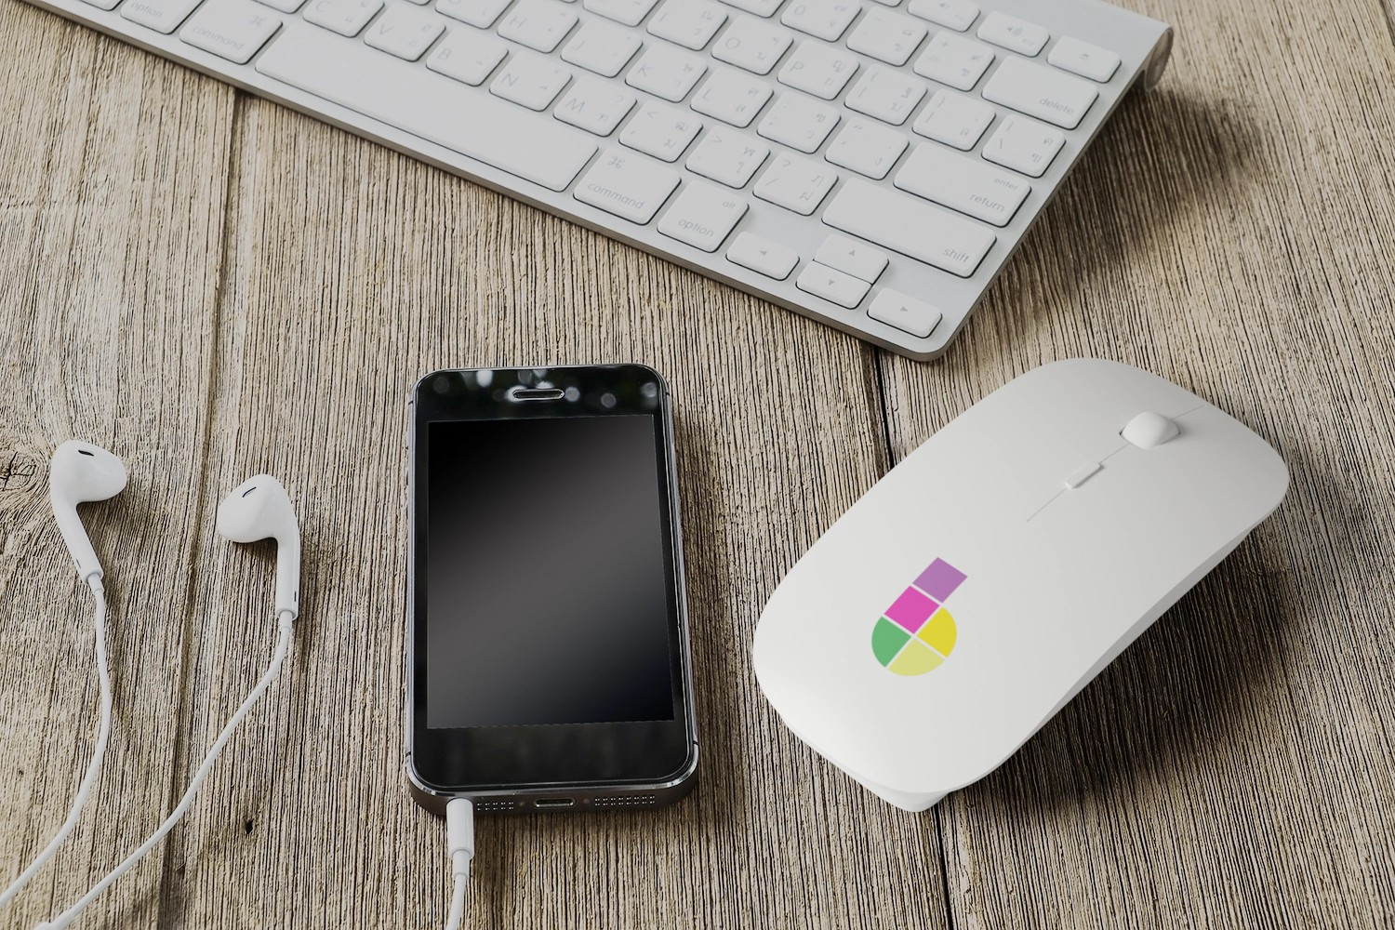
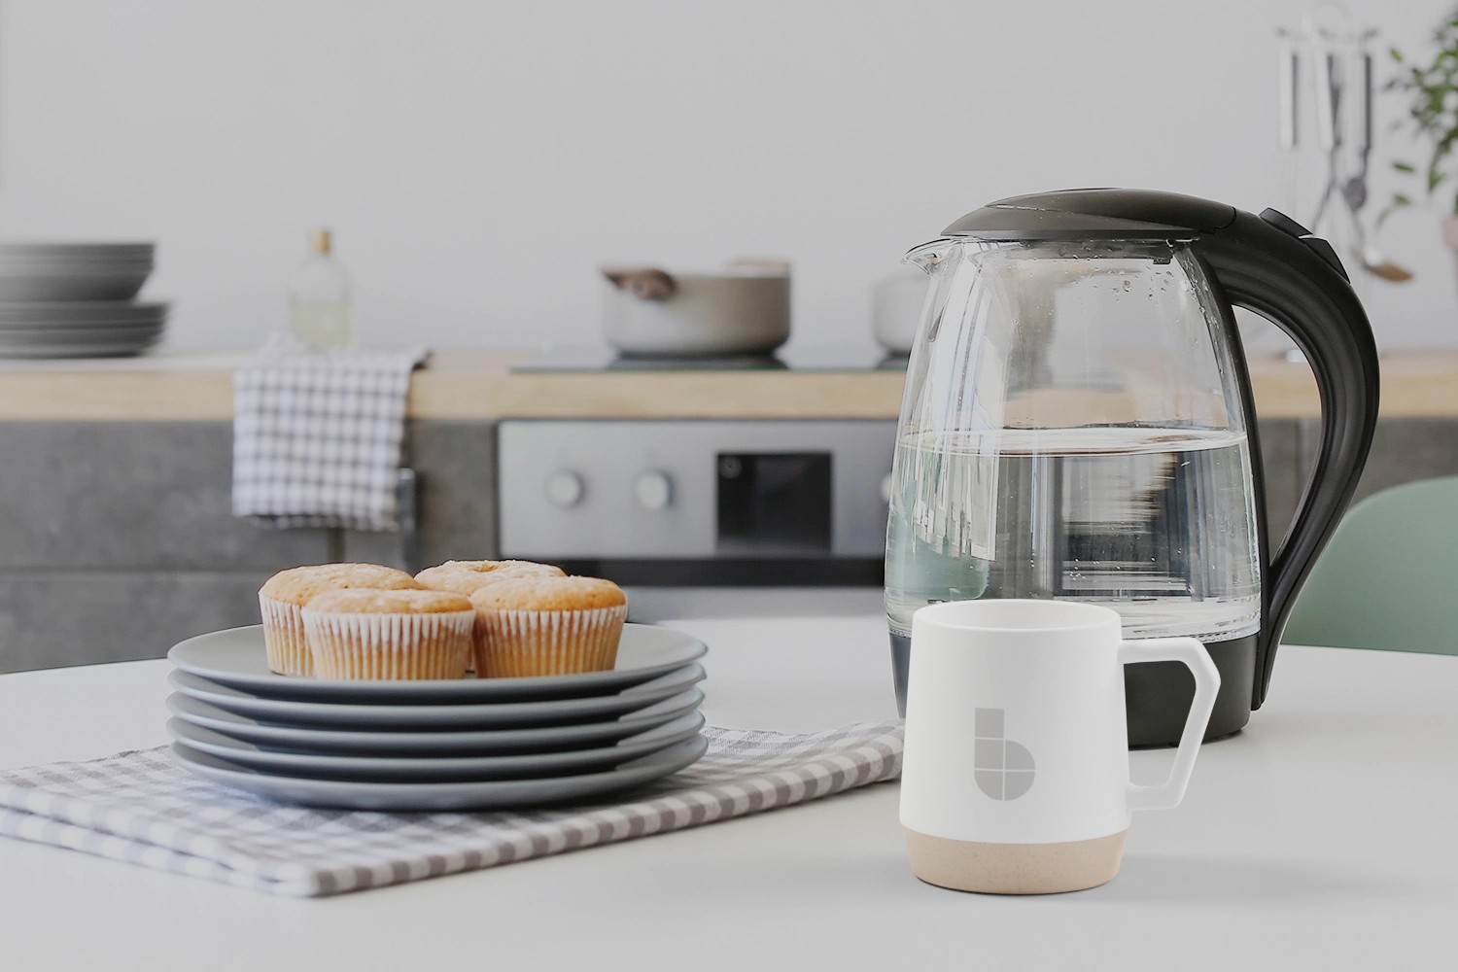
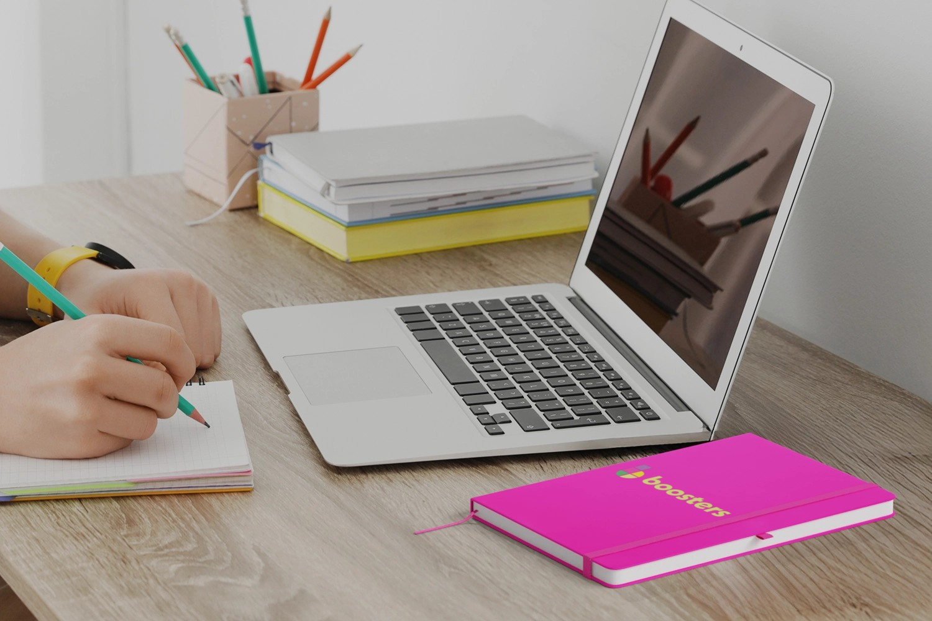
Why do you need us?
Branded promotional merchandise will make an impact with your clients & will be remembered longer than many other forms of advertising – in fact 75% of people surveyed say they could recall or were still using a promotional item given to them from up to 12 months previously.

Slide 5
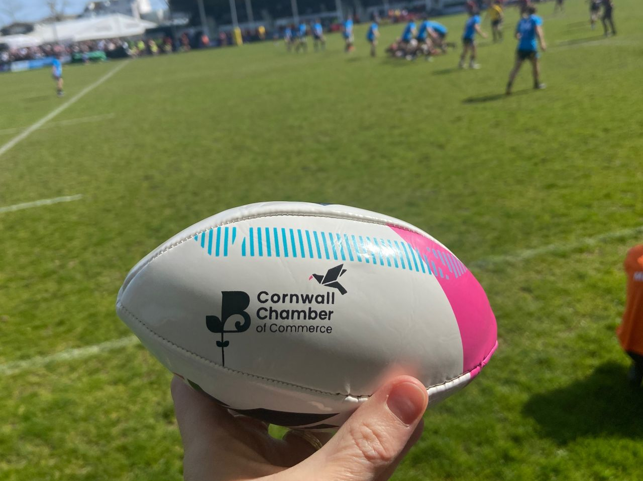
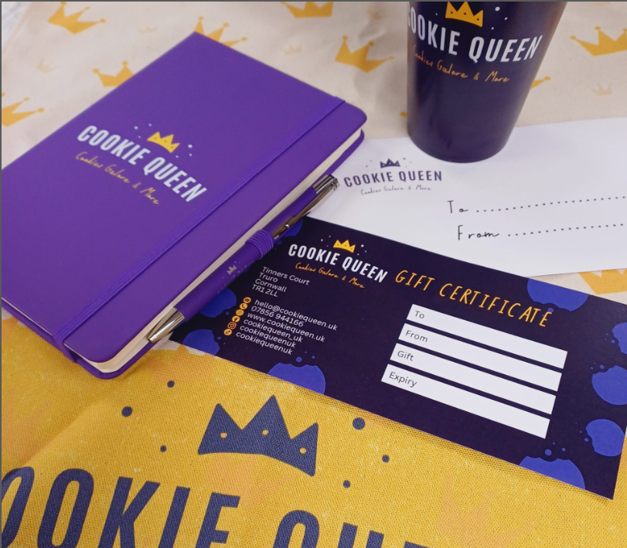

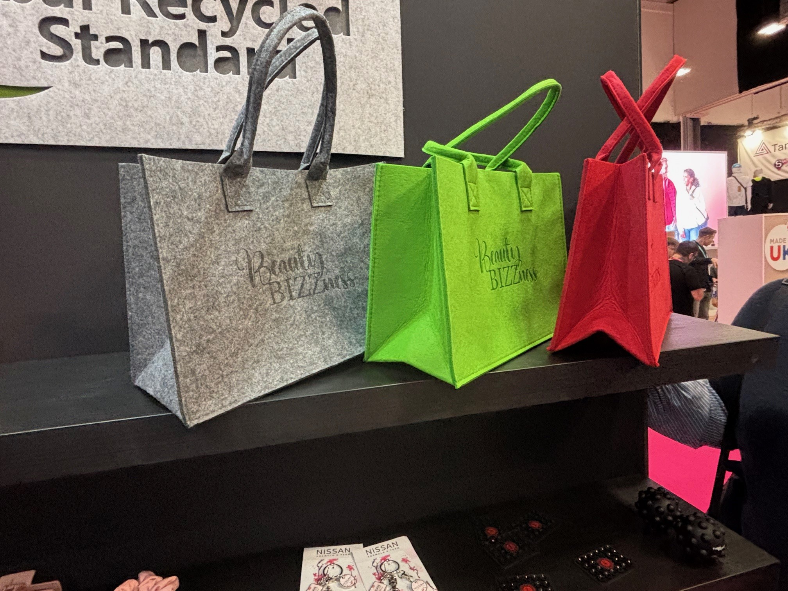

Slide 6
We’re all about connections
At Boosters, we’re all about creating connections; connecting your business with customers, new audiences with your brand, and people with products.

Slide 7

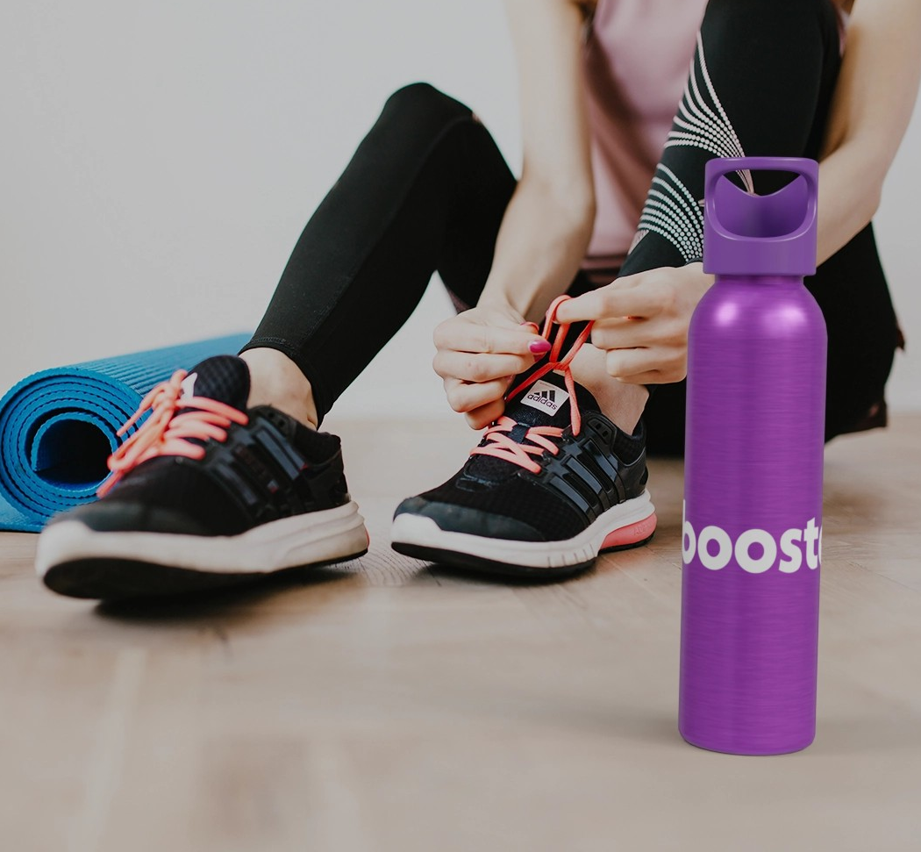
So, Why should you choose Boosters?
We understand merchandise, it’s what we
do, it’s all we do, and this is to ensure you
the best service, the best products and the
best for your business.
When we tell you we want to help it’s because we do – we want you to have the right merchandise for your brand, whether this will be your first or the thousandth order you have placed we promise…
We’ve got you

Slide 8


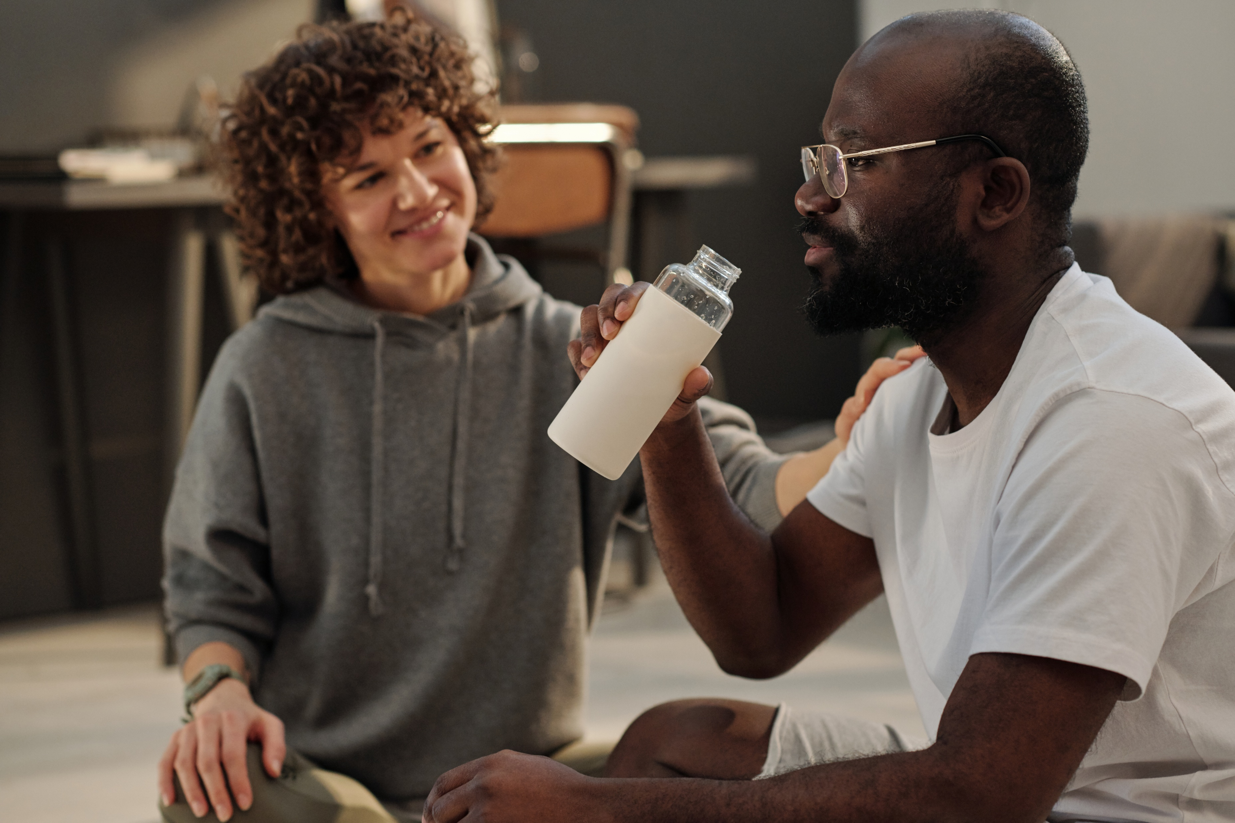
Team Boosters
Vicky Hanks – Head of Business Development
Vicky@Boosters.co.uk
Martyn Saulsbury – Client Relationship Manager
Martyn@Boosters.co.uk
Roy Rogers – Client Relationship Manager
Roy@Boosters.co.uk
Stacey Bray –Lawrence – Office Manager
accounts@boosters.co.uk
Chris Hicklin – Graphic Design
artwork@boosters.co.uk
Craig Harrison – Sales Director
Craig@boosters.co.uk
Donna Lee – Managing Director
Donna@boosters.co.uk
Vicky Hanks – Head of Business Development
Vicky@Boosters.co.uk
Roy Rogers – Client Relationship Manager
Roy@Boosters.co.uk
Stacey Bray –Lawrence – Office Manager
accounts@boosters.co.uk
Chris Hicklin – Graphic Design
artwork@boosters.co.uk

Slide 9
Together, we’ve got you
From pens to custom t-shirts, if you’re looking for merchandise that connects your brand to your customers - we’ve got you.

Slide 10



