Slide 1
5 Key Data Points in 5 Minutes

Slide 2
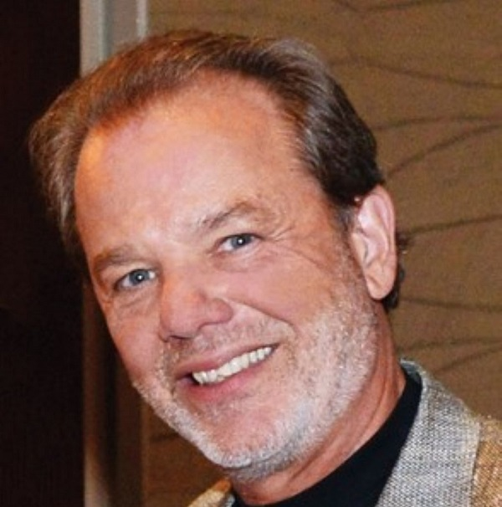
Sam Lippman
President
Lippman Connects
@samlippman

Slide 3
Attendees Trust In-Person Events
2023 | 2024
IN-PERSON EVENTS
75% | 80%
Professional Trade Orgs
68% | 68%
Academic Institutions
65% | 61%
Webinars
48% | 44%
Company Leaders
45% | 42%
Thought Leaders
36% | 31%
Media Outlets
12% | 12%
Blog Posts
9% | 9%
Government Leaders
8% | 8%
Social Media/Influencers
6% | 7%
Source: 2024 Freeman Syndicated Survey of Event Attendees

Slide 4
Point 1: At-Risk Exhibitors
Are you securing additional meeting room space for your organization?
(All Respondents)
Are you securing additional meeting room space for your organization?
(Anchors/Large Exhibitors)
13%
86%
Yes
Yes
87%
14%
No
No
Source: Freeman 2024 Exhibitor Trends Report

Slide 5
Point 1: At-Risk Exhibitors
Exhibitors Considering Corporate Events
No, third-party events work for us
48%
38%
No change yet, but might consider in the future
35%
43%
Yes, already planning or executing
17%
19%
Freeman 2023
Freeman 2024
Source: Freeman 2024 Exhibitor Trends Report

Slide 6
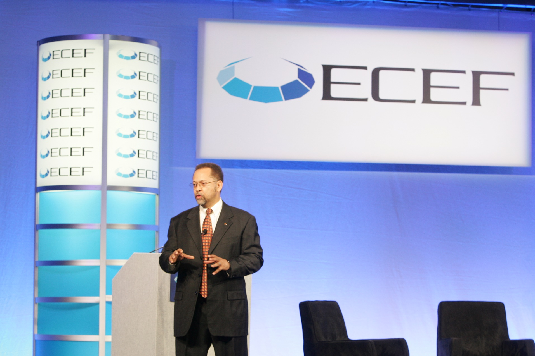
Point 1: At-Risk Exhibitors
ECEF 2008 Keynote
CMO Reveals Strategy That Created Corporate Event and Reduced Exhibition Participation
Greg Reid, YRC Worldwide’s CMO, presented a case study on why a $10 Billion Fortune 500 company reduced its exhibition participation by 45% while channeling marketing funds into developing and executing its own corporate event.

Slide 7
Point 2: Exhibitor Packages
Top Requested Assistance from Organizers
64%
62%
41%
27%
Source: Freeman 2024 Exhibitor Trends Report

Slide 8
Point 3: Connecting in Advance
Want to Set Up On-Site Meetings in Advance
68%
64%
Source: Freeman 2024 Exhibitor Trends Report

Slide 9
Point 3: Connecting in Advance
Exhibitors’ Top 3 Elements for Business
Preset meetings with qualified attendees 41%
Providing product samples or service demos 41%
Offering hands-on demos, sessions at booths/activations 40%
Source: Freeman 2024 Exhibitor Trends Report

Slide 10
Point 4: Attraction ≠ Retention
What Matters to Attendees
64%
45%
44%
43%
28%
28%
22%
6%
6%
3%
4%
Immersive experiences
Customized agendas
Tech
Atmosphere
Quality F&B
After-hours events
Comfortable seating
Gamification
Natural lighting
Wellness Activations
Other
Source: 2024 Freeman Syndicated Survey of Event Attendees

Slide 11
Point 4: Attraction ≠ Retention
Attendees’ Preferred Keynotes
39%
34%
14%
11%
2%
1%
Source: 2024 Freeman Syndicated Survey of Event Attendees

Slide 12
Point 5: Event Objectives
Previous Method for Approaching Audiences
1. Generation
2. Gender
3. Socioeconomics
4. Event Type
5. Industry
Source: 2024 Freeman Syndicated Survey of Event Attendees

Slide 13
Point 5: Event Objectives
NEW Method for Approaching Audiences
1. EVENT OBJECTIVES
2. Generation
3. Gender
4. Socioeconomics
5. Event Type
6. Industry
Source: 2024 Freeman Syndicated Survey of Event Attendees

Slide 14
Point 5: Event Objectives
LEARN
NETWORK
HAVE FUN
DO BUSINESS

Slide 15
Point 5: Event Objectives
Case Study
Attendees asked to share their event objectives.
86% responded.
Based on their event objectives and demographics, attendees were put in 1 of 6 persona-based cohorts.
Attendees were asked if they wanted a schedule based on their event objectives.
Attendees who accepted suggested schedule had a
34% higher NPS.

