Slide 1
Begin with People: Designing the Event of the Future
Notes:
We’re so glad to be here with you today. We’re going to have, an interesting conversation about the Event of The Future and audience expectations
Time for Q&A at the end. Use your CHIME app!!
Encore partnered with Kantar, a leading global research firm. We knew, as you do, that things are shifting. With focus on the generational shift, ESG and ROI, our investment
helped us validate audience expectations and offer a perspective on these key trends

Slide 2
Begin with People: Designing the Event of the Future
Notes:
A quick minute on the methodology
Expert Interviews - a work futurist, the president of the event safety alliance, a creative strategist to a digital anthropologist -not your usual suspects
Trend Mapping Workshop
Implications Workshop -8 Hypothesis
Strategic Trend Development -landed on 6

Slide 3
6 Trends Driving the Event of the Future
Design for Belonging
Champion Longevity
Event Value
In-Between Space
Emotive Affect
Technology-Driven Connection
Notes:
All 6 of these have one thing in common -people.
We will touch on these throughout our conversation
You will see a pattern of how change is affecting how people, your audiences, view the value of events and how that value shift is also shifting behavior
QUICK OVERVIEW

Slide 4
6 Trends Driving the Event of the Future
Design for Belonging
Champion Longevity
Event Value
In-Between Space
Emotive Affect
Technology-Driven Connection
Notes:
QUESTION: So, Erin, let’s start with the trend, designing for belonging. When we spoke a few weeks ago prior to this event,
one of the things that stood out to me the most was how effectively Out & Equal designs for belonging.
Why is that so important and can you give us an example of elevating DEIB?
Representation is key for the audience to feel seen. Be bold with that.
CLICK TO 5

Slide 5
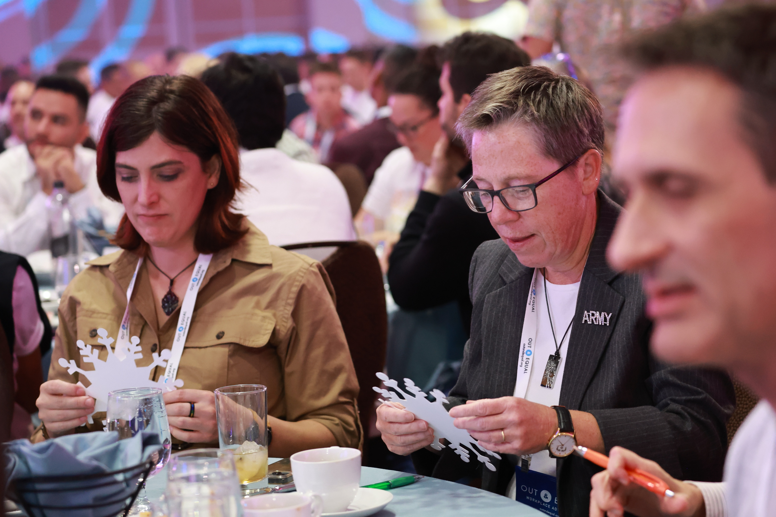
Notes:
Example: Snowflake activation. Had everyone write down what they were “covering” at work and then crumple it up into a snowball. Snowball fight.
Adding play enhances belonging.

Slide 6
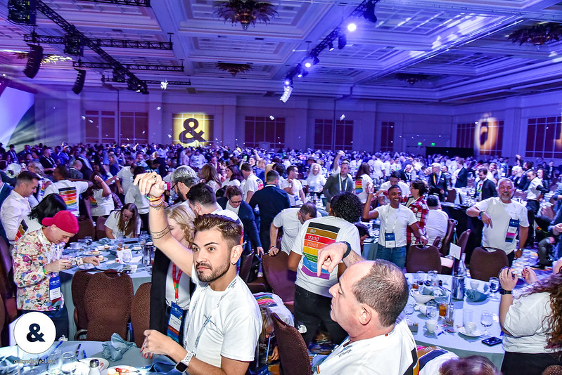
Notes:
CHRISTINE
I love this.
We know belonging exists beyond the LGBTQ+ community, what we’ve learned from the research is that it’s an expectation for the majority of modern professionals,
especially the upcoming generations.
in your snowflake example, you created a meaningful and emotional response, the trend of Emotive Affect. Those WOW moments
The trend tells us that measuring the attendee’s emotional response will become a primary design input and metric for IMPACT at events.

Slide 7
Notes:
ERIN ASKS CK Question: We are a cause-based organization, so emotional connection is critical to our success.
Christine, how important is it to create a sense of belonging and emotive affect for an organization that isn’t cause-based?
It’s equally important for the event of the future for all event types, exhibitions and conventions included
This is one piece of the “time value equation”, the idea that if I’m going to spend my time and money, I need to see my ROI, and a curated event, designed for me, helps to validate that ROI.
Belonging also includes accessibility. A ramp stage right is no longer enough, or making sure you have 4 kinds of non-dairy products.
The event of the future includes consideration for font type and size, color used on screen, area of respite for neurodiverse needs and lighting for example.

Slide 8
Notes:
Lip reading example
SLIDE 8 Here is our own example, at ASAE how our booth design encouraged DEIB conversation, the first touchpoint was the buttons -before any conversation or sales engagement,
leading to a different conversation about how Encore can help to design -in this example, create connection.

Slide 9
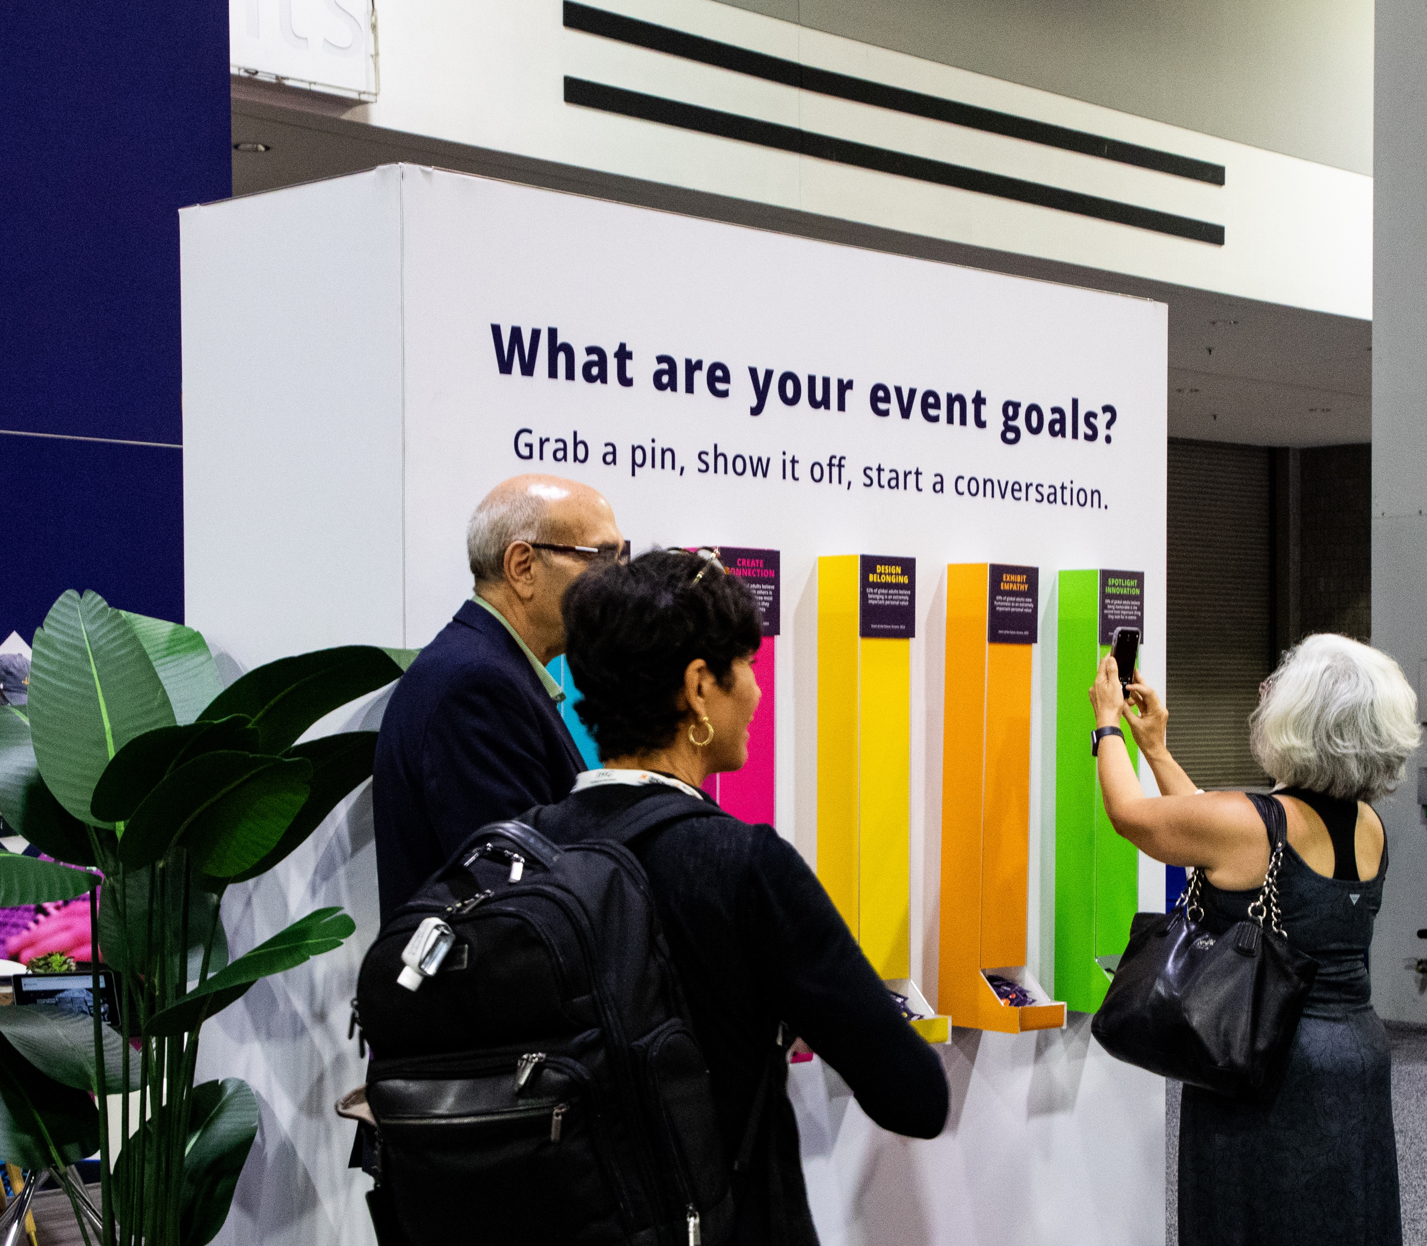
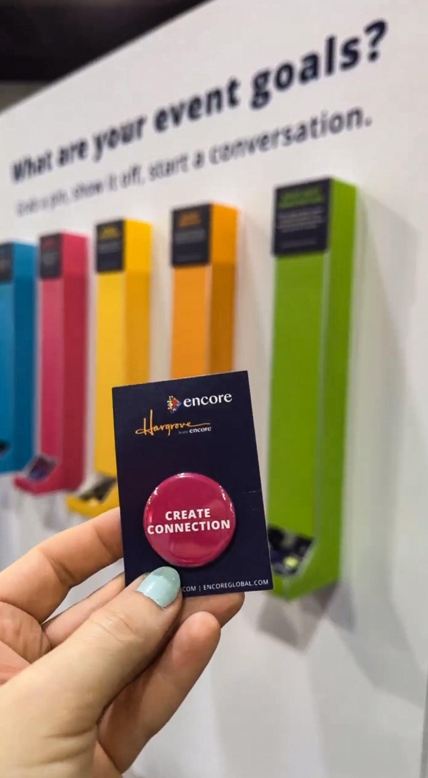
Notes:
Here is our own example, at ASAE how our booth design encouraged DEIB conversation, the first touchpoint was the buttons -before any conversation or sales engagement,
leading to a different conversation about how Encore can help to design –and.. create connection.
This aligned to the objective ASAE had for the overall exhibition, focused on the importance of DEIB.
So collectively, the audience was having purposeful experiences
CHRISITNE ASKS ERIN
Erin, I know you do some really cool stuff to bring people together, can you talk a bit about your community engagement efforts and what this audience might learn from that?

Slide 10
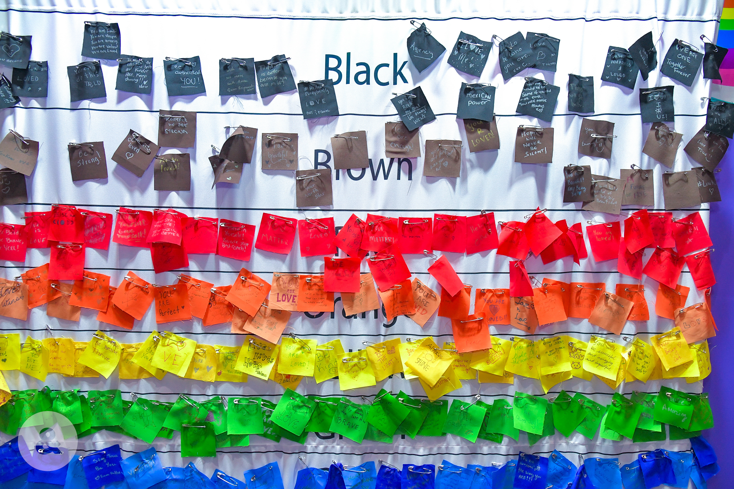
Notes:
Creating “choose your journey” moments, for example…Our & Equal has 12 community engagement groups
We build interactive workshops, take input, created audience curated moments
What you see here is a purposeful experience that allowed the audience to curate the future of content
Christine:
The fundamental to understand the community, IS the audience.
Your exhibitions/conventions can be designed for IMPACT, aligning to the expectations of the audience –be it attendees, exhibitors, sponsors, speakers

Slide 11
Notes:
When we think about exhibition/conventions, how we active space matters.
When you infuse your space with multiple choice offerings, you give attendees the ability to control and define their event experience.
We are all used to using the pool for a convention reception, or pre-function areas for registration, but how about using space in other ways?
Could you create experiences, for example, at a city wide using the walking paths more purposefully?
CLICK TO NEXT

Slide 12
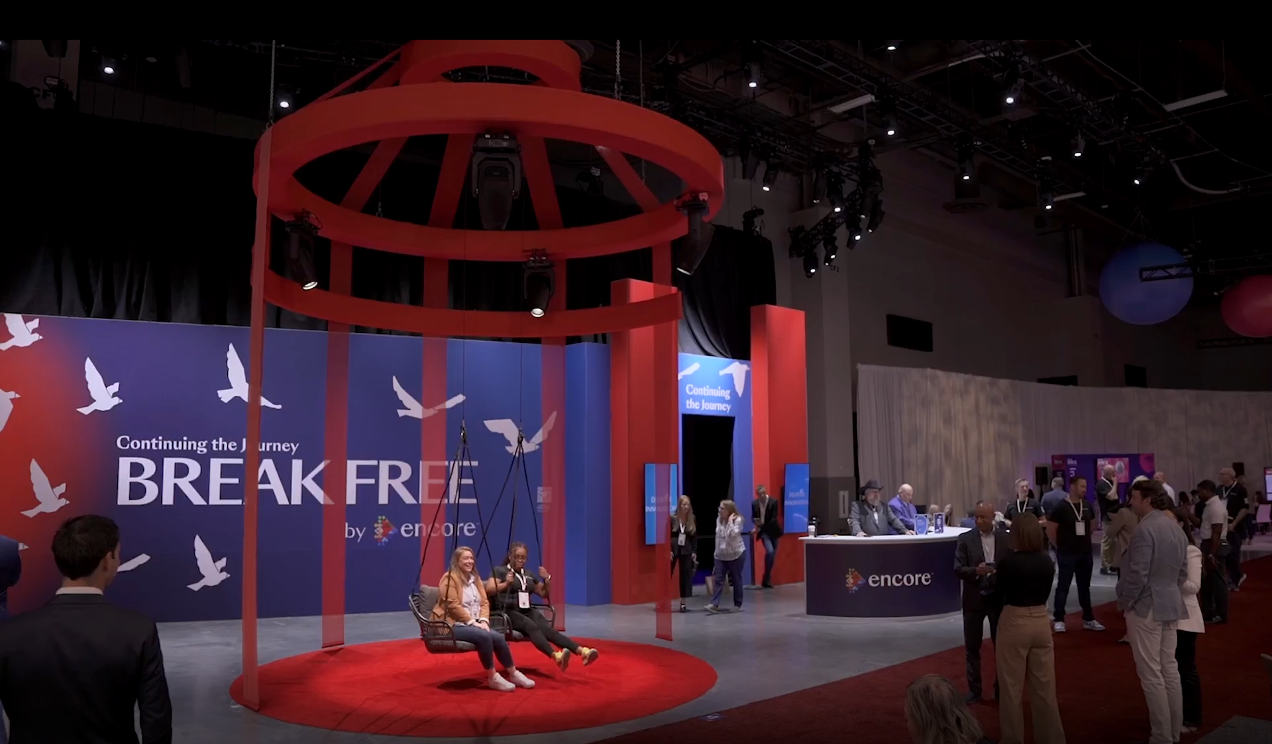
Notes:
An exhibit experience can look very different -here is the Encore experience at IMEX 2023, which purposely used the space to
To create an experience that evokes emotion and deep thought
A space for connection, where technology was used to prompt conversation on the thoughts and feelings evoked from the experience
A casual quiet space –a space for respite
A speakeasy where the energy ramped up and down depending upon the time of day. Quiet zone in the morning to early afternoon, then more energy to a happy hour early evening.
We call this a next gen tradeshow experience because the goal was to create an experience that ensured interactions were elevated above a typical transactional nature.
The strategy for the experience, the design of the spaces helped achieve that.

Slide 13
Notes:
QUESTION: Erin, how do you think about spaces to connect people?
[Erin]
We think about that in many ways, one example is specific to food and beverage experiences, for example. Not doing seated plated meals.
Color coding the community groups so they can find “their people” by colored tags in the cafeteria. Organic interactions is a goal of theirs.
Tents for waiting for buses. AC. Place to interact. Multi-use with VIP spaces and Non-VIPs.
ERIN ASK : Christine, from a design thinking perspective, we’ve got all these great ideas going to create belonging, emotional connection, to activate differently to foster organic connections.
But talk to us about the role of technology to help facilitate human interaction.

Slide 14
Notes:
[Christine]
That’s a great question Erin.
One of the 6 trends puts a focus on the expectation that despite emerging tools and immersive technologies, people continue to crave in-person connections. The event of the future, in most all formats -including exhibits and conventions, will be tech-first and data-driven, deepening engagement and measuring interactions. The key however is to ensure the authenticity of human connection remain unaltered.
ERIN, are you seeing this shift and how are you leaning into technology to support community interaction?
[Erin]
We do lean into Tech, and believe it needs to be used purposefully.
The tools today offer the ability to facilitate interaction, but I agree with you in that we can’t lose sight of human connection when implementing tech.
And data collection needs to be actionable, if you collect the data, use it smartly, use it to continue to evolve the experience.

Slide 15
Notes:
CHRISTINE: That’s a great point Erin, in the rich, but low-tech example of Snowflake, how did you collect data and what did you do with the data collection?
ERIN: Manual coding, quality not as rich/trade off -rich data changed our strategy to the business of belonging, through authenticity, rising tide, intersectional allyship. Learning and evolving
QUESTION: Sam, I’d love now to open it up to the audience to get their insights and questions.

