Slide 1
CEIR INSIGHTS TO SUPPORT EVENT PLANNING
July 2023
Presenters:
Nancy Drapeau, IPC, VP of Research, CEIR Ryan Brown, Executive Director, SpaceCom
Prepared especially for:
Midsize Show Roundtable
Pittsburgh
November 15, 2023

Slide 2

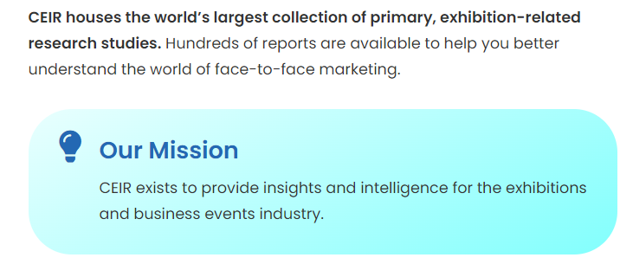
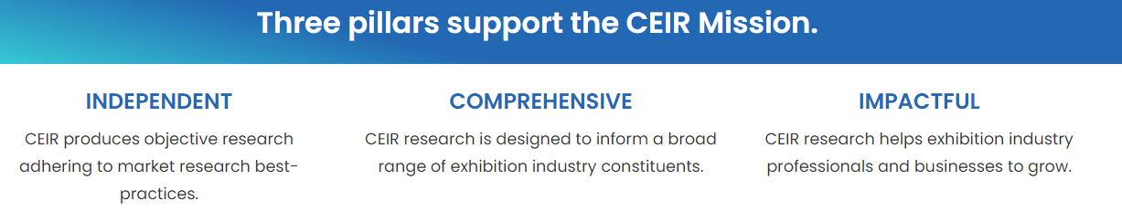
FMI visit www.ceir.org

Slide 3

Today’s Agenda
Discuss event approaches considering:
  Macroeconomy, state of the industry
  Attendee acquisition trends
  Exhibit sponsorship sales trends

Slide 4
Where is the Industry Now and What is the Outlook?

Slide 5
Question to the Group
Compared to 2019 or pre-pandemic, are the results for the last edition of your event for:
  Attendance?
  # of exhibiting companies?
  NSF of paid space?
  Gross revenues?
Raise of hands for:
  Higher
  Same
  Lower

Slide 6
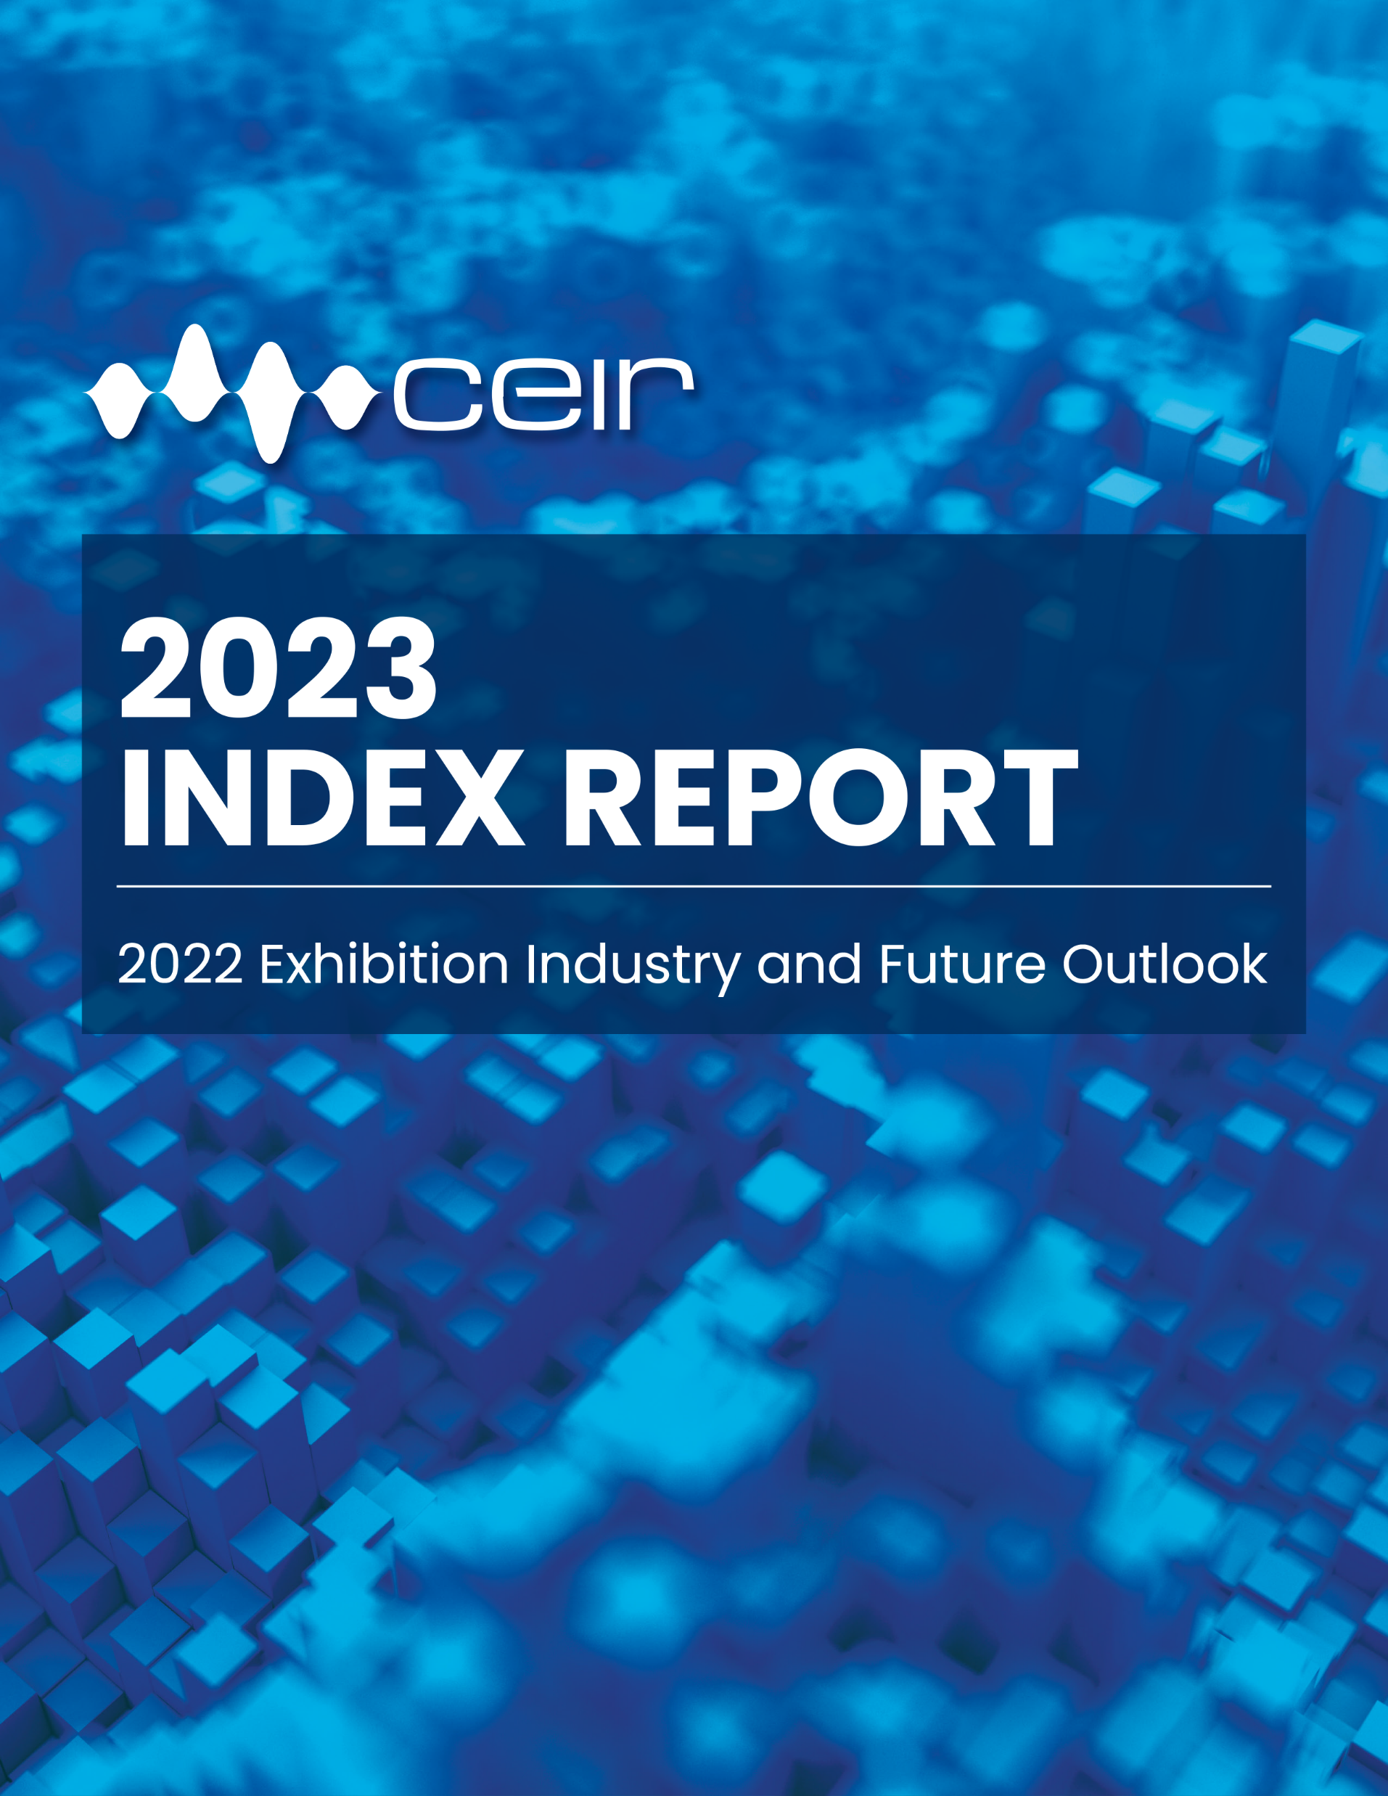
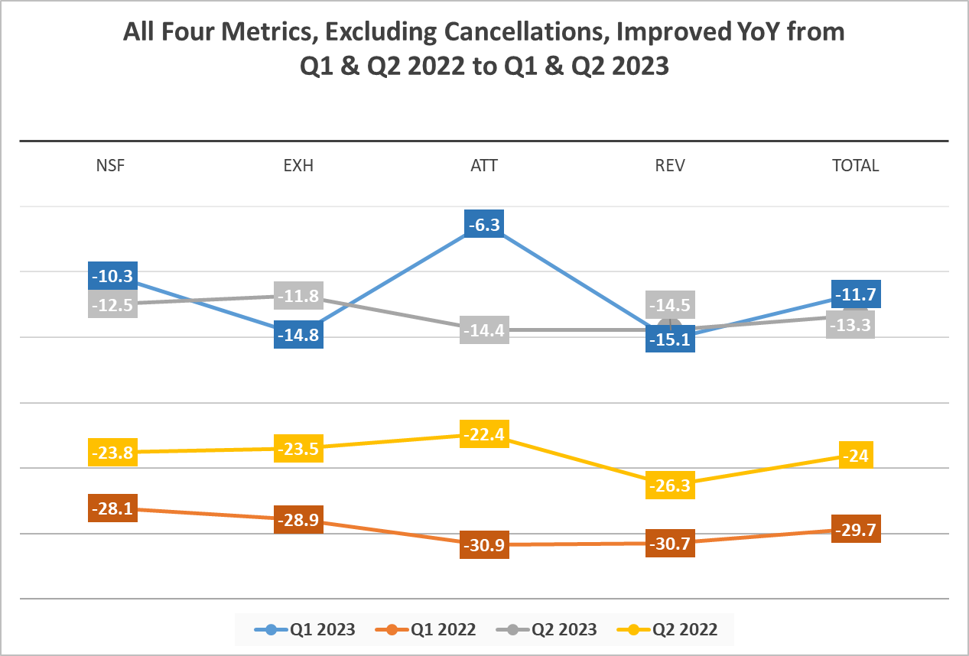
Each Metric Improves in 2023
2023
2022
Source: CEIR Q1/Q2 2023 Index vs. Q1/Q2 2022 Index Results

Slide 7
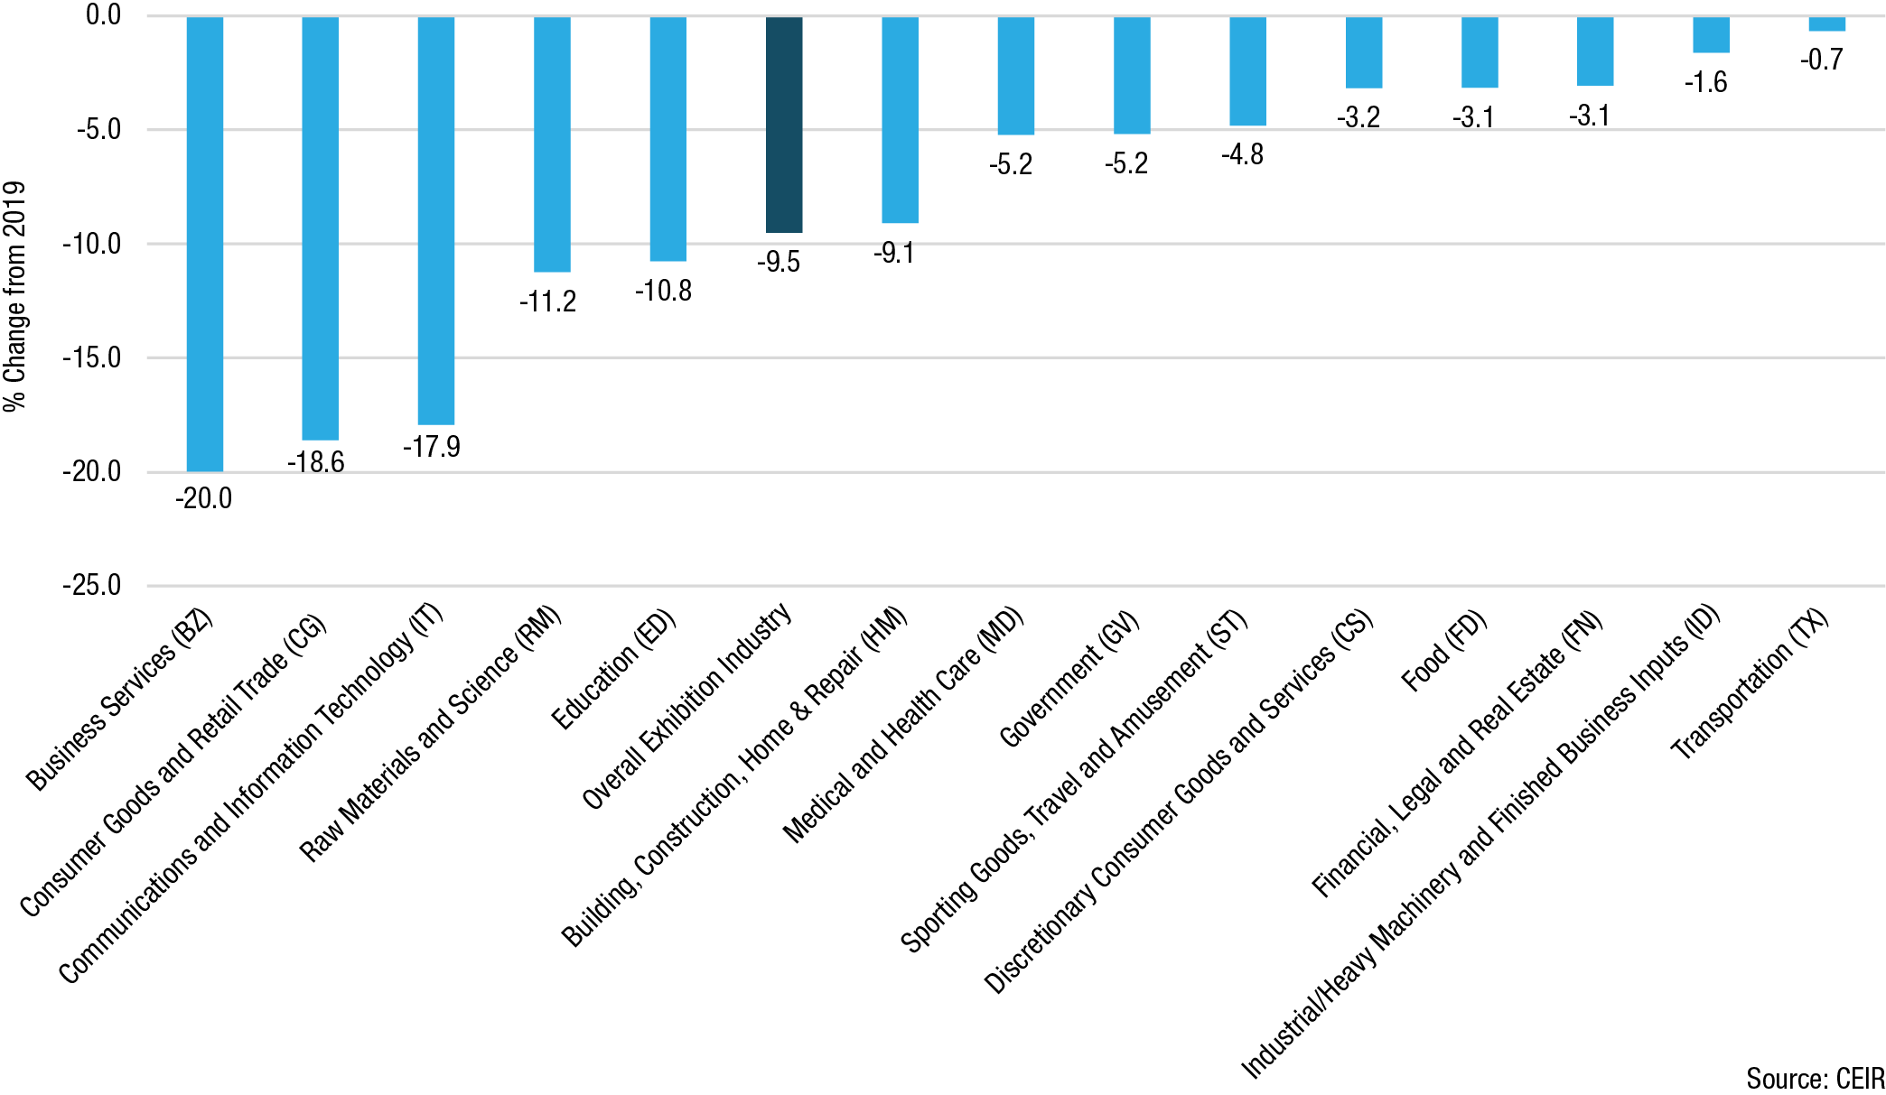
Industry is Still Rebounding in 2023, Some Sectors Faring Better than Others
CEIR Total Index by Sector, 2023, Percent Change from 2019

Slide 8
Industry is on Track to Recover in 2024
CEIR Total Index
Deviation from 2019
Real GDP Growth

Slide 9
2024 Outlook by Sector
All But 2 Forecast to Fully Recover
Industrial/Heavy Machinery and Finished Business Inputs
Transportation
Sporting Goods, Travel and Amusement
Food
Building, Construction, Home & Repair
Raw Materials and Science
Discretionary Consumer Goods and Services
Communications and Information Technology
Medical and Health Care
Financial, Legal and Real Estate
Government
Business Services
Education
Consumer Goods and Retail Trade

Slide 10
Chance of Recession at Best is Even Odds, Likely Technical. Biggest Challenge Will Be Persistence of Higher Costs.
CPI in September is 3.7%, still above 2% target
02
Though inflation is declining, prices will remain high, without any deflationary pressures
03
So costs will be a consideration for both attendees and exhibit, sponsorship sales
04
Odds of recession, 40% to 50%, if occurs, likely to be technical
01

Slide 11
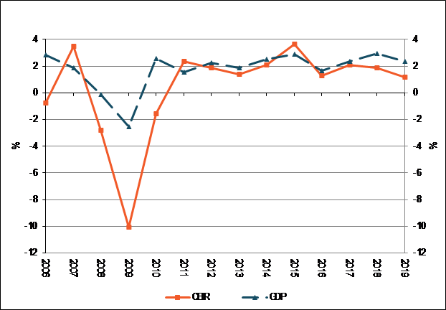
Remember: No Matter the Economic Environment – The B2B Exhibition Industry is Resilient

Slide 12

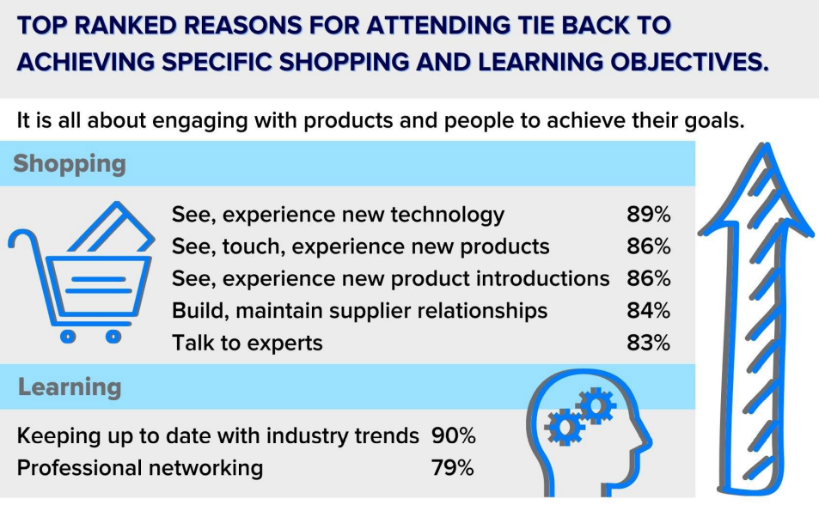
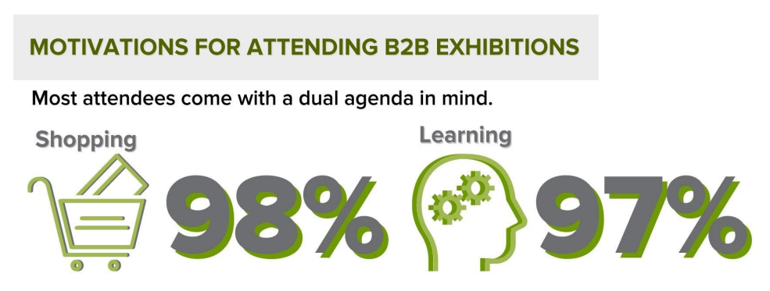
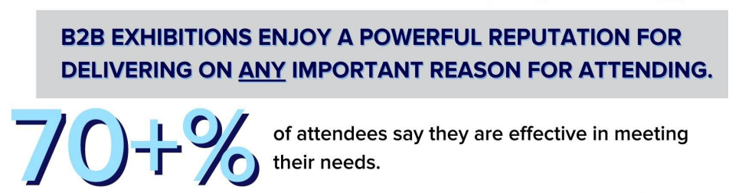
Attendees Are Back for In-person EXPERIENCES

Slide 13
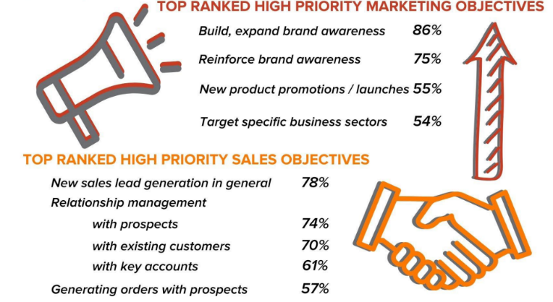
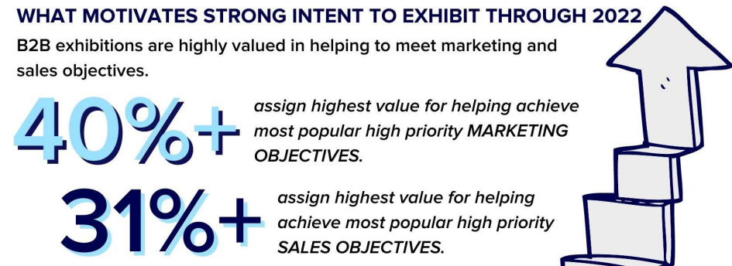
Exhibitors Are Back Because Events Deliver

Slide 14
Play to Areas of Strength of Mid-Sized B2B Exhibitions, Exploit Larger Show Weaknesses
Source: CEIR 2018 Attendee ROI Playbook Part 07

Slide 15
Attendee Acquisition

Slide 16
Question to the Group
Which performance metrics do you set during attendee acquisition planning?
  Total registration #
  Registration count by channel
  Registration count by partners
  Attendee satisfaction/NPS
  Something else

Slide 17

Setting Goals at Outset Helps Focus Team Efforts

Slide 18
Question to the Group
Are attendees waiting until the last minute to register for your event?
  Yes
  No

Slide 19

Registering Closer to Event Persists –
Source of Heartburn
Might starting earlier reverse this trend?
  30% that started 9 months or earlier, exceeded 2019 results vs. 19% that started later.
Remember official end of the pandemic was May 11, 2023, not that long ago!

Slide 20
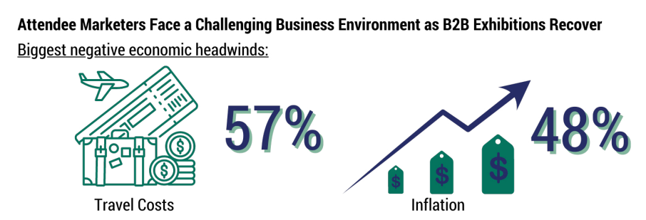
Travel Costs Are Biggest Headwind for Attendee Acquisition

Slide 21
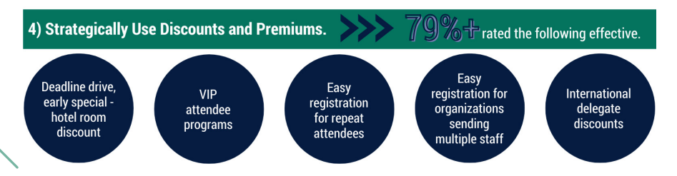
Use Premiums and Discounts in 2024 to Alter Late Signup Registration Trend? Other ideas?

Slide 22
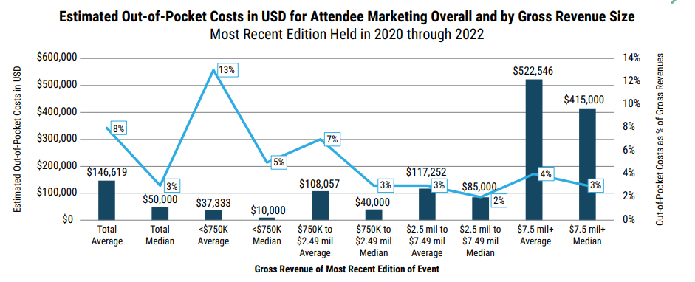
Attendee Acquisition Costs – A Larger Share of Event Revenues, the Smaller the Event

Slide 23
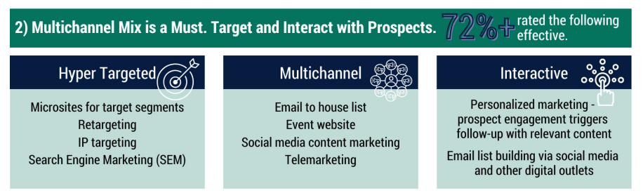
Keep Pace with Shifting Media Habits

Slide 24
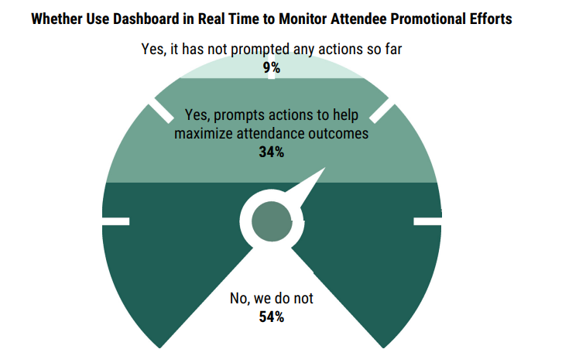
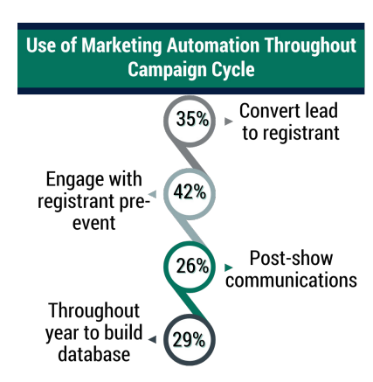
Use Marketing Automation and Real-Time Dashboards

Slide 25
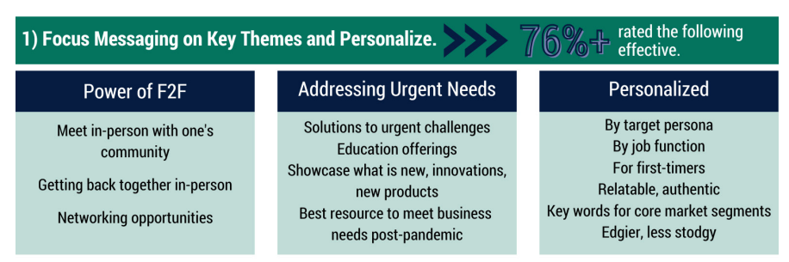
Messaging Approach to Align and Connect with What Attendees Want

Slide 26
Exhibit and Sponsorship Sales

Slide 27

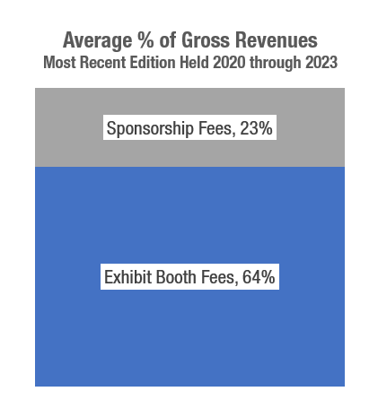
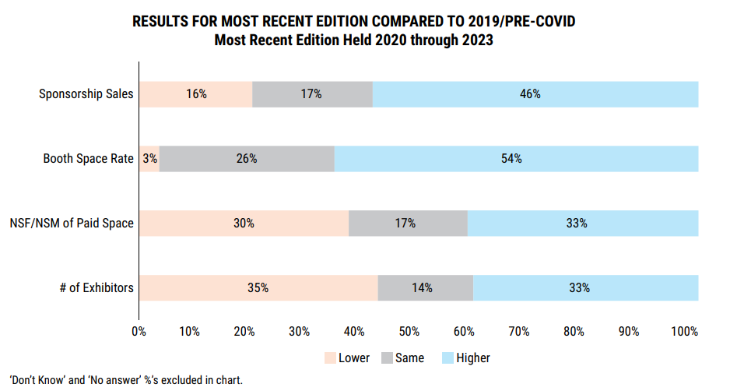
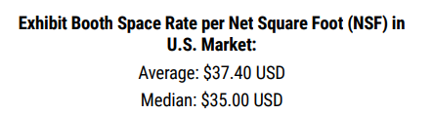
Recovery To-Date Driven More by Increased Booth Space Rates and Sponsorship Sales
Notes:
For organizers whose recent B2B exhibitions have met or exceeded 2019 gross revenues, all measures are higher: 84% increased booth rates and 77% sustained higher
sponsorship sales. Also, 70% say the number of exhibiting companies is higher, and 75% say NSF/NSM of paid space is higher. Suggests they were willing to push on all measures and got good outcomes.
Yes, there is a connection between those that succeeded with matching or exceeding 2019 results with perceptions that the health of their industry. Sixty-eight percent of recently held B2B exhibitions that have exceeded 2019 gross revenues say the health of industry sectors served is positive, compared to 40% of surveyed organizers in general.
Larger events, with $1 million + gross rev, closest to 2019, 93%. Also the case for those what rely more heavily on sponsorships, 93.7% where 25%+ of gross revenues come from sponsorships.

Slide 28
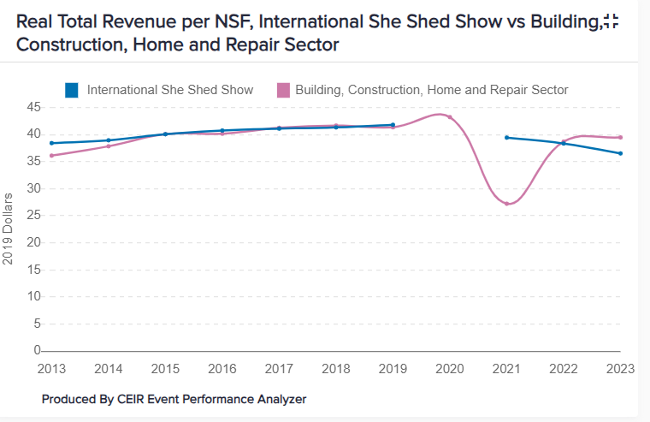
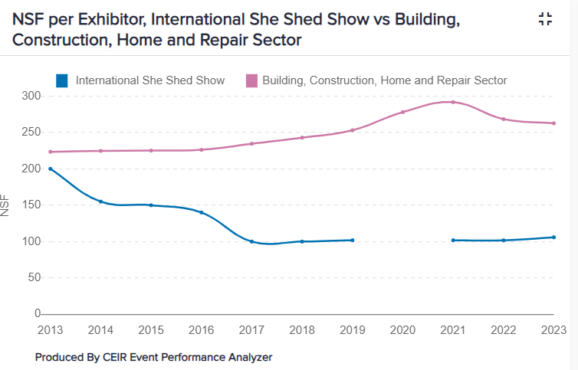
Event Performance Analyzer Charts+ Can Help with Setting Goals

Slide 29
Question to the Group
Which options do you use to sell exhibits? Are options different for selling sponsorships?
  Staff assisted
    by phone
    by email
    by video conference
    In-person
  Self-serve, online form

Slide 30
Remote Staffing, Online Self-Serve Deliver for Exhibit Sales
Notes:
This is an area where deploying sales staff appropriately, efficiently can help boost gross revenue outcomes.
Do you sell exhibits or sponsorships via – remote staff options? Online self-serve?
What are the outcomes?
Among those that use self-serve –how has exhibit/sponsorship sales staff reacted to this? Any adjustments to how sales staff are compensated? Any adjustment to which exhibit/sponsorship sales efforts in-person sales efforts are used?

Slide 31
For Sponsorships Sales, Staff-Assisted, Remote or In-Person Work Best
Notes:
This is an area where deploying sales staff appropriately, efficiently can help boost gross revenue outcomes.
Do you sell exhibits or sponsorships via – remote staff options? Online self-serve?
What are the outcomes?
Among those that use self-serve –how has exhibit/sponsorship sales staff reacted to this? Any adjustments to how sales staff are compensated? Any adjustment to which exhibit/sponsorship sales efforts in-person sales efforts are used?

Slide 32
Which performance metrics do you set for exhibit and sponsorship sales?
Gross sales
Net profit
Support to anchor, strategically important exhibitors
Options for exhibitors of all sizes
General sentiment metrics
Specific metrics on exhibitor/sponsor results compared to their goals

Slide 35
Takeaways from Today’s Session
Macroeconomic
The industry is forecast to fully recover in 2024
Though inflation is ebbing, pricing will remain high
Integrate compelling event that aligns with what attendees and exhibitors want
Leverage areas of advantage midsized shows enjoy
Attendee Acquisition
Set goals that will build back your attendance
Plan and start early to maximize registration outcomes
Use premiums, discounts to offset attendee cost concerns
Assure multichannel mix is in line with current media habits
Use marketing automation to maximize engagement, prospect conversions
Exhibit and Sponsorship Sales
Moving forward, charge based on value, do not discount
Use sales methods strategically – use lower cost options to free up in-person sales efforts for highest value opportunities
Use performance metrics to focus team on desired revenue goals AND best outcomes for exhibitors, sponsors and the attendee experience

Slide 36
Resources
For Your Planning Needs

Slide 37

Use CEIR’s Industry Benchmarking Tool to Understand Your Event’s Market Position
Benchmarks are rebounding, but how much? The CEIR Index and Event Performance Analyzer have the answers!
Complimentary copy of the latest CEIR Index Sector report for your show ($450 value)
Your event performance is visualized, compared to CEIR Index benchmarks, in easy-to-read line and stack bar charts, with forecast through 2023.
FREE ACCESS to 13 charts, downloaded to excel. Download charts in multiple formats.
Access the CEIR Event Performance Analyzer here.
Want help getting started? Contact CEIR VP Nancy Drapeau, IPC at ndrapeau@ceir.org

Slide 38
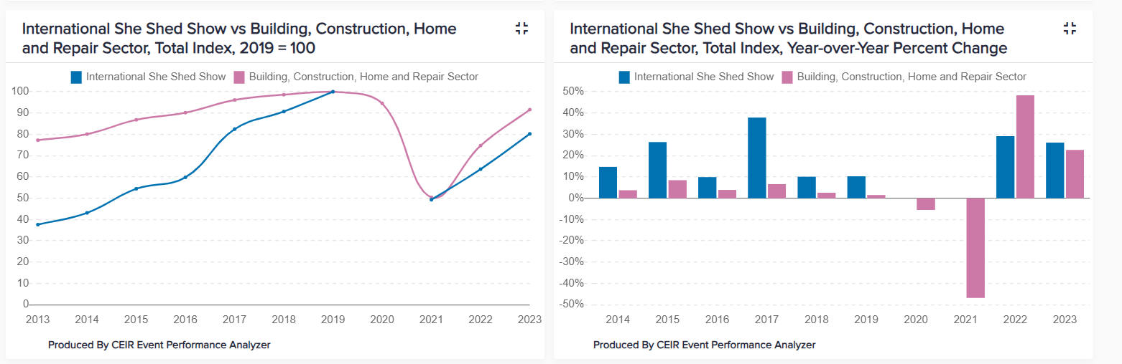
https://analyzer.ceir.org/login

Slide 39
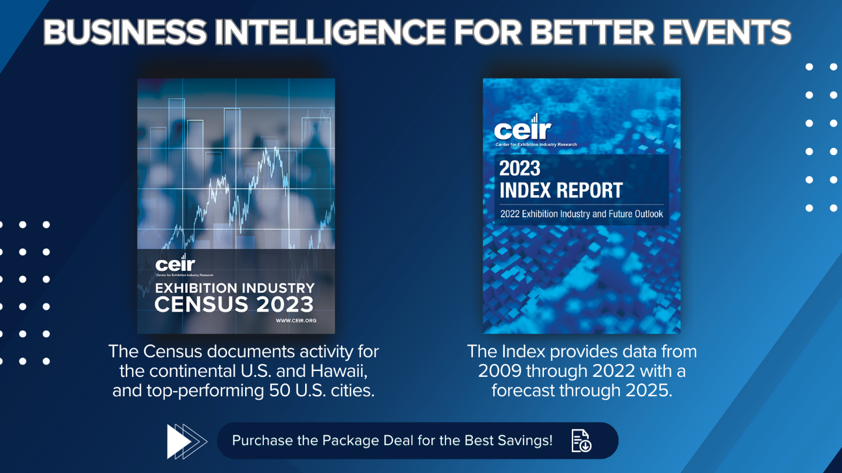

Slide 40


CEIR Research to Support Your Business Needs
Help us keep you informed on trends impacting your business.
Scan QR code to donate
2023 CEIR Index Report
Attendee-Focused Studies
2018 Attendee ROI Playbook Series
2018 How to Grow Attendance
2017 Cost to Attract Attendees Report
2016 Attendee Retention Insights Study Series
Exhibitor-Focused Studies:
2019 Head of Marketing Insights Series
2018 Marketing Spend Decision
2017 How the Exhibit Dollar is Spent
2016 Changing Environment of Exhibitions Study
Other Trend Studies:
2021/2022 Omnichannel Insight Series
2020 to 2022 Research on Impact of COVID on US B2B Exhibition Industry
2021 CEIR Global Virtual Event Trends
2020 Attendee Matchmaking Study
2021 and 2020 COVID Related Research
2017 Attendee Floor Engagement Study Series
2016 Digital Toolkit to Enhance the Attendee Experience Study Series
Cultivating an Innovative Culture and Mindset - Even in Mature Industries
Industry Insight Series Reports to Share with Your Exhibitors, topics below and more:
How Exhibitors Can Improve Lead Quality and Sales Conversion
Designed to Engage – How to Build Elements of Engagement in Booth Design
How Exhibitors Can Use Games and Contests To Drive Greater Trade Show Success
99 Cost-Savings Tips and Tricks for Exhibit Managers
2023 CEIR Census Report
2023 Attendee Acquisition Trends
2019 B2B Exhibition Sponsorship Playbook Series
2023 Exhibit and Sponsorship Sales Driving Revenue Growth Series NEW!
NEW!!!!!
Exhibit and Sponsorship Sales Driving Revenue Growth Series

Slide 41


Slide 42

Nancy Drapeau, IPC
VP of Research
CEIR
Ndrapeau@ceir.org
+1 (207) 332-9839
Cathy Breden, CMP-F, CAE, CEM
CEO
CEIR
Cbreden@ceir.org
+1 (972) 571-0449
Ryan Brown
Executive Director
SpaceCom
rbrown@ntpevents.com
+1 (703) 706-8218

