Slide 1
Heads Will Spin 360⁰ When This Fearless CEO Dusts Off His Crystal Ball

Slide 2
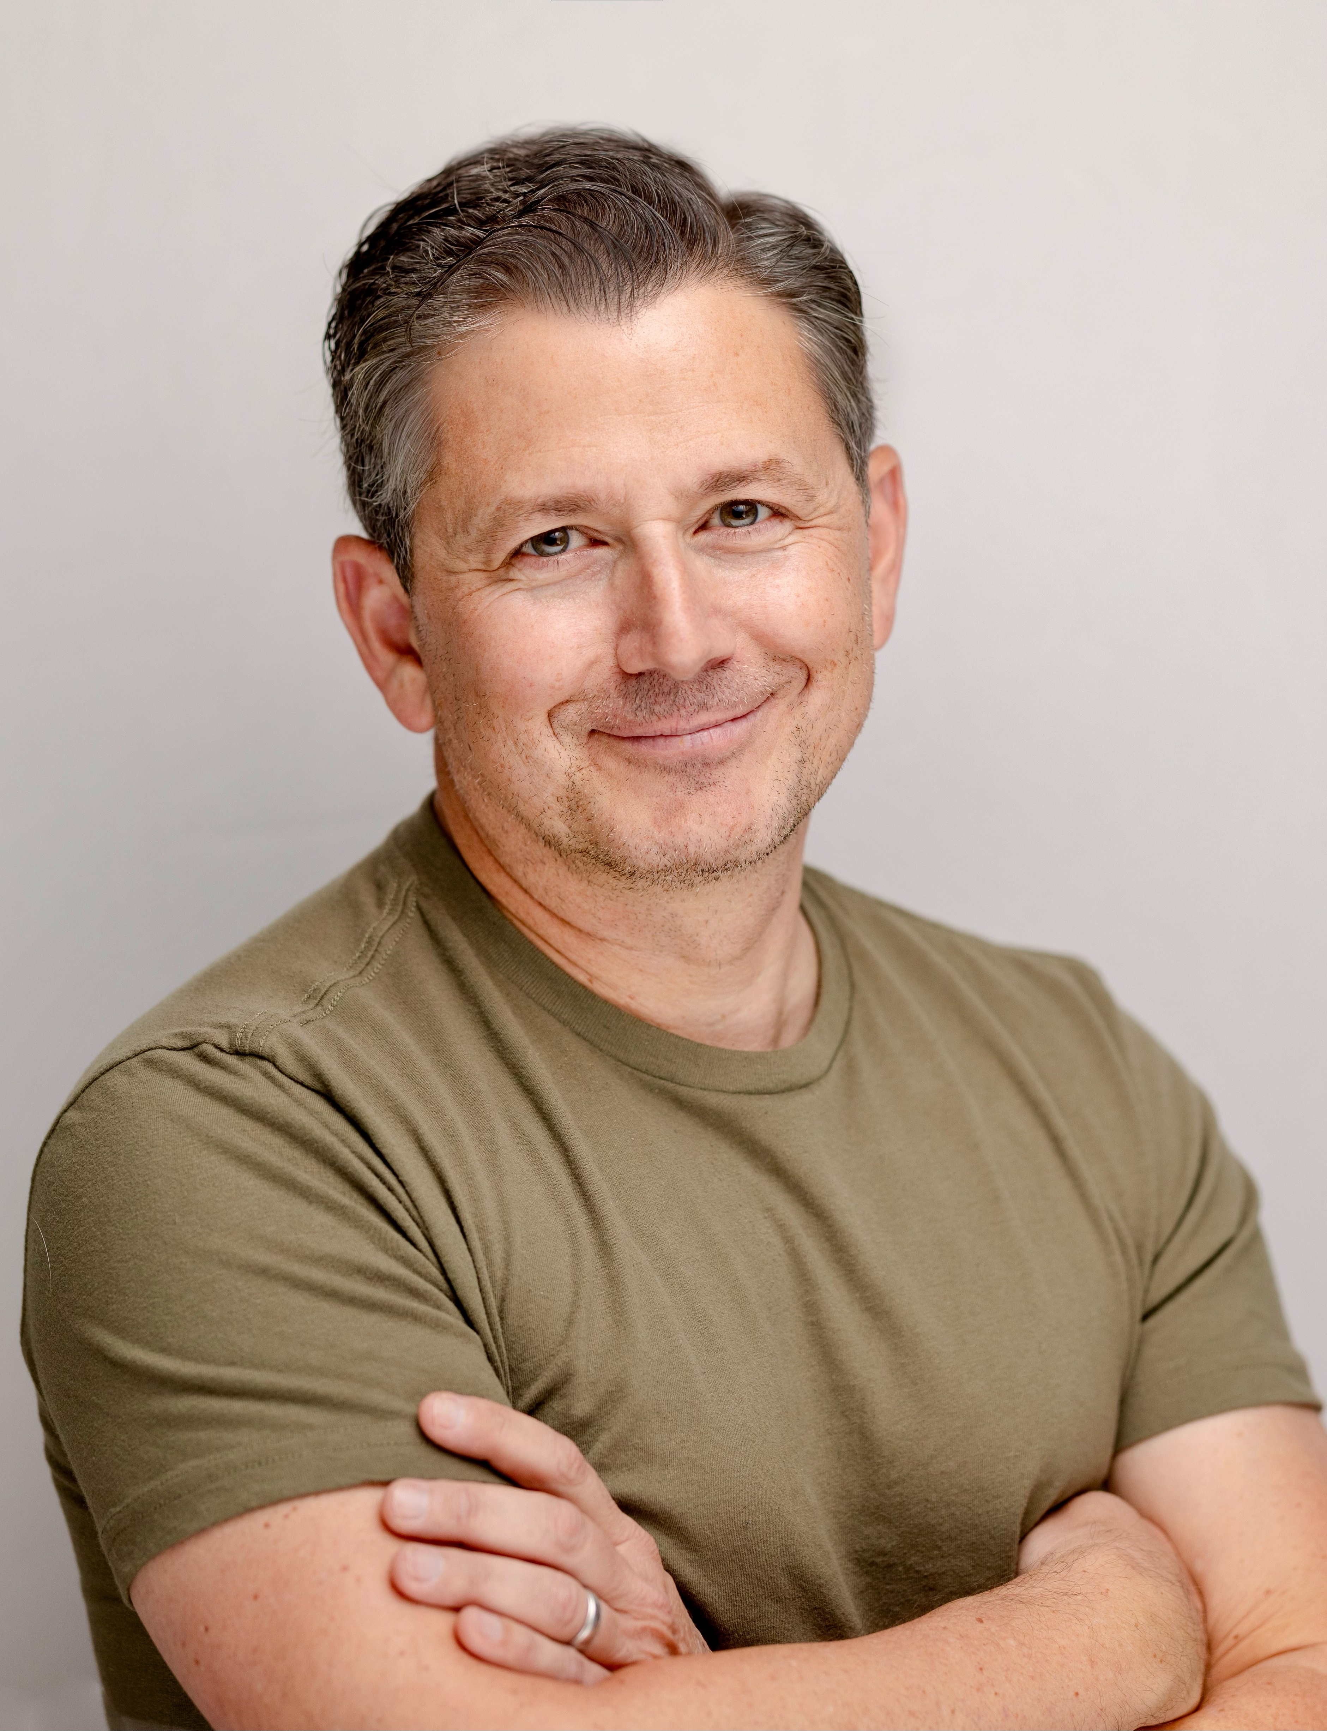
Greg Topalian
Chairman
Clarion Events North America
@ClarionEventsNA

Slide 3
10 YEARS
AGO

Slide 4
MY
PREDICTIONS

Slide 5
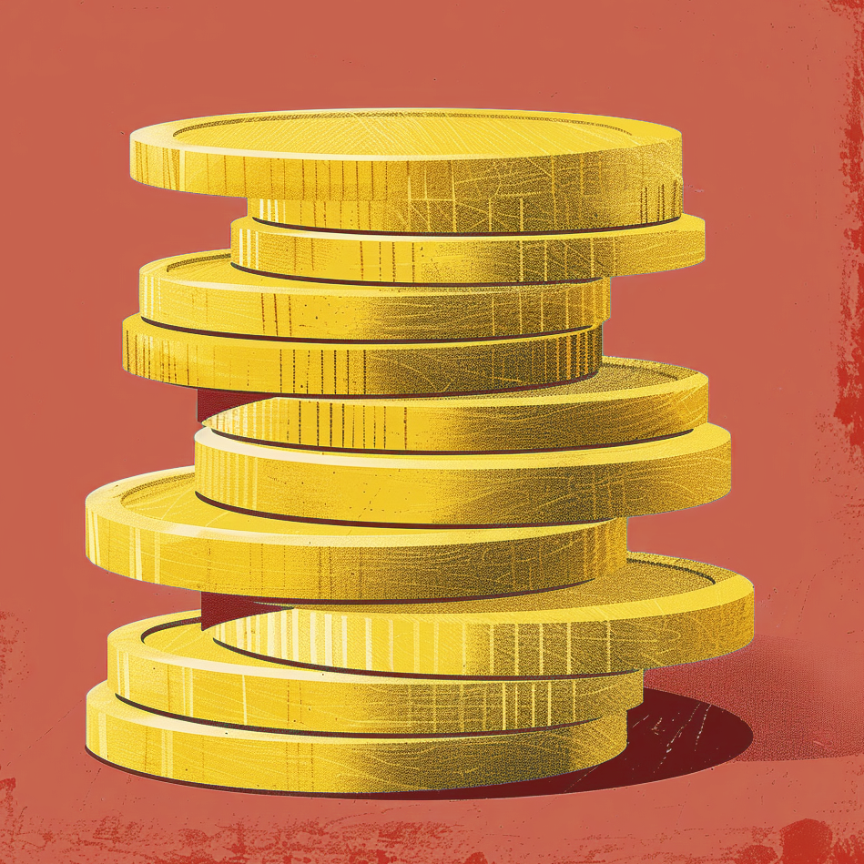
PREDICTION
ONE

Slide 6
PREDICTION
TWO

Slide 7
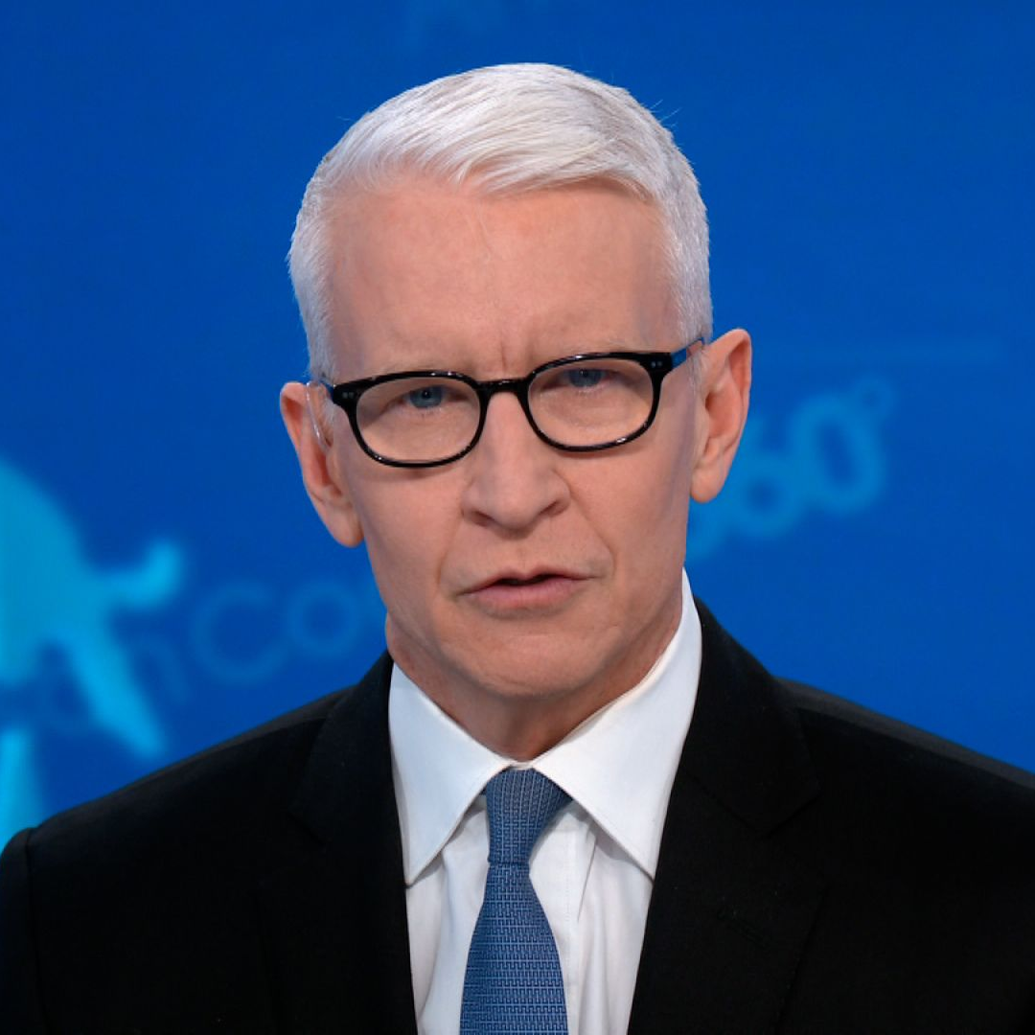
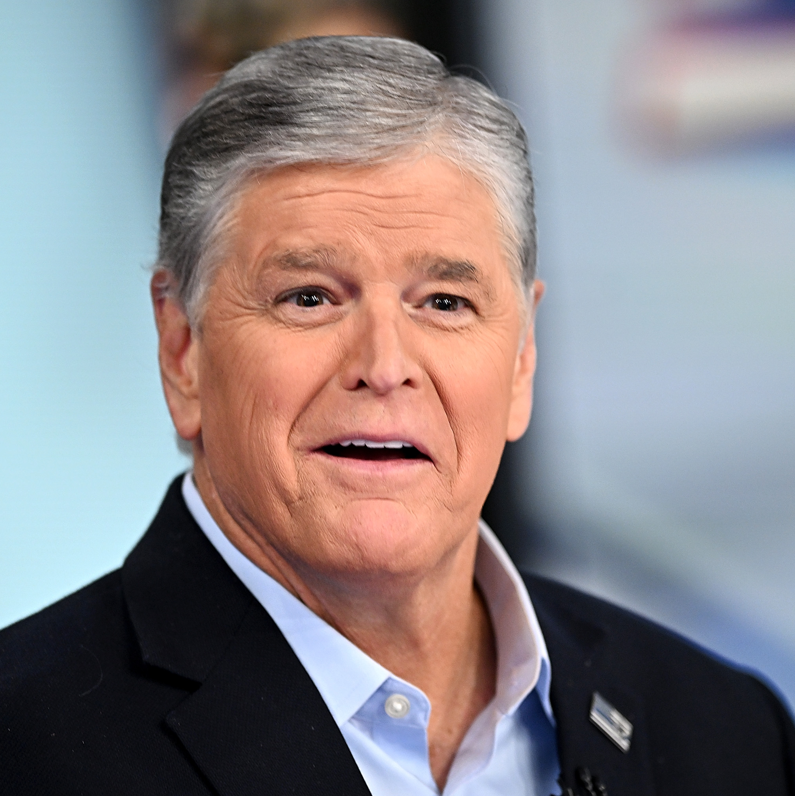
PREDICTION
THREE

Slide 8
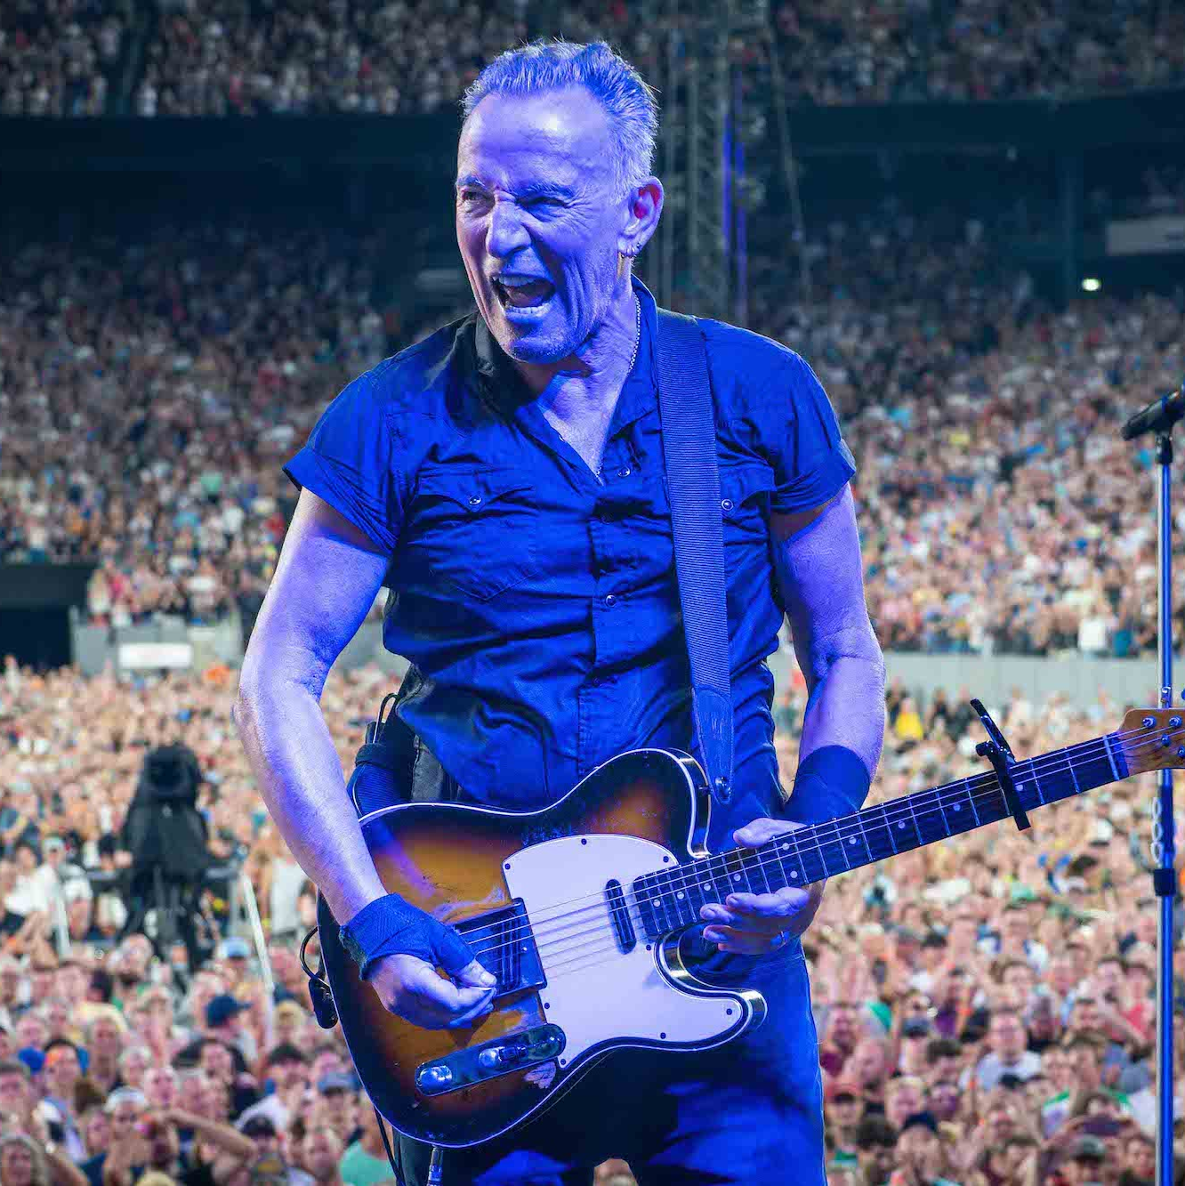
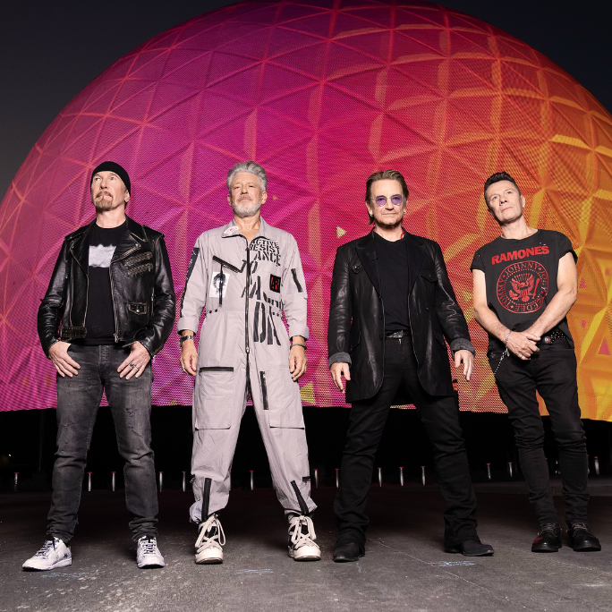
PREDICTION
FOUR

Slide 9
PREDICTION
FIVE

Slide 10
Q&A

