Slide 1
Keynote:
Unlocking Innovation & Fostering an Ecosystem: How One Show Helped Transform a City

Slide 2




Melissa Medina
Co-founder, CEO, & President
eMerge Americas
@melissamedinavo

Slide 3


Unlocking Innovation + Fostering an Ecosystem: How One Show Helped Transform a City

Slide 4


TODAY’S JOURNEY
  My Roots + My Story
  About eMerge Americas
  More Than An Event
  Constantly Evolving
emergeamericas.com

Slide 5








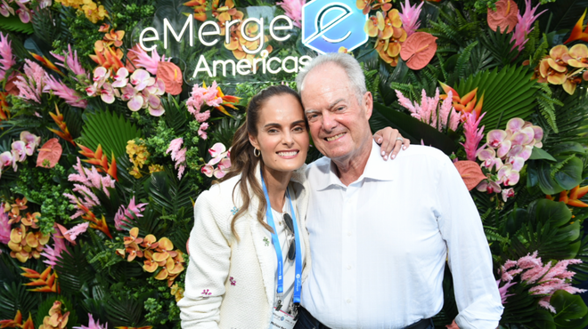

MY ROOTS + MY STORY
emergeamericas.com

Slide 6

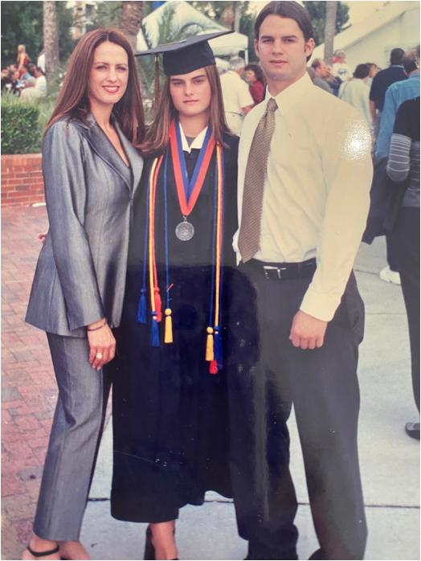


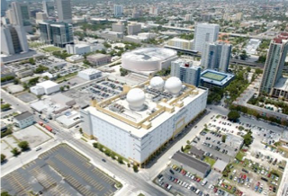
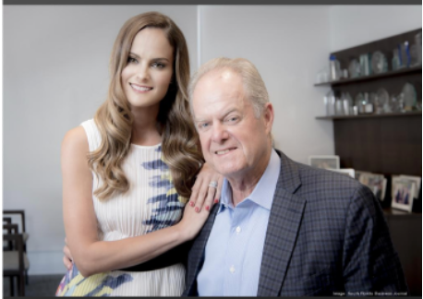


MY ROOTS + MY STORY cont.
Technology Foundation of the Americas Est. 2012
emergeamericas.com

Slide 7

ABOUT eMERGE AMERICAS
Since 2014, eMerge Americas has led the charge in helping to transform Miami into a global tech hub.
HOW IT ALL BEGAN
Fustration + Passion
Finding A Void In The Market
Research + Implementation
At eMerge Americas, our mission is to foster innovation and entrepreneurship, while continuing to build and grow Miami as a global technology hub. Miami’s connection to LatAm, as well as its unique ability to build, grow and welcome others is an integral part of its history and culture.
emergeamericas.com

Slide 8
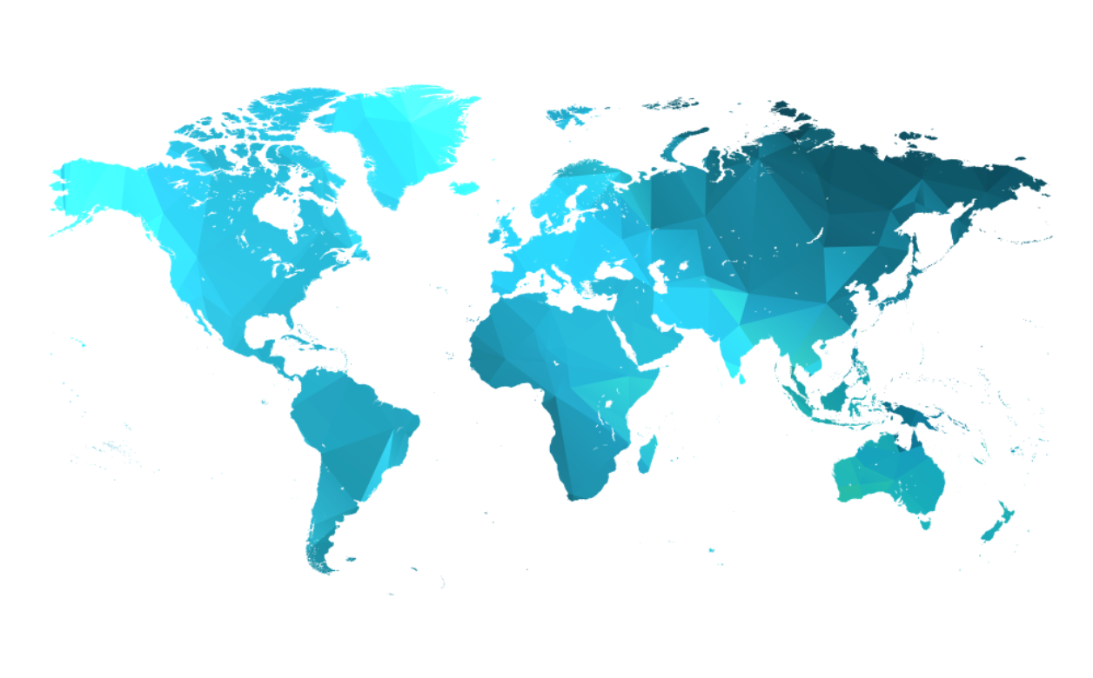
THE PREMIER GLOBAL TECH EVENT
AN INTERNATIONAL + DIVERSE COMMUNITY
22,000+
Attendees
76%
Senior Executives Or Above
292
Sponsors + Exhibitors
59
Countries Represented
47
U.S. States Represented
40%
Women
69%
Identify As Multicultural
65,000
Weekly Newsletter Subscribers
*2024 Post-Event Data
emergeamericas.com

Slide 9


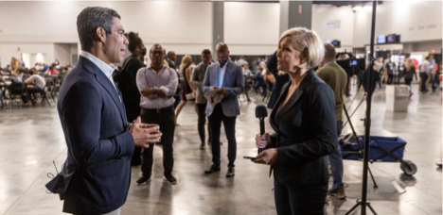

WORLDWIDE MEDIA COVERAGE
400+
Registered Media
There are over 200 articles, live broadcasts and features covering eMerge Americas and subsequent content from the conference, which extends across the globe.
emergeamericas.com

Slide 10

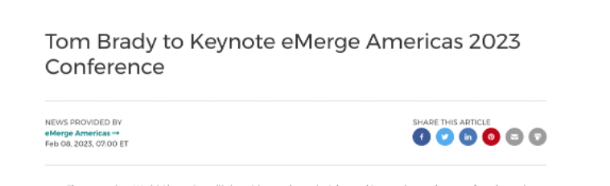
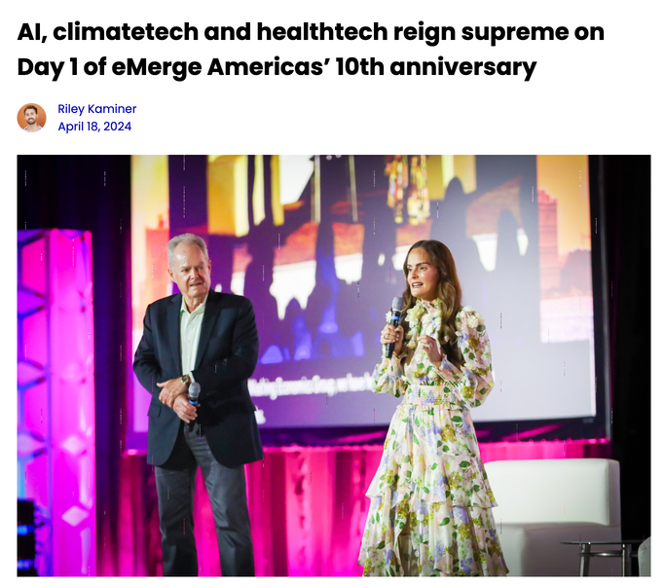
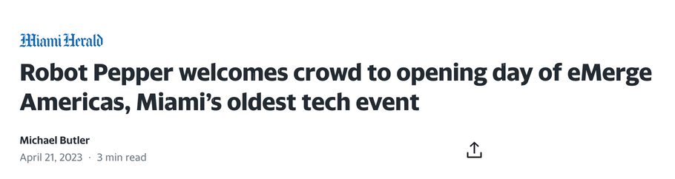
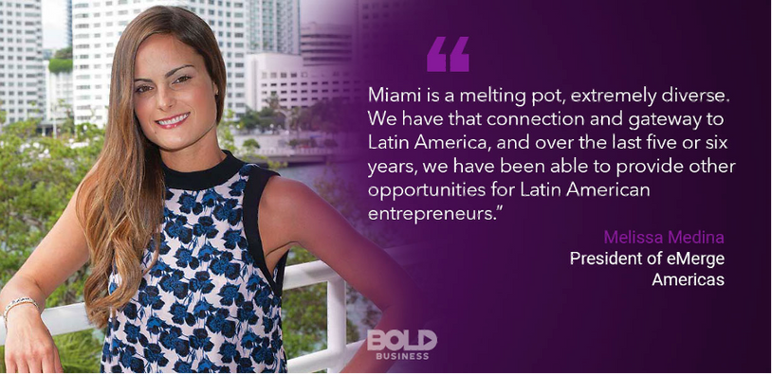
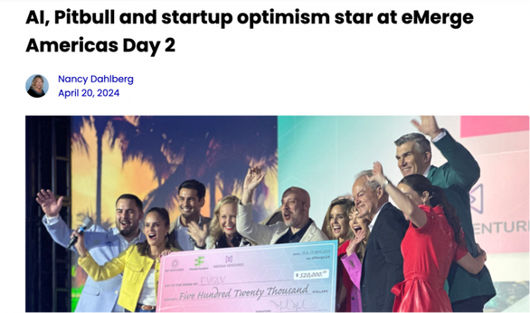
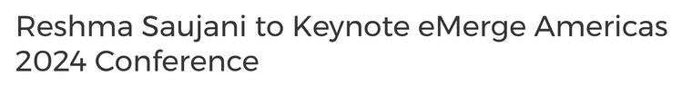
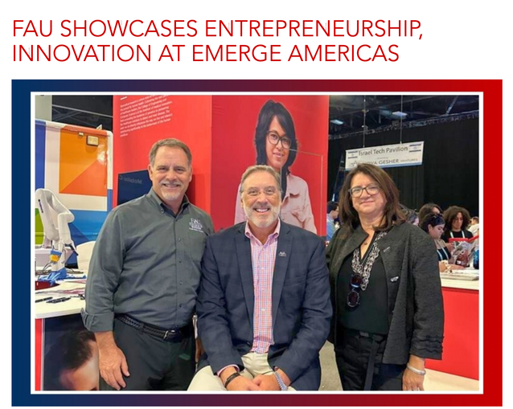
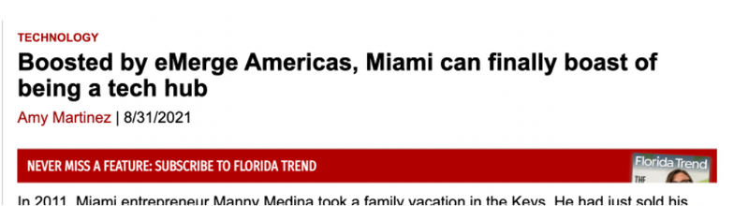
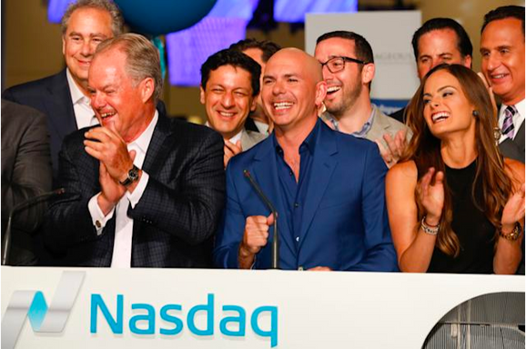

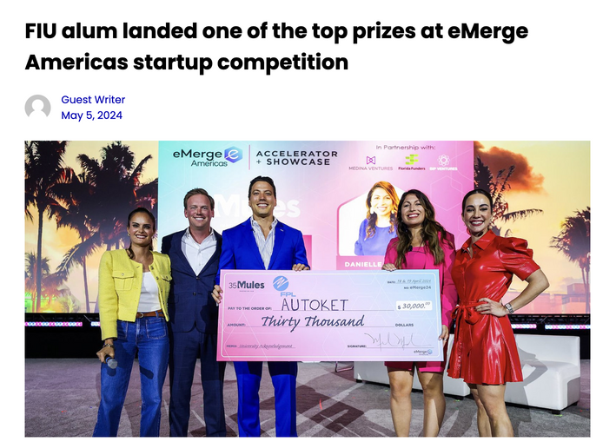
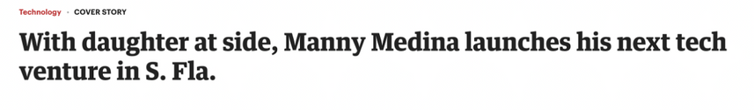
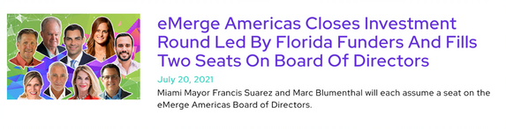
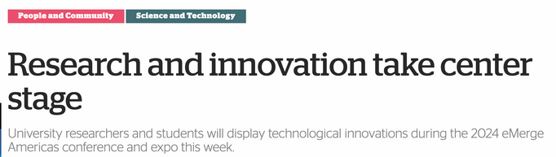
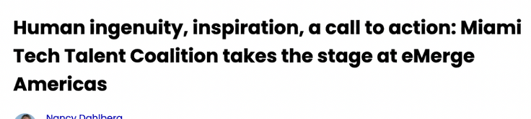
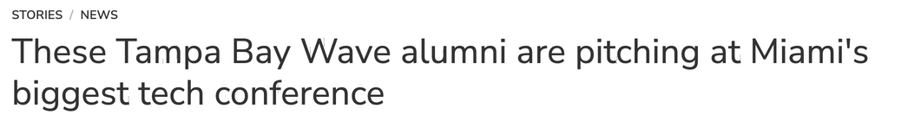
HEADLINES

Slide 11
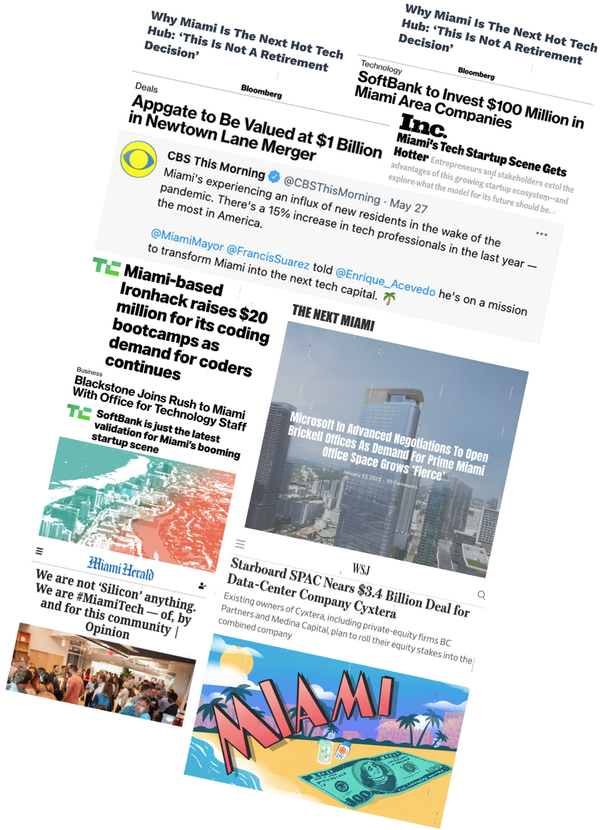
BIENVENIDO A MIAMI
Propelled by the pandemic, Miami has gained validation as a global tech hub with a massive migration of tech talent and investors.
emergeamericas.com

Slide 12


A LOOK BACK AT 10 YEARS

Slide 13

MORE THAN AN EVENT
eMerge Americas is an ecosystem that is making a direct and
transformational economic impact on Miami and the entire State of Florida.
Almost $3B
Total Cumulative
Economic Impact*
10,000+
Total Jobs Created*
* Source: Washington Economics Group Analysis of
eMerge Americas cumulative economic impact on Florida
emergeamericas.com

Slide 14
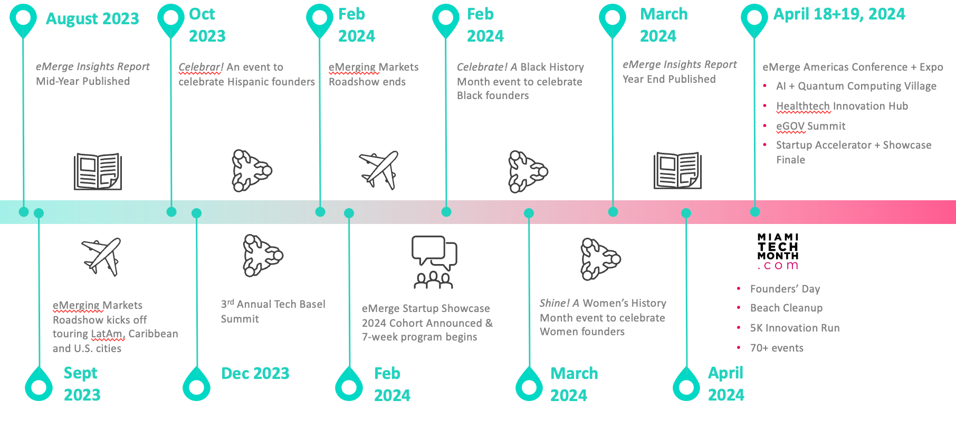
IT’S A YEAR-ROUND PLATFORM
emergeamericas.com

Slide 15

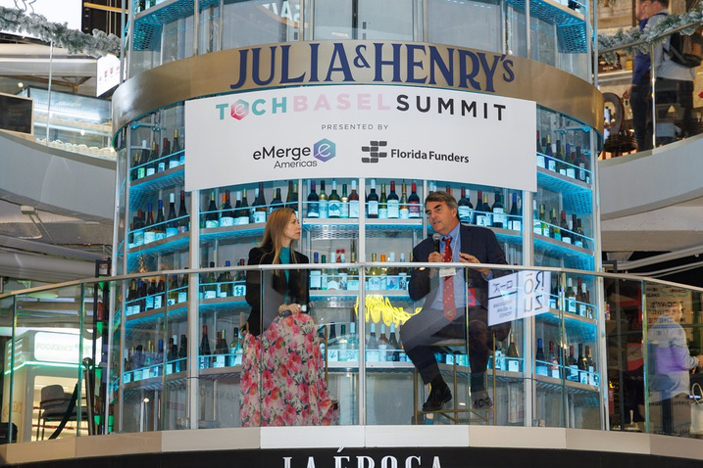
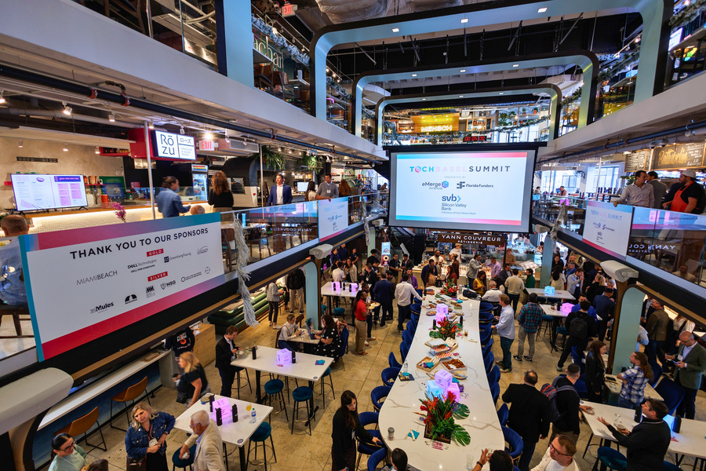
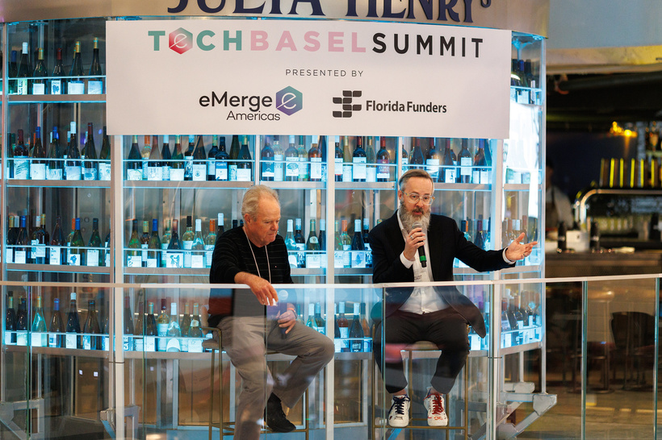
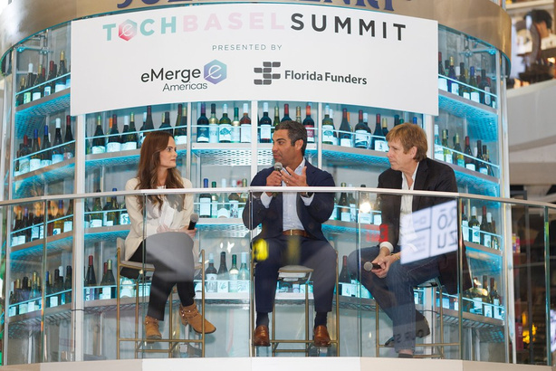
FOR THE ART OF INVESTING + INNOVATION
Tech Basel Summit
Leveraging the excitement around Art Basel, Tech Basel Summit is a one-day, invite-only event for founders, family offices and investors to connect, converse and collaborate.
TechBaselWeek.com
A full week of South Florida's must-go-to tech events during Art Basel 2023.
emergeamericas.com

Slide 16

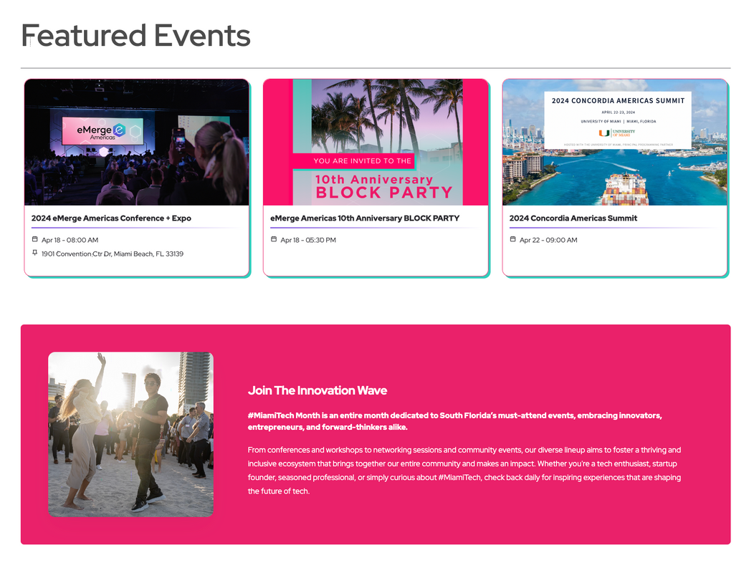
MIAMITECHMONTH.COM
#MiamiTech Month is an entire month dedicated to South Florida’s must-attend events, embracing innovators, entrepreneurs, and forward-thinkers alike.
From conferences and workshops to networking sessions and community events, our diverse lineup aims to foster a thriving and inclusive ecosystem that brings together our entire community and makes an impact.
emergeamericas.com

Slide 17


DIGITAL MARKETING EFFORTS
A turnkey solution with a suite of customizable tools to prescribe the best mix to engage your company’s target audience for year-round engagement
END-TO-END TOOL SUITE
eMerge Insights Report
The Brief Newsletter
Virtual events + Webinars
Award-winning Short Form Videos
emergeamericas.com

Slide 18

WEBINARS + VIDEO SERIES
Our in-house teams produce, promote and execute virtual events and video content.
emergeamericas.com

Slide 19
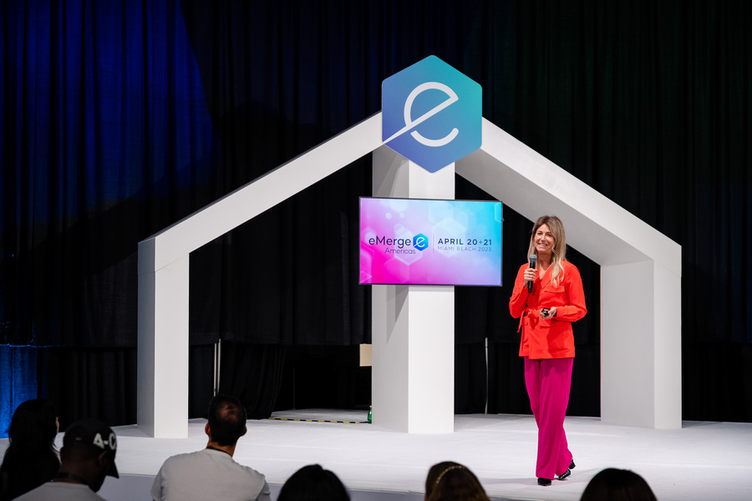

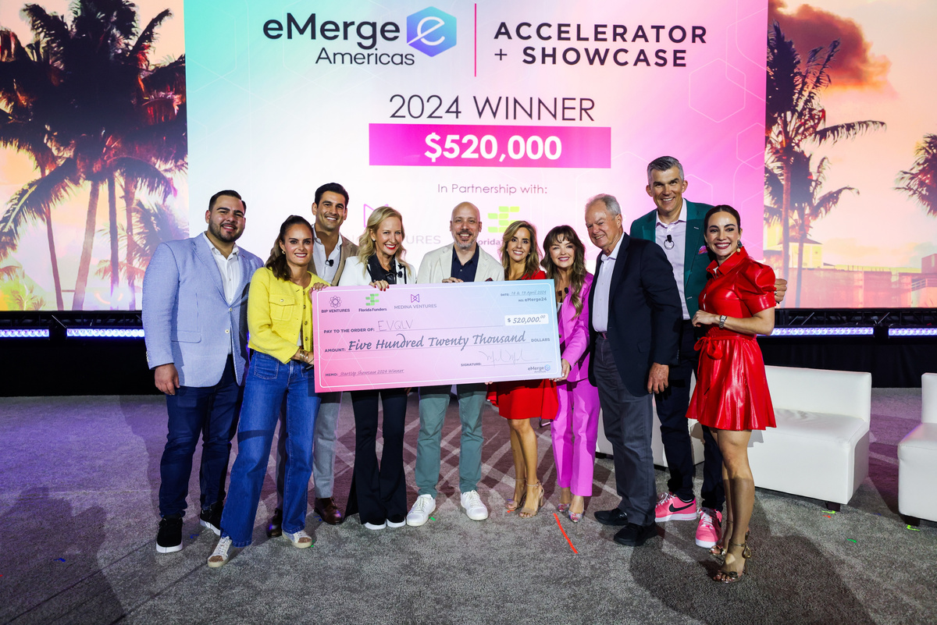
EXCLUSIVELY FOR STARTUPS
Featuring 100 early and later stage innovative companies invited to a 7-week virtual program culminating in a pitch competition at the eMerge Americas conference.
All companies have access to:
  Mentorship
  Investors, talent and corporate partners
  Exhibit space
  Curated networking events
  Opportunity to win a $520,000 investment
emergeamericas.com

Slide 20
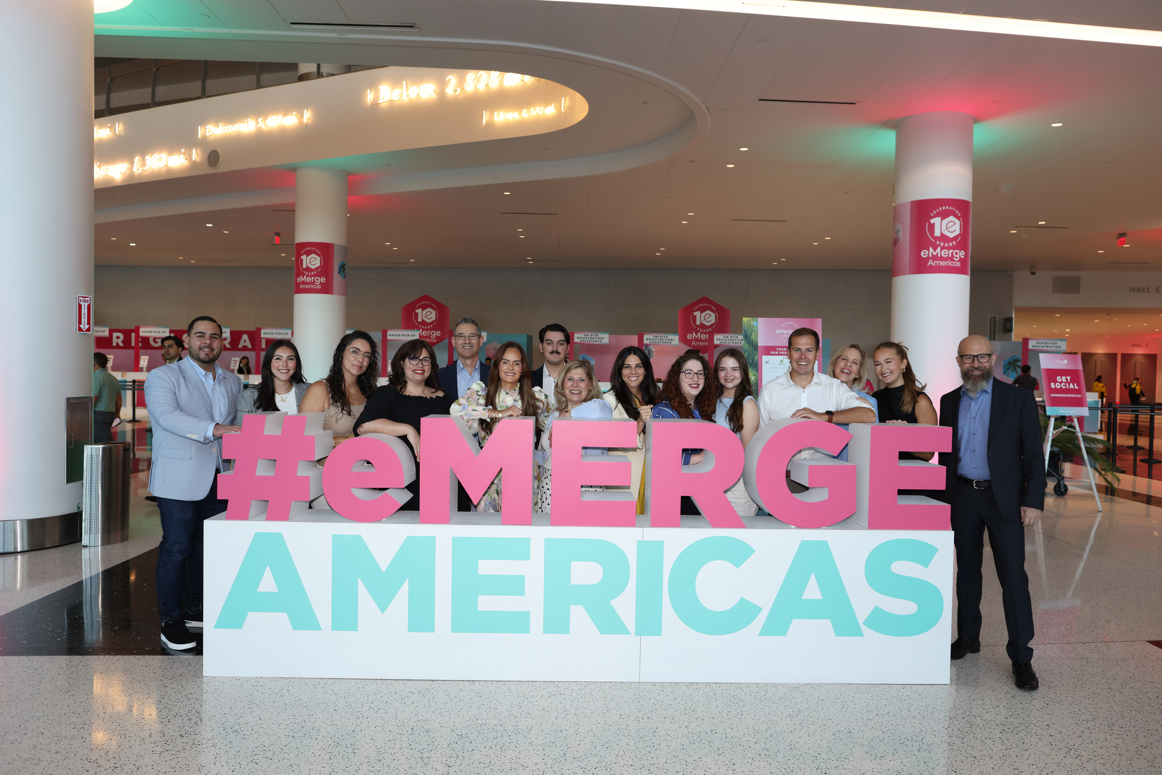
2024 CONFERENCE RECAP
DAY 1
emergeamericas.com

Slide 21



LATEST VENTURE
Melissa Medina
CEO + Co-Founder, eMerge Americas
Partner, Medina Ventures
DECADE OF DEALS
A global platform + accelerator and pre-eminent tech startup hub of Southeast USA and the Americas.
THE PIPELINE
We are intimately familiar, have mentored and gained the trust of a network of 1,000+ startups that are often overlooked by traditional VCs.
1,000+
Startups Graduated From Accelerator
$2.5B
Raised By eMerge Alumni Startups
15+
Successful Alumni Exits
emergeamericas.com

Slide 22

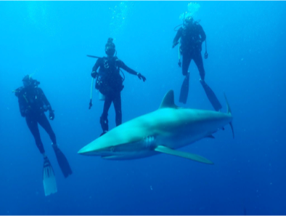

emergeamericas.com
“The people who are crazy enough to think they can change the world are the ones who do.”
~Steve Jobs
emergeamericas.com

Slide 23
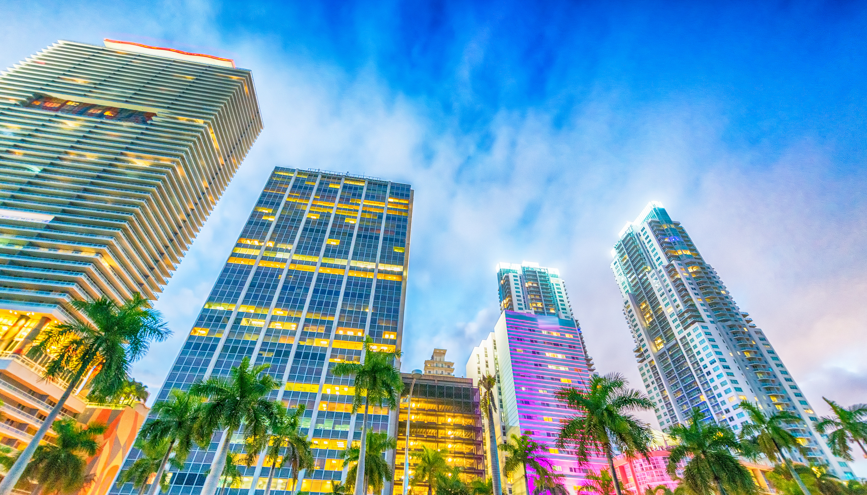





THANK YOU + LET’S CONNECT
@melmedina305
mmedina@emergeamericas.com
emergeamericas.com

