Slide 1
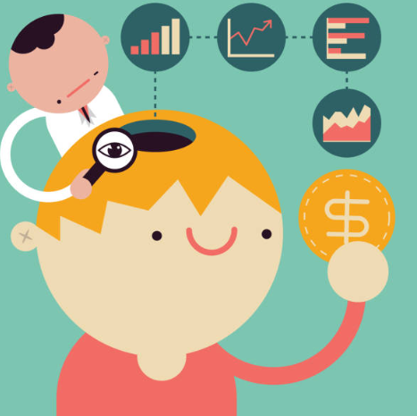
A Rational Decision Maker
Notes:
Driven by Economics

Slide 2
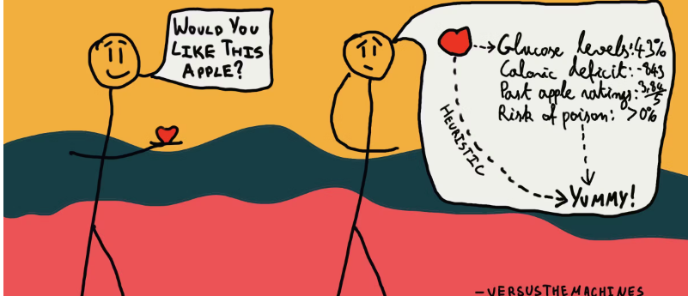

Slide 3
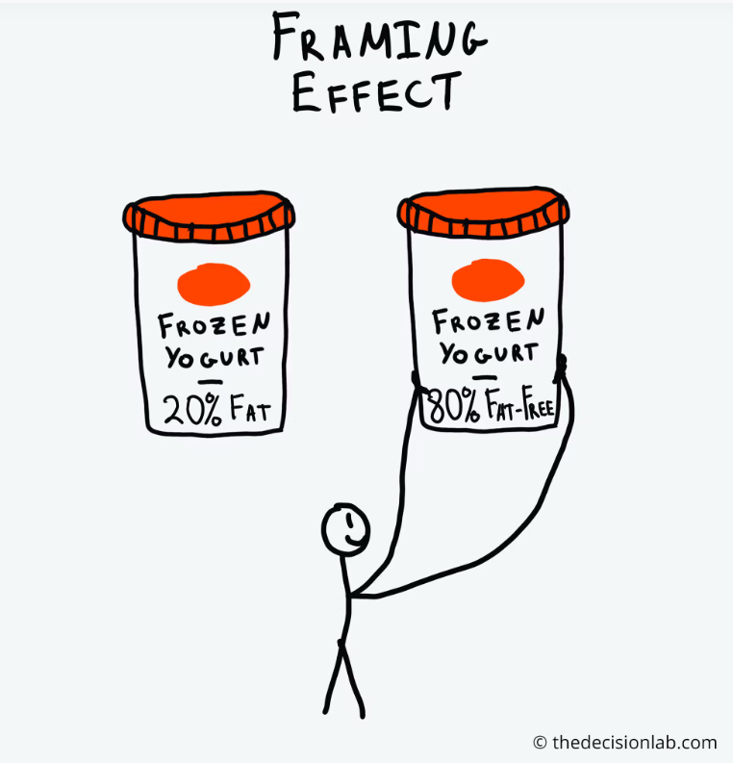
Notes:
1. We are not cold-blooded optimisers – not biases but cognitive inclinations (response to how we have evolved and behave in real life. BS looks at what people do, do rather than what they should do
2. BS is not all about nudges – human emotions, decision making and real-life behaviours (helps us to understand why people make decisions, judgements, how they understand themselves and others)
Example of Framing effect

Slide 4
Behavioural science looks at what people do, rather than what they should do

Slide 5
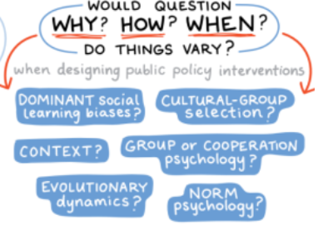
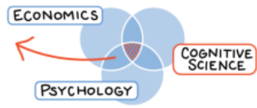
BEHAVIOURAL
SCIENCE
What is Behavioural Science

Slide 6
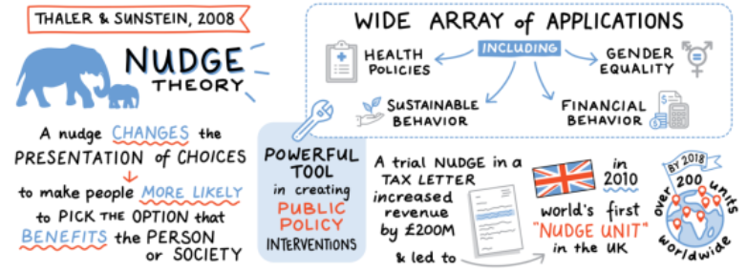
Applying Behavioural Science

Slide 7


Slide 8
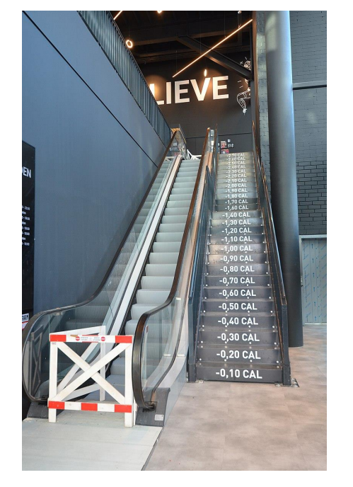

Slide 9
the fun theory piano steps - Google Search

Slide 10
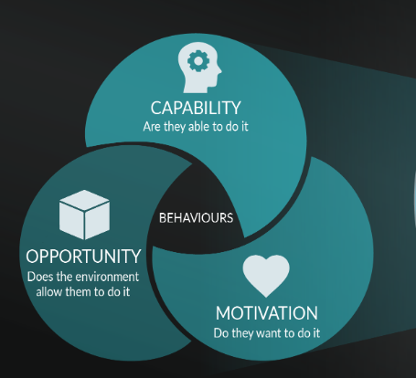
COM-B model
A behaviour change framework that proposes three necessary components for any behaviour (B) to occur

Slide 11
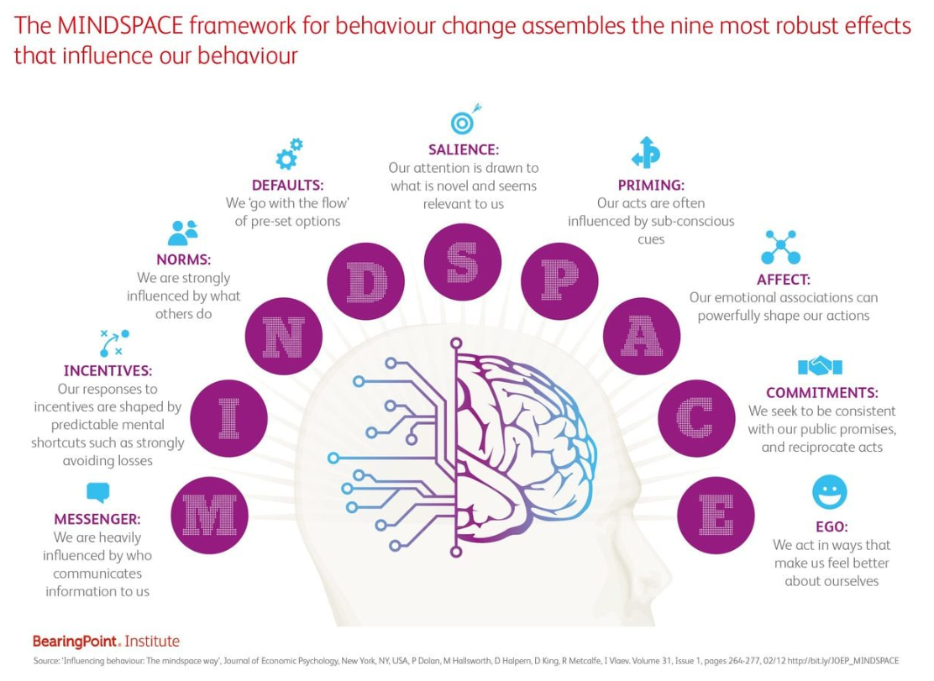
MINDSPACE
A tool used to integrate principles of behavioural science in policymaking. It highlights nine important factors that influence all behaviour

Slide 12


3 Key Takeaways
Learning and development is instrumental in driving behaviour change to improve productivity, performance and engagement
Behavioural science frameworks such as COM-B and MINDSPACE can help us design interventions that drive this behaviour change
This approach has the potential to actually make a difference - positively impacting the lives of employees, the performance of organisations and possibly society as a whole

