Slide 1
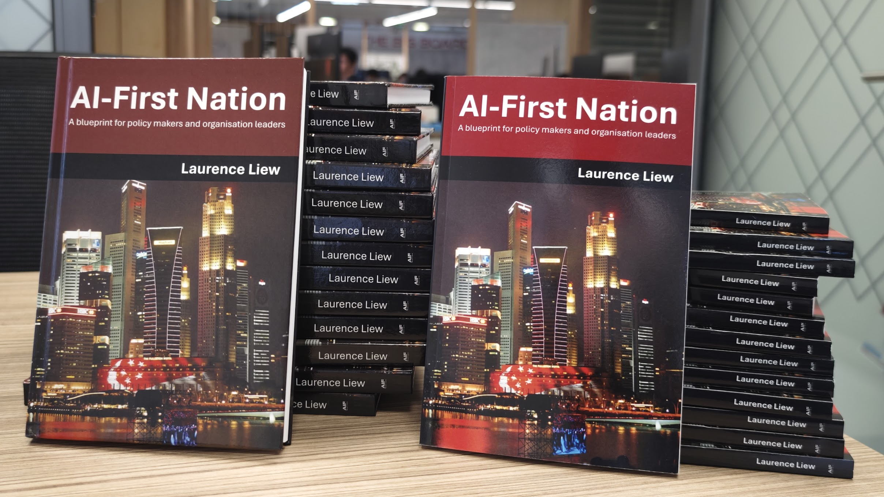
Future of Learning
Reshaping Teams, Work & Learning in the Age of Agentic AI
Laurence Liew | Director, AI Industry Innovation | AI Singapore
Notes:
Good morning. I am Laurence Liew, Director for AI Industry Innovation and AI Makerspace at AI Singapore. Today I want to talk about something that keeps educators, trainers, and business leaders up at night: how do we train people for an AI era when AI itself is changing faster than we can design curricula?
DELIVERY NOTE: Establish the problem immediately. Pause after the question.

Slide 2






AI Singapore
AI
PRODUCTS
AI
GOVERNANCE
AI TALENT DEVELOPMENT
Build catalytic AI products/solutions to enrich Singapore AI Ecosystem
Establish Singapore as a leading hub for responsible and trusted AI
Nurture and empower the next generation of AI professionals, and position Singapore as a hub for AI talent
Support Singapore’s vision to be a leader in developing scalable, impactful AI solutions strategic to the nation
AI RESEARCH
AI TECHNOLOGY
AI
INNOVATION
Sustain investments in fundamental AI research to ensure SG’s relevance in the global AI race
Support applied AI research projects which are aligned to the National AI Strategy
Catalyze and support more widespread industry adoption of AI
Notes:
Quick context about who we are. AI Singapore is Singapore's national AI programme, bringing together government, academia, and industry. We focus on AI research, technology development, industry adoption, governance, and AI products.

Slide 3
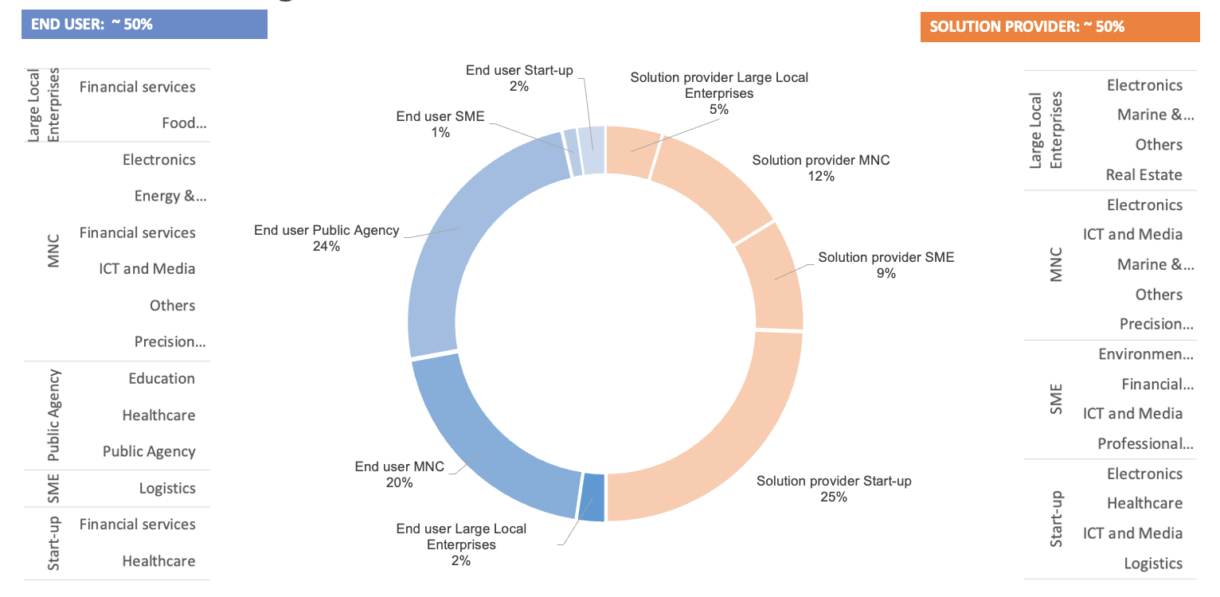
Real World Industry Projects Delivered
8 Years
300 AI projects deployed
500 AI Engineers trained
1000 Companies engaged
250,000 Completed AI For Everyone
> 300
completed
As of July 2025
Notes:
More importantly for today's conversation, we have trained over 500 AI engineers through our AI Apprenticeship Programme, with a 90% placement rate. We have completed over 300 real-world AI projects with companies.
This is not theory. This is battle-tested experience at scale. Everything I share today comes from actually doing this work with hundreds of people.
These numbers represent real people solving real problems. Every statistic here represents a career transformed, a company empowered, and Singapore's AI ecosystem strengthened.

Slide 4
The AI Readiness Index: Capability Model
Value is in Tier 2-3: Applying judgment to direct AI
AI-
TIER 3: AI-COMPETENT
Architecting AI systems
Working ABOVE AI agents
COMPETENT
AI-READY
Data analysts, power-users of LLMs, basic apps via no-code, low-code. Attend (online) courses, youtube videos.
TIER 2: AI-READY
Building LLM applications
No-code/low-code platforms
Managers and team leads need this
AI-AWARE
Working professionals requiring skills to use AI tools (like Copilot, AI-infused marketing/sales tools like Mailchimp etc). Don’t require technical training. Only require vendor training on the tools – usually bundled as part of the purchase of the tool and offered FREE.
TIER 1: AI-AWARE
Using Copilot, ChatGPT Vendor training only
Everyone needs this
TIER 0: AI-UNAWARE

Slide 5
We are at an inflection point where agentic AI systems are not just automating tasks—they are performing entire knowledge worker roles.
The New Reality
Notes:
Here is what is keeping leaders up at night: AI is no longer optional. It is transforming every industry, every job function, every business process. But here is the challenge - the very nature of the skills we need is changing faster than we can train people. [PAUSE]
Traditional approach: hire more people, train them on tools, hope for the best. But that approach is not working anymore. Why? Because AI is fundamentally changing WHAT we need people to do.
We are not just automating tasks. We are transforming entire workflows, decision-making processes, and the fundamental relationship between humans and technology.

Slide 6
Competition Moves Upstream
What AI Commoditized:
✅ Excellent writing (GPT-4)
✅ Code syntax (Copilot)
✅ Data analysis (Claude)
✅ Document summarization
What Humans Now Compete On:
• How well can you THINK?
• Can you ARCHITECT systems?
• Can you EVALUATE ai-generated output critically?
• Can you ask WHY repeatedly?
📈 The basis of competition has moved UPSTREAM to JUDGEMENT!
Notes:
Look at what AI has commoditized in just the past two years:
Excellent writing - GPT-4 writes better than most humans.
Code syntax - Copilot completes code instantly.
Data analysis - Claude analyzes spreadsheets in seconds.
Document summarization - AI reads and summarizes faster than any human
.
So what do humans now compete on? [PAUSE]
How well can you THINK?
Can you ARCHITECT systems?
Can you EVALUATE AI-generated output critically?
Can you ask WHY repeatedly until you get to root causes?
These are not technical skills you can teach in a bootcamp. These are judgement capabilities that must be developed over time through real experience. This is what we must train people for.

Slide 7
100E Powered by AI Apprenticeship Programme (AIAP)

Slide 8
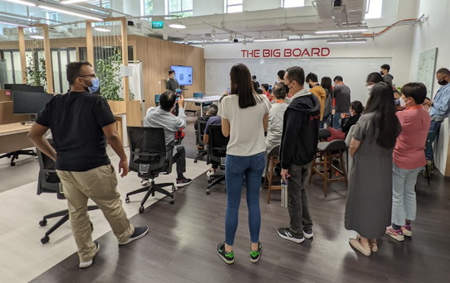
The AIAP Approach
Phase 1 (Deep-Skilling) - Building JUDGEMENT!
Understanding over syntax
Foundations matter!
Socratic
Why and Why not!
When to use. When not to use!
Phase 2 (Project)
Real-world projects (real-world pain!). Including AIAP-Foundations!
Team-work (humans + humans)
Team-work (humans + agents) / 2024
Stakeholder management
Deploy systems
Theory meets practice!
The 'Why?' Protocol:
Student: 'I chose this algorithm'
Instructor: 'Why?'
Student: 'It's more accurate'
Instructor: 'What did you trade off?'
Student: [must apply JUDGMENT]

Slide 9
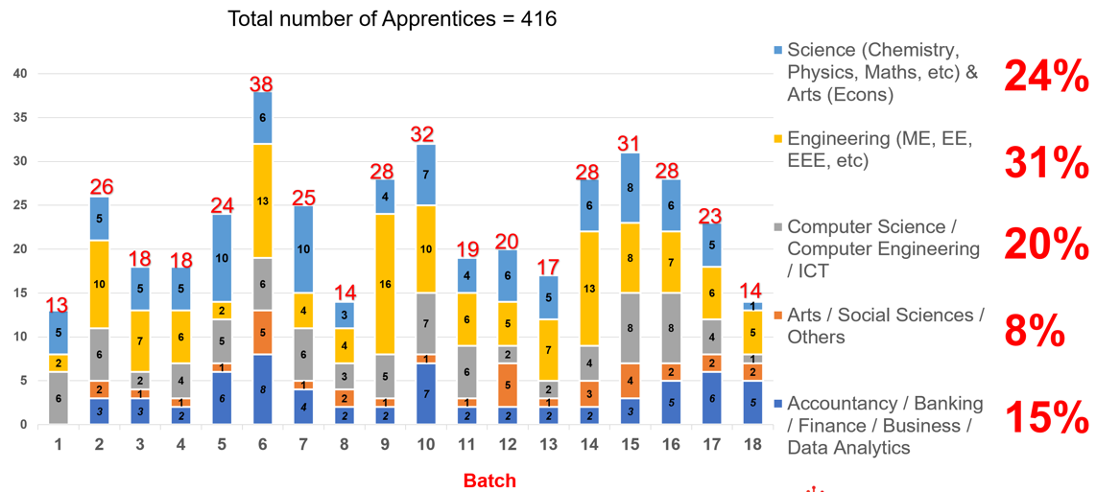
The AI Apprenticeship Programme Outcomes
🎓 500+ AI engineers trained |🚀 300+ AI projects completed | 📊 90% placement rate

Slide 10







AIAP Evolution
AIAP
2018
2019-2023
2024
2025
AIAP
Foundations
2024…

Slide 11








AIAP-Foundations
Real humans monitor progress of simulation
Monitoring Dashboards
Human AI Mentor
Human MLOps
AI Mentor Agent
MLOps Mentor Agent
AIAP-Foundation Agentic Platform
PM also plays the role of Project Sponsor
Human Learner
Sponsor Agent*
Human PM
Human Project Sponsor
Apprentice Agent*
Problem Statement
PM Agent
Anonymized past 100E scenarios and public or generated datasets
Generated scenario and datasets based on learner problem statement
Consultant Agent
* Available in 2026

Slide 12
The Death of One-Size-Fits-All Learning
Traditional E-Learning:
❌ Generic content for everyone
❌ Abstract examples
❌ 5% retention after 30 days
❌ 'But how does this apply to ME?'
AI-Powered Learning:
✅ Role-specific curriculum
✅ Company-relevant examples
✅ Higher retention
✅ Aaahhhhhhhh!'
Predict HDB price
Predict HDB price
Predict HDB price
Employee churn prediction
Predict machine failure
Classify high risk customers…

Slide 13
Stop RE-Skilling | Start PLUS-Skilling
❌ Traditional RE-Skilling
✅ PLUS-Skilling Revolution
'Your job is obsolete,
learn something new'
❌ Abandon 20 years of expertise
❌ Compete with fresh graduates
❌ Start from zero
❌ Generic training programs
Example:
'I am a 38-years old engineer and want
to career switch to become an AI developer'
‘Keep your expertise
Add AI capabilities'
✅ Leverage domain knowledge
✅ AI amplifies experience
✅ Build on strengths
Winning formula: Domain + AI => Supercharged
Example:
Accountant + AI = Fraud expert
Engineer + AI = Data Scientist for Global Engineering

Slide 14
The AI Era Education Imperative
Stop Training People to Compete with AI — Start Building Judgment at Scale
AI = Prediction | Humans = Judgment
Your competitive advantage is not what AI can predict, but the quality of human judgment you can deploy.
Strong Foundations + PLUS-Skilling
Fundamentals remain essential
Add AI skills integrated into curriculum
Prompt engineering, agentic AI, LLM development
Enable: Judgment + Leverage
Focus on Uniquely Human Capabilities
Judgment (weighing trade-offs)
Asking 'Why?'
Making decisions under uncertainty
Ensure: Relevance
Judgment Must Be Learned By Doing
Move from static courses to adaptive learning
Create environments where people learn by doing
Make decisions, own outcomes, learn from consequences
Build: Systems that enable judgment at scale
Co-Invention is Mandatory: Reorganize around Prediction / Judgment split
Notes:
The compounding effect of continuous learning cannot be overstated. After AIAP, graduates do not stop learning. They continue to grow in their roles, taking on increasingly complex challenges.
Year one: they deliver their first production AI system. Year two: they mentor others and lead projects. Year three: they architect solutions and drive strategy. This is the talent pipeline you need.
And because they grew within your organization, they understand your business deeply. They are not just technical experts - they are business-aligned technical experts.

Slide 15
Software Engineering in the age of AI
FSE 2025 Research: Skills & Knowledge for AI-Enhanced Software Development
🔬 GOOGLE RESEARCH FOUND
✓ AIAP ALREADY DELIVERS
Future developers need skills of TODAY'S senior developers
Six-step workflow requires domain expertise at EVERY step
Developers < 1 year experience perform 7-10% WORSE with AI
Real risk of “deskilling” without proper training
✓ 9-month immersive program builds senior-level judgment
✓ Real projects force all 6 steps of workflow (50+ hrs/week)
✓ Apprentices work WITH senior AI engineers (avoid deskilling)
✓ 500+ graduates with production-ready AI + domain expertise
"The AI-enhanced developer (of tomorrow) will need to have the skills & knowledge of today's senior developer."
— Kam et al., FSE 2025 (Google Research)
Notes:
Let me share something that validates everything we have built with AIAP. [PAUSE]
What did Matthew Kam's team find?
Finding 1: Six-step AI workflow requires domain expertise at EVERY step.
How AIAP addresses: We build deep technical skills FIRST before real projects.
Finding 2: Junior developers take 7-10% LONGER with AI tools.
How AIAP addresses: After 9 months, graduates have 2-3 years equivalent experience.
Finding 3: AI-enhanced developers need today's senior developer skills.
How AIAP addresses: This IS our PLUS-Skilling model. Deep + Broad + Domain.
Finding 4: Risk of "deskilling" without proper training.
How AIAP addresses: We build fundamentals first. Understand WHY before using AI.
This is not us claiming success. This is peer-reviewed research validating our approach.
CRITICAL ATTRIBUTION NOTE: This is external validation. Speak confidently but humbly. You validate research, you did not author it. Always attribute to Matthew Kam's team at Google Research.

Slide 16
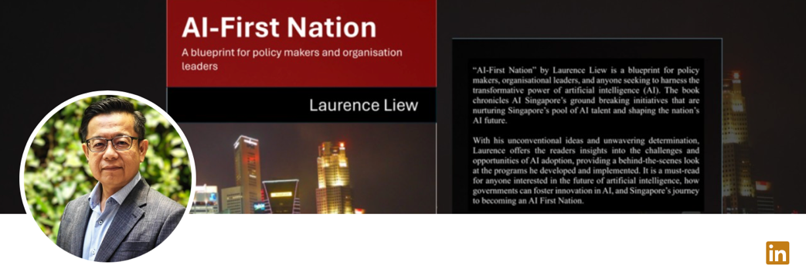
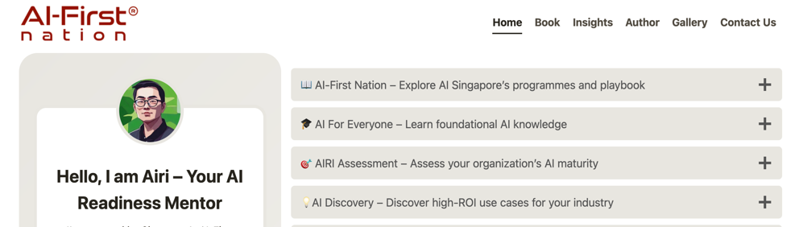

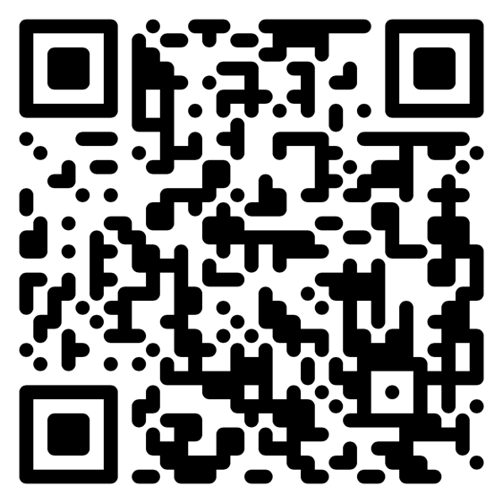
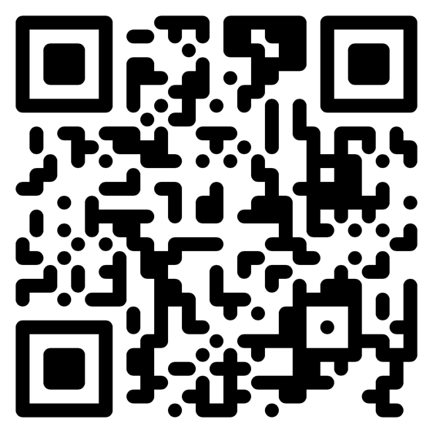
Connect with me on Linkedin!
Chat with me on

