Slide 1

Future of Work
Reshaping Teams, Work & Learning in the Age of Agentic AI
Laurence Liew | Director, AI Industry Innovation | AI Singapore
Notes:
Good morning. I am Laurence Liew, Director for AI Industry Innovation and AI Makerspace at AI Singapore. Today I want to talk about something that keeps educators, trainers, and business leaders up at night: how do we train people for an AI era when AI itself is changing faster than we can design curricula?
DELIVERY NOTE: Establish the problem immediately. Pause after the question.

Slide 2






AI Singapore
AI
PRODUCTS
AI
GOVERNANCE
AI TALENT DEVELOPMENT
Build catalytic AI products/solutions to enrich Singapore AI Ecosystem
Establish Singapore as a leading hub for responsible and trusted AI
Nurture and empower the next generation of AI professionals, and position Singapore as a hub for AI talent
Support Singapore’s vision to be a leader in developing scalable, impactful AI solutions strategic to the nation
AI RESEARCH
AI TECHNOLOGY
AI
INNOVATION
Sustain investments in fundamental AI research to ensure SG’s relevance in the global AI race
Support applied AI research projects which are aligned to the National AI Strategy
Catalyze and support more widespread industry adoption of AI
Notes:
Quick context about who we are. AI Singapore is Singapore's national AI programme, bringing together government, academia, and industry. We focus on AI research, technology development, industry adoption, governance, and AI products.

Slide 3
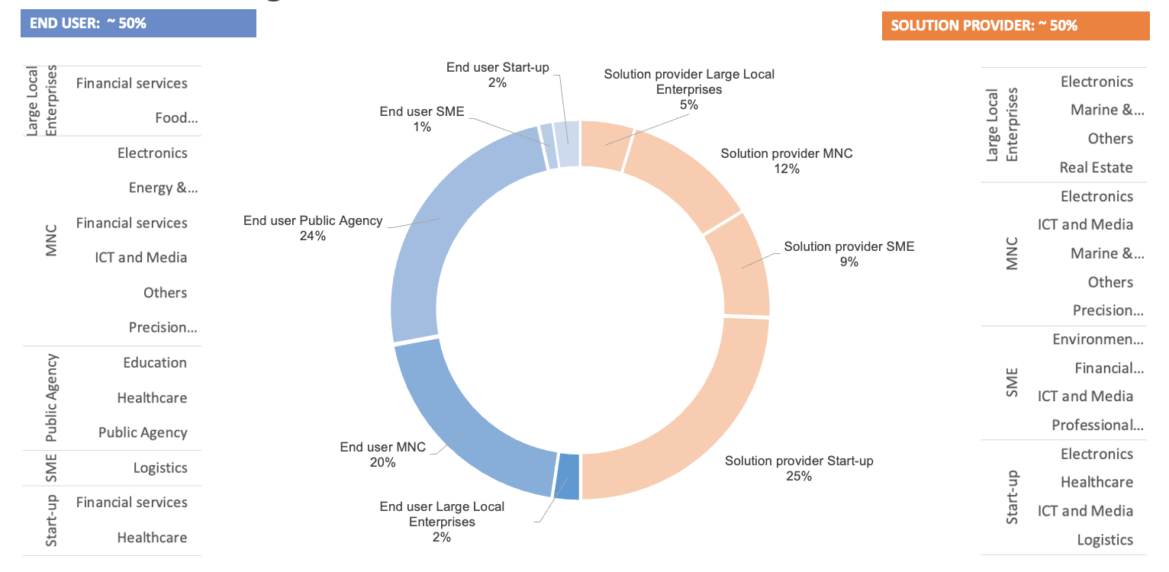
Real World Industry Projects Delivered
8 Years
300 AI projects deployed
500 AI Engineers trained
1000 Companies engaged
250,000 Completed AI For Everyone
> 300
completed
As of July 2025
Notes:
More importantly for today's conversation, we have trained over 500 AI engineers through our AI Apprenticeship Programme, with a 90% placement rate. We have completed over 300 real-world AI projects with companies.
This is not theory. This is battle-tested experience at scale. Everything I share today comes from actually doing this work with hundreds of people.
These numbers represent real people solving real problems. Every statistic here represents a career transformed, a company empowered, and Singapore's AI ecosystem strengthened.

Slide 4
The AI Readiness Index: Capability Model
Value is in Tier 2-3: Applying judgment to direct AI
AI-
TIER 3: AI-COMPETENT
Architecting AI systems
Working ABOVE AI agents
COMPETENT
AI-READY
Data analysts, power-users of LLMs, basic apps via no-code, low-code. Attend (online) courses, youtube videos.
TIER 2: AI-READY
Building LLM applications
No-code/low-code platforms
Managers and team leads need this
AI-AWARE
Working professionals requiring skills to use AI tools (like Copilot, AI-infused marketing/sales tools like Mailchimp etc). Don’t require technical training. Only require vendor training on the tools – usually bundled as part of the purchase of the tool and offered FREE.
TIER 1: AI-AWARE
Using Copilot, ChatGPT Vendor training only
Everyone needs this
TIER 0: AI-UNAWARE

Slide 5
We are at an inflection point where agentic AI systems are not just automating tasks—they are performing entire knowledge worker roles.
The New Reality
Notes:
Here is what is keeping leaders up at night: AI is no longer optional. It is transforming every industry, every job function, every business process. But here is the challenge - the very nature of the skills we need is changing faster than we can train people. [PAUSE]
Traditional approach: hire more people, train them on tools, hope for the best. But that approach is not working anymore. Why? Because AI is fundamentally changing WHAT we need people to do.
We are not just automating tasks. We are transforming entire workflows, decision-making processes, and the fundamental relationship between humans and technology.

Slide 6
AI is NOT Overhyped—It's Misunderstood
Industrial Revolution-scale transformation >>>> INTERNET
Cognitive work done by AI at a fraction of the cost in a fraction of the time!! → COSTS COLLAPSE!
THE ELECTRICITY PARALLEL
AI is the first tool that learns from use…Every day you wait, competitors build better AI
Notes:
Some people say AI is overhyped. They are wrong. AI is not overhyped - it is misunderstood. [PAUSE]
This is MORE than the internet. We are looking at Industrial Revolution-scale transformation. The cost collapse we are seeing is unprecedented - cognitive work done by AI at a fraction of the cost in a fraction of the time.
In the 1900s,when ELECTRICTY was introduced - only 3% of factories adopted electricity and saw NO gains. Why? Because they just replaced steam engines with electric motors but kept the same factory floor layout. By 1920, factories that REDESIGNED their entire layout around electricity saw 300-500% productivity boosts.
Hence if you look at using AI to replace specific tasks only – you are missing the bigger picture. You need to leverage Aito transform your whole workflow, organization, ecosystem.
AI different from every tool before it: AI is the first tool that learns from use. It gets better as more people use it.
That changes everything about how we must approach training.
DELIVERY NOTE: The electricity parallel is crucial - slow down here. This sets up the co-invention concept that runs through both presentations.

Slide 7
The New Division of Labor: Prediction vs. Judgment
AI = PREDICTION
HUMANS = JUDGMENT
Computational statistics
Pattern recognition
Next word, next move
Cancer from image
Code completion
Speed: Microseconds
Cost: Cents
⚠️ HAS ZERO JUDGMENT
Weighing trade-offs
Understanding context
Evaluating preferences
Deciding what to build
Making strategic calls
Costs: High
✨ THIS IS IRREPLACEABLE
Owning outcomes
Notes:
Let me give you the most important framework for understanding AI and training. Everything else I say today builds on this. [PAUSE]
AI and Machine Learning excel at PATTERN RECOGNITION. It is about finding PATTERNS in data and making PREDICTIONS based on those patterns. Generative AI adds content generation - it can predict the next word, the next image, the next code snippet.
AI is computational statistics. It recognizes patterns and predicts outcomes. It does this at microsecond speed for cents. These are powerful capabilities. [PAUSE]
But here is what AI cannot do: exercise JUDGEMENT. [Spell it out]
AI cannot understand deep context. It cannot make ethical decisions. It cannot think strategically about what problem is worth solving. It cannot evaluate whether a technically correct answer is actually the right solution for the business. It cannot weigh trade-offs or evaluate preferences. It cannot own outcomes.
This distinction - between PATTERN RECOGNITION and JUDEGEMENT - is crucial to everything about training people for the AI era. We need to train people for the things that require judgement, not the things that require prediction. Keep this framework in mind - I will refer back to it repeatedly.
DELIVERY NOTE: This is your foundational framework. Take your time. Use hand gestures to physically separate "prediction" and "judgement." This will be referenced throughout both presentations.

Slide 8
"Spreadsheets didn't eliminate accountants. They eliminated arithmetic. The job shifted entirely to applying judgment: which numbers to input, how to interpret outputs, what trade-offs to make."
The Historical Parallel
Notes:
Traditional training approaches are failing. Three-month bootcamps that focus on using GUI tools without deep understanding. Online courses that teach algorithms but not how to deploy them in production. Programs that teach Python but not software engineering best practices.
The result? Graduates who have certificates but cannot deliver real-world AI solutions. Companies that hire these graduates and then spend six more months training them. And a growing junior gap crisis that threatens our entire AI talent pipeline. [PAUSE]
But there is a better way. And we have proof that it works.
Let me show you what we built at AI Singapore, and more importantly, the outcomes we have achieved at scale.

Slide 9
"AI generated 90% of the code. Human judgment provided 100% of the architecture."
The Reality of Production Systems

Slide 10
The Six-Step AI Workflow: Why Judgment Matters MORE
Domain expertise required at every step - this is not prompt engineering, it's judgment engineering
1. IDENTIFY
AI: What info does AI need?
👤 Human knows: Context, requirements, constraints
2. ENGAGE
AI: Prompt AI clearly
👤 Human knows: Problem statement, desired outcomes
3. EVALUATE
AI: Check AI output
👤 Human knows: Quality standards, best practices
4. CALIBRATE
AI: Steer AI with feedback
👤 Human knows: Desired results, trade-offs
5. TWEAK
AI: Improve AI output
👤 Human knows: Domain expertise, coding standards
6. FINALIZE
AI: Document reasoning
👤 Human knows: Why solution works, decisions made
⚡ THE CRISIS: Junior developers used to build foundational skills by doing the repetitive work that AI now automates.
If AI does the repetitive work, and juniors never build foundational skills, how do they develop the judgment needed for these 6 steps?
Notes:
Let me break down the six-step workflow from Matthew Kam's research. This shows exactly why pattern recognition alone is not enough - we need judgement at every step.
Step 1 - IDENTIFY: AI processes queries. Humans determine WHAT is needed based on domain expertise. Without understanding the problem deeply, you cannot even formulate the right query.
Step 2 - ENGAGE: AI responds to prompts. Humans clearly express needs and context. Effective engagement requires communication skills and technical understanding.
Step 3 - EVALUATE: AI provides outputs. Humans cross-check against domain knowledge to catch failures. This is where junior developers without expertise fail - they cannot evaluate if outputs are correct.
Step 4 - CALIBRATE: AI refines based on feedback. Humans assess if outputs meet requirements. This requires both technical skills and business understanding.
Step 5 - TWEAK: AI generates variations. Humans iteratively improve and optimize. Engineering skills matter here - knowing what to change and why.
Step 6 - FINALIZE: AI produces solution. Humans integrate into systems and ensure production readiness. This requires full-stack capabilities and systems thinking.
See the pattern? At EVERY step, humans need domain expertise and judgement. Junior developers lacking expertise cannot identify needs, evaluate outputs, or integrate properly.
This is not prompt engineering. This is JUDGEMENT engineering. And judgement requires the deep fundamentals and broad capabilities we build through PLUS-Skilling.
DELIVERY NOTE: Walk through methodically. Use visual. Build to soundbite with maximum impact.

Slide 11
The Three Stages of AI Empowerment
STAGE 1:
Just One Man
🧑
STAGE 2:
Man + Iron Man Suit
🧑🦾
STAGE 3:
Leading Avengers
🧑🦾🦸🦸‍♀️🦸‍♂️
Pre-AI Era: • Computer as tool • Manual work • Limited by human speed • One person, one output
PLUS-Skilling: • Individual + AI • Augmented capabilities • 10x productivity • One-person superhero
Agentic AI Teams: • You + AI agents • Each agent specialized • You orchestrate & judge • Superhero team leader
Notes:
Think of Iron Man. Tony Stark without the suit is brilliant. But Tony Stark WITH the suit is transformational. The suit amplifies his capabilities without replacing his judgement.
This is the model for individual augmentation. AI tools are the Iron Man suit. But you need the Tony Stark underneath - the knowledge, the judgement, the strategic thinking.
Junior developers without fundamentals are like trying to wear the Iron Man suit without being Tony Stark. The suit does not help. It actually makes things worse because you do not know how to use it effectively.

Slide 12
What We Actually Know About AI and Jobs
"I can tell you, no one knows anything."
— Ethan Mollick, Wharton AI Expert (CNBC, Oct 2025)
❌ WHAT WE DON'T KNOW
Which jobs will change
What skills will matter in 5 years
How fast disruptions will happen
Notes:
Let me bring in more expert voices to validate what we are seeing.
Professor Ethan Mollick from Wharton says: "No one knows anything" because no one has five years of experience with generative AI yet. But the evidence DOES show three critical patterns:
First, properly trained professionals with AI tools show 25-40% productivity gains. BCG and P&G studies demonstrate this consistently. But notice: PROPERLY TRAINED professionals. Training matters.
Second, soft skills matter MORE in the AI era. Leadership is about asking right questions, not having all answers. Communication becomes critical. Stakeholder management becomes essential. AI cannot replace these human capabilities.
And third, from Matthew Kam's research, the six-step AI workflow requires human judgement at every step:
1. IDENTIFY what AI needs - requires domain expertise
2. ENGAGE effectively - requires communication skills
3. EVALUATE critically - requires technical knowledge
4. CALIBRATE results - requires domain expertise
5. TWEAK and improve - requires engineering skills
6. FINALIZE and deploy - requires systems thinking
This is not prompt engineering. This is JUDGEMENT engineering.
DELIVERY NOTE: "This is not prompt engineering. This is judgement engineering" is your soundbite. Deliver with conviction. Pause after.

Slide 13

I am a 38-year engineer, I want to do a mid-career switch!

Slide 14



PLUS-skill and Deep-skill! Not re-skill!
+
=

Slide 15

Future of Work (1)
“Managers” will be replaced by
AI

Slide 16
Future of Work (2)
“Managers” will be replaced by
AI
Managers who uses a fleet of AI AGENTS
Data Scientists, Lawyers, Doctors, Accountants, Engineers….

Slide 17
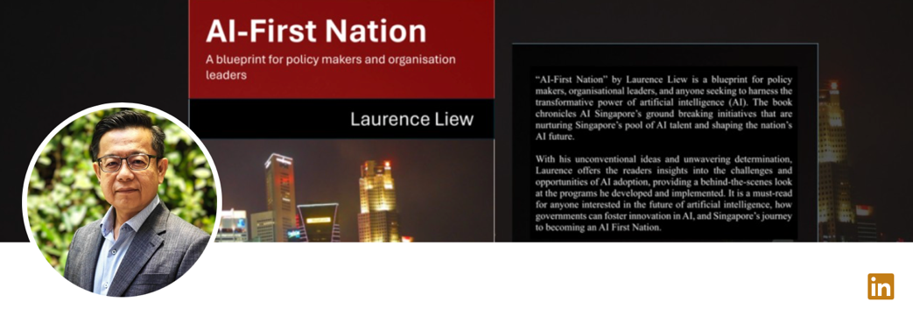
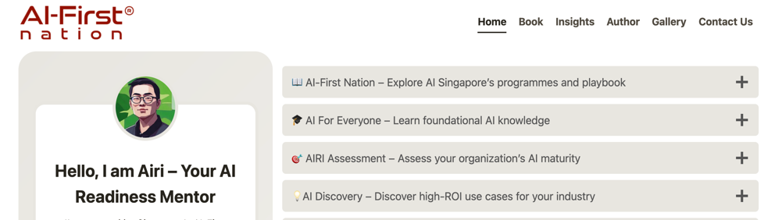

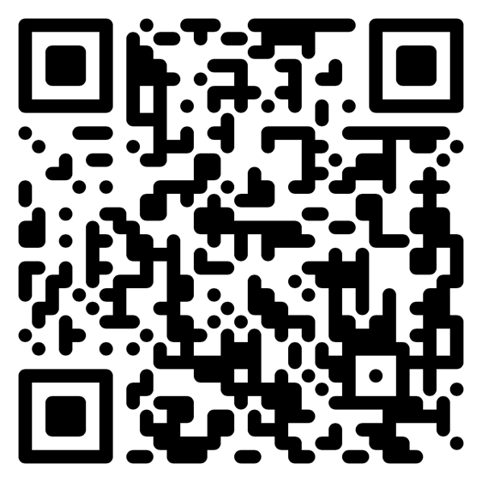
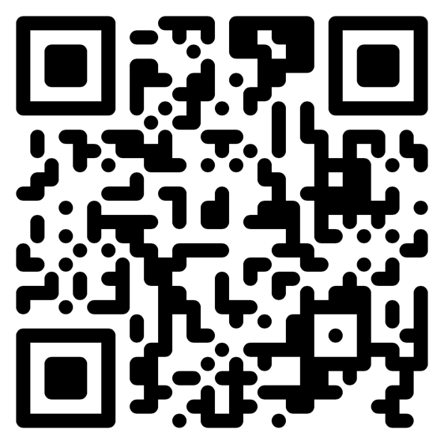
Connect with me on Linkedin!
Chat with me on

