Slide 1
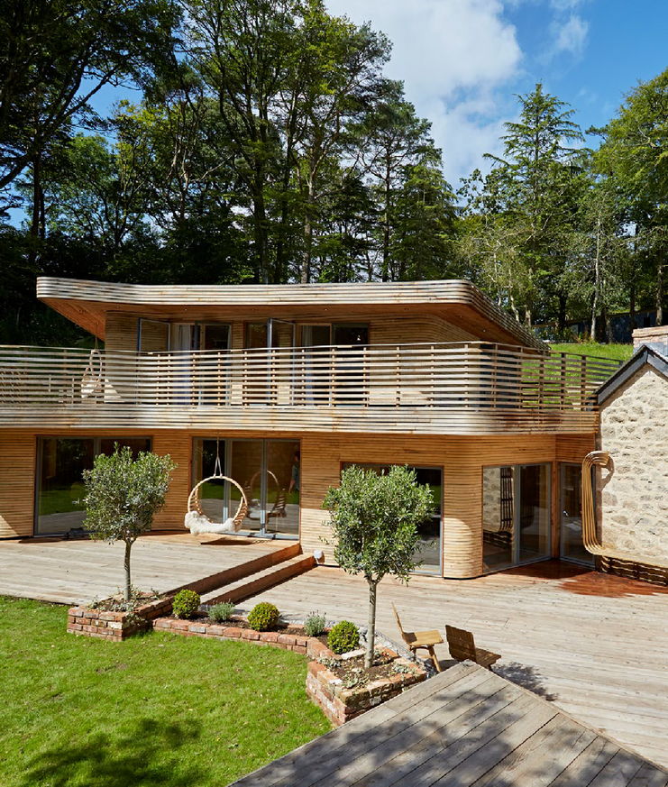

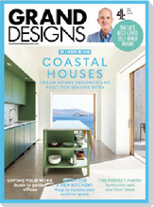
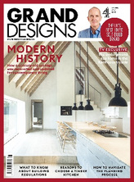
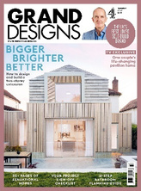
How to become a Grand Designs magazine
approved partner
Engage with an audience who are passionate about
creating a dream home that they long to live in
What is the Grand Designs magazine Premium Partner scheme? It’s a coveted Grand Designs magazine endorsement. Being a Premium Partner will send a strong signal to a wider audience that an approved brand represents excellence in its industry, offering products and services of the best quality. The magazine approvals team will identify, assess and select brands suitable for Premium Partner status. Companies which meet
the criteria will need to demonstrate exemplary customer service, product innovation and sustainable business practices.

Slide 2

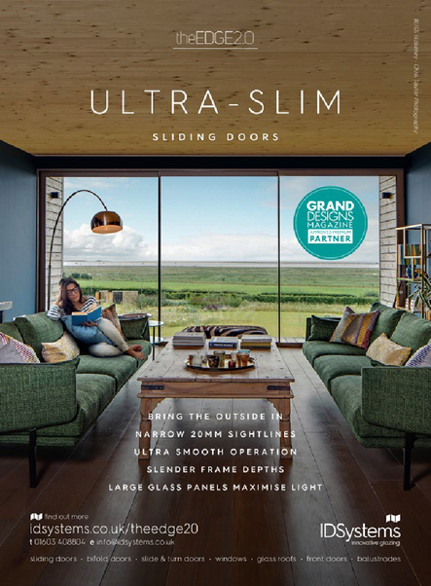


How being a Grand Designs partner can benefit your brand
Grand Designs magazine is a multi- platform global brand. It has the power to enhance a partner brand’s reach and influence with a highly motivated, high-income audience. The magazine represents 20 years of authority in the arena of self-build, renovation and home-improvement inspiration and ideas.
How it works
The approvals team will pre-select brands that align with the Grand Designs magazine ethos.
We will be looking for trustworthy expertise, quality products and an eco-conscious track record. Selected companies will be expected to provide customer testimonials, along with evidence of their sustainability and business ethics policies. If a brand passes the screening process, it will be able to select from a range of Grand Designs magazine Premium Partner endorsement opportunities.

Slide 3
Grand Designs Magazine Approved Premium Partner
GRAND DESIGNS MAGAZINE - APPROVED PREMIUM PARTNER - MENU OF OPPORTUNITIES | TIER 1 £10,000 | TIER 2 £7,500 | TIER 3 £5,000 | TIER 4 £2,500
Print Advertising - Full page adverts within Grand Designs Magazine. | x2
TV & Radio - The Grand Designs Approved Partner branding can be included as an endorsement applicable to your business incorporating TV & Radio advertising campaigns. | • | •
Promoted targeted solus emails - The solus emails are sent to subscribers who have requested information on a particular product/service and will incorporate the Grand Designs Approved Partner endorsement. | x4 | x3
Paid media - The Grand Designs Approved Partner endorsement can be included within your business message on PPC marketing, branded content and display ads. | • | • | •
Website logo - The Grand Designs Approved Partner endorsement can be incorporated across the website pages of your business. | • | • | • | •
Social video marketing - The Grand Designs Approved Partner endorsement can be incorporated when promoting your company on YouTube, Facebook, Instagram, Vimeo and X. | • | • | • | •
Fleet vehicles & company clothing branding - The Grand Designs Approved Partner endorsement can be incorporated on fleet vehicles and clothing along with the opportunity to include the branding at shows & exhibitions. | • | • | • | •
Marketing collateral - The Grand Designs Approved Partner endorsement can be incorporated on the printed marketing material including, leaflets, brochures & magazines, relating to your business. | • | • | • | •
Premium Partner company advertorial on the Grand Designs magazine website. 12 month tenancy - The advertorial will remain on the website for 12 months incorporating the Grand Designs Approved Partner logo. 25k social media impressions, included one week after the advertorial live date, to drive traffic to the advertorial. | • | • | • | •
Promoted company social media posts - 25k impressions relevant to each post sent directly to Grand Designs followers who match a target audience across Facebook, and Instagram. Each social post will incorporate the Grand Designs Approved Partner endorsement. | x6 | x6 | x4 | x2

Slide 4
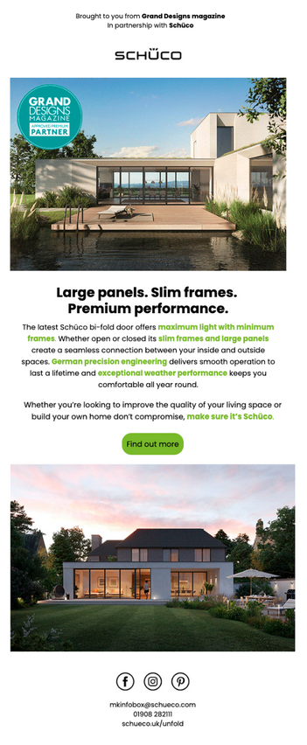
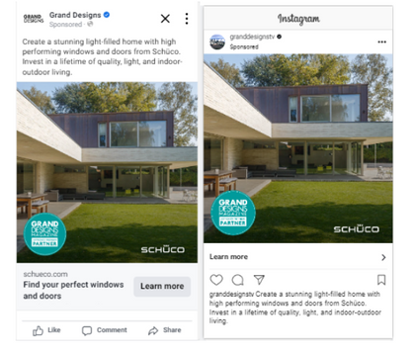
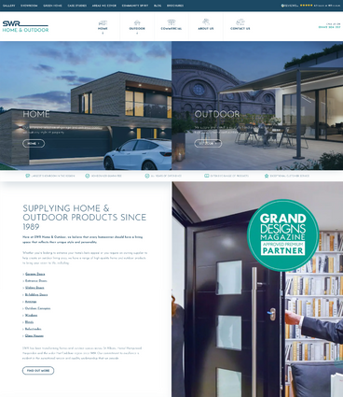
Creative Examples
Solus Emails
Social Posts
Websites
GRANDDESIGNS portfolio of products
GRANDDESIGNS portfolio of products

Slide 5
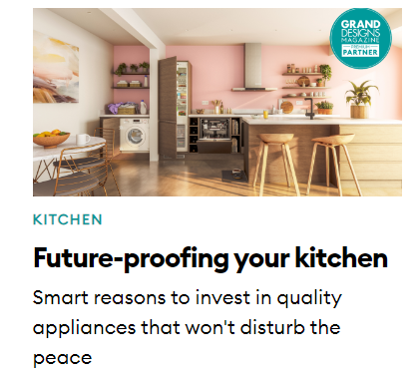
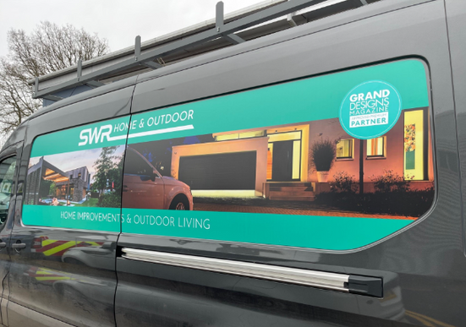
Creative Examples
Advertorials
Branding
GRANDDESIGNS portfolio of products
GRANDDESIGNS portfolio of products

Slide 6

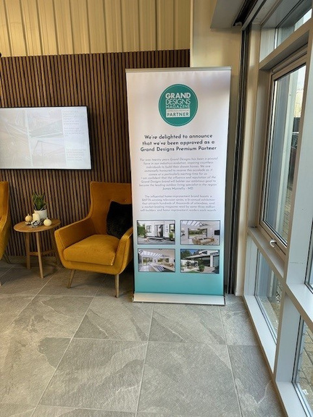
Creative Examples
Branding
Branding
GRANDDESIGNS portfolio of products
GRANDDESIGNS portfolio of products

