Slide 1
MEDIA PACK
2024

Slide 2
Summary
Brand overview​
Digital data​
Online feature​
Targeted solus newsletter​
Re-targeting and geo-targeting​
Social media​
Lead gen​
Display advertising​
Premium partner

Slide 3
Brand overview
The Grand Designs portfolio, run by Media 10 includes a biannual live event and the monthly publication, based on the hit television show hosted by Kevin McCloud and broadcast on Channel 4 and All 4. The show includes a series of inspirational, self-build and renovation projects that span a wide range of styles, periods, locations and budgets​
​
Grand Designs' digital presence offers fully responsive, multi-platform inspiration and includes architecture, design, construction and interiors ideas, as well as advice to empower the audience to create their own Grand Design. The website provides the user with a stream of exclusive articles, expert advice and home-related news keeping viewers engaged and up-to-date with the latest developments.

Slide 4
(How we get our data)
(How we get our data)
Their interests​
How is the data gathered?
Brand overview
Newsletter subscribers are regularly asked to update their product interests to keep the audience engaged
DIGITAL
PRINT
LIVE
SOCIAL
36,000 PRINT AND DIGITAL COMBINED SUBSCRIBERS
DEMOGRAPHIC
574,286
72% social grade A-B
847,000
FOLLOWERS
Regular reader surveys
QR codes in both print and digital issues
Giveaways
88% have a mortgage or own a house outright
209,090
63,990
£76k average household income
NEWSLETTER
COMPETITIONS
QR CODES
170,000
Data is sourced from QR codes spread throughout the shows, allowing customers to be targeted based on their interests
SUBSCRIBERS
Regular competitions feature across both print and digital platforms - this helps to create a targeted audience with specific interests
WEBSITE
PRE-SHOW FORM
granddesignsmagazine.com
When signing up to visit the live event all attendees are required to provide their:
76,000
Interests​
UNIQUE USERS PER MONTH
Reason for visiting
Personal details

Slide 5
Online feature
Bespoke advertorial features, that can be run across granddesignsmagazine.com, in print or social media
CONTENT TAILORED TO YOUR PRODUCT OR SERVICE
EDITORIAL-STYLE FORMAT TO INSPIRE AND INFORM
BESPOKE CREATIVE SOLUTIONS
OPTION TO INCLUDE VIDEO
Example of an online feature
Boost traffic to your content
Enhance the number of impressions reaching your native article with a newsletter inclusion. The Grand Designs subscribers database includes a total subscriber base of 170,000 with an average open rate of 26%

Slide 6
Targeted newsletters
Interest | Database
Holidays | 22,954
Kitchens | 22,017
Furniture | 19,774
Bathrooms | 18,444
Gardens/Leisure | 11,599
Doors/Windows | 11,453
Internal Decór Paint | 10,838
Engaging information on your product or service delivered to the inbox of Grand Designs subscribers, with data lists split into interest categories.
Choose from one of the below data pots, or take an even more targeted approach from one of the sections listed on the right.
Lighting/ Electrical | 10,391
Heating | 9,602
Home Tech Security | 9,231
Soft Furnishings | 8,887
Flooring | 8,808
Lighting | 8,580
Landscaping | 8,002
Renewables | 6,577
Self-build and
renovation
Kitchens and
bathrooms
Home
interiors
35,643 contacts
41,457 contacts
44,398 contacts
Outdoor
Living
Living
sustainably
Smart home
technology
28,719 contacts
10,889 contacts
26,496 contacts
Example of a targeted solus email

Slide 7
Retargeting and audience extension
Expand your adverts reach by re-targeting interest-based data from across those who have opened a Grand Designs targeted newsletter or the audience who have read an article on the Grand Designs magazine website.
Your potential clients will see your advert on social media and Google, with a guaranteed agreed number of impressions to expand its reach.
• GRANULAR TARGETING
• CONSUMERS HAVE PURCHASING INTENT
• GOALS CAN BE VARIED - TRAFFIC, ENGAGEMENT, SIGN-UPS ETC.
• ACCESS THE GRAND DESIGNS DATA
•OPTION TO TARGET GEOGRAPHICALLY, BY JOB TITLE OR INTEREST
Grand Designs- Retargeting and audience extension examples

Slide 8
Promoted social media content
With a combined reach of 847,000 individuals, the Grand Designs social media eco-system puts your brand front and centre with impressions guaranteed.
ACCESS THE GRAND DESIGNS ENGAGED AUDIENCE ACROSS FACEBOOK AND INSTAGRAM
GUARANTEED MINIMUM NUMBER OF IMPRESSIONS
AWARENESS
CAMPAIGN
TRAFFIC
CAMPAIGN
CLICK-THROUGH GOES TO YOUR OWN WEBSITE
25,000
impressions
25,000
impressions
50,000
impressions
50,000
impressions
REPORT OF SOCIAL PERFORMANCE PROVIDED
75,000
impressions
75,000
impressions
Example social campaigns

Slide 9
Lead gen
Lead Generation presentation
Using the Grand Designs database, your brand will be promoted by the in-house team to generate leads for you to convert into sales. The database of affluent engaged customers trust the Grand Designs brand and therefore vouch for all companies that are worked with.​
Grand Designs use your content to create promotions and
a unique landing page. This is then promoted to the
Grand Designs audience to generate leads based on
your requirements. ​
​
5.
Leads are collected and securely delivered to you in a format of your choice
2.
Marketing assets are created
4.
Through multiple targeted emails, social media campaign campaigns (Reach over 100,000 impressions) and editorial newsletter with 170,000 engaged subscribers)
3.
A bespoke landing page is created on the Grand Designs website where your potential customers fill in their details and consent for your company to follow up with them
1.
Client sends the campaign content​
Campaign run across 3 months

Slide 10
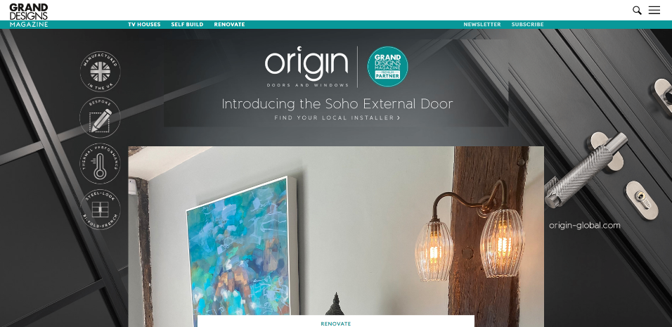
Display advertising
Reach a high-income, highly motivated audience of self-builders, renovators and home improvers. 76,000 average unique visitors each month.
HOMEPAGE TAKEOVER
LEADERBOARD (728 X 90)
MPU (300 X 250)
Entry level based on a one-month tenancy minimum

Slide 11
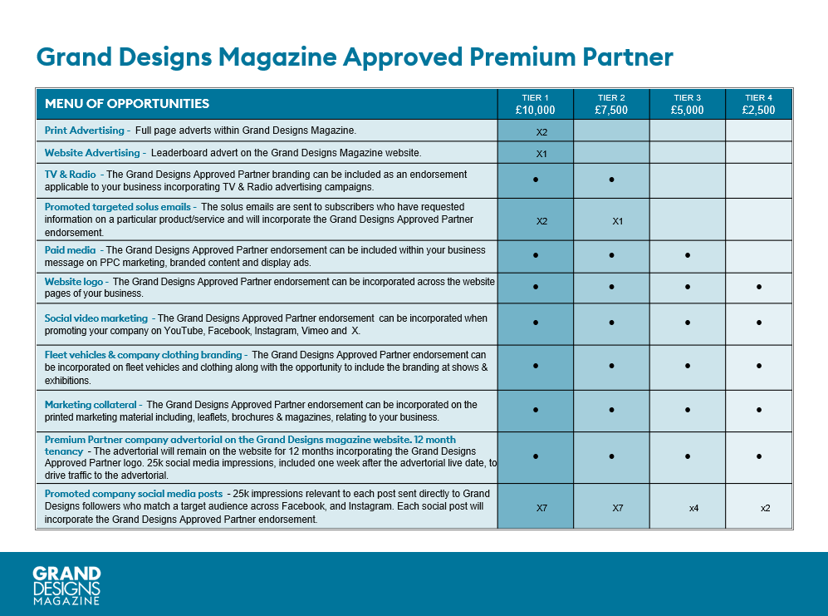
Example Premium Partner creative content Example Premium Partner creative content - 2

