Slide 2
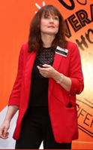
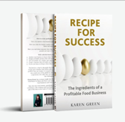
Buyer
My background
Commercial Director

Slide 3
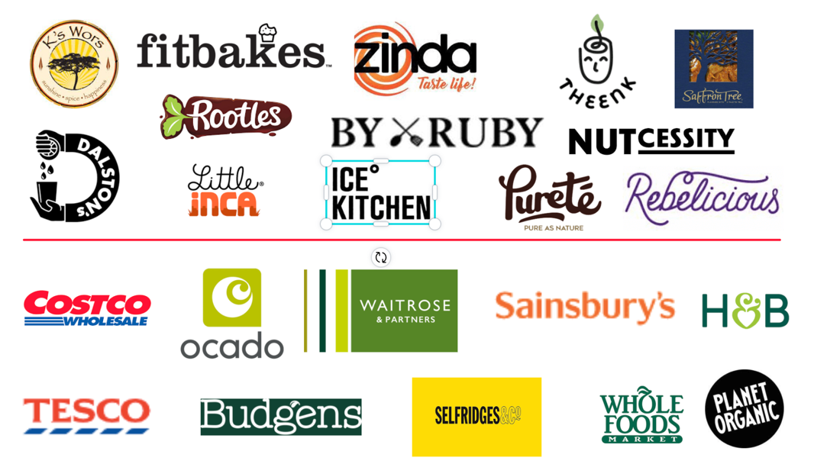

Slide 4
State of the nation

Slide 5
Opportunities for successful UK growth
Product
Impact of recession
Importance of age
Health trends
Breakfast and lunch
Collaboration
Importance of frozen
Routes to market
Grocery Retailers
Growth of own label
Power of World foods
Demise of wholesalers
eg Tree of life, Vegan kind
Alternatives routes to market

Slide 6
Product opportunities

Slide 7
Impact of the Recession
Eating out
Restaurants
Eating in
Take Away
Eating in
Home cooking
Eating in
Chilled Ready meals
Eating in
Frozen Ready meals
Eating out and takeaways will be hit by rising costs and staff availability
Phenomenal growth of Cook! +33% (frozen)and Charlie Bighams +26% (chilled)
32% of consumers have said price squeeze will impact on eating healthily and veggie sales down 7.5% (IRI Worldwide)
49% of families with a household income of under £30,000 were buying less fresh veg due to growing concerns over household finances (You gov)
But remember the older, affluent will be less affected

Slide 8
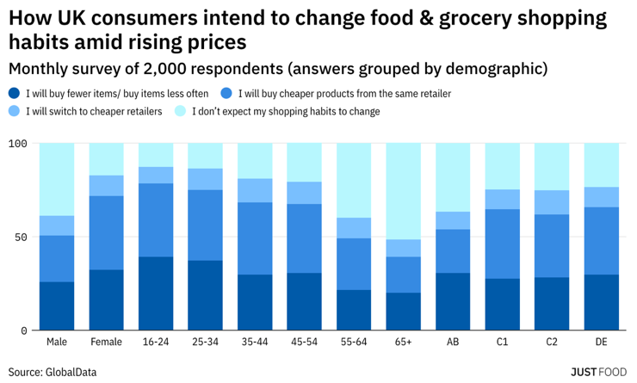
Older people
Well travelled – inspirational foods
Time poor – sandwich generation
Last generation that can cook?!
Health conscious

Slide 9
Winning categories in the last recession
Total FMCG – Top 10 Growing Categories – Value Sales CAGR - 2007 to 2014 (filtered to categories worth more than £100m annually)
#1
#2
#3
#4
#5
Healthier Biscuits
+13%
Chilled Flavoured Milk
+11%
Ground Coffee/Beans
+11%
Cat & Dog Treats
+10%
Chilled Burgers/Grills
+9%
#6
#7
#8
#9
#10
Savoury Biscuits
+9%
Ethnic Ingredients
+9%
Flavoured Meats
+9%
Cider
+9%
Chilled Frkfrtr/Cont. Sausage
+8%

Slide 10
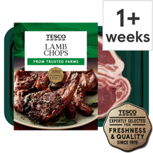
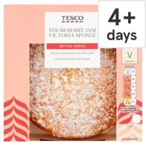
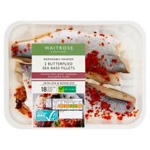
What categories and brands do well?
Categories with >40% sales from over 65s
Brands with >50% sales from over 65s
Chilled Cakes
Fresh Lamb
Chilled Prepared Fish
Yoghurt Drinks & Juices

Slide 11
Health opportunities
Plant based – all BOL is plant based
Free from eg Clives/Genius gluten free
High in protein – myprotein,
Keto/low carbohydrate – keto8
Low calorie – WW/Slimming world
Other diets eg macro/paleo – Gym kitchen

Slide 12
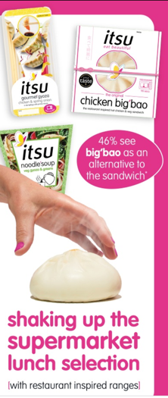
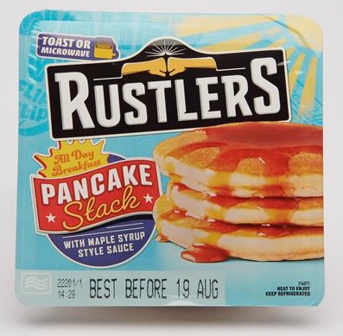
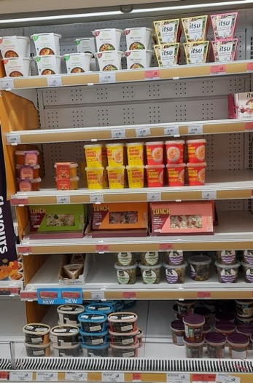
Different meal occasions – driven by hybrid working
Breakfast
Lunch

Slide 13
Growth of collaboration
Collaborations with meat replacements eg Tesco RM with Beyond meat
This in sandwiches etc
Iceland – collabs with Greggs, TGI Fridays and Harry Ramsden, Chiquito, Yo Sushi even Cathedral city!
Mindful chef frozen in Waitrose
High street restos eg Cote in Ocado, Zizzies and Carluccios in Sainsburys and Tesco
Mindful chef and Deliciously Ella

Slide 14
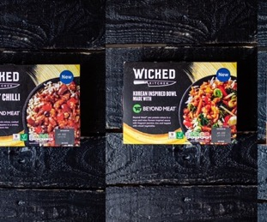
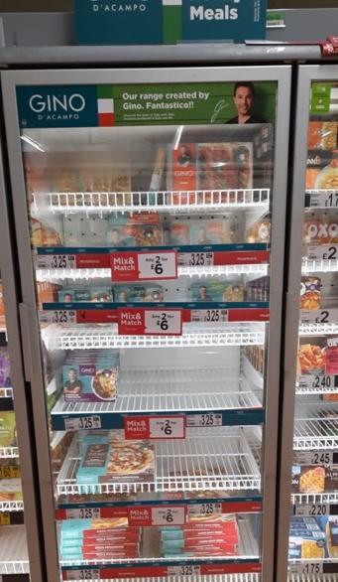
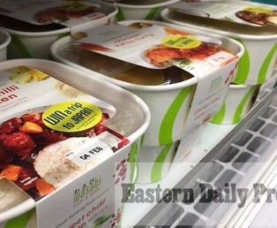

Slide 15
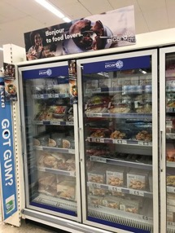
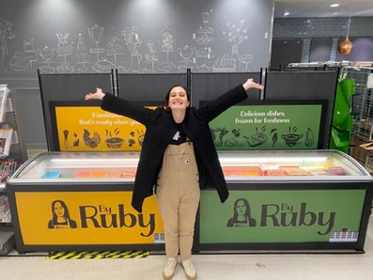
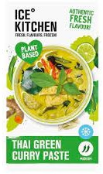
Growth of premium frozen
Picard in Tesco
By Ruby branded freezers in
Waitrose and Booths
Itsu Bao buns
Ice kitchen – from sweet to savoury

Slide 16
Routes to market

Slide 17
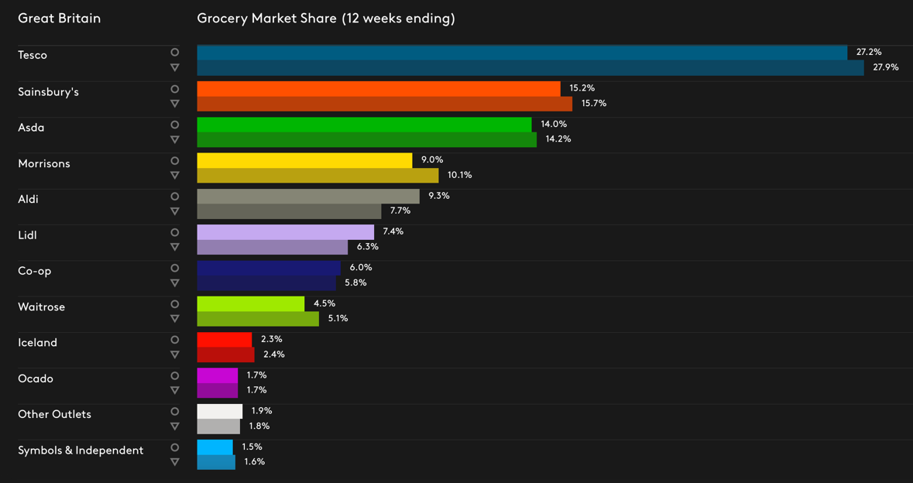
Introduction to UK Grocery

Slide 18
Growth of own label

Slide 19
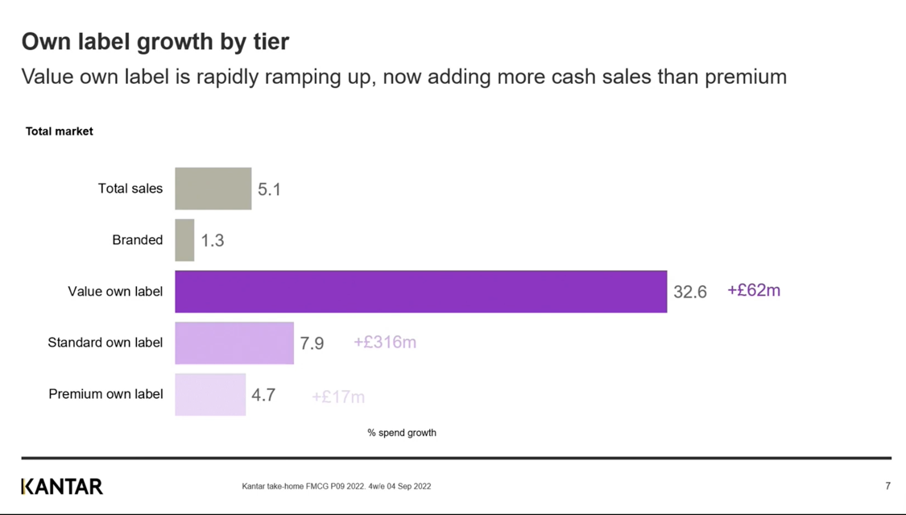
Good/better/best

Slide 20
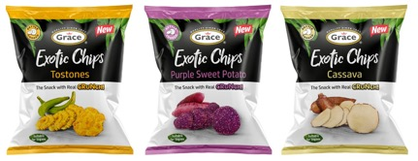
The power of world foods

Slide 21
Award winning ways!

Slide 22
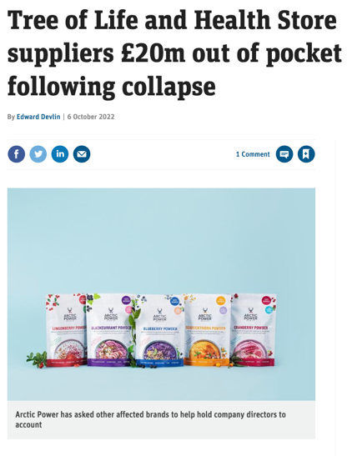
Wholesaling
Direct Delivery

Slide 23
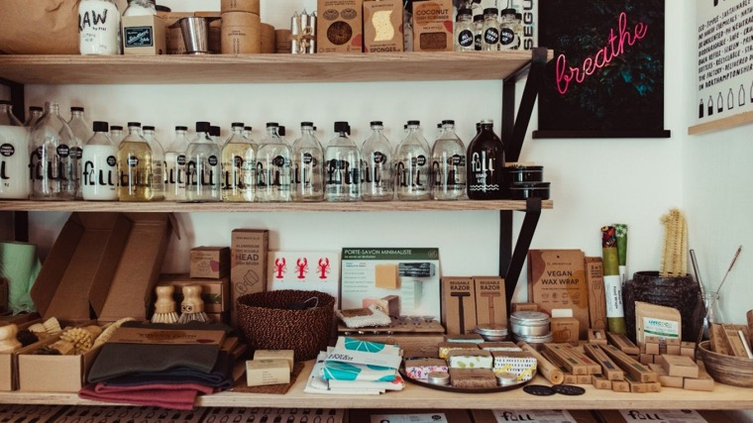

Slide 24
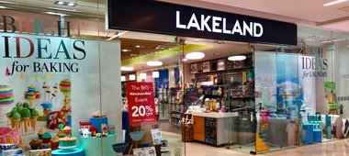
Lakeland
66 stores
Flagship Windermere
AB over 55s
Foodies!

Slide 25
TK Maxx
352 stores – Flagship Oxford Street

Slide 26
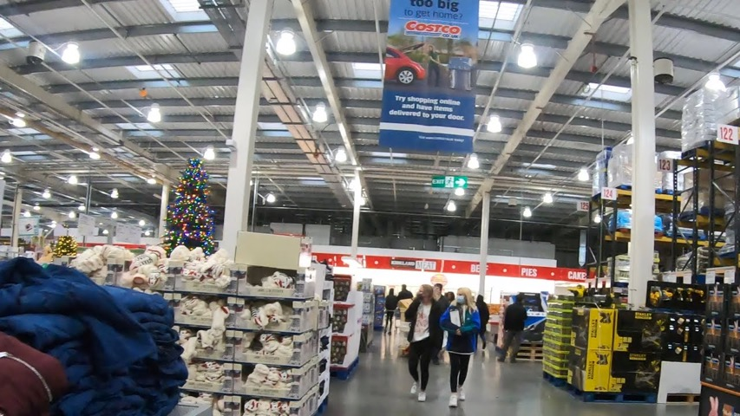
Costco
29 Warehouses
Flagship Watford (and head office)
AB shoppers
Affluent Foodies!
Massive volumes

Slide 27
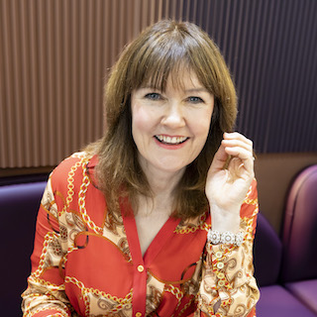
Thank you!
Please get in touch:
Karen Green
karen@foodmentor.co.uk
https://www.linkedin.com/in/thekarengreen
Join me on a strategy call https://www.foodmentor.co.uk/discovery

