Slide 1


Why Your Travel Business Lives or Dies on Data You Can't See

Slide 2

Vervotech Product Ecosystem
Three Pillars of Travel Data Infrastructure
Hotel Mapping
The Unique ID Standard
Room Mapping
Intelligent Room Standardization
Profit Maximizer
AI-Driven Revenue Optimization
Reconfirmation Automation

Slide 3
Vervotech Product Ecosystem
Three Pillars of Travel Data Infrastructure
Hotel Mapping
The Unique ID Standard
Room Mapping
Intelligent Room Standardization
Profit Maximizer
AI-Driven Revenue Optimization
Reconfirmation Automation

Slide 4
Vervotech Product Ecosystem
Three Pillars of Travel Data Infrastructure
Hotel Mapping
The Unique ID Standard
Room Mapping
Intelligent Room Standardization
Profit Maximizer
AI-Driven Revenue Optimization
Reconfirmation Automation

Slide 5
Vervotech Product Ecosystem
Three Pillars of Travel Data Infrastructure
Hotel Mapping
The Unique ID Standard
Room Mapping
Intelligent Room Standardization
Profit Maximizer
AI-Driven Revenue Optimization
Reconfirmation Automation

Slide 6



Vervotech Product Ecosystem
One Property = One ID
Assigns unique Vervotech ID to every property globally
99.998% mapping accuracy across 3M properties
Integrates with 400+ suppliers via API

Slide 7

Vervotech Product Ecosystem
One Property = One ID
Assigns unique Vervotech ID to every property globally
99.998% mapping accuracy across 3M properties
Integrates with 400+ suppliers via API

Slide 8

Vervotech Product Ecosystem
One Property = One ID
Assigns unique Vervotech ID to every property globally
99.998% mapping accuracy across 3M properties
Integrates with 400+ suppliers via API

Slide 9
Hotel Mapping - The Data Foundation
Hotel Mapping - Beyond Hotels
Complete Accommodation Inventory Coverage
Smarter and in-depth data analysis

Slide 10
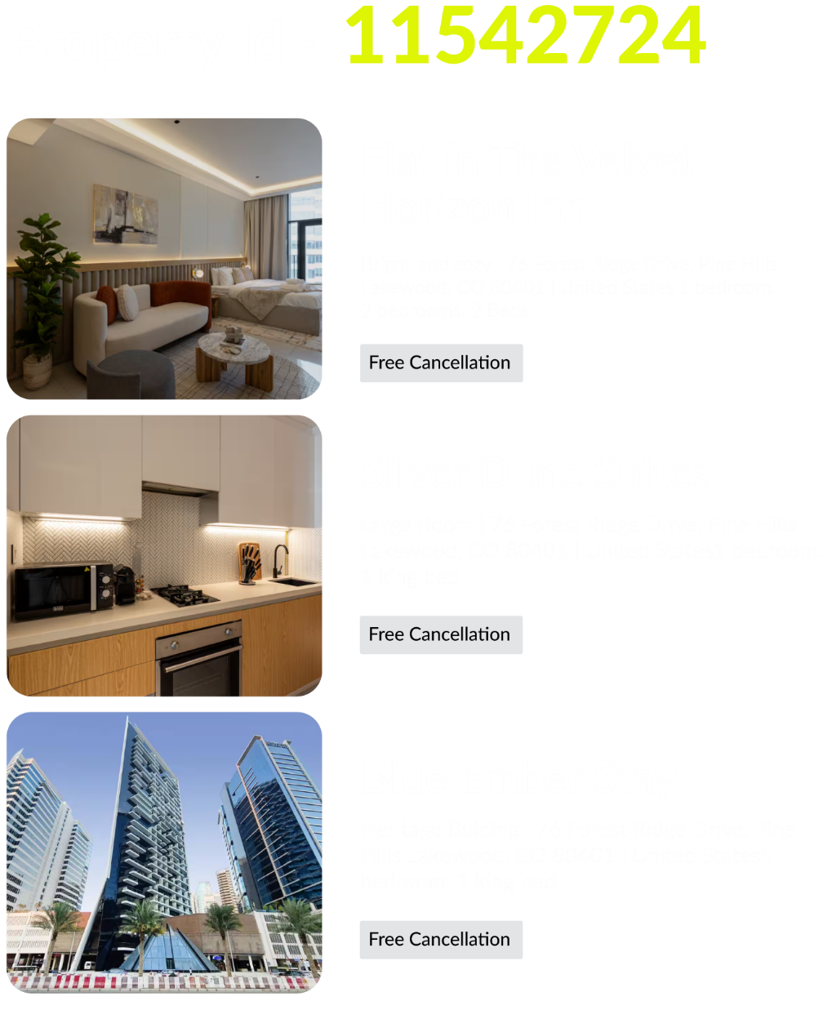
Hotel Mapping - The Data Foundation
Hotel Mapping - Beyond Hotels
Complete Accommodation Inventory Coverage
Smarter and in-depth data analysis
NHA Mapping: Non-hotel accommodations - villas, homes, unique stays

Slide 11
Hotel Mapping - The Data Foundation
Hotel Mapping - Beyond Hotels
Complete Accommodation Inventory Coverage
Smarter and in-depth data analysis
NHA Mapping: Non-hotel accommodations - villas, homes, unique stays
Apartment Mapping: Serviced apartments and extended stay properties

Slide 12
Business Impact - Hotel Mapping
Revenue Growth
Every unmapped property is a lost revenue

Slide 13
Business Impact - Hotel Mapping
Control Financial Losses & Improve Guest Experience
Revenue Growth
Every unmapped property is a lost revenue
Every Bad map is a financial loss and unhappy customer

Slide 14
Business Impact - Hotel Mapping
Control Financial Losses & Improve Guest Experience
Revenue Growth
Every unmapped property is a lost revenue
Every Bad map is a financial loss and unhappy customer
ROI: Weeks, not months

Slide 15
Room Mapping - Real Time Precision
Clear Names Inspire Confident Bookings
The Problem
"Deluxe Room with King Bed and Downtown View" vs "DLX King Room, City View" vs "Deluxe king room with cityscape view"- All describe the same room

Slide 16
Room Mapping - Real Time Precision
Clear Names Inspire Confident Bookings
Our Solution
AI-powered algorithmic standardization Real-time processing during live search

Slide 17
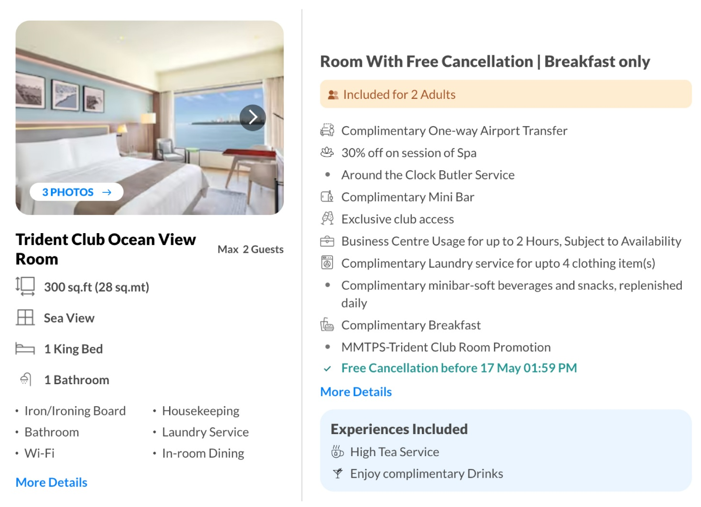
Room Mapping - Real Time Precision
Clear Names Inspire Confident Bookings
Room Mapping - The Structured
Data Advantage
We Don't Just Group - We Map Structured Data
Structured data mapping with granular attributes
Rule based configuration, tailored for specific businesses

Slide 18
Room Mapping - Customer Experience ROI
Time saved correcting room data at scale

Slide 19
Room Mapping - Customer Experience ROI
Time saved correcting room data at scale
Boost in look to book ratio

Slide 20
Room Mapping - Customer Experience ROI
Time saved correcting room data at scale
Boost in look to book ratio
Reduced Cart-abandonment

Slide 21

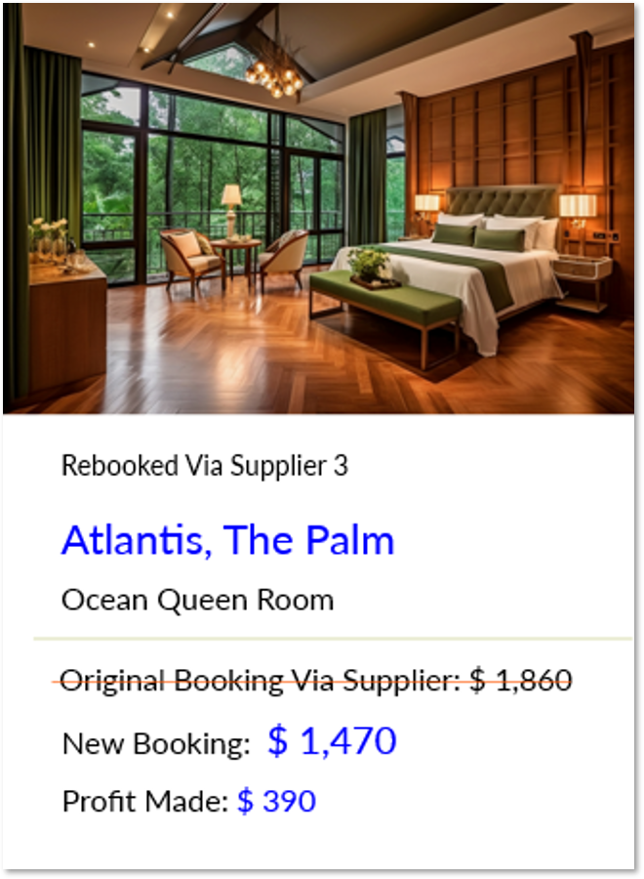

Profit Maximizer
Available for Room Mapping Subscribers
Unlock Hidden Revenue from Post-Booking Price Drops
Detect Price Drops
Locks price difference as pure profit
Rebook Automatically
Zero impact on customer experience

Slide 22
Profit Maximizer
Superior Room Mapping
Better mapping = more rebooking opportunities = bigger profits
200+ global clients trust our room mapping technology
Discover more rebooking opportunities across suppliers
Increase profit margins by 20-40%
Proven scale across different business models and sizes

Slide 23
Why Choose Vervotech
Risk-Free Guarantee
Transparent & Secure
100% financial responsibility for rebooking errors
No hidden partnerships or forced supplier funnels
Privacy-First
Supplier Intelligence
Your contracts, your control, zero data leakage
Real-time price analytics and forecasting

Slide 24
Partner Solutions
Expanding Operational Capabilities
Vervotech provides the data foundation
Best-in-class partners solve operational challenges
Growing ecosystem for seamless workflows

Slide 25
Reconfirmation Automation by ZealConnect
AI-Powered Hotel Reconfirmation & HCN Management
Portal with real-time SLA tracking and VIP prioritization
Verified Contact Database for accurate hotel information
AI Agents: 24/7 calls & emails with full transcripts
AI Auditor: Quality assurance for all confirmations

Slide 26
What Makes Us Different
Supplier Integration
HCN Network
Auto-fetch HCNs from OTA portals, bedbanks, and DMCs
30-40% bookings
auto-confirmed via partner sharing
Eliminate duplicate work across your network

Slide 27
The Vervotech Platform Advantage
Unified Data Infrastructure
APIs for all mapping needs
Real-time synchronization across suppliers
Built for AI integration
99.9% uptime SLA with enterprise-grade security

Slide 28
Why Industry Leaders Choose Vervotech
Technology
Scale
99.998%
3M Properties across
accuracy with AI at core
400+ suppliers

Slide 29
Measurable Industry Impact
Trusted by Global Leaders
OTAs and Metasearch Engines

Slide 30
Measurable Industry Impact
Trusted by Global Leaders
OTAs and Metasearch Engines
Tour Operators and Wholesalers

Slide 31
Measurable Industry Impact
Trusted by Global Leaders
OTAs and Metasearch Engines
Tour Operators and Wholesalers
Travel Management Companies

Slide 32
Measurable Industry Impact
Trusted by Global Leaders
OTAs and Metasearch Engines
Tour Operators and Wholesalers
Travel Management Companies
1,000+ Travel Platforms
50+ countries

Slide 33
Partner with Vervotech
Transform Your Travel Technology Infrastructure
www.vervotech.com
Eliminate data friction | Maximize revenue | Scale with confidence
sales@vervotech.com
+1 214 444 6834 | +91 9881995722

