Slide 1
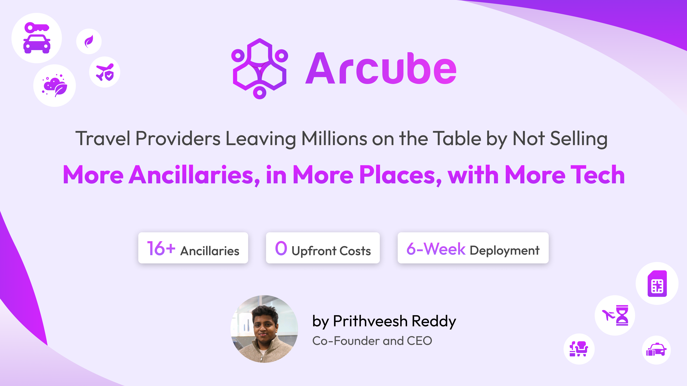
Notes:
Good afternoon everyone, I am Prithveesh, the co-founder & CEO of Arcube. Arcube is a Manchester based travel tech company and what we do is very simple. We help airlines, travel agents and other travel companies generate new ancillary revenue.
We do that by helping them launch over 16 new ancillaries products like E-Sims, Car rentals, and baggage insurance from 1000s of suppliers across the world with 1 integration in less than six weeks and 0 upfront cost.

Slide 2
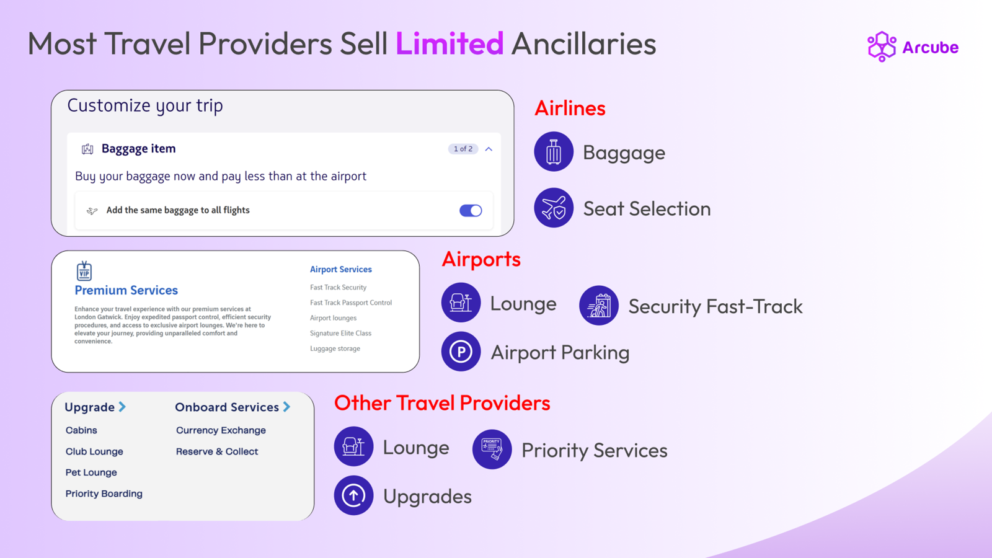
Notes:
Currently most travel providers stick to only selling traditional ancillaries directly in their checkout flow
For Airlines, that could be just seats & bags
And for hotels, room upgrades and breakfast.
And in today’s market that’s simply not enough to stay competiive

Slide 3
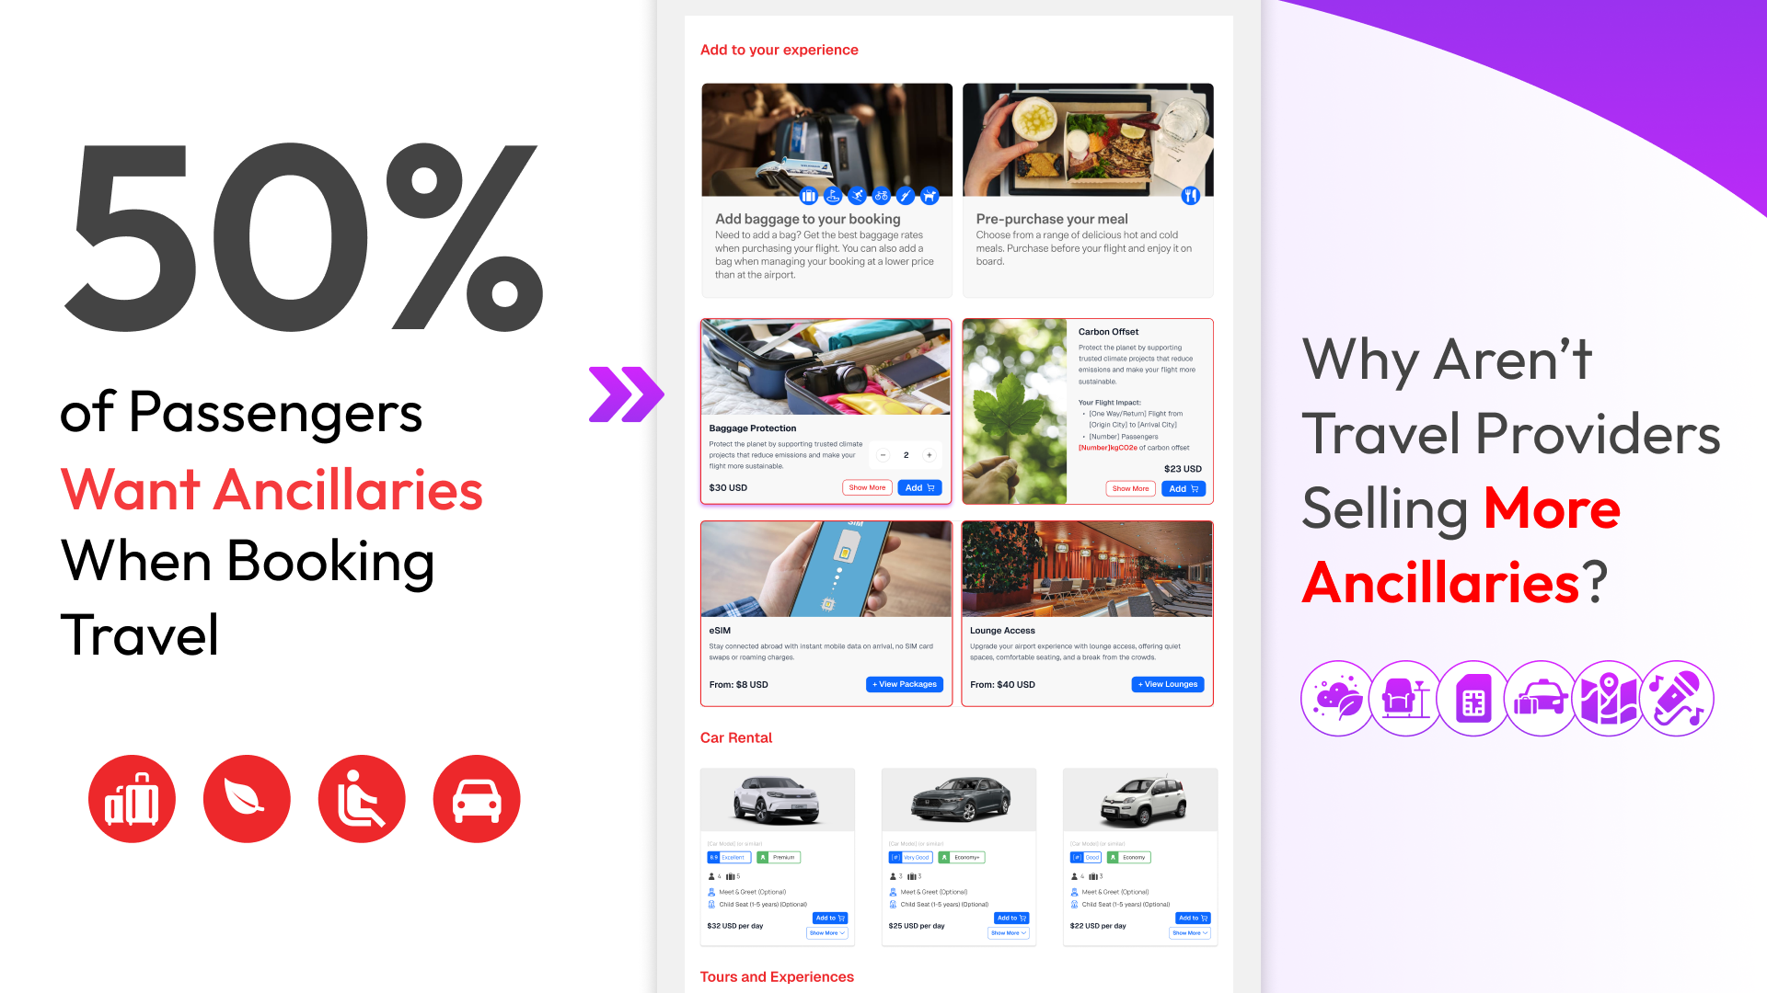
Notes:
And the demand from the travellers is clear too.
We see that over 50% of the travelers want to purchase all the extras that they need for their trip (weather that is E-Sims or Car rentals) at the time of booking their flight or their hotel directly in the booking flow with a single transaction.

Slide 4
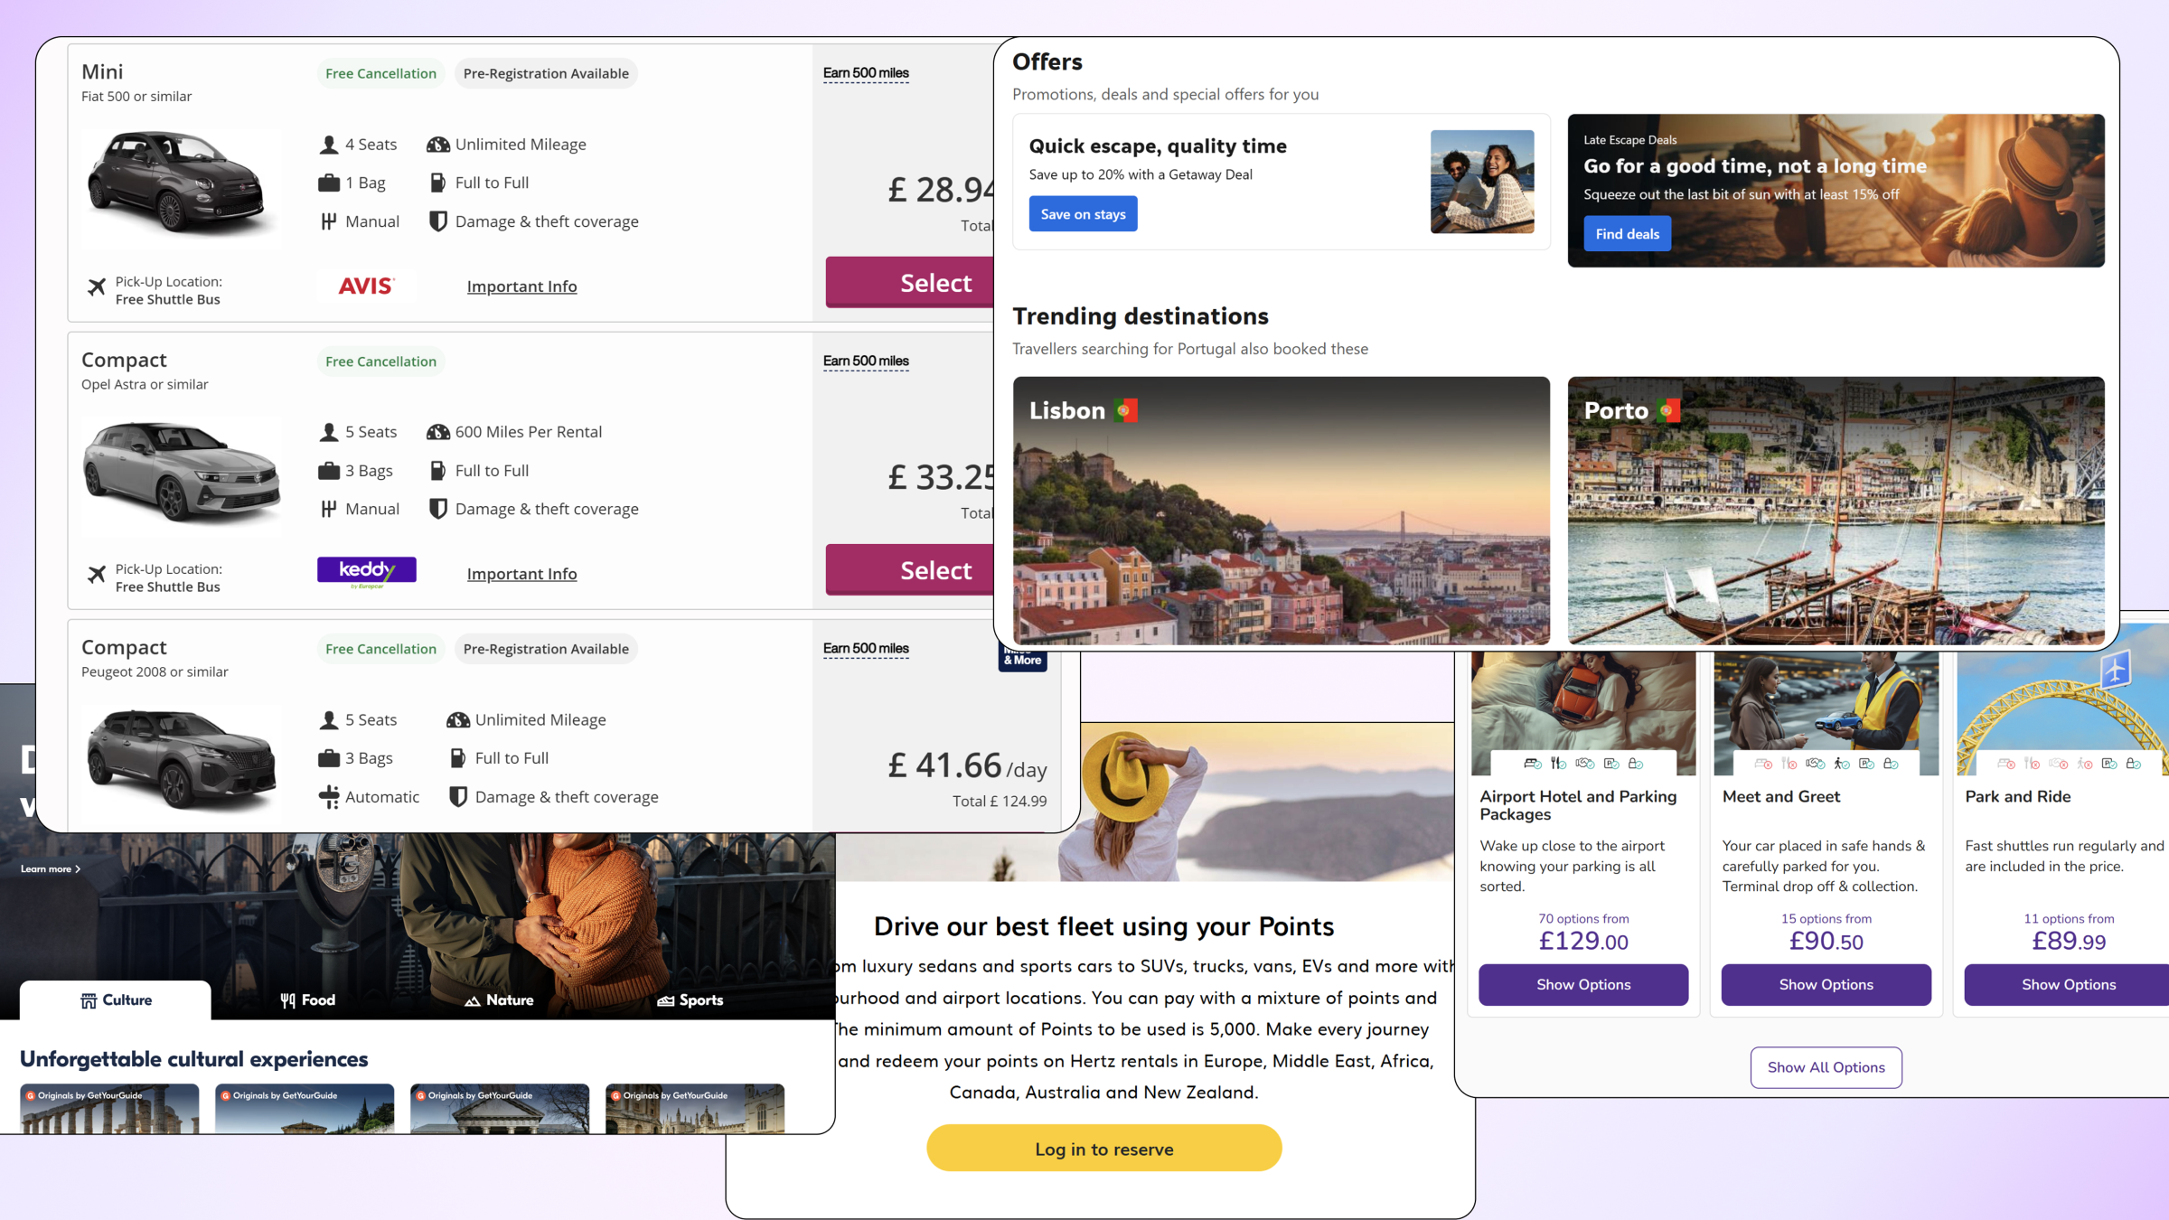
Notes:
However the current traveler experience looks something similar to this where they have to visit multiple sites to purchase ancillaries. The travelers are purchasing these products regardless but it's not with your company so this is revenue you could potentially capture.

Slide 5
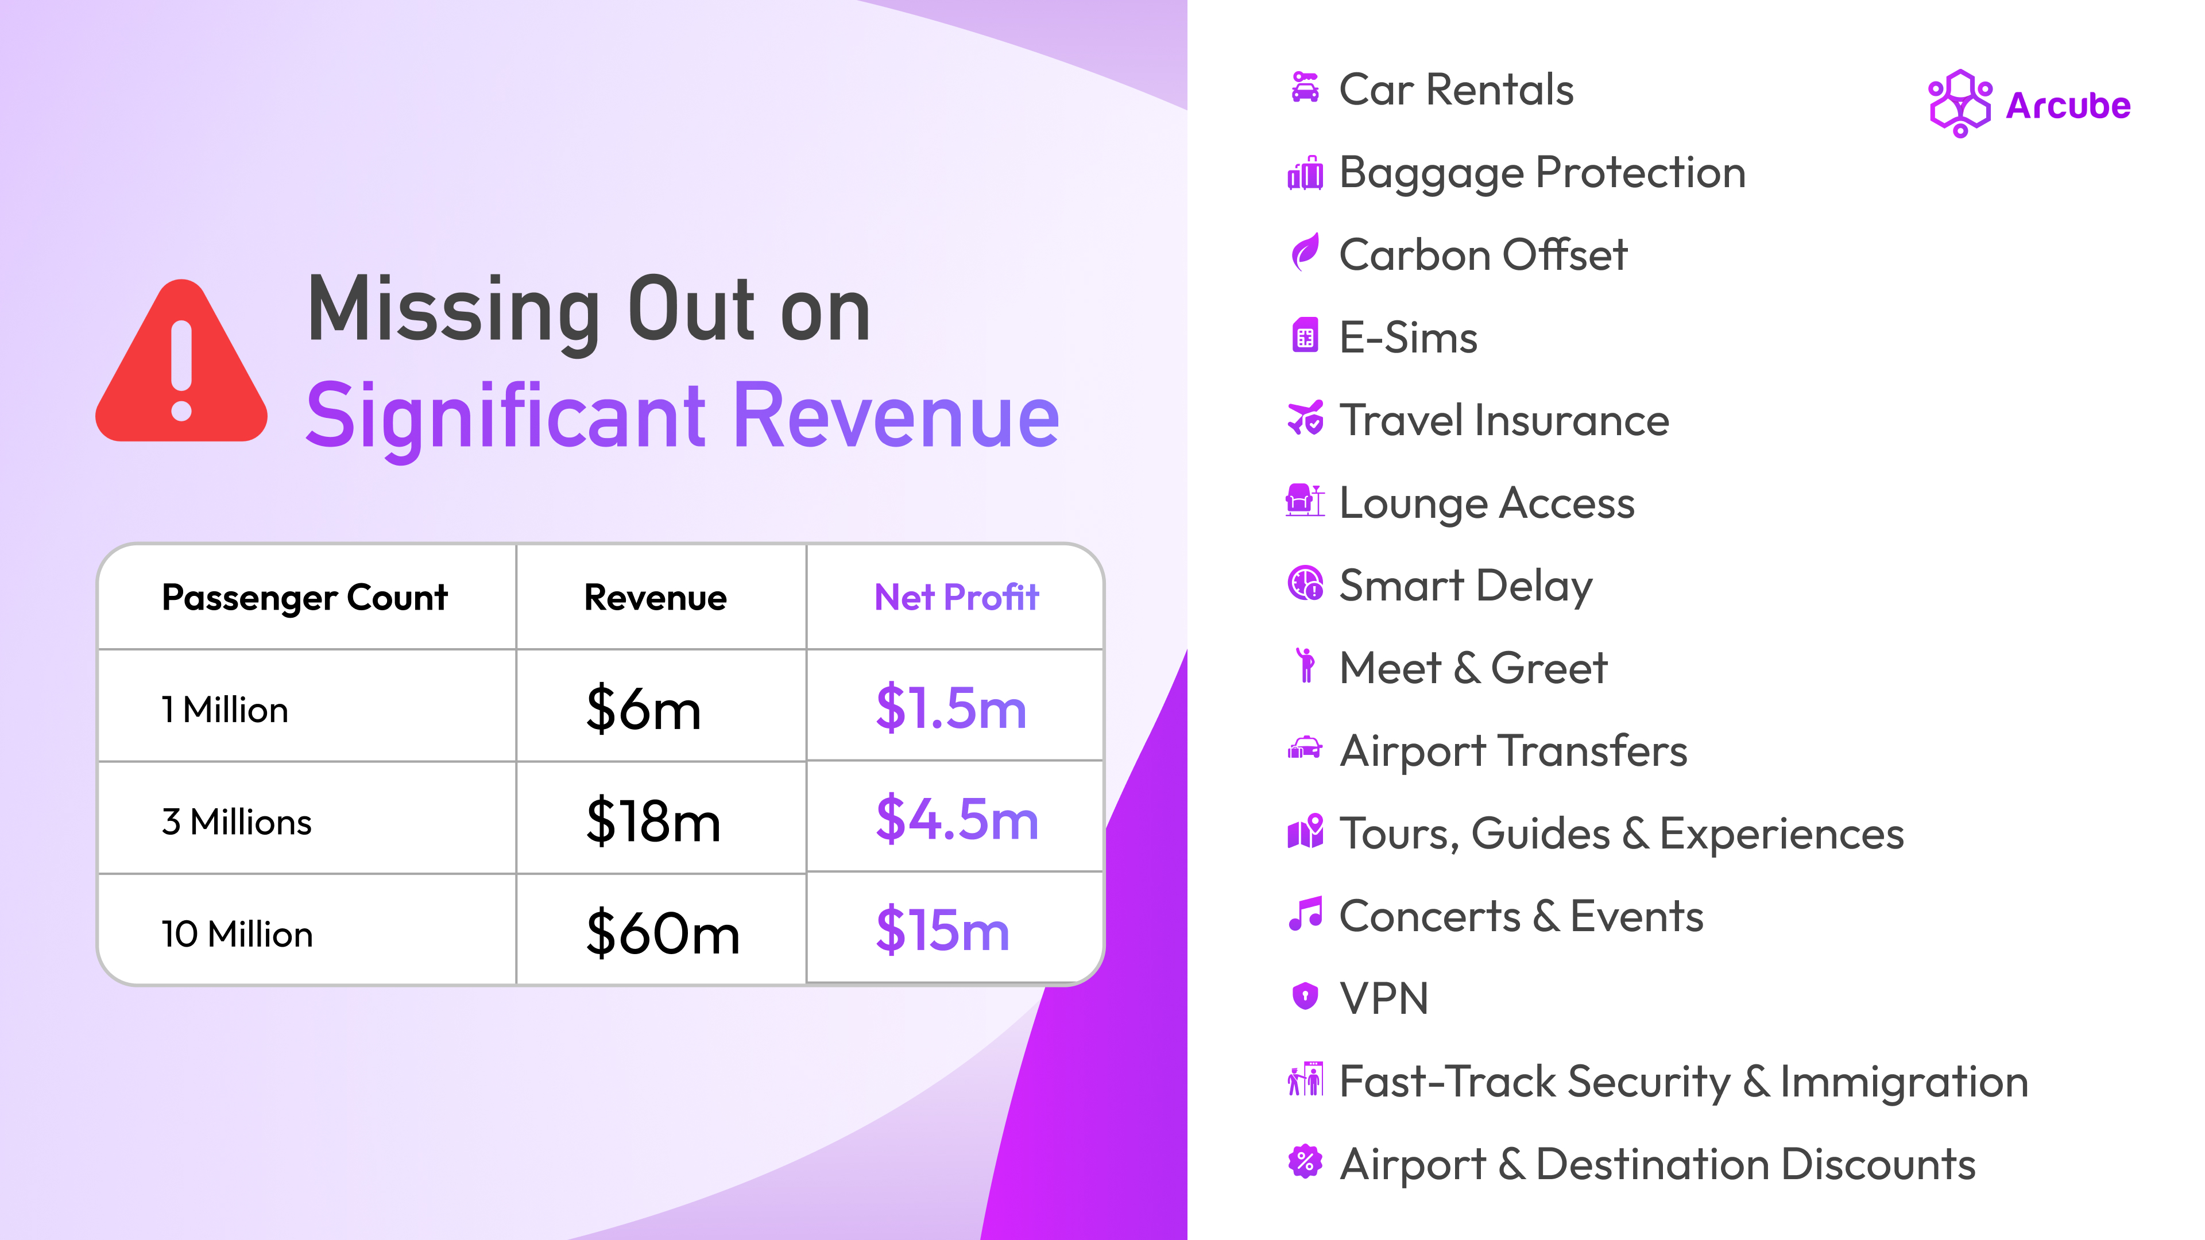
Notes:
By not offering high-demand, high-margin ancillaries like eSIMs, car rentals, carbon offsetting, and refund protection, travel companies are missing out on least $6 million in revenue per million passengers. For a travel company serving 10 million travellers, that’s a $60 million opportunity left on the table.
So when there is clear traveller demand and a substantial financial upside why aren’t most travel companies sell ancillaries directly in their booking flow

Slide 6
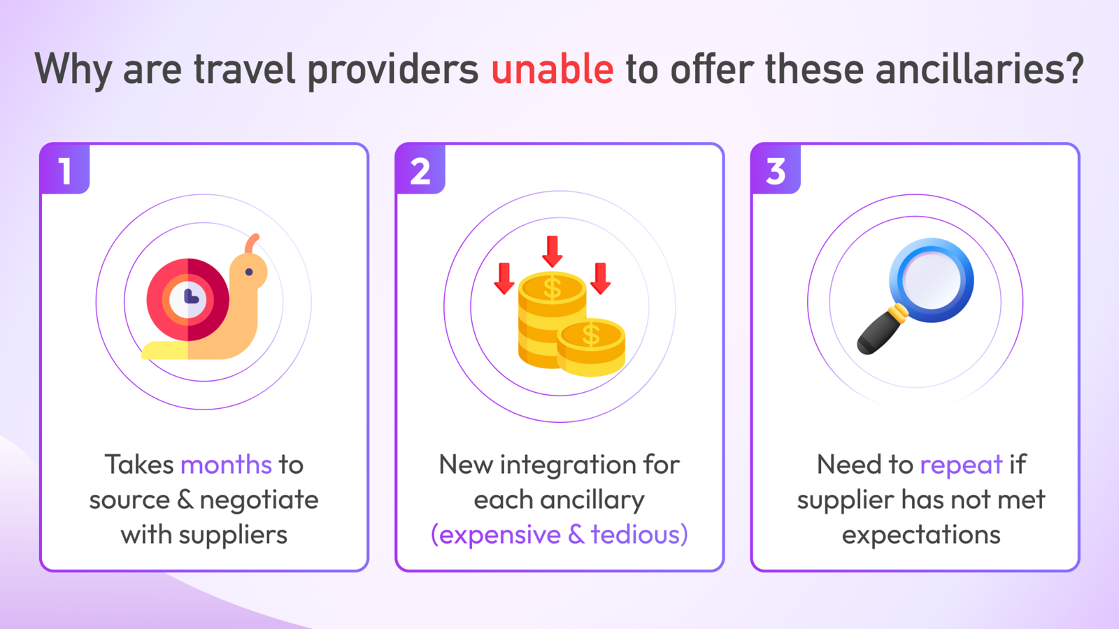
Notes:
Because the process of launching a new ancillary product looks something like this.
If a travel company wants to launch a new ancillary product, they have to go through the process of sourcing a supplier, doing an RFP, negotiate with them, legals, integrations and launching.

Slide 7
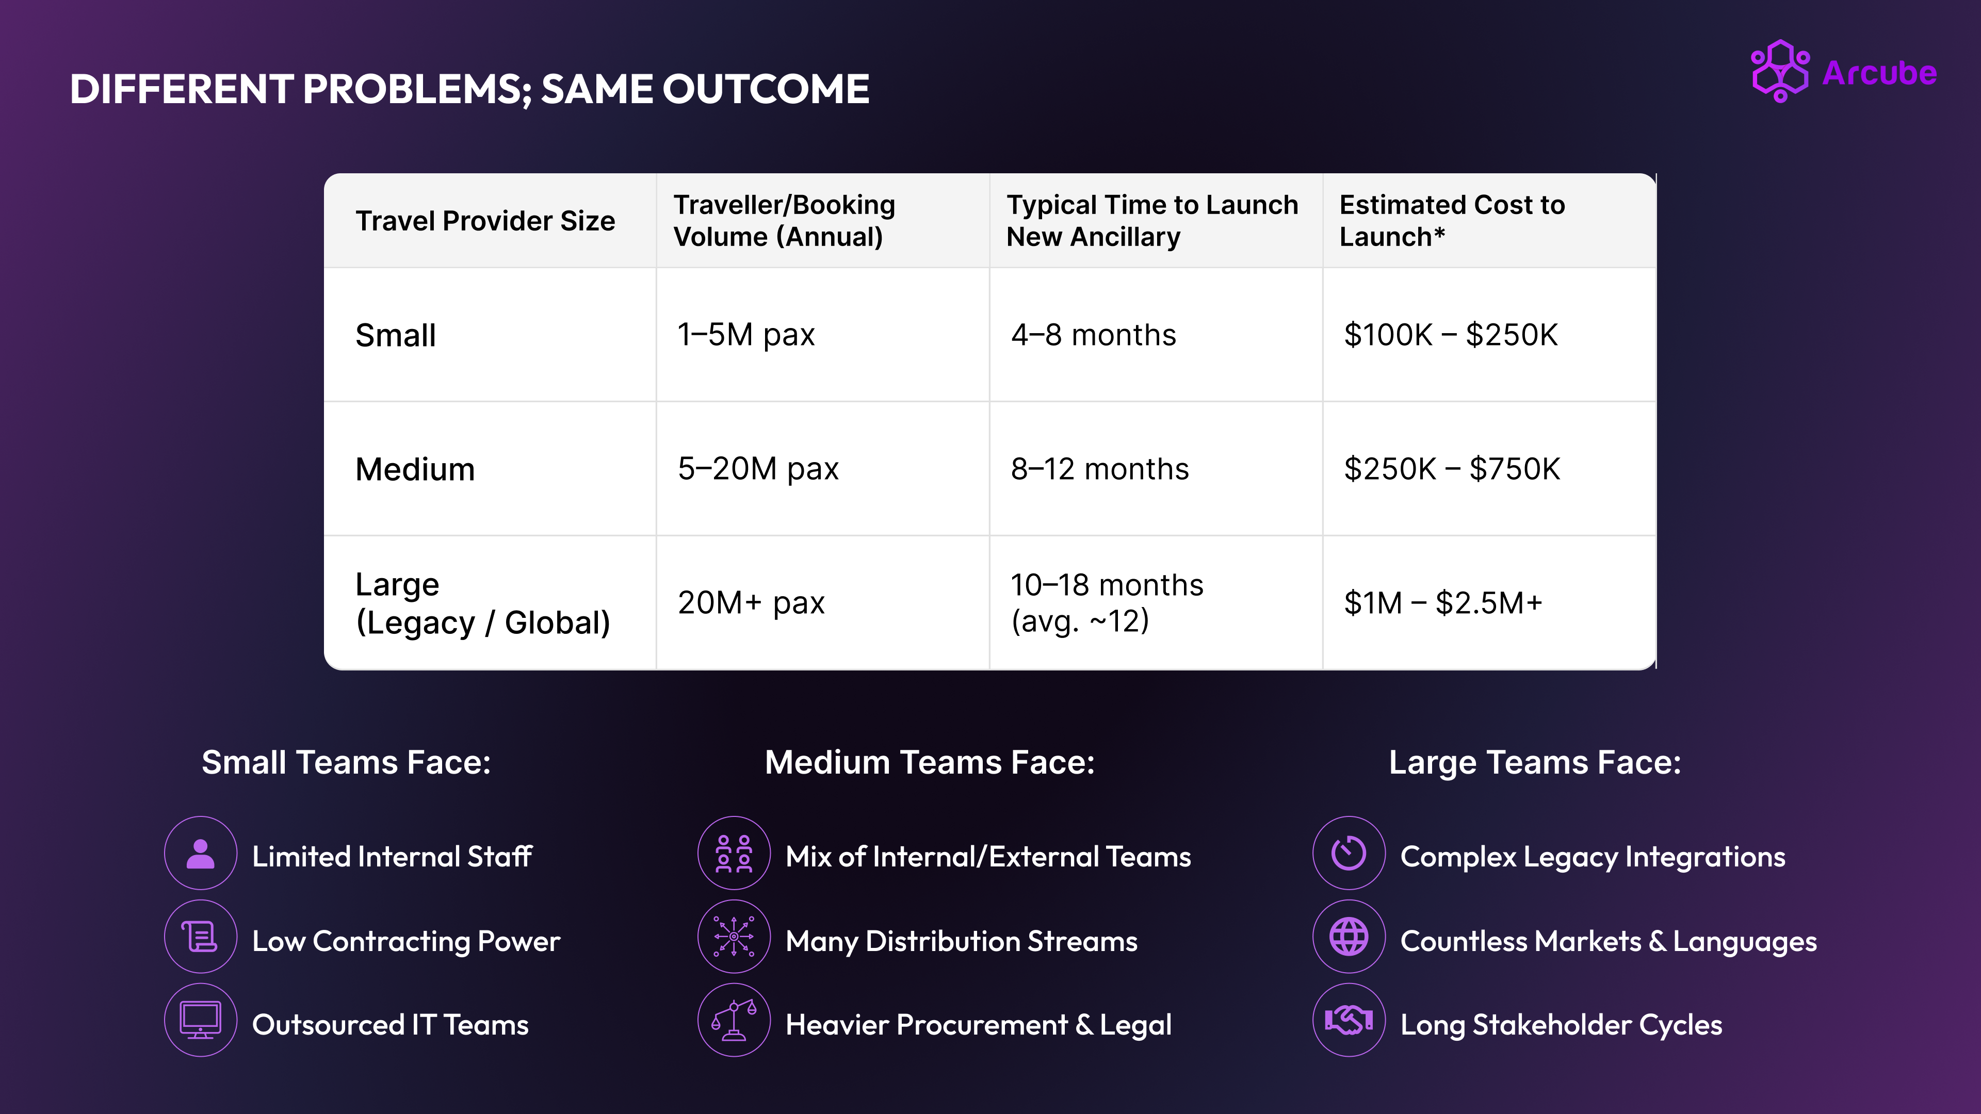
Notes:
To take the example of an airlines.
A medium sized airlines…
A large sized Airlines…
And evening after completing the entire process, spending a Signiant amount of time and money, there is no guarantee that a single supplier can cover all the destinations that your travellers travel to
And if and when the suppliers starts to underperform, you have to repeat this entire process again.

Slide 8
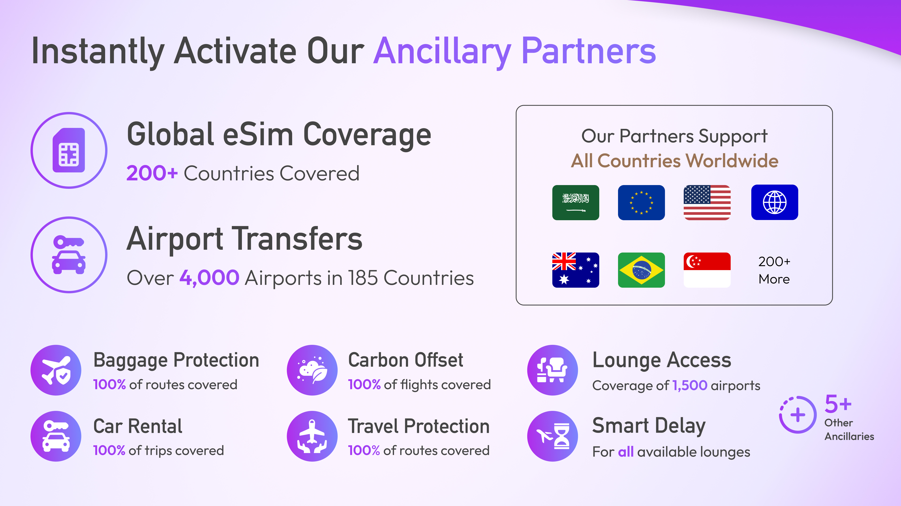
Notes:
At Arcube, we’ve spent the last 3 years sourcing, vetting, and integrating 100s of top-performing ancillary providers across so that airlines don’t have to. With a single integration, travel companies can now access over 16 ancillary products, with global coverage across every single destination their travellers fly.
And to give you a gist of our coverage
We cover all the countries in the world for E-Sims, Baggae Protection & Carbon offset
We provide airport transfers in over 4000 airports across 185 countries
And lounge access and fasttrack lanes in over 2000 airports across the world.
And you can access that inventory with highly competitive rates with a single integration in less than 6 weeks

Slide 9
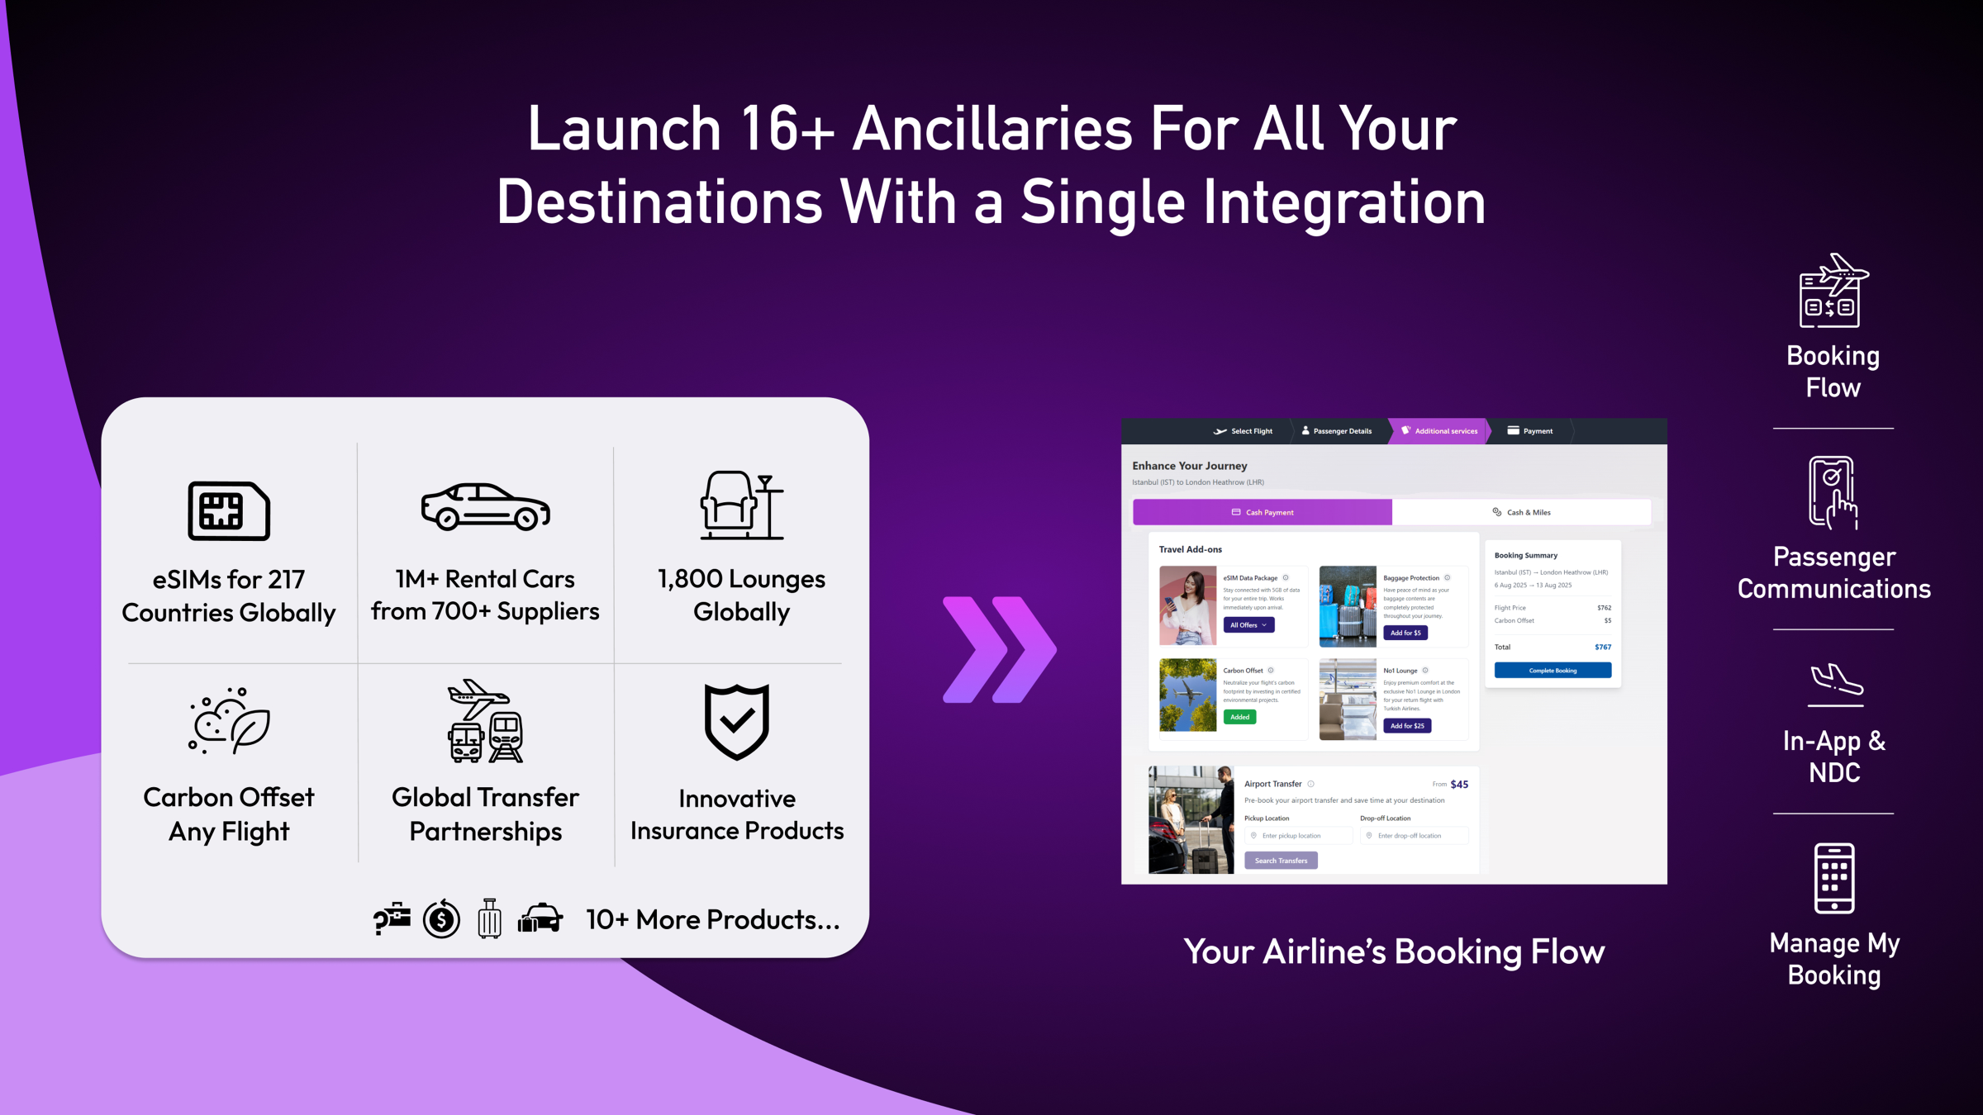
Notes:
These ancillaries can be directly added to your checkout flow, your app and several other touchpoints with either an API or a widget integration.

Slide 10
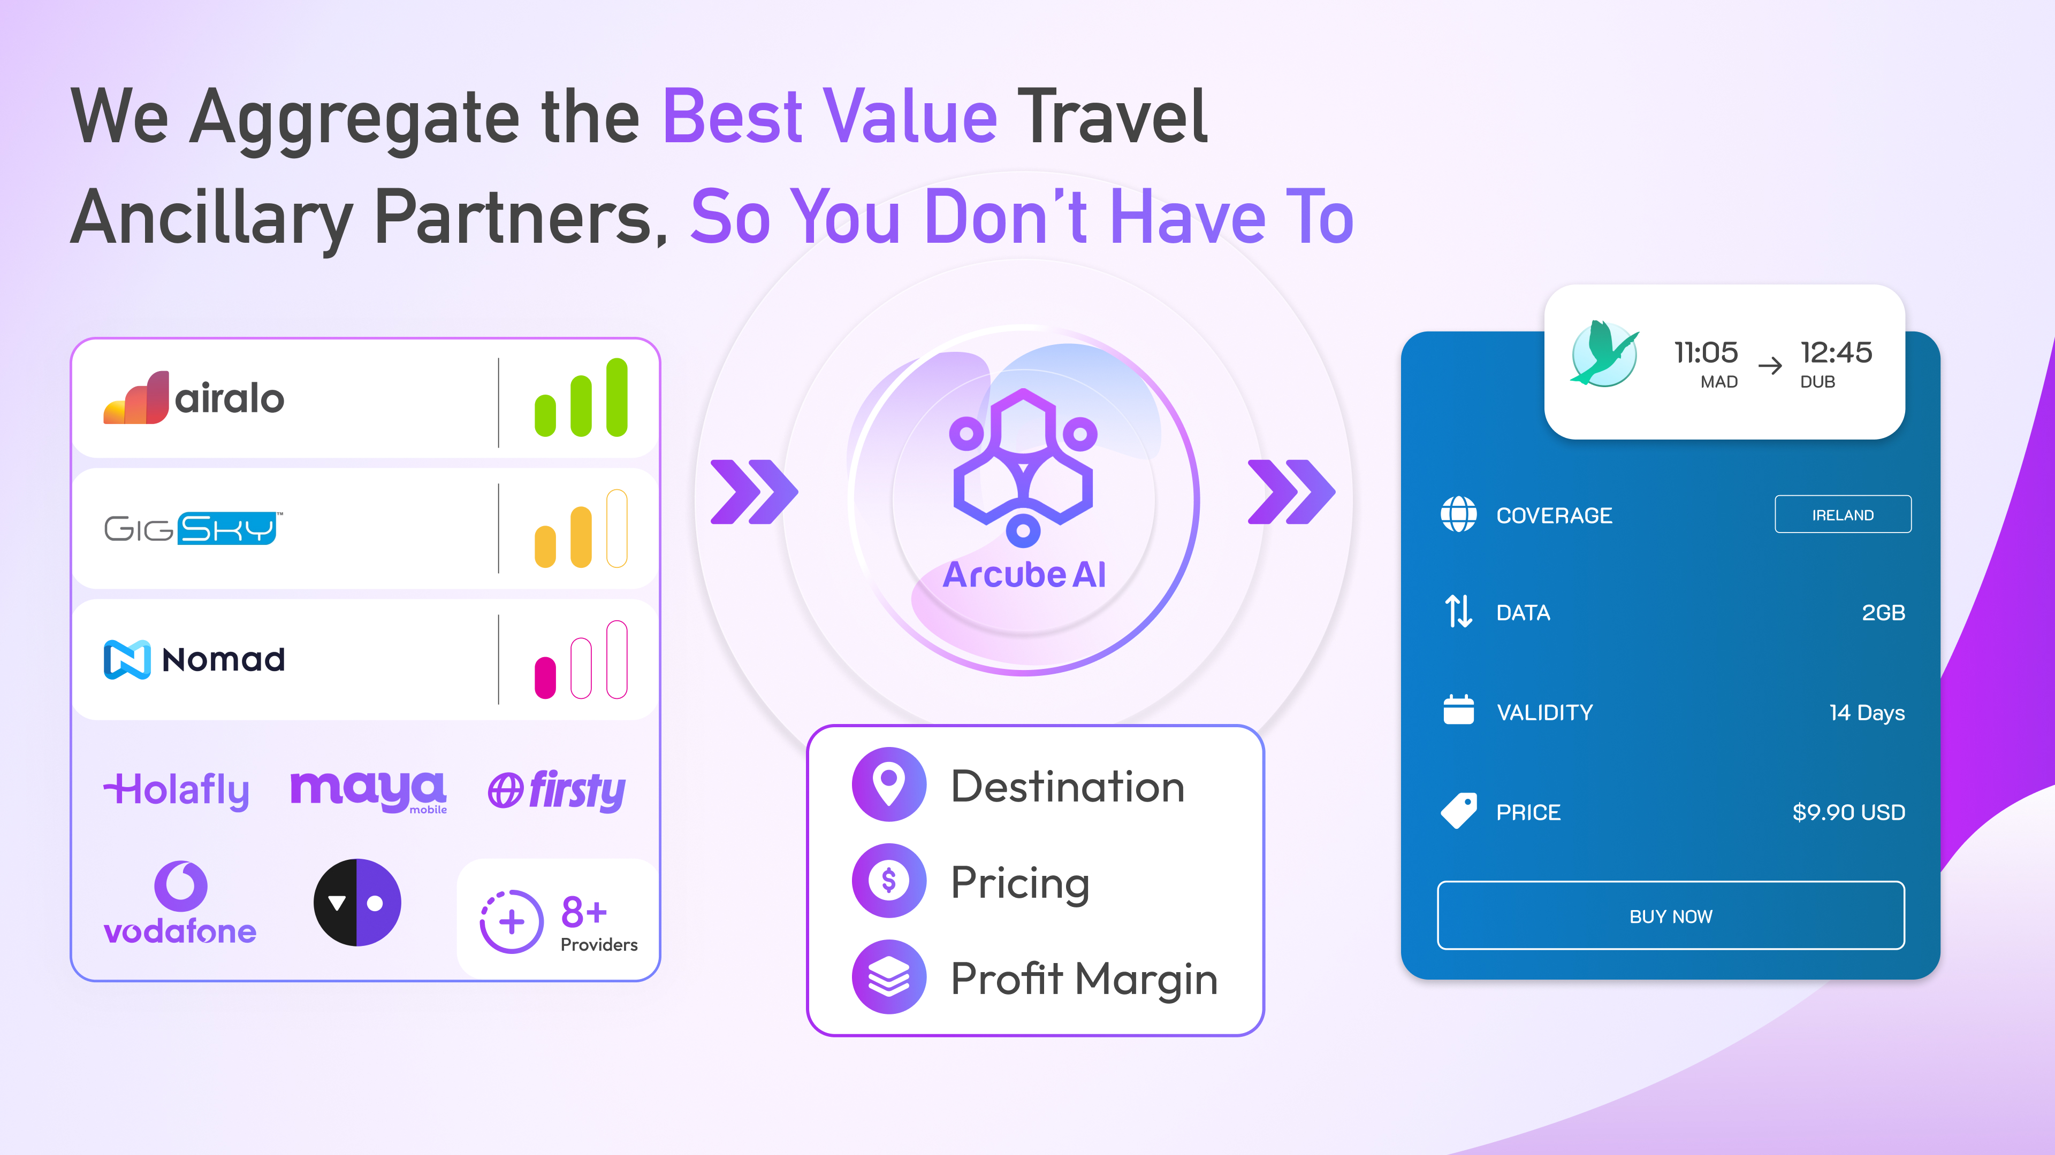
Notes:
Slide 9 – We work with dozens of suppliers for each ancillary and our AI automatically recommends a supplier to a passenger based on where they are flying, affordable pricing and the highest profit margin for the airline. With this model, if a supplier, underperfors, our AI simply selects the next best supplier without any changes required on the Airline’s end.

Slide 11
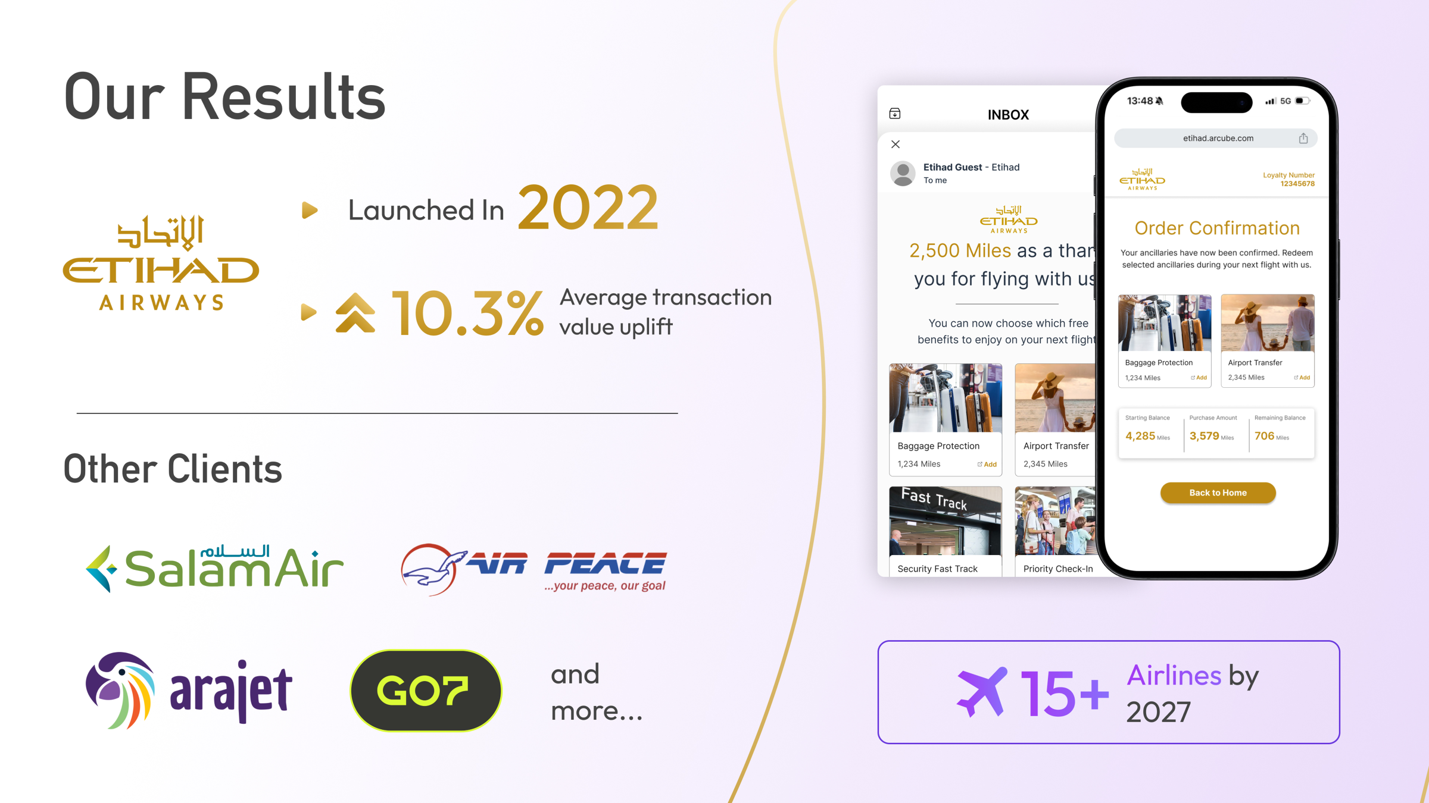
Notes:
We launched with Etihad Airways and we helped them generate millions in new revenue and increased their average order value by 10.3%
This year, we went live with SalamAir & Arajet. And by the end of this year, we will be working with 7 travel providers across 4 continents all of whom are signed and actively integrating.

Slide 12
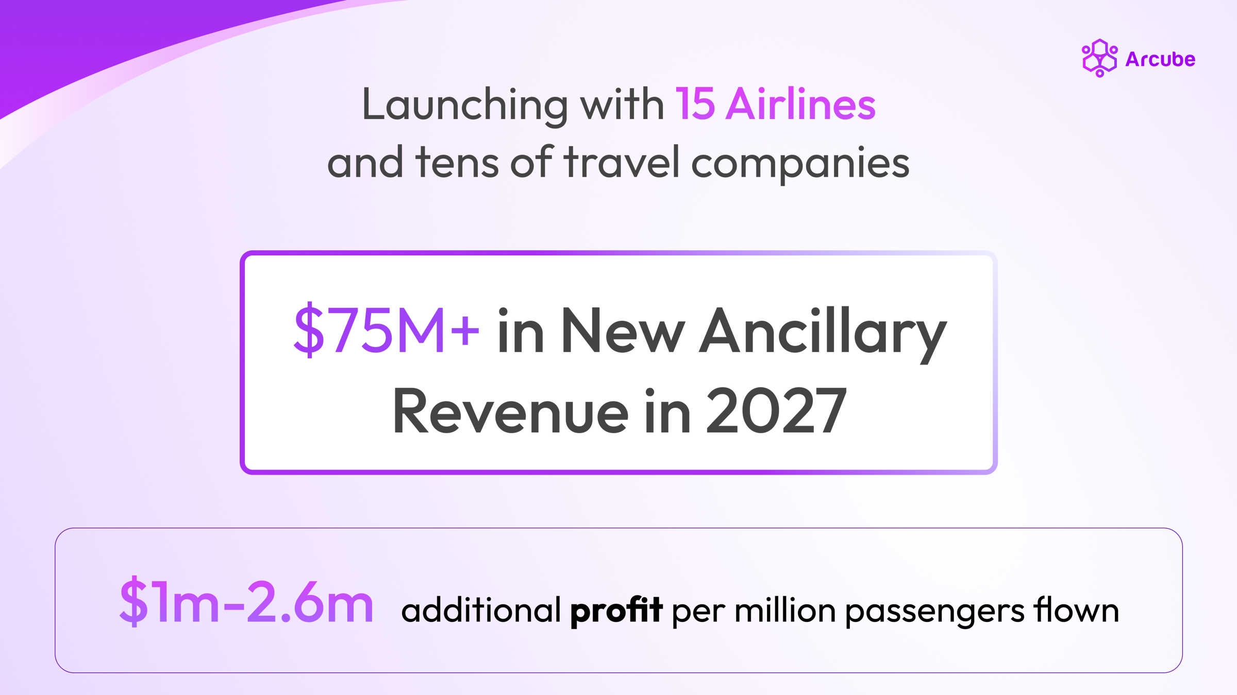
Notes:
And we are continuing to grow, by the end of 2027, we are expected to be working with over 15 travel providers and help them generate over $75m in new incremental revenue, and this is what we consider to be our NorthStarr Metric

Slide 13

Notes:
If you are travel provider looking to launch new ancillaries and create a new revenue stream in a matter of weeks with no upfront cost, feel free to connect with me.
Thank you.

