Slide 1


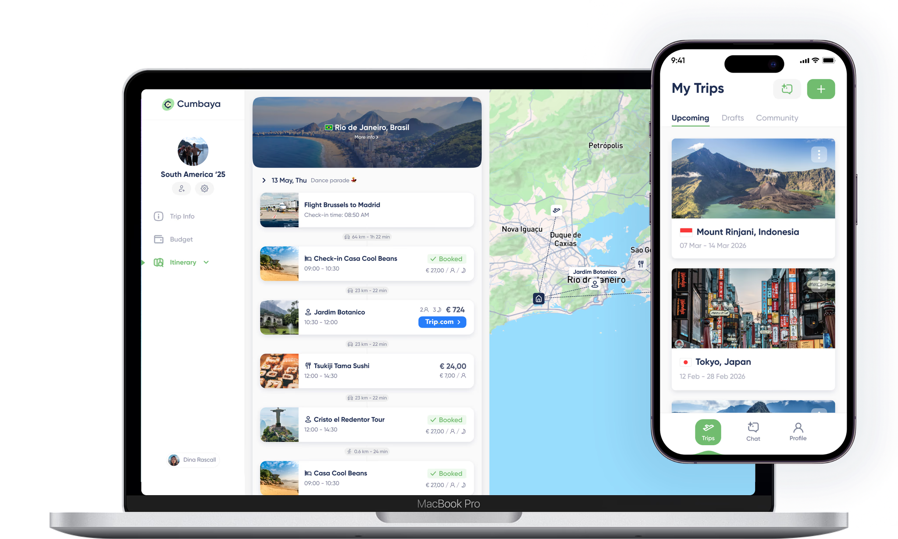

The AI Compass
for Travel Companies

Slide 2



The Travel Company Squeeze
Pressure on Margins
Manual Planning & Booking
Demanding Traveller Expectations

Slide 3




Slide 4
The Opportunity
Turnover
£ 1.0M
1
FTE

Slide 5
The Opportunity
Turnover
+ 20% Efficiency gain
£ 1.2M
£ 1.0M
1
FTE

Slide 6
The Opportunity
Turnover
£ 1.4M
+ 40% Efficiency gain
£ 1.0M
1
FTE

Slide 7

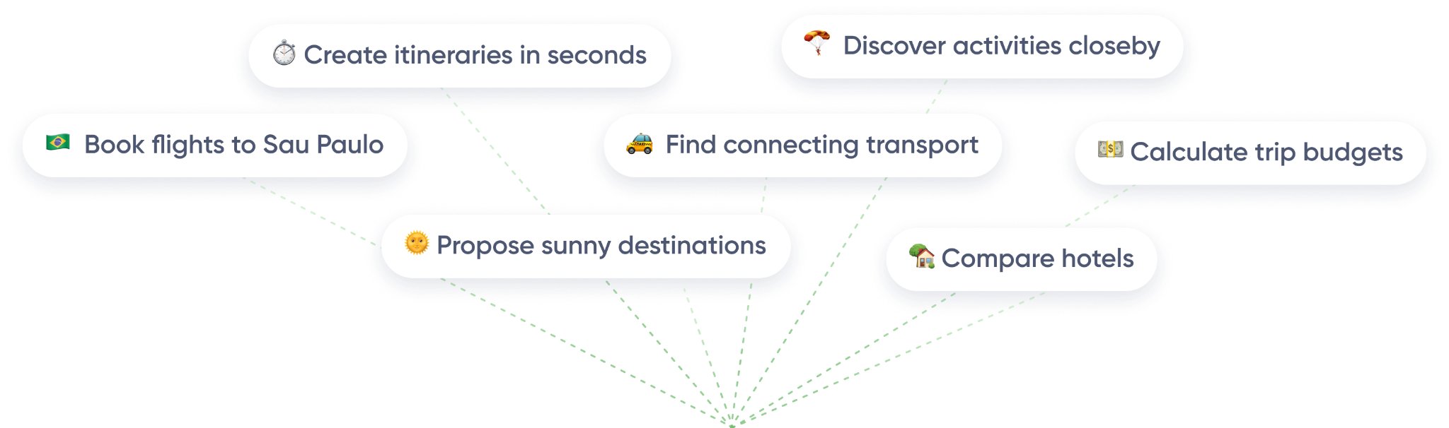
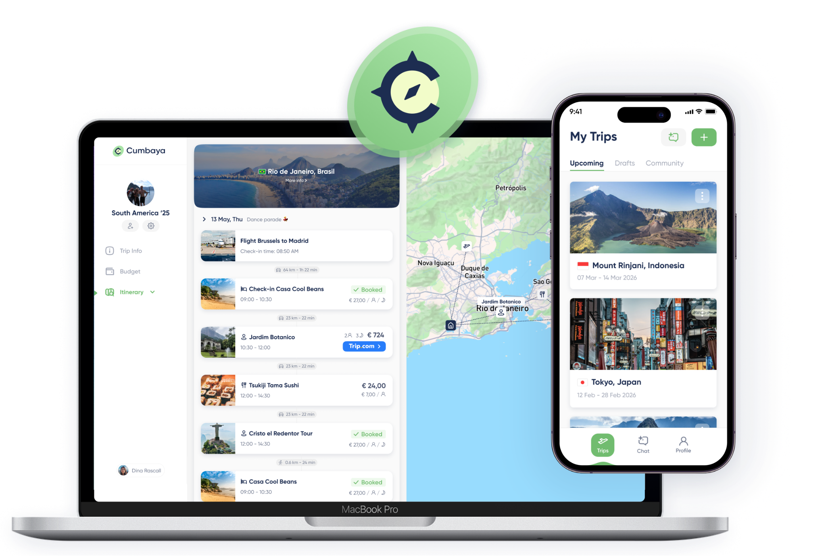



Cumbaya scales Human Expertise with Agentic AI

Slide 8
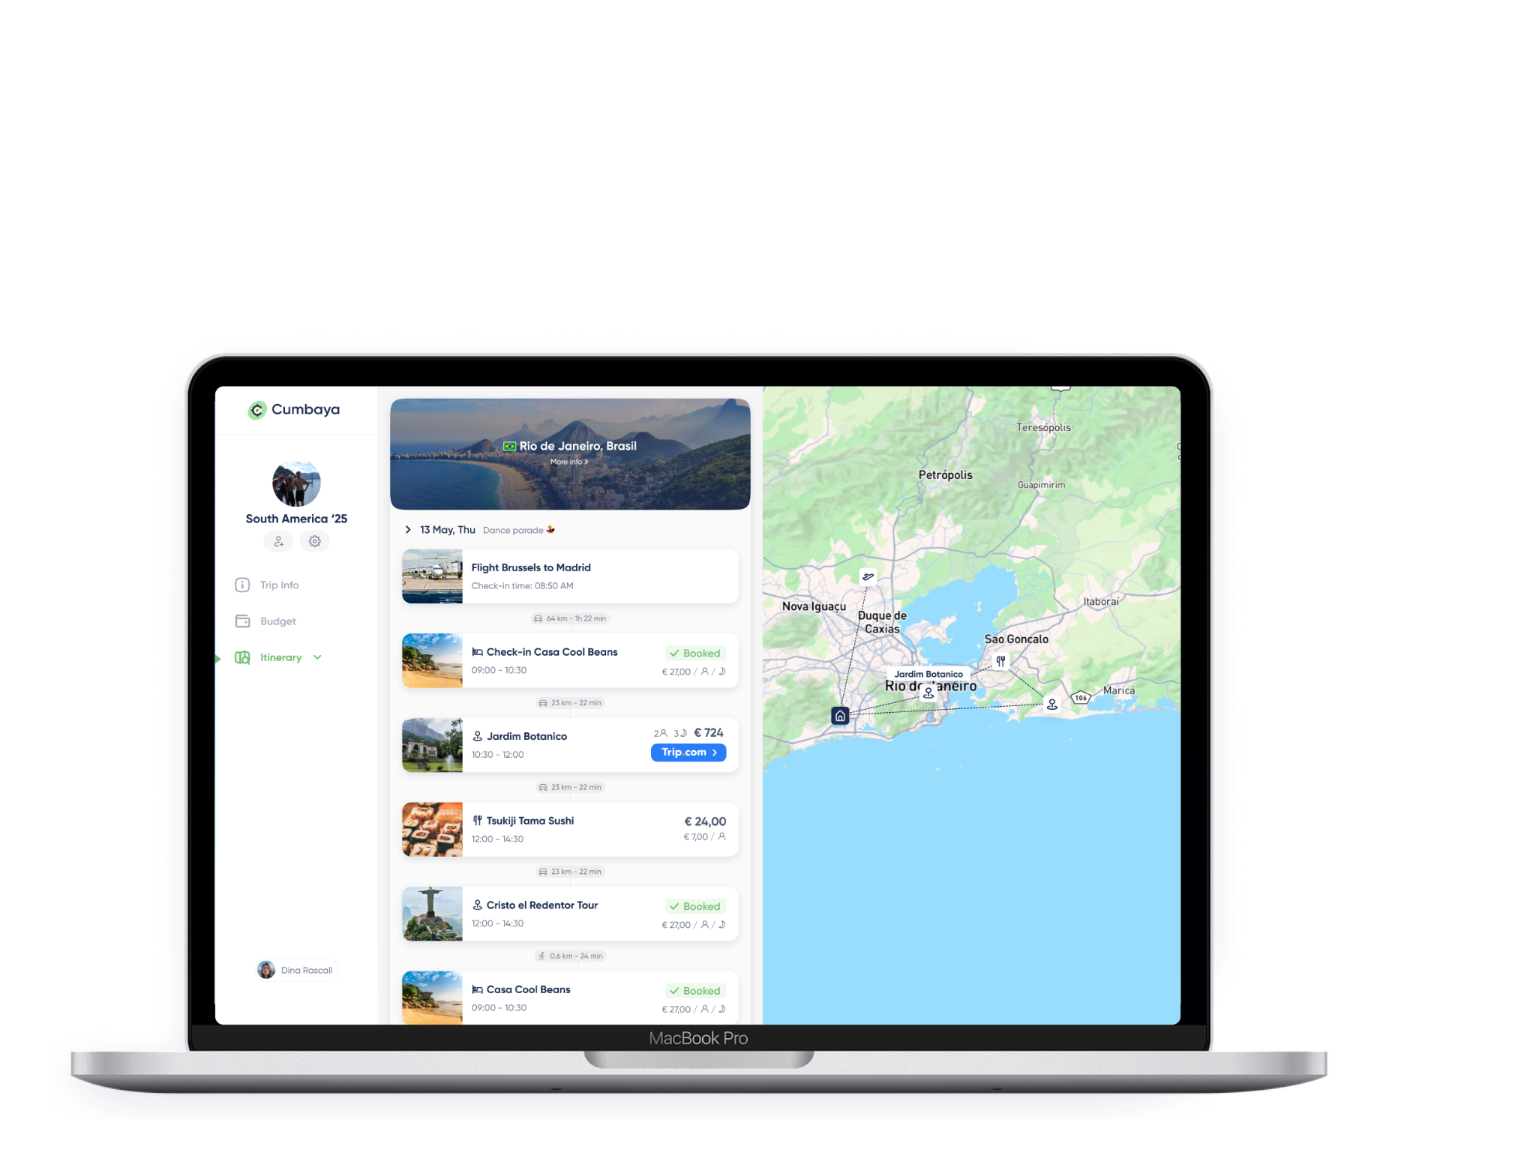





Our AI handles the complexity of
planning & booking
Cumbaya AI Model
Fully automated itineraries &
bookings

Slide 9
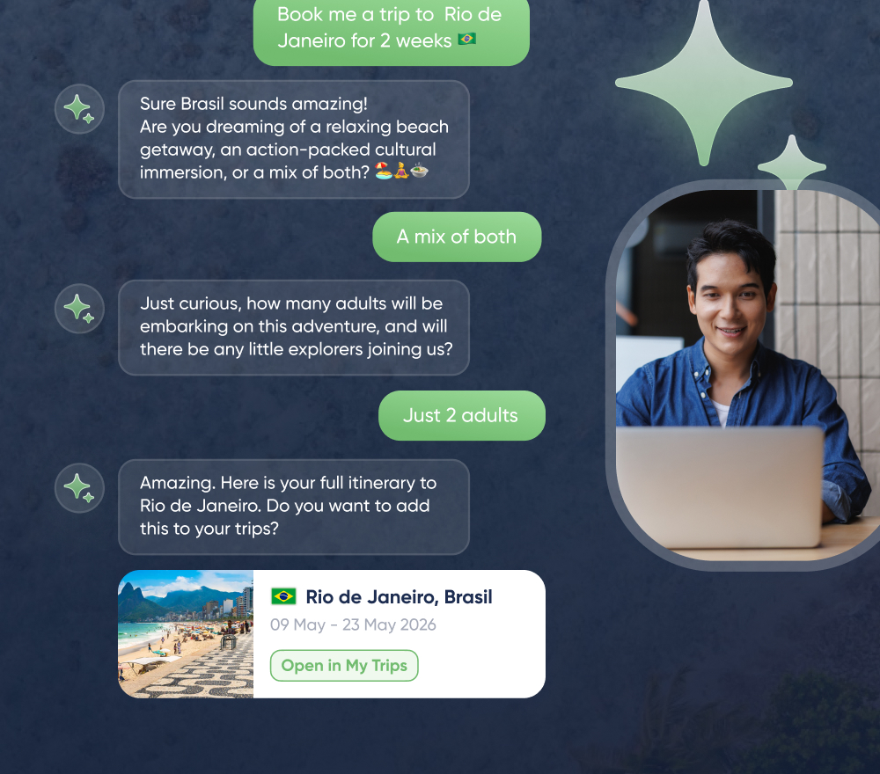
Each task is performed
by a specialised AI Agent
Select best hotels
Book activities
Find cheapest flights
Check opening hours
Calculate distances
Optimise budget & margins
…

Slide 10


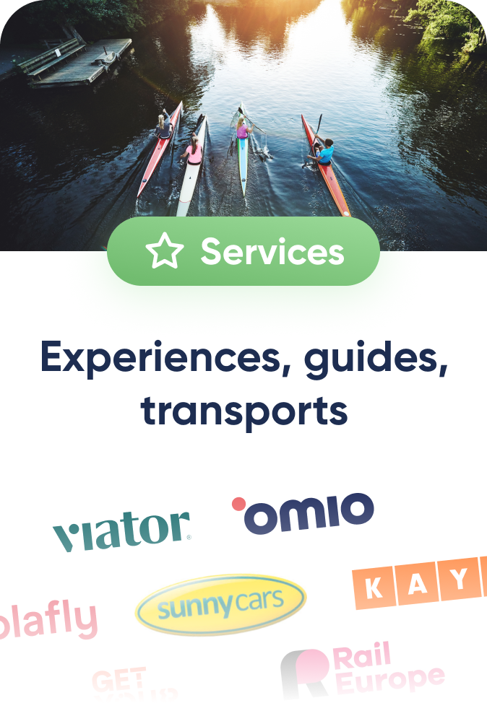
We integrate the Agency’s suppliers
Their rates & markups

Slide 11
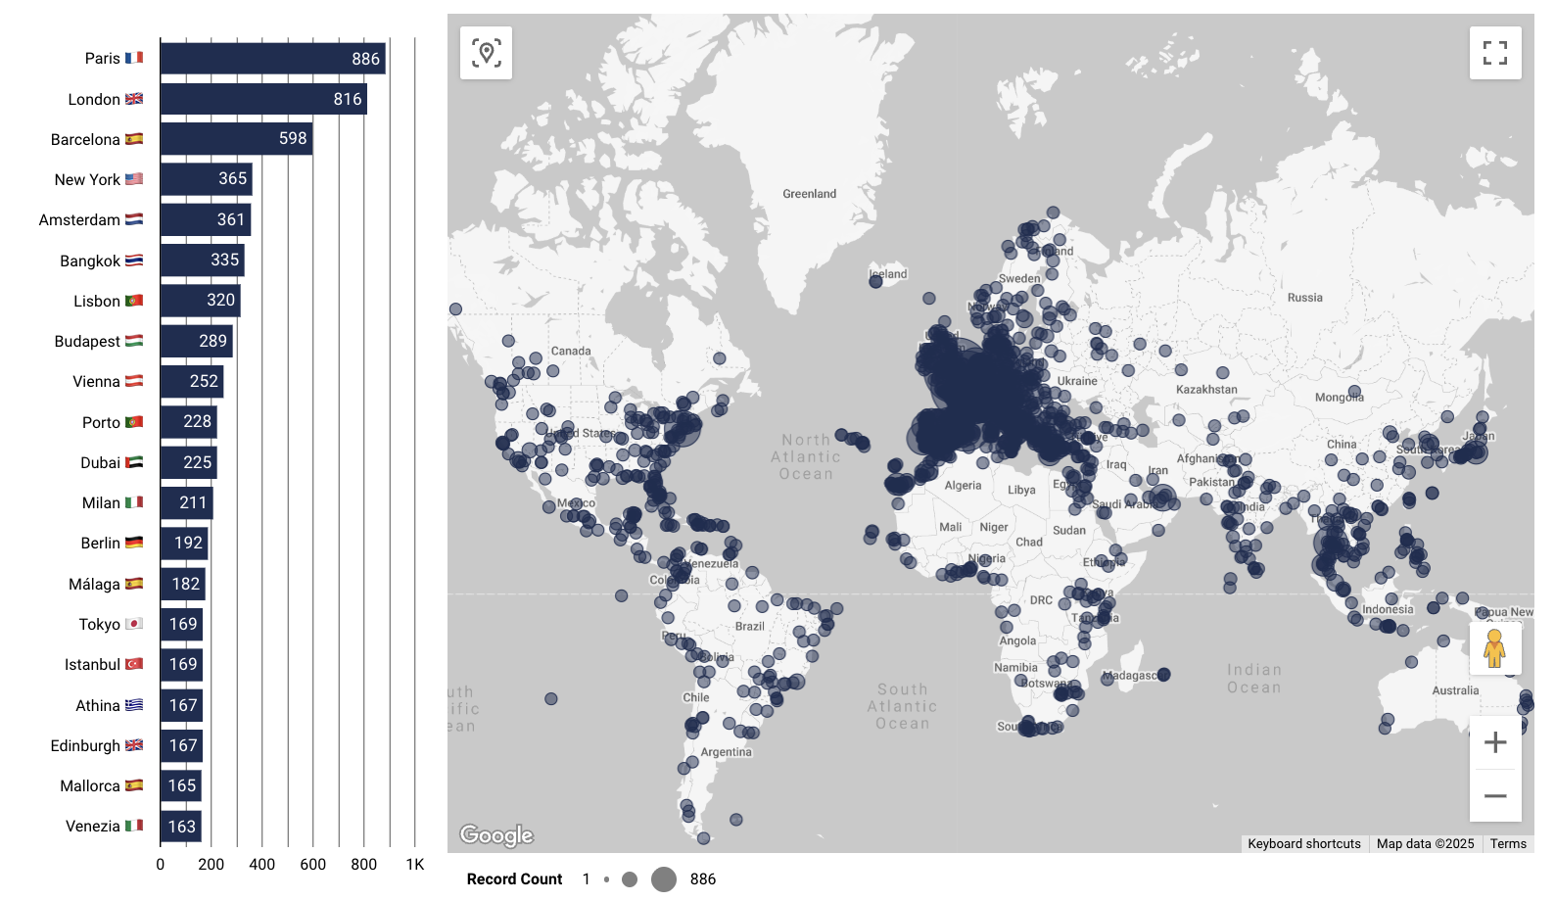
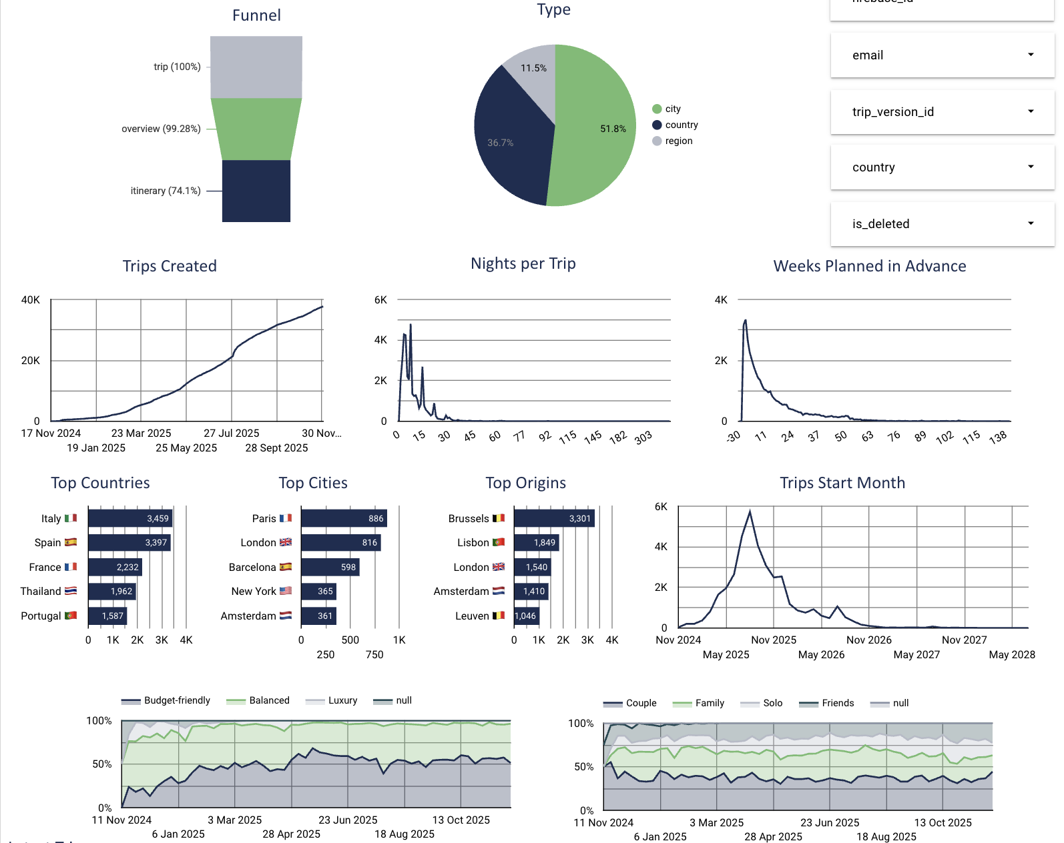
We capture the data of travellers

Slide 12
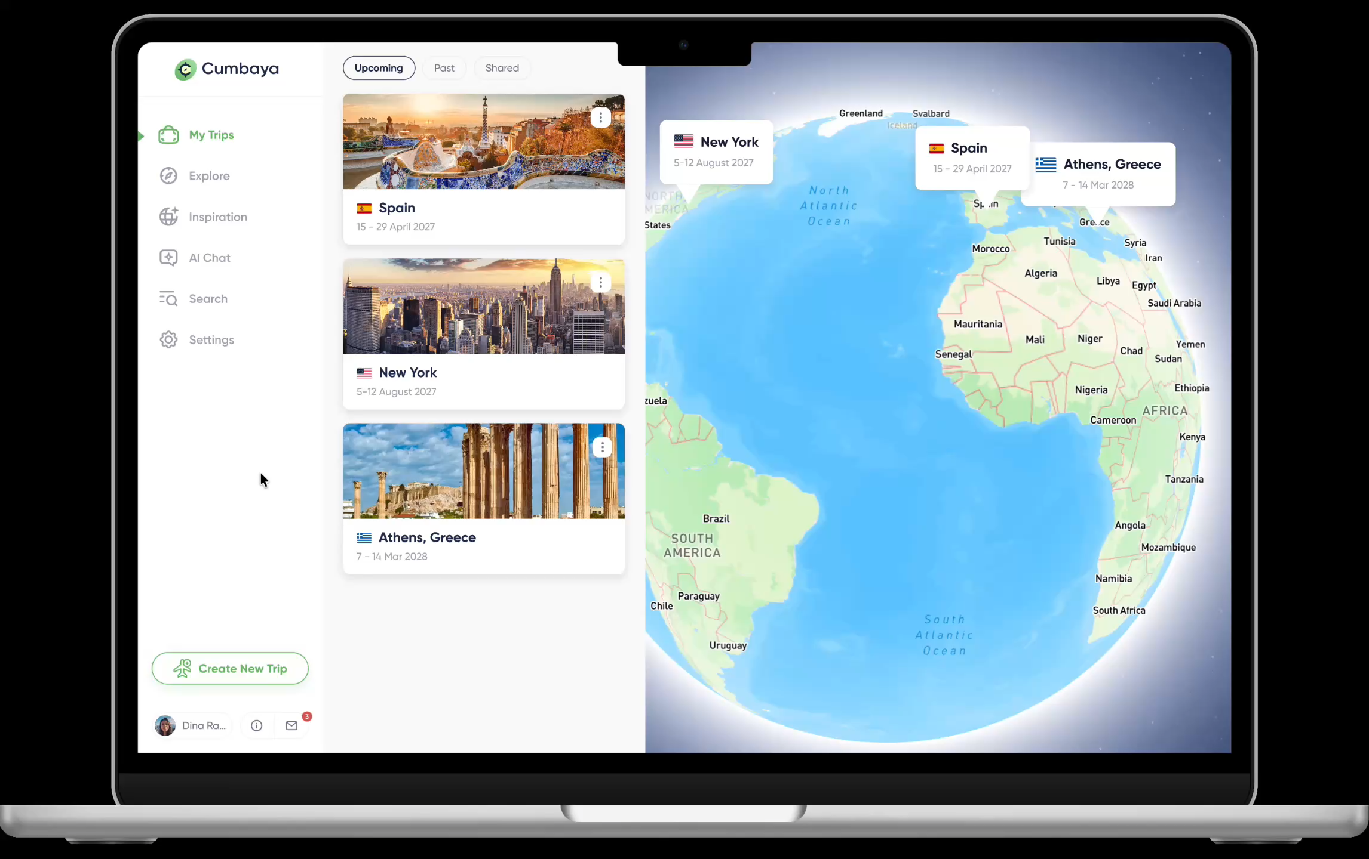

Slide 13
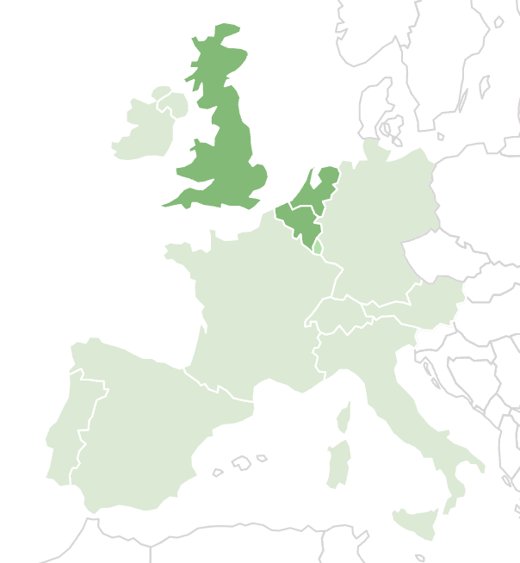




Scaling the ecosystem
through strategic consortia
€25M+ ARR
by 2030
€300K
ARR
today

Slide 14
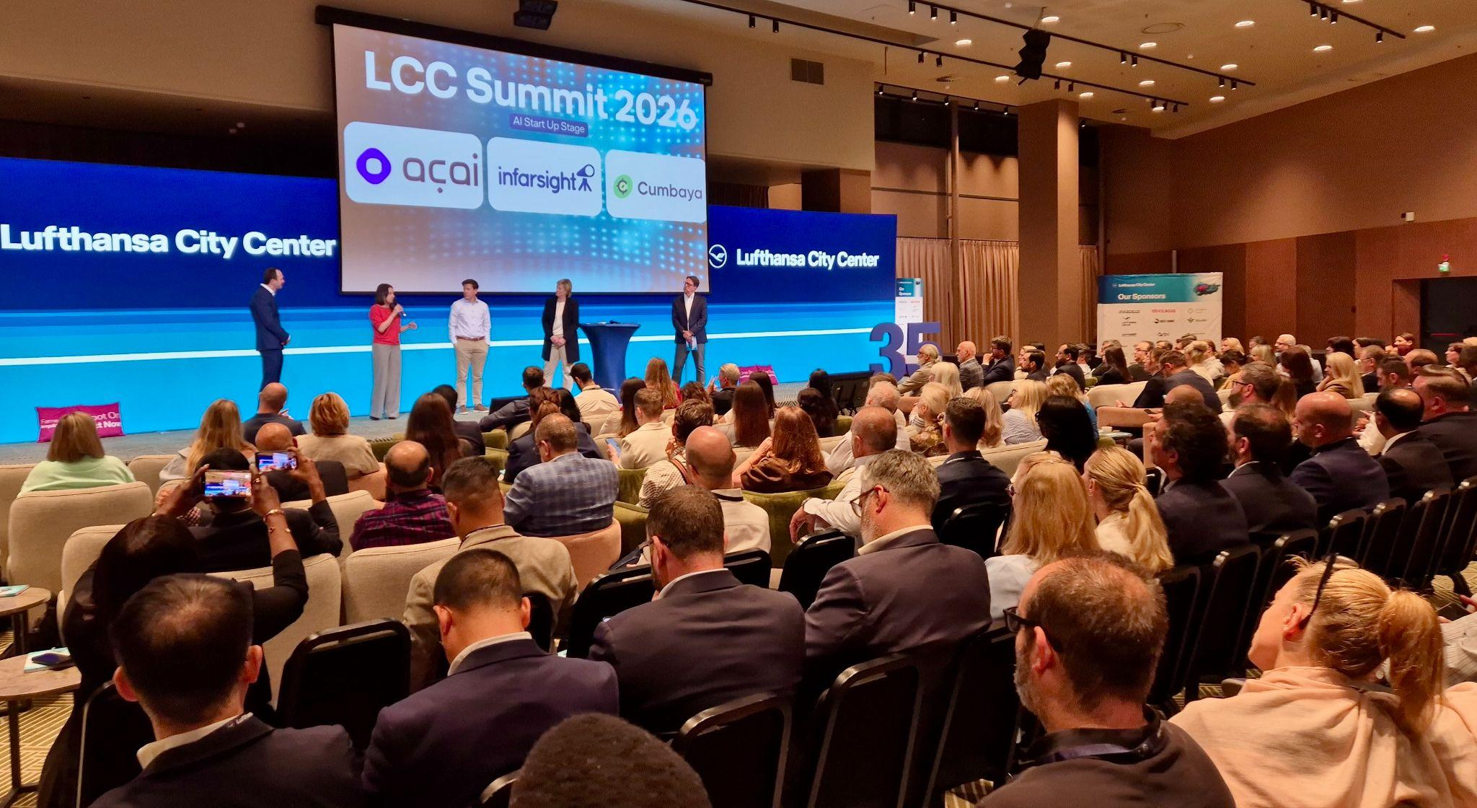

Slide 15
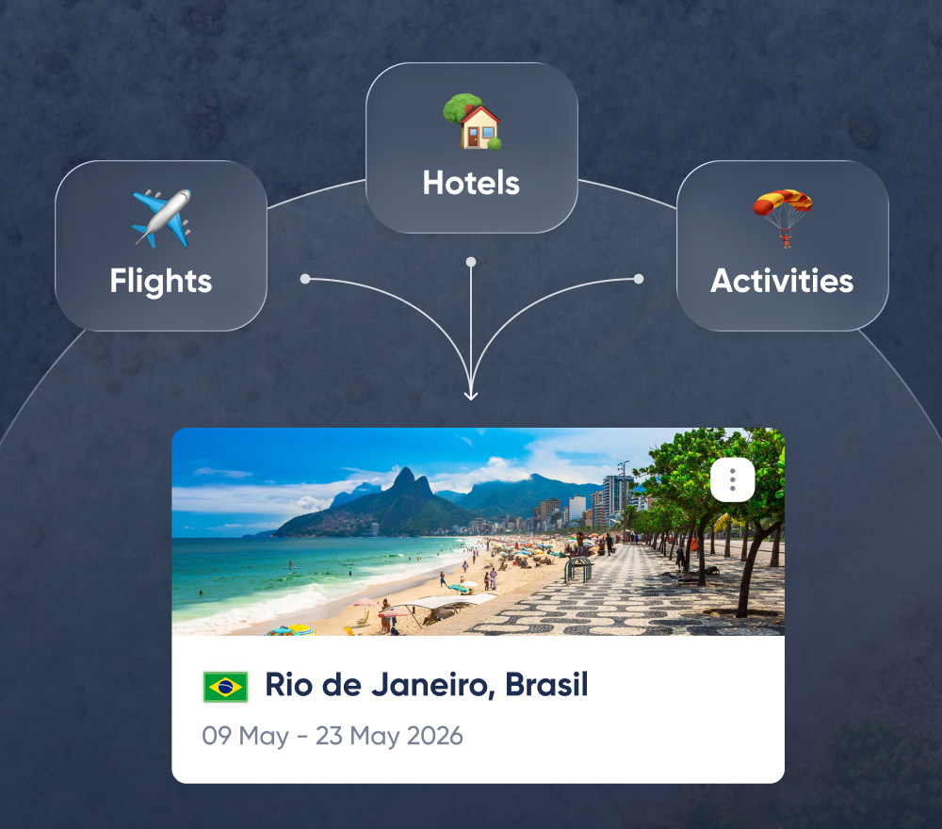
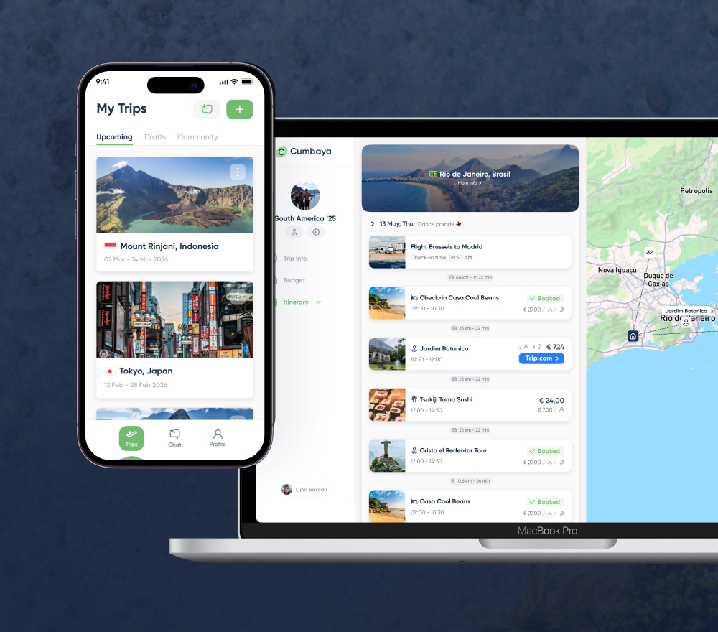
Let the numbers speak
Automated Planning & Booking
Dynamic
Packaging
Online & Mobile Presence
4h/trip
+10%
25-50 Y
Manual labour
Margin
Younger audience

Slide 18
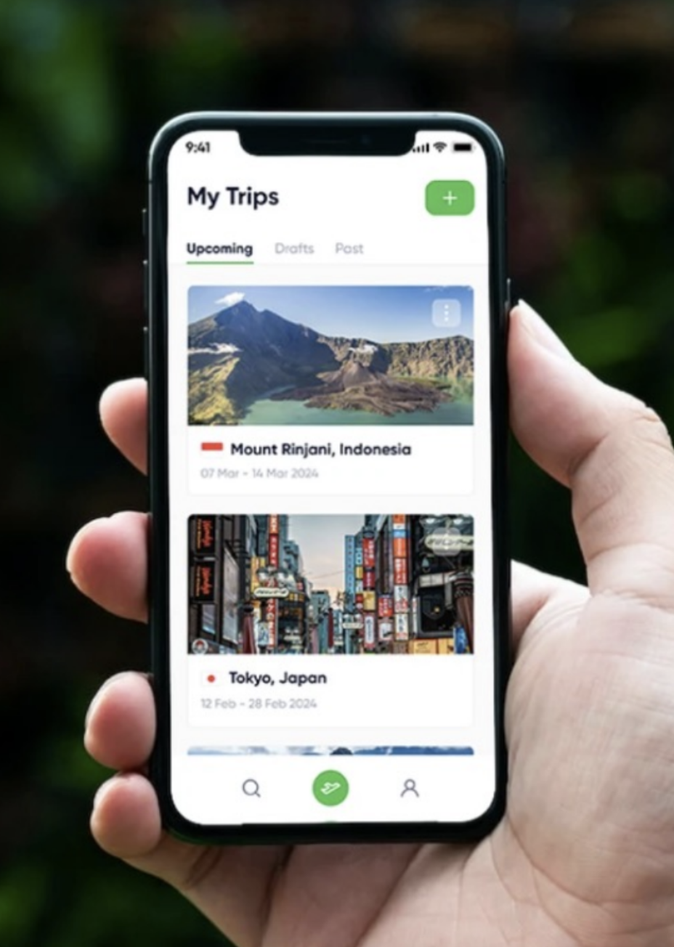
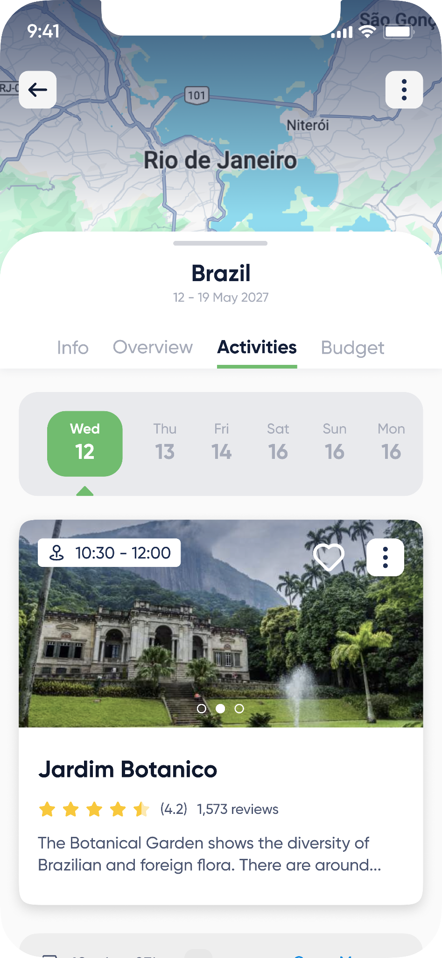





Together with travel companies,
we are the future of travel
Find us at booth N26
Thank you!
Contact me
sven.hermans@cumbaya.travel
+32 475 72 55 55
https://cumbaya.travel
Leuven, Belgium
Sven Hermans
CTO

