Slide 1

The (very) near future of travel search & retail with Agentic AI

Slide 2
Travellers Dream in Experiences
Travel Search Thinks in Fields

Slide 3
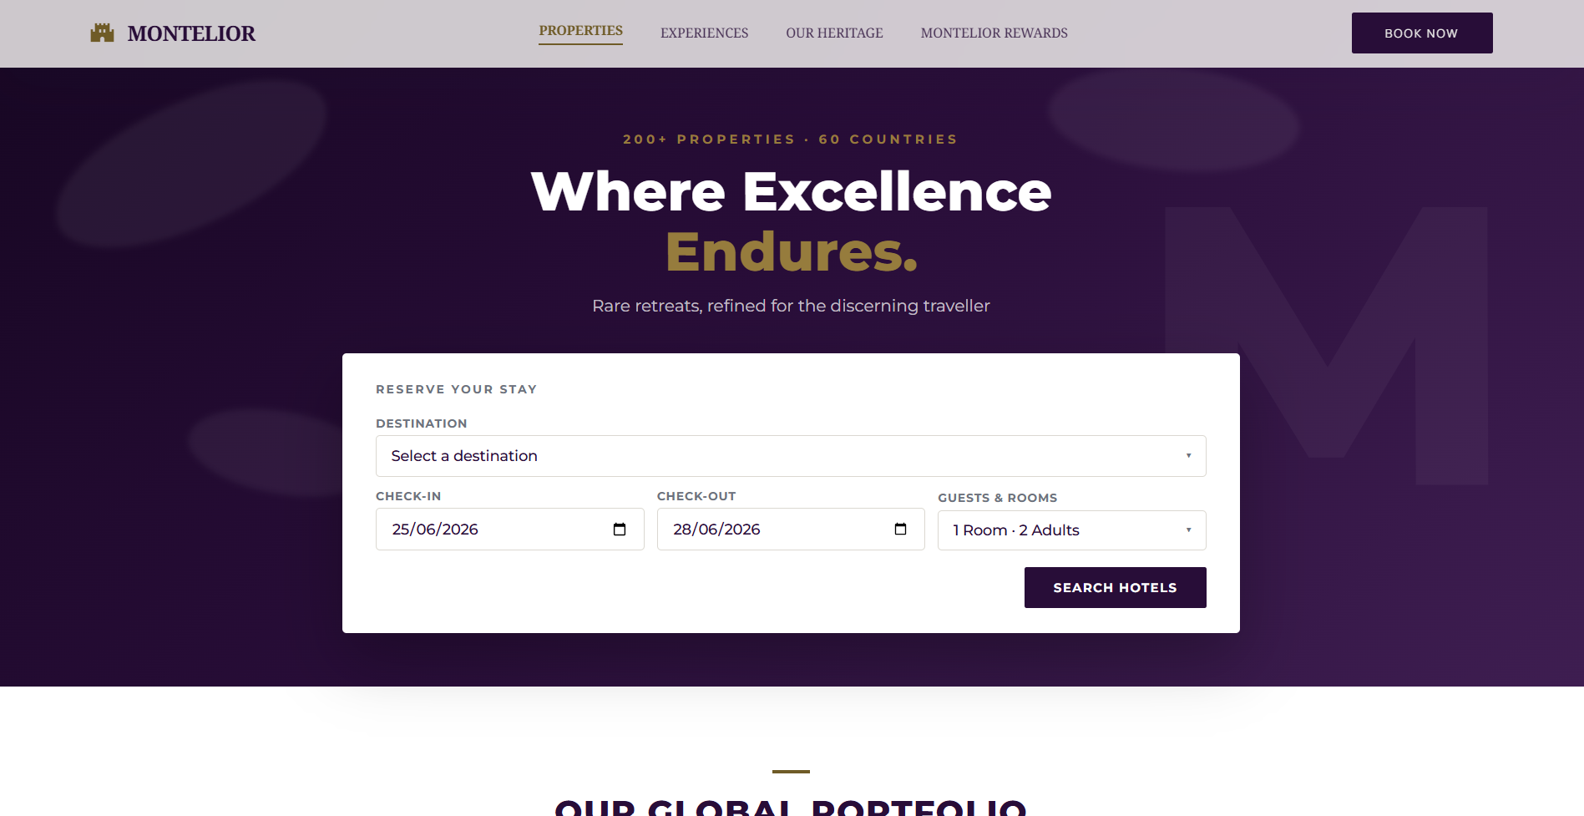
Upsell & Cross Sell
sample subhead
Bullet 1
Bullet 2
Bullet 3

Slide 4
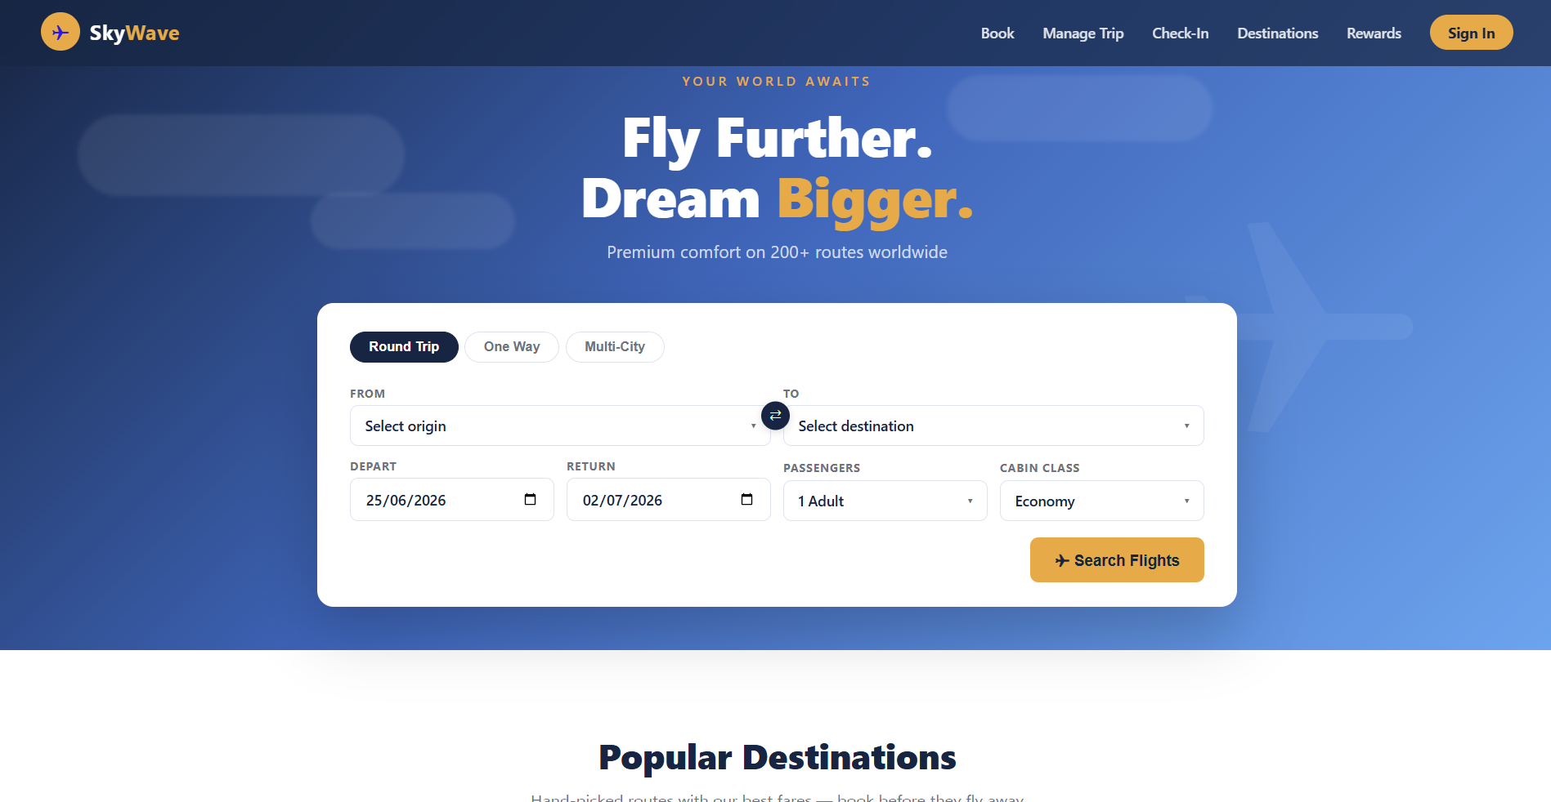

Slide 5
The search box wasn't a design choice
It was a technology constraint

Slide 6
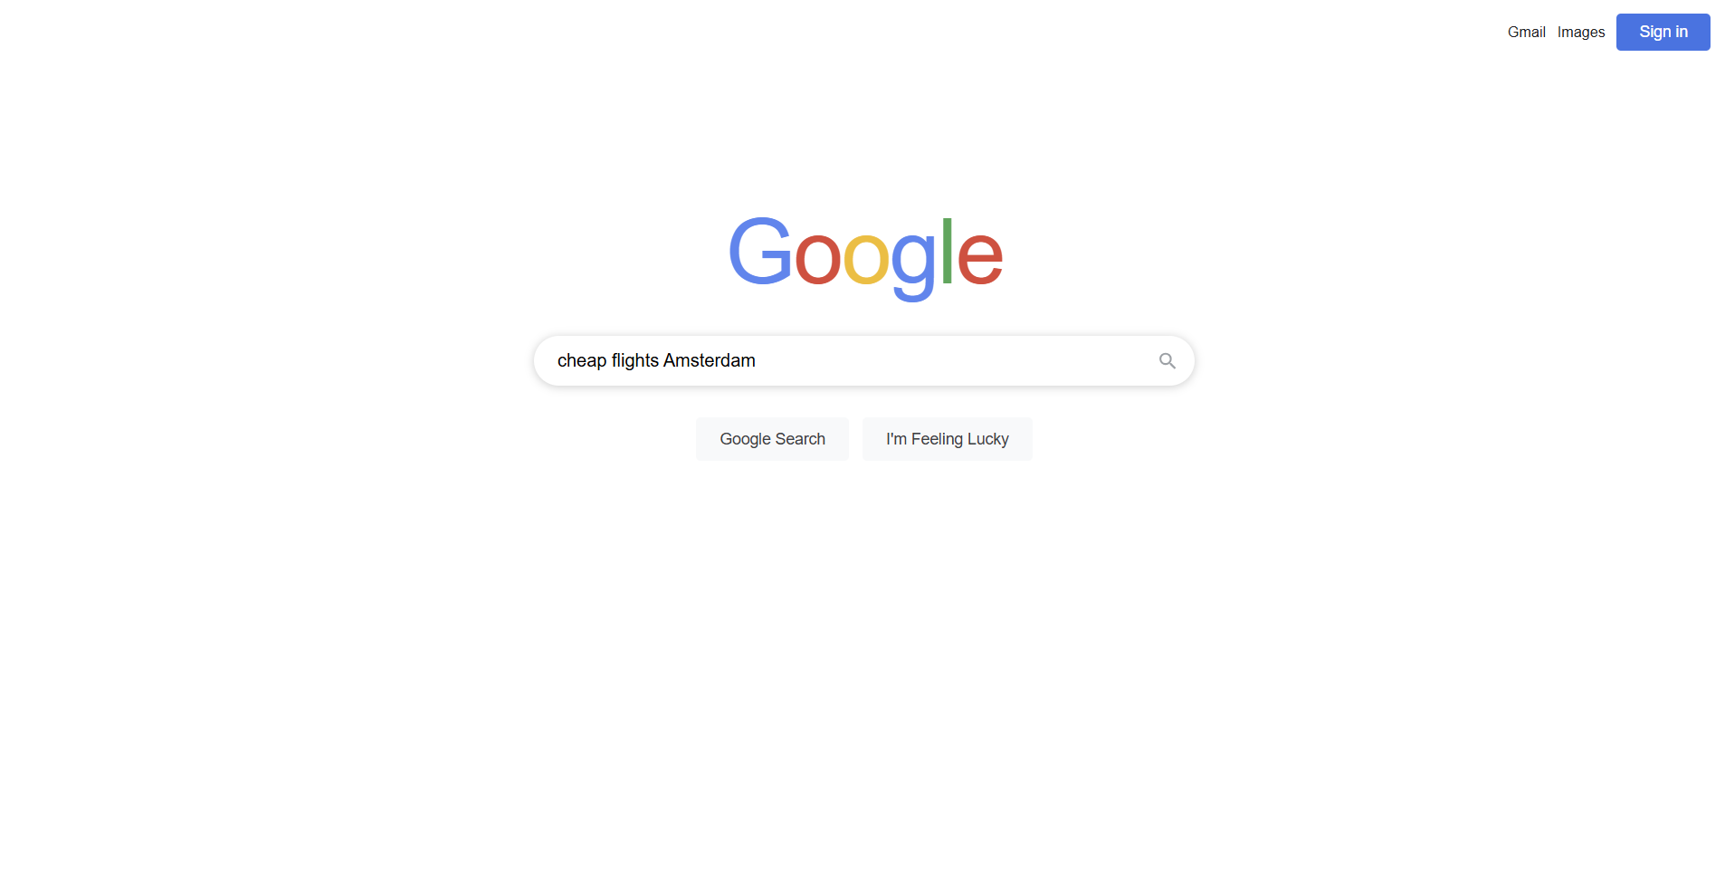
Search is changing
It used to be a means to find the next place to search

Slide 7
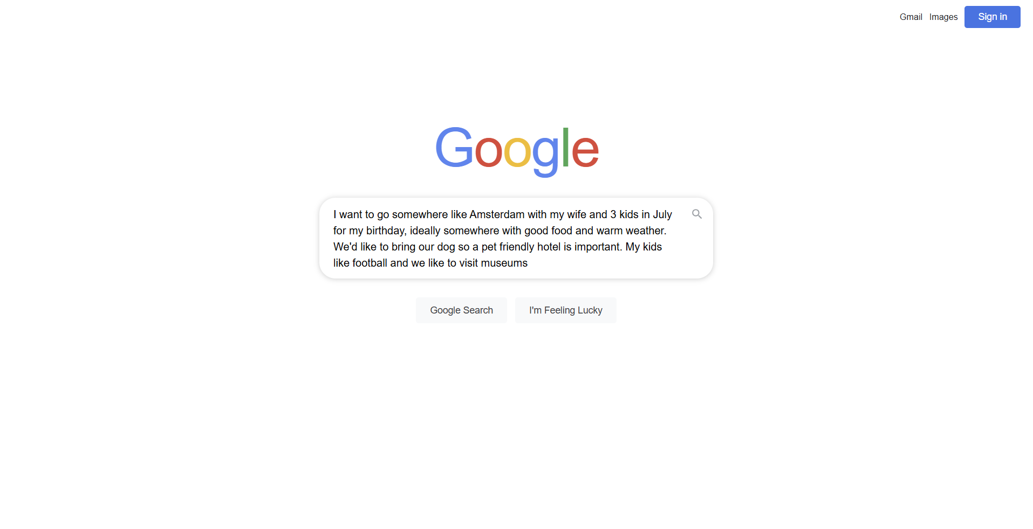
Search is changing
…and now it is becoming a method to communicate intent

Slide 8
The retail opportunity
Upsell potential increases with context
Without context, it becomes a list
Would you like a bag?
Would you like a seat?
Would you like insurance?
Would you like breakfast?
Would you like a transfer?
With context, it becomes part of the offer
For a family traveller:
"You're arriving at 5am with two children. Shall I reserve a room from the night before so you can check in immediately?"
For a skier:
"I can arrange equipment transport and airport transfers."
For a business traveller:
"Moving to the later departure saves £200 and still gets you home the same evening."
For someone celebrating an anniversary:
"I've found three hotels that previous guests consistently describe as unforgettable."

Slide 9
Consistency across channels travellers already use

Slide 10
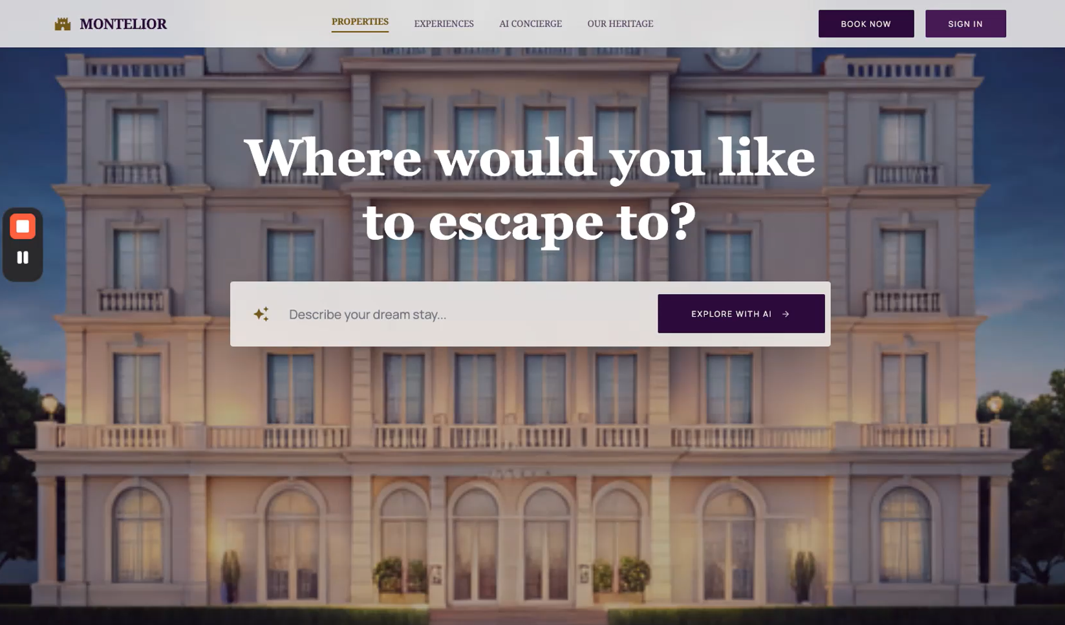
Sample bullets
sample subhead
Bullet 1
Bullet 2
Bullet 3

Slide 11
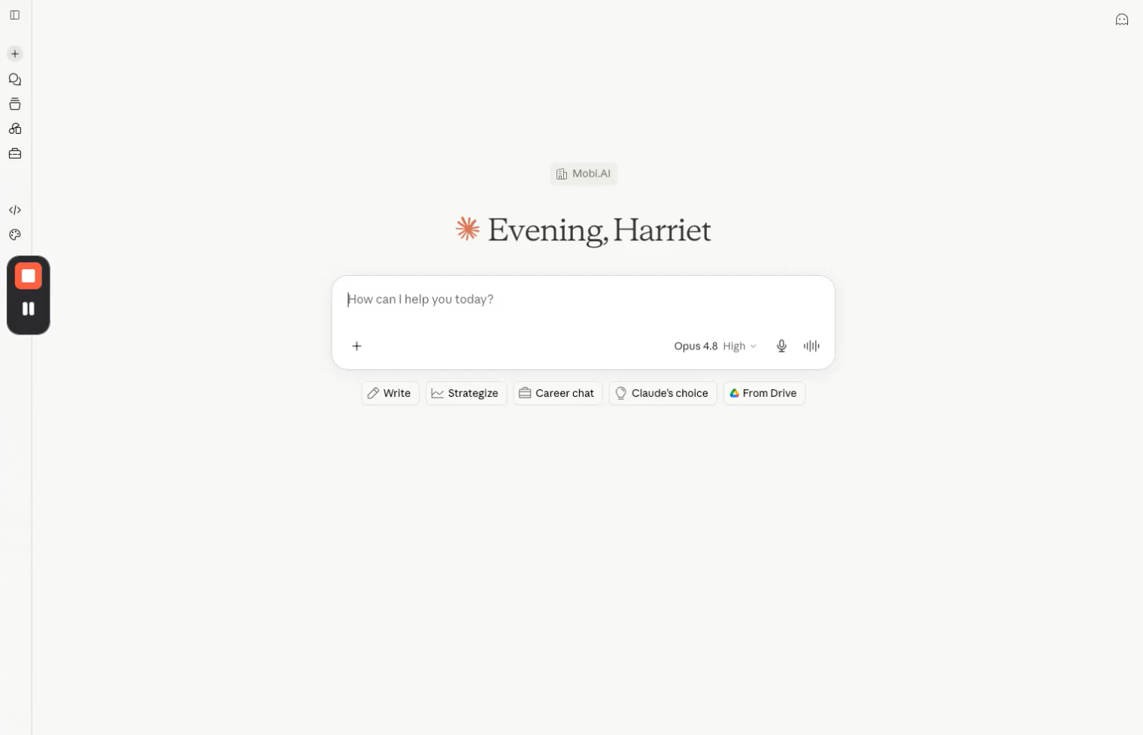
Sample bullets
sample subhead

Slide 12
The introduction of payments with be a gamechanger

Slide 13
The future of travel retail isn't a better booking form
It's understanding the experience the traveller is trying to create

Slide 14
..and helping them get there

Slide 15
Stuart Barwood, Chief Revenue Officer
stuart@mobi.ai

