Slide 1
AI in Travel: From First Call to Full Autonomy; Where Are You on the Journey?
Timothy Smee – Product Manager - NFON
Notes:
Hello everyone, my name is Tim Smee I'm a Product Manager at NFON, we build cloud communications for businesses across Europe. Which means I spend a lot of time thinking about what happens when the systems that connect businesses to their customers either hold up or fall apart.
Today we’re going to talk about just this, what happens when something goes wrong, what might happen now, and what could happen in the future with Ai. We’ll also talk about how you can map out your Ai journey and how you see where you are on this journey. So no product pitch, I want to help you understand where you are and hopefully give you a plan around how to get to where you need to be in the coming years.
Scenario based talk…

Slide 2
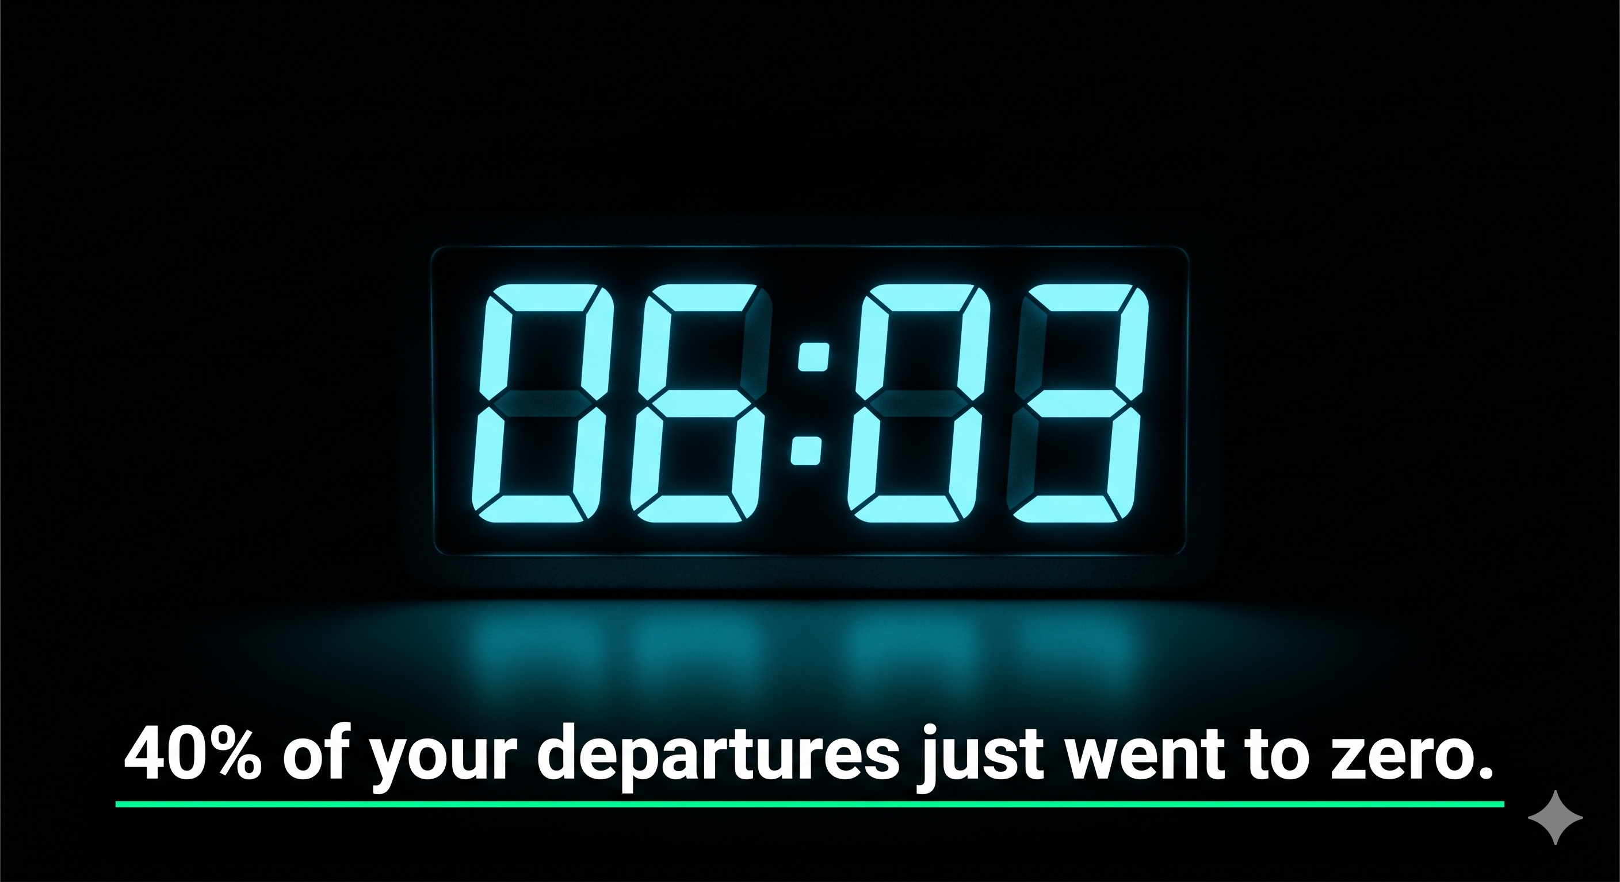
Notes:
"It's 6am on a Tuesday. A weather system has just grounded 40% of your departures. Your phones start ringing at 6.03.
In the next 90 minutes, one of two things happens.
Your operation holds. Customers are rebooked, notified, and looked after before most of them have left the terminal. Your brand comes out of it intact — maybe even stronger.
Or the queues build. Hold times hit 45 minutes. Agents are checking three systems to find a single booking. Customers take to social media before they've spoken to anyone. And the brand damage compounds every minute you can't get ahead of it.
Every single person in this room has lived one of those two scenarios. Some of you have lived both.
Airlines cut over 13,000 flights in May 2026 alone. 2 million seats. A single hub disruption generates up to 80,000 inbound customer queries within four hours.
The question I want to explore with you today isn't whether disruption is coming. It's whether you've built for it."

Slide 3
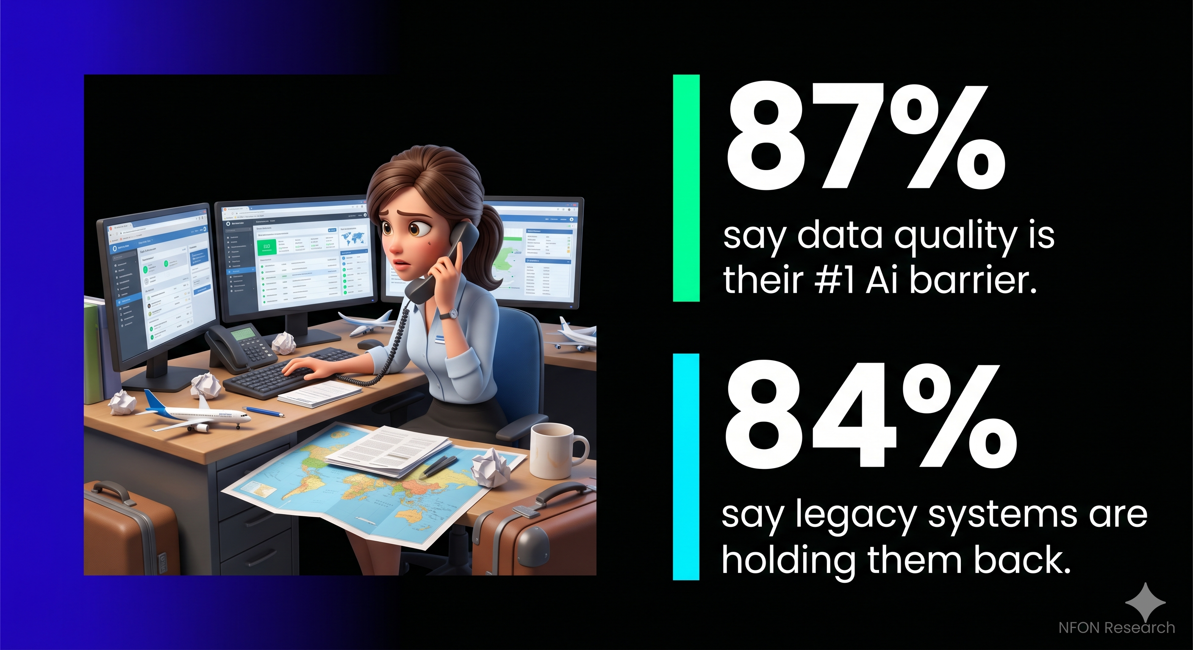
Notes:
Here's what I see when I talk to travel businesses about their Ai strategy.
The ambition is real. The investment intentions are genuine. The technology on the roadmap is impressive.
And then I ask: what happens when a customer calls right now? And the answer is usually three systems, a long hold time, and an agent doing their best with tools that weren't designed for this.
The gap between where most businesses think they are on their Ai journey and where they are, is significant.
And the data backs this up. You are not alone in this room.
87% of your peers say data quality is their number one barrier to Ai progress.
84% say legacy communication systems are holding back their Ai progress.
[Pause and let that land]
I'm not sharing those numbers to make you feel bad. I'm sharing them because I want you to feel understood. This isn't a failure of ambition. It's a structural problem — and structural problems have structural solutions.
The average travel business takes 31 months from starting their Ai journey to seeing meaningful impact. The ones that move faster aren't spending more money. They're starting in the right place.
So where is the right place? That's what the next ten minutes are about."

Slide 4
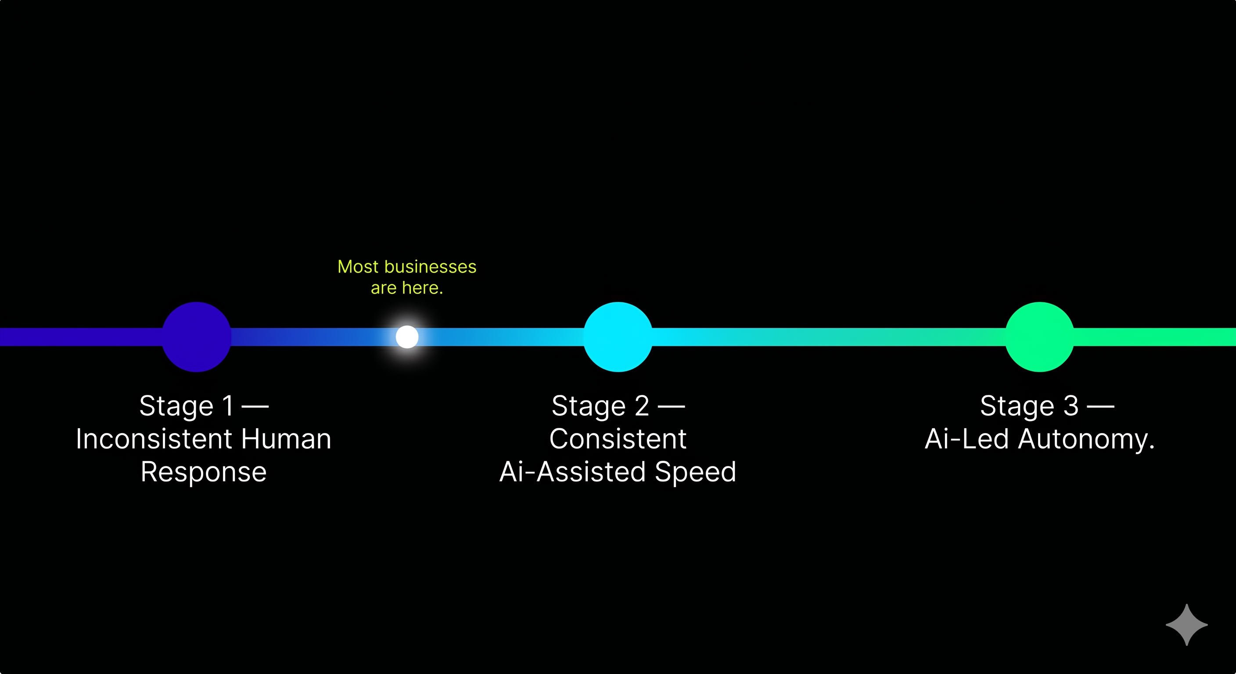
Notes:
I want to give you a framework you can actually use. Not a product pitch. Not a feature list. A maturity model you can locate yourself on — honestly — and use to work out what the next move is.
Three stages. Most travel businesses are somewhere between Stage 1 and Stage 2. Very few are at Stage 3 yet. And that's fine — because knowing where you are is the first step to knowing where to go.
Let me walk you through what each one actually looks like

Slide 5
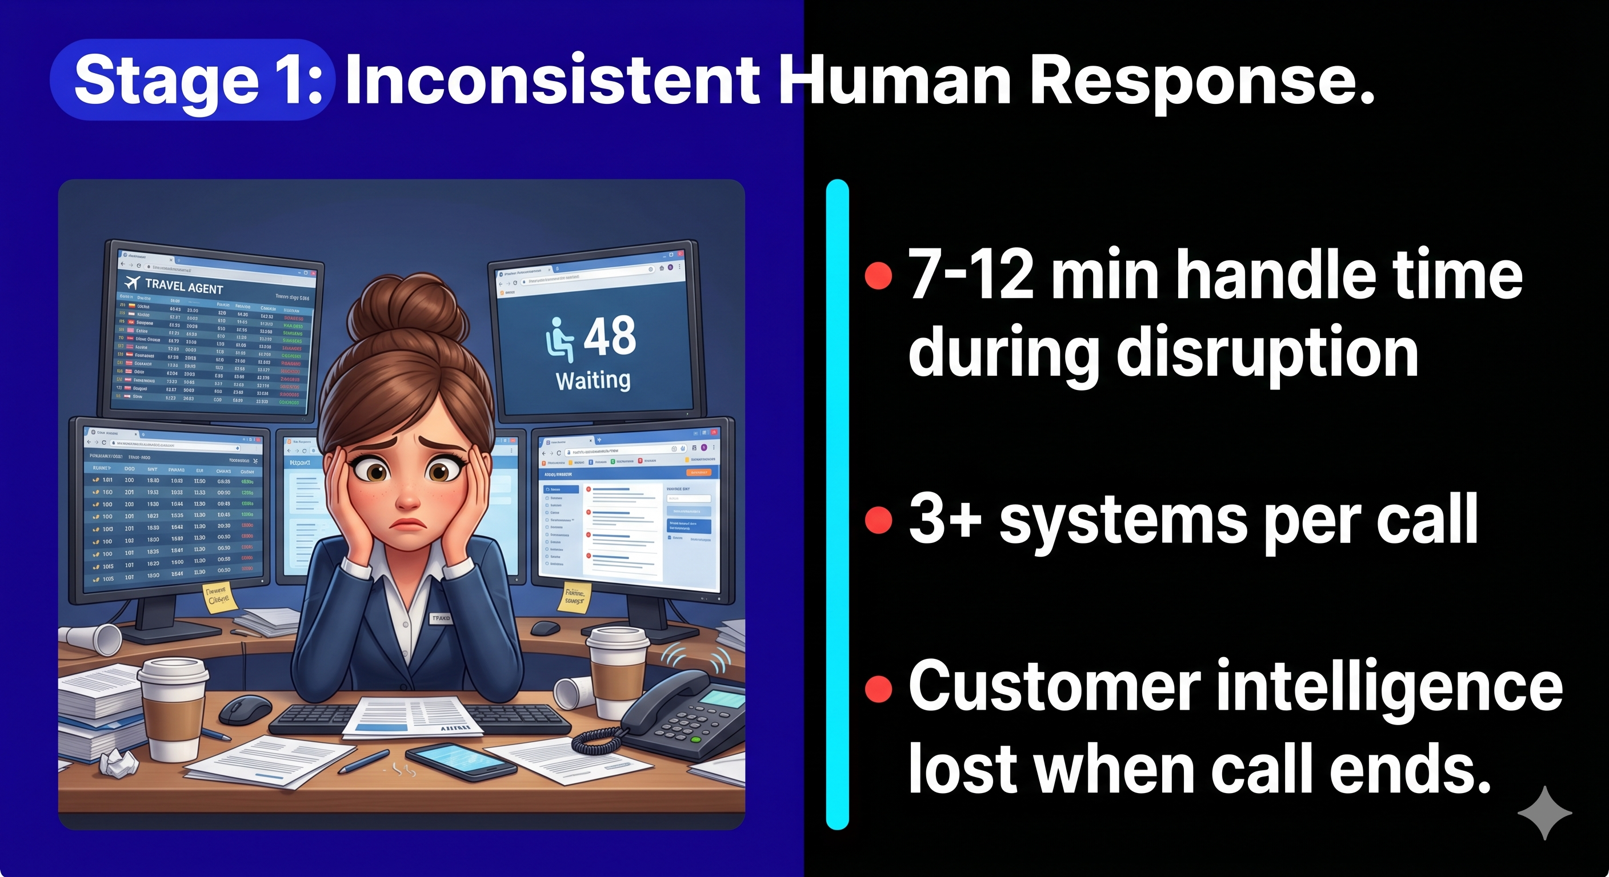
Notes:
Stage 1 is where most businesses are. And I want to be clear — this isn't about the quality of your people. Your agents are capable. Your team cares. The problem is what the systems are giving them to work with.
Picture that 6am disruption scenario again. An agent picks up. They need the customer's booking reference. They go to system one. They need the rebooking options. They go to system two. They need the loyalty status. System three.
Meanwhile the customer is stressed, far from home, and losing patience with every second of hold music.
The average handle time during a disruption event at Stage 1 is 7 to 12 minutes per call. When you're getting 80,000 inbound enquiries in four hours, that maths doesn't work.
And here's the part that doesn't show up in the handle time metric: when that call ends, everything learned in that conversation, the context, the sentiment, the pattern, largely disappears. It doesn't feed back into how the next interaction is handled. It doesn't help the team understand where the real volume is coming from.
The data is generating noise. Not intelligence.
[Pause]
If that sounds familiar, you're at Stage 1. And 87% of your peers are right there with you

Slide 6
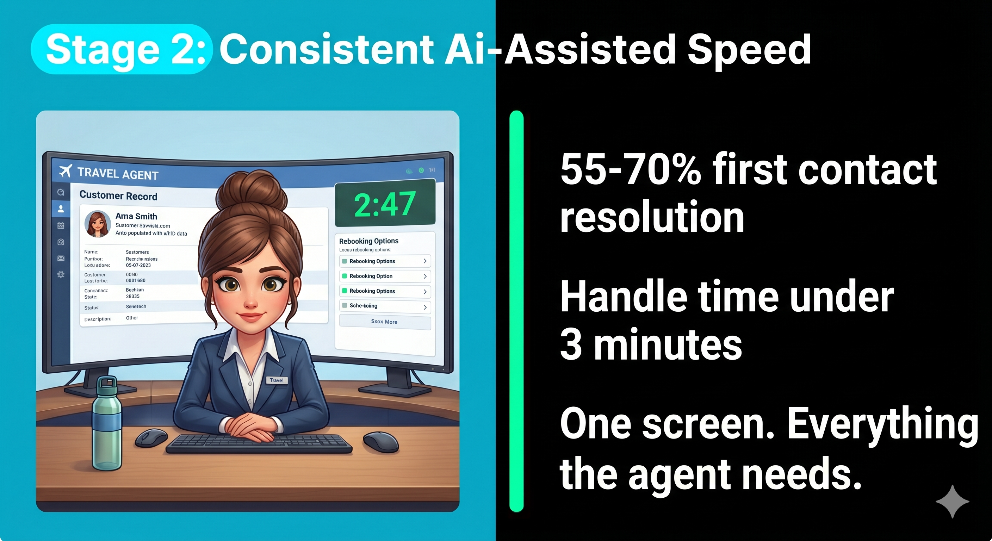
Notes:
Stage 2 is where Ai starts doing its actual job.
Same disruption. Same 6am. Same volume spike.
But this time the agent picks up and the customer record is already on screen, pulled automatically from the booking reference in the IVR. The Ai has surfaced three rebooking options ranked by availability and the customer's travel history. The agent confirms. Call resolved in under three minutes.
The Ai isn't replacing the agent. It's removing every piece of friction that was slowing them down.
First contact resolution rates at Stage 2 run between 55 and 70%. Handle time drops below three minutes. And because the system is doing the retrieval work, the agent is free to do the thing only humans can do, read the room, manage the emotion and most importantly, make the customer feel like someone cares.
The technology to get here exists right now. The gap between Stage 1 and Stage 2 is almost always the same thing: the communication infrastructure wasn't built to feed the Ai the data it needs in real time.
84% of travel organisations say legacy communication systems are holding them back. Stage 2 requires those systems to be replaced or properly integrated. Not worked around. Not patched. Replaced or integrated.
That's a change management conversation as much as a technology one.
But here's what I want you to hold onto: the jump from Stage 1 to Stage 2 isn't about buying more sophisticated Ai. It's about building the foundation underneath it

Slide 7
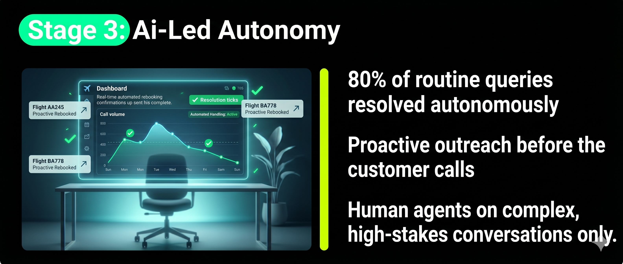
Notes:
Stage 3 is where the conversation gets interesting.
Same disruption. But this time — the customer never needs to call.
Before the passenger picks up their phone, the system has already identified every affected booking, cross-referenced seat availability on alternative flights, applied loyalty tier prioritisation, and sent personalised rebooking options to each customer via their preferred channel.
The customers who do call — because some always will — are routed immediately to a human agent for the situations that genuinely need human judgment. Complex multi-leg itineraries. Distressed passengers. Medical requirements. Edge cases that fall outside standard policy.
Gartner predicts that agentic Ai will autonomously resolve 80% of common customer service issues by 2029. That's three years away. The businesses arriving there first are already building for it now.
And here's the thing about Stage 3 that most people miss: it doesn't eliminate your contact centre team. It elevates them. Your best people stop spending their day on tasks a well-integrated system could handle — and start focusing on the conversations that actually require human judgment and human empathy.
76% of travel leaders are already formalising a model where Ai handles routing and routine resolution while humans manage the complex, emotional, high-stakes interactions.
That's not a smaller team. That's a better one.
[Pause]
So. Three stages for your Ai journey

Slide 8
The answers tell you exactly where your bottleneck is.
How many systems do your agents need to resolve a call?
What happens to that conversation’s intelligence when it ends?
Could your infrastructure handle a 500% volume spike right now?
Do you know your first contact resolution rate – and what is driving it down?
Are you optimising for deflection or resolution?
Notes:
Before you leave today and go back to your roadmap planning and your vendor conversations — I want to leave you with five questions.
These aren't rhetorical. They're diagnostic. The answers will tell you exactly where the bottleneck is in your own operation.
[Click through each question one at a time]
One. When a customer calls, how many systems do your agent need to access to resolve the issue?
Two. What happens to the intelligence from that conversation after the call ends?
Three. If your call volume spiked 500% in the next hour — what would your infrastructure do?
Ada's 2026 research found that resolution rate is the metric consumers rank as most important in travel customer service. Businesses rank it seventh.
That gap — between what your customers are measuring you on and what you're optimising for — is where most Ai investment in travel is going wrong right now."
Four. Do you know your first contact resolution rate — and what's specifically driving it down?
Five. Are you optimising for deflection rate or resolution rate? Because they are not the same thing.

Slide 9

Notes:
I want to leave you with something useful, not just a slide to photograph.
If you want to know exactly which stage you're at, scan the first QR code. It's a 30-second, five-question diagnostic. You'll get your stage score immediately and a guide to what moving forward actually looks like for your specific situation.
[Pause]
The gap between Stage 1 and Stage 3 isn't technology. It's infrastructure, data, and the decision to start.
The businesses that win the next five years in travel won't be the ones with the most sophisticated Ai. They'll be the ones who built the right foundation underneath it.
Thank you. I'm around for the rest of the day, come and find me

