Slide 1



+
Automate This, Not That:
How Modern TMCs Are Scaling Service
Liz Doyle
GTM, Front
Greg Apple
CEO, Amgine

Slide 2

Notes:
“Liz: Before I kick off today’s presentation, I want to start with someone you all know. Her name is Jane.
Jane is your client's CFO.
Her EA emails in requestiung a new flight LAX to London on Tuesday — departure in 3 days.
It came in at 11pm. She expects business class, and she needs a hotel the same night she lands.

Slide 3




The traveller experience should feel seamless
IDEAL STATE
Jane needs to book a trip
She receives an answer instantly
Jane needs to make a trip change
She receives a timely response on any channel
Notes:
Whether it’s the initial point of booking your trip or wanting to make urgent changes when it’s nearing your travel date - you don’t want a rigid process or to be second guessing how to best get in touch with your TMC.
So that’s why TMC’s need be able to offer fast, reliable and personalised support not matter how or where your clients contact you

Slide 4









THE CHALLENGE
But the reality is often a fragmented and inconsistent experience due to siloed teams, channels and technology
Notes:
Every TMC has two worlds. Most are still bridging them manually.
Agents spend their days Request arrives → Agent reads it → Switches to GDS → Checks policy → Switches back → Responds → Traveler replies → Repeat.

Slide 5
THE CHALLENGE
75%
of time spent on a travel request is spent moving information — not making decisions.
Notes:
Whether it’s the initial point of booking your trip or wanting to make urgent changes when it’s nearing your travel date - you don’t want a rigid process or to be second guessing how to best get in touch with your TMC.
So that’s why TMC’s need be able to offer fast, reliable and personalised support not matter how or where your clients contact you
—
Inside your TMC, that kicks off a chain of manual steps: parse the request, check her policy, identify what's missing, query the GDS, clarify, respond, book, confirm.
Multiply that by hundreds of requests a day across email, Slack, WhatsApp, and phone — and you have the coordination tax.
The real cost isn't just speed. It's your best agents spending their time on structured, automatable work when they should be handling the requests that actually need their judgment. The inbox is full, SLA risk is invisible, and the team is exhausted.
That's what today is about — not just automation, but knowing exactly where to put it."
the manual handling your agents absorb before they touch a single GDS

Slide 6
Most solutions close one half of the loop.
Shared Mailboxes | Request arrives. Multiple agents receive the request. Agent manually interprets intent, checks GDS, builds options, follows up.
Booking automation | Booking completes. The conversation, exception, traveler question? Back to a separate inbox.
Chatbot / AI responses | Handles the question. Can't touch the booking.
Notes:
What are most teams getting wrong?
Key message: Every system doing its job. Nobody closing the gap.
So the answer isn't another tool.
Every tool on that last slide works.
The problem is that none of them were built around the bigger picture of a traveler’s journey end to end.
That's what's been missing.
Not more automation — a framework for deciding what should be automated, what still needs a human, and what should never be touched by AI at all.
Everything in a travel operation fits into one of three buckets."

Slide 7



Three buckets.
Everything fits into one.
AUTOMATE
ASSIST
OWN
Repeatable work that AI can handle end-to-end
Work where humans still need to act with AI help
Work that needs human judgement, accountability, empathy
Notes:
Three buckets. Everything in your operation fits into one of them.
How do you decide what to automate, assist, or protect?
Key message: Not all travel requests are equal — and your workflow shouldn't treat them like they are.
Bucket 1 — Automate: Work where the answer is repeatable. Jane's flight request: parse it, check policy, query the GDS, send options, book it. AMGiNE handles this end-to-end — no agent needed until something needs escalation.
Bucket 2 — Assist: Work where a human needs to decide, but shouldn't have to start from scratch. A policy exception, a traveler with specific preferences, a response that needs personalising. Front's Copilot pulls the history, flags the context, drafts the reply — the agent just makes the call.
Bucket 3 — Protect: Work that should never feel automated. A VIP stranded at midnight. A client relationship that's at risk. A disruption that needs someone to actually own it. This is where your team's judgment and reputation live — and the whole point of buckets one and two is to protect this one.
Greg: Right now, most teams don't have that separation. Jane's routine booking and a disrupted VIP hit the same inbox at the same time. There's no layer deciding which one needs a human and which one doesn't. So agents handle everything manually — and the work that actually matters gets the same attention as data entry.

Slide 8

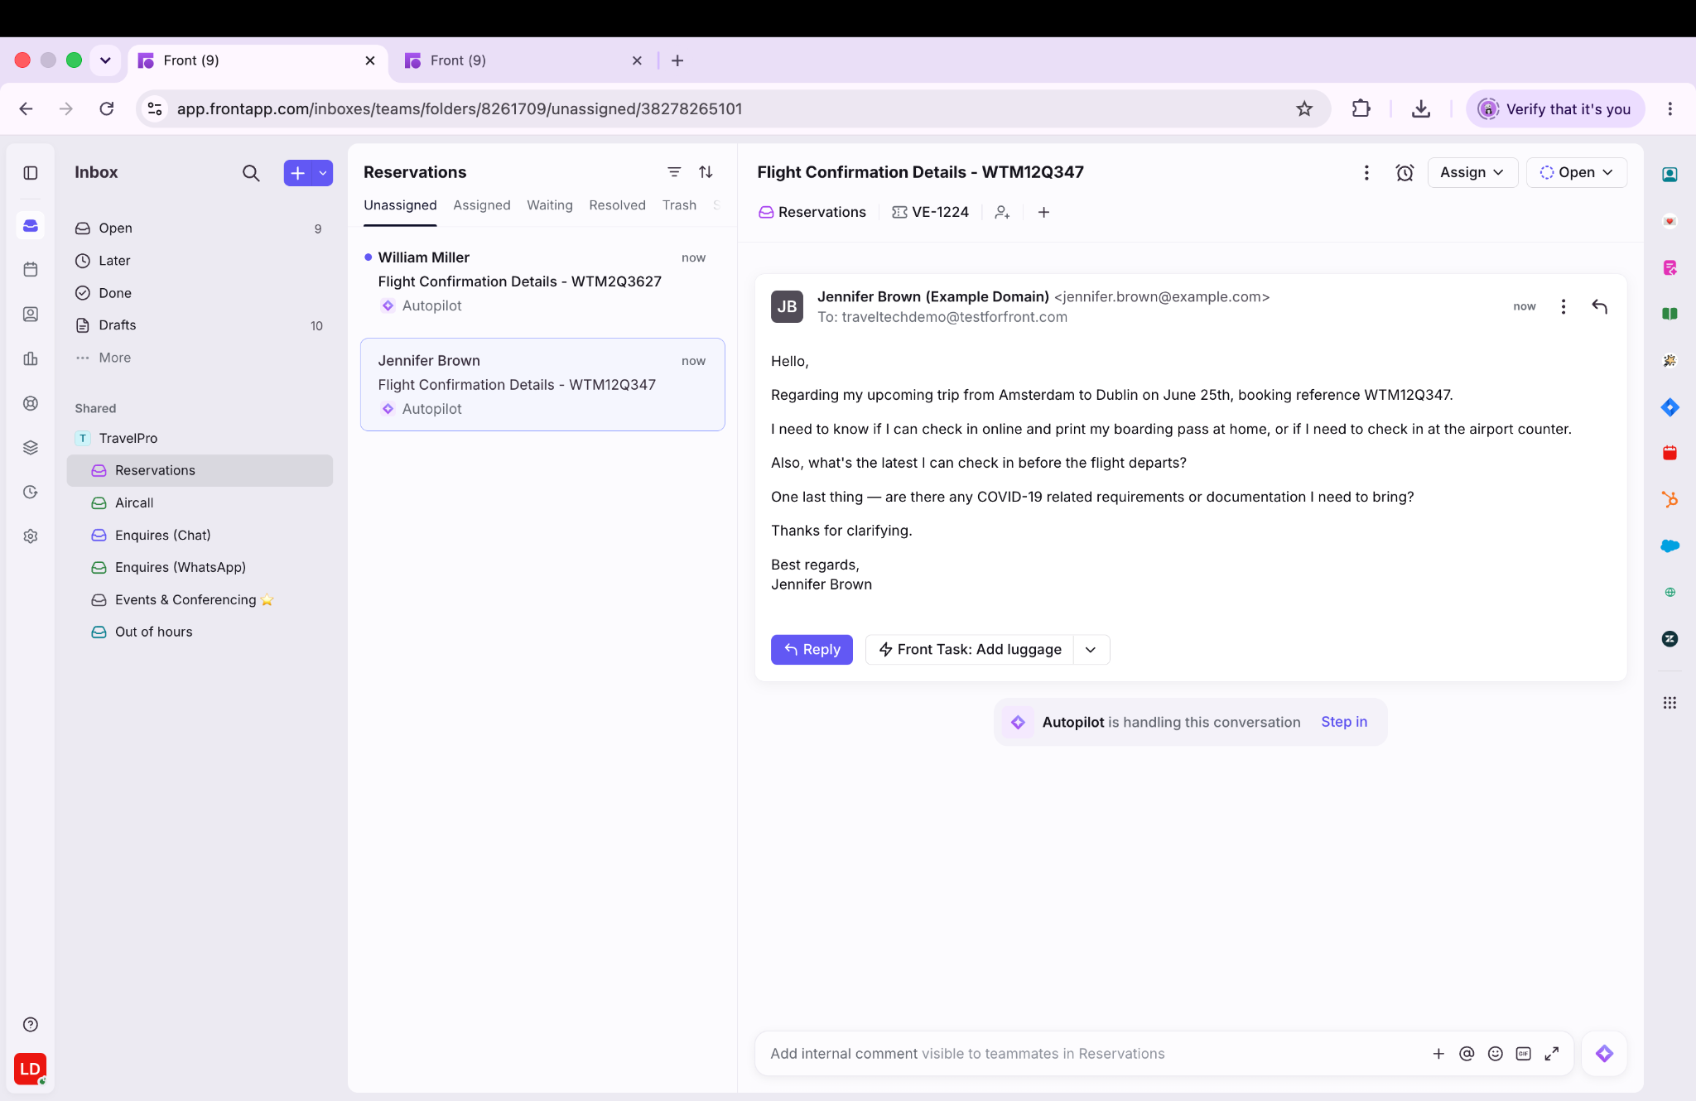
+

Slide 9

Capture
AUTOMATE
Jane's EA’s email lands in Front, alongside requests from WhatsApp, phone, every other channel
Notes:
Liz, how does Front handle everything coming in across so many channels?
Key message: Front is the front door. Everything flows through it — and only the right work gets routed onward.
Liz — walk through Jane's story from the Front side:
Jane's email lands in Front — alongside requests from Slack, WhatsApp, phone, every other channel

Slide 10




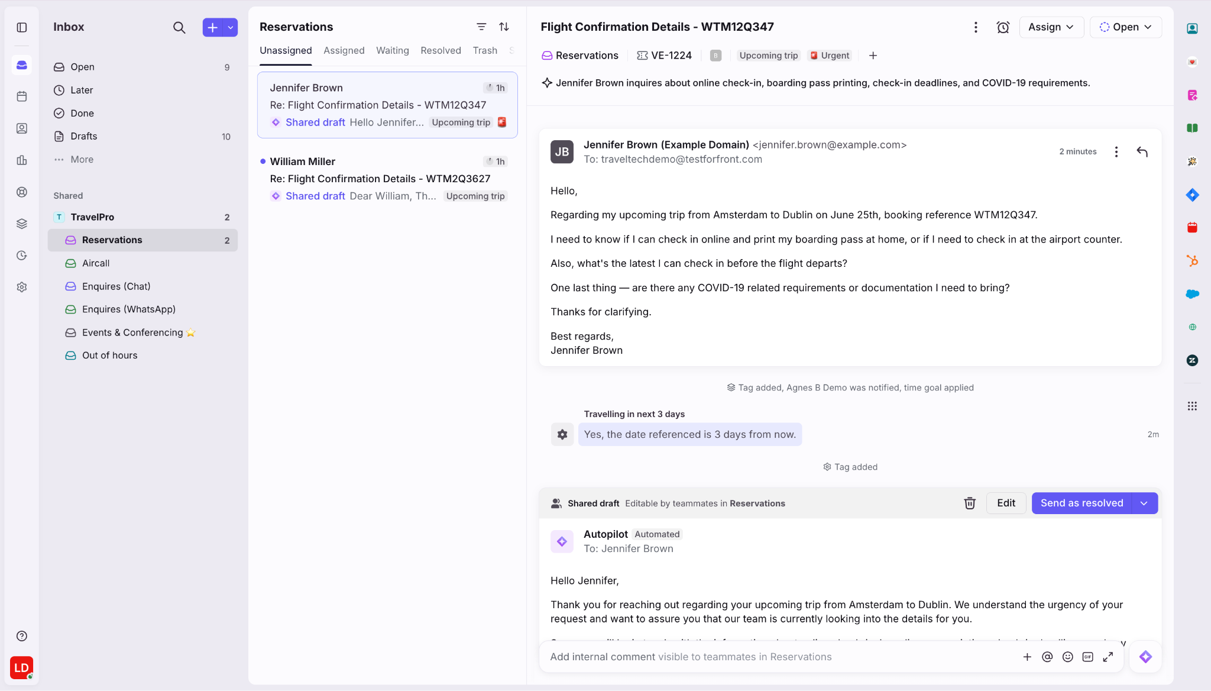

Classify
AUTOMATE
Front reads the message, classifies it: request type, urgency, traveler tier, likely policy implications
Notes:
Classifies it: new booking, standard tier, no immediate policy flag
Automate, Assist or Own?

Slide 11




Route
AUTOMATE
Front routes it automatically to AMGiNE for fulfillment, no agent has touched it yet
Notes:
Routes it to AMGiNE — no agent has touched it
AMGiNE spots the missing departure city, follows up automatically: "Which city are you departing from?"
Jane replies: ORD. AMGiNE queries the GDS, applies policy, returns 3 options
Jane selects her flight → AMGiNE books it → confirmation sent

Slide 12
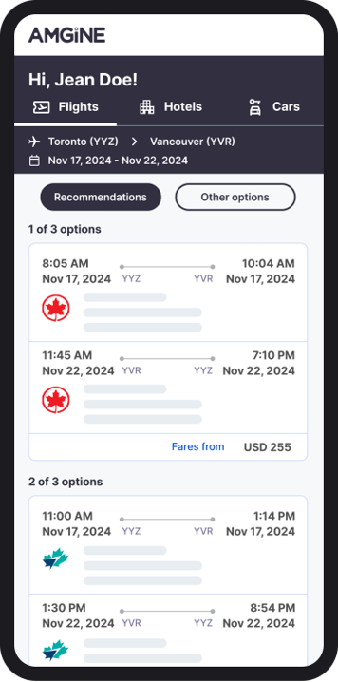


transforms unstructured data into itineraries
AUTOMATE
Emails, whatsapp, sms, spreadsheets, or forms, AMGINE reads the request and delivers options instantly.
Notes:
Key message: AMGiNE handles the complex booking work. Anything that needs a human comes back to Front — with full context attached.
Greg — AMGiNE's side:
Front routes Jane's request to AMGiNE with classification already done
AMGiNE reads the message, spots what's missing (departure city) → follows up automatically: "Which city are you departing from?" — no agent involved
Jane replies: "ORD" → AMGiNE queries the GDS, applies policy, generates 3 itinerary options → sent to Jane instantly
Jane can adjust conversationally via JENi AI: "Actually I need Sep 30 – Oct 3"
Jane picks her flight → AMGiNE auto-books → traveler notified
Proof point: 7x faster processing on automatable requests

Slide 13
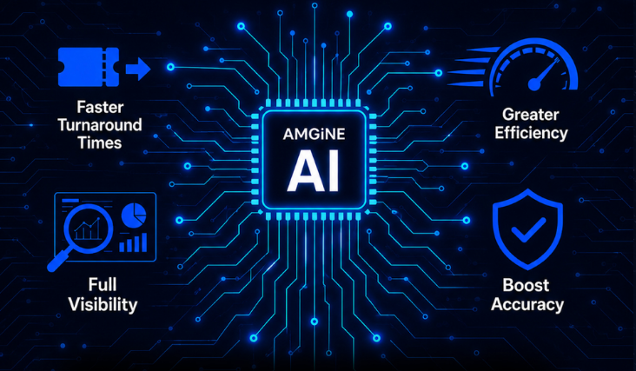
handles booking end to end
AUTOMATE
From request to confirmed itinerary. Automated, accurate, and in seconds.
Notes:
Key message: AMGiNE handles the complex booking work. Anything that needs a human comes back to Front — with full context attached.
Greg — AMGiNE's side:
Front routes Jane's request to AMGiNE with classification already done
AMGiNE reads the message, spots what's missing (departure city) → follows up automatically: "Which city are you departing from?" — no agent involved
Jane replies: "ORD" → AMGiNE queries the GDS, applies policy, generates 3 itinerary options → sent to Jane instantly
Jane can adjust conversationally via JENi AI: "Actually I need Sep 30 – Oct 3"
Jane picks her flight → AMGiNE auto-books → traveler notified
Proof point: 7x faster processing on automatable requests

Slide 14

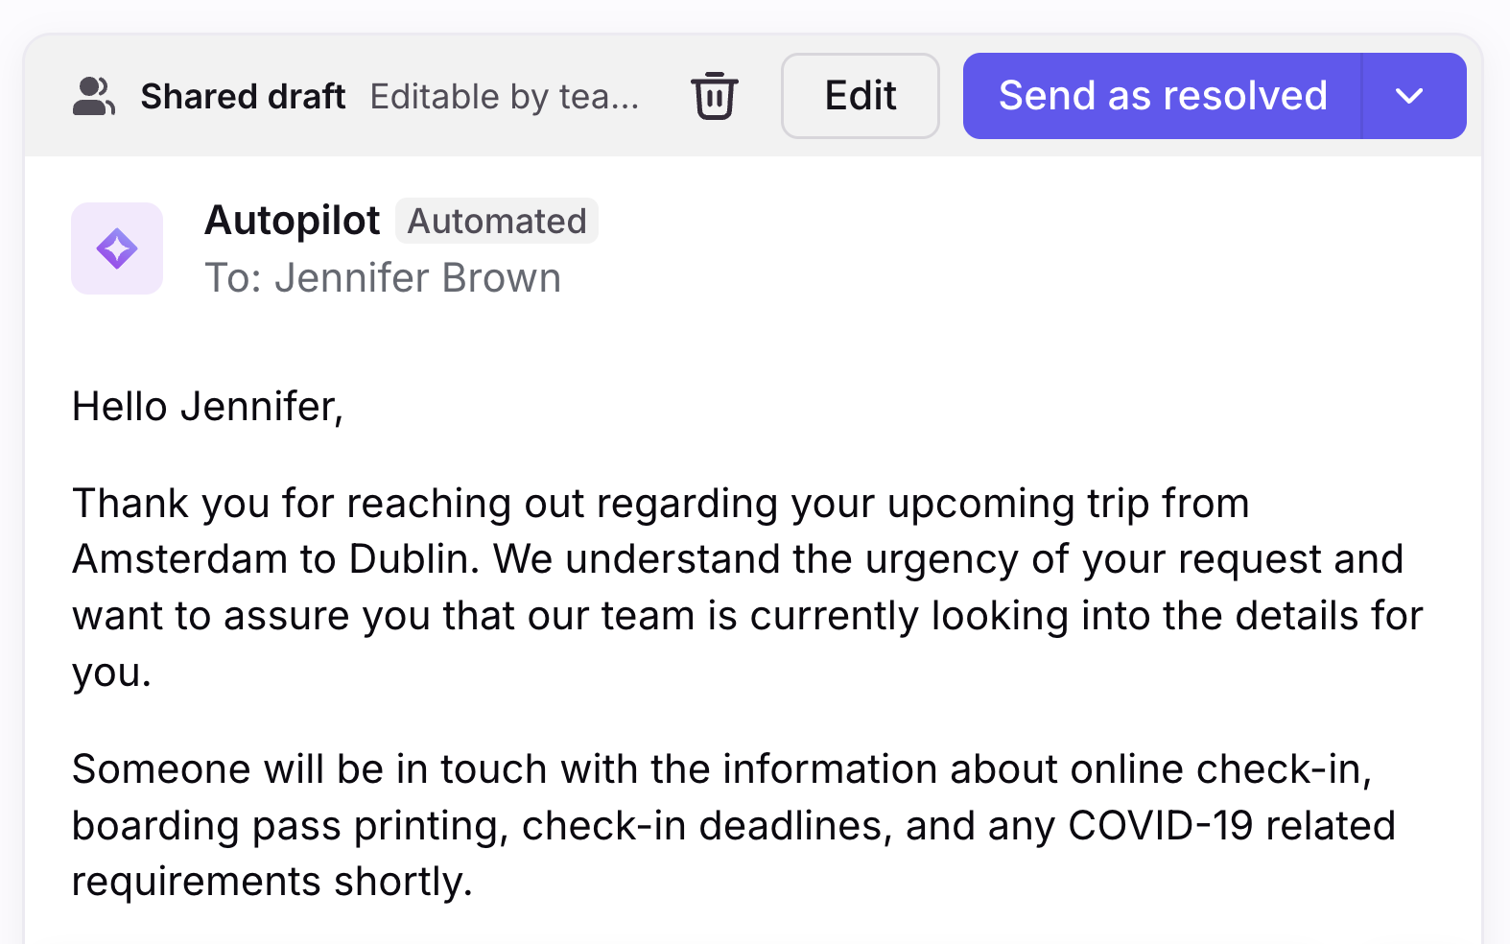

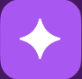
Human in
the Loop
ASSIST
OWN
Amgine
Hi Jennifer,
Thanks for your request, we would be delighted to add a hotel for Jane to the trip.
We have two options for Jane based on your policy….
With Front, agents still control nuanced or critical requests.
Trip Preview: REF-01234
Link: http://agentapp/transactions/REF-01234
Notes:
ASSIST
Jane's company has a negotiated rate at the Marriott near LHR. It's sold out for her dates.
AMGiNE finds two alternatives — one is cheaper but off the preferred vendor list, one is pricier but on it.
Neither is a clean approve.
The agent needs to know whether this client prioritises vendor compliance or cost, and advise Jane accordingly.
Why it needs a human: it's account knowledge, not policy logic.
OWN — if something goes wrong
Jane's flight gets cancelled. She's connecting to a client meeting. She's a VIP.
This never touches automation. An agent owns it — calls Jane directly, rebuilds the itinerary, manages the relationship. Copilot helps with context but the agent is accountable start to finish.
This is the moment your team's reputation lives or dies. The whole point of the first two buckets is to protect this one.

Slide 15
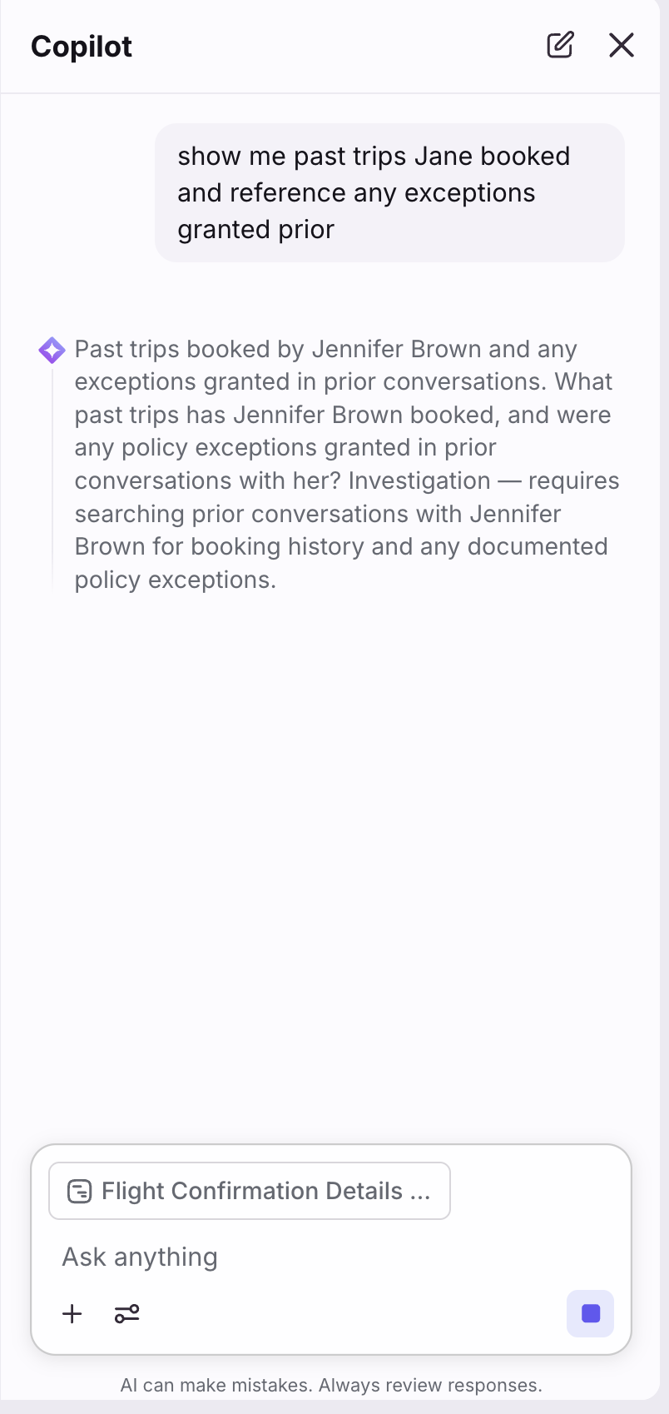

Copilot Assists
ASSIST
Copilot surfaces
Jane's traveller history.
Notes:
Liz — when it comes back to Front:
Jane also needs a hotel. It's £30 out of policy. AMGiNE flags it and hands back to Front. Here's what the agent sees:
Conversation arrives structured, tagged, and assigned — no manual triaging
Copilot surfaces Jane's traveler history, past exceptions, VIP status — full context before the agent opens the message
Agent @mentions the travel manager in an internal comment to approve the exception — one thread, no separate email chain
Exception approved → one clean, personalised response to Jane
Smart CSAT monitors the interaction quality automatically — flagging anything that needs review before it affects the client relationship
Front isn't a better inbox. It's the layer where human judgment lands — with everything it needs already there.

Slide 16
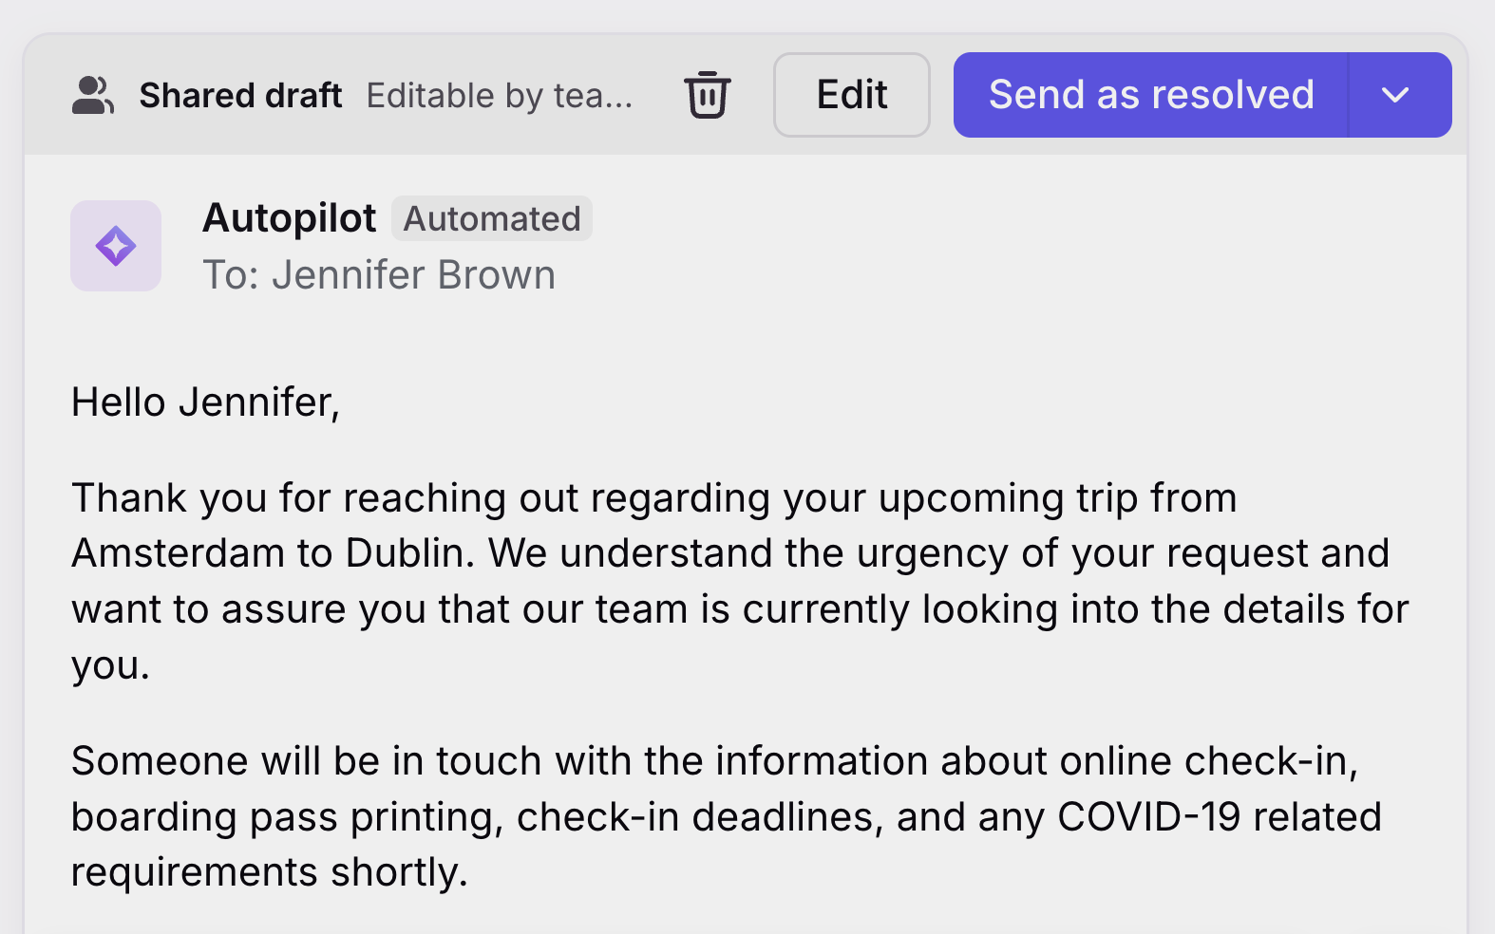

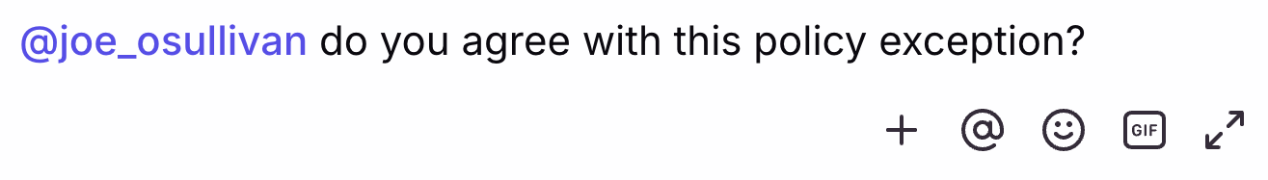
Seamless
Collaboration
ASSIST
Amgine
Hi Jane,
Thanks for your request, we would be delighted to upgrade you and add a hotel to the trip.
To help us find you the best accommodation can you share
One thread.
No separate email chain.
Amgine
we would be delighted to upgrade you and add a hotel to the trip.
Notes:
Liz — when it comes back to Front:
Jane also needs a hotel. It's £30 out of policy. AMGiNE flags it and hands back to Front. Here's what the agent sees:
Conversation arrives structured, tagged, and assigned — no manual triaging
Copilot surfaces Jane's traveler history, past exceptions, VIP status — full context before the agent opens the message
Agent @mentions the travel manager in an internal comment to approve the exception — one thread, no separate email chain
Exception approved → one clean, personalised response to Jane
Smart CSAT monitors the interaction quality automatically — flagging anything that needs review before it affects the client relationship
Front isn't a better inbox. It's the layer where human judgment lands — with everything it needs already there.

Slide 17

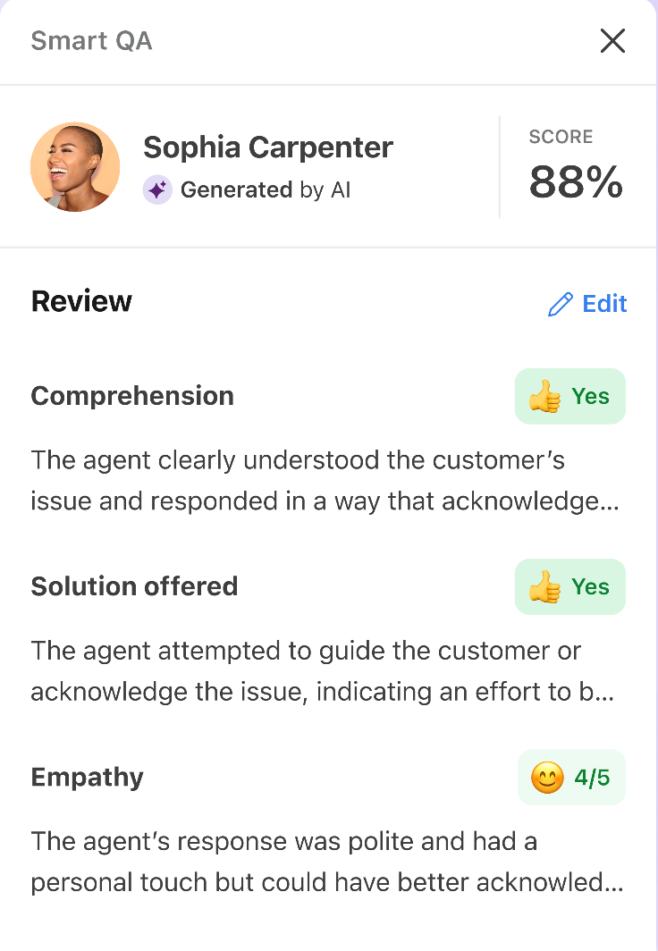
Every Conversation.
Analysed.
AUTOMATE
Smart QA and CSAT monitors the satisfaction + interaction quality automatically.
Upsell Offered
Notes:
Liz — when it comes back to Front:
Jane also needs a hotel. It's £30 out of policy. AMGiNE flags it and hands back to Front. Here's what the agent sees:
Conversation arrives structured, tagged, and assigned — no manual triaging
Copilot surfaces Jane's traveler history, past exceptions, VIP status — full context before the agent opens the message
Agent @mentions the travel manager in an internal comment to approve the exception — one thread, no separate email chain
Exception approved → one clean, personalised response to Jane
Smart CSAT monitors the interaction quality automatically — flagging anything that needs review before it affects the client relationship
Front isn't a better inbox. It's the layer where human judgment lands — with everything it needs already there.

Slide 18

+
Together, the loop completes.
Notes:
Why does this only work as a connected workflow — not two separate tools?
Key message: Neither layer gets you there alone. Together, the loop closes.
Greg: AMGiNE without Front = processed bookings surfacing in a chaotic inbox. Context gets lost. Agents start from scratch.
Liz: Front without AMGiNE = agents still doing the data-entry work before they can apply any judgment. Great coordination layer on top of a manual fulfillment problem.
Together — the full flow:
Front: captures all inbound → classifies → routes to AMGiNE
AMGiNE: interprets → processes → fulfills → confirms → escalates exceptions back to Front
Front: human-in-the-loop coordination → Copilot assists the agent → Smart CSAT monitors quality
Request arrives. It's handled. Agent only touches what genuinely needs them.

Slide 19

PROOF POINT
Travel & Technology Group
ATLAS TRAVEL
87%
7x
93%
New
CSAT Score
Faster
Processing time
Travel
Conversion rate
+
Notes:
What have you seen from teams?
Key message: The math only works when both layers are in place.
Greg: Atlas Travel deployed Front + AMGiNE together — not to replace agents, but to give them their time back.
Before: manual intake, manual interpretation, manual coordination, slow response, inconsistent visibility
After: request captured, classified, fulfilled, resolved or escalated with context
Results: 7x faster processing on new reservation requests · 94% trip conversion rate · same team, dramatically higher volume

Slide 20
















Come Join Us
Trusted by the 100+ travel companies and 9,300 global customers
Notes:
Here’s a quick look at a few of the 100 TMCs worldwide we’re proud to partner with worldwide.

Slide 21


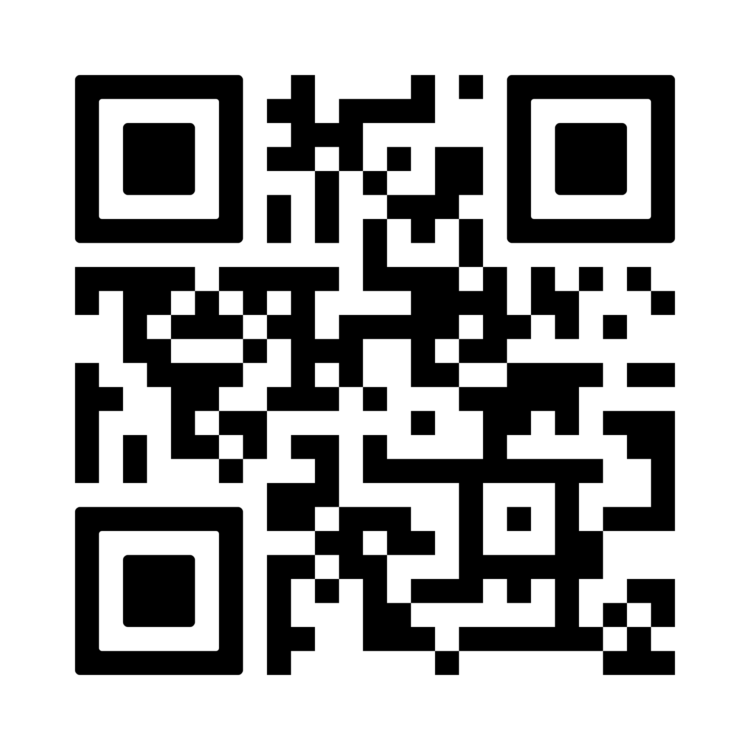
+
Front Booth #N43
Notes:
What should TMC leaders do first?
Key message: One honest look at where your team's time goes will tell you everything.
Pick a week. Pull your request volume. Ask your agents what they actually spent their day doing.
What you'll often find is that a significant portion of the day goes on coordination — getting information into the right place, chasing missing details, moving things between systems. That's time your team would rather be spending on the requests that actually need them.
The teams seeing results aren't doing anything exotic. They've connected the intake to the fulfillment to the agent workflow — so the routine stuff gets handled automatically, and people show up where they're actually needed.
If you want to see what that looks like for your operation specifically, come find us at the Front booth. We'll walk through it with you.
The goal isn't fewer people. It's making sure your best people are working on the right things.

