Slide 1



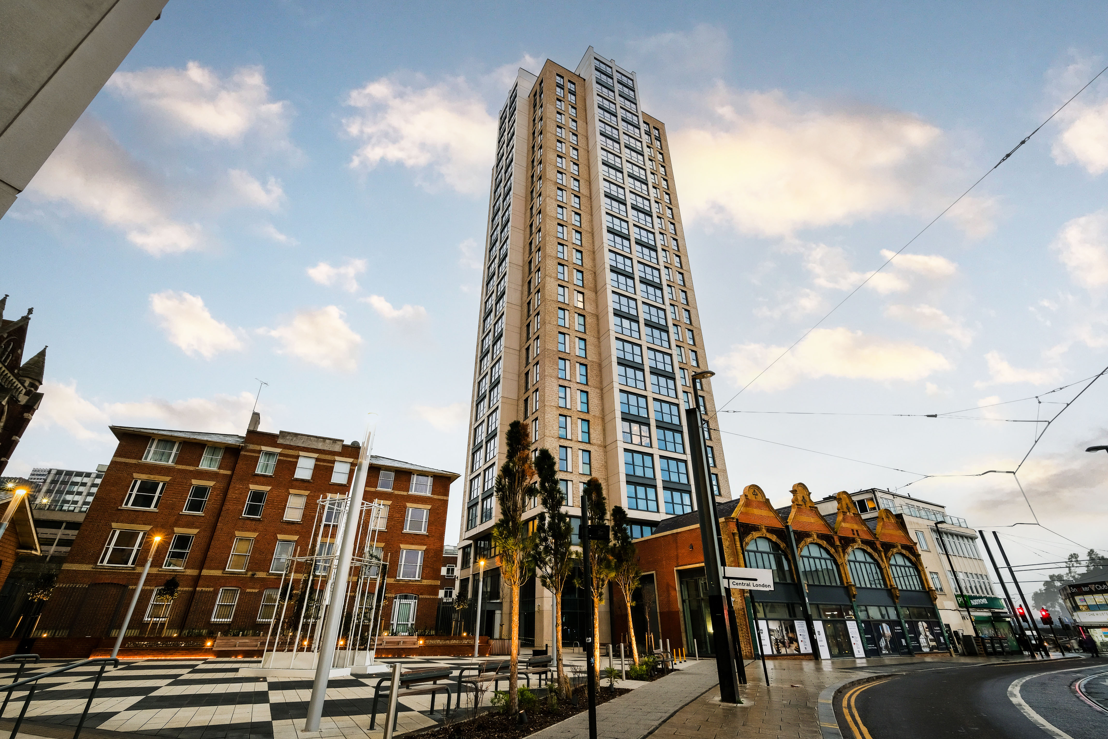
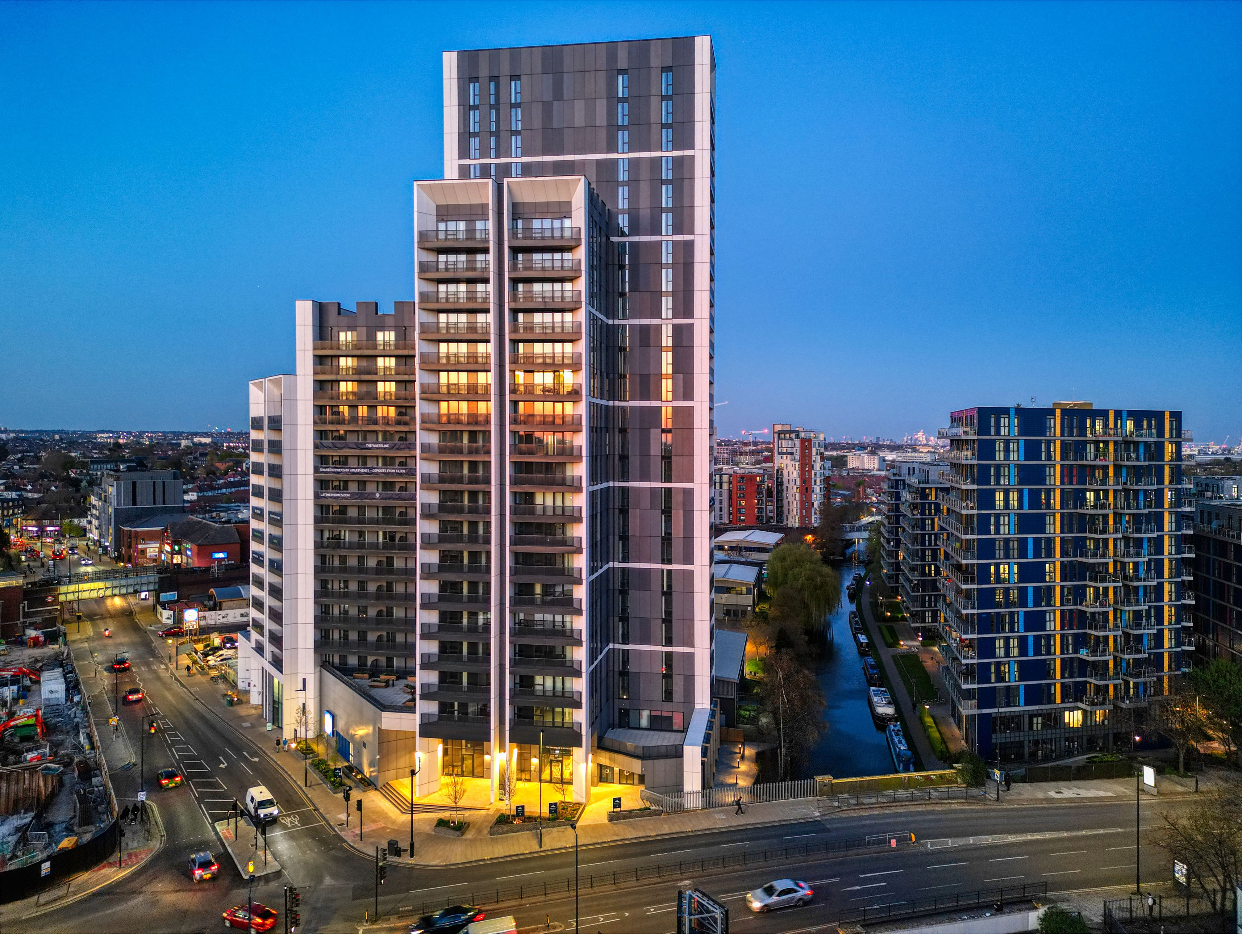
Delivering at Height - Built in London
Completed schemes
High Cross | Croydon, London
The Waterline | Alperton, London
134 homes | 19 storeys | 100% affordable
251 homes | 22 storeys | affordable-led regeneration

Slide 2
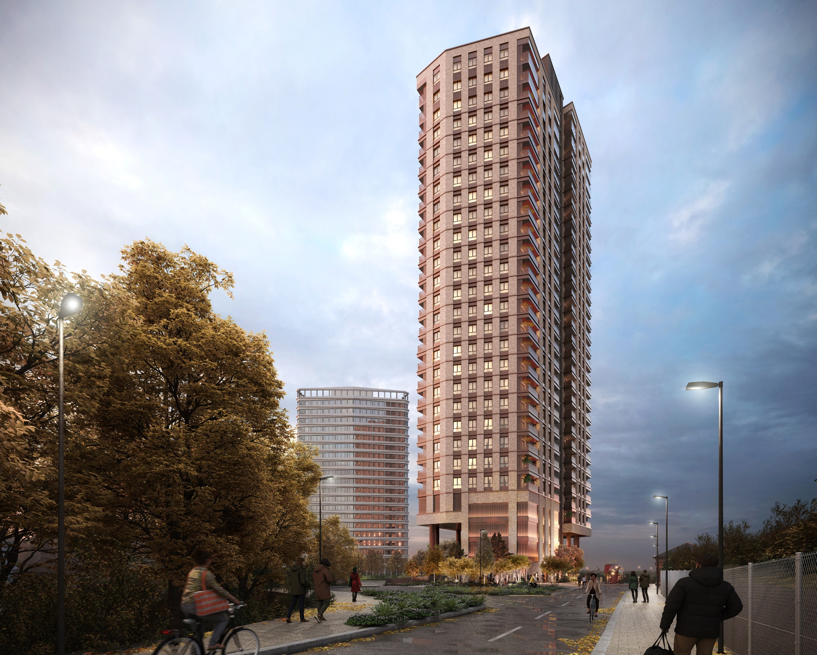
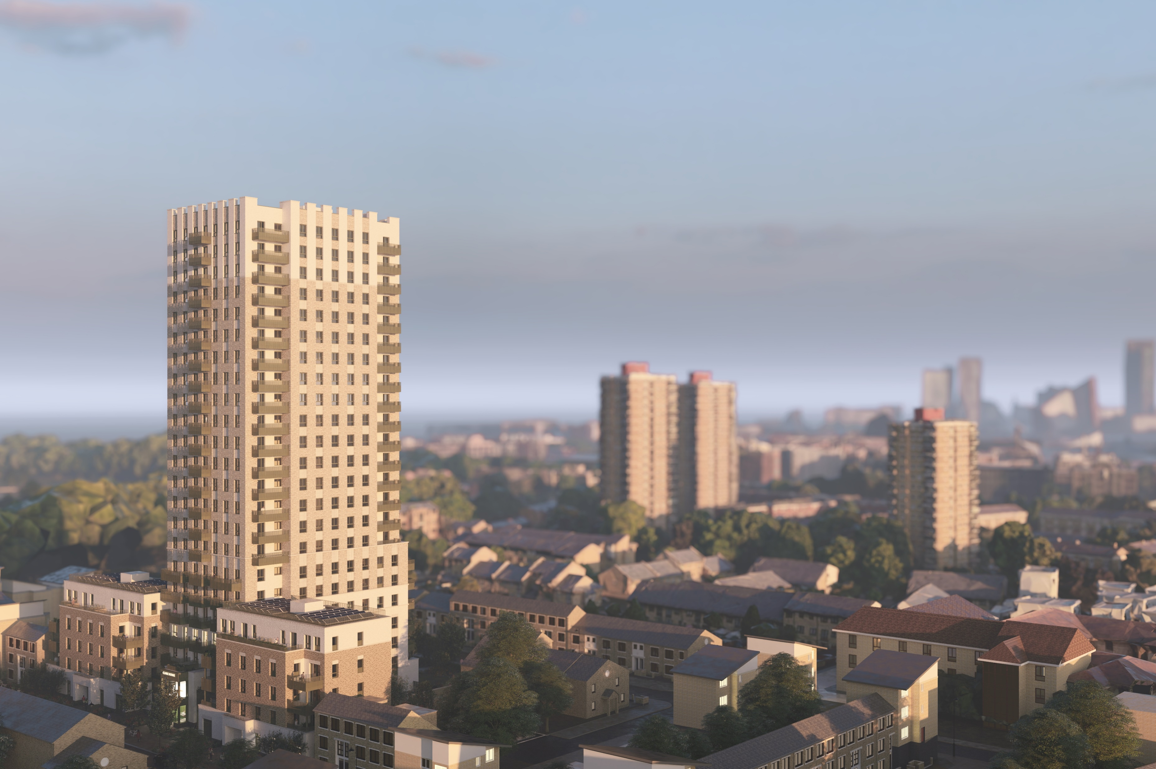
Delivering at Height - Upcoming in London
Under construction schemes
Argenta | Brent, London
Clare House | Bow, London
c.180 homes | 25+ storeys | major brownfield site
145 social rent homes | 23-storey new build replacing ageing high-rise

Slide 3
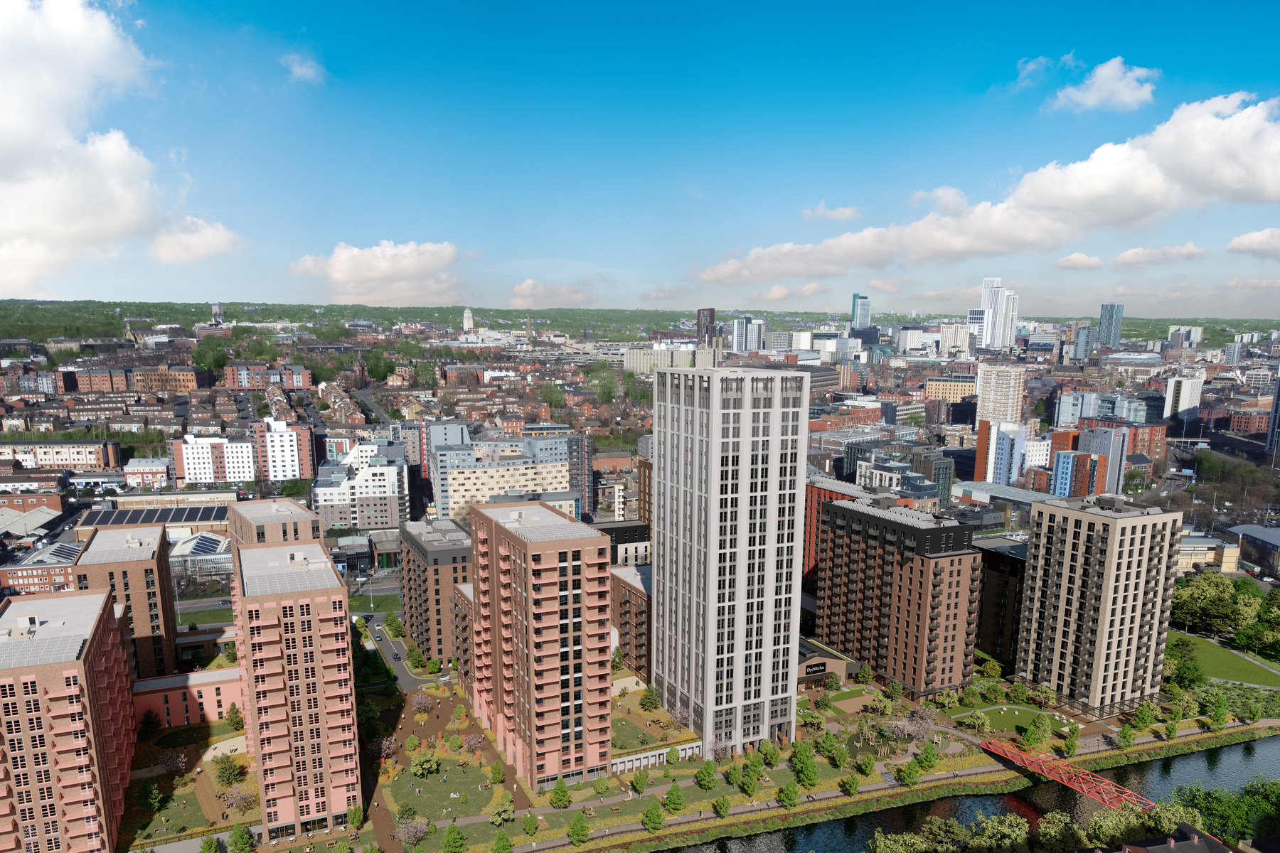
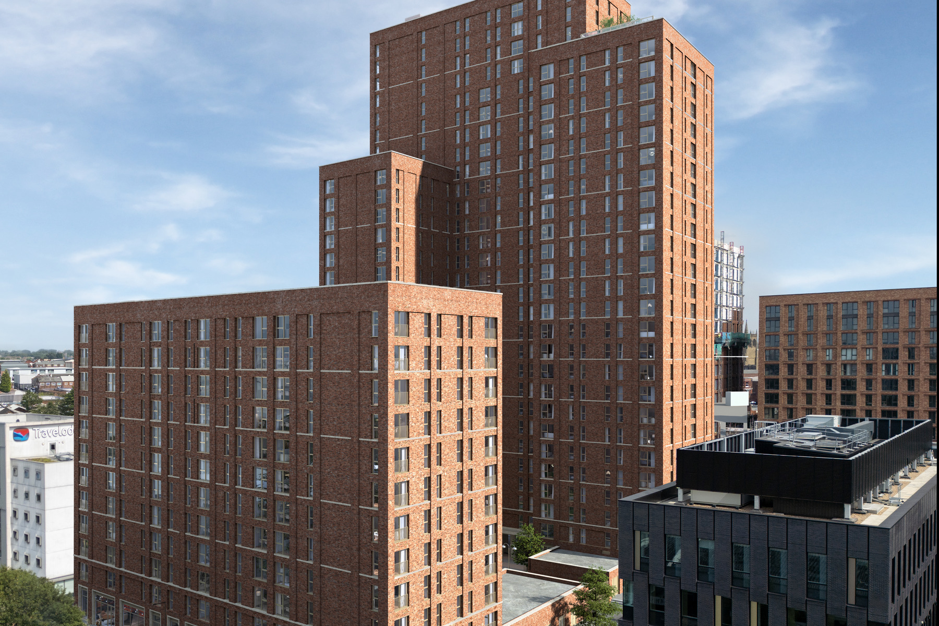
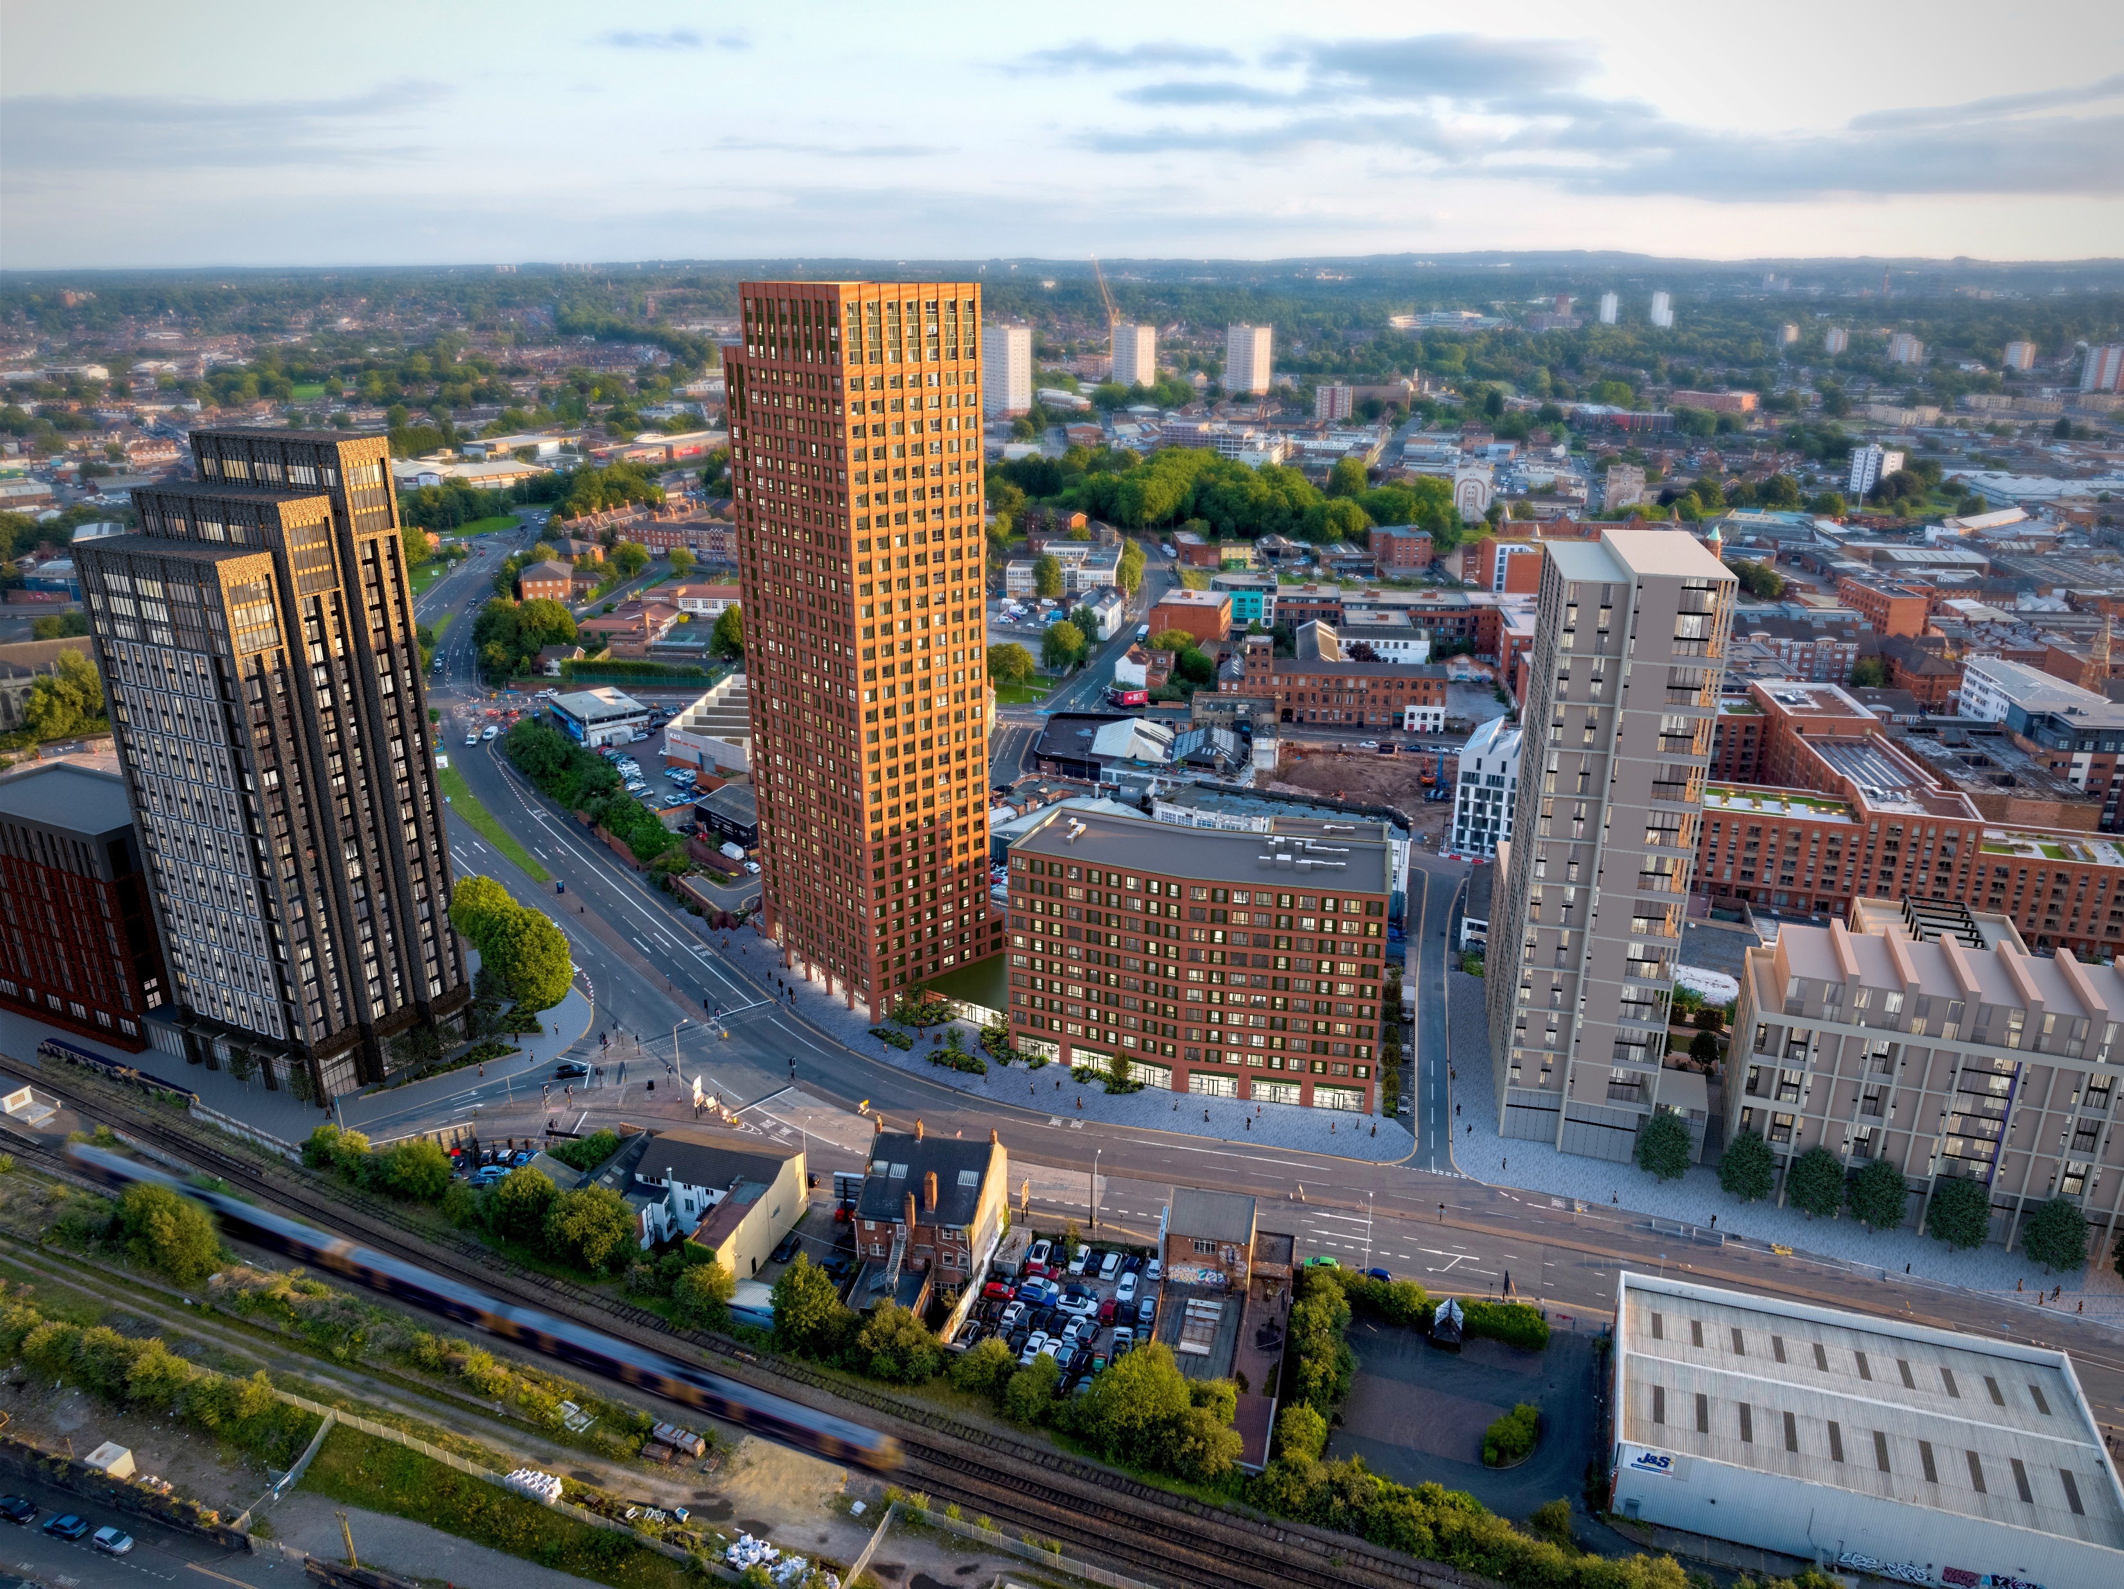
Delivering at Height - Across the Country
Schemes outside London
[ Insert image ]
Dyecoats | Leeds
Brewery Gardens | Manchester
High Street | Digbeth, Birmingham
1,800+ homes | 17-storey first phase | flagship brownfield placemaking
505 homes | 29 storeys | 60% affordable | brownfield regeneration
481 homes | 33-storey | 50%+ affordable | major urban regeneration

Slide 4


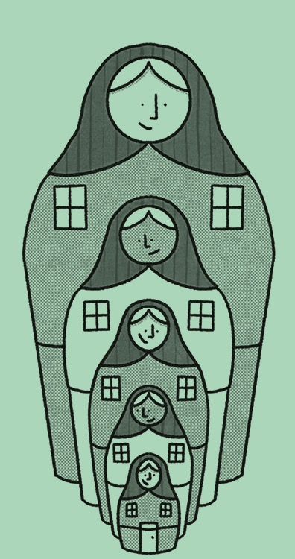
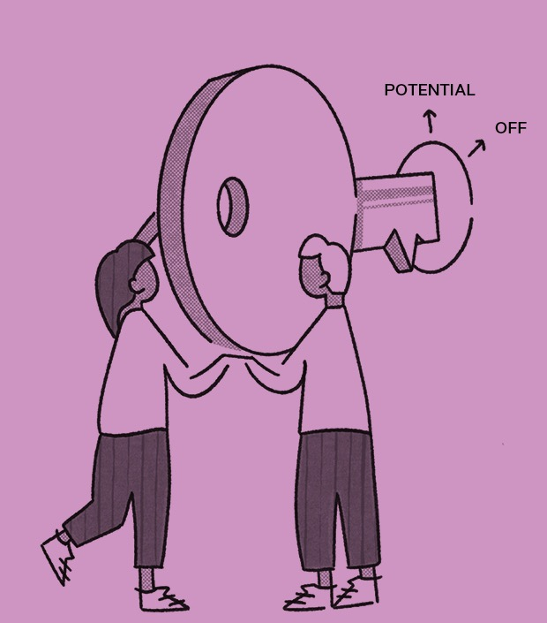
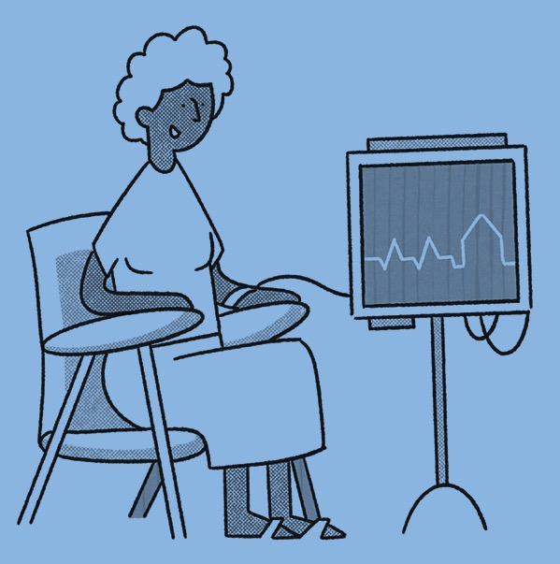
A Practical Test for Tall Buildings
Connection
Resilience
Sufficiency
Trust
Health
Does the building help people feel part of a community, not isolated?
Can it adapt to climate change, technology and changing demographics?
Are homes practical and affordable with manageable ongoing costs?
Do residents understand the building and feel listened to and safe?
Does the home support wellbeing through daylight, air quality and green space?

