Slide 1


Defining a Tall Building is Subjective
Policy: 8 storeys / 50% taller than surrounding heights / noticeably taller / 30m +
Regulation: HRBs / over 6 floors
Community perception: taller than context / noticeable change to context
Resident perception: have to use lift to access homes / Stronger relationship to view than to ground
Urban Design: buildings that mark / wayfind using height

Slide 2
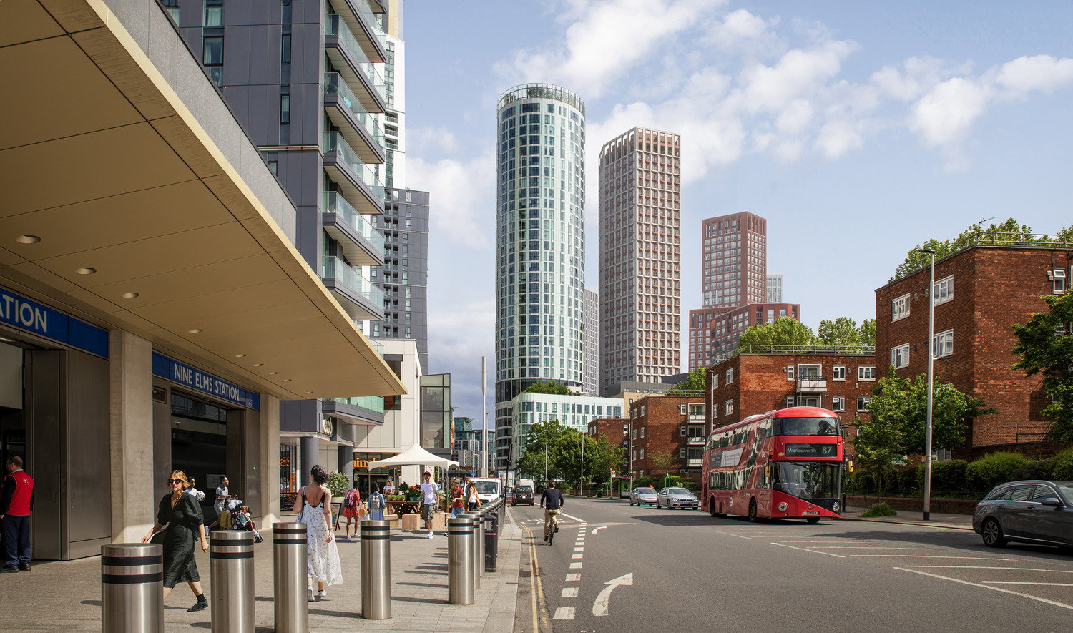
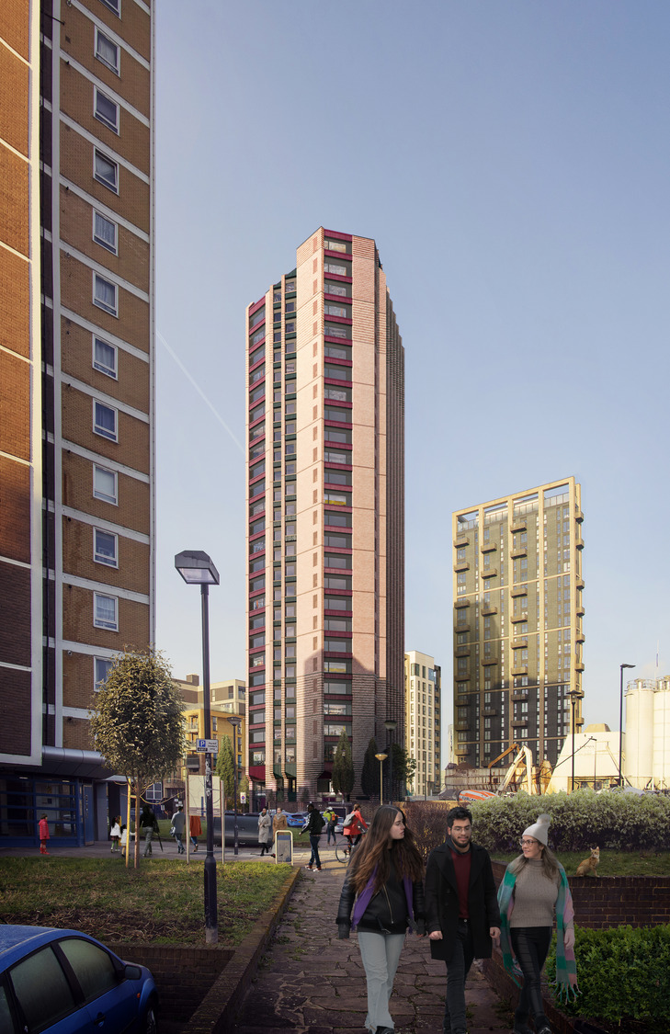
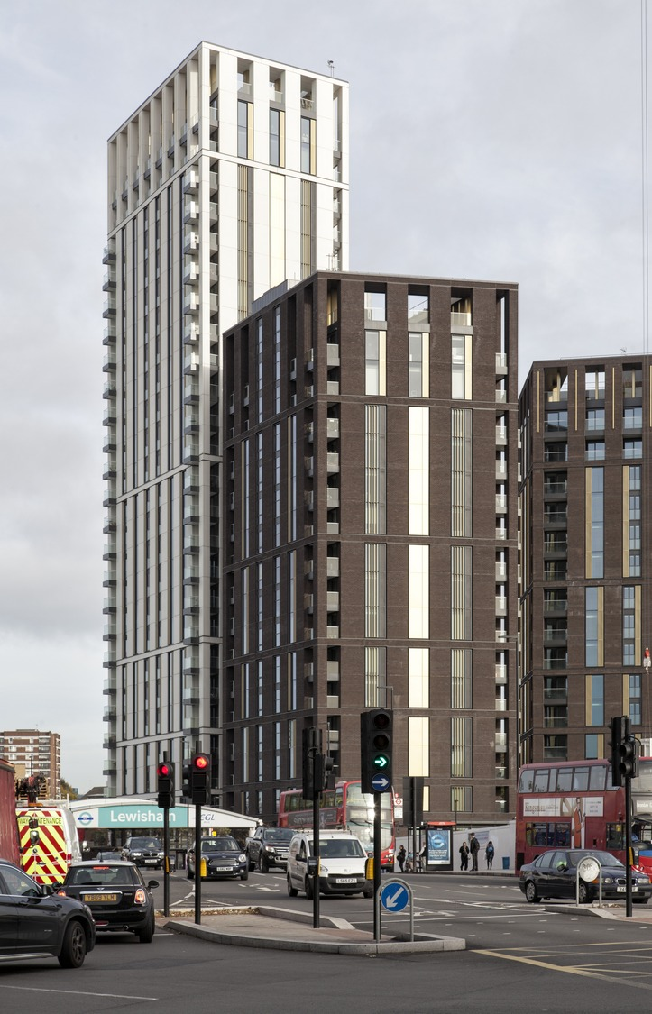
Wyvil Road, London
No of Homes: 347
Height: 37 storeys
Use: BTR / affordable / retail
Amenities: Courtyard garden / shared internal amenity for both tenures
Ravensbourne Wharf, London
No of Homes: 414
Height: 27 storeys
Use: Student / PBSA / light industrial floorspace
Amenities: student amenities, cafe, roof terraces
Lewisham Gateway Ph1, London
No of Homes: 350
Height: 20 storeys
Use: affordable and private sale / mixed use
Amenities: rooftop terraces / co working spaces

Slide 3
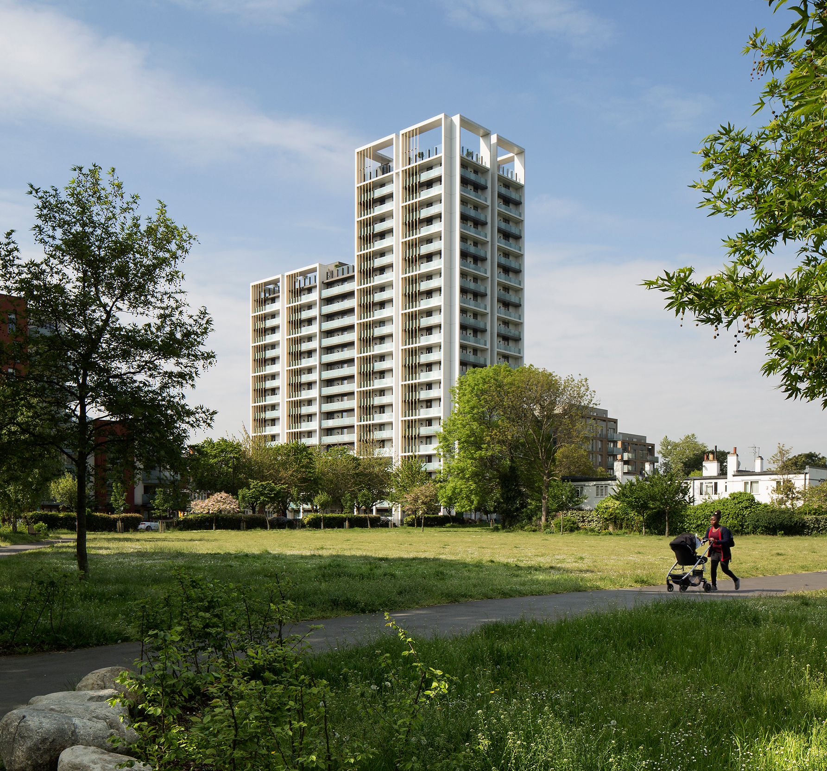
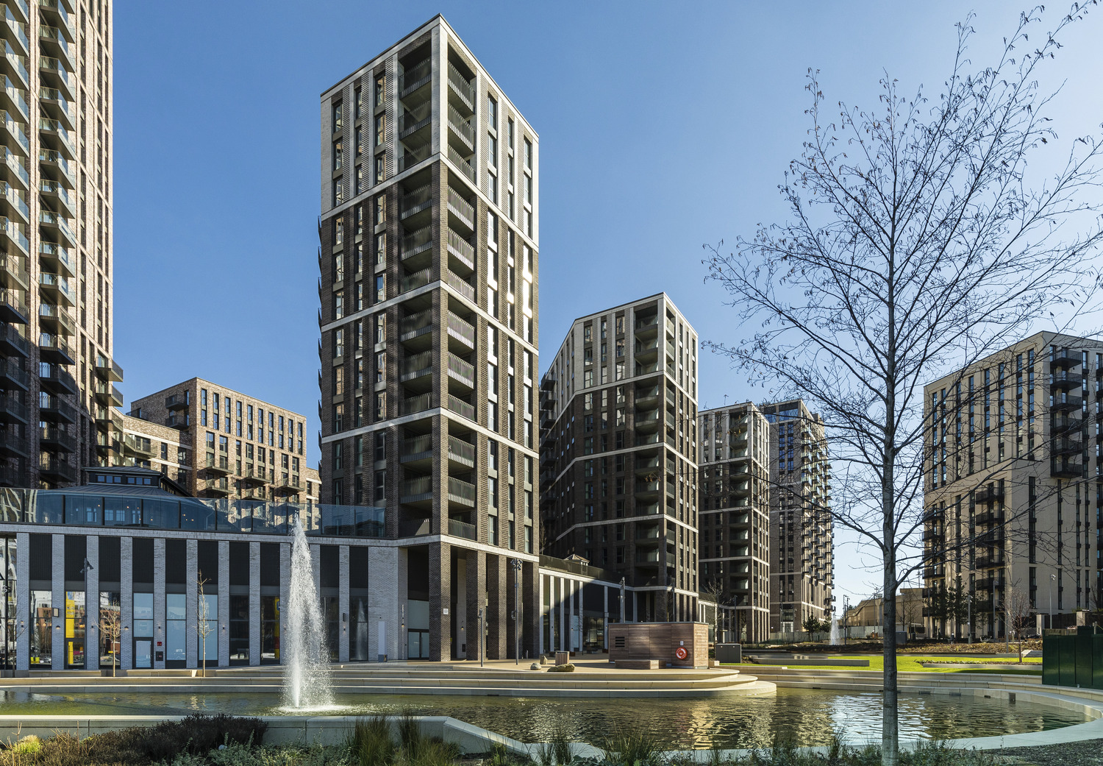
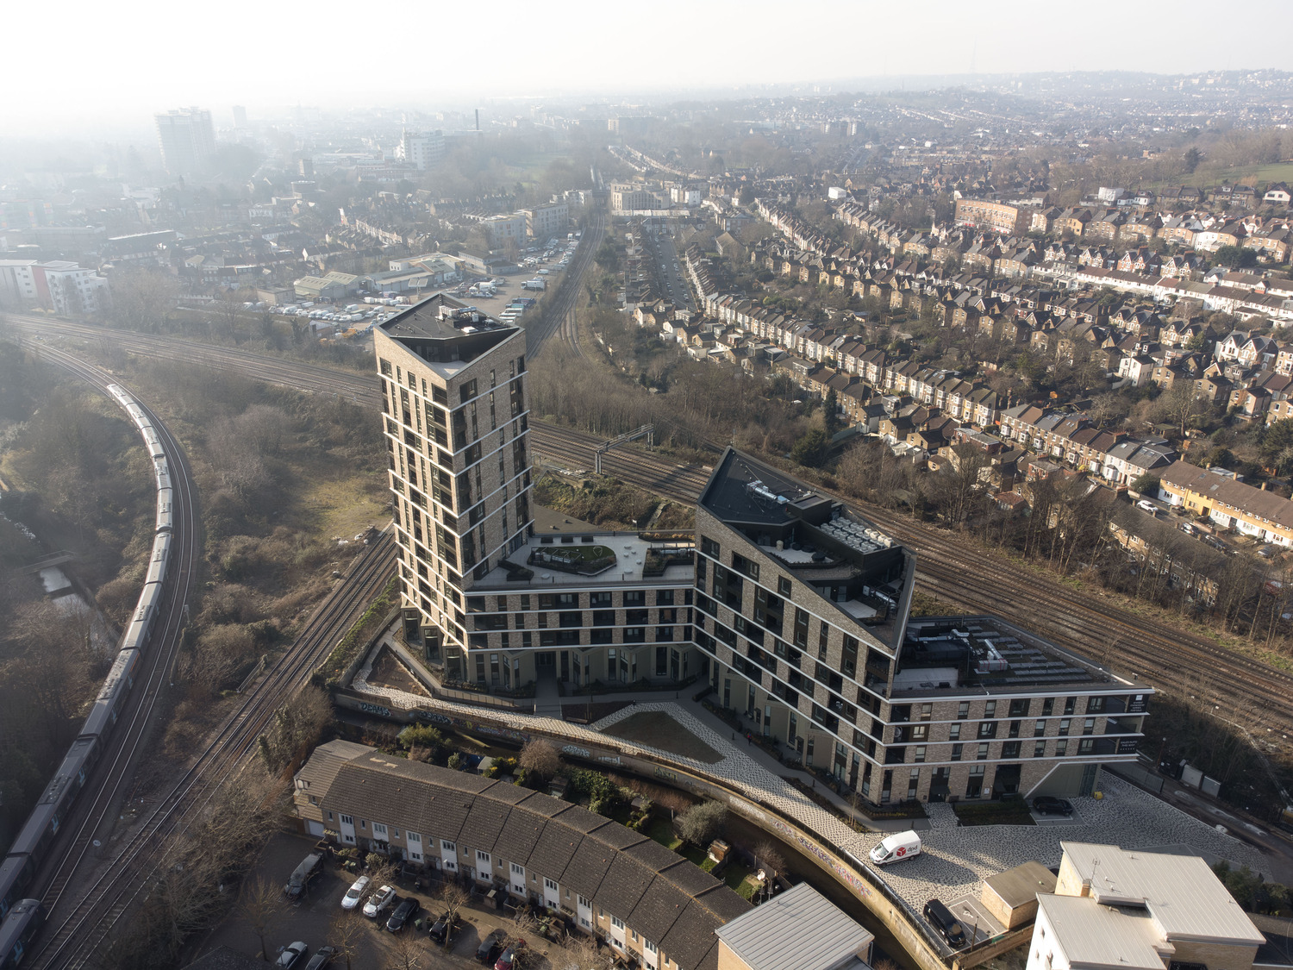
Wayland House, London
No of Homes: 159
Height: 20 storeys
Use: private sale / affordable
Amenities: shared lobby / communal rooftop gardens
Canada Gardens, London
No of Homes: 743
Height: 26 storeys
BTR / mixed use
Amenities: shared lobby / lounges / library / co-working / community gardens / cafe
Axion House, London
No. homes: 140
Height: 16 storeys
Uses: Mixed-use / 100% Affordable
Amenities: shared rooftop terraces / public realm

Slide 4
Design Considerations for Living at Height
Amenities: ground floor / top floor / view / balconies
Environmental: daylight / overheating / wind / noise / fresh air
Identity: local versus metropolitan / street versus view
Community shaping: 1,2,4,8 interactions / place-shaping / gated versus integrated
Tenure: families / sharers / individuals
Servicing: Cleaning / deliveries / façade maintenance

