Slide 1

Making High-Rise Living Work
Tall Buildings in London: Development, Management & Resident Experience
Abi Oguntokun | Director of Landlord Services
Southwark Council

Slide 2
Making High-Rise Living Work
Urban Need
Tall buildings are part of London’s housing future
Resident Experience
Safety, affordability and trust define success
Long-Term Stewardship​
High-rise housing is a long-term service
Operational Leadership
Good outcomes depend on skilled, accountable management

Slide 3
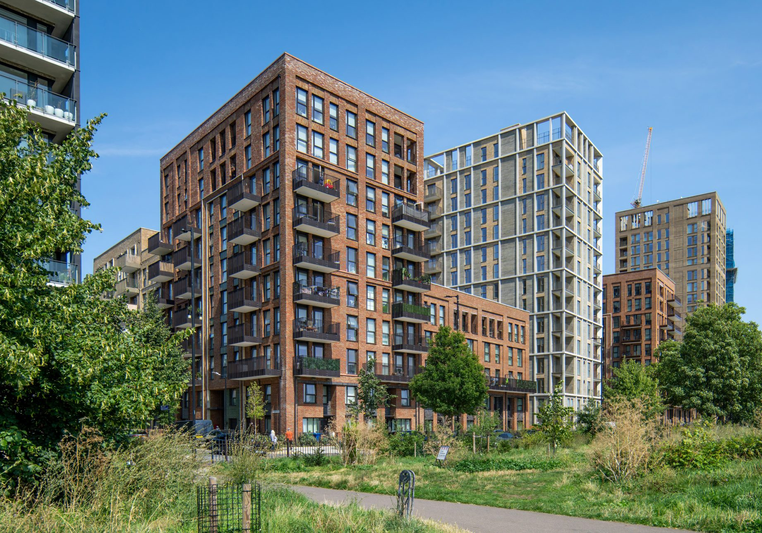
Aylesbury Estate
Safety Complexity
  Remediation, regulation and resident confidence
Operational Pressure
  Lifts, heating and communal services
Trust and Disruption
  Residents living through uncertainty

Slide 4
What Needs to Change?
Design for the Long Term
Develop sustainable solutions that support future housing needs and long-term asset performance.
Maintain Service Quality During Renewal
Ensure consistent, reliable services for residents throughout renewal programmes.
Build Specialist Operational Capacity
Strengthen expertise, skills, and structures to deliver complex housing services effectively.
Measure Success Through Resident Experience
Track outcomes based on what matters most to residents, using feedback, satisfaction, and lived experience as key indicators.

