Slide 1



Interim findings from Co-operation in Social Housing Commission

Slide 2

Formed in 1975 – 51 years old
Uniquely we exist to provide, support and promote co-op and community-led housing solutions

Slide 3
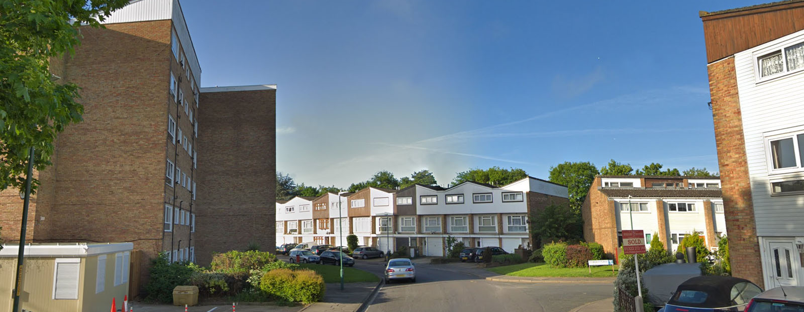
We are a Landlord - Registered Provider of Social Housing

Slide 4
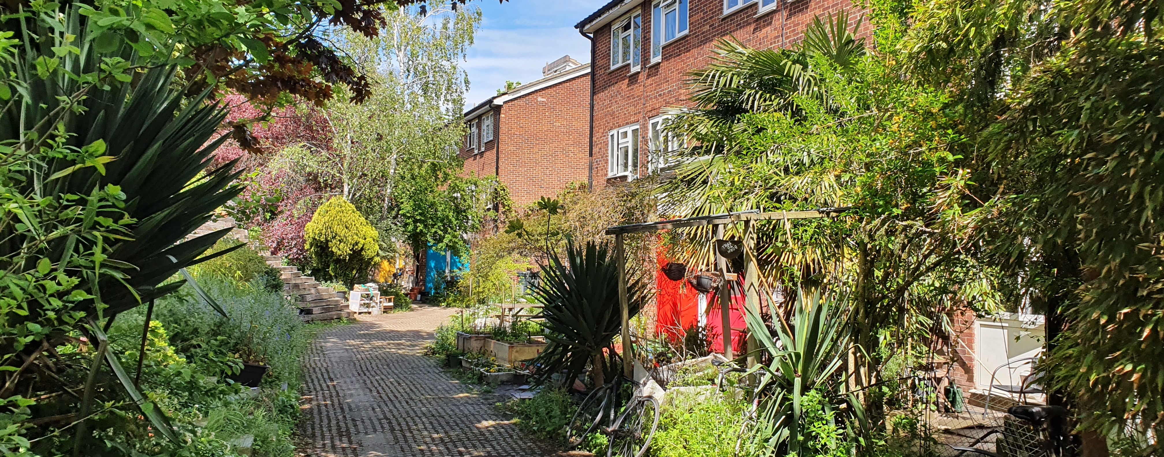
We support over 36 co-ops with management services

Slide 5
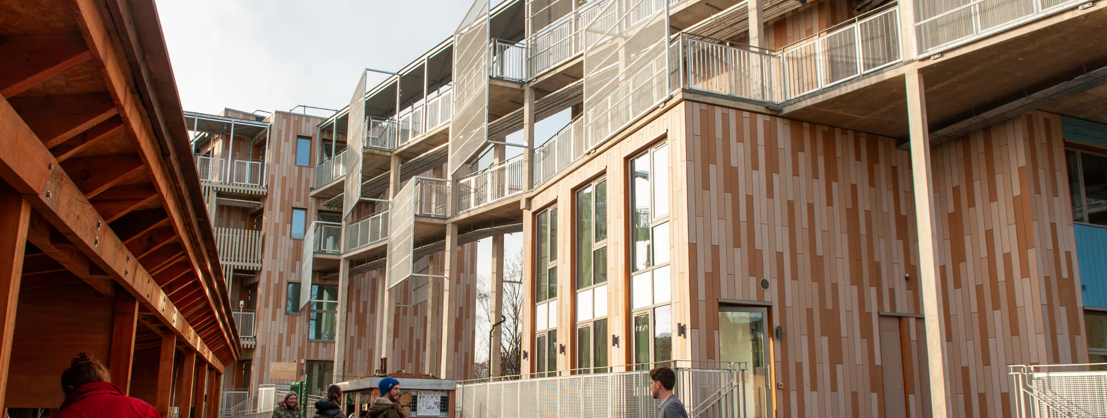
We promote
co-operation and community led housing solutions

Slide 6


Win/win – build in resilience
Communities know what is best for them – and de-risk management
RPs know how to manage compliance risk and regulation
Create self-sustaining communities, tap into an untapped talented resource
“Registered providers must assist tenants who wish to implement tenant-led activities to influence and scrutinise their landlord’s strategies, policies and services.”
“Registered providers must support tenants to exercise their Right to Manage, Right to Transfer or otherwise exercise housing management functions, where appropriate.”

Slide 7

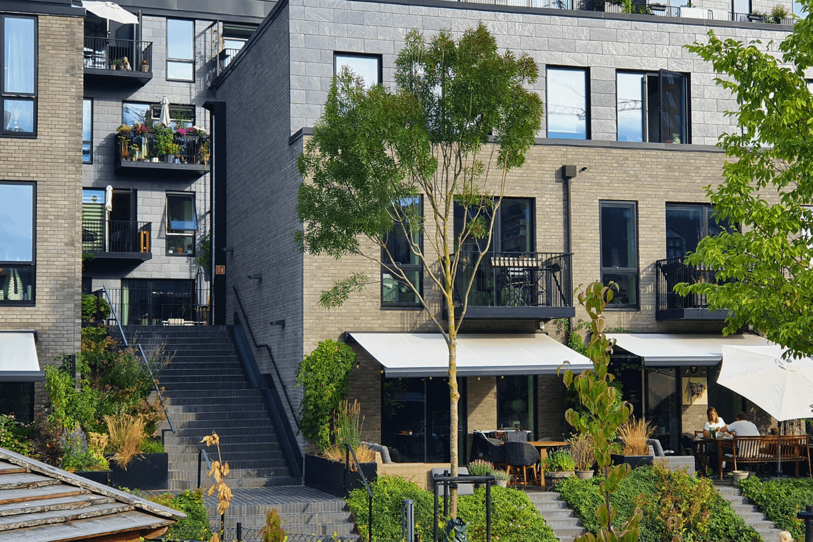
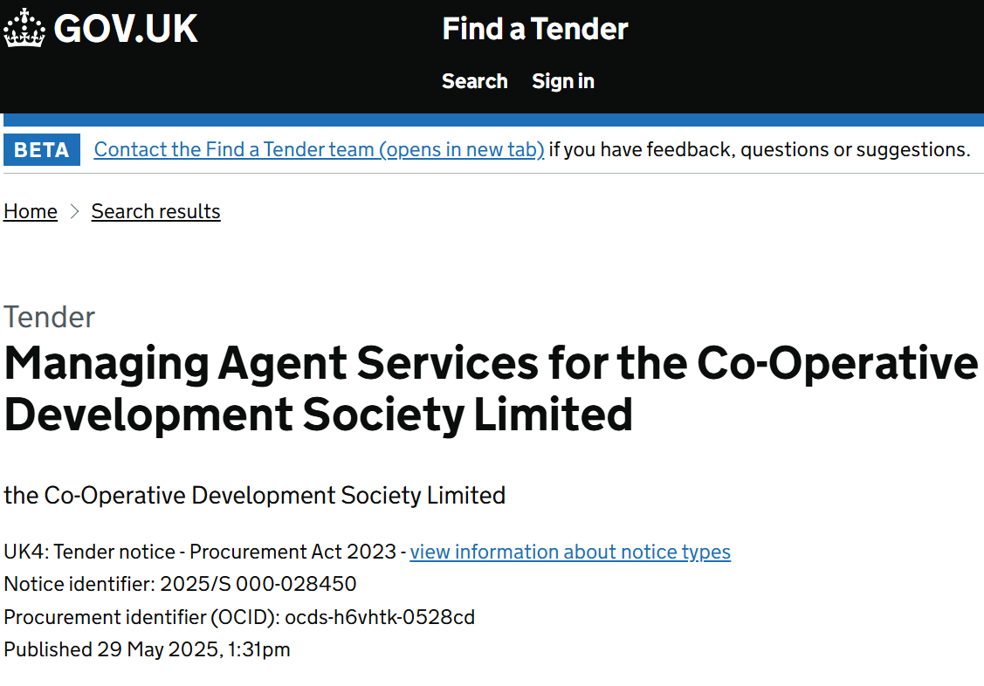
Collective Ownership
Impactful investment to address the private rental crisis, with fair, resident-controlled housing.
Build Belonging
Turning developments into strong communities with a sense of belonging and neighbourly living.
Procurement Framework
New technology-driven Open Framework, fully compliant and supportive of place and community-based landlords
and contractors

Slide 8














Co-operation in Social Housing
Commission

Slide 9

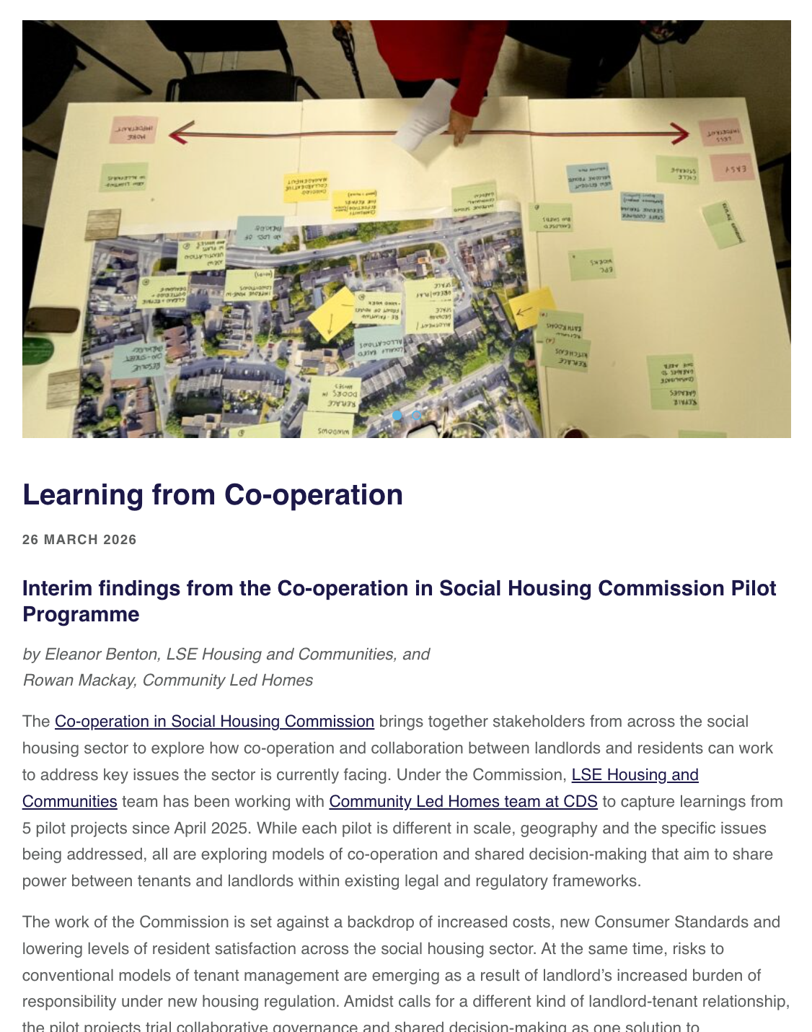
1. Learning from experience
2. Live pilot projects
3. Informing future practice
Outputs due Autumn 2026

Slide 10

What is Collaborative Decision-Making?
Collaboration, not devolution
Sharing power within existing roles and responsibilities
Mutual benefit and understanding
Being accountable to everyone's priorities and constraints
Issues and solutions together
Coming with an open and flexible agenda.
Ongoing feedback & accountability
Creating dialogue with leadership and wider residents
Building trust through repetition
Meet regularly, show consistency, demonstrate reliability

Slide 11
The decision-making cycle
1. Issues and solutions
Setting the agenda, defining the problems, understanding priorities and constraints, and proposing solutions together
4. Reflection and evaluation
Evaluating what's changed? What hasn’t? How do we want to do this differently next time?
2. Decisions and recommendations
Agreeing priorities though compromise and negotiation
3. Consultation and feedback
Hearing from outside voices, revising proposals securing commitments. No loose ends!

Slide 12
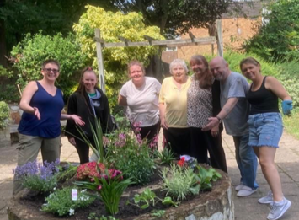
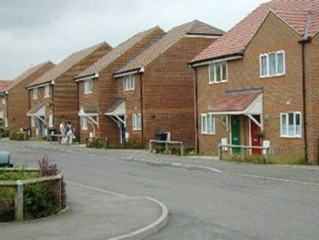

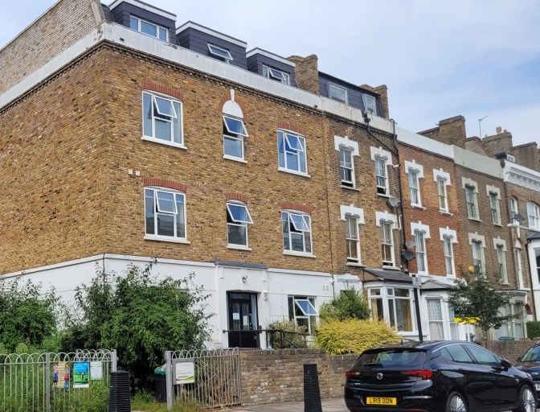
The Pilots
Phoenix Place
Major and capital works, repairs, allocations
Golden Hill
Procurement, major and capital works, repairs, allocations
St Luke’s Woodside
Housing delivery, allocations, tenant support
Davenant Road
Participatory budgeting, tenant wellbeing and development

Slide 13
What have we learned?
Knowledge-sharing is power-sharing
Housing is personal. Relationships are historical
Flexibility and legitimacy are a balancing act
Communities are complex
Co-operation is a skill
Effective co-operation needs structural support
Read more at communityled.homes/latest

Slide 14
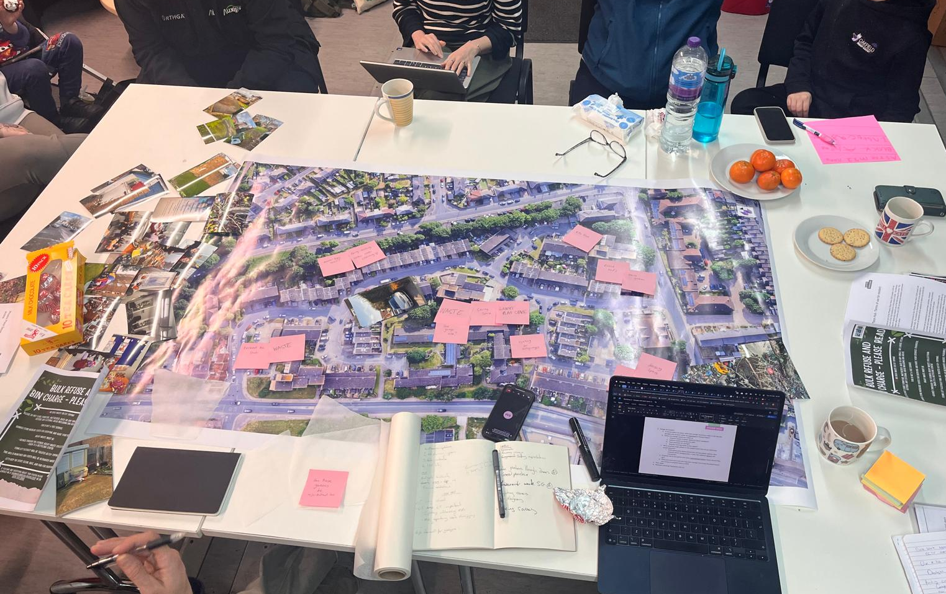
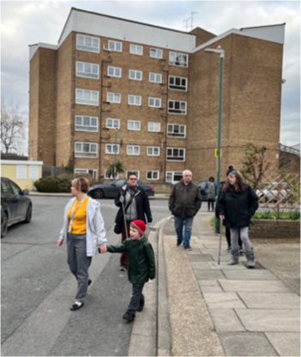
Reflections from Phoenix Place

Slide 15
Look out for…
Published recommendations
Collaborative governance model
Sector guidance
Question for discussion…
What are the opportunities and challenges for the sector in adopting collaborative decision-making?

