Slide 2
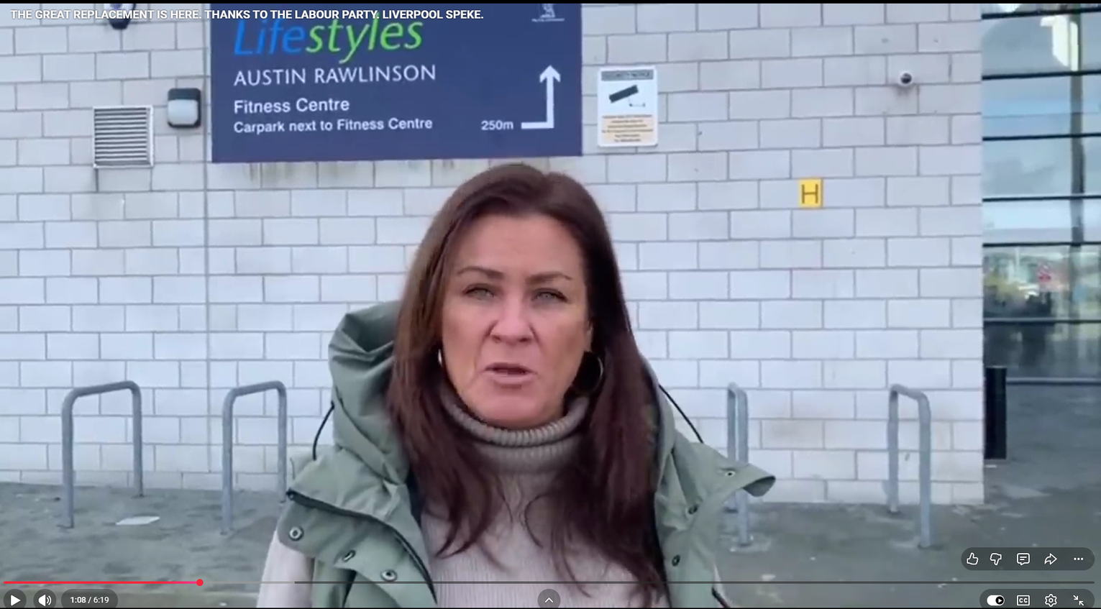
📽️ THE GREAT REPLACEMENT IS HERE. THANKS TO THE LABOUR PARTY. LIVERPOOL SPEKE.
“We’ve heard that 95% of the homes will go to migrants, which would just be the end of the community really.”
“It’s not a racial thing, it’s a cultural thing. It’s a different culture to us.”
“The children have been followed home on the bus. Muslim men taking pictures of young girls on the bus.”
“It’s causing disharmony in the estate and it will kick off.”

Slide 3
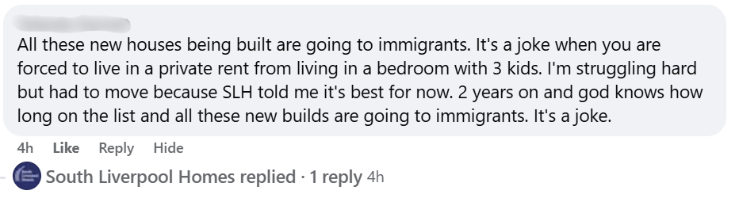
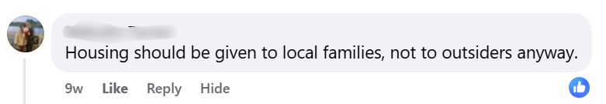
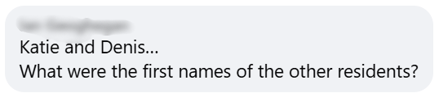

On our socials

Slide 4
Our values and behaviours

Slide 5
Customer insight
  76% did not understand how allocations work or only had a rough idea.
  49% said they receive no information at all about how homes are allocated.
  Only 37% believed the process is fair.
  33% believed immigration status influences who gets a home; 23% believed ethnicity plays a role.
  Word‐of‐mouth and social media were major information sources, increasing exposure to misinformation.

Slide 6

Colleague insight
  68% regularly encounter myths from customers - most commonly about immigration.
  76% felt familiar with the policy, but only 46% felt confident explaining it.
  Knowledge‐to‐confidence gap is significant.
  59% felt equipped to challenge misinformation, leaving 41% unsure or not equipped.
  Staff requested simple tools: FAQs (61%), training sessions (61%), infographics (44%) and
  short videos (29%).

Slide 7

In person events
  Gave the facts about how social housing is allocated.
  Challenged common myths and misconceptions around fairness, waiting lists, and who is prioritised for housing.
  Explored real-life issues around supply and demand.
  Created space for honest conversations.
  Set out our commitment to transparency.

Slide 8

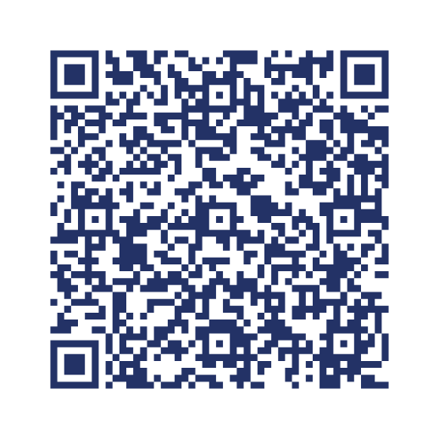
Sharing our learnings with the sector
#Let’sTalkFacts
Who gets our homes?
southliverpoolhomes.co.uk/who_gets_our_homes_toolkit

