Slide 1

Rethinking repairs
Ian Hancock
Executive Director of Property
24 June 2026

Slide 2
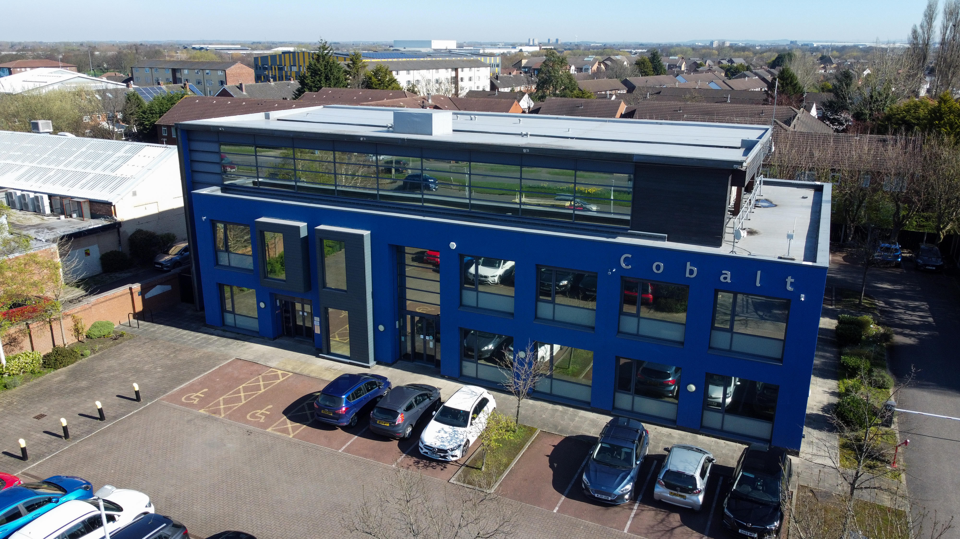
Cobalt Housing
Community-based housing association
Formed in 2003
Manage 6,000 homes
Ambitious growth plans
Our purpose
We will provide quality homes and services and maximise the positive impact of our investment for the communities we serve.
Notes:
Cobalt Housing is a community-based housing association
Formed in 2003 following stock transfer
Manage around 6,000 homes in North Liverpool
Expanding into new neighbourhoods
Our Purpose
We will provide quality homes and servicesand maximise the positive impact of ourinvestment for the communities we serve.

Slide 3
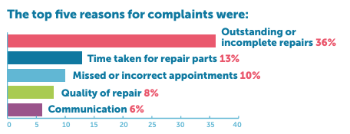
Performance and Customer Service
Declining repairs service
High inbound calls
High numbers of complaints
Low customer satisfaction
Low morale
High numbers of repairs
Damp and mould
Challenges with digital systems
Consumer Standards - C2

Slide 4
Immediate Priorities
Increase colleague and contractor resources
Listen to customers, colleagues and contractors:
  Answer the phone
  Make an appointment
  Turn up
Small in-house team - what can they offer?
Improvement plan
Customer and Board options for the future operating model

Slide 5
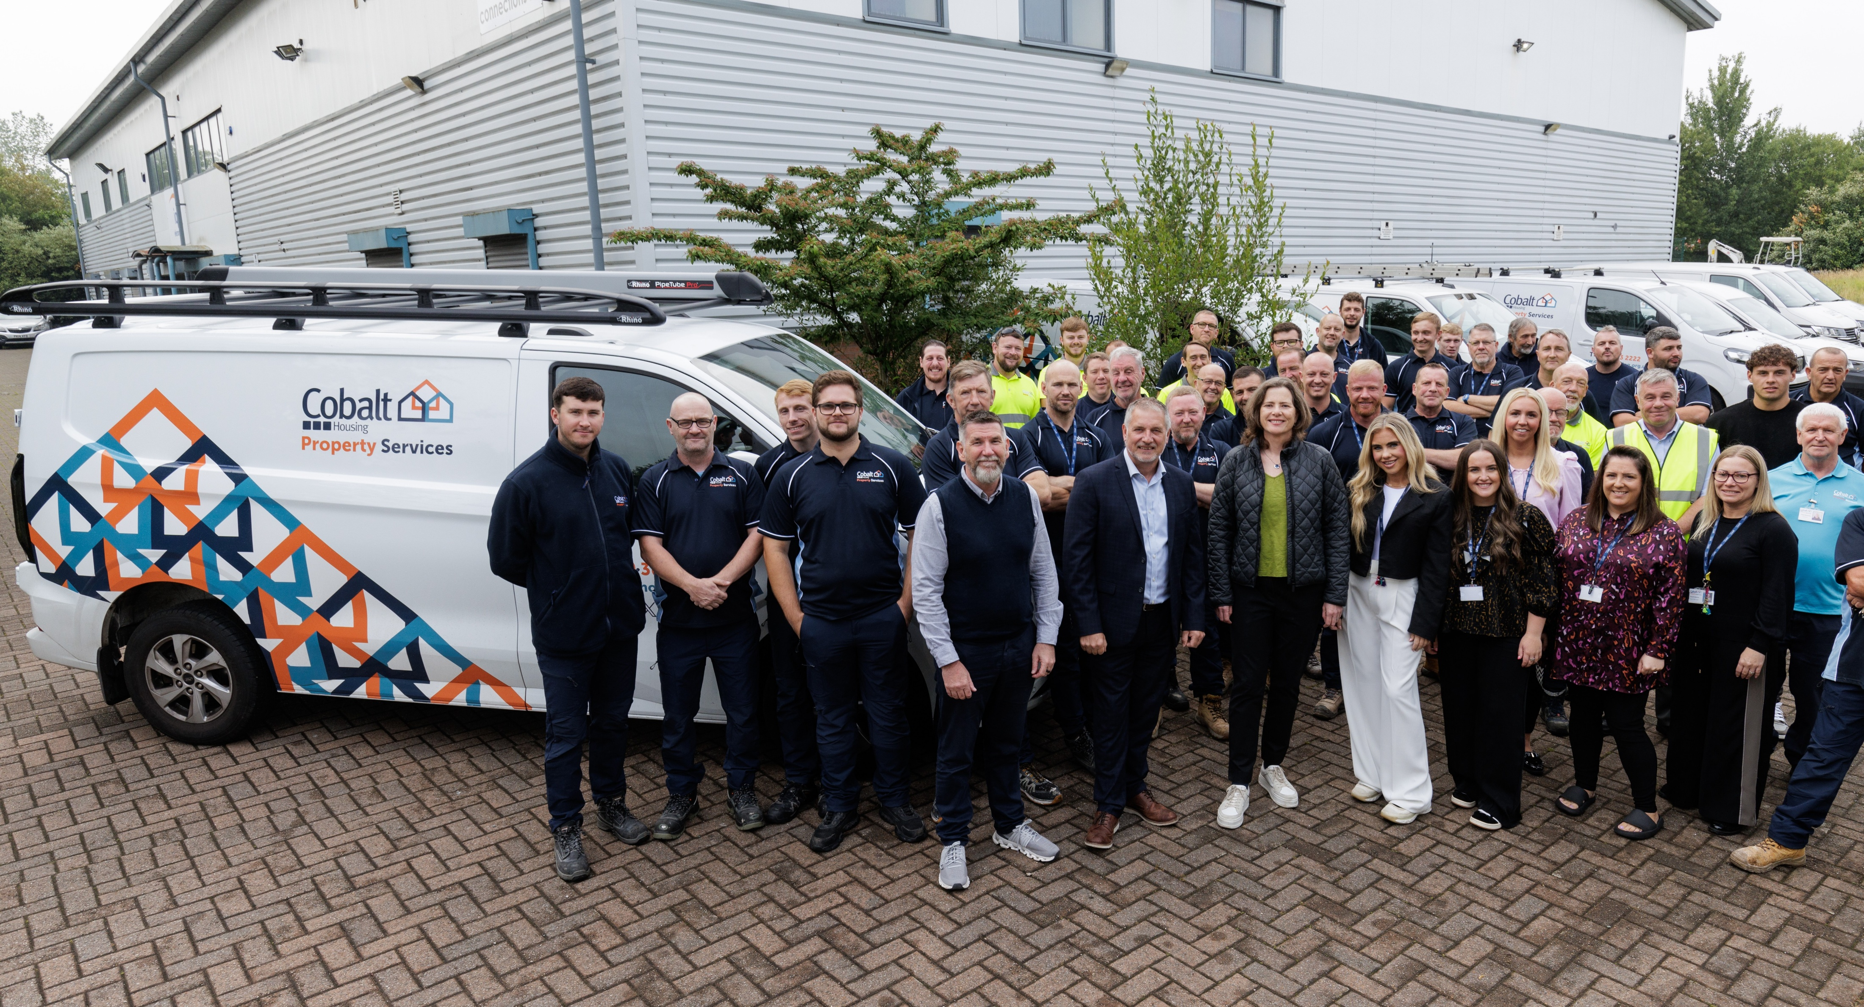
Improving our Repairs
Exit the existing contract
Develop inhouse service
New Repairs Standard
Task and Finish Group
Notes:
Improve customer outcomes
Improve value for money
Social Value outcomes

Slide 6
Improving our Repairs
Co-locate teams
Procure local contractors
Upscale investment programmes
New damp and mould, HHSRS and disrepair team
New digital systems
New depot and office
Rebrand service
Review Repairs Standard
Customer and colleague communication
New management team and operating model
Involving customers
Notes:
Co-locate repairs and contact centre teams
Procure local contractors, then transfer colleagues to Cobalt
Upscale investment programmes
New damp and mould, HHSRS and disrepair team
New digital systems
New depot and office
Rebrand in-house team
Review Repairs Standard
Customer and colleague communication plan
New management team and operating model
Involving customers

Slide 7
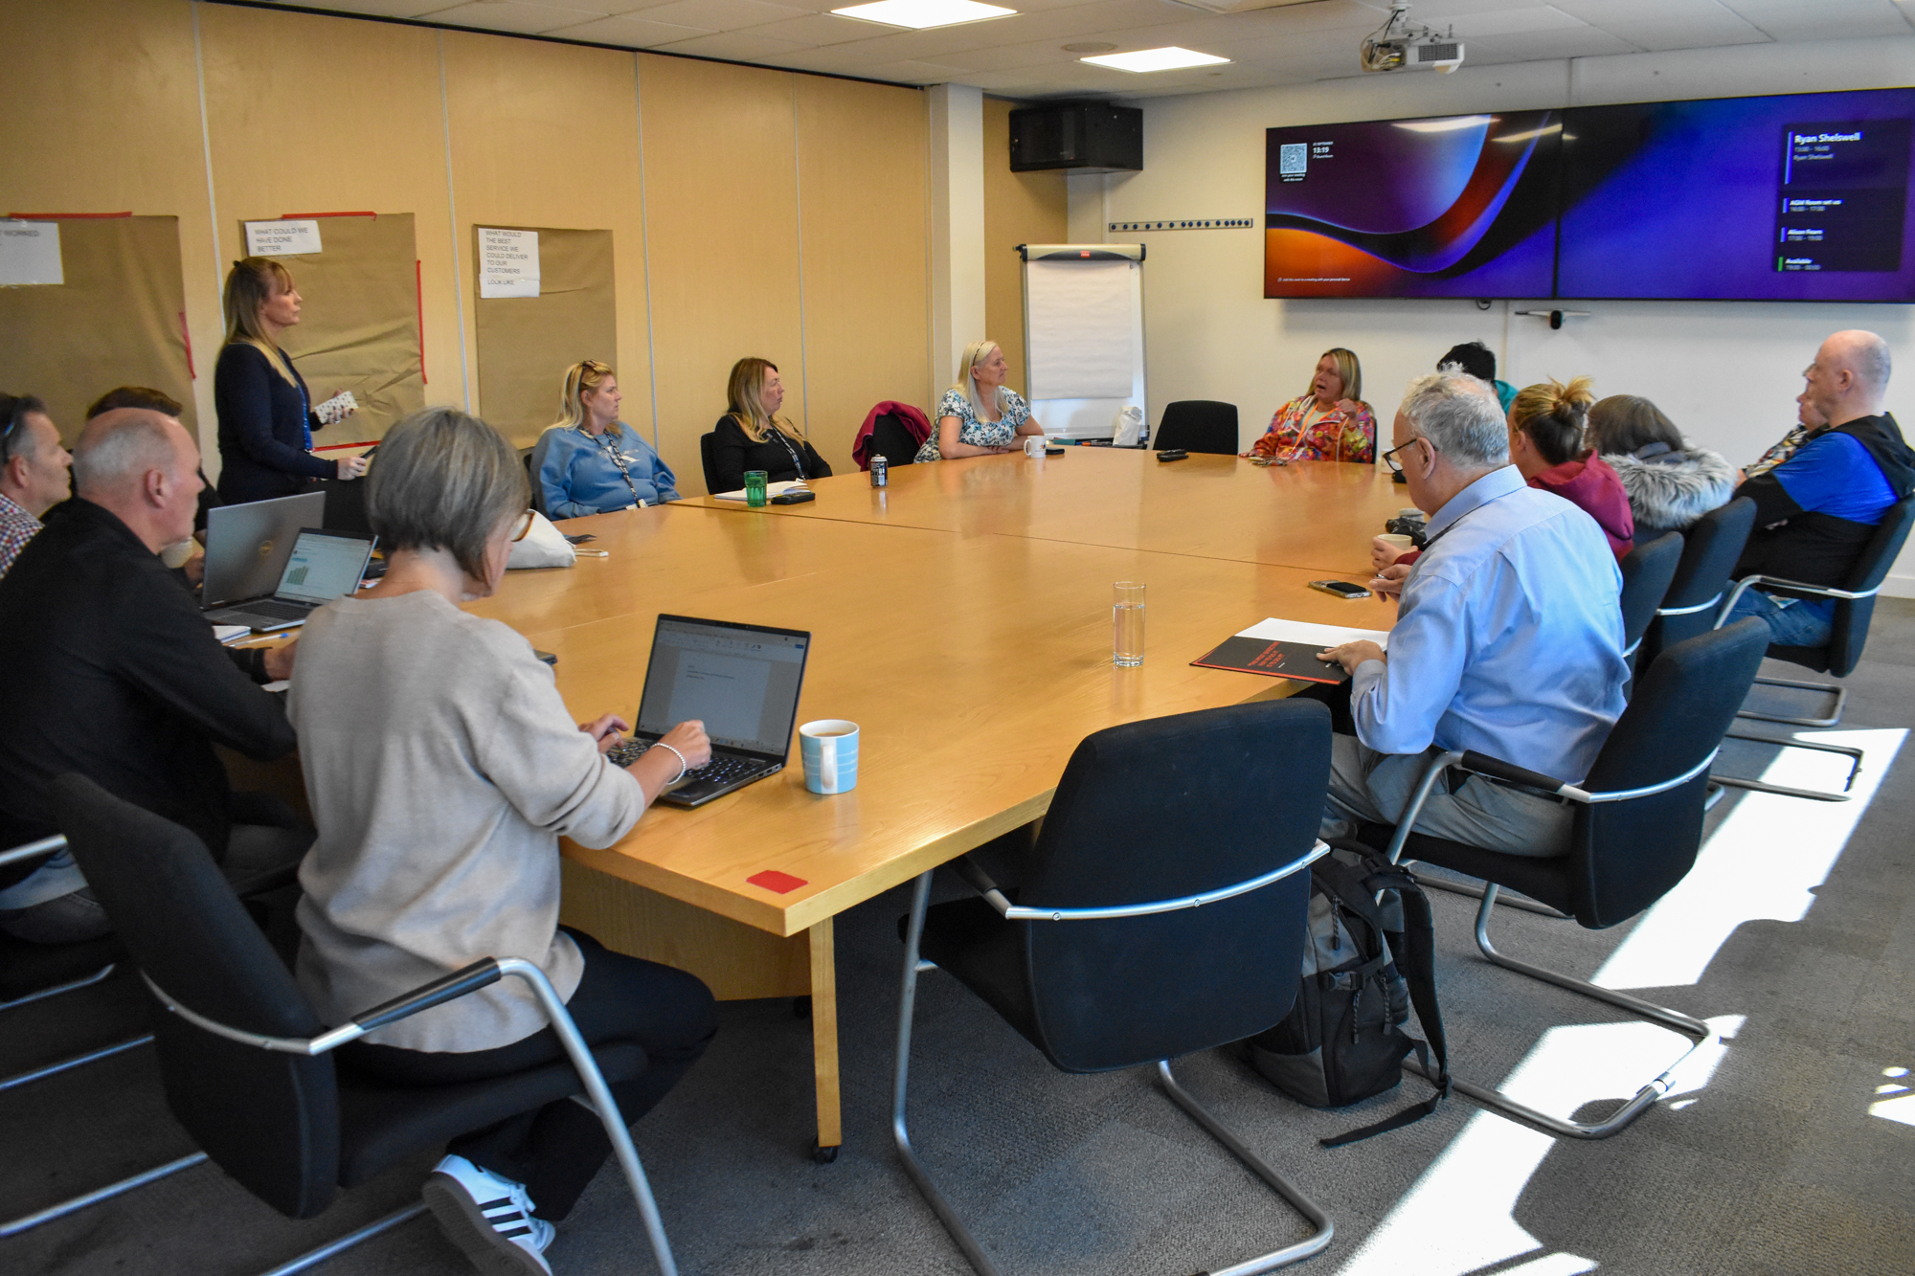
Customer Voice
Customer network events
Outbound calls
Big Listen
Complaints clinics
Transactional customer surveys
Scheme meetings
Customer workshops

Slide 8
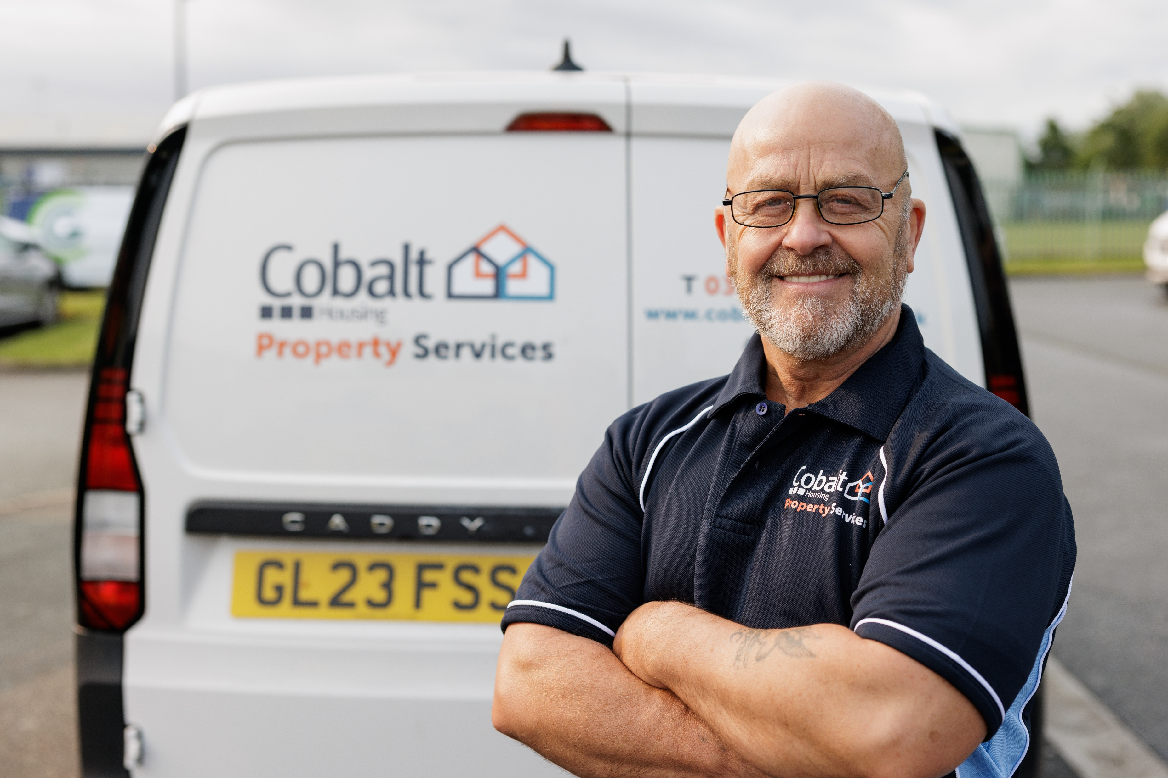
Repairs Standard
New repair categories and targets
Surveyor appointments and timescales
Appointments offered
Process for follow on repairs
Code of conduct for trades and contractors
Commitment to review in 12 months
Notes:
Worked with customers to develop a new repairs standard and define expectations:
New repair categories and targets
Surveyor appointments and timescales
Appointments offered
Process for follow on repairs
Code of conduct for trades and contractors
Commitment to review in 12 months

Slide 9
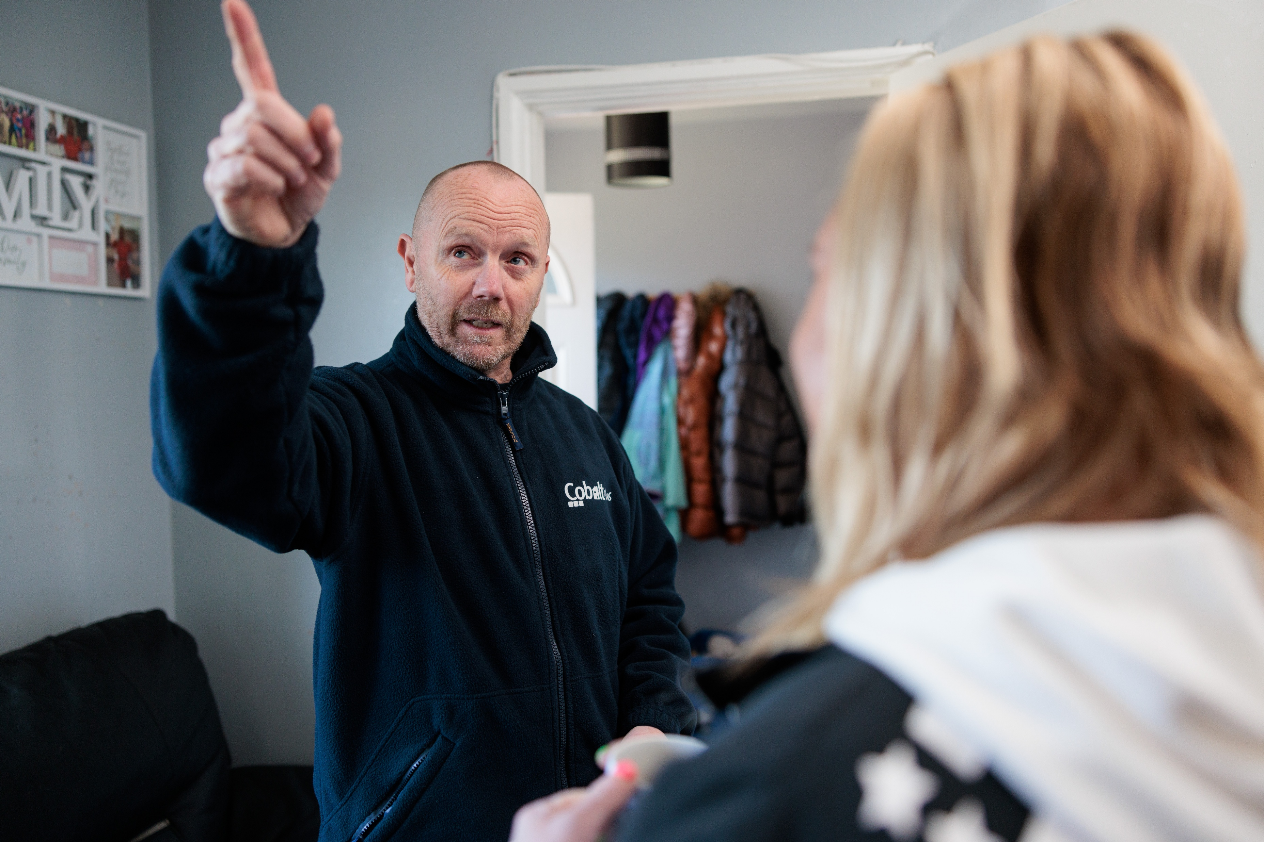
Repairs Standard - 12 month customer review
  School run appointment slots
  Evening and Saturday morning appointments
  Specific appointment slots for specific customer needs
  Written visit summaries from surveyors
  Text functionality

Slide 10
The impact
Improved customer satisfaction: 37% to 74%
Emergency repairs performance: above 95%
Routine repairs performance:
62% to above 95%
Repairs complaints down 20%

Slide 11
Consumer Standard regrade
Notes:
Where we were
What we’ve changed
How we did it – behaviours
Why it matters
Culture of continuous improvement
Change is normal
Need to support each other

Slide 12

Continuous Improvement
Fully insourced from Dec 2025
Repairs Performance Group
Co-located stores with Huws Gray
PowerBI reporting and data analytics
Local employment and apprentices
Investment strategy: reactive to proactive
5-year Business Plan
Listen, learn, refine
Notes:
Fully insourced from Dec 2025
Repairs Performance Group – customer voice
Collocated stores with Huws Gray
PowerBI reporting
Data analytics
Local employment and apprentices
Investment strategy – proactive from reactive
CHPS 5-year Business Plan
Listen, learn and refine

