Slide 1
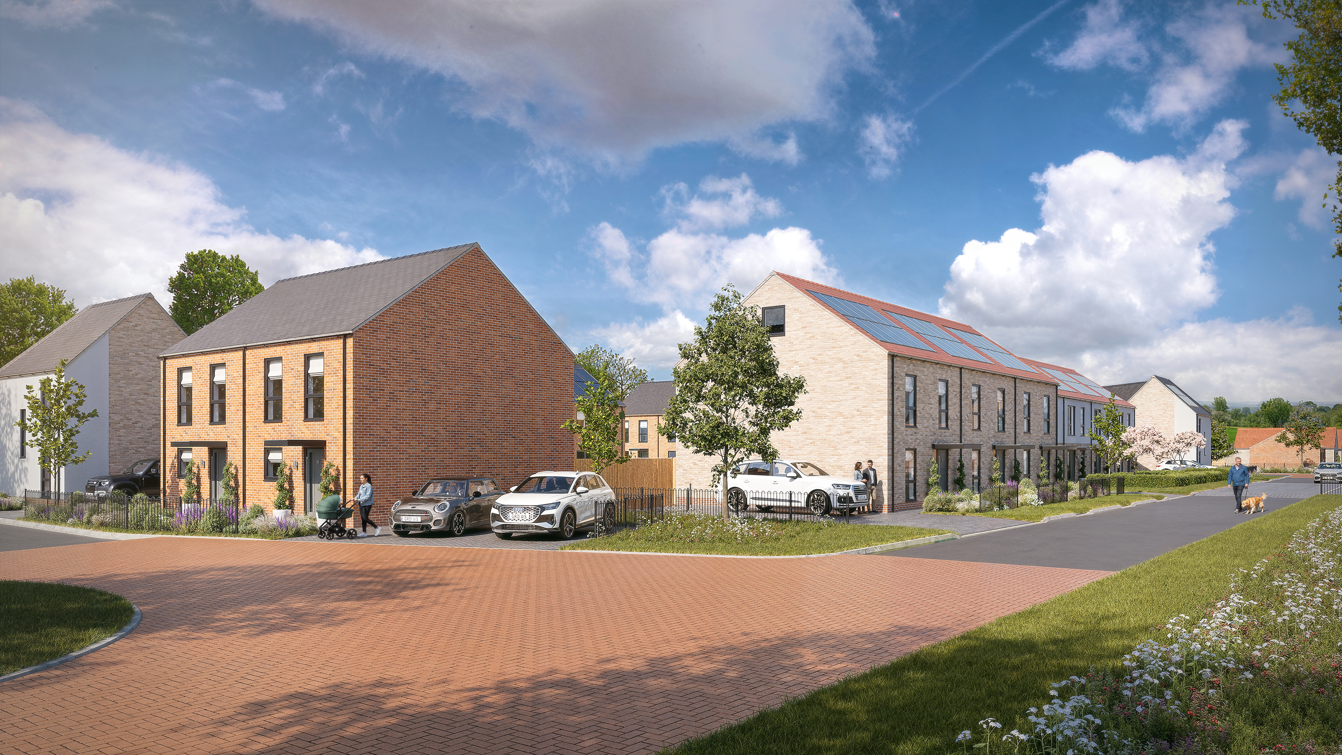

Future proofing new homes against climate risk
Jenny Crane
City of Lincoln Council

Slide 2
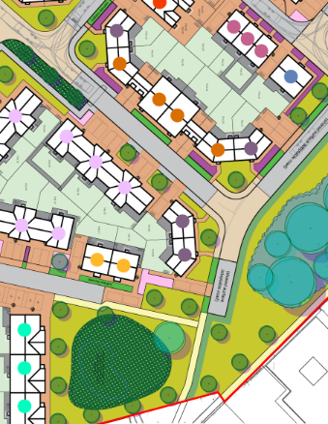
Climate risk in housing delivery
For new build homes, resilience decisions are made early: location, layout, fabric, landscape and handover.
Location
Integrate local infrastructure and natural shading opportunities from the outset.
Layout
Shape streets and homes to limit solar gain while protecting daylight and natural ventilation.
Landscape
Treat trees, habitats, SuDS and permeable surfaces as core resilience infrastructure.
Notes:
For new build homes resilience decisions are made early – as officers we don’t always have control over the location, as a council we own land and priority is the delivery of homes on our own land – we need to consider the pros and cons of what we have and how we can work with it to our advantage. We can however make more considered decisions on the layout of schemes and homes themselves, the fabric of those homes and the landscape around them.
Using trees, habitats, attenuation, permeable paving and SUDs to support the development and protect homes from extreme weathers where possible
Handover of those homes can impact on effectiveness of the homes usage – are residents aware of how to make the best benefit from their homes?
Climate resilience needs to sit alongside cost, carbon and housing delivery – not behind them

Slide 3
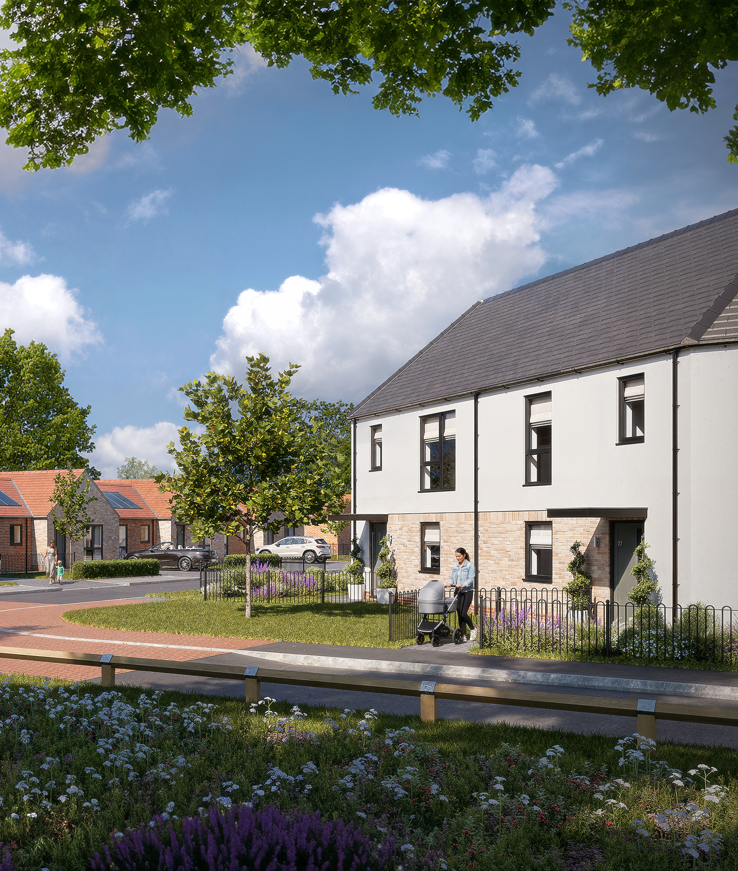
Designing homes to build out climate risk
1
Orientation & glazing
Orientate buildings well, plan massing, shape and window ratios to limit solar gain while protecting daylight.
2
Shading & landscape
Use reveals, external shading and any tree canopy where possible to keep homes and streets cooler.
3
Low-carbon technology
Specify PV, ASHPs, MVHR bypass, EV charging and heat recovery around tenant usability. Increased insulation to keep homes warm in winter and cool in summer
Notes:
Designing our Council homes carefully considering:
Building orientation
Strategically placing glazing to consider overheating
Considering proximity to trees and the shading they can provide to prevent summer overheating and possible buffers from harsh winds
Technology included to support our tenants to reduce their household bills where possible – limiting exposure to energy price volatility through considered design and use of the right technology

Slide 4
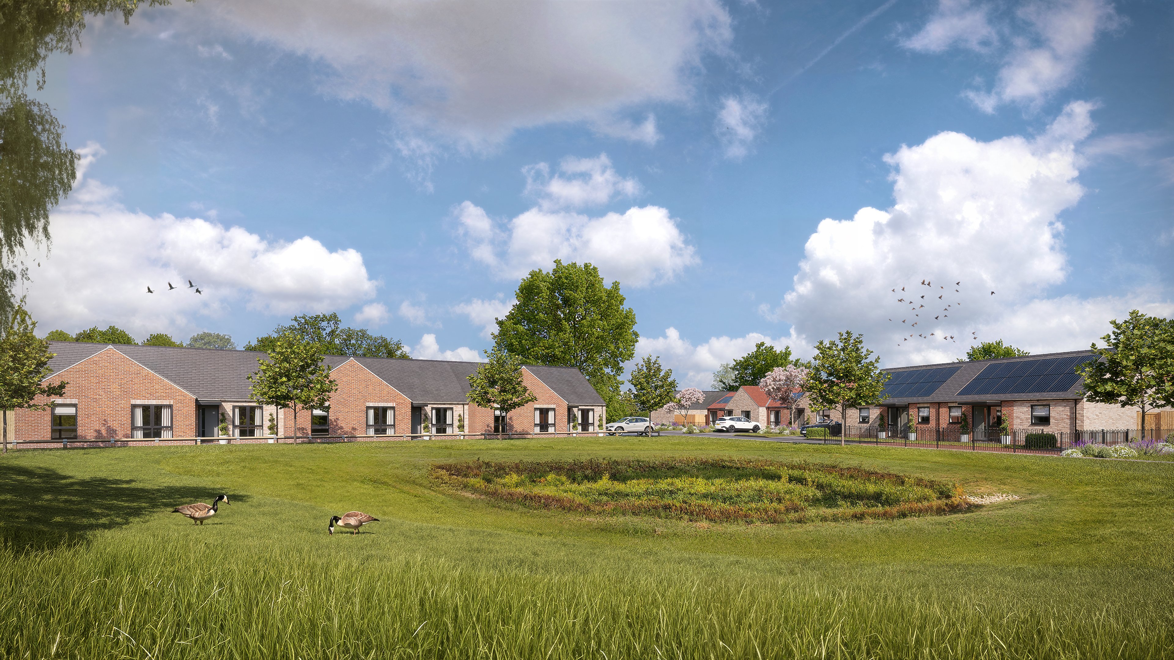

Jasmin Green, Lincoln
A live opportunity to demonstrate climate-conscious new build delivery.
Low-carbon specification
PV panels with battery back up, air source heat pumps, EV charging , MHV and fabric-first performance.
Comfort by design
Orientation, glazing strategy, shading and ventilation considered together.
Landscape as infrastructure
Tree retention, 10% increase in BNG, SuDS and habitat corridors/refugia designed in early.
Notes:
Jasmin Green – currently on site
EPC A rated
50 new council rented homes - mix of bungalows, houses and apartments
These all have solar panels with battery back ups, air source heat pumps, EV charging, mechanical heating and ventilation.
The buildings have been designed considering orientation, the impact of glazing and natural shading hand in hand with ventilation.
Retained as many trees as possible, some have been removed, exceeding the 10% policy increase in BNG, SUDs and attenuation. Habitat considered early with hedgehog highways, bird and bat boxes, bee/insect bricks, hedgehog and reptile refugia as well as planting additional trees.
All ground floor dwellings meet M4(3) of building regs (wheelchair user – we have a huge need for wheelchair friendly and adapted homes) to reduce requirement for adaptations to these homes but also to existing homes which could be unsuitable for adapting and providing homes which can be adapted easily to prevent upheaval for families

Slide 5
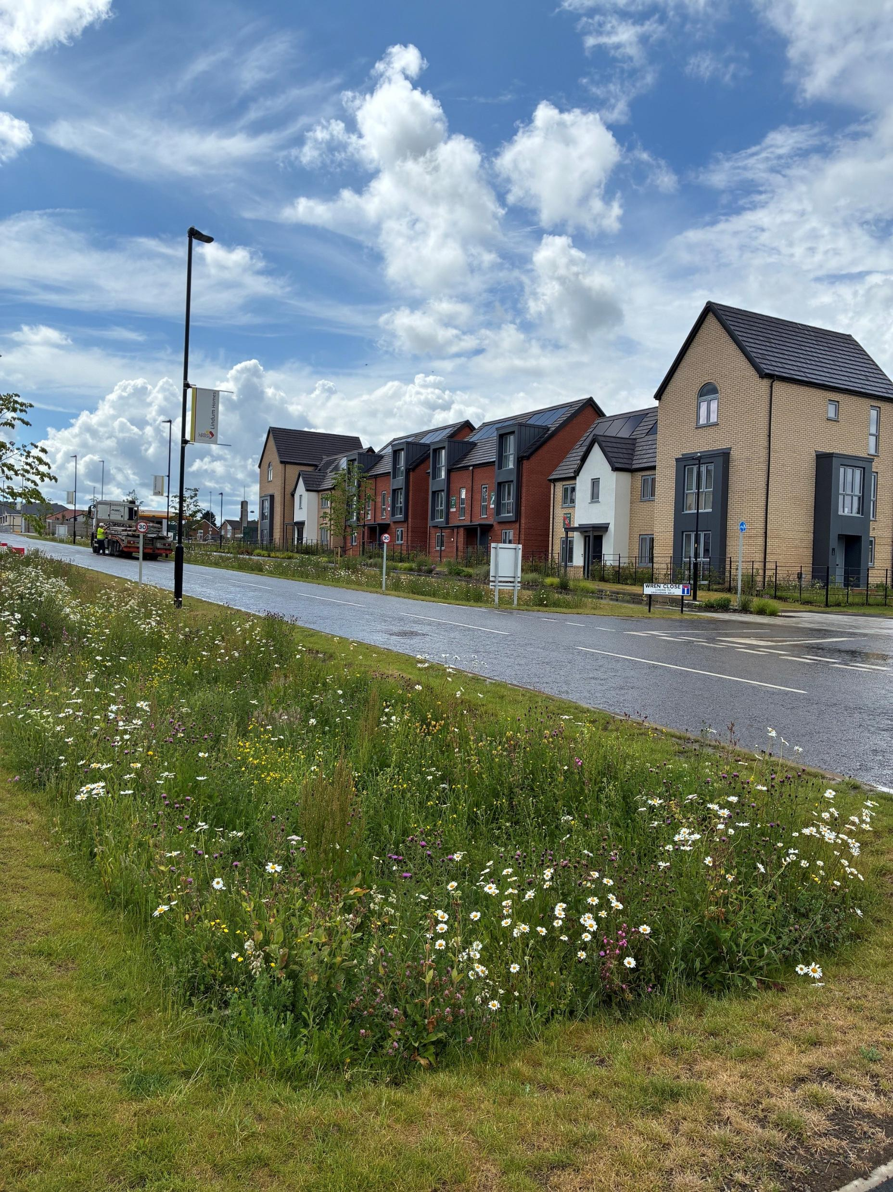


Charterholme
Sustainable living designed around energy efficiency, biodiversity and long-term resilience
Tree-lined SuDS with wildflower planting
Active travel links to the city centre
Protecting existing habitats while creating new ones
PV panels, EV chargers, ASHPs, enhanced fabric performance and smart metering across all homes
Optimised design, orientation and form to maximise passive efficiency
Notes:
Charterholme – private sale development of 52 new homes part of a wider sustainable urban extension to the city. The first homes to be built on a site of around 3200
Sustainable Urban Living with cycle and pedestrian links into the city
Suds containing wildflowers and tree lined – adopted by the highways authority
PV panels
EV chargers
ASHPs
Efficient lighting and water fittings
Smart metering

Slide 6
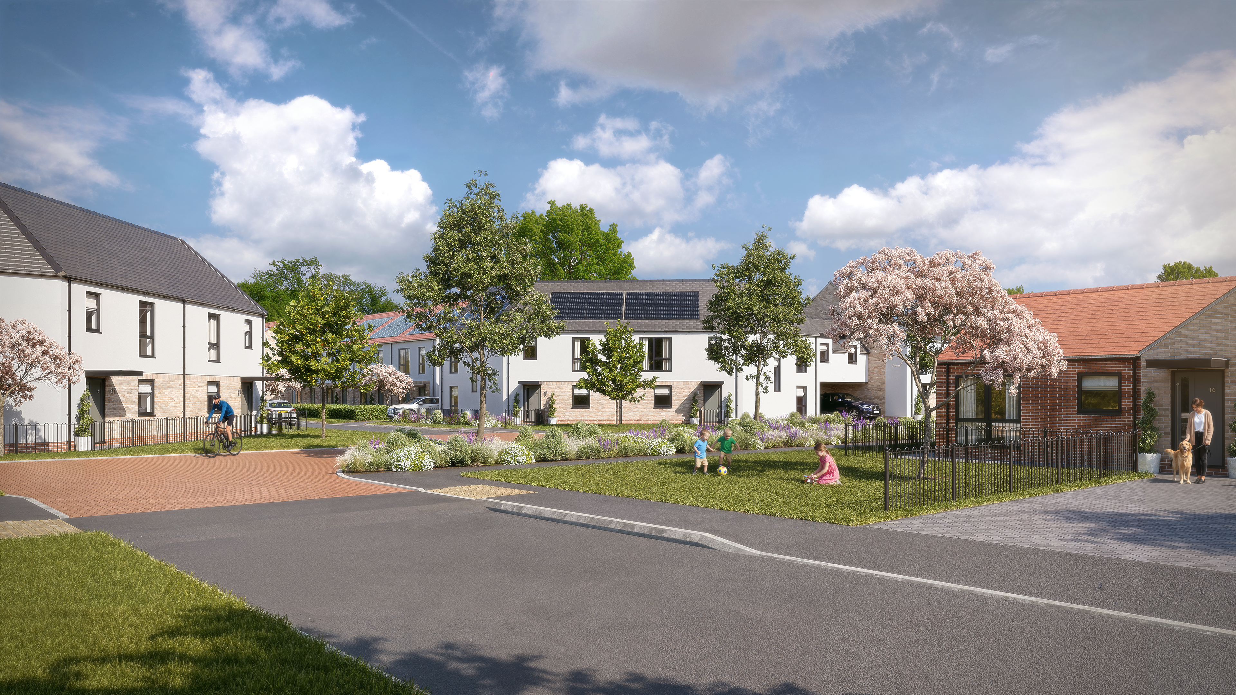

Close the loop after occupation
Measure reality
Compare bills, summer temperatures, maintenance issues and comfort feedback with design intent.
Learn what matters
Review tenant experience to understand which interventions make the biggest difference for end users.
Invest next
Prioritise future spend around proven tenant impact, resilience value and compliance confidence.
Notes:
Use the schemes as a living prototype: compare design assumptions with real life tenant experience, then feed the evidence into the next specification – what works?
Compare tenant bills from existing council homes into new ones as part of the picture in assessing what is working for tenants – reducing energy bills and consumption
How we handover the homes matters – if tenants/residents are not aware or confident in how they use the technology in their homes they will not make the best use of it – we haven’t got this right yet but working on it.
Design decisions become evidence only when residents live with them.

Slide 7
Key takeaway
Build in climate resilience
at the earliest design stage for maximum effectiveness
The biggest opportunities sit early — in the location, layout, fabric, landscape and handover decisions.

