Slide 1
Architecting the Future
Architecting the Future
ChatGPT in AECO Workflows

Slide 2
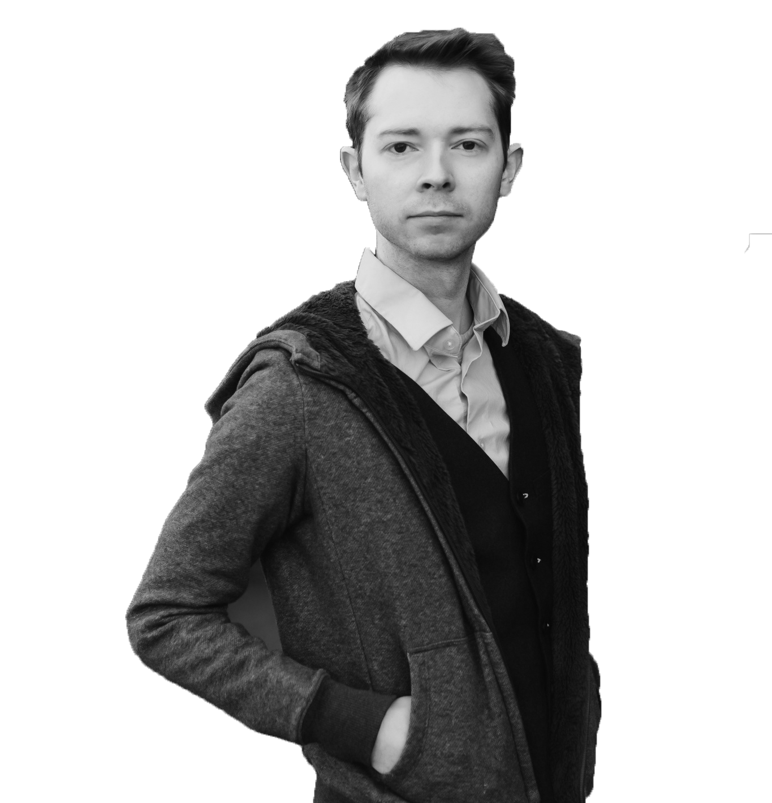
Hello! I’m Jarod
Design - Marketing - AI Specialist at NEWMARK.
Wholly dedicated to new technology; “Obsessed with AI” is the understatement of the century.

Slide 3
And I’m Sonja
Licensed architect in Illinois and Associate Director at bKL Architecture.
Teamed with a few colleagues in a bimKL research group, leading the office’s AI initiative.

Slide 4
Table of Contents.
Explain
Get into it
Identify
Play
01
02
The foundational architecture and key capabilities of ChatGPT
Series of guides for creating targeted and strategic prompts
03
04
Potential applications of ChatGPT in the AECO industry
Methods for integrating ChatGPT into daily workflows

Slide 5
Explain.
01
The foundational architecture and key capabilities of ChatGPT

Slide 6
What is GPT?
It stands for:
Generative
Pretrained
Transformer
It can create or generate text, responses, or content that wasn’t explicitly programmed into it.
Before being used, it has already been trained on a vast dataset of text, learning language patterns, facts, and how to respond to different inputs.
A model architecture designed to handle sequential data by focusing on the importance of each word or character, enabling effective language understanding and generation.

Slide 7
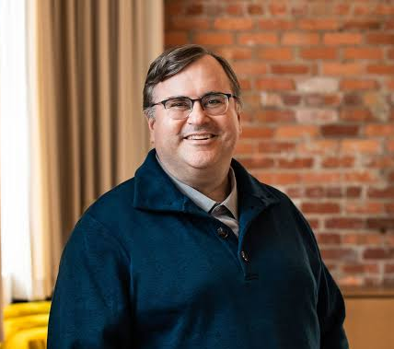
Brief history..
2015
2022-2023
2024
OpenAI was founded by Elon Musk (PayPal, SpaceX, Tesla, Neuralink and The Boring Company), Sam Altman (Y Combinator), Reid Hoffman (LinkedIn), Peter Thiel (PayPal) and others..
It’s mission was to ensure that Artificial General Intelligence (AGI) benefits all of humanity.
ChatGPT and GPT-4, a Large Language Model created using deep learning techniques,* captured the public’s attention with its conversational capabilities.
GPT-4o (2024) was made freely available to the general public.
o1(under preview) and o1-mini are the latest released models using advanced reasoning.
*Deep Learning: ChatGPT is based on deep learning, specifically a neural network architecture known as a Transformer.

Slide 8
How does it work?
LLMs are made of software, but they do not work like most software.
They are probabilistic and mostly unpredictable, producing different outcomes given the same input.
Though they don’t think, they produce simulations of human language and thought that are, as far as we can tell, original enough that they out-invent most humans.
They are perceived as more empathetic, and more accurate, than human doctors in controlled trials.

Slide 9
LLMs are essentially just a really fancy autocomplete. So how can a fancy autocomplete do these things? The answer so far, as described in an excellent overview in the MIT Technology Review is “nobody knows exactly how—or why—it works.”
― Ethan Mollick

Slide 10
Capabilities
Contextual Text Generation.
Multimodal.
Multilingual.
Customizable.
Capable of producing text that is contextually relevant, mimicking human-like conversations based on deep subject understanding.
Can process and generate responses not just based on text but also voice and images.
Proficient in multiple languages.
Highly adaptable, it can follow specific instructions and adapt its responses to fit the needs of various user scenarios.

Slide 11
Limitations
Hallucinations.
Data Bias and Errors.
Nuance Challenges.
Limited Real-Time Updates.
Can generate incorrect or fictional information, with high confidence!
Despite advancements, it can still manifest biases present in its training data or make errors in understanding and generating responses.
While significantly improved, it may still struggle with very complex nuances of human emotions or highly specialized knowledge areas.
Its knowledge is current up to its last training cut-off in October 2023, so it sometimes may not provide info on events occurring after that date, unless you specifically prompt it to search the web.

Slide 12
Did you know?
ChatGPT allows users to opt out of having their data used for training models. Free users can disable chat history and paid users have a toggle option under Settings / Data Controls.
Use temporary chat to prevent a chat from being stored in the chat history, and toggle “memory off” to prevent it from selectively memorizing things from the chats.
Team and Enterprise licenses follow SOC compliance standards and by default do not use the data for model training.
However, if you share a link of a chat or any of the proprietary GPT’s with an external user or a individual account, (free or paid) the data used in the GPT is no longer subject to the enterprise privacy tier.

Slide 13
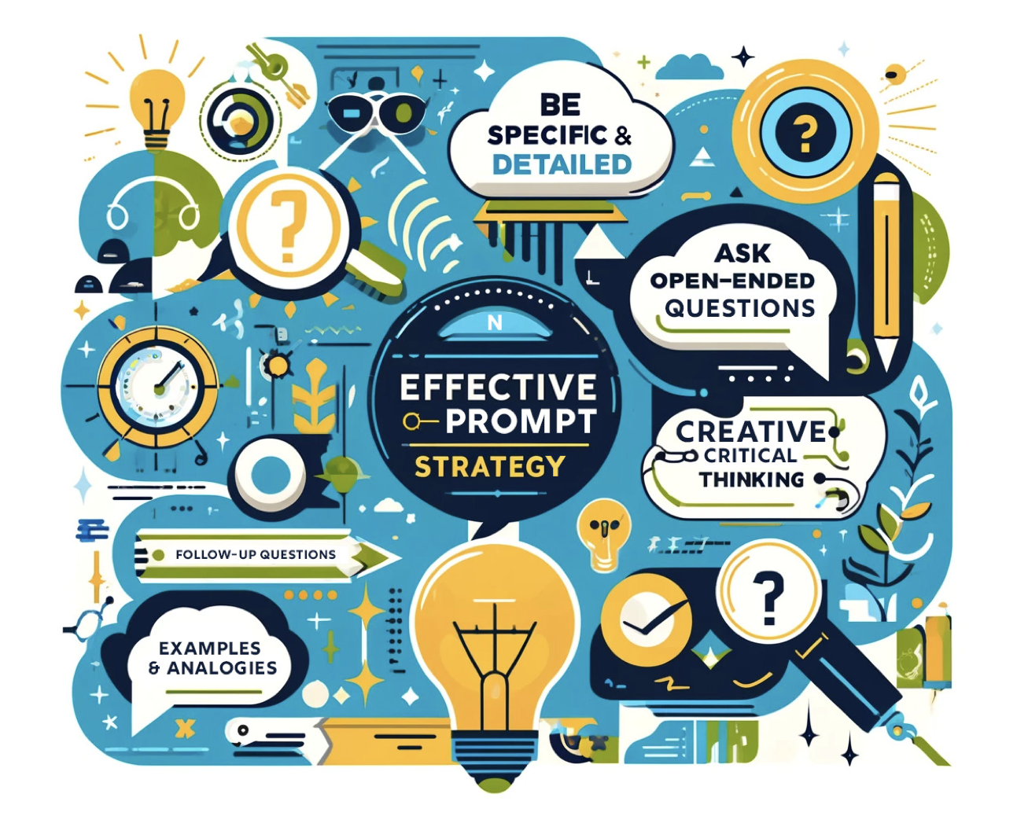
Get into it.
02
Series of guides for creating targeted and strategic prompts
Fun Fact: 90% of the images you’ll see…
AI Generated + Photoshop

Slide 14
The most creative people are not those with the highest IQ. The most creative are those that learned to play in everything they do.
― Dr. MacKinnon

Slide 15
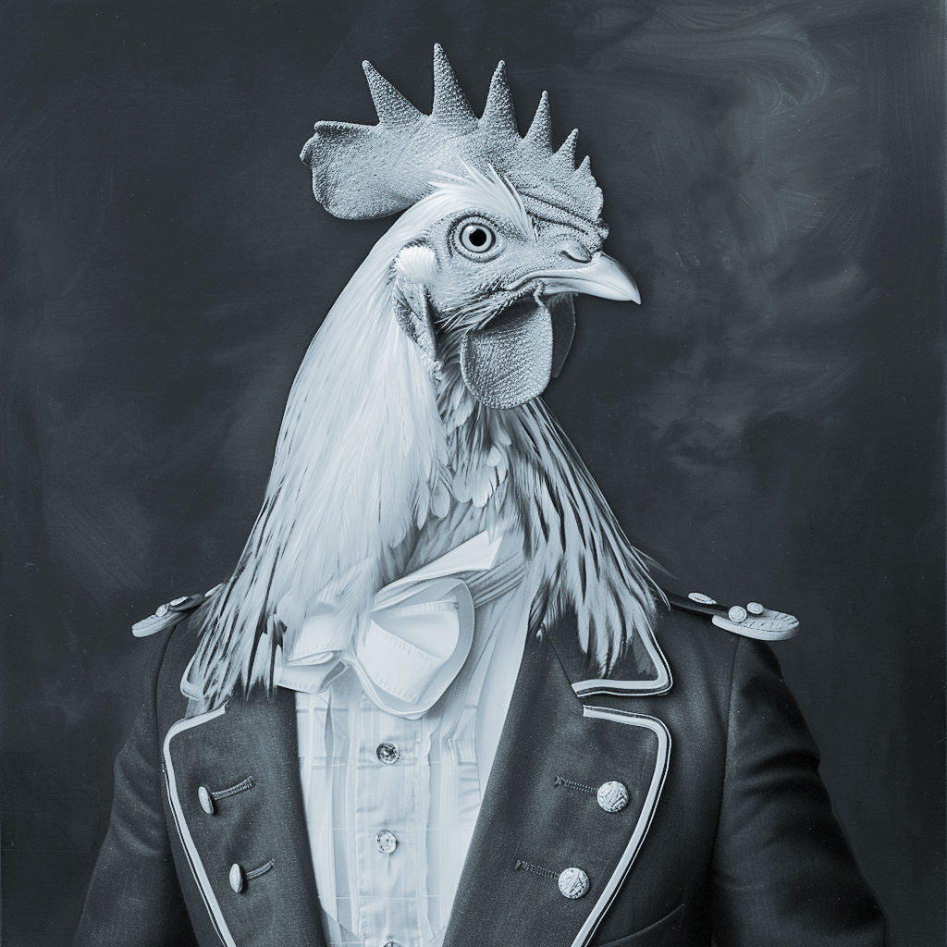
(Do not take prompting too seriously)
The early bird gets the worm

Slide 16
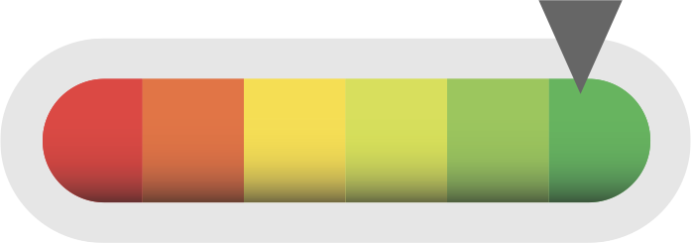
The Importance of Articulation.
Trust?
Check the work.
Reiterate.
Make it your own.
Rephrase and respond. Challenge AI to show reasoning (4o Model, not o1)
Create options. Tell AI to make your prompt more concise.
Customize prompts to your goals
Algorithmic
No Context, Open Ended Questions

Slide 17
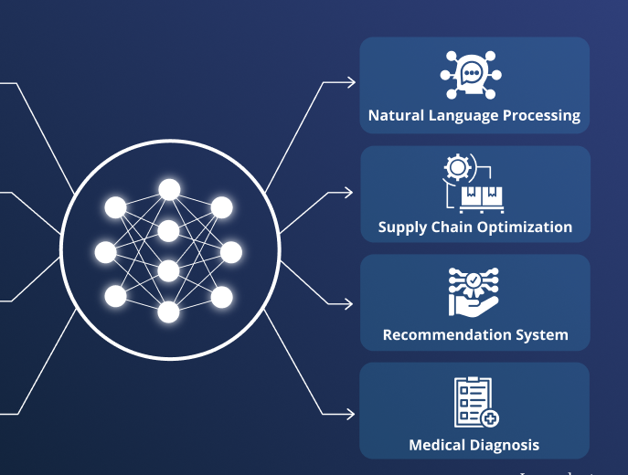
Top AI Terms to know for conversation
Model: (Not Victoria Secret), this is a mathematical process of understanding a concept and prediction result. | LLM (Large Language Model): GPT models are trained on large datasets and are more accurate than machine learning algorithms because they can grasp the complexities of natural language. | Training Data/Pre-Training: The data used to teach an AI model to recognize patterns and make decisions. A risk is AI being trained on AI | Context Window: The portion of text that the model considers when generating a response or prediction.
NLP (Natural Language Processing): Field of AI that focuses on the interaction between computers and humans (This is Siri / Alexa) | Machine Learning: use of algorithms and statistical models to work toward a goal using trial and error. (Learn from experience) | Deep Learning: A subset of machine learning that uses neural networks with many layers (deep neural networks) to model complex patterns in data. | Neural Network: A series of algorithms that attempt to recognize underlying relationships in a set of data through a process that mimics the human brain
 | Tokenization: The process of converting text into smaller units (tokens) that the model can understand and process. | API (Application Programming Interface): A set of rules and protocols for building and interacting with software applications, allowing different systems to communicate with each other. (API Key to connect) | Let’s go down the rabbit hole

Slide 18
Prompt Guide Structure.
Act as a [ ROLE ] | Create a [ TASK ] | Show as [ FORMAT ]
Define [ TASK ] | State the [ ACTION ] | Clarify the [ GOAL ]
Explain Problem [ BEFORE ] | State Outcome [ AFTER ] | Ask for the [ BRIDGE ]
Give the [ CONTEXT ] | Describe [ ACTION ] | Clarify the [ RESULT ] | Give the [ EXAMPLE ]
R - T - F
T - A - G
B - A - B
C - A - R - E

Slide 19
Example:
[ROLE]
[TASK]
[FORMAT]
Act as a:
Create a:
Show as:

Slide 20
Example:
[TASK]
[ACTION]
[GOAL]
Define the:
State the
Clarify the

Slide 21
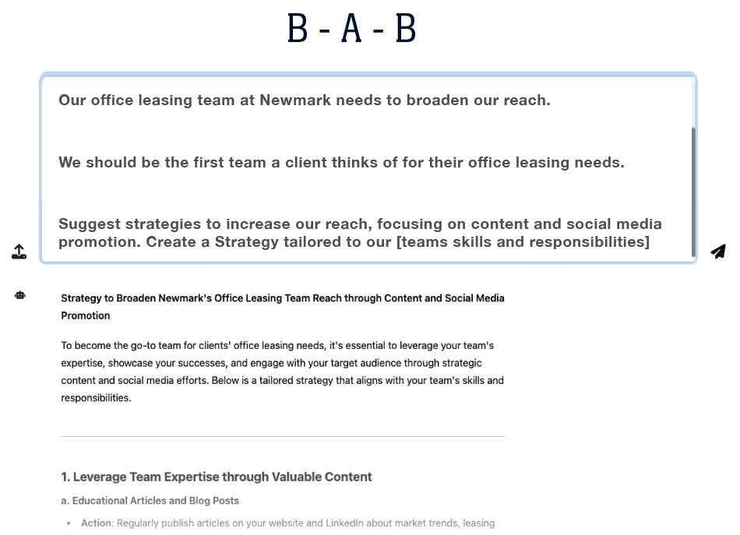
Example:
[BEFORE]
[AFTER]
[BRIDGE]
Act as a:
Create a:
Show as:

Slide 22
Example:
[CONTEXT]
[ACTION]
[RESULT]
[EXAMPLE]
Give the:
Describe the:
Clarify the:
Give an:

Slide 23
Identify.
03
Potential applications of ChatGPT in the AECO industry

Slide 24
Use cases:
Sustainable Design
Summarize Reports or Lease Agreements
The Right Fit
As an architect. Generate an innovative concept for sustainable townhome in Chicago. Be detailed about each feature.
I’m going to paste in a market report. I want you to summarize it for me. Here is the market report: [Paste in MS Word version of PDF report]
Summarize the key points of this lease agreement in bullet points under 150 words.
What ideal tenants would you recommend for a 34,000 SF space on the intersection of Ashland and Pershing in Chicago, IL. This space is new and near high density residential.
Make an architectural illustration of this concept

Slide 25
Sustainable Features to Image [4o]

Slide 26
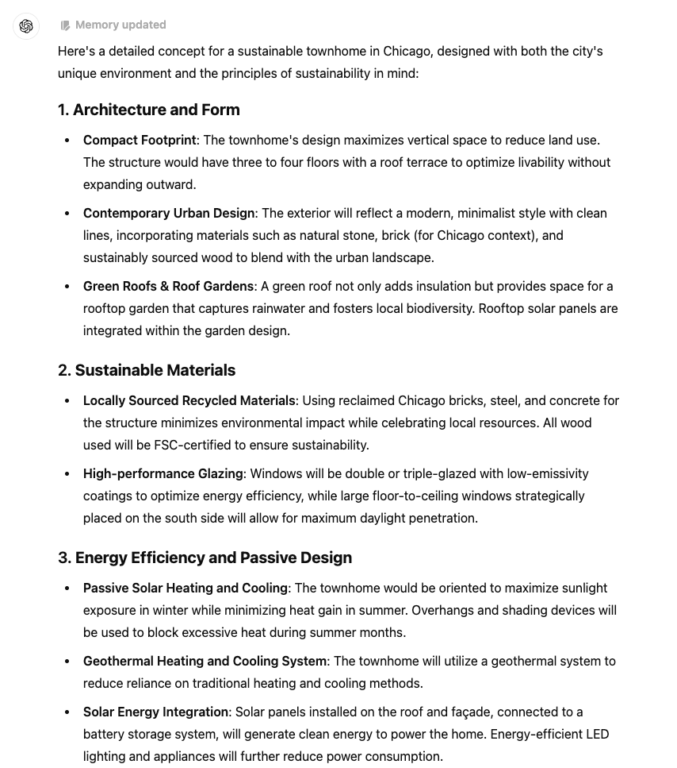
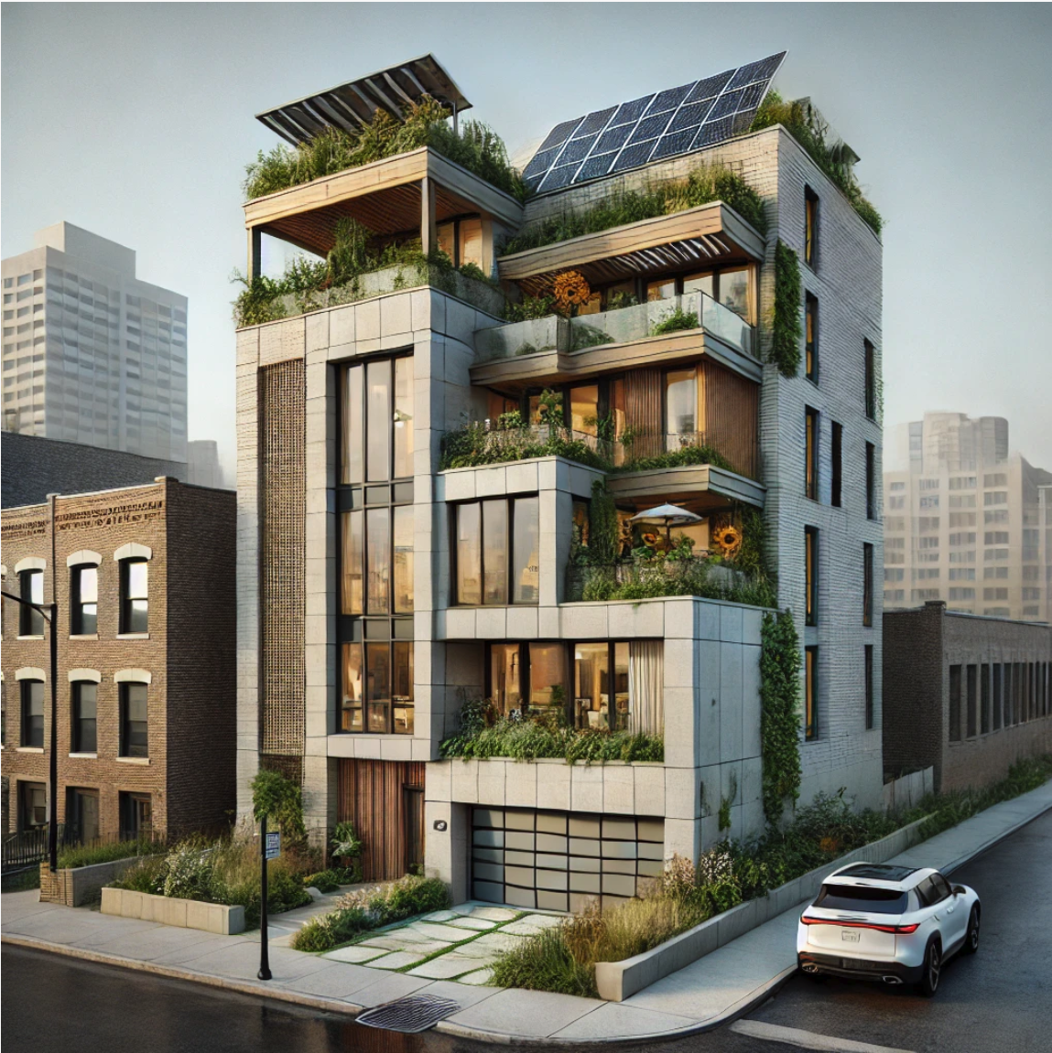
Sustainable Features to Image [4o]
“As an Architect. Generate an innovative concept for a sustainable townhome in Chicago. Be detailed about each feature.”

Slide 27
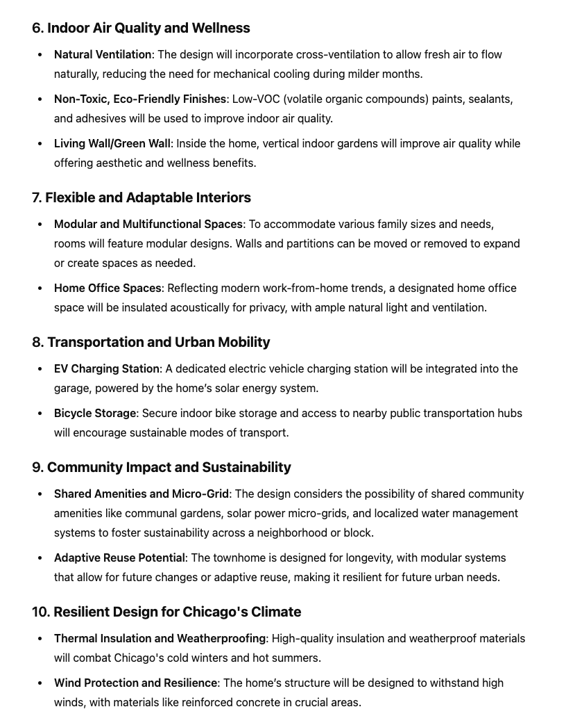
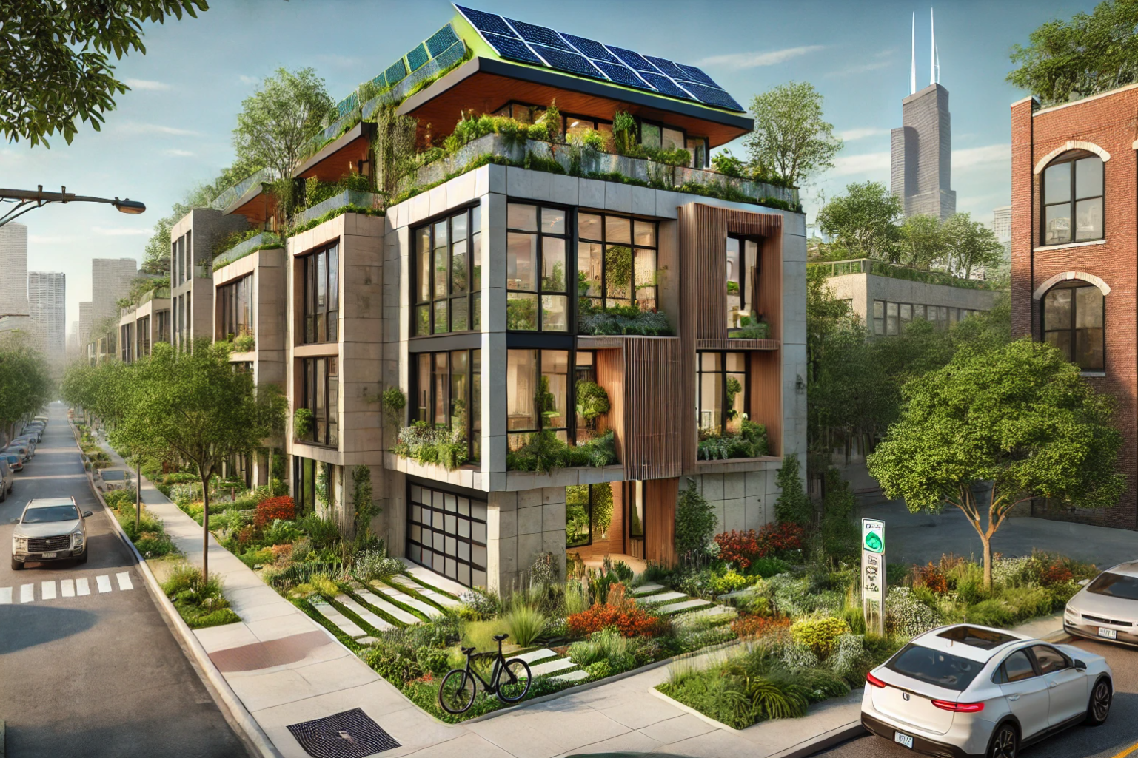
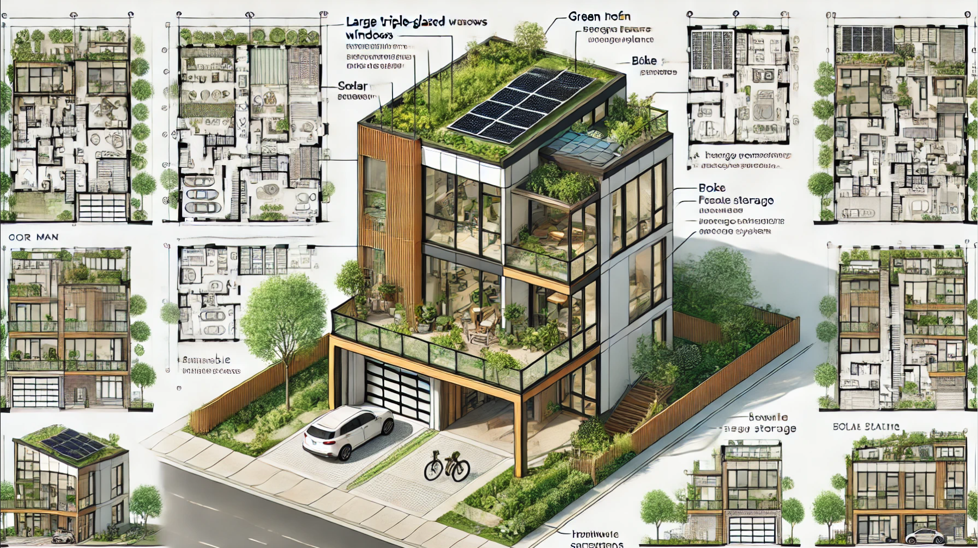
Sustainable Features to Image [4o]
You can Start in o1 for text, then step back to 4o for images
“Make an architectural illustration of this concept as a render in a Chicago neighborhood”
“Make a version as a Blueprint Render”

Slide 28
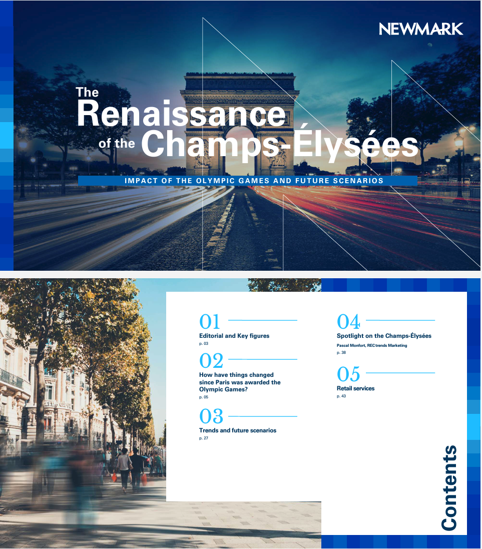
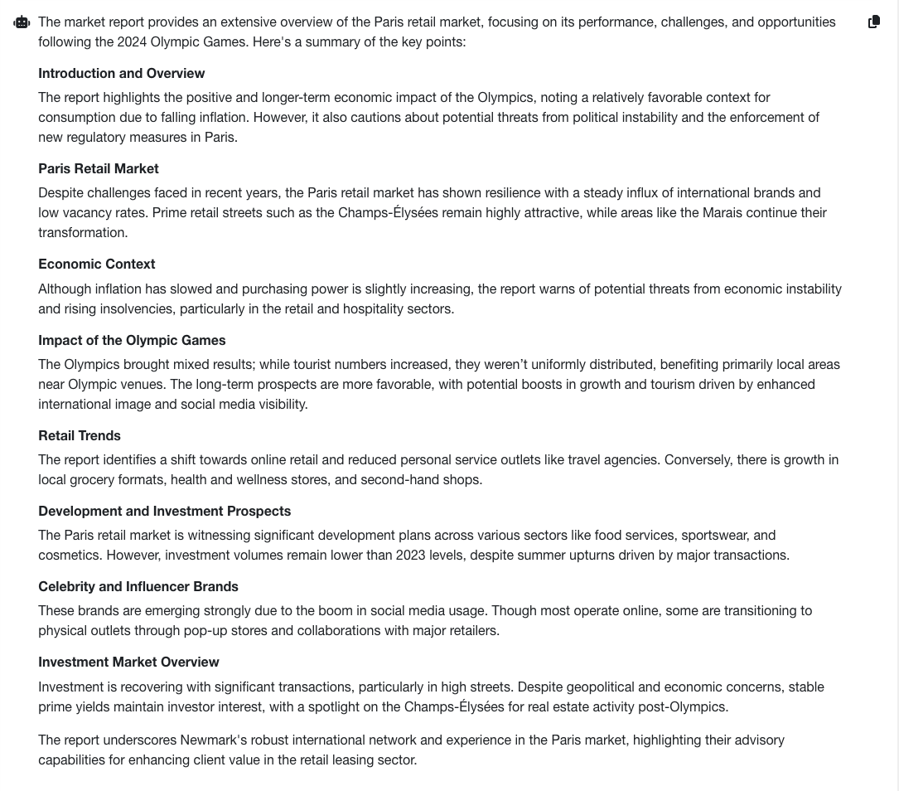
Summarize Reports or Lease Agreements
“You are a Corporate Real Estate Analyst. I'm going to paste in a market report. I want you to summarize it for me.
Here is the market report:” Use Adobe PDF to export to word, then copy the Text and paste entirely into your GPT model of choice.

Slide 29
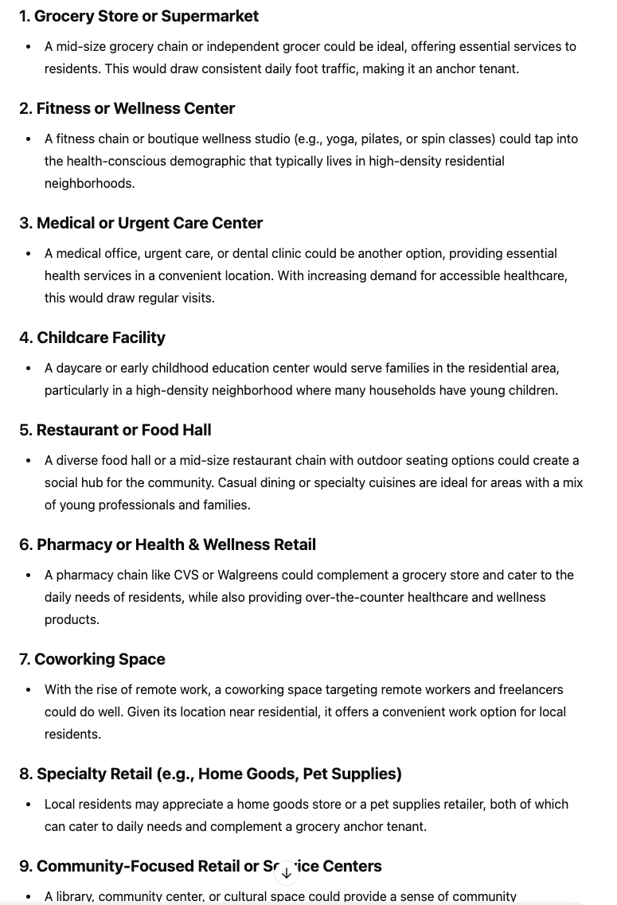
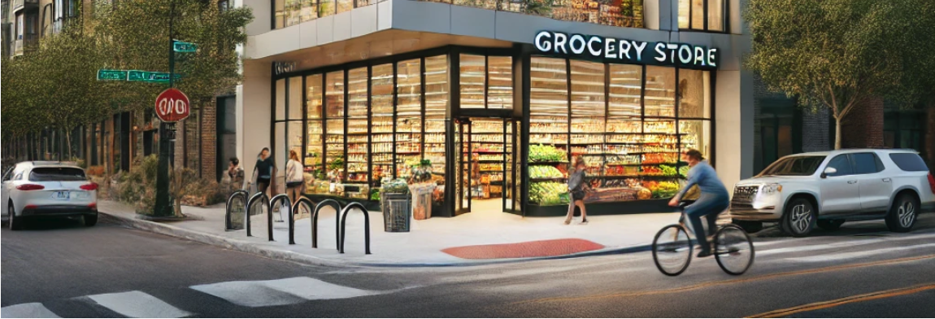
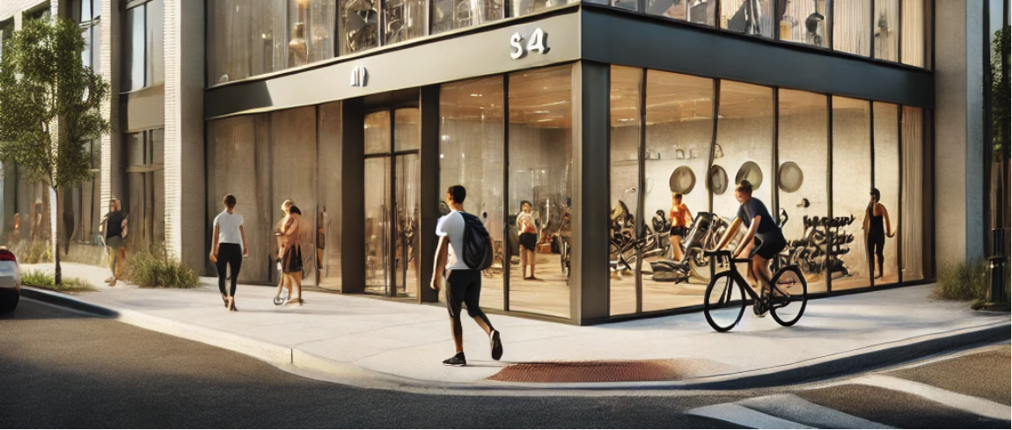
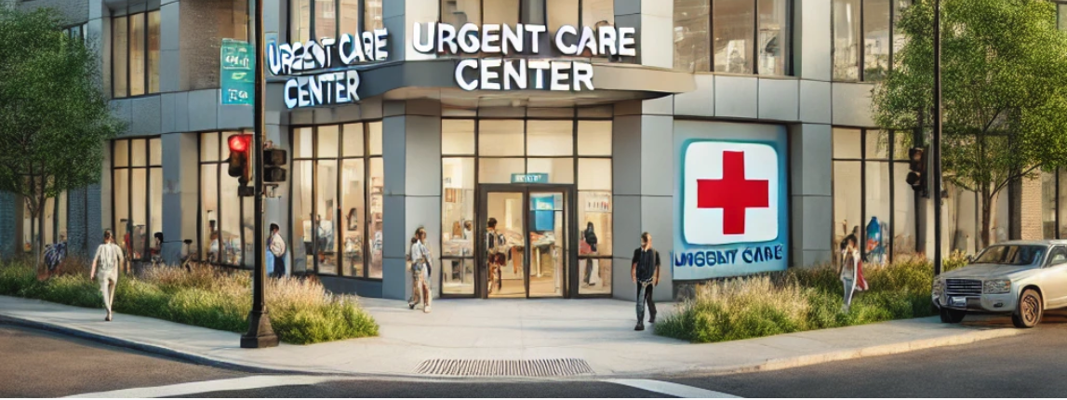
The Right Fit - Justified Suggestions
“As a Corporate Real Estate Broker in Retail. What ideal tenants would you recommend for a 34,000 SF space on the intersection of Ashland and Pershing in Chicago, IL. This space is new and near high density residential.”

Slide 30
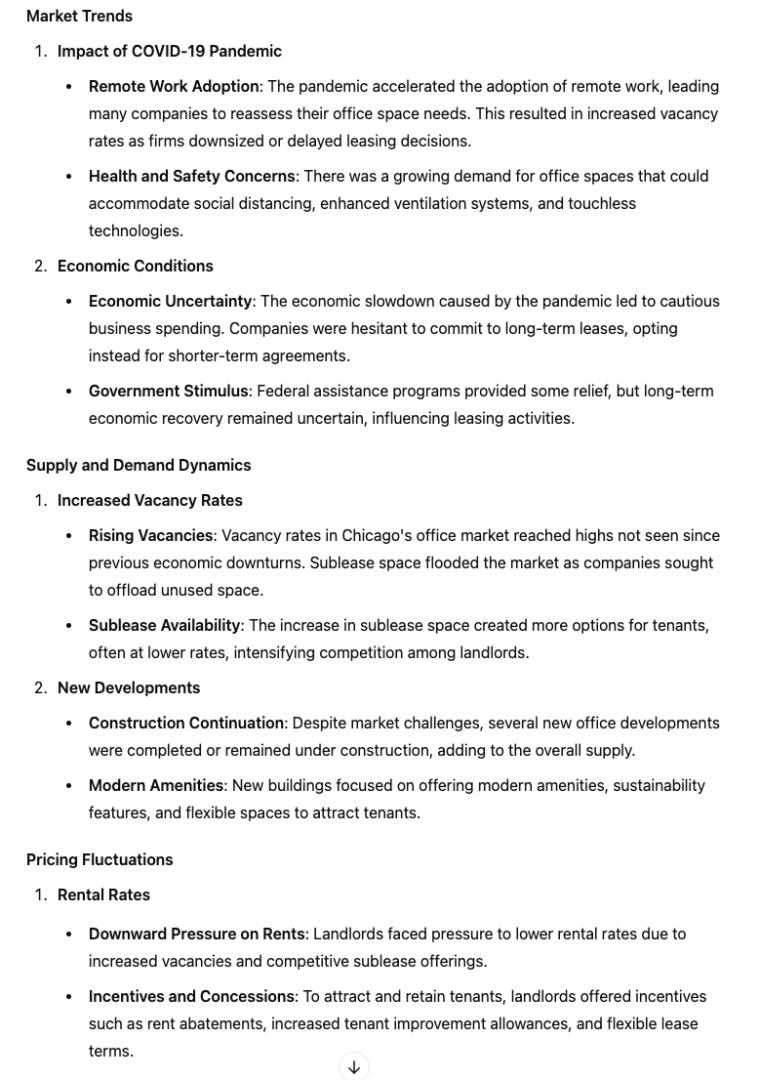
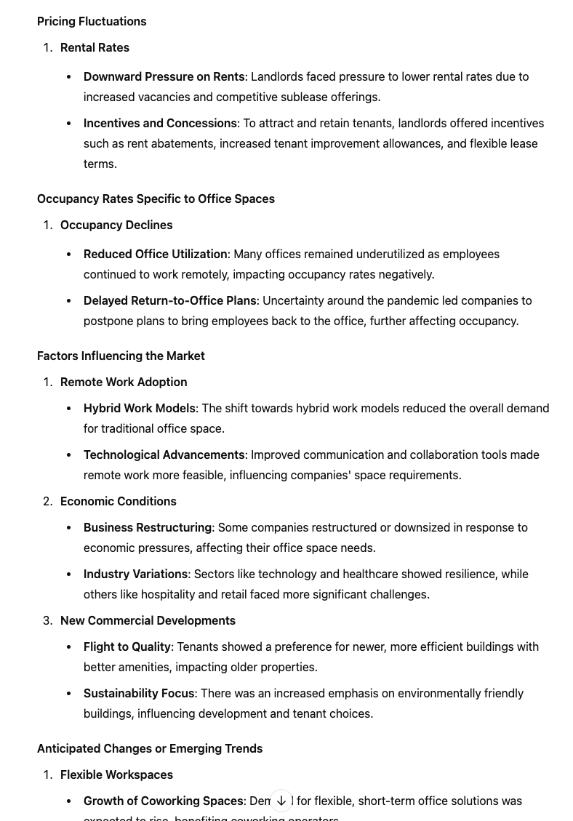
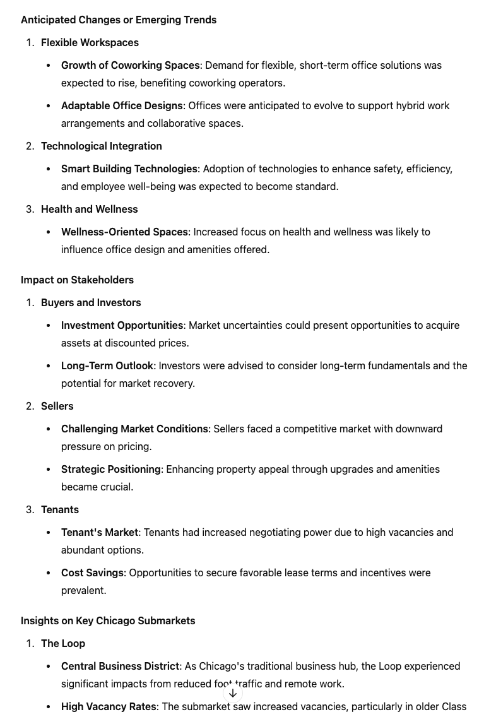
Draft a Prompt - Elevate the Prompt with GPT - Reiterate - Create
“Provide a comprehensive analysis of the current office leasing market in Chicago. Focus on market trends, supply and demand dynamics, pricing fluctuations, and occupancy rates specific to office spaces. Discuss factors such as remote work adoption, economic conditions, and new commercial developments that influence the market. Highlight anticipated changes or emerging trends that may impact buyers, sellers, investors, and tenants. Include insights on key Chicago submarkets like the Loop, River North, and West Loop.”

Slide 31
Additional Use cases:
Holistic Budget Setting
Multiple Factor Ranking Importance of Clients
Speaker Preparation
What is the average cost of a month long trip to Xi’an China from USA Chicago Illinois flying economy.
Show your work.
I am going to give you a list of companies. I want you to order them by two combined factors. Net worth & Importance to [field of work]
Act as a professional consultant on time management, specializing in the Eisenhower Matrix.

Slide 32
Complex - Multifactored Budgeting

Slide 33
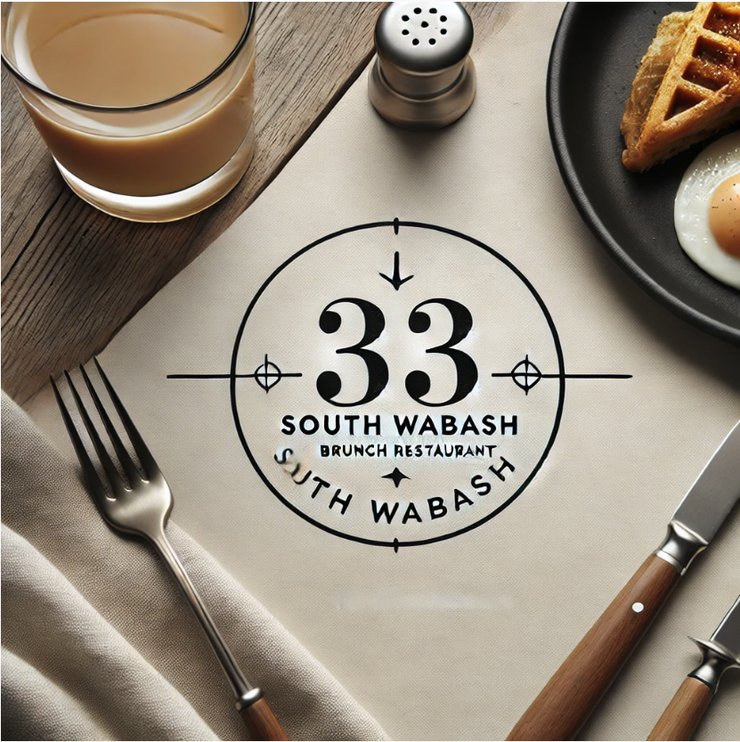
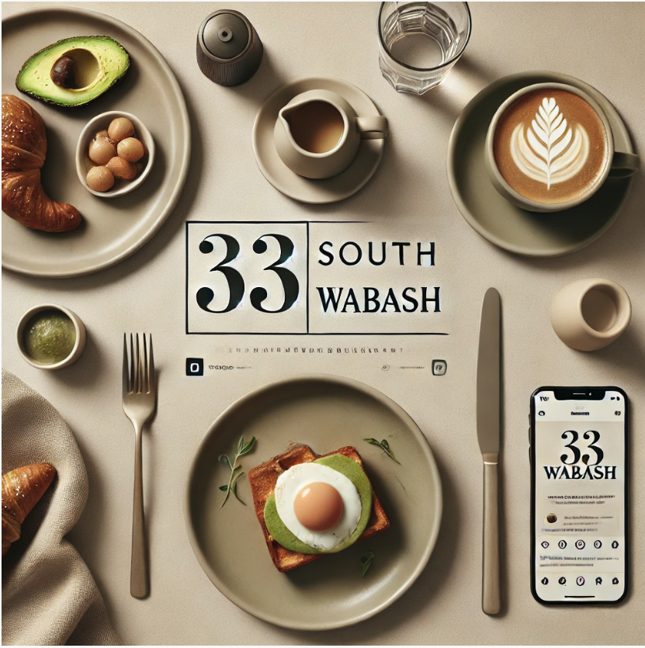
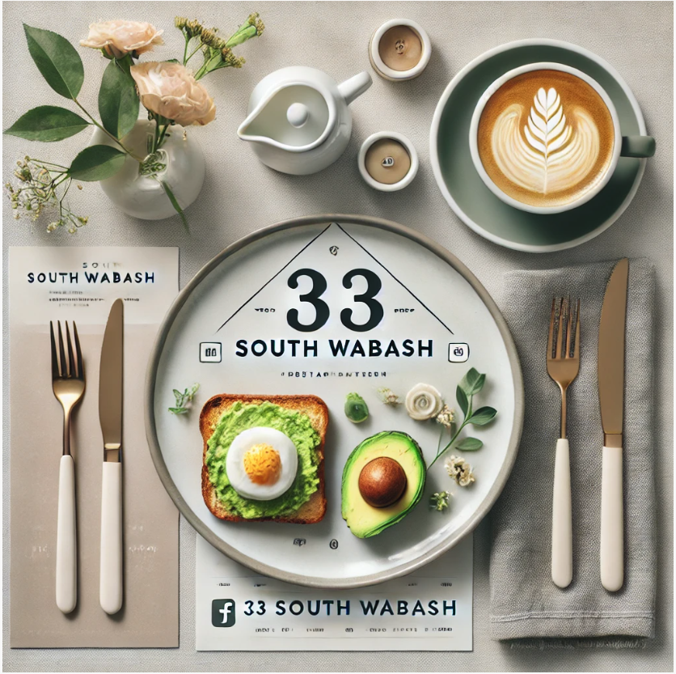
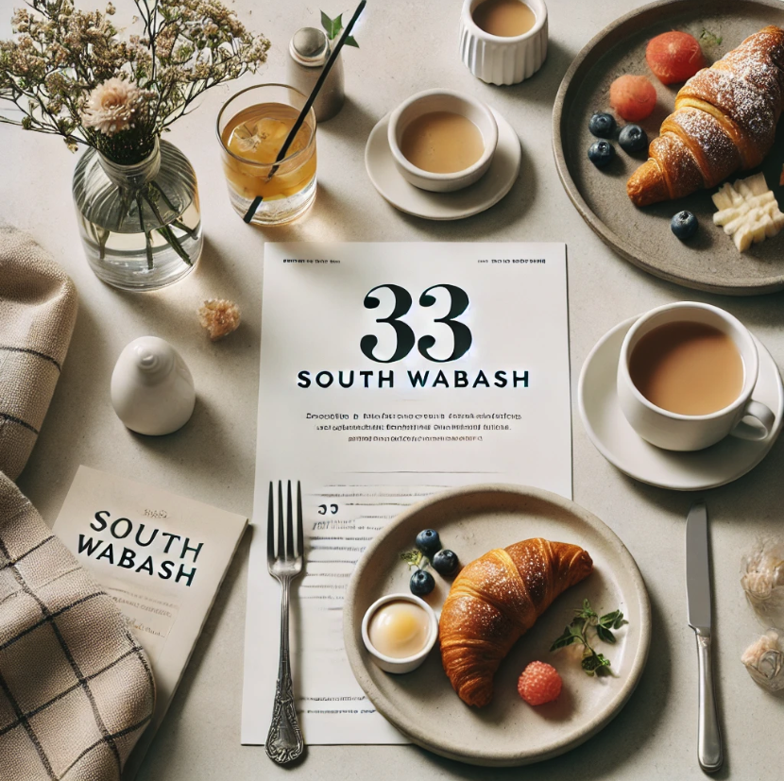
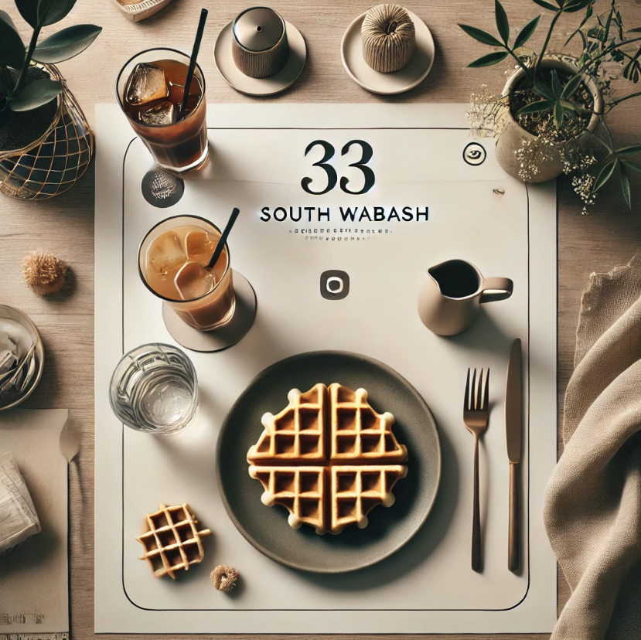
Building/Address Logos
Create a logo "33 South Wabash". This should be a minimalist logo for a bunch restaurant, instagram worthy setting, clean and minimalist, focus on the logo quality

Slide 34
Use cases [GPTs]:
Minutes Generator
Office Standards Guide
Project’s Spec Guide
Generates meeting minutes from a text transcript following a provided outline.
This GPT can provide answers to questions related to various company policies, based on office-specific standards.
A specifications expert capable of providing detailed references and analysis for submittal-related inquiries

Slide 35
Use cases:
Audience?

Slide 36
Play.
04
Methods for integrating ChatGPT into daily workflows

Slide 37
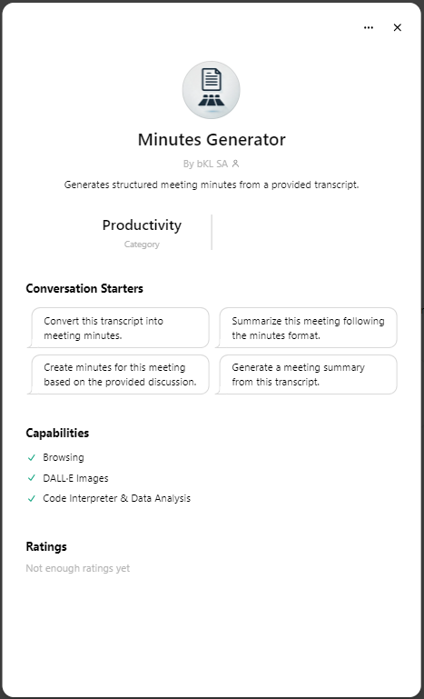
Minutes Generator.
Generates meeting minutes from a text transcript following a provided outline.

Slide 39
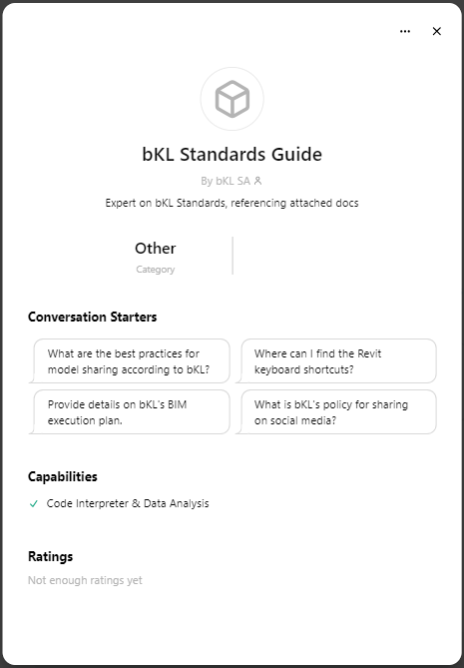
Office Standards Guide
This GPT can provide answers to questions related to various company policies, based on office-specific standards.

Slide 41
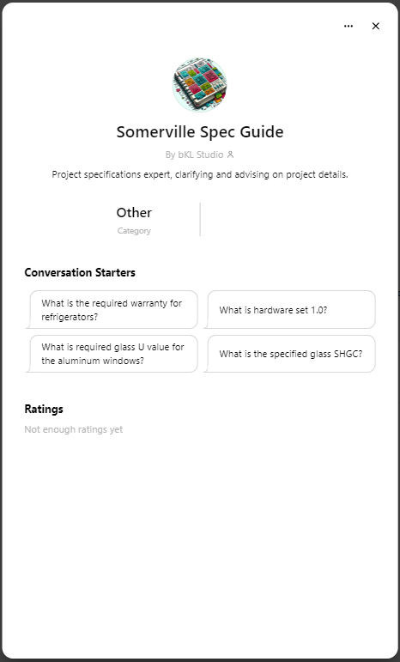
Project’s Spec Guide
A specifications expert capable of providing detailed references and analysis for submittal-related inquiries.

Slide 43
Thank you!
Do you have any questions?
Jarod Spohrer <jarod.spohrer@nmrk.com>
Sonja Flint <sflint@bklarch.com>
Credits.
Presentation Template: SlidesMania
Fonts used in this presentation: Antic Slab & Calistoga.

