Slide 1

Building Your Presence with PR
Presented by Winger Marketing

Slide 2
agenda
What is PR?
Goals of PR
Understanding what’s newsworthy
Building a proactive PR strategy
Benefiting from owned and earned media
Developing a PR tool kit and measuring results
Media Coaching & Training / Copyright © 2020 Winger Marketing / 2
Notes:
In the PR 101 section we will discuss the definition of PR, goals and benefits of PR, measuring PR and close by answering any questions you may have.
So, what is PR? When you hear the word public relations, what do you think of? (Answer in workbook)

Slide 3
“
Publicity is absolutely critical.
A good PR story is inﬁnitely more effective than a front-page ad.
– Richard Branson
Notes:
Effective PR comes from a deep understanding and mastery of the issues around the industry and business you represent and the ability to express those powerfully and honestly.
And that, like good journalism, takes time.

Slide 4
Empowering PR Tips You’ll Learn
Must-know basics of public relations – including goals and benefits
Understanding what’s newsworthy
Building a proactive PR strategy
Benefiting from owned and earned media
Developing a PR tool kit
Media Coaching & Training / Copyright © 2020 Winger Marketing / 4
Notes:
In the PR 101 section we will discuss the definition of PR, goals and benefits of PR, measuring PR and close by answering any questions you may have.
So, what is PR? When you hear the word public relations, what do you think of? (Answer in workbook)

Slide 5
What is PR?
Goals of PR
PR Tool Kit
Quick Tips
Summary / Q&A

Slide 6
WHAT IS PR?
Elements of public relations
Earned Media - Opportunities for free placement in the media
The story is told from a journalist’s perspective
Placement occurs at the discretion of the news outlet
PR creates awareness for your brand
It doesn’t always happen on your timeline and requires patience
There are no guarantees & PR can be challenging to measure

Slide 7
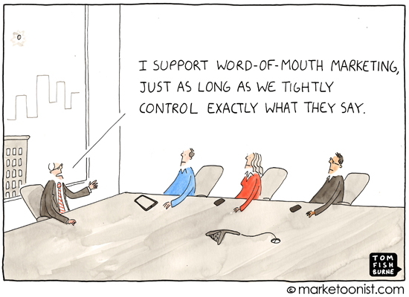
Media Coaching & Training / Copyright © 2020 Winger Marketing / 7

Slide 8
PR VS. ADVERTISING
 | PR | Advertising
Cost | Free for Earned Media | Paid
Control | Guidance, but no control | 100%
Consumer Perception | Unbiased | Biased
Focus | Reputation | Sales
Level of Creativity | The Hunt for News | Ad Campaign Development
Target Audience | The Public Through Media | The Public/Buyers
Notes:
Several people use the terms PR and advertising interchangeably, but they are two completely yet complimentary tools. We’ll go over some of the differences and then look at a case study with which we are all familiar – Toyota.
1.Earned (free media) vs paid space
PR: Free publicity for the company. From news conferences to press releases, you're focused on getting free media exposure for the company and its products/services.
Advertising: The company pays for ad space. You know exactly when that ad will air or be published.
2. Level of creative control
PR: You have no control over how the media presents your information, if they decide to use your info at all. They're not obligated to cover your event or publish your press release just because you sent something to them.
Advertising: Since you are paying for the space you have control over the content/creative.
3. Shelf life
PR: Your press release will most likely only run once in a publication.
Advertising: Your creative content can run in the same media outlet (i.e. magazine, website, etc.) for as long as your budget allows.
4. Consumer perception
Public Relations: When someone reads a third-party article written about your product or views coverage of your event on TV, they're seeing something you didn't pay for with ad dollars and are more likely to view your product or service as credible.
Advertising: Consumers on auto defense and know when they’re being sold a product or service
5. Level of creativity:
PR: Since PR is based on third-party endorsements and news, the focus is on finding a newsworthy angle with which to entice the media
Advertising: The most effective and notable ads are engaging and highly creative, so a lot of time is dedicated to coming up with campaigns that stand out.
6. Target audience: While both PR and advertising strive to reach the greater public audience, each uses a different vehicle. PR develops relationships with the media while advertisers strive to development direct relationships with the public.
7. Objective:
PR: PR communications are written with an emphasis on facts – a no-nonsense news format. Any blatant commercial messages in your communications will be disregarded by the media.
Advertising: Ads focus on obviously motivating a sale with language and images that scream “Buy me!” “Now!”
8. Measurement:
PR: While the PR measurement tools are constantly evolving, the most common measurement tool is evaluating coverage recaps, which detail clips, placement, quality of vehicle, etc.
Advertising: Advertising value can be measured with pre and post testing when consumers are asked about their perception of a product or service before and after being exposed to an ad.

Slide 9
PR as Thought leadership
A component of a Marketing/PR strategy
Thought Leadership – owned or but can be earned
Case study
Blog
Published article
Downloadable guide on your website for lead generation
White paper
Media Coaching & Training / Copyright © 2020 Winger Marketing / 9

Slide 10
What is PR?
Goals of PR
PR Tool Kit
Quick Tips
Summary / Q&A

Slide 11
PR GOALS
Attract attention / generate brand awareness
Stimulate involvement or influence thinking and perceptions
Generate positive and consistent word-of-mouth
Target a specific audience – what is your message?
Have you thought about how PR can help you meet your business goals?
If you had to focus on one message, what would it be right now?
?
Notes:
Taking your story to the next level first involves assessing your goals. For example, you may want more people to attend your event. You might think a splashy feature in your favorite national magazine would help meet that goal… But take a closer look at the way your audience makes decisions. This will help drive your public relations decisions. What’s your real media goal? Positive and consistent word-of-mouth? E-newsletters placements that can easily be forwarded to friends?
Have you really been thinking about how to meet your
goals? If you had to change one strategy, what would it
be?

Slide 12
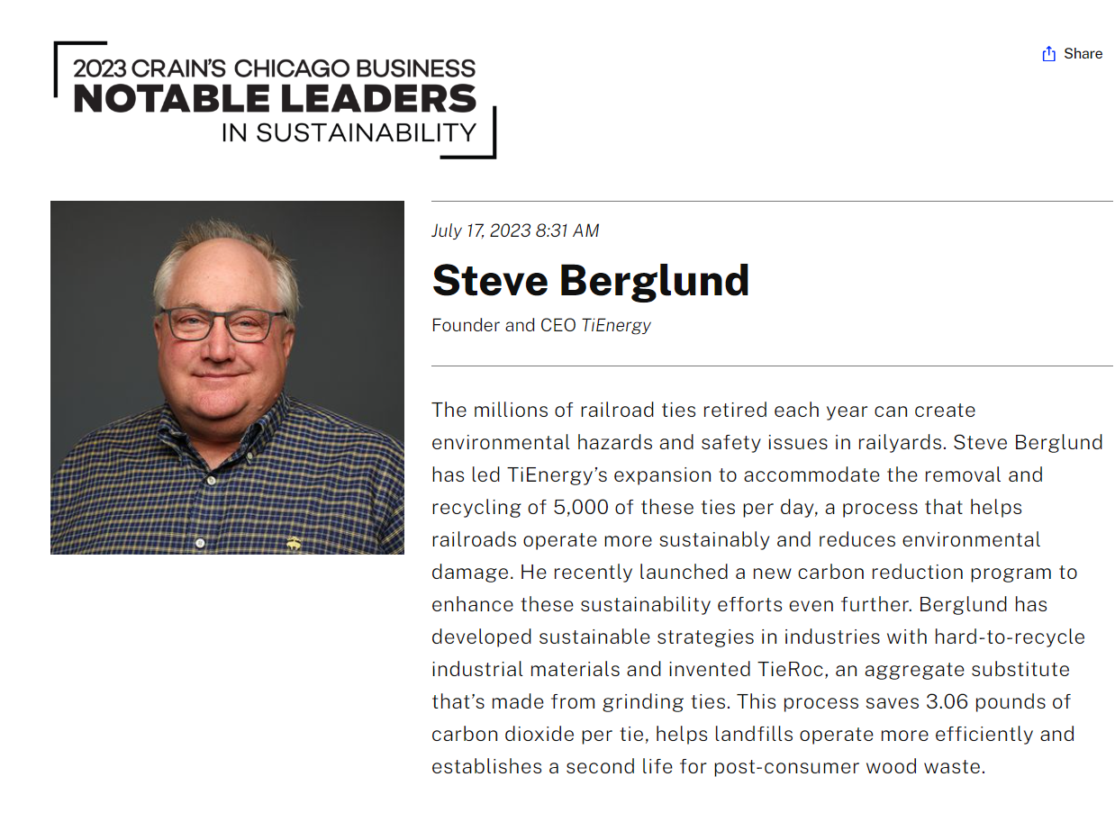
Example:
Midwest companies – sustainability award
Goal: Brand awareness, influence thinking and perceptions
What:
Award Opportunity
Leadership positioning
Why:
Highlight a differentiator
Win an award for sustainability
Third-party credibility
News to communicate
  Press Release
  Email
  LinkedIn Post
  Blog Post

Slide 13

Example:
Midwest companies – sustainability award
Goal: Brand awareness, influence thinking and perceptions
Outcomes:
Featured in Crain’s Chicago Business (print and electronic) - Reach of 381k
99 media mentions from the press release we issued
Press release reach of 48 Million
201 views of the blog post on the website
Engagement at 3:41 minutes/sec
.

Slide 14
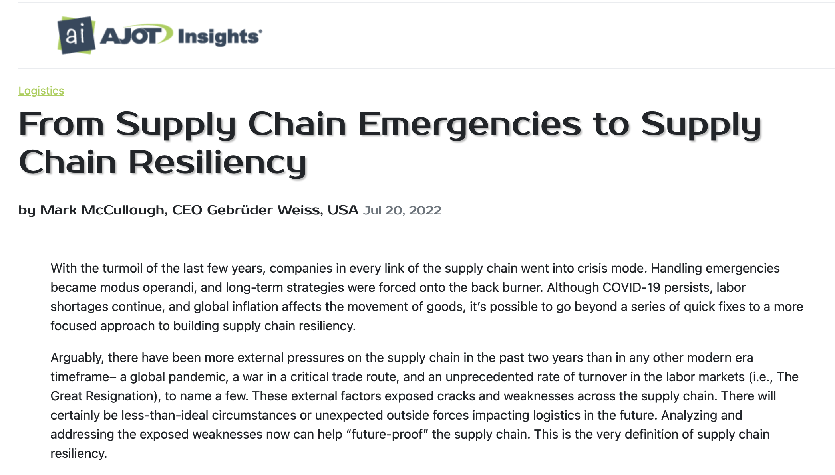
Example:
Gebrüder Weiss –media placement
Goal: Brand Awareness, Target Audience and Industry Leadership Positioning
What:
Create a “thought leadership” piece in a leading industry publication.
Why:
The journal is read by the company’s primary clients
Provides a favorable message during a challenging time.
Positions the CEO as a trustworthy expert
Enhances third-party credibility
Outcomes:
Exposure to 49.2K monthly visitors
Read by 10.1K subscribers
114 website visits from referral traffic

Slide 15
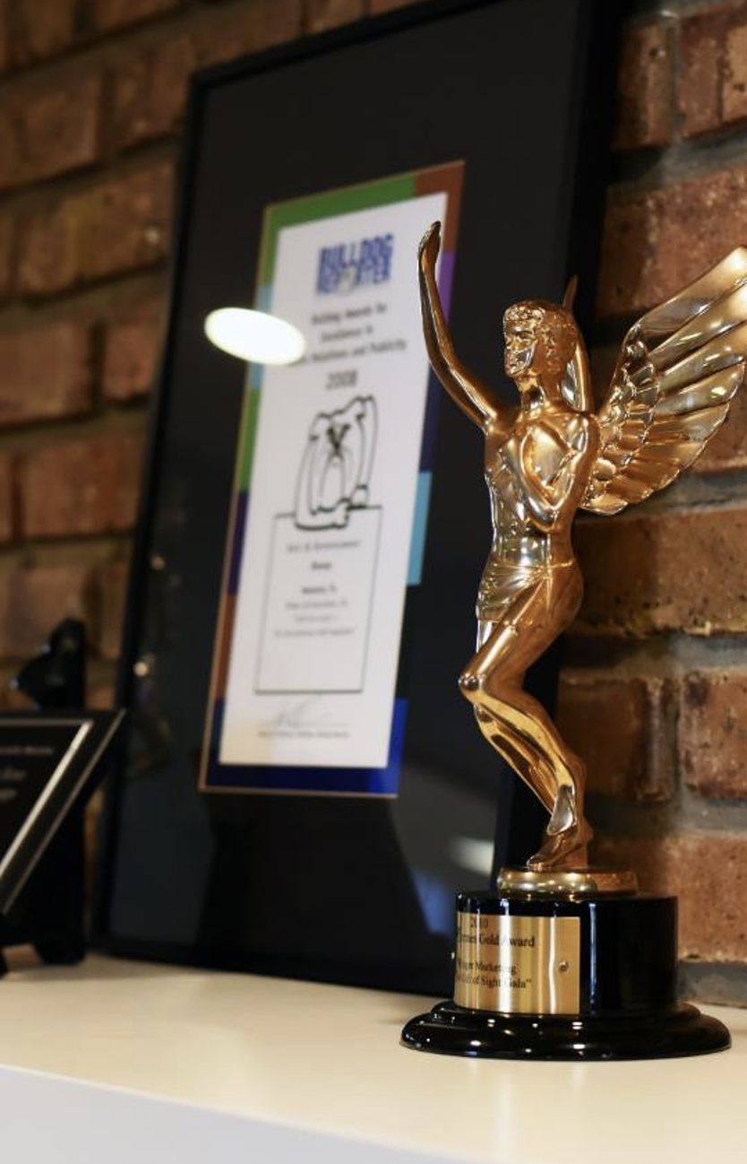

WHAT MAKES NEWS
New Products or Technology
New Offices, Locations and Leadership
Interesting Case Studies
Nominations, Certifications and Awards
Donations to Charities
Speaking at Events
Copyright © 2022 Winger Marketing / 15

Slide 16

WHAT ISN’T NEWS
An employee’s third anniversary
Adding a new entry-level or mid-level worker
Donating $150 to the local Girl Scout Troop
Your eighth year in business
Offering work from home
Repaving your parking lot
Copyright © 2020 Winger Marketing / 16

Slide 17
What is PR?
Goals of PR
PR Tool Kit
Quick Tips
Q&A

Slide 18
WHAT’S IN A TOOL KIT?
Contacts, sources, experts, and news hooks
Media Lists and Contact Information
Photography or Graphics
Your News/Pitch
Distribution Channels
Your Expert
Amplification
Notes:
Before you set out to write material for your tool kit, take time to think about where you will use it and how necessary this is for your business. Most large corporations need to have a press kit ready to send for press or investors, but small businesses don't often use a complete kit unless they have something major to announce. The kit will be hardcopy (in a folder), electronic (on your website), or both.
The latest press releases will give the media a few options on angles to take with a story.
The corporate fact sheet is a quick overview of the corporation and its place within its industry. You can include some key dates within the framework of a historical timeline
The bios highlight education/training, motivation, community involvement, awards/honors and current residence. It helps the reporter identify angles and facilitates more focused interview questions.
Any photos of executives, projects, etc. that will bring a story to life and entice the media and/or compliment a news angle
You should also include product or latest project information/sell sheets.

Slide 19














STEP 1: Create a media list
Media – trade/professional
Notes:
Sell sheets/product information

Slide 20








STEP 1: Create a media list
Media – National Consumer
Notes:
Sell sheets/product information

Slide 21











STEP 1: Create a media list
Media – Local Publications & Blogs
Notes:
Sell sheets/product information

Slide 22

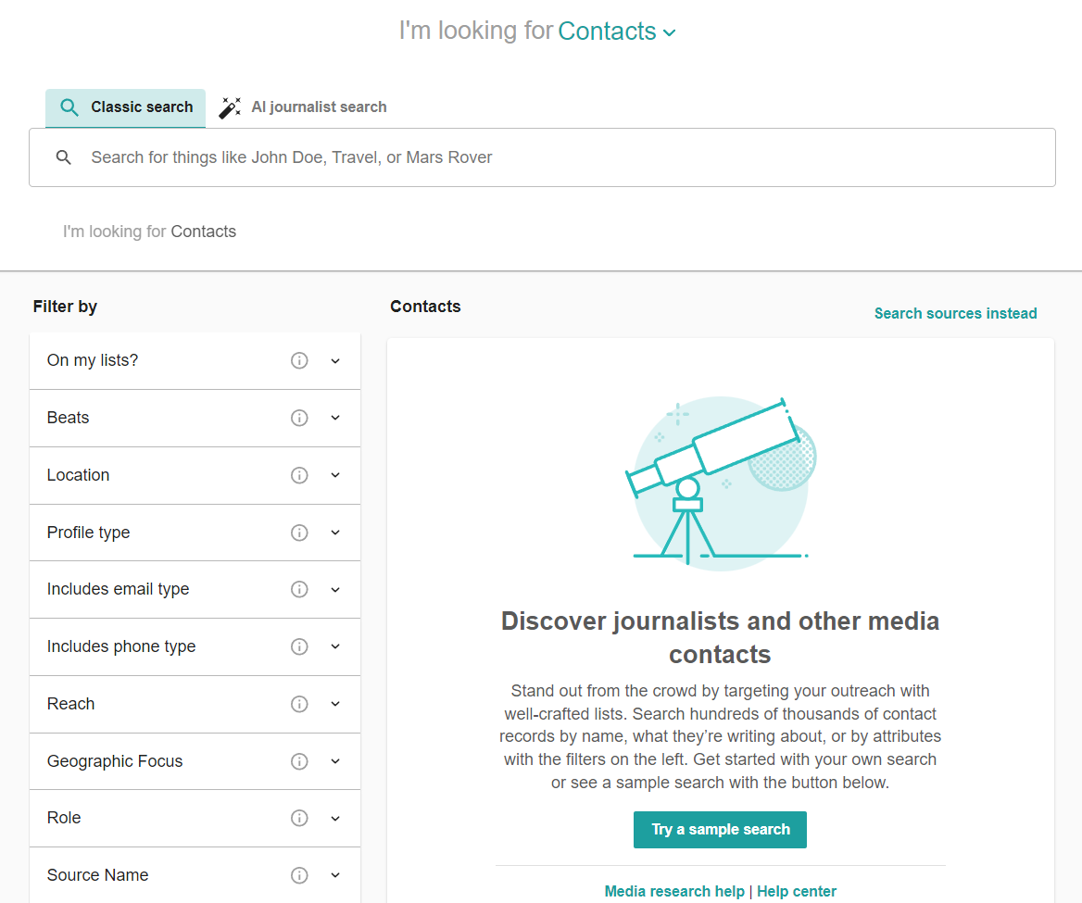
STEP 2: What’s my news? (Private organization)
MEDIA LISTS
HOW TO BUILD A MEDIA LIST:
  RESEARCH
  Determine Publication Names
  Research Editors and Reports
    Cover News in Your Geographic Area
    Write About Your Area of Business/Expertise
  Create Your Own Email/Phone List
  PAY FOR A SERVICE
  Meltwater
  MuckRack
  Cision
  WORK WITH AN AGENCY
Notes:
Sell sheets/product information

Slide 23

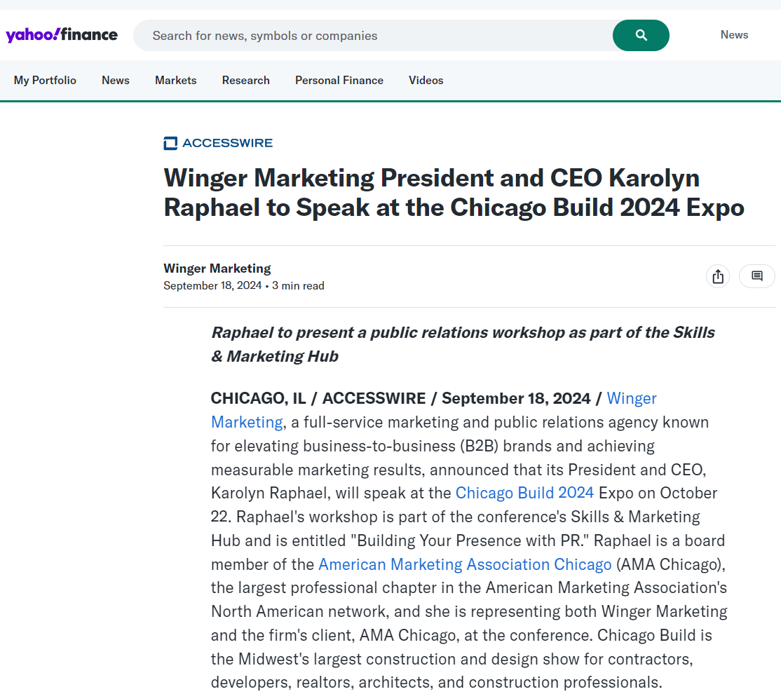
STEP 2: What’s my news? (Private organization)
NEWS RELEASE OR PITCH?
  PRESS RELEASE
  New Service
  New Leadership
  Awards
  Events
  PITCH
  A Case Study
  Unique employee engagement program
  A cool customer story or unusual project
Notes:
Sell sheets/product information

Slide 24







How should I distribute my news?

Slide 25
STEP 3: What’s The Pitch?
What is A Pitch?
Tips for writing a successful pitch:
A “pitch” to the media is the crux of your story.
Review the writer and submission guidelines
Keep it short
Start with the news – What’s your ideal headline?
Outline who, what, when, where
Follow-up
Notes:
Sell sheets/product information

Slide 26
STEP 4: Being prepared and helpful
INCREASE YOUR CHANCES OF PLACEMENT
here is what journalists and Influencers want
A pitch or press release that includes an image
Pre-packaged content is helpful
BUT
It must be a good photo AND good content
Photo resolution that is at least 300 dpi but under 1 MB
Include a photo credit and caption
Many influencers want $$
Notes:
Sell sheets/product information

Slide 27

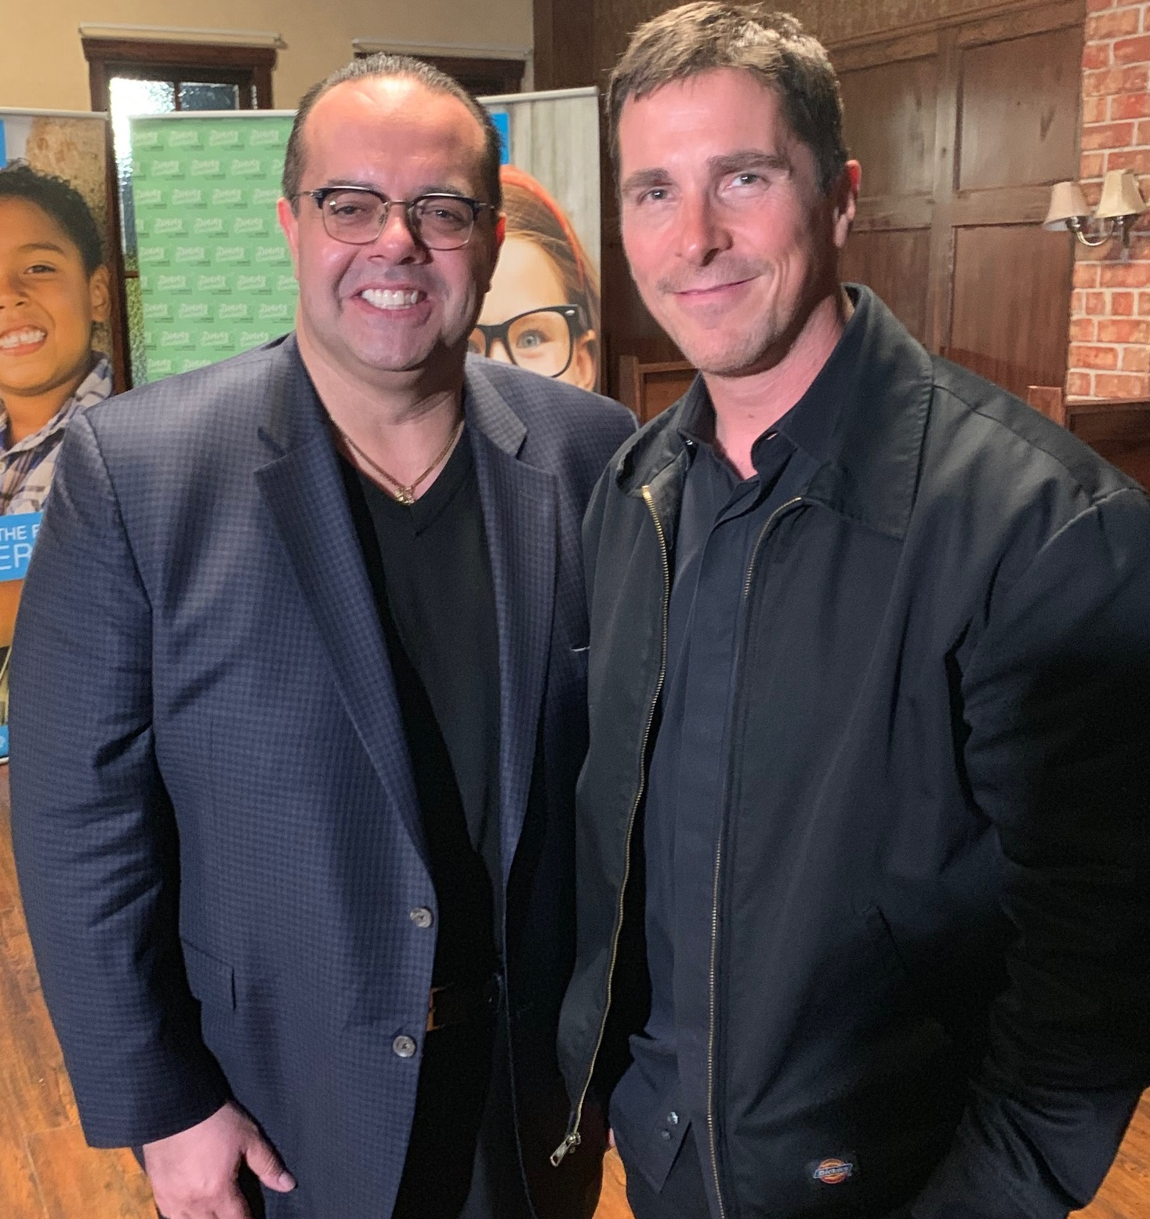
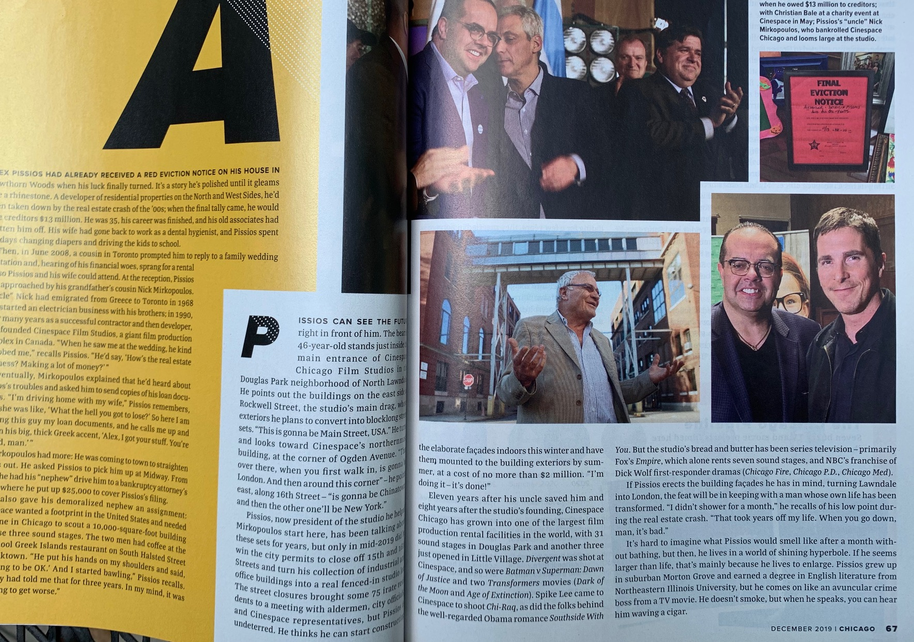
STEP 4: Being prepared and helpful
A SUCCESSFUL PITCH
Photo Credit: Karolyn Raphael
Photo Caption: President & CEO of Cinespace Chicago Film Studios Alex Pissios welcomes Academy Award winner Christian Bale to the Chicago Studios
Notes:
Sell sheets/product information

Slide 28
What is PR?
Goals of PR
PR Tool Kit
Quick Tips
Q&A

Slide 29
WHAT’S IN A PRESS KIT?
Press release
Sell sheets/product information
Fact sheet
Logo
Hi-res company logo
Historical timeline
Photography (include captions if applicable)
Executive bios
Boilerplate
Notes:
Before you set out to write material for your tool kit, take time to think about where you will use it and how necessary this is for your business. Most large corporations need to have a press kit ready to send for press or investors, but small businesses don't often use a complete kit unless they have something major to announce. The kit will be hardcopy (in a folder), electronic (on your website), or both.
The latest press releases will give the media a few options on angles to take with a story.
The corporate fact sheet is a quick overview of the corporation and its place within its industry. You can include some key dates within the framework of a historical timeline
The bios highlight education/training, motivation, community involvement, awards/honors and current residence. It helps the reporter identify angles and facilitates more focused interview questions.
Any photos of executives, projects, etc. that will bring a story to life and entice the media and/or compliment a news angle
You should also include product or latest project information/sell sheets.

Slide 30

STEP 2: write a press release
PRESS RELEASE STRUCTURE
Anatomy of a standard press release:
Headline: News sounding in all caps
Subhead: Witty in caps and lowercase
Notes:
Contact info in top corner
Keep subheading to one line when possible
Links to more details (if applicable)
Include company social media accounts (if applicable)
Try to limit release to one page when possible
5 W’s:
Explicit
WHO are you?
WHAT do you do?
WHEN is it? (if time sensitive)
WHERE is it? (events/locations)
Implicit
WHY – Why should your audience care about your news? YOU are only 1 in 1000 releases!

Slide 31
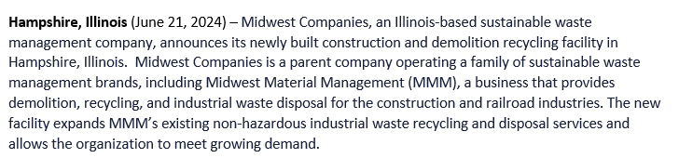
STEP 2: write a press release
PRESS RELEASE STRUCTURE
Anatomy of a standard press release:
Dateline: City and Date
First paragraph: who, what, when and where
Notes:
Contact info in top corner
Keep subheading to one line when possible
Links to more details (if applicable)
Include company social media accounts (if applicable)
Try to limit release to one page when possible
5 W’s:
Explicit
WHO are you?
WHAT do you do?
WHEN is it? (if time sensitive)
WHERE is it? (events/locations)
Implicit
WHY – Why should your audience care about your news? YOU are only 1 in 1000 releases!

Slide 32
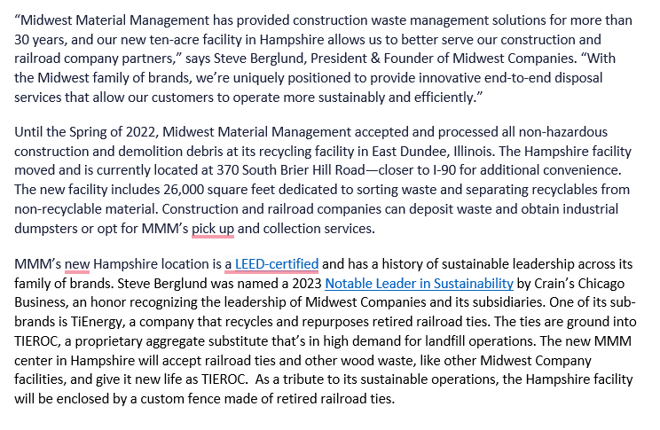
STEP 2: write a press release
PRESS RELEASE STRUCTURE
Anatomy of a standard press release:
Second paragraph: Relevant information on business/news (Why)
Third paragraph: Quote from authority
Subsequent paragraph: less relevant information
Notes:
Contact info in top corner
Keep subheading to one line when possible
Links to more details (if applicable)
Include company social media accounts (if applicable)
Try to limit release to one page when possible
5 W’s:
Explicit
WHO are you?
WHAT do you do?
WHEN is it? (if time sensitive)
WHERE is it? (events/locations)
Implicit
WHY – Why should your audience care about your news? YOU are only 1 in 1000 releases!

Slide 33
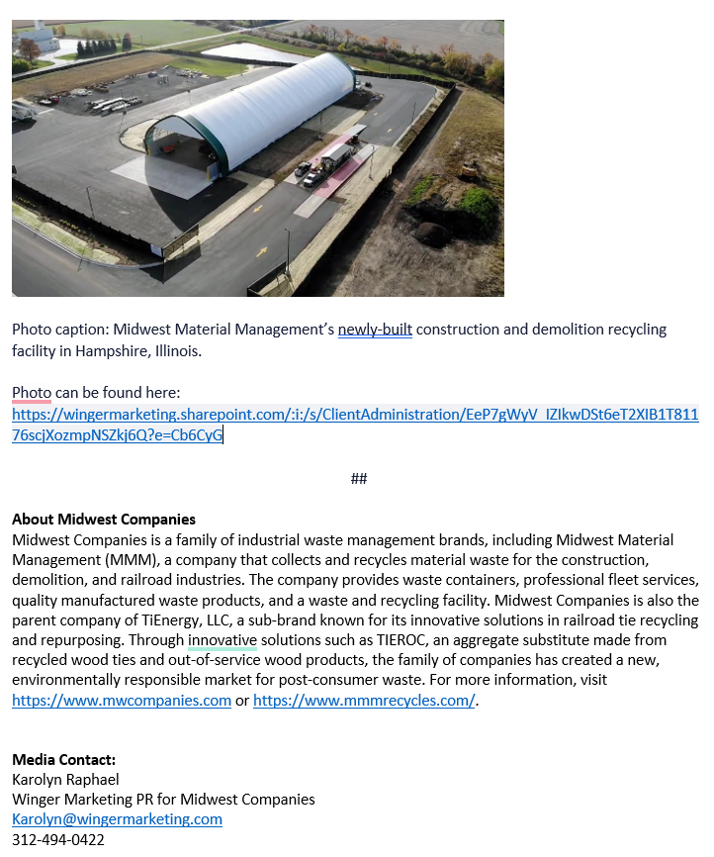
STEP 2: write a press release
PRESS RELEASE STRUCTURE
Anatomy of a standard press release:
Photo and Caption: Link to a high-resolution file
Last paragraph: boilerplate
Contact
Notes:
Contact info in top corner
Keep subheading to one line when possible
Links to more details (if applicable)
Include company social media accounts (if applicable)
Try to limit release to one page when possible
5 W’s:
Explicit
WHO are you?
WHAT do you do?
WHEN is it? (if time sensitive)
WHERE is it? (events/locations)
Implicit
WHY – Why should your audience care about your news? YOU are only 1 in 1000 releases!

Slide 34









STEP 2: write a press release
FREE PR OPPORTUNITIES
Notes:
Contact info in top corner
Keep subheading to one line when possible
Links to more details (if applicable)
Include company social media accounts (if applicable)
Try to limit release to one page when possible
5 W’s:
Explicit
WHO are you?
WHAT do you do?
WHEN is it? (if time sensitive)
WHERE is it? (events/locations)
Implicit
WHY – Why should your audience care about your news? YOU are only 1 in 1000 releases!

Slide 35
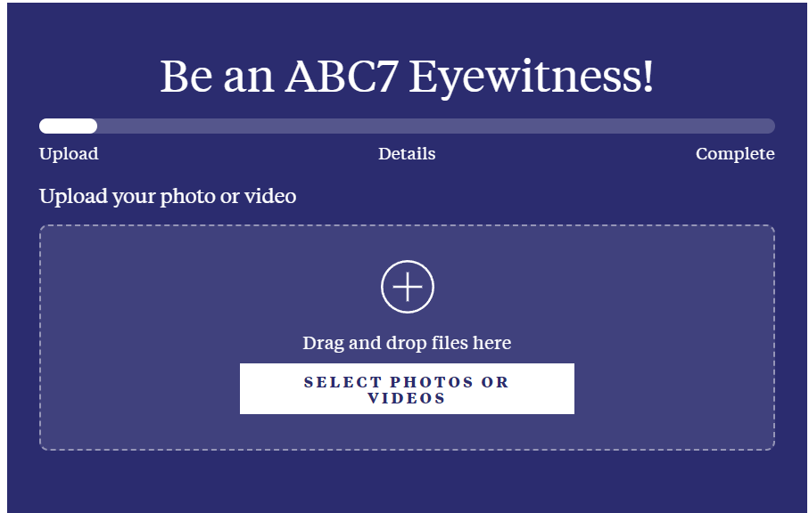
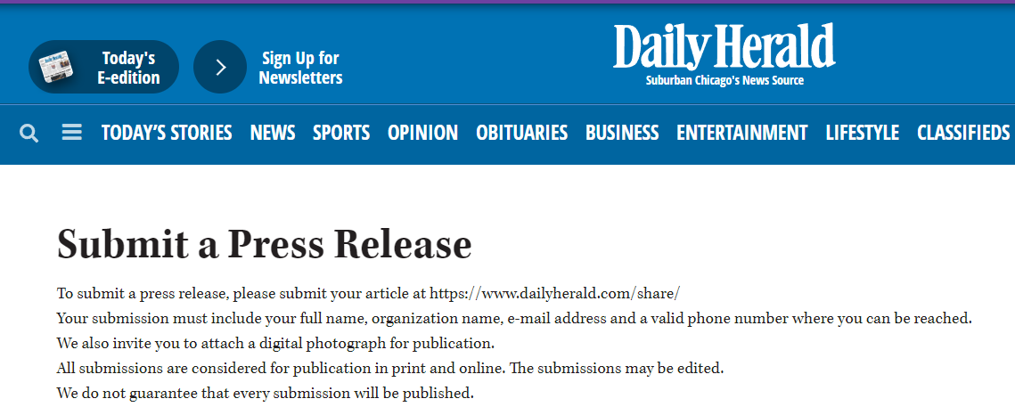


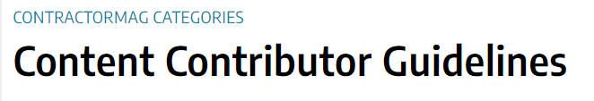
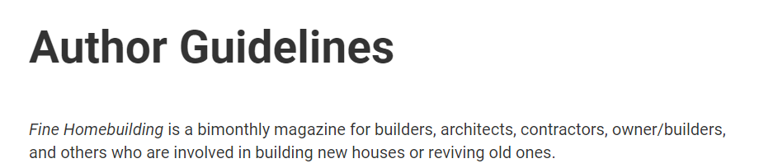
STEP 2: write a press release
FREE PR OPPORTUNITIES
Notes:
Contact info in top corner
Keep subheading to one line when possible
Links to more details (if applicable)
Include company social media accounts (if applicable)
Try to limit release to one page when possible
5 W’s:
Explicit
WHO are you?
WHAT do you do?
WHEN is it? (if time sensitive)
WHERE is it? (events/locations)
Implicit
WHY – Why should your audience care about your news? YOU are only 1 in 1000 releases!

Slide 36
Goals of PR
IN REVIEW
IN REVIEW
Increase
Increase Brand Awareness
Shape
Shape Public Perception
Build and Maintain
Build and Maintain Reputation
Foster
Foster Community Relationships
Generate
Generate Positive Media Coverage

Slide 37
Earned vs. Owned Media
- Earned Media: Free publicity generated by third parties such as journalists, bloggers, and customers.
- Owned Media: Content you create and control, like blogs, social media, and newsletters.
Both are essential for a comprehensive PR strategy.

Slide 38
What is PR?
Goals of PR
PR Tool Kit
Quick Tips
Q&A

