Slide 1
Digital Marketing: Key Areas of Focus & Impactful Strategies
v
October 2024

Slide 2
Brittney Fenimore
Digital Brand Manager & Senior Associate
MY PRIMARY FOCUS:
Brand communications, digital presence, and strategy.
Brand Standards
Website, social media, email, video, etc.
Campaigns
WHAT I DO:
Lead DLR Group's digital presence – website, social media, email – by setting our strategies, managing our content by working with our marketing leaders on their campaigns, and moving the needle on brand recognition.
TIME WITH DLR GROUP:
9 years

Slide 3
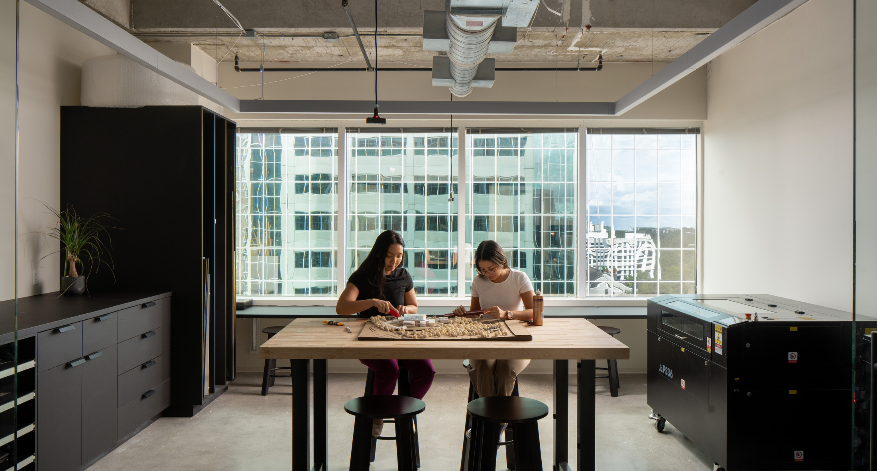
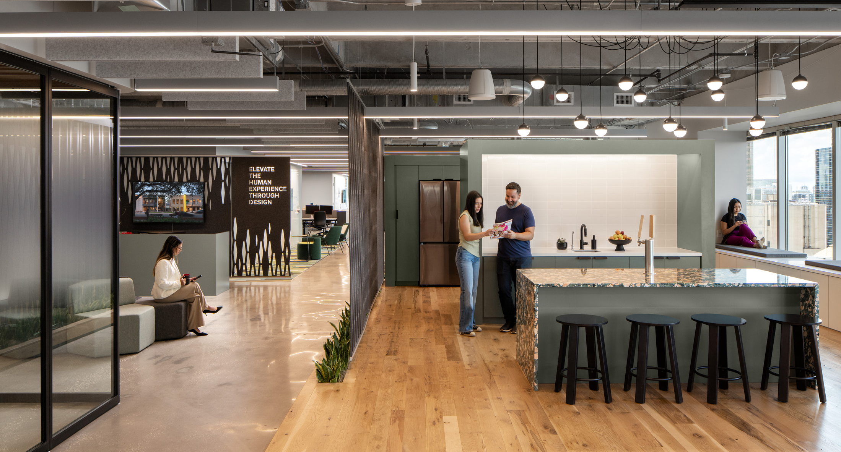
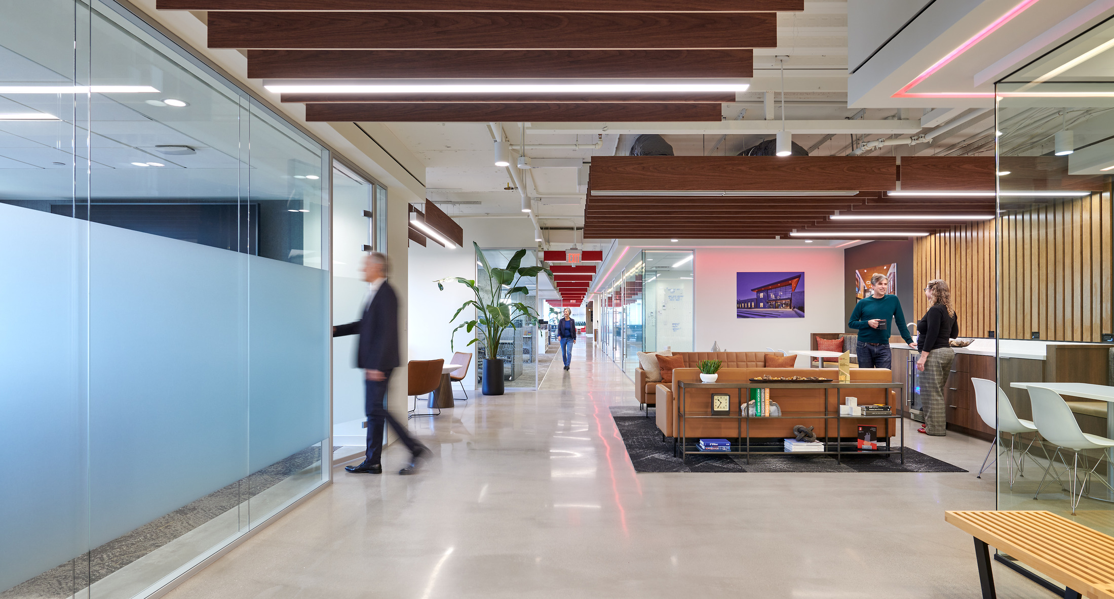
v
1600+ Employee-owners
33 Locations World-wide
1966 Year Established
Notes:
We are an integrated design firm offering architecture, engineering, interiors, planning, and much more.

Slide 4
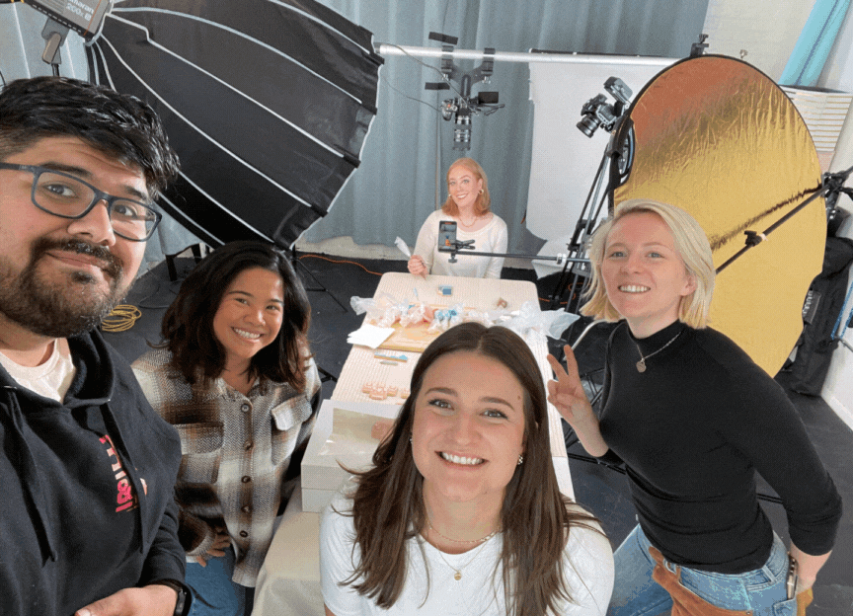
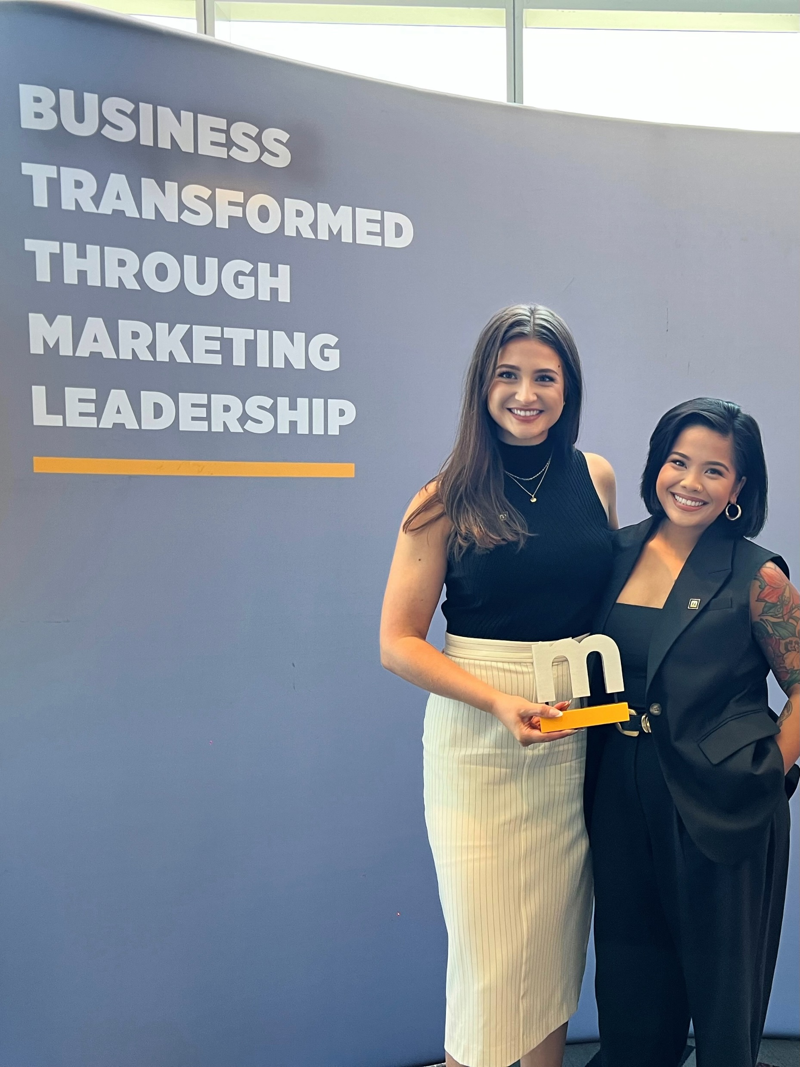
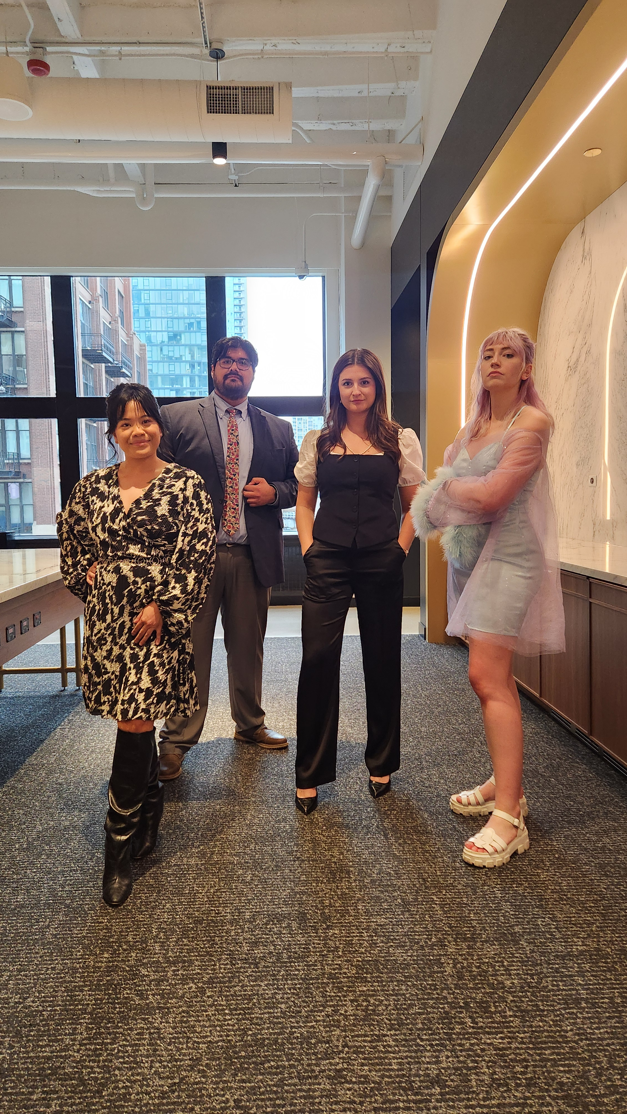
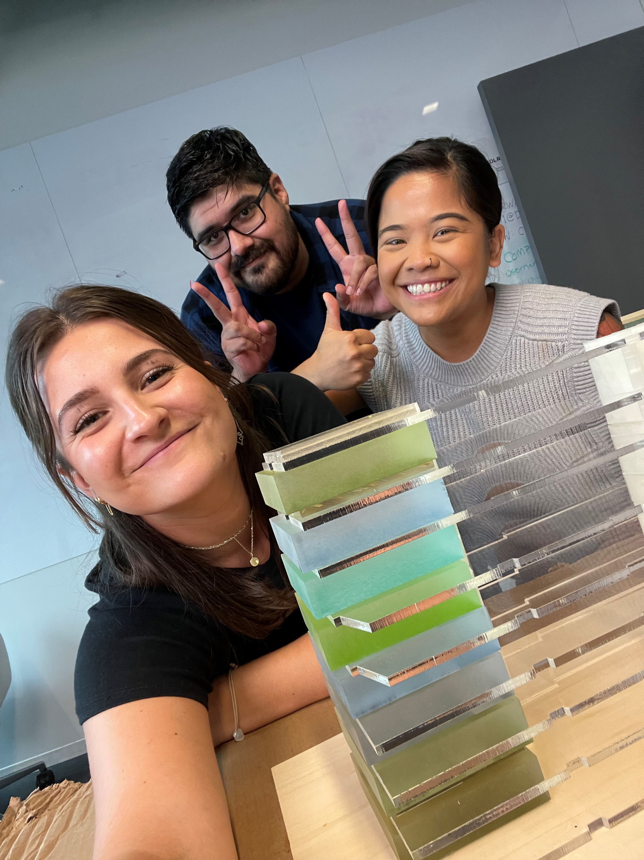
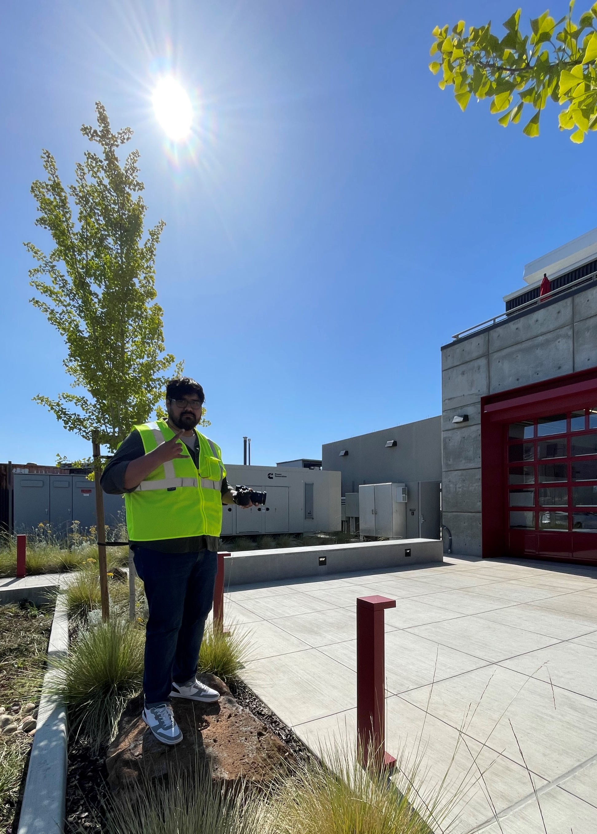
DLR Group’s Digital Team
We are a small but mighty team for this global firm.
Brand Communications Leader
Digital Brand Manager
Digital Specialist
Social Media Specialist
Videographer
Notes:
The reason I wanted to include this is for one reason: what I am sharing today is done by very small group of people. I know that digital teams are small. So, I hope what you hear today feels feasible. Because (next slide)

Slide 5
2024 vs. 2023
Attract
96%
37%
Social impressions
SEO impressions
159%
62%
47%
Social link clicks
Social engagements
Site new users
Engage
Convert
108%
Number of site contacts
Maintain
25%
1.5%
Social followers
Site repeat visitors
Notes:
Here is what we have been able to accomplish as a team using the strategies I will be sharing today.

Slide 6
Agenda
01
Assess & Refocus your KPIs
03
Growth Strategies
Organic
Paid
04
Iterative Approach
02
Digital Marketing Channels & Content
05
Q&A
Notes:
With the volume of content we will cover today, please know that this deck is also meant to be a takeaway. There is intentionally a lot of detail so that you can take this deck, review it, and apply it.
Assess & Refocus your KPIs:
Assess and refocus to match your why.
KPIs: we’ll go over the standard ones. Then, we’ll discuss ways to link it back to your why so you can re-focus them, if needed. Let’s not forget about ROI!
These are your key areas of focus.
Marketing Channels & Content:
Now that we have our benchmarks (KPIs), we can transition to where these show up across our digital channels.
Let’s go over some of your digital channel options and how they fit with your KPIs.
Growth Strategies:
Now that we’ve looked at our KPIs and our marketing channel options, we can focus on specific growth strategies:
Organic
Paid
Iterative Approach: now, how do you keep up?

Slide 7
Assess & Refocus Your KPIs
KPIs

Slide 8
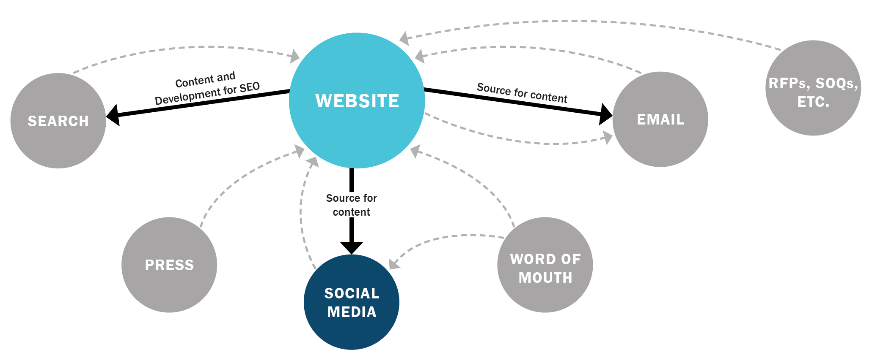
Inbound Marketing
ASSESS & REFOCUS YOUR KPIs
*A business methodology that attracts customers by creating valuable content and experiences tailored to them. While outbound marketing interrupts your audience with content, inbound marketing forms connections they’re looking for and solves problems they already have. [HubSpot]

Slide 9
Why Are We Different?
ASSESS & REFOCUS YOUR KPIs
KPIs for (1) inbound marketing and (2) the service industry are unique.
Conversion
ROI
Resources
Our industry has a high conversion threshold.
Think about the level of trust needed to “convert” your audience to work with your firm?
Difficult to track when there are no direct sales or conversions involved.
Do you know if your campaign fostered more trust from your digital audience? Is one direct message from a potential client a “good” ROI?
Every day, more and more tools require $$$. And assessing your competitors and tracking your KPIs manually takes hours.
Is manual tracking a “good use of our time”?
Considerations
Notes:
“Right Brittney, we know this.” But I say this simple reminder because it can be challenging to start honing strategies, present to leadership, assess performance, etc. when you have less finite metrics.

Slide 10
Recommended KPIs
ASSESS & REFOCUS YOUR KPIs
Objective | Attract | Engage | Convert | Maintain
Digital KPI | Digital reach (social reach + SEO impressions + press impressions) | Site unique visitors and visits Multimedia eng. % (VR, 3D, etc.) Social engagement rate Site engagement rate Newsletter open rate | Newsletter sign-ups Contact rate (site) Job application rate (site) # of press coverage articles | Social followers Newsletter list size Repeat visit %
Signal Metrics | Site unique visitors Site page views Social follower growth SEO first page rankings | Bounce rate Visits with site multimedia engagements (video, galleries, VR Toggle, 3D Storyscape, 360 Map) Newsletter clicks and CTO rate Site repeat visitors PV/V | Visits to the Contact Us page Visits to Career page # of contacts with journalists | Organic social reach Social shares Newsletter click rate
Dimensions | Social reach by network | Traffic by source Traffic by device type Traffic by content type/site section Social engagement by network Social engagement by post type | Traffic by source Traffic by device type | Social followers by network
Data Source | Google Analytics Social platform analytics Google Search Console PR tool | Google Analytics Social platform analytics Newsletter tool | Google Analytics Social platform analytics PR tool | Social platform analytics Newsletter tool

Slide 11
Recommended KPIs - FOCUS
ASSESS & REFOCUS YOUR KPIs
Objective | Attract | Engage | Convert | Maintain
Digital KPI | Digital reach (social reach + SEO impressions + press impressions) | Site unique visitors and visits Multimedia eng. % (VR, 3D, etc.) Social engagement rate Site engagement rate Newsletter open rate | Newsletter sign-ups Contact rate (site) Job application rate (site) # of press coverage articles | Social followers Newsletter list size Repeat visit %
Signal Metrics | Site unique visitors Site page views Social follower growth SEO first page rankings | Bounce rate Visits with site multimedia engagements (video, galleries, VR Toggle, 3D Storyscape, 360 Map) Newsletter clicks and CTO rate Site repeat visitors PV/V | Visits to the Contact Us page Visits to Career page # of contacts with journalists | Organic social reach Social shares Newsletter click rate
Dimensions | Social reach by network | Traffic by source Traffic by device type Traffic by content type/site section Social engagement by network Social engagement by post type | Traffic by source Traffic by device type | Social followers by network
Data Source | Google Analytics Social platform analytics Google Search Console PR tool | Google Analytics Social platform analytics Newsletter tool | Google Analytics Social platform analytics PR tool | Social platform analytics Newsletter tool
Notes:
REMINDER: this has taken us years to figure out / to hone in on. It feels like a lot but this is a process that happens overtime.
So, no matter where you are in your process, I hope you don’t feel too overwhelmed because it does just take time.

Slide 12
Marketing Funnel
ASSESS & REFOCUS YOUR KPIs
KEY PERFORMANCE INDICATORS
Digital reach
Site unique visitors
Attract
Site engagement rate
Social engagement rate
Social engagement by post type
Engage
Newsletter sign-ups
Contact rate (site)
Number of press coverage articles
Convert
Social followers
Repeat site percentage
Newsletter click rate
Maintain
Notes:
What is a marketing funnel?

Slide 13
Digital Marketing Channels & Content

Slide 14
Marketing
Channels

Slide 15
Podcasts
Video Marketing
Email Marketing
SEO
Geofencing
Search Engine Marketing
Marketing Channels
Retargeting
Content Marketing
Social Media
Website
Influencer Marketing
Blogs
Public Relations
Events
Notes:
Now that we have our benchmarks (KPIs), we can transition to where these show up across our marketing channels. Here’s a pretty inclusive look at ALL marketing channels (including non-digital ones)

Slide 16
Podcasts
Video Marketing
Email Marketing
SEO
Geofencing
Digital
Search Engine Marketing
Marketing Channels
Retargeting
Content Marketing
Social Media
Website
Influencer Marketing
Blogs
Public Relations
Events
Notes:
Here are the digital marketing channels we are going to focus on for today.

Slide 17
Assessment
DIGITAL MARKETING CHANNELS
Learn about where your audience and why they are there
Ask for feedback
Define your business assets, marketing assets, budget, and goals.
What are the best ways for you to reach and build trust with your audience?
Overlay a Competitor
(& Aspirational) Set Analysis.
Define Your Business Goals
Define Your Audience
1
2
Choosing Your Digital Marketing Channels
5
3
Adapt
Test Channels
Pull back to do more: where are you seeing the most results? Focus there.
SEO & Content
Paid Ads
Social Media Organic Campaigns
Email Marketing
4
Analyze
Gather more feedback
Refine your campaigns
Analyze the ROI on each channel
Notes:
Choosing what works for your firm requires a bit of work. Here is a process for determining which digital channels are worth your time.

Slide 18
Assessment
DIGITAL MARKETING CHANNELS
This is a continual process:
Define Your Business Goals
Define Your Audience
Choosing Your Digital Marketing Channels
Adapt
Test Channels
Analyze

Slide 19
Two Critical Channels:
Website & Social Media
What does an audit + action process look like?

Slide 20
Exercise
ASSESS & REFOCUS YOUR KPIs
Website
Open a page on your website.
What is the number one thing you want your user to do?
How do you want them to do it?
ASK YOURSELF:
THEN ASK:
What is the first thing you see?
What information do you get BEFORE you start scrolling?
Notes:
Here is an example of assessing your KPIs and taking an action to improve them.

Slide 21
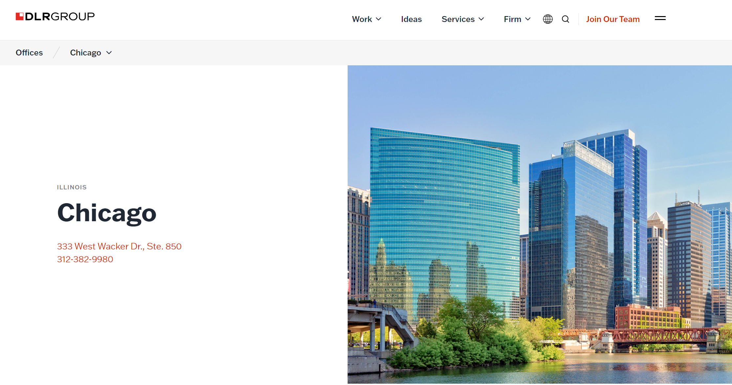
Website Example 1
ASSESS & REFOCUS YOUR KPIs
PAGE Your Chicago office page has your highlighted work at the top and contact information at the bottom.
BEHAVIOR User lands on the page, scrolls halfway down, stops, clicks into the mega-nav, goes to “Contact Us,” and then without submitting a contact to the general form, they exit.
TAKEAWAY One interpretation is that your audience is looking for specific Chicago office contact information.
With short attention spans, if that info. is not immediately found, you lose them.
ACTION Move your contact module to the top of your Chicago office page.
See if your user behavior changes.
Notes:
This seems very simple, but it is something that is consistently overlooked. Your users are telling you what they want.

Slide 22
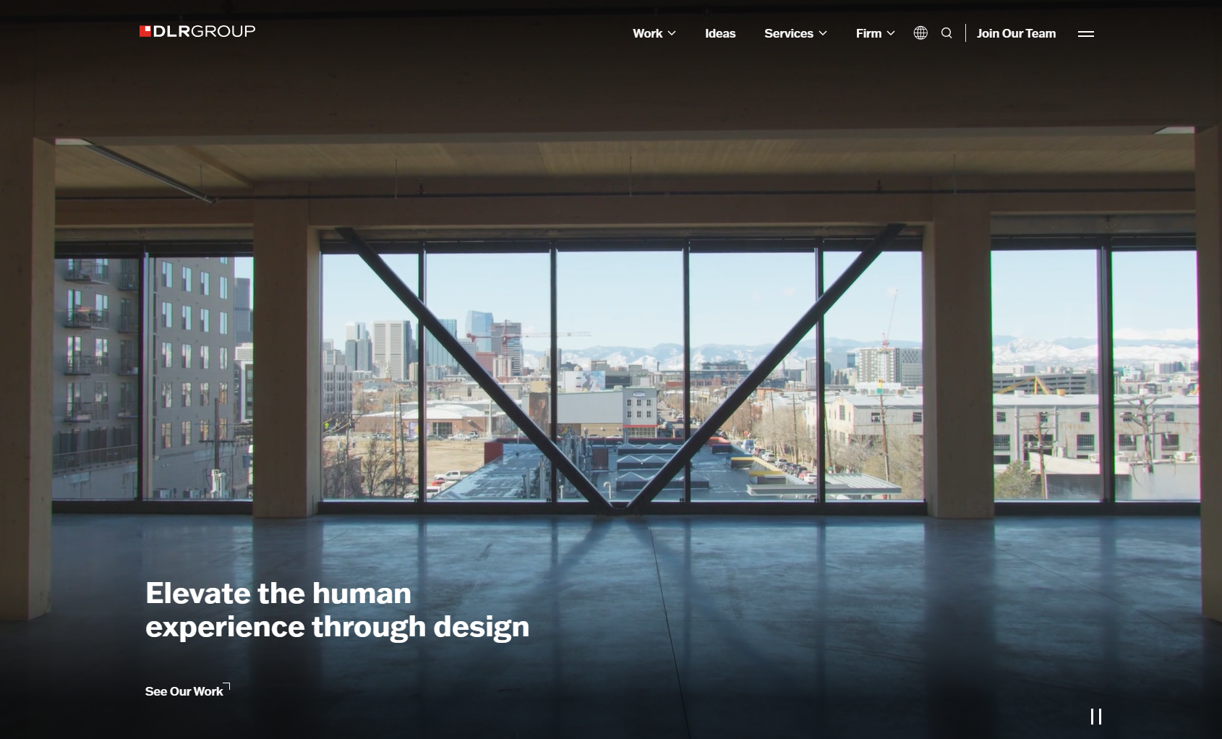
Website Example 2
ASSESS & REFOCUS YOUR KPIs
RESULTS
87.5% increase in clicks to our “Work” menu.
This tells us:
Our audience wants to see all our work, not just mass timber. and/or
The CTA confused them.

Slide 23
Website Strategy
ASSESS & REFOCUS YOUR KPIs
*Pages can have different strategies.
Some pages you want the user to …
… scroll to learn more.
… fill out a form.
… contact you.
… click your link bio.
… comment.
Balancing various strategies on your digital channels is a good thing.
Strategies
Notes:
Picking an effective strategy does not happen overnight. So, how do you do that?

Slide 24
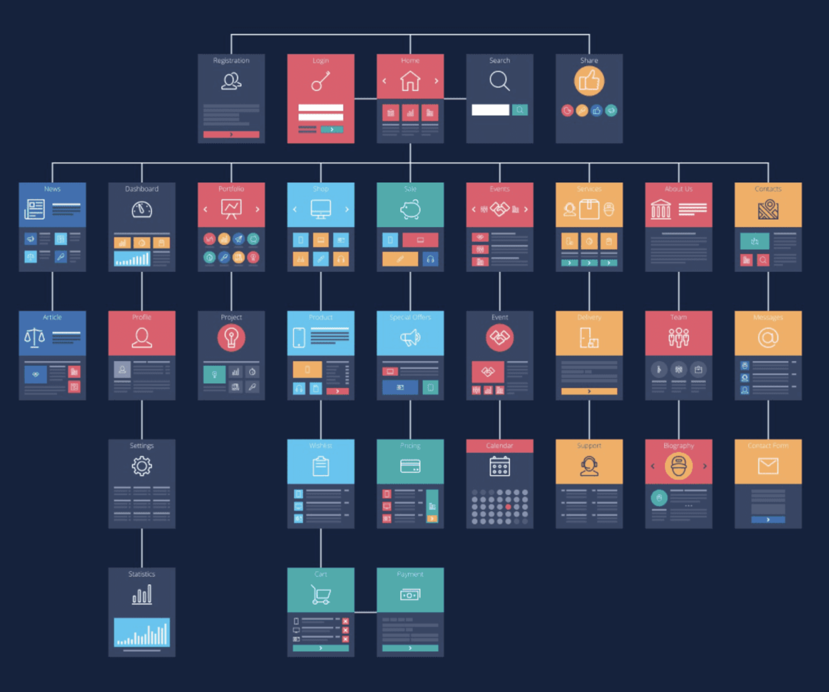
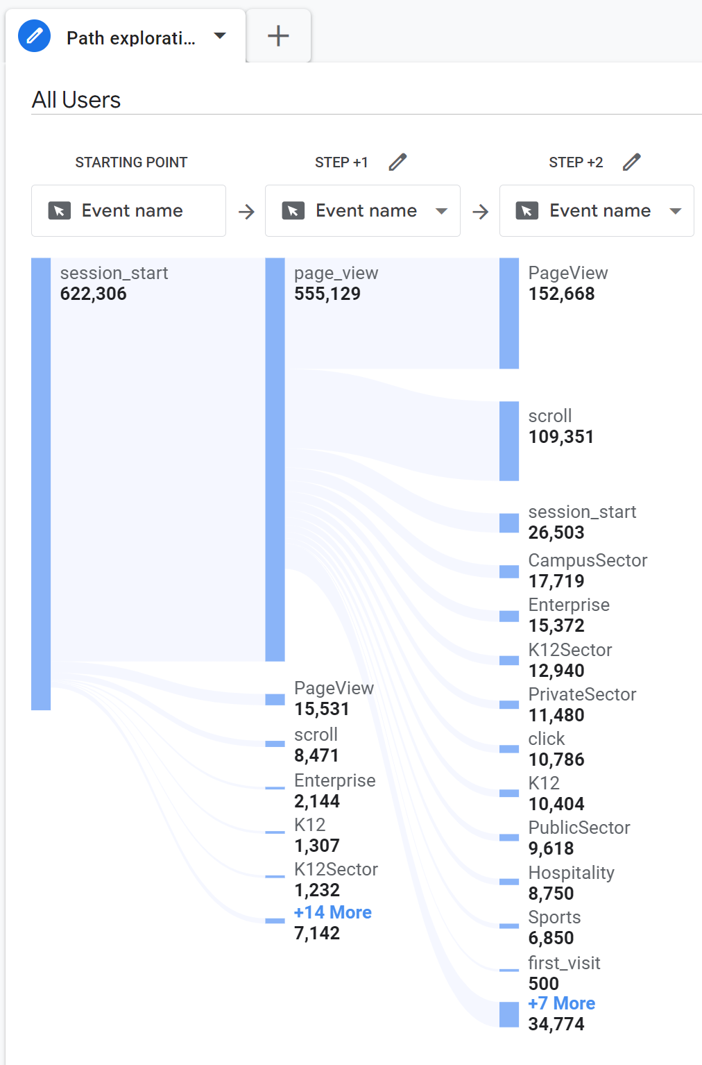
Balancing various strategies on your digital channels is a good thing.
AUDITING YOUR WEBSITE
Start by reviewing the following:
Site map
Path exploration report (using G4, previously Google Universal Analytics)
Heat map (using a tool like SEMRush)
Notes:
Let your audience tell you. Do so by reviewing these three together. This is how you can put the pieces together for what your audience is looking for. All of which only helps inform your KPIs. Do you need to focus on scroll depth? On bounce rate (referred to as engagement rate now)? Etc.

Slide 25
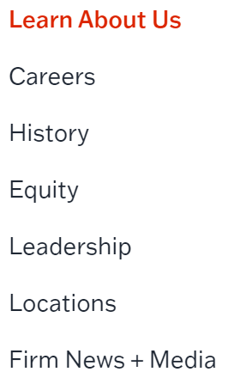
Social Media - Content Marketing
DIGITAL MARKETING CHANNELS
Content Marketing
Social Media
Each platform has a different audience, purpose, and tone.
Be mindful of how you show up and what content you put on each.
What DLR Group content goes on the platform?
Projects
Press
Awards
Design Process
All Content
Awards
People
Observances
Press
Awards
Events
Firm News
People
Projects
Ideas
Used for discovery
Projects
Ideas
Used for discovery
Used only to host our website videos
China platform
Notes:
Getting a little more granular, here is an example of what our social media assessment resulted in. Based our audience’s behaviors, we saw that overtime it became clear what our audience wanted to engage with on each platform. That allowed us to hone in on content.
But the other piece of the puzzle was volume, frequency, posting day, and posting time. That is where competitor analysis comes into play.
The link icons indicate that we primarily share content that links back to our website (inbound marketing).

Slide 26
Social Media - Competitor Analysis
DIGITAL MARKETING CHANNELS
Projects
Press
Awards
Design Process
All Content
Awards
People
Observances
Press
Awards
Events
Firm News
People
Projects
Ideas
Used for discovery
Projects
Ideas
Used for discovery
Used only to host our website videos
China platform
Notes:
We have found the greatest ROI on Instagram and LinkedIn. These are where designers, clients, and partners are primarily active.

Slide 27
Social Media - Competitor Analysis
DIGITAL MARKETING CHANNELS
When conducting competitor analysis, keep your KPIs top of mind.
Digital reach
Site unique visitors
Count frequency of posts
Record the vanity metrics (# of likes)
Populate a calendar to review posting days
Site engagement rate
Social engagement rate
Social engagement by post type
Newsletter sign-ups
Contact rate (site)
Number of press coverage articles
Social followers
Repeat site percentage
Newsletter click rate
Notes:
No access to paid tools?

Slide 28
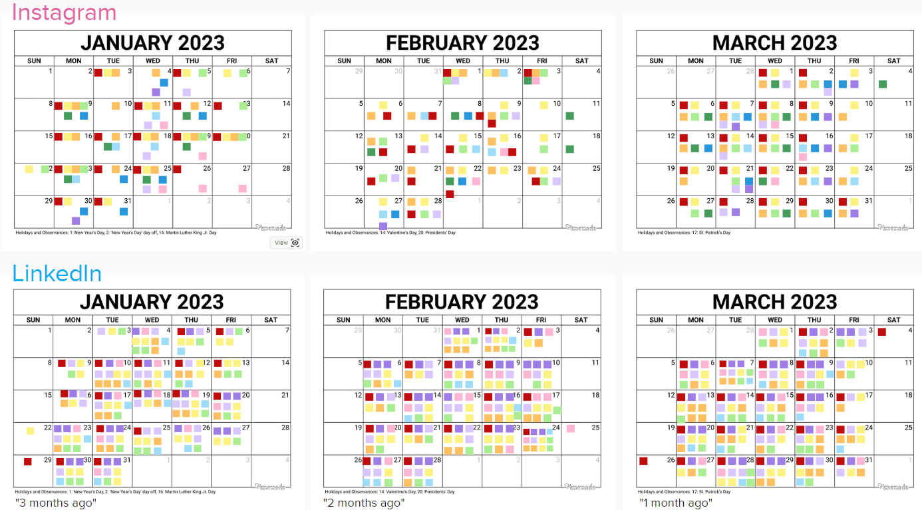
Notes:
When I say place the posts on a calendar, I mean literally put them on a calendar. (sticky notes are our various competitor)

Slide 29
Findings
DIGITAL MARKETING CHANNELS
Instagram
LinkedIn
Average # of Posts Per Month
Average # of Posts Per Month
6
5
7
4
9
17
2
15
15
6
Average of 32 posts per month
Average of 24 posts per month
Average of 21 posts per month
Average of 17 posts per month
Average of 15 posts per month
Average of 11 posts per month
Average of 25 posts per month
Average of 19 posts per month
Average of 34 posts per month
Average of 22 posts per month
Number of Followers
Number of Followers
Most Popular Days to Post
S | M | T | W | T | F | S
Data from January, February, and March 2023
Notes:
Here is what we found. Now, I do need to mention that we need to be careful when looking at numbers like this in isolation.
With Instagram, these firms could have used various growth strategies to gain a large following, and then cut back on posting for maintenance.
With LinkedIn, these firms may have started with fewer posts to get an engaged audience, and then slowly ramped it up based on demand. Unlike Instagram where accounts with the most followers post the least, the LinkedIn accounts with the largest volume of posts have both the most followers and the least. Another reason to keep testing.

Slide 30
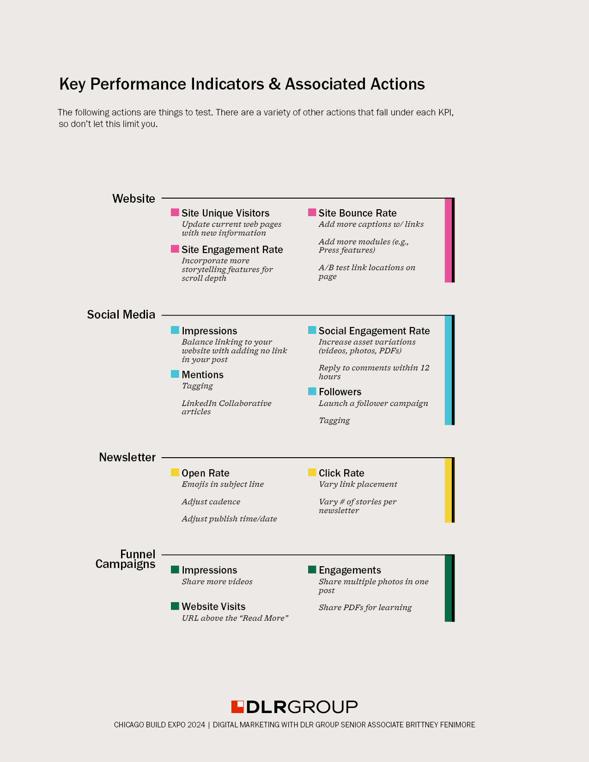
What actions are associated with KPIs?
https://indd.adobe.com/view/3a23a4a1-dfde-4a31-9d0a-f80f096ca6b6
PW: ChicagoExpo2024

Slide 31
Takeaways
DIGITAL MARKETING CHANNELS
Social Posting
Website
Focus
Adapt
You do not need to post every day.
Look at your competitor set and your aspirational set. How often are they posting? Do they have a consistent high volume of likes?
Less than 10% of websites are analyzed and set up for the best user experience. So, your competitor’s website might look pretty, but it doesn’t mean it’s performing.
Be careful not to spread yourself too thin. Your company does not need to be active on every platform.
Pull back to grow more.
Review your strategies and competitors twice a year, at minimum.
There is a balance between taking enough time to test strategies (minimum 90 days) and trying new ones.

Slide 32
Growth Strategies

Slide 33
If you took your logo off your post,
would your audience still recognize your brand?
ASK YOURSELF:
Whether it’s through your colors, tone of voice, people, etc., think about your look and feel.

Slide 34
Marketing Funnel
GROWTH STRATEGIES
KPIs
Digital reach
Site unique visitors
Attract
Site engagement rate
Social engagement rate
Social engagement by post type
Engage
Newsletter sign-ups
Contact rate (site)
Number of press coverage articles
Convert
Social followers
Repeat site percentage
Newsletter click rate
Maintain
Notes:
Now we start to put it all together.
Here are the KPIs associated with each step in the marketing funnel…

Slide 35
Marketing Funnel
GROWTH STRATEGIES
KPIs
DIGITAL CHANNELS
Digital reach
Site unique visitors
Social Media
Paid Search
Digital Advertising
Public Relations
Influencer Marketing
Attract
Site engagement rate
Social engagement rate
Social engagement by post type
Website
Social Media
Engage
Newsletter sign-ups
Contact rate (site)
Number of press coverage articles
Convert
Website (Contact Us)
Social followers
Repeat site percentage
Newsletter click rate
Maintain
Email Marketing
Notes:
… and here are the digital channels. Let’s put these two together and talk through growth strategies at each level of the funnel.

Slide 36
Growth by Two Routes
GROWTH STRATEGIES
Organic
Paid
Funnel Campaign Approach
Repurposing & A/B Testing
Employee Advocacy
SEO
Lead Generation
LinkedIn Advertising
Retargeting

Slide 37
Funnel Campaign Approach: Social Media
GROWTH STRATEGIES: ORGANIC
1
KPIs
SOCIAL MEDIA CONTENT
Digital reach
Site unique visitors
Attract
Video
Site engagement rate
Social engagement rate
Social engagement by post type
Engage
Photos & PDF
Newsletter sign-ups
Contact rate (site)
Number of press coverage articles
Newsletter Promotion
& Link Preview
Convert
Social followers
Repeat site percentage
Newsletter click rate
Maintain
Newsletter/Email
Notes:
Here’s what you’re looking at: for the KPIs at each level in the marketing funnel, we have identified the content that best directly impacts that KPI.
For example, at the top of the funnel, the social media KPI associated with “ATTRACT” is digital reach. Through a lot of testing, we found that sharing VIDEOS on our social media are the best way to get the greatest digital reach.
That is the methodology as we move down the funnel.

Slide 38
Funnel Campaign Approach: Social Media
GROWTH STRATEGIES: ORGANIC
1
KPIs
SOCIAL MEDIA CONTENT
Digital reach
Site unique visitors
Attract
Video
Site engagement rate
Social engagement rate
Social engagement by post type
Engage
Photos & PDF
Newsletter sign-ups
Contact rate (site)
Number of press coverage articles
Newsletter Promotion
& Link Preview
Convert
Social followers
Repeat site percentage
Newsletter click rate
Maintain
Newsletter/Email
Notes:
Here’s where the inbound marketing approach comes into play. We use these posts to link to our website, bringing our audience into our network.
This phased approach brings your community along an educational journey. Those that stick with you down the funnel are interested in your firm.

Slide 39
Funnel Campaign Approach
GROWTH STRATEGIES: ORGANIC
Video
POINTERS & RESULTS
Attract
You don’t always need expensive production.
Our top performing videos are almost always ones we have taken on our phones vs. a professional production.
When filming, think about scale, beat, the story, etc.
Put your best clip(s) in the first 10 seconds.
Recommend to use a 1080x1080px video on LinkedIn.
Notes:
The following slides are meant as a takeaway for you, so I am only going to highlight one bullet on each slide but I really encourage you to go through and read these pointers!

Slide 40
Funnel Campaign Approach
GROWTH STRATEGIES: ORGANIC
POINTERS & RESULTS
PDFs on LinkedIn: On average, our posts with PDFs have a 23% ER/I.
Most resources will tell you that a >2% ER/I is good, but we target at least 7%.
People like tangible takeaways (e.g., something you download).
Since posting PDFs on LinkedIn eight months ago, every one of those posts ranks in the top 20% of our posts by ER/I.
Engage
Photos & PDF

Slide 41
Funnel Campaign Approach
GROWTH STRATEGIES: ORGANIC
POINTERS & RESULTS
Cross promote your newsletter across your social media channels.
Promote exclusive content only shared in the Newsletter and tease that.
KPI: Number of Press Coverage Articles Here are ways digital can support growth:
Link directly to the press coverage on social media
Always tag the publication
Add the URL ABOVE the “read more” button
Newsletter Promotion
& Link Preview
Convert

Slide 42
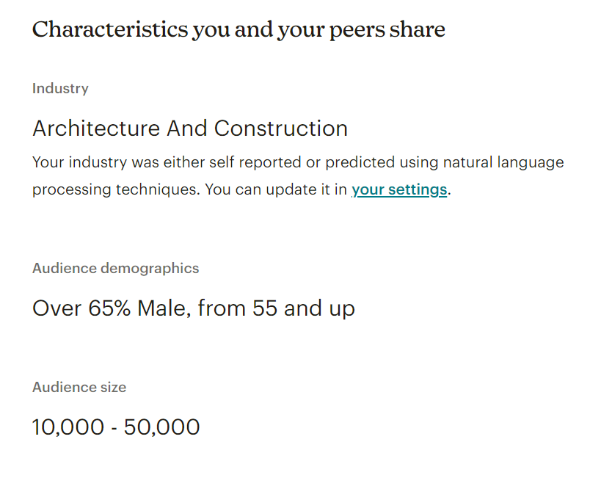
Funnel Campaign Approach
GROWTH STRATEGIES: ORGANIC
POINTERS & RESULTS
Include exclusive content in your emails and newsletters to add additional value for your audience.
Industry benchmarks:
Open rate: 27.9%
Click rate: 4.7%
Unsubscribes: 0.3%
Test volume of content in your emails (e.g., one feature story vs. three stories). This action is to improve the “Newsletter Click Rate” KPI.
Maintain
Newsletter/Email

Slide 43
How have we used this approach?

Slide 44
Campaign: Career Technical Education
GROWTH STRATEGIES: ORGANIC
Purpose
Timing
We have three new CTE projects opening this fall and two large-scale events that our team wanted to focus our PR efforts on.
The goal was to leverage the volume of content in a variety of ways:
Project features
Thought leadership articles
Videos
Photos
PDFs of case studies
Eight feed posts and one LinkedIn newsletter across 90 days.

Slide 45
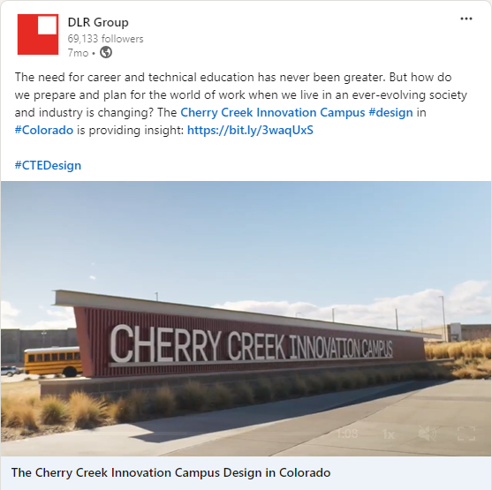
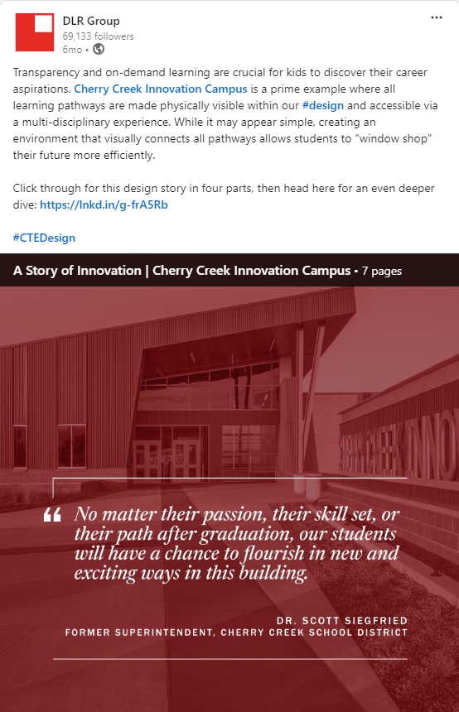
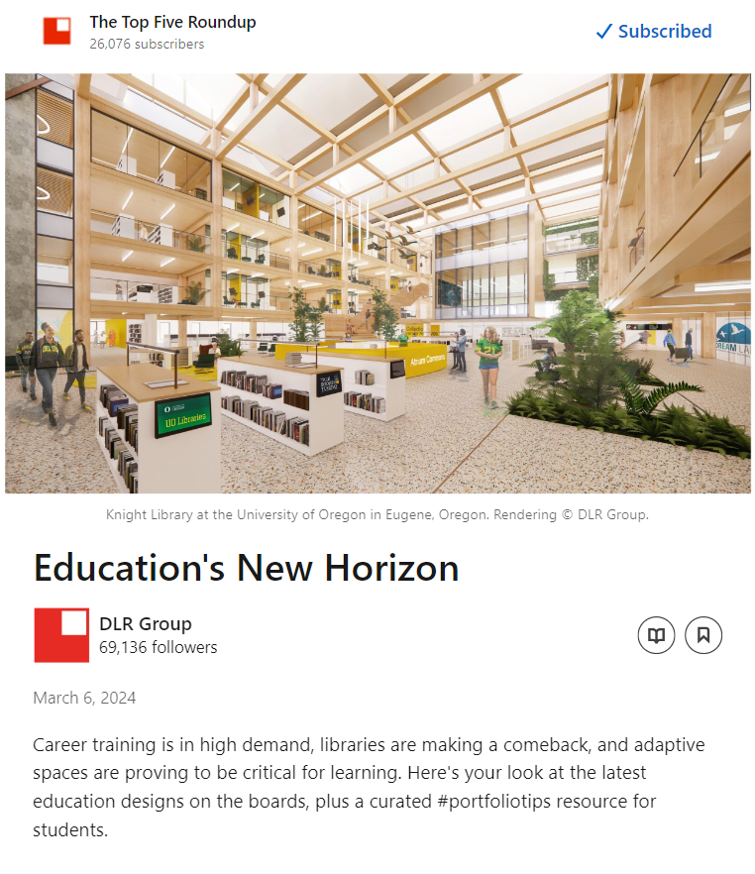
Attract
Engage
Convert
Maintain
Video
Photos
PDF
Link Preview
Newsletter

Slide 46
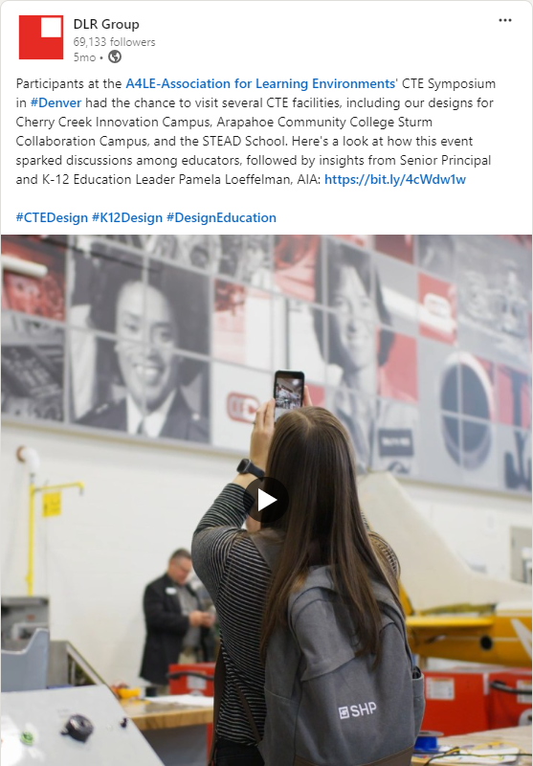
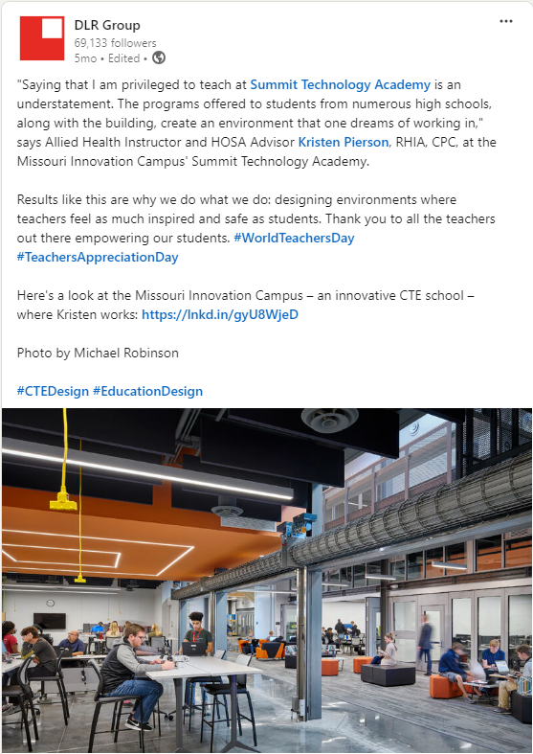
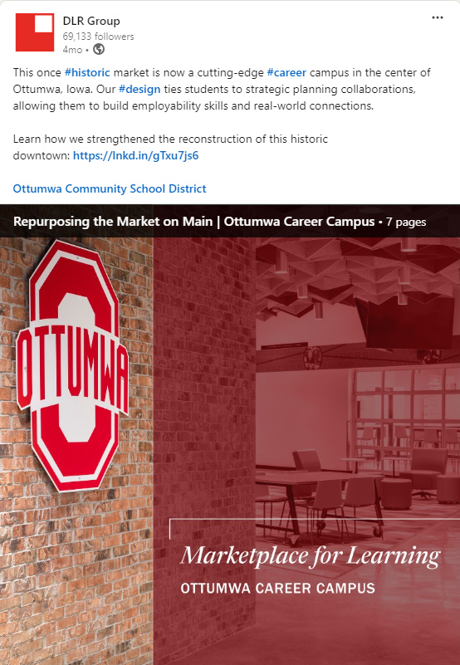
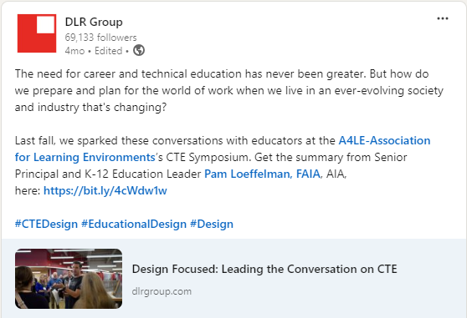
Attract
Engage
Convert
Video
Photos
PDF
Link Preview

Slide 47
Results
GROWTH STRATEGIES: ORGANIC
Notes:
Portfolio Tips
CTE campaign
Mass timber
CTE Newsletter audience:
Salesperson
Architect
Creative Designer
Interior Designer
Project Manager
CEO/Director

Slide 48
Results
GROWTH STRATEGIES: ORGANIC
Funnel: Attract
KPI: Impressions
30%
Social Impressions | These posts received this percentage more impressions than our other posts.
Notes:
Portfolio Tips
CTE campaign
Mass timber
CTE Newsletter audience:
Salesperson
Architect
Creative Designer
Interior Designer
Project Manager
CEO/Director

Slide 49
Results
GROWTH STRATEGIES: ORGANIC
Funnel: Attract
KPI: Impressions
30%
Social Impressions | These posts received this percentage more impressions than our other posts.
Funnel: Engage
KPI: Engagements
106%
Social Engagements | These posts received this percentage more engagements than our other posts.
Funnel: Convert
KPI: Click-thrus
Notes:
Portfolio Tips
CTE campaign
Mass timber
CTE Newsletter audience:
Salesperson
Architect
Creative Designer
Interior Designer
Project Manager
CEO/Director

Slide 50
Results
GROWTH STRATEGIES: ORGANIC
Funnel: Attract
KPI: Impressions
30%
Social Impressions | This number is compared to the posts meant for engagements.
Funnel: Engage
KPI: Engagements
106%
Social Engagements | This number is compared to the posts meant for impressions.
Funnel: Convert
KPI: Click-thrus
Funnel: Maintain
KPI: Click rate
3.2%
Engagement Rate | Compared to our average 2.6% ER. It saw +8% views than previous newsletters.
Notes:
Portfolio Tips
CTE campaign
Mass timber
CTE Newsletter audience:
Salesperson
Architect
Creative Designer
Interior Designer
Project Manager
CEO/Director

Slide 51
Funnel Campaign Approach
GROWTH STRATEGIES: ORGANIC
Notes:
Portfolio Tips
CTE campaign
Mass timber
CTE Newsletter audience:
Salesperson
Architect
Creative Designer
Interior Designer
Project Manager
CEO/Director

Slide 52
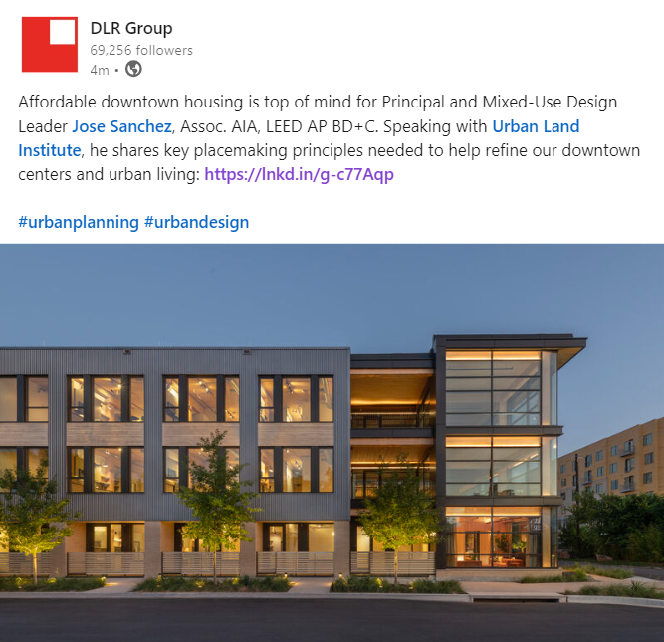
Content Repurposing
GROWTH STRATEGIES: ORGANIC
2
It’s not necessarily your content, it could be your promotion.
Sort your content by impressions, then take your lowest performing content, apply edits, and post it again.
Original
Updated
Cut copy in half
Opened with a statement vs. a question
Tagged the thought leader and publication
Uploaded an image vs. link preview
RESULTS:
26%
Impressions
167%
Engagements
5.54%
Engagement Rate
2.63%
171%
Clicks
Notes:
A lot has changed in the second post. Here are the results.
This is not an example of AB testing, this a repurposing. That means that can turn the post on its head and change as much as we want. AB testing is where you change ONE element of the post.

Slide 53
AB Testing
GROWTH STRATEGIES: ORGANIC
Image
A
(with people)
VS.
B
(without people)
Notes:
With that said, I do recommend you run AB tests. And not just do it for one or two posts. With so many factors, you need a solid data pool to glean insights from. Test at least five posts, and build off the success of the other.
Start by changing one thing. Run it again with a different post. If you’re seeing the same results (aka one is clearly performing better than the other), then start the next variation.

Slide 54
AB Testing
GROWTH STRATEGIES: ORGANIC
Copy
B
(without people)
(quote)
VS.
C
(without people)
(statement)

Slide 55
AB Testing
GROWTH STRATEGIES: ORGANIC
Link
C
(without people)
(statement)
(In Copy)
VS.
D
(without people)
(statement)
(In Comments)

Slide 56
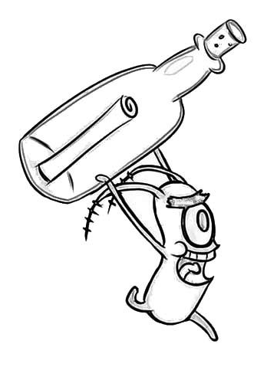
AB Testing
GROWTH STRATEGIES: ORGANIC
Image
Copy
Link
A
(with people)
B
(without people)
(quote)
C
(without people)
(statement)
(In Copy)
VS.
VS.
VS.
B
(without people)
C
(without people)
(statement)
D
(without people)
(statement)
(In Comments)
Notes:
So on and so forth until you find your secret recipe for success.

Slide 57
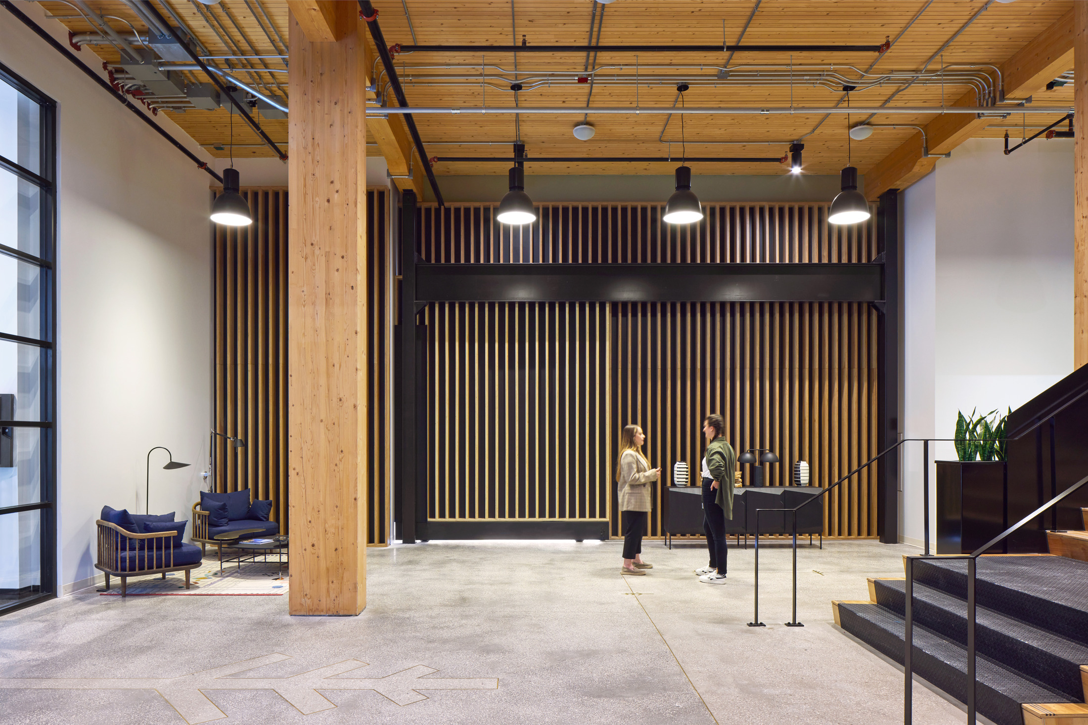
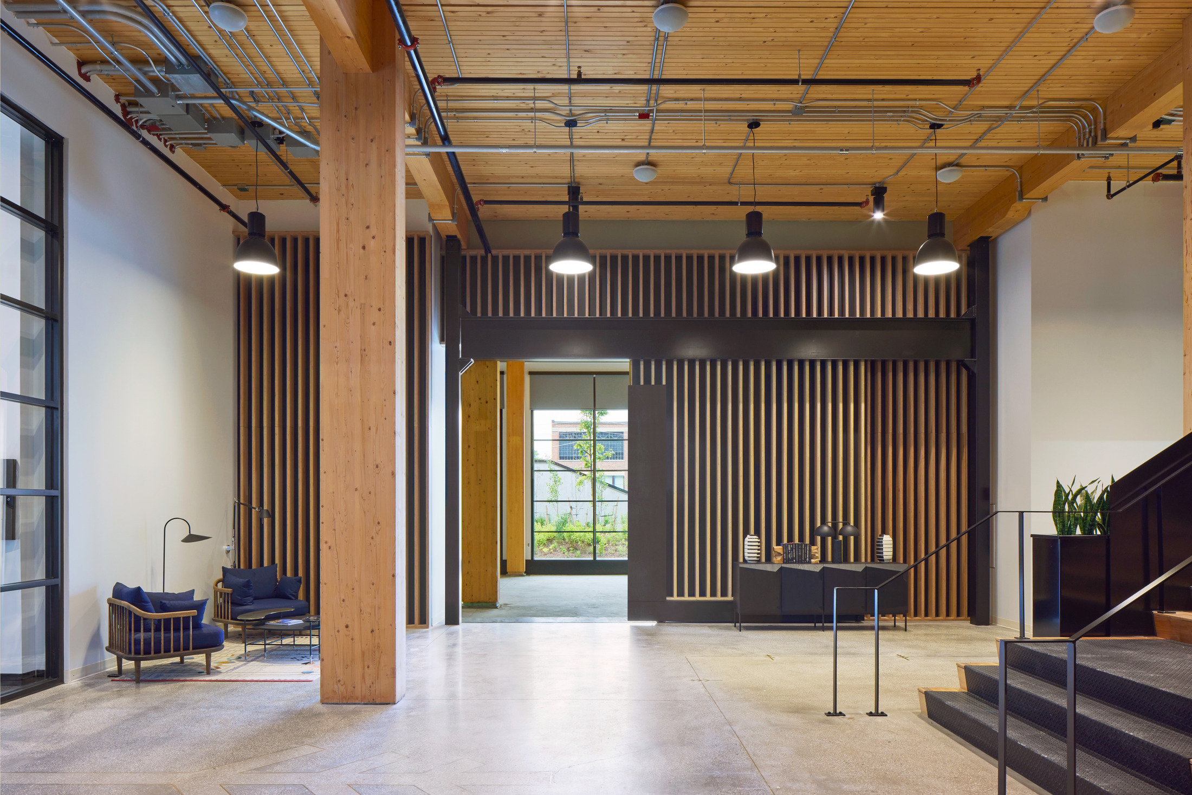
AB Tests Examples
GROWTH STRATEGIES: ORGANIC
Image
People vs. No People
Copy vs. No Copy
Copy
Quote vs. Statement
Emojis vs. No Emojis
<100 characters vs. >100 characters
Link
Link above “Read More” vs. below “Read More”
Link vs. No Link
Link in Copy vs. Link in Comment
“Lifestyle retail is about creating vibrant spaces that cater to modern consumers' evolving needs,” says Principial and Middle East Design Director Scott Pryde, RIBA ARB. Read his in-depth interview with @designmiddleeast here: https://www.dlrgroup.com/press/scott-pryde-design-middle-east/
“Lifestyle retail is about creating vibrant spaces that cater to modern consumers' evolving needs,” says Principial and Middle East Design Director Scott Pryde, RIBA ARB, in an in-depth interview with @designmiddleeast on #lifestyleretail in the Middle East. Get the full story here: https://www.dlrgroup.com/press/scott-pryde-design-middle-east/
Middle East Design Director Scott Pryde, RIBA ARB, shares our #design philosophy for lifestyle retail. Read his in-depth interview with @designmiddleeast here: https://www.dlrgroup.com/press/scott-pryde-design-middle-east/
“Lifestyle retail is about creating vibrant spaces that cater to modern consumers' evolving needs,” says Principial and Middle East Design Director Scott Pryde, RIBA ARB, in an in-depth interview with @designmiddleeast on #lifestyleretail in the Middle East. Get the full story in our comments.
Read the story here: https://www.dlrgroup.com/press/scott-pryde-design-middle-east/
Notes:
Here are some ideas for AB testing.

Slide 58
Employee Advocacy
GROWTH STRATEGIES: ORGANIC
3
“On average, your individual LinkedIn posts will see
561% more reach than your company account.”
– Amelia Sordell, Founder of Klowt, a personal branding agency
Your employees / teammates are your best resource.
They have the connections on LinkedIn, in email, etc.
You may hear, “Our company needs to post x, y, and z.” In reality, your target audience is more likely to be connected with your employees / teammates than your page.

Slide 59
SEO
GROWTH STRATEGIES: ORGANIC
4
Here are some FREE tools to use:
SEMrush
Ahrefs
Yoast SEO
SimilarWeb
Track your search rankings, perform competitor analysis, content and technical SEO audit of your website, SEO writing assistant, and more.
A great way to use this tool is to paste your competitor’s website and find potential link-building opportunities.
This will suggest how to tweak your content to optimize for search engines. Primarily for WordPress users.
use this to estimate how much search traffic a website gets (traffic sources, locations, and more). This is a helpful tool for competitor research.
Notes:
I like to think that SEO is working smarter, not harder.

Slide 60
Two Routes
GROWTH STRATEGIES
Organic
Paid
Funnel Campaign Approach
Repurposing & A/B Testing
Employee Advocacy
SEO
Targeting & Retargeting
Lead Generation
LinkedIn Advertising

Slide 61
Narrow Your Audience
GROWTH STRATEGIES: PAID
1
Geofencing
IP Address
Behavioral
Keyword+Search
Retargeting
New User Targeting
Reengage interested/bounced users
Higher CTR than other ad methods Uses cookies to track and recapture
Acquire New Audiences
Top of the Funnel
Brand Awareness
Notes:
Options for either pathway
These are great tools, but the internet is obviously a huge space. We don’t want to advertise to everyone, so we have a few tools to make sure your message is going to go to who you want to talk to.
Each of these can be used to retarget, or to engage new audiences.

Slide 62
GROWTH STRATEGIES: PAID
This is a cookie-based technology that uses simple a JavaScript code to anonymously “follow” your audience all over the internet. Retargeting campaigns are useful for re-engaging website visitors to tell them relevant information and pull them back into our marketing funnel.
Retargeting
keyword
EXIT
AD
dlrgroup.com
dlrgroup.com
keyword
Notes:
This is one of the two pathways and applies to users who are already in our funnel and have been on our website. This allows us to capitalize on that visit long after they leave.
Essentially works like a cookie, though they can get wiped. It’s also only on that device whereas the pixel goes across devices.
WordPress plugin where we add the code. For a developer, they can add it to the header of the code.
A user landed on a project page on your website but bounced. You retarget them with an ad for a related project, idea, or press release, bringing them back to your site.

Slide 63
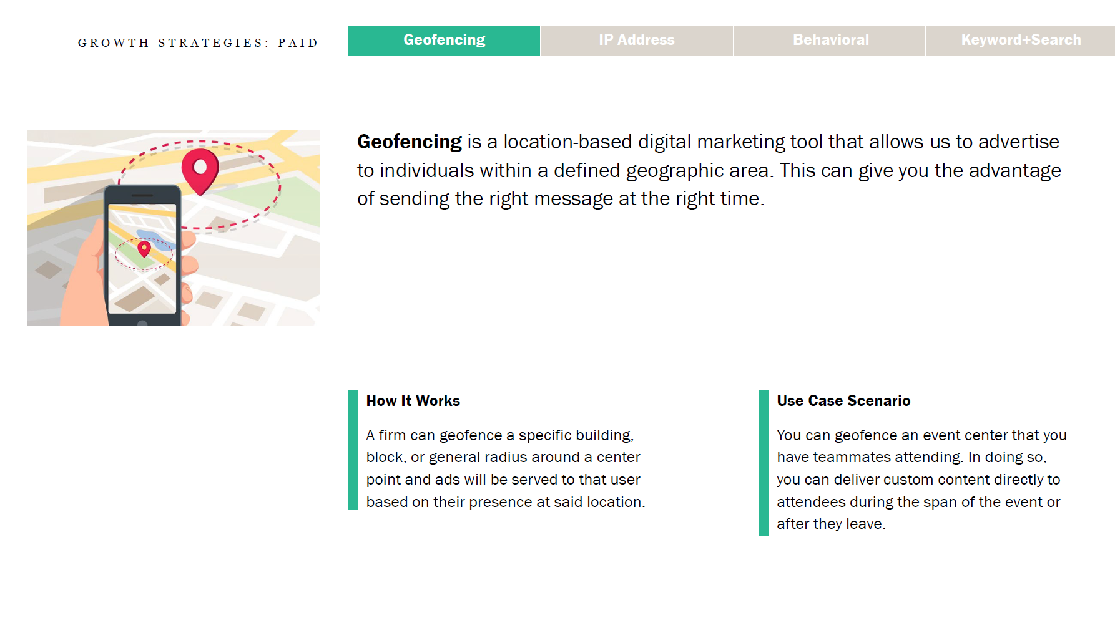
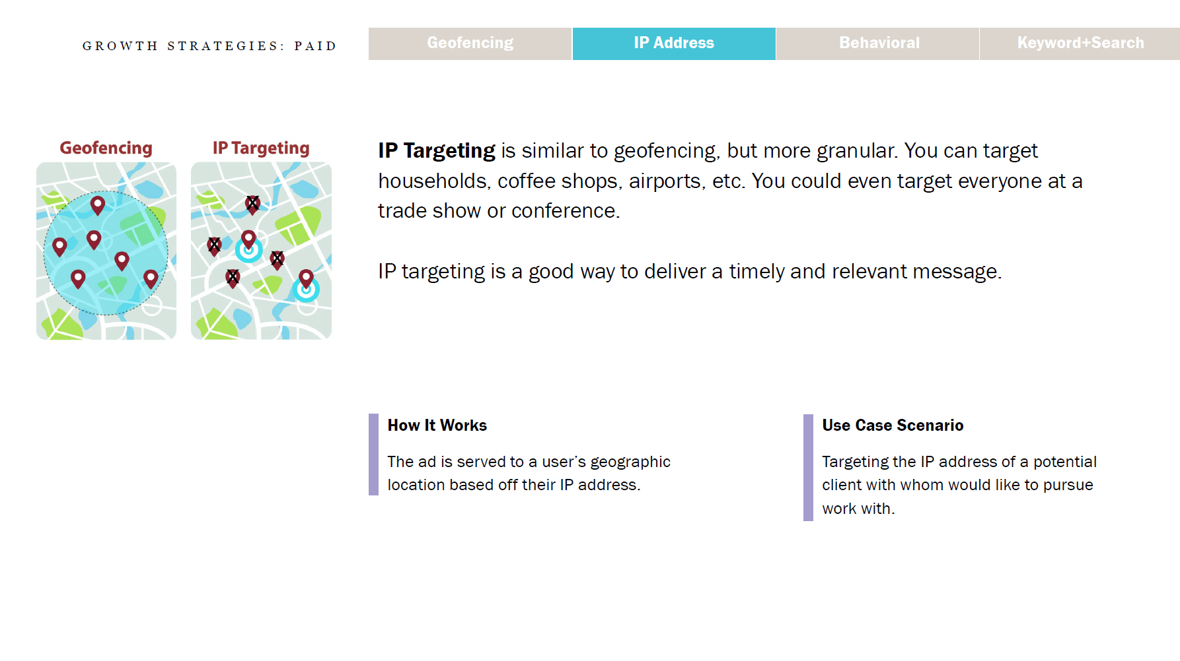
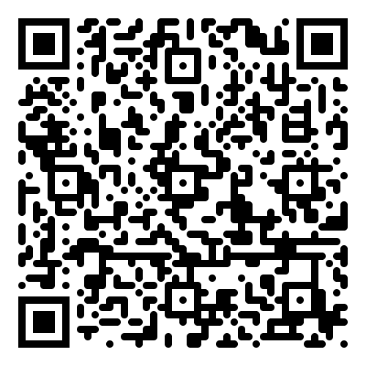
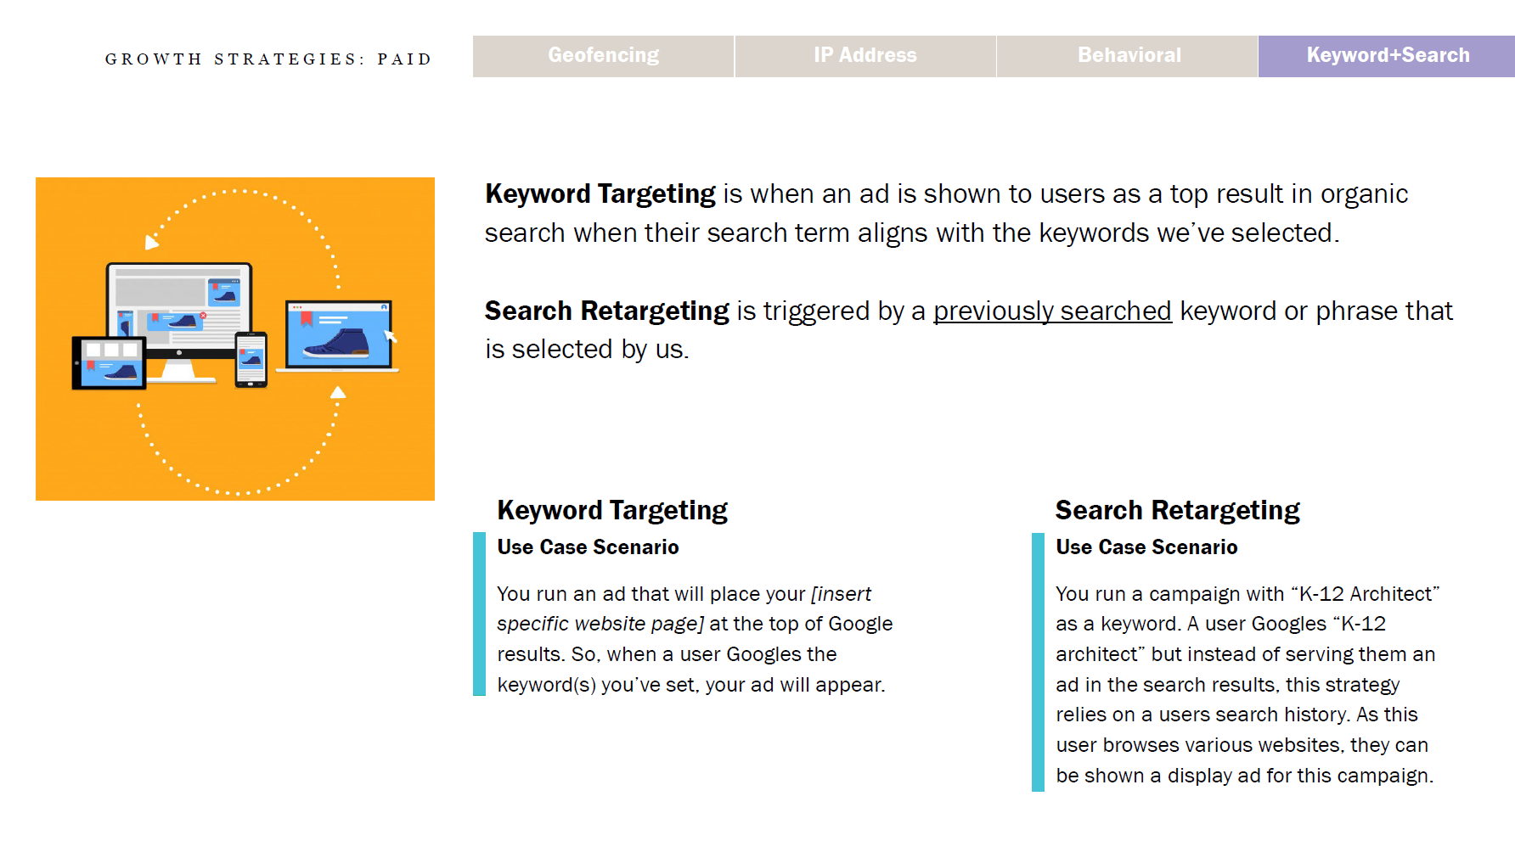
Targeting & Retargeting Pathways
https://acrobat.adobe.com/id/urn:aaid:sc:US:8b3f9892-13c2-4e25-99f4-922c2f0edb79

Slide 64
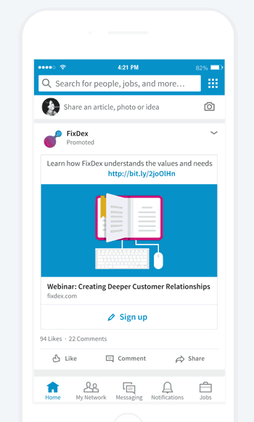
Lead Generation
GROWTH STRATEGIES: PAID
2
“LinkedIn Lead Gen Forms streamline lead generation by auto-populating users' LinkedIn profile information when they click on your ad. This simplifies the process for users, allowing them to submit their information with ease and boosting lead generation efficiency. Furthermore, the collected data can be effortlessly synchronized with your CRM system.”
– Jim Habig, LinkedIn VP of Marketing
Notes:
LinkedIn Lead Gen Forms is one of the platform's most powerful offerings for lead generation.
This is done in your Campaign Manager. There are plenty of easy to understand articles and how-to’s online.

Slide 65
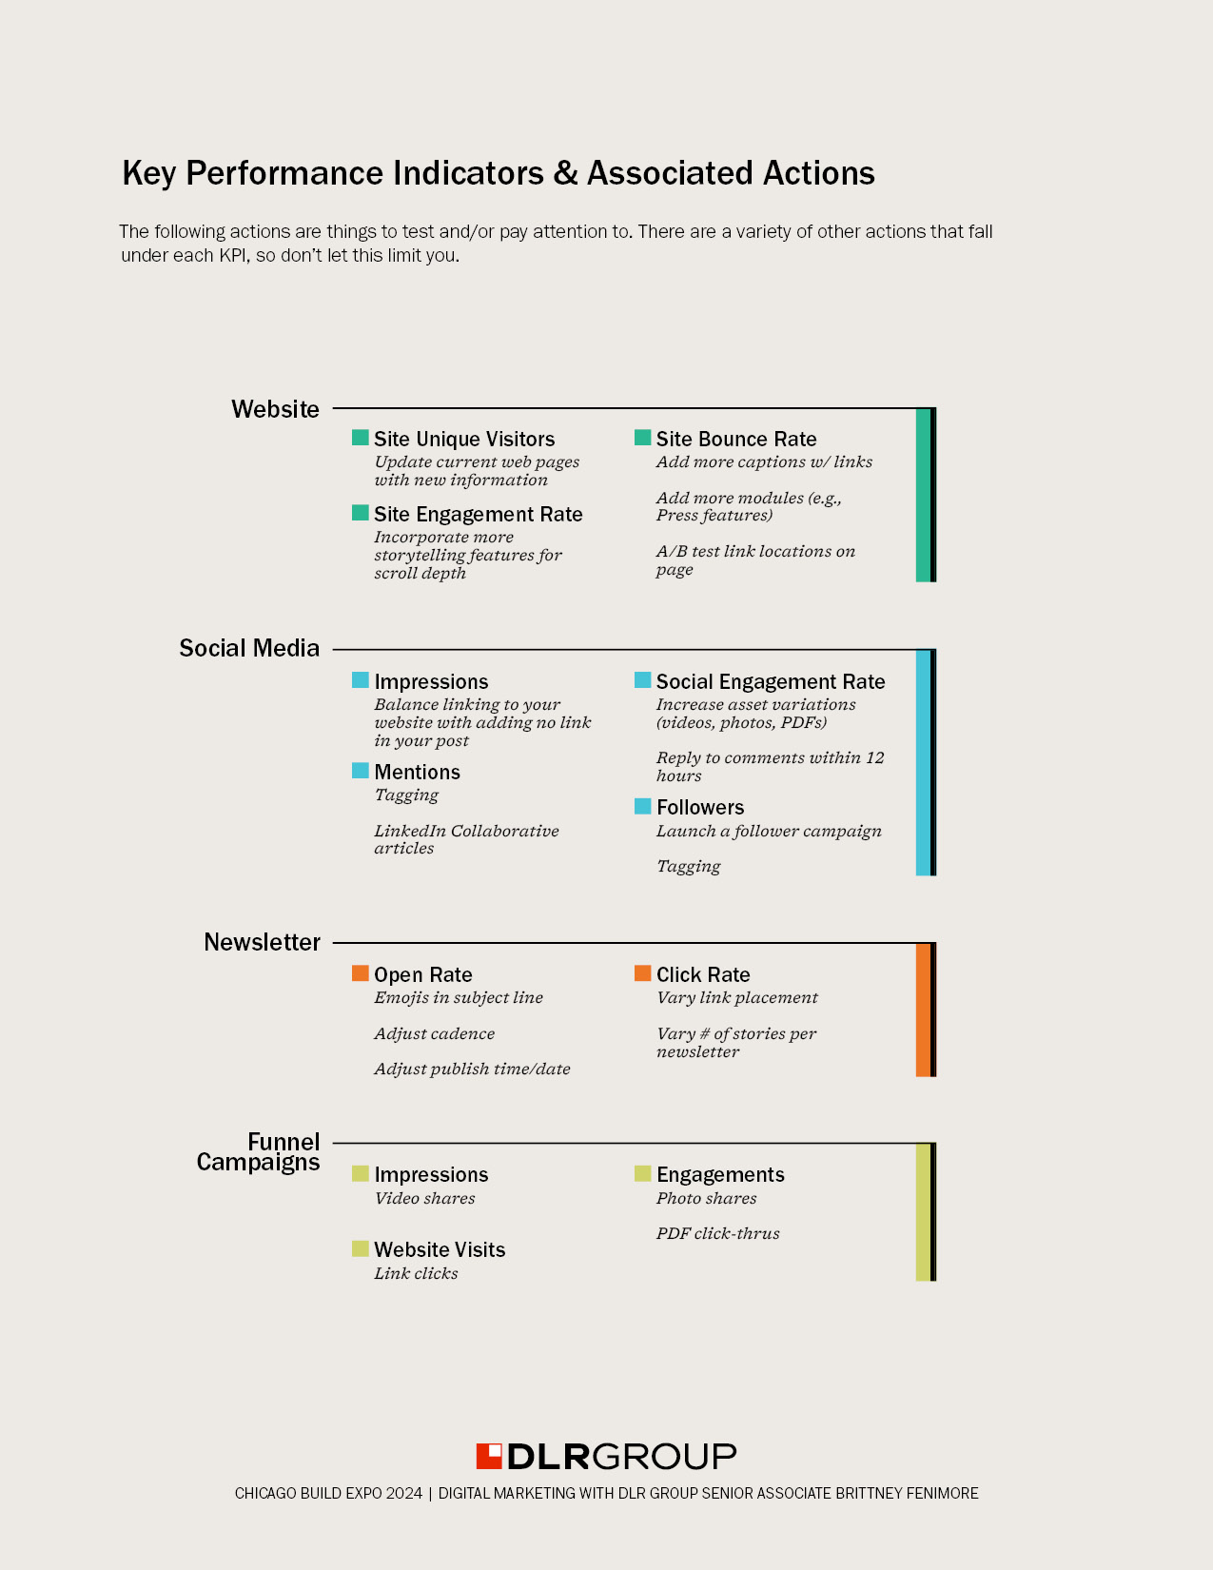
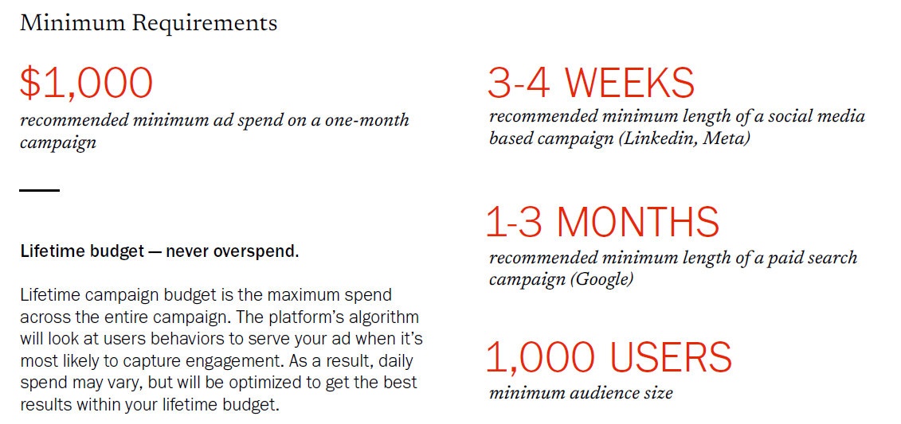
LinkedIn Advertising
GROWTH STRATEGIES: PAID
3
Though it is expensive compared to other ad
types – like Meta or Google – this is where
our primary audience is active.
Here are standard minimum requirements
to effectively leverage LinkedIn Advertising ……..……..…….
Notes:
I recommend taking a course on this. Here are the bare minimums, but with so many ad options, it is worth it to do you homework.

Slide 66
Why?
GROWTH STRATEGIES: PAID
Inbound Marketing: these paid strategies capitalize on the data gathered by mammoths like Google and Meta, allowing us to keep the user engaged with our content long after we meet them at a conference or they leave our website.
Notes:
To expand on the success of our digital marketing and lead generation efforts. We have a great inbound strategy that gets the user onto our website and into our funnel, but the journey currently concludes once they leave the site.
With retargeting specifically, we can capitalize on a website visit long after the user leaves. With geofencing, we can capitalize on attending a conference long after it ends or before it begins. With keyword and behavioral targeting, we can capitalize on the data collected by mammoths like Google and Meta for many years prior.
In conjunction with other digital tools share data with sales and marketing teams (e.g., DealFront, Factors.ai, etc.), you can continue to custom curate and serve content to key decision makers while bridging the gaps internally between your brand, business development, and marketing teams.

Slide 67
Applying an Iterative Approach

Slide 68
What Next?
ITERATIVE APPROACH
1
Define Your Business Goals
2
Define Your Audience
POINTERS
Review analytics on a 30-day cycle.
Apply minor changes over time; don’t bite off too much.
Your lessons learned should be transferrable but remember that every channel and platform are different.
Nothing is written in stone.
Don’t chase.
Choosing Your Digital Marketing Channels
3
Test Channels
4
Analyze
5
Adapt
Notes:
Let’s go back choosing your digital channels

Slide 69
Digital Marketing:
Key Areas of Focus and Impactful Strategies
Assess and Refocus Your KPIs
Marketing Channels & Content
Growth Strategies
Iterative Approach
Match your WHY. With so many KPIs to choose from, narrow them down to follow your marketing funnel:
Attract
Engage
Convert
Maintain
Overlay your KPIs with the purpose and goals of each digital marketing channel.
Organic
Funnel Campaign
Repurposing & A/B Testing
Employee Advocacy
SEO
Paid
Targeting &
Retargeting
Lead Generation
LinkedIn Advertising
Testing, applying, and adapting is a never-ending cycle. Embrace it.
Four
Learning Objectives

Slide 70
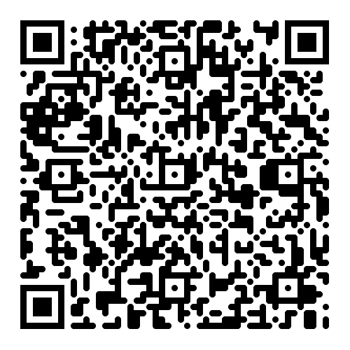
Thank you!

