Slide 1
Beyond Buzzwords: Creating Marketing Strategies that Actually Drive Business Growth
Karen Hatfield
President & Chief Marketing Muse
Pythia Marketing Strategy
Chicago Build 2024
October 23, 2024

Slide 2
Marketers are liars. --Tom Owen
©Pythia LLC. All rights reserved.
Notes:
Tom Owen—legal contact for the Scott Tissue and Paper Towels businesses at Kimberly Clark
When I finished grad school here in town at Kellogg I joined K-C when their marketing organization was based in Neenah, Wisconsin
I was so excited at the prospect of working on household brands like Huggies and Kleenex. And in my career there I was able to work on the sexiest brands in the company—KOTEX, DEPEND, topics that would shut down conversations at cocktail parties. But I digress. When I started, I worked on toilet paper—specifically Scott Tissue, 1000 sheets per roll. And paper towels—Scott, Viva, and Hi-Dri. And here Tom Owens was, countering my enthusiasm and starry-eyed visions by calling me a liar.
His reasoning, as he put it: Marketers will put a drop of aloe in a vat of tissue pulp and then claim on the package that it has all of these health benefits, and those are lies.
There are also plenty of marketers—not unlike other parts of business--who get caught up in buzzwords because it’s something new & shiny, it’s trendy, or maybe it just confuses non-marketers enough that it makes the person seem like they know what they’re talking about. But that doesn’t reflect well on marketers, and it doesn’t get the job done.

Slide 3
Good marketers are matchmakers
©Pythia LLC. All rights reserved.
Notes:
Now, I disagree with Tom’s blanket statement. Since leaving K-C I’ve worked as a marketing executive and consultant in many different businesses from manufacturing to tech to insurance, B2B and B2C and B2B2C. I’ve met some people along the way who fit Tom’s description. But what I’ve learned is that the best marketing isn’t about tricking people and using smoke & mirrors. And it isn’t about using buzzwords to sound smart and convince people you know what you’re doing. It’s about focusing on what the business needs to accomplish, designing a plan to achieve it, and then doing effective “matchmaking”—reaching people with a genuine need and a desire to address that need, and offering them a real solution.

Slide 4
©Pythia LLC. All rights reserved.

Slide 5
How to be a good matchmaker
Begin with the end in mind
Know who you’re talking to
Meet them where they are
Guide them through the journey
Build the plan
Stay focused
©Pythia LLC. All rights reserved.

Slide 6
Begin with the end in mind
What are you really trying to accomplish?
Specific goals—revenue, # of new customers, # of total customers
©Pythia LLC. All rights reserved.

Slide 7
Know who you’re talking to
Target customers
More like a certain segment of your current customers?
New customers for your current products?
More products for your current customers?
Demographics/firmographics, company characteristics, specific companies
Personas/titles—individual decision makers or buying groups
What are their pain points?
What are the most important things they need to know from you?
©Pythia LLC. All rights reserved.

Slide 8
Target audience outline
Priority | Primary | Secondary | Influencer | Influencer
Target
Pain points
Message points (value propositions)
Where to reach them
©Pythia LLC. All rights reserved.

Slide 9
Target audience outline
Priority | Primary | Secondary | Influencer | Influencer
Target | Real estate/facility director | Procurement director | CFO | Project manager
Pain points
Message points (value propositions)
Where to reach them
©Pythia LLC. All rights reserved.

Slide 10
Meet them where they are
Digital places
Social media (LinkedIn, Facebook, Instagram, X, TikTok…) paid media vs owned media
Google
Trade associations—sites, groups
Streaming, programmatic display
Email
Don’t spam people…please…
In person
Trade conferences, meetups
Hosting events
Networking events
Influencers
Paid influencers, content creators
Word of mouth/referrals
Where can you reach them?
Where are they receptive to your message?
©Pythia LLC. All rights reserved.
Notes:
Where will you get the biggest bang for your buck?
A combination of tactics is generally better than putting everything in one tactic

Slide 11
Guide them through the journey
Outlining the different stages a customer goes through when making a decision helps you determine the tactics to use and content to create to move someone through the process.
Knowing what questions customers need to answer within each stage in order to move to the next page informs your content.
Have a clear call-to-action with each marketing piece, appropriate to the stage they’re in.
©Pythia LLC. All rights reserved.

Slide 12
Customer Journey
Step
Awareness
Consideration
Close/Purchase
Goal
Introduce your target audience to your brand, products, solutions
Educate the prospect on selecting the right brand/product/service
Convince the prospect that your solution will solve their pain
Question
What’s the pain point they’re experiencing for which you’re the solution?
What should they be comparing and considering?
Why are you the right choice? What do they need to know to make a decision?
Key point
Need to reach consumers beyond your current base of followers
They recognize they have a problem, now they need deeper understanding of solutions.
They understand the problem and solution, now they need to ensure the right fit/choice.
Dating
analogy
Swipe right
Dating
Proposal
©Pythia LLC. All rights reserved.

Slide 13
Customer Journey (continued)
Step
Awareness
Consideration
Close/Purchase
Paid search Advertising & landing pages Content—shared (earned media)
Media relations
Trade shows & presentations
Blogs
Drip email sequence
Social media posts
Webinars
Downloadable PDFs—how-to guides, specific topics/features, research reports
Sales meetings
Free samples
Pitch deck
Proposals
Promotional emails
Sales meetings
Purchase pages
Free trial
Sample Marketing Tactics
Tools/ Calls to
Action
Sign up for our email newsletter
Follow us on [social media] for helpful information/tips & tricks Join us for a [introductory] webinar Read our blog for useful info
Join us for a how-to webinar (more focused topics) Download our how-to guide/ informational article
Click to schedule a call
Click to purchase/buy now
Pitch deck, proposal
Website pricing page
Competitive comparisons
©Pythia LLC. All rights reserved.

Slide 14
Strategic initiatives
What are the select few initiatives that will support your objectives?
Many potential approaches:
Seasonal (back-to-school, holiday season, cold & flu season)
Functional (maintain base sales + gain new customers)
Audience segments
Focus is your friend—a few focused initiatives are much more impactful & easier to manage than a complex plan
Prioritize
Build your collection of tactics based on the customer journey

Slide 15
Pull it all together into the plan
Objectives
Initiatives
Tactics
Measurement
Primary objective:
Secondary objective:
Initiative #1
Initiative #2
Initiative #3
Initiative #1
Initiative #2
Initiative #3
Initiative #1
Initiative #2
Initiative #3
©Pythia LLC. All rights reserved.

Slide 16
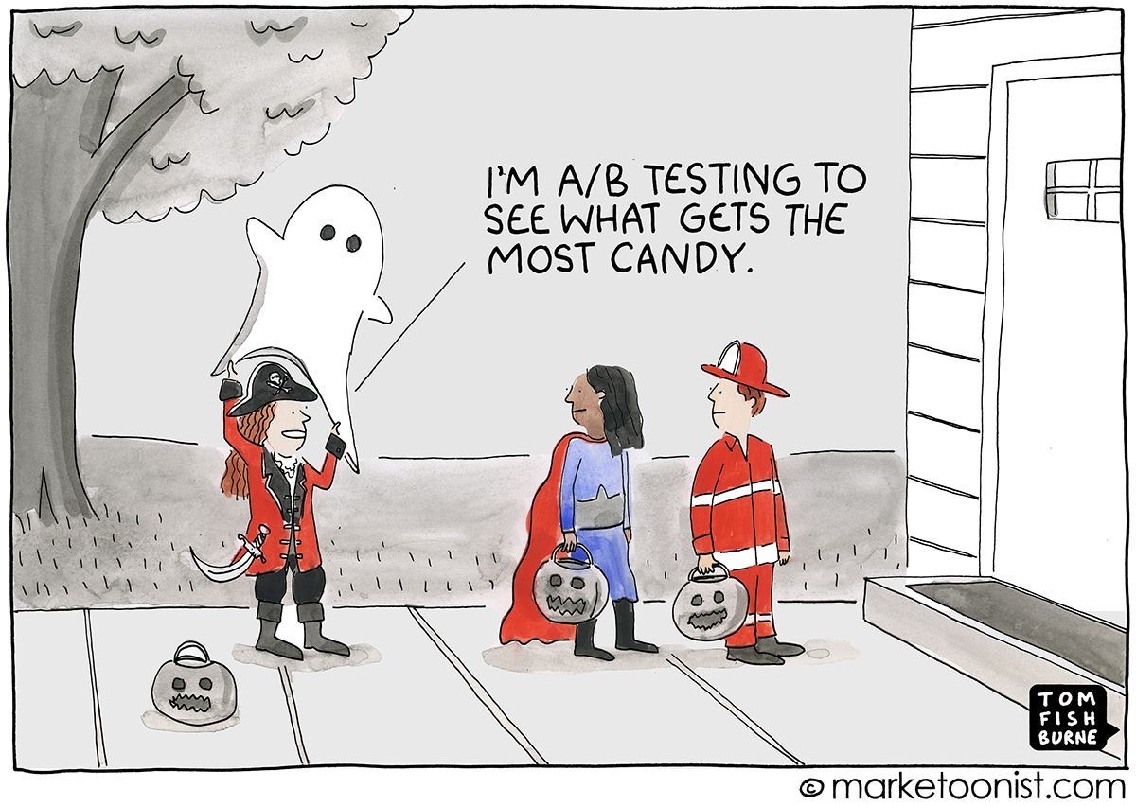
Remember to test!

Slide 17
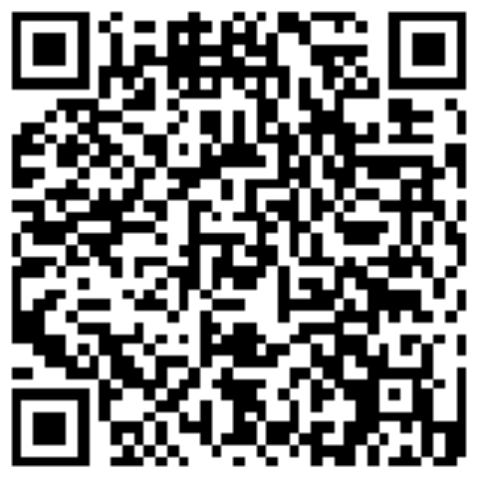
Thank you!
Karen Hatfield
Pythia Marketing Strategy
©Pythia LLC. All rights reserved.

Slide 18
Bonus!
©Pythia LLC. All rights reserved.

Slide 19
Tips & tricks
Invest in making your branding, strategy, and plan solid. Having those elements done with thought and rigor make subsequent steps clearer and easier to execute.
Create your FAQs from the questions you typically get asked. Use them on your website and as the basis for creating content for different stages in the customer journey.
Marketing automation can take a lot of pressure off of you and lead to a better experience for your prospects and customers. And it doesn’t have to cost a fortune.
Make the most out of every tactic.
When you participate in a trade show, webinar, or other event, think beyond the “day of.” What can you do before the event to reach people, promote your presence, arrange meetings, and direct them to you when they’re at the event? How will you collect names/contacts at the event itself, and give people a reason to talk to you at the event? How will you follow up—not just immediately after the event, but moving them through the “consideration” stage?
Repurpose content. Tailor your content to the channel, but the “meat” can often be reused in meaningful ways. A blog post can be broken into chunks and used as social media posts. A good infographic or PDF can be offered as an incentive for email collection.
Leverage positive consumer feedback to your benefit. Highlight testimonials from customers, anonymizing as needed. Create case studies to help prospective customers see themselves in your work and follow your plan for solving their problem.
Don’t try to be on every social media channel or implement every possible marketing tactic. Focus on where you can make the best impact and reach the most prospective customers.
©Pythia LLC. All rights reserved.

Slide 20
Start with your business goals + do a little math
How many clients do you need to achieve your target revenue?
Revenue = # of clients * average spending per client
Conversion rate = Out of every 10 people you talk to, how many become clients?
1 in 3 = 33%
1 in 10 = 10%
1 in 100 = 1%
The number of prospective clients you need to reach in a given period is the number of new clients needed divided by your conversion rate
If you need 50 new clients in a year and you have a 10% conversion rate, then you need to “talk” to 50/(.10) prospects in that year or 500 people
The general rule is that someone needs to hear your message 9 times before they take action
It is beneficial to reach your prospects multiple times within a purchase cycle
50/year
= 500
per year
.10
conversion rate
This is how many people you need to reach with your marketing plan in each time period.
If your goal is 50 new clients in a year and your prospect number is 500 people to reach, that’s how many people you have to reach each year (without subtracting repeat customers).
If your target is monthly or weekly, adjust accordingly!
©Pythia LLC. All rights reserved.

