Slide 1
MAUGE.COM
CHICAGO BUILD 2024
CHICAGO’S BOUTIQUE BRAND EXPERTS
BRANDING PRINCIPLES: HOW TO AMPLF Y YOUR BRAND

Slide 2
Businesses live through their brands, and brands live through their creative.
INTRODUCTION
Energize, clarify, differentiate. That’s what good brands do.
But it takes work. And that work starts with naming.

Slide 3
NAMING YOUR BUSINESS OR PRODUCT
Keep the name simple but make sure it’s clean
(not used elsewhere)
Engage a trademark attorney EARLY to assist in securing a name
Purchase all the associated domains
Develop an Email address consistent with the entity name

Slide 4
NAMING SAMPLES

Slide 5
Knowing success takes collaboration from the start, we open by listening to your story how you tell it — focused on who you serve, how you serve them, and where we fit in. Then, once we discover your wants and audit your assets, we explore your market to define your needs, establish a scope, and plot a proper course of action.
BUILD YOUR BRAND NARRATIVE

Slide 6
Create Your Product Definition
BUILD YOUR BRAND NARRATIVE
What type of market - B2B, B2C, Commercial, Residential, Retail?
Who is the end user?
Clearly Communicate Your Brand Promise

Slide 7
Create Your Messaging
BUILD YOUR BRAND NARRATIVE
Equipped with our insights and jointly-craft strategy, we build
— prototyping creative that manifests your purpose and communicates your impact, before iterating options and applications alongside you.
The brand narrative will incorporate all of the elements of your product definition

Slide 8
Good brands are memorable brands. And since their colors, logos, and icons are what people see first, their signatures are what people remember most.
BUILD YOUR BRAND NARRATIVE

Slide 9
Your BRAND Consists of the Following Elements
BUILD YOUR BRAND
Brand Narrative
Logo – ligature only or includes an icon
Typography system – font
Color Palette
Imagery

Slide 10
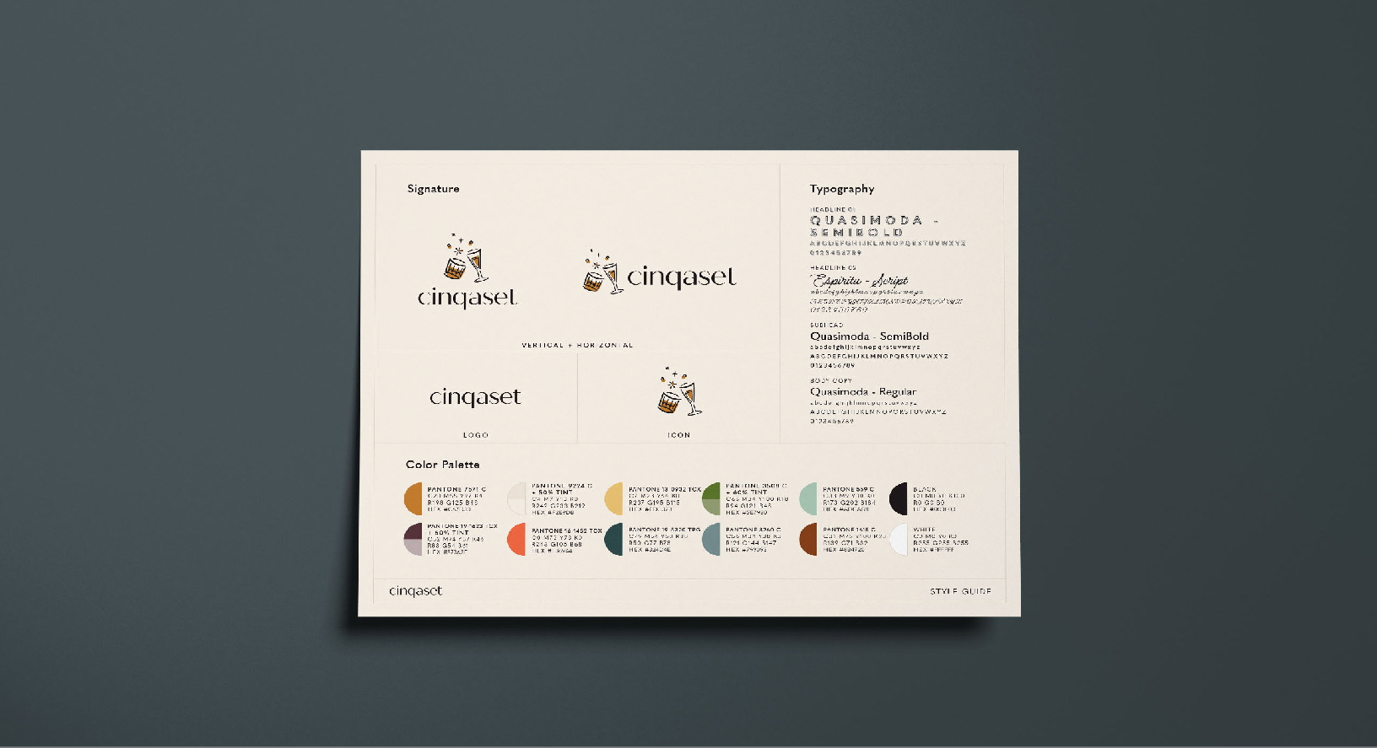
SAMPLE STYLE GUIDE

Slide 11
SAMPLE BRAND GUIDE

Slide 12
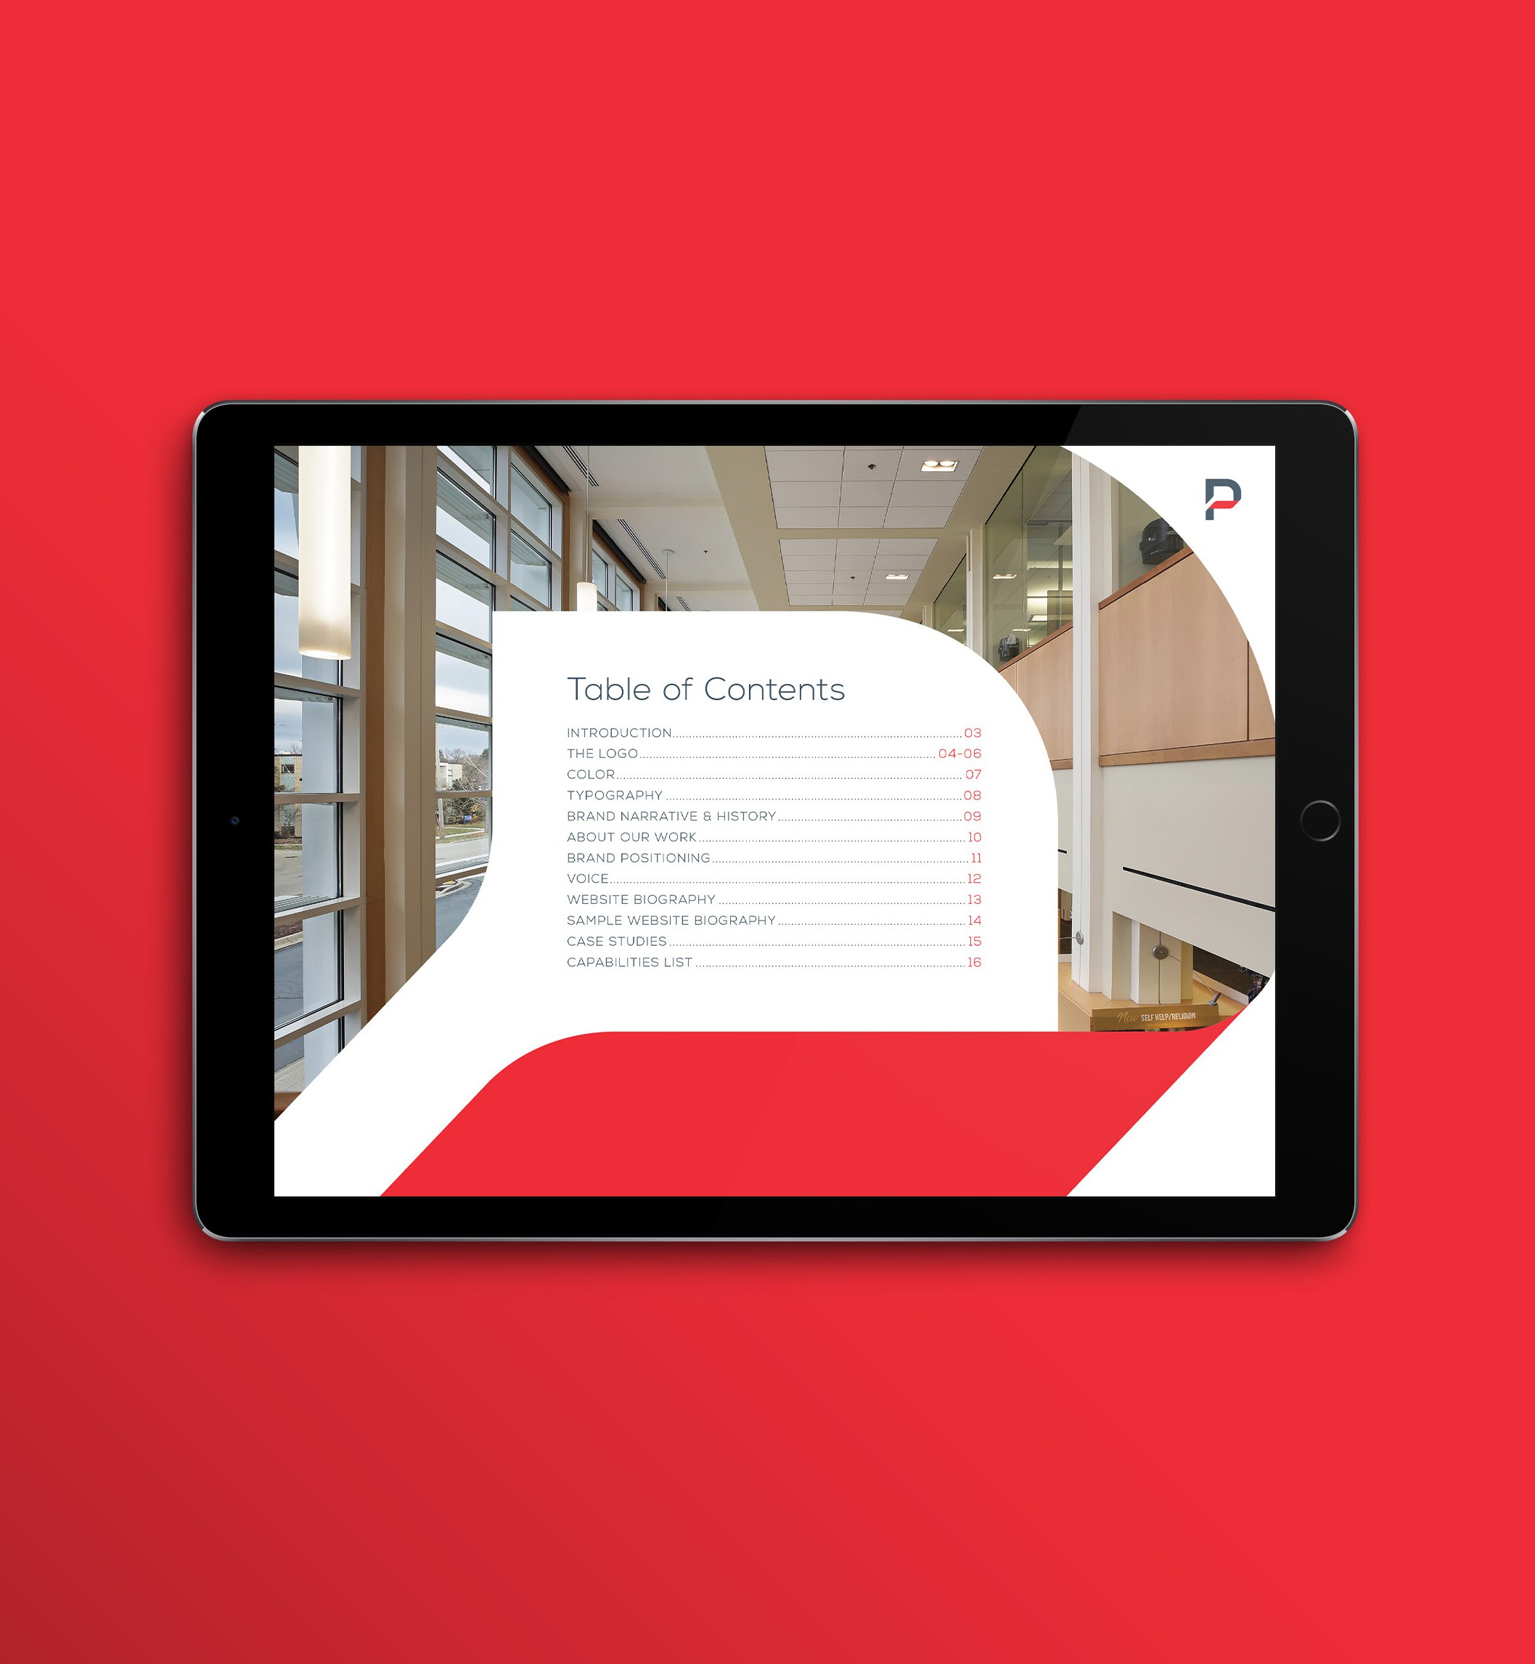
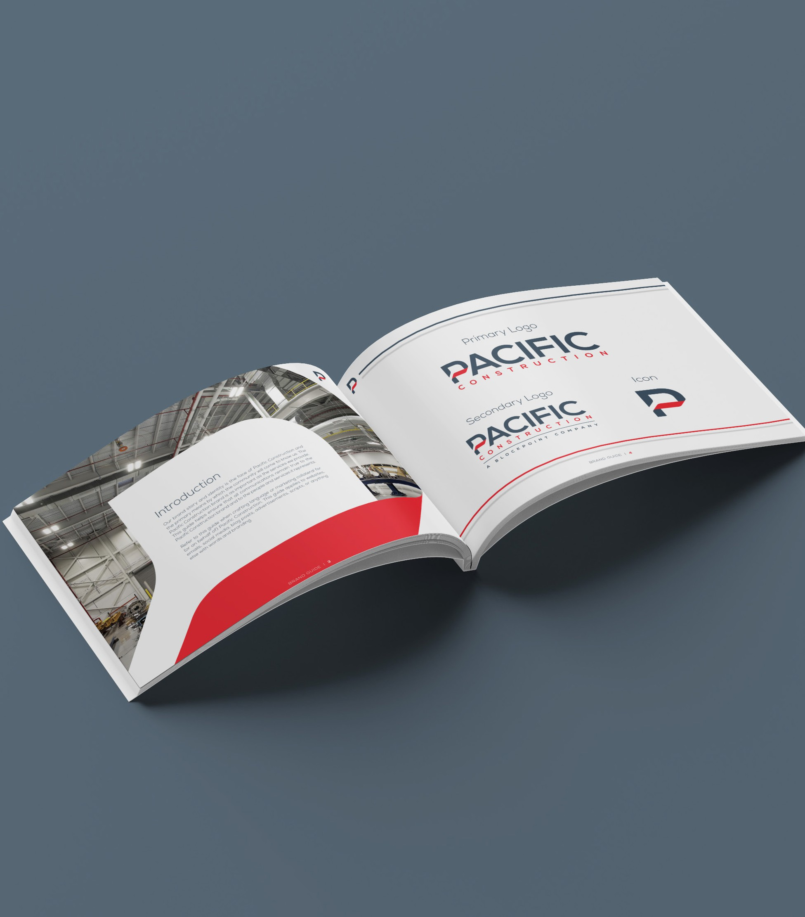
SAMPLE BRAND GUIDE

Slide 13
A Brand Manual is the Guide
to Defining the Usage Rules of Your BRAND
SAMPLE BRAND MANUAL
Name
Slogans
Product Definitions
Web Domains
Logotypes
Icons
Typographic System
Color Palette
Imagery

Slide 14
A Style Guide or Brand Manual
is your Corporate Identity Rule Book!
YOUR CORPORATE IDENTITY
Name
Slogans
Product Definitions
Web Domains
Logotypes
Icons
Typographic System
Color Palette
Imagery

Slide 15
Create a Marketing Plan that includes
MARKETING YOUR BRAND
Goals
Target Demographics
Primary Messaging
Channels
Cadences
Ad Types
Budgets

Slide 16
Design + Customize Branded Ads for Multi-Channel Campaigns
MARKETING MIX
OOH / OOO
Search Engine
Social Media
Email
Radio
Print
Events
Promotables

Slide 17
Digital Ad Content
DIGITAL MIX
Google Search Ads
Retargeting Ads
IP Targeted Ads
Social Media Ads
Facebook Posts + Stories
Instagram Posts + Stories

Slide 18
© 2024 MAUGE INC.
FOR MORE INFORMATION
GINNA RYAN | BUSINESS DIRECTOR | 773.328.5764
CARMEN MAUGERI 09.30.24 | CREATIVE MARKETING DIRECTOR | 773.328.5762
CHICAGO’S BOUTIQUE BRAND EXPERTS
1629 N. MILWAUKEE AVE, 2ND FLOOR | CHICAGO, IL
773.395.9919

