Slide 1
Low-Carbon Concrete Solutions: Reducing Environmental Impact in Construction
Robert Rescot, Ph.D., P.E.
Executive Director
Notes:
Scouting video playlist: https://www.youtube.com/playlist?list=PLo9XIs4IIoGcYppogYqZ4vdSfomO3nrDT

Slide 2
Learning Objectives
Understand how cement technology has progressed to create concrete that may looks the same but has been engineered to reduce carbon footprints, even up to being carbon negative.
Learn the about the lifecycle of concrete and how it can be rehabilitated, repaired, and/or recycled to make today’s investment into multi-generational investment
Learn about Environmental Product Declarations (EPDs) for cement and concrete that define the carbon footprint created for construction. Contextualizing this against the life cycle of concrete provides useful data for quantifying a carbon footprint and choosing the best suited low carbon concrete options.
Learn about how construction techniques have changed to optimize the use of concrete and how its use opens the door for other environmentally friendly features such as electric vehicle infrastructure.

Slide 3
Cement Technology

Slide 4
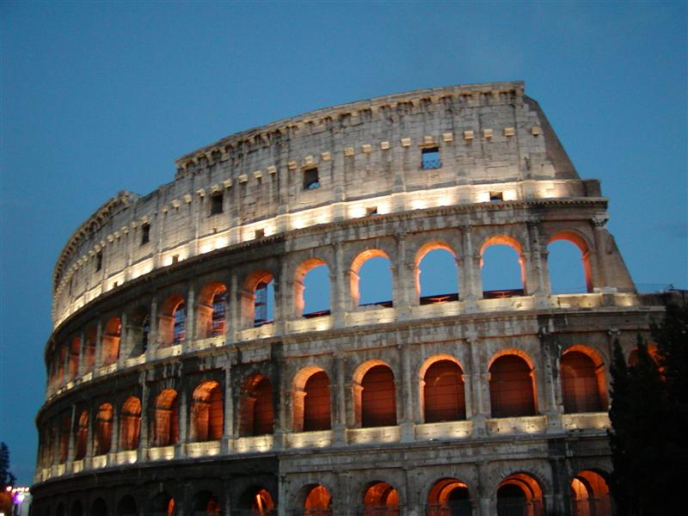

Slide 5
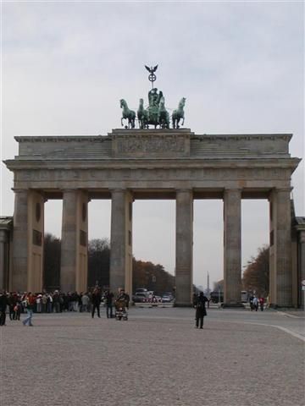

Slide 6
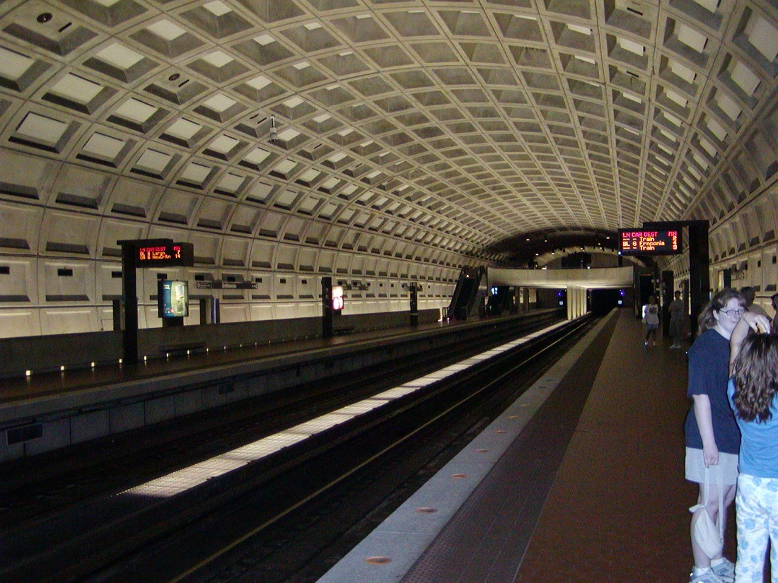

Slide 7
Are these all the
same concrete?

Slide 8
Are these all the
same concrete?
NO!

Slide 9
What is Concrete?
Cement
Water
Coarse Aggregates
Fine Aggregates
Other Chemicals
Air

Slide 10
What is Cement
Limestone
Clay
Fly Ash
Chalk
Alumina
Shale
Sand
Iron Ore
Kiln Fired @ 1,500-3,000°F

Slide 12
Variations
Natural impurities in materials
Grain sizes
Material ratios
Heating temperatures
Other additives

Slide 13
Heat Sources
Fossil fuels
Landfill generated gas
Other waste heat
Tire buring
Nuclear?

Slide 14
Aggregates
Naturally harvested (quarrying)
Synthethics
Captured carbon
Other waste products
Coffee grounds

Slide 15
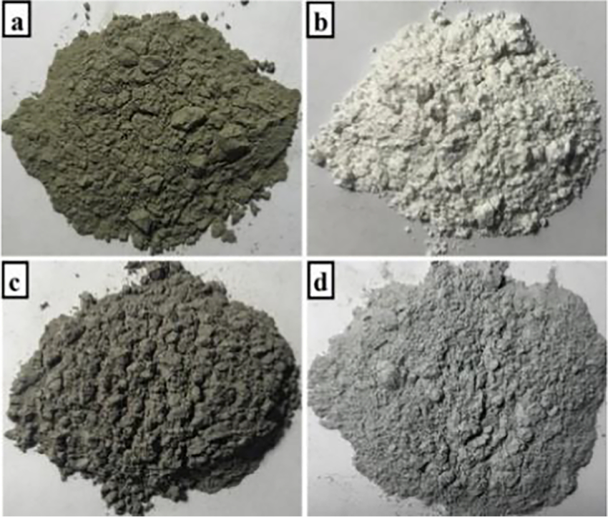
Reducing Cement Content
Supplementary Cementious Materials (SCMs)
Fly Ash (i.e. from power plants) (c)
Silca fume (from silicon production) – (d)
Blast furnace slag (from steel production)
Shale
Marble dust (b)
Calcinated Clays
Volcanic ash
Cement is (a)
Notes:
https://www.researchgate.net/figure/The-samples-of-a-cement-b-marble-dust-c-fly-ash-and-d-silica-fume_fig1_363858044

Slide 16
Carbon Capture Reusage
Capture C0₂ emissions from other sources
Inject emissions into wet concrete
C0₂ will react with other additives to mineralize
Multiple comercialized additives for this

Slide 17
Reducing C0₂
Alternative Heat Soures for Making Cement
Reduce Cement
Injecting Captured CO₂
Local Sources

Slide 18
Concrete Can be
Carbon Negative

Slide 19
Concrete Lifecycle

Slide 20
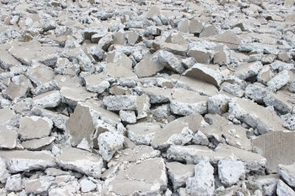
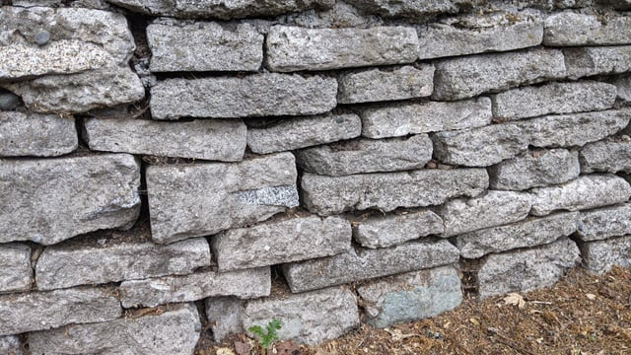
Cradle-to-Grave
Concrete construction can last for generations
Obsolete and damaged concrete can be recycled
Crshed and re-used for new concrete
Crushed for erosion control
Landscaping

Slide 21
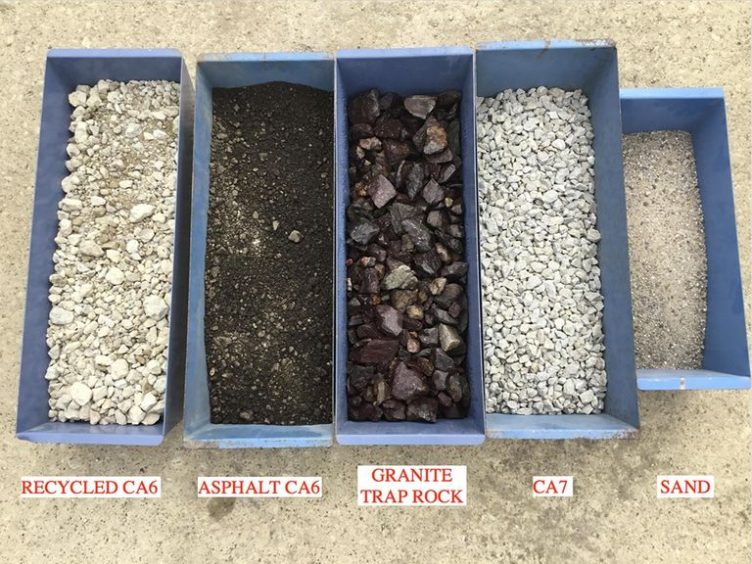
Notes:
https://springfieldcr.com/

Slide 22
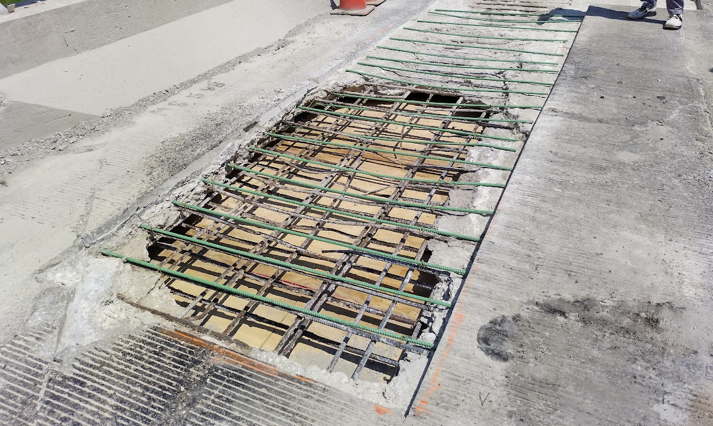
Causes of Damage
Physical Damage
Underdesigned
Unintentional usages (impacts)
Trees
Water
Freeze-Thaw
Corrorion of steel
Chemical Reactions
De-icing agents
Chemical spills
Alkali-Silica Reactivity (ASR)
Improper construction

Slide 23
Concrete Maintenance
Clean expansion joints
Maintain drains
Keep concrete clean and free of chemicals
Advoid physical damage i.e. dragging or scrapping

Slide 24
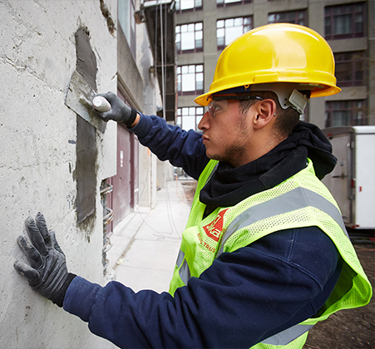
Concrete Repairs
Cut/Grinding out damage
Drill in connecting steel
Replace steel
Place concrete
Skim coat
Saw cut/ drill to stop crack propagation
Diamond grind surface

Slide 25
Environmental Product Declarations - EPDs

Slide 26
EPDs:
Quantifying
Environmental
Impact

Slide 27
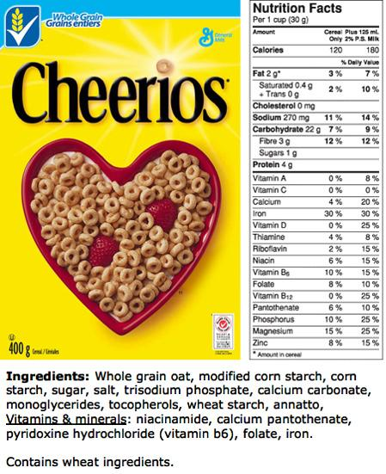

Slide 28
Unit of Measure:
Global Warming
Potentials (GWP) KG-CO₂
(equivalent)

Slide 29
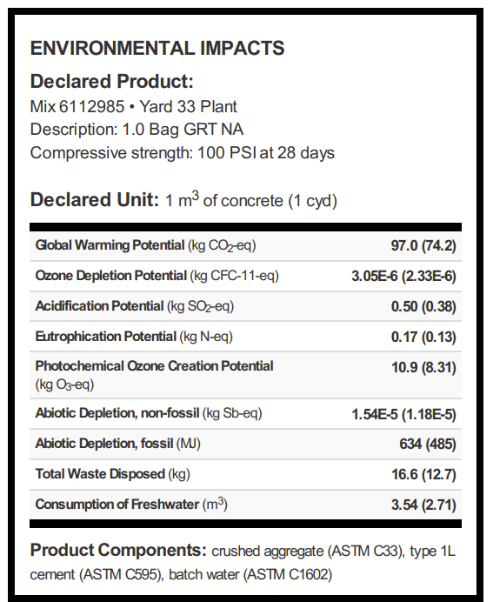
This Environmental Product Declaration (EPD) reports the impacts for 1 m³ of ready mixed concrete mix, for use in business to-business (B2B) communication meeting the following specifications:
ASTM C94: Ready-Mixed Concrete
UNSPSC Code 30111505: Ready Mix Concrete
CSA A23.1/A23.2: Concrete Materials and Methods of Concrete Construction
CSI Division 03-30-00: Cast-in-Place Concrete

Slide 30
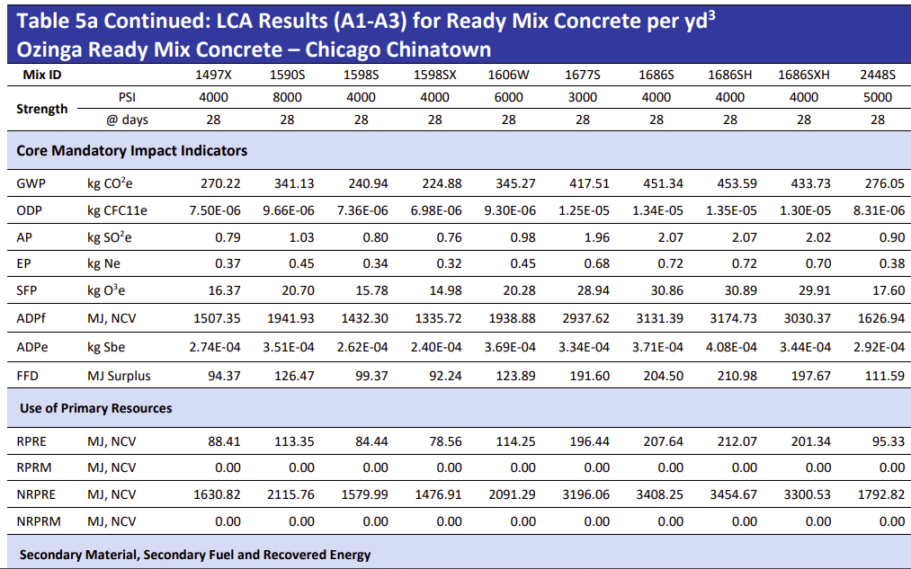

Slide 31
EPD Considerations
Raw materials sources
Production methods
Transportation
Construction

Slide 32
Other Conditions NOT in EPD
Site spcific issues
Conversion of forested land to industrial faciality
Engandangered speciales
Water sources
Runoff
Waste Disposal Options
Power sources
Expected life cycle

Slide 33
Need to factor EPDs
of alternatives to
expected lifecycle -
NOT up-front impact

Slide 34
EPDs can be part of
procurement
Process.
If you value it, spec it.

Slide 35
Specifying Low Carbon
Plan, design and engineer design with goals in mind.
Establish a carbon budget. Contractors need flexibility to meet goal.
Consider incentive bid credits for meeting or exceeding goals.
Standards already in place, many suppliers already on board

Slide 36
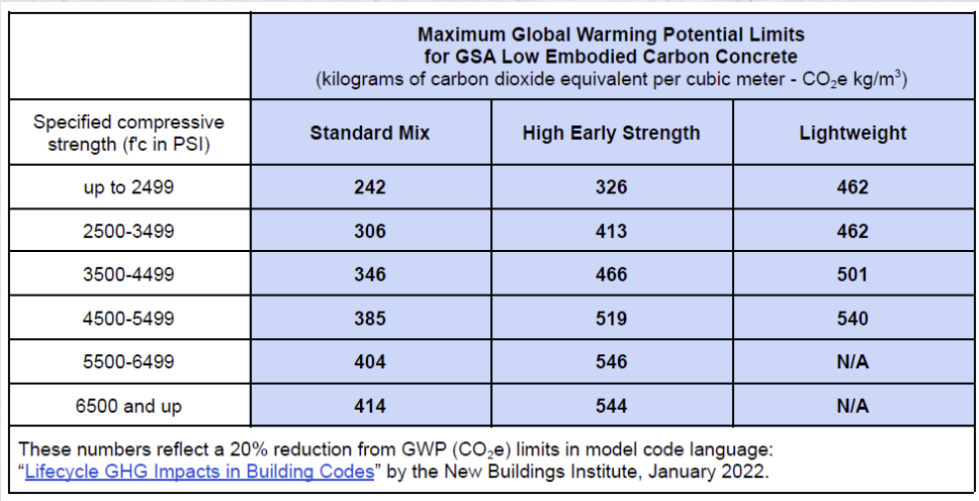
GSA Requirements

Slide 37
Modern Construction

Slide 38
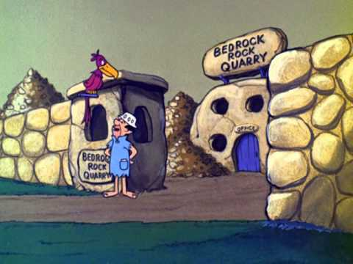

Slide 39
Advances in Construction
Blended Cement
Admixtures
Fiber Reinforcement
Recyled Materials
Engineering

Slide 40
Blended Cements
Optimal mix of cement elements
Combines traditional cement with other materials to reduce cement
Fly Ash
Slag
Silica Fume
Volcanic Ash
(More)

Slide 41
Admixtures
Cheicals to alter properties
Reduce water
Decrease set time
Increase set time
Increase air content
Increase workability
Hundreds of products to meet specific needs
Curing compounds

Slide 42
Fiber Reinforcement
Small fibers blended to enhance strength, reduce cracking
Simmilar to geo-textiles
Omni directional enhancement
Fiber types
Fiberglass
Polypropylene / Nylon
Kevlar
Steel
Sisal
Coconut

Slide 43
Looking
Forward….

Slide 44
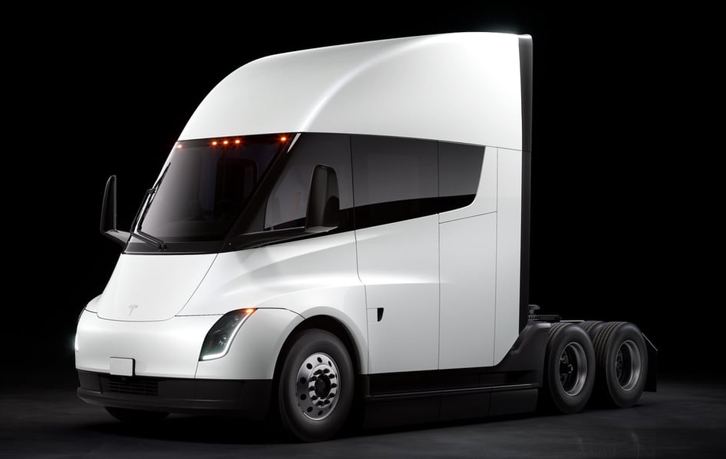

Slide 45
Electric
Trucks
are a
Game Changer

Slide 46
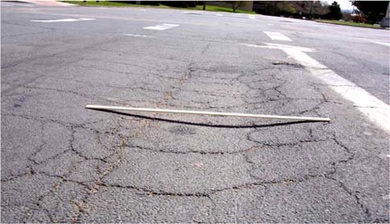
Electric Vehilce Factors
No transmission – immediate & direct power to wheels
Increased wheel torque
Increased loads (battery + cargo)
Asphalt pavements can not withstand the increased

Slide 47
Engineering
Enhanced modeling optomizes materials needs
Helps reduce material needs
Can compare multiple options to find optimal design
Product testing technology to optomize mix design
Field testing with maturity meters
Lab created strength curves
Options for pre-cast, cast-in-place, and ready mixed concrete

Slide 48
Questions?
Visit our Website www.ilcpa.org
Robert Rescot, Ph.D., P.E.
Executive Director rrescot@ilcpa.org
217-553-4756
?

