Slide 1


Low-Carbon Concrete for a Sustainable & Resilient Future Using Low Carbon Concrete to Build The Reed at Southbank, Chicago, IL
Eamonn Connolly, SE, PE
Director of Engineering,
McHugh Concrete Construction

Slide 2
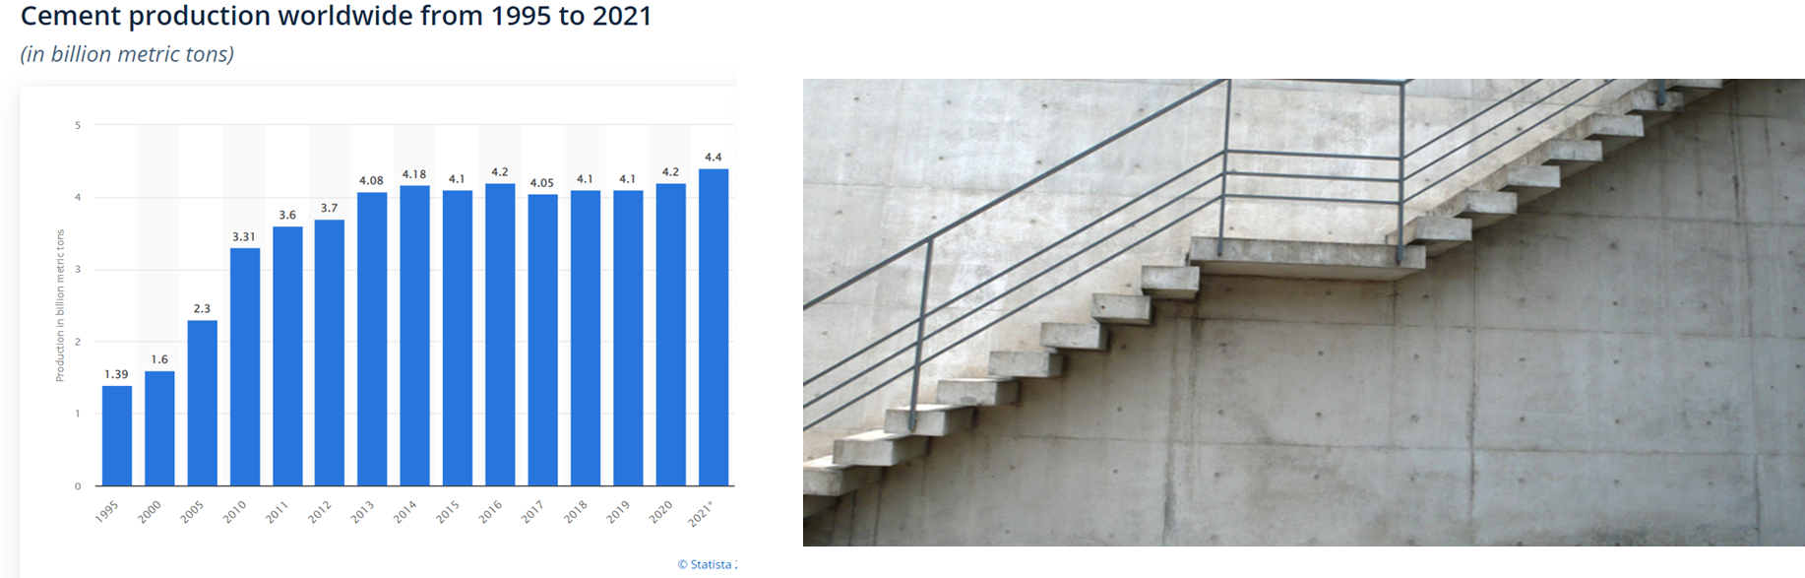
Concrete
The most widely used material in the world
Portland Cement production currently over 4.4 billion tonne per year
Cement production is around 8% of global CO2 emissions
AIA, ACI, ASCE, NRMCA, PCA, and other industry stakeholders are committed to rapidly and dramatically reduce CO2 emissions

Slide 3
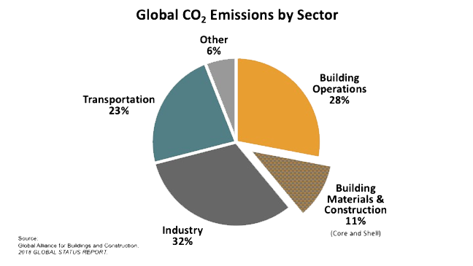
Low Carbon in Concrete Construction
What is it? How do we measure?
(KG CO2/material)
Global Warming Potential (GWP)

Slide 4
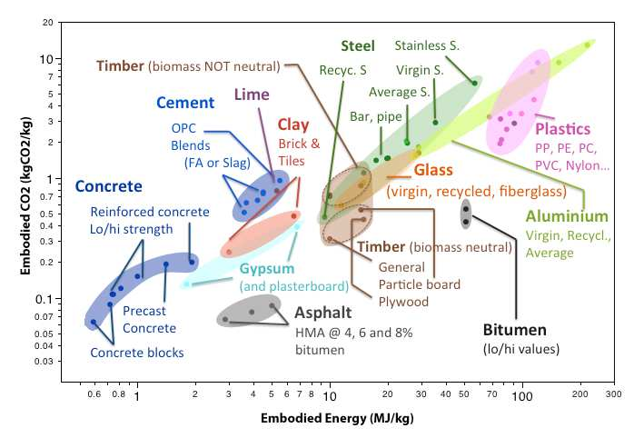
Embodied CO2 vs Energy
Embodied CO2 and embodied energy for materials typically used in the construction industry. Selection of data from Hammond(2011)
Intrinsically, concrete has a very low energy and carbon footprint compared to most other materials. However, the volume of Portland cement required for concrete construction makes the cement industry a very large emitter of CO2.

Slide 5
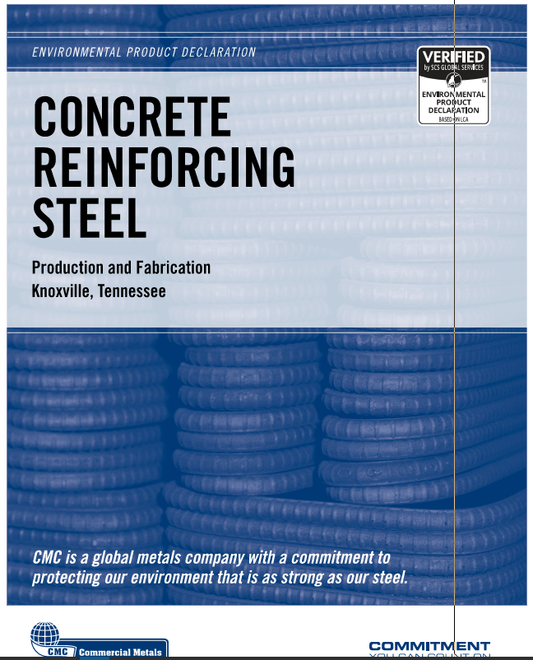
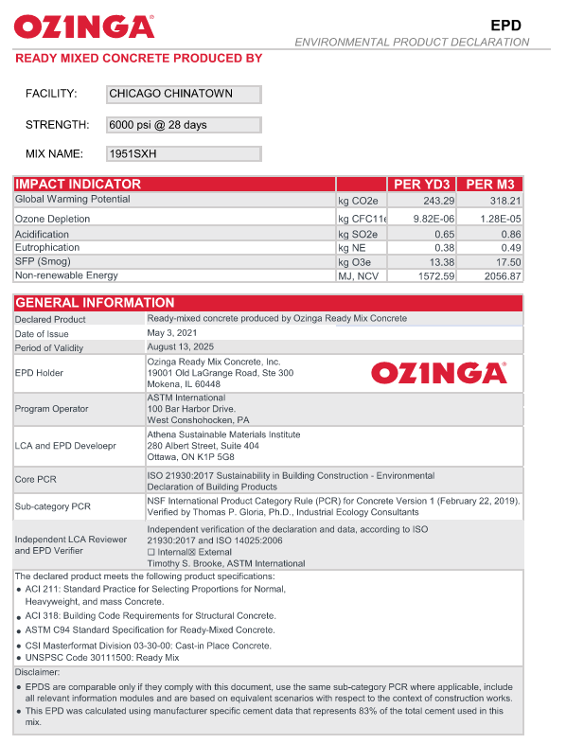
How to Verify
Life Cycle Analysis (LCA) to determine Global Warming Potential (GWP)
Environment Product Declaration (EPD) “carbon nutrition labels”
International Standard Methodology - ISO14025, 14040 & 14044
Tools
EC3 Embodied Carbon Calculator
OneClick LCA

Slide 6
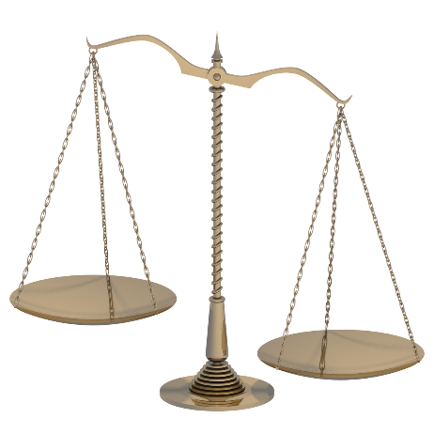
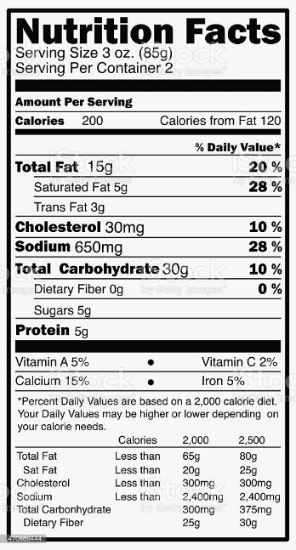
EC3 - Embodied Carbon in Construction Calculator
Online tool
Enables easy comparison and assessment of carbon emissions for various materials
Creates project carbon benchmark, budget & targets
Online Database of (EPD’s) Environmental Product Declarations for various materials
Many suppliers have uploaded their EPD’s to this database, many have not
Default values for concrete are very conservative
Use of default values will result in heavy bias towards other materials, such as mass timber
Architects, Engineers & Owners use this tool at inception of project to decide structural system

Slide 7
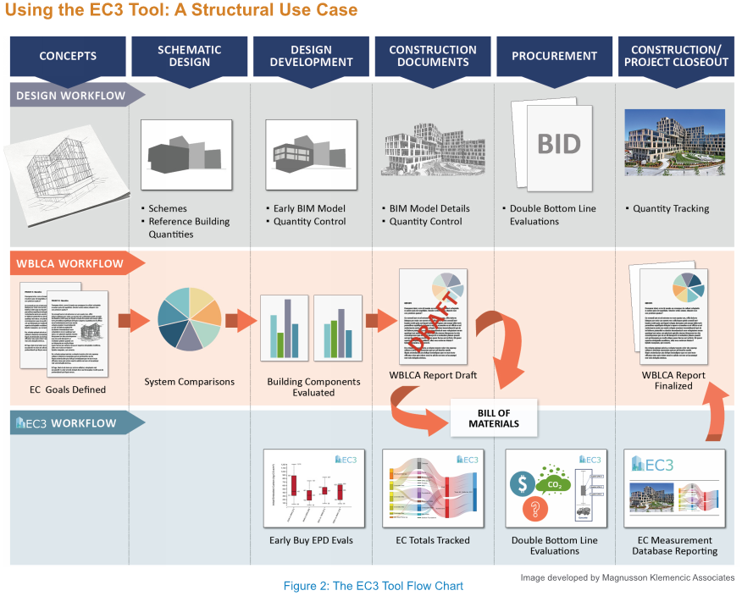
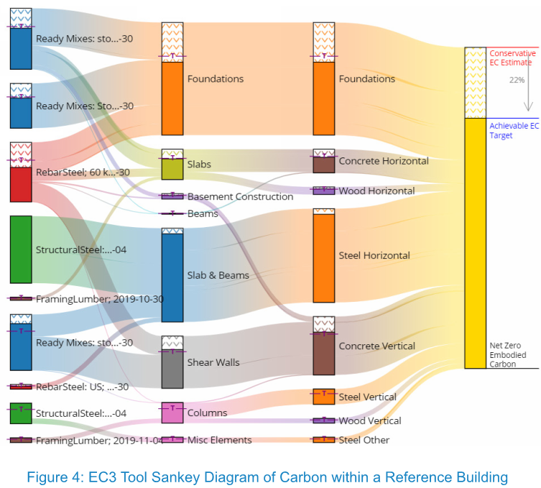
EC3 - Embodied Carbon in Construction Calculator

Slide 8
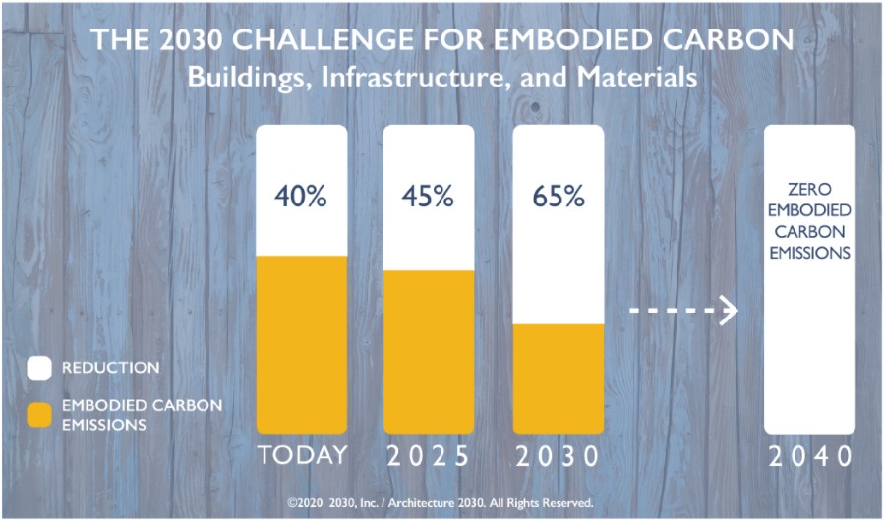
Why is this important to us?
CHANGE TO CONSTRUCTION
Industry
Government
Clients
Concrete is a big target for
embodied carbon reduction

Slide 9
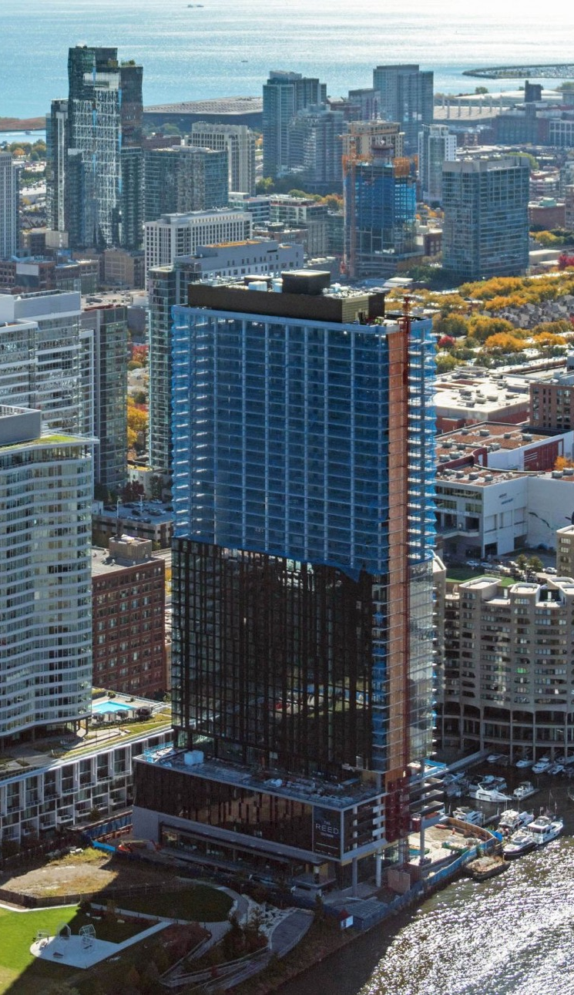
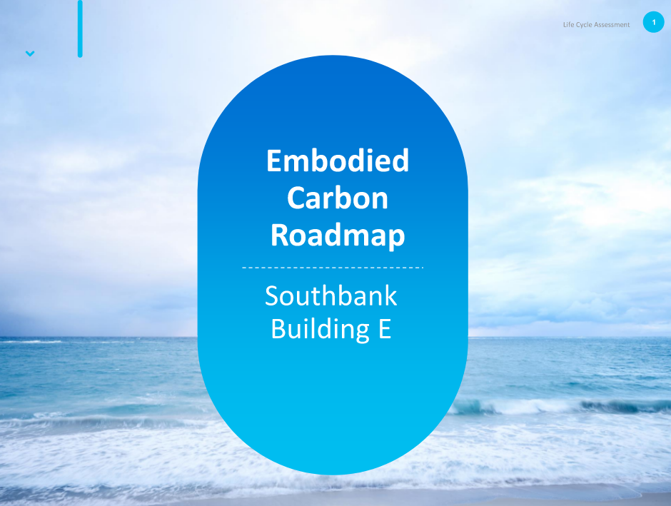
Movable Bridge Workshop
Movable Bridge Workshop

Slide 10
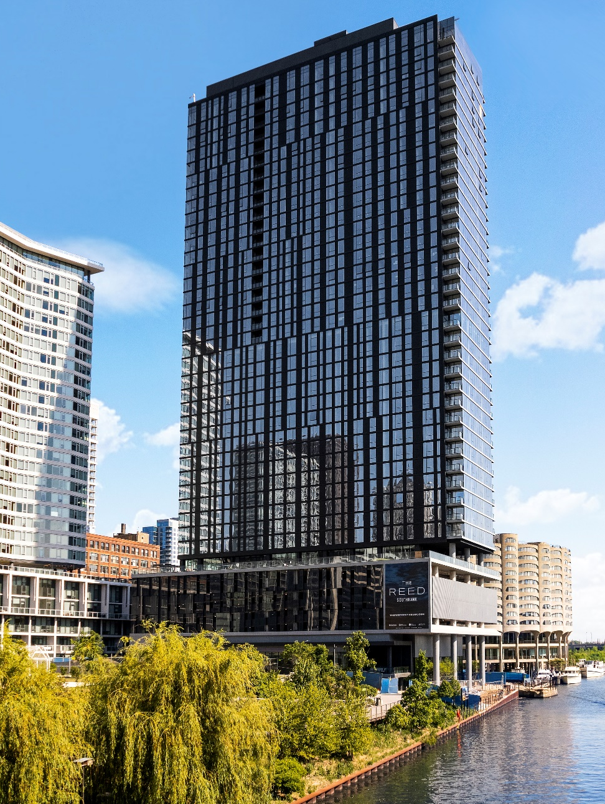
The Reed at Southbank Building E
663,000 sf, 41-story cast-in-place concrete structure
The Reed is the first high-rise in Chicago built with a new low-carbon concrete mix, replacing up to 30-70% of Portland Limestone cement with SCM
In partnership with Oremus Materials and Master Builders Solutions, our team helped develop this greener concrete mix to meet Lendlease’s goal in reducing building’s overall carbon footprint.
Our team maintained a three-day pour cycle throughout the duration of the project with a daily crew size of 90

Slide 11
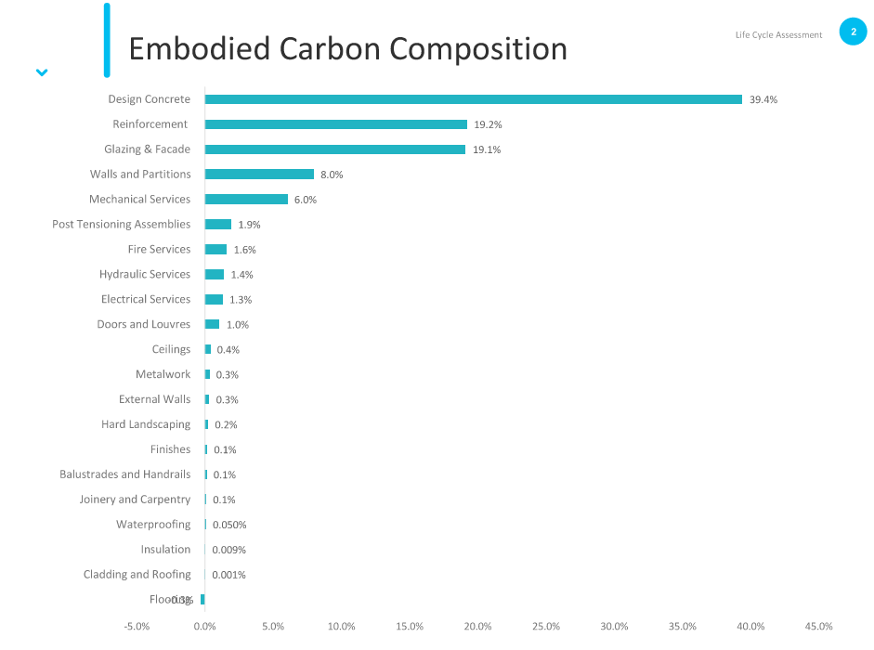
Embodied Carbon Composition

Slide 12
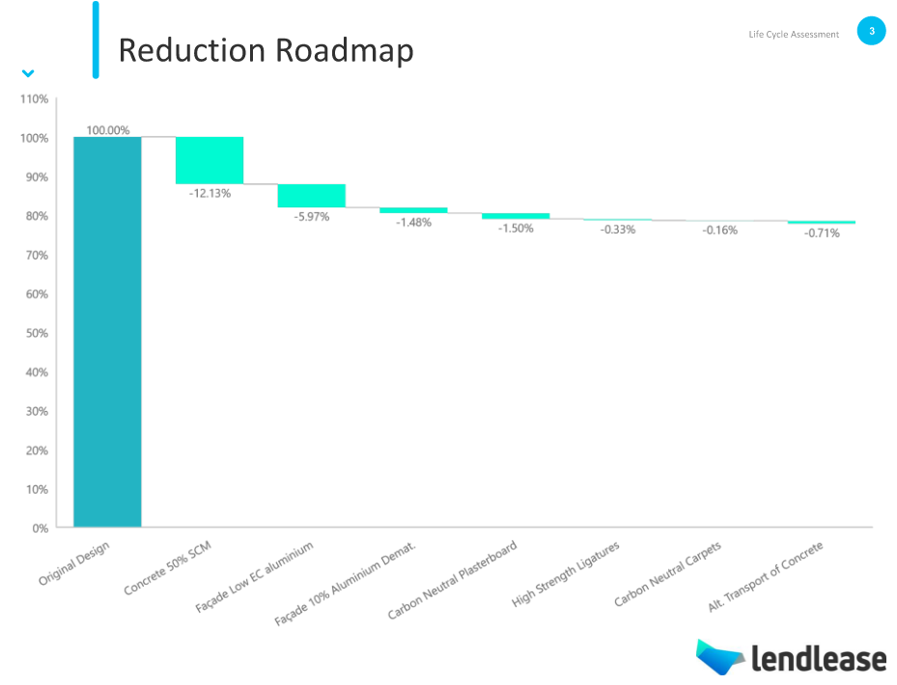
Reduction Roadmap

Slide 13
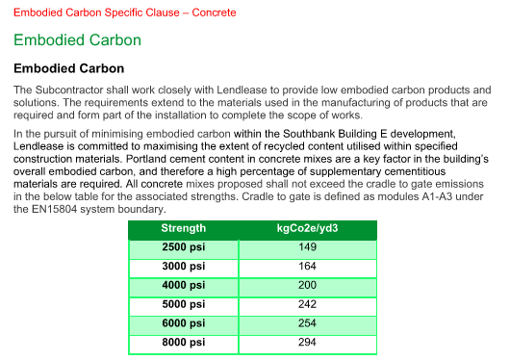
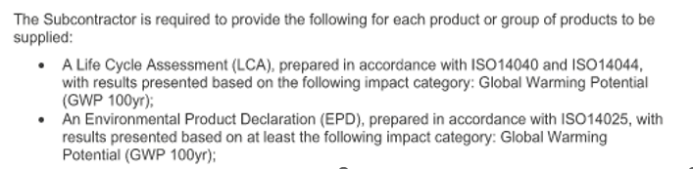
Lendlease’s Specifications for
The Reed at Southbank Building E

Slide 14
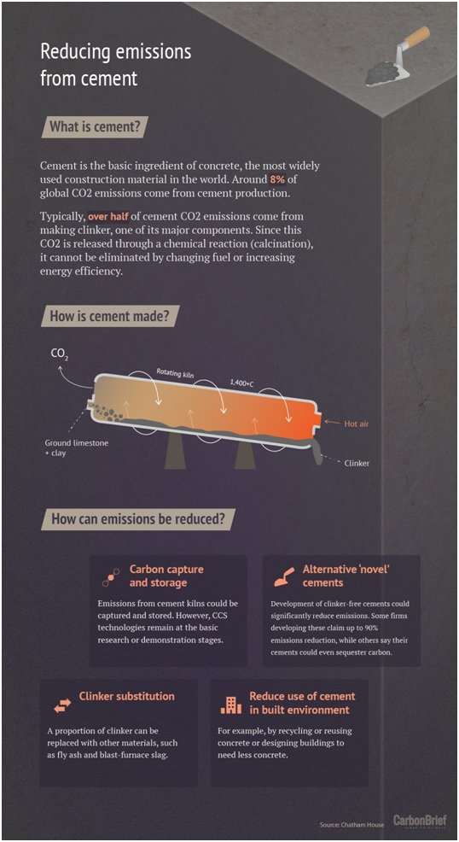
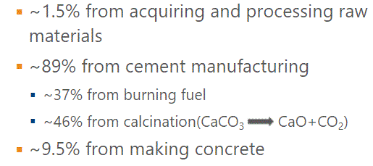
How Can We Make Greener Concrete?

Slide 15
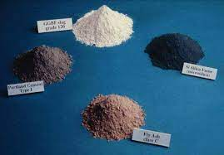
Take out the Portland Cement!!
Utilize Supplementary Cementitious
(SCMs)
Fly Ash
Slag
Silica Fume
(We are already doing this…)
New Strategies
Higher % SCMs
Portland-Limestone Cement (Type 1L Cement)
Ground Glass Pozzolan (GGP)
Limestone Calcined Clay Cements (LC3) (Metakaolin)
Bottom Fly Ash mining
Recycled Aggregate & Crushed hydraulic cement concrete
Pozzolans – burnt plant materials
Artificial fine and course aggregate created by carbon capture (“grow your aggregate”)
ACI is actively working to revise code to allow the use of new green strategies

Slide 16
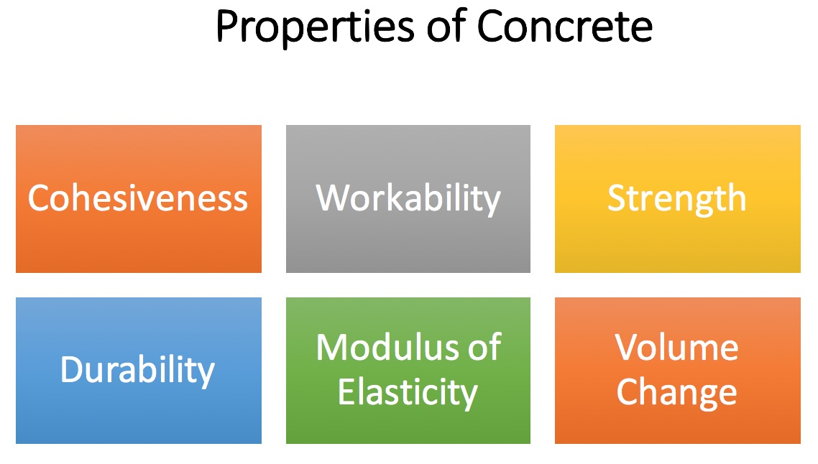
A High Replacement of Portland… WILL Change the Concrete
Slump loss rate
Pumpability
Workability
Set time
Finish ability
Curing Requirements
Early Strength
Weather Sensitivity
Long term strength
Durability

Slide 17
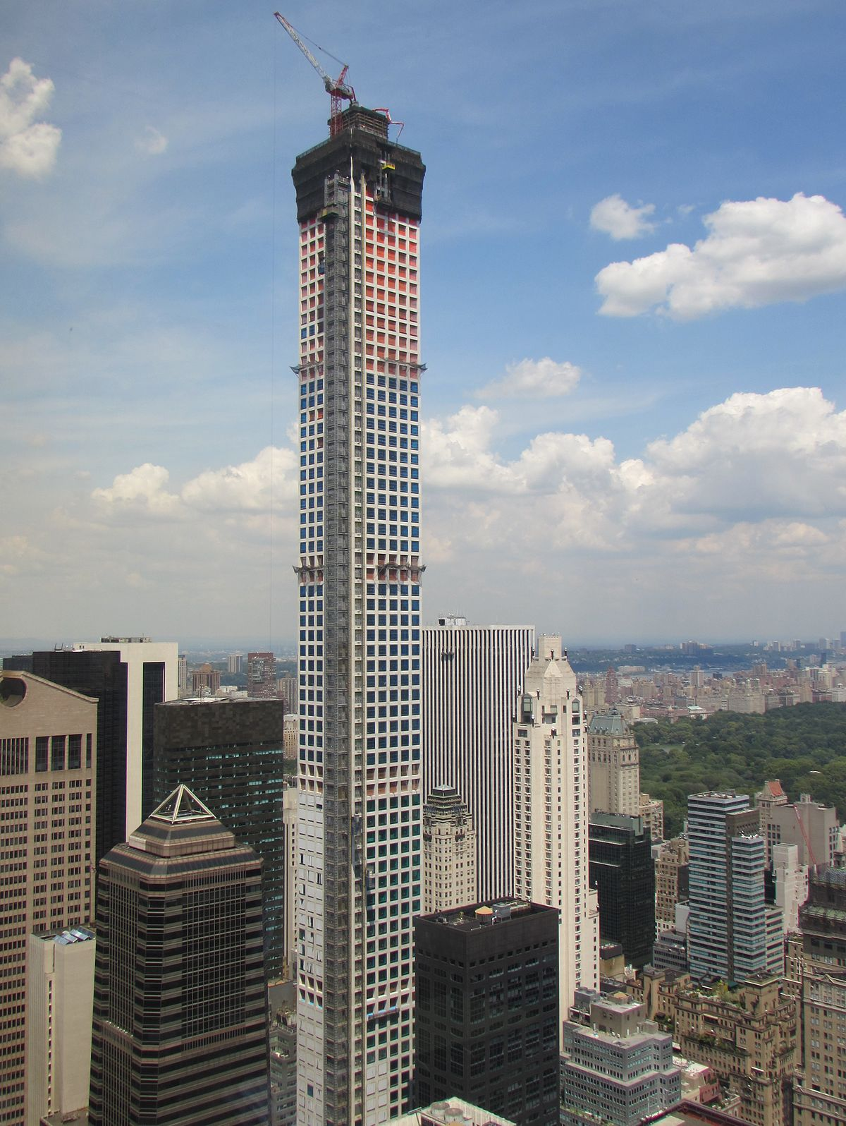
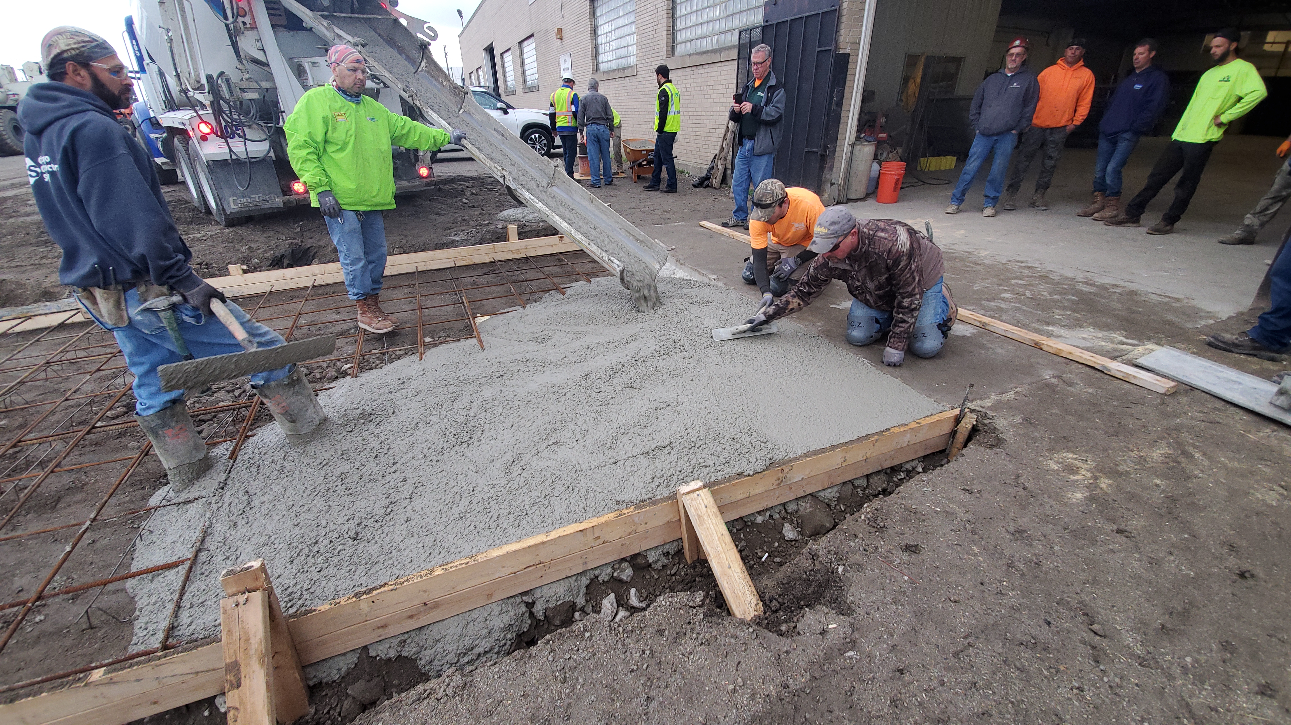
The Green Team – The Reed at Southbank
How did we meet the specifications?
Partnered with Oremus Material
& Master Builders
Green Sense Concrete
Previously used in New York at
432 N Park Avenue
Created a new mix design specific
for The Reed at Southbank

Slide 18
The Solution
14% Lower than spec requirements
32% Lower than NRMCA Average

Slide 19




The Future
Green Solution
Not Just Concrete
Rebar, PT, Formwork
Cost Impact

Slide 20
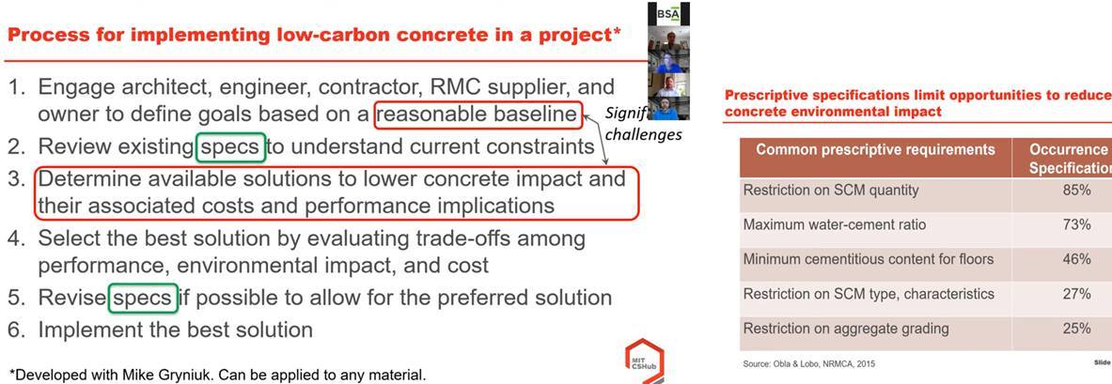
Specifications
Review specifications to permit low-carbon concrete

Slide 21
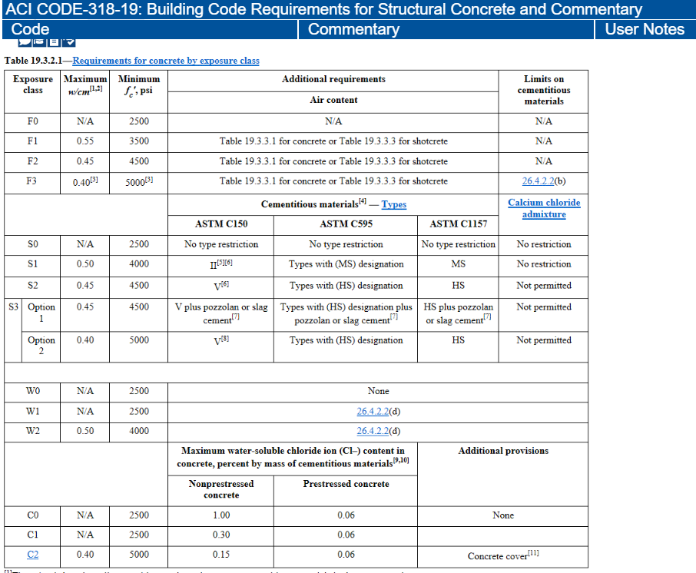
Increase with cm & Reduce f’c
Increase with cm ratio to max allowed by code based upon exposure class
Reduce f’c and extend time to achieve it
Could reduce cement requirements > 20% to 30%

Slide 22
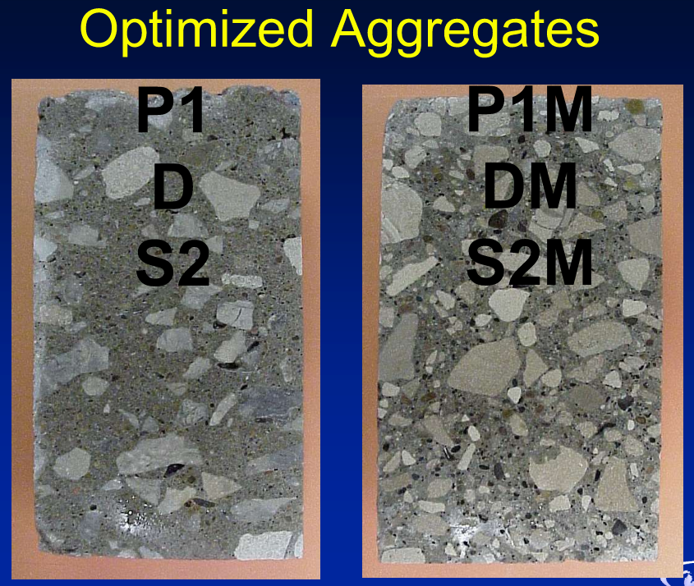
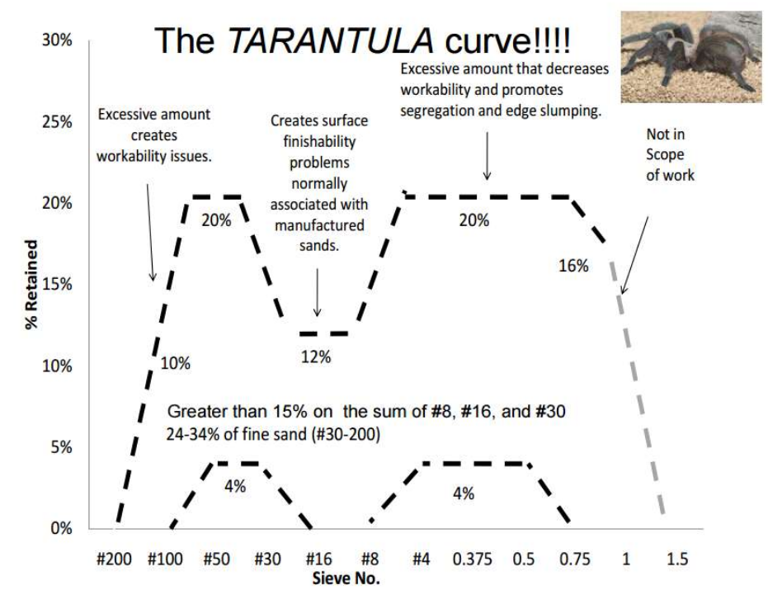
Optimized Mix Design
Replace cement with aggregate by better packing the aggregates to reduce paste volume
Move away from traditional proportioning such as absolute volume method (ACI 211, ACI 301, PCA) which does not consider aggregate grading and admixtures
Lower cement content does not mean lower strength!
Less shrinkage
Less heat of hydration
Approach can reduce cement requirements > 20% to 30%
Void Ratio Method – https://cptechcenter.org/publications
Tarantula Curve – http://www.trantulacurve.com/

Slide 23
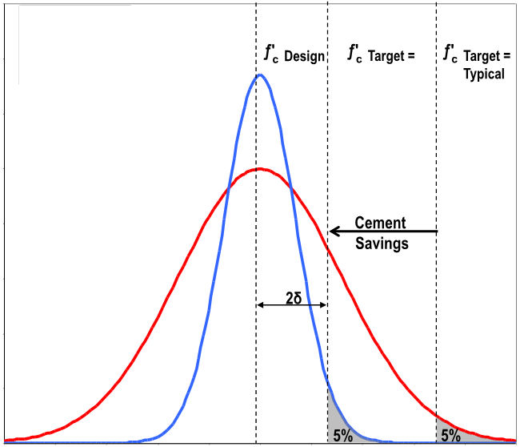
Reduced Ready-Mix Variability
Reduce the mix performance variability, will reduce cement required in the mix to ensure target design strengths
Concrete Testing is the primary source of variability
Could reduce cement requirements > 20% to 30%

Slide 24
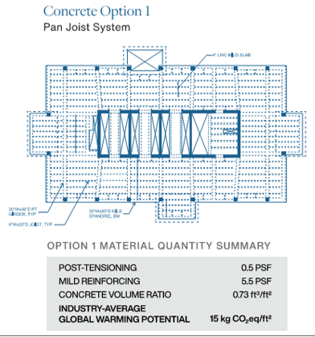
Other Green Strategies
Optimized structural systems to:
Reduce f’c and increase time to achieve it
Use round columns where possible
Reduce concrete volume wherever possible
Reduce column spacing --> reducing concrete in floor framing /utilizing RC framing
Example of Optimized concrete framing

Slide 25
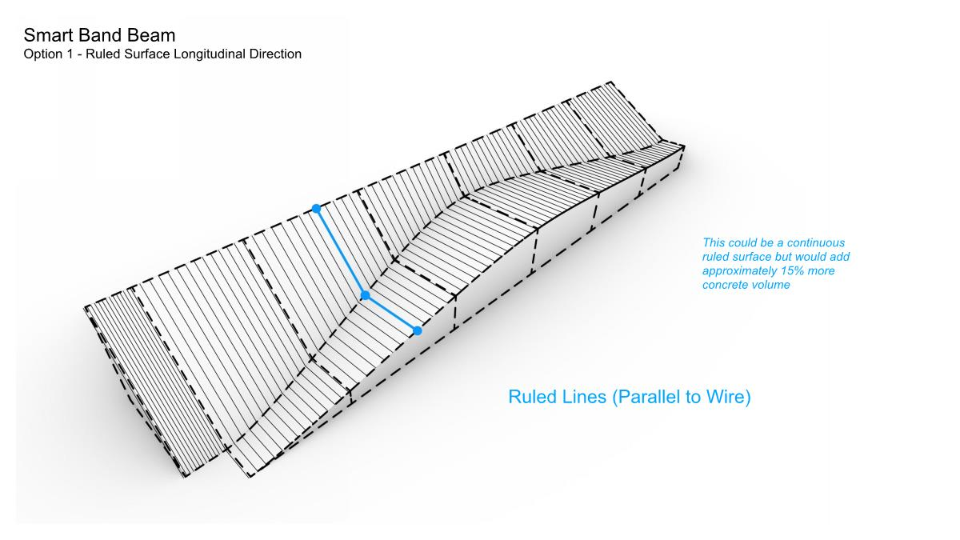
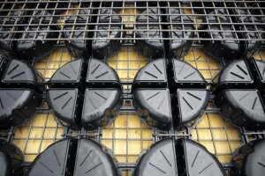
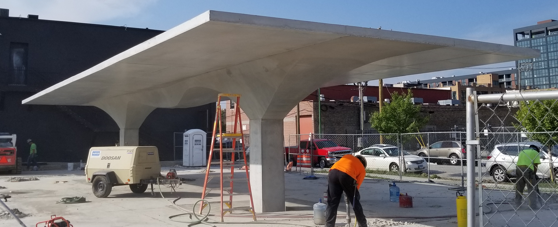
Other Green Concrete Strategies
Optimized structural systems to:
Reduce concrete volume
Void Forms
Novel Framing

Slide 26
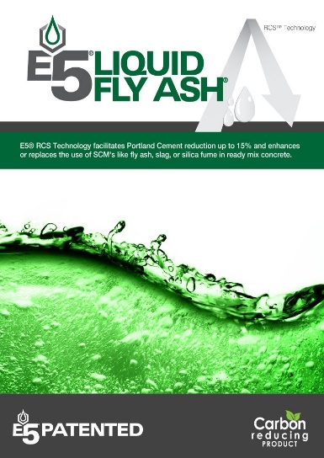
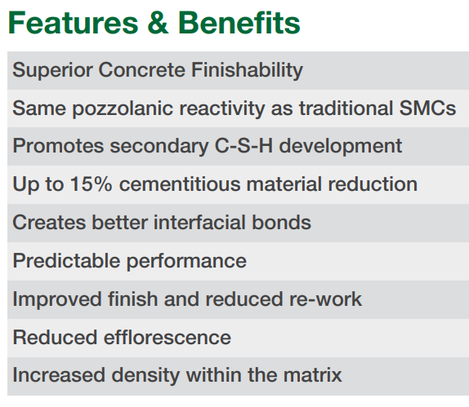
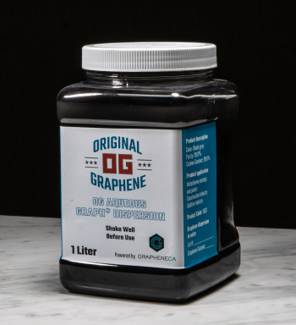
Admixtures!
Carbon Cure –
CO2 Mineralization
Nano-silica Pozzolanic Admixture
Graphene Admixture
Available
Already specified
4%-6% cement reduction
$
New to market
Up to 15% cement reduction
$$
Not commercially
available
Claimed 20% cement
reduction
$$$$

Slide 27
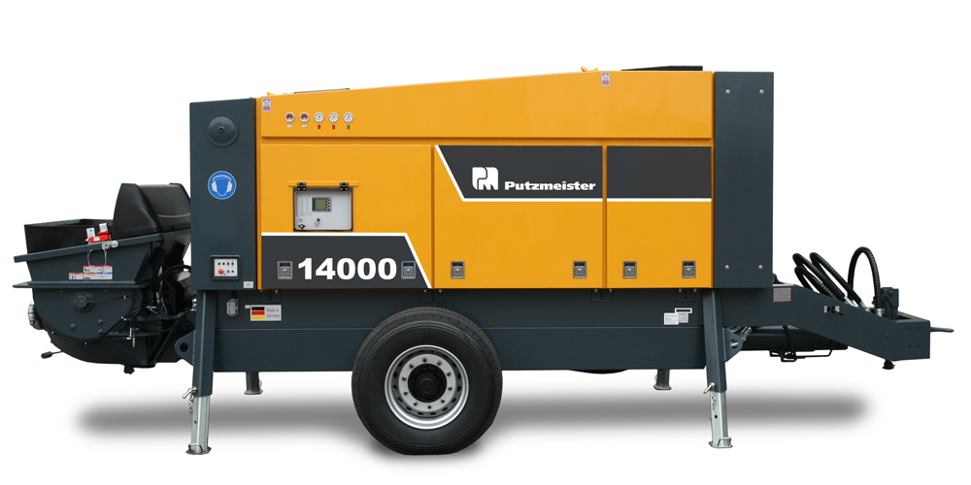
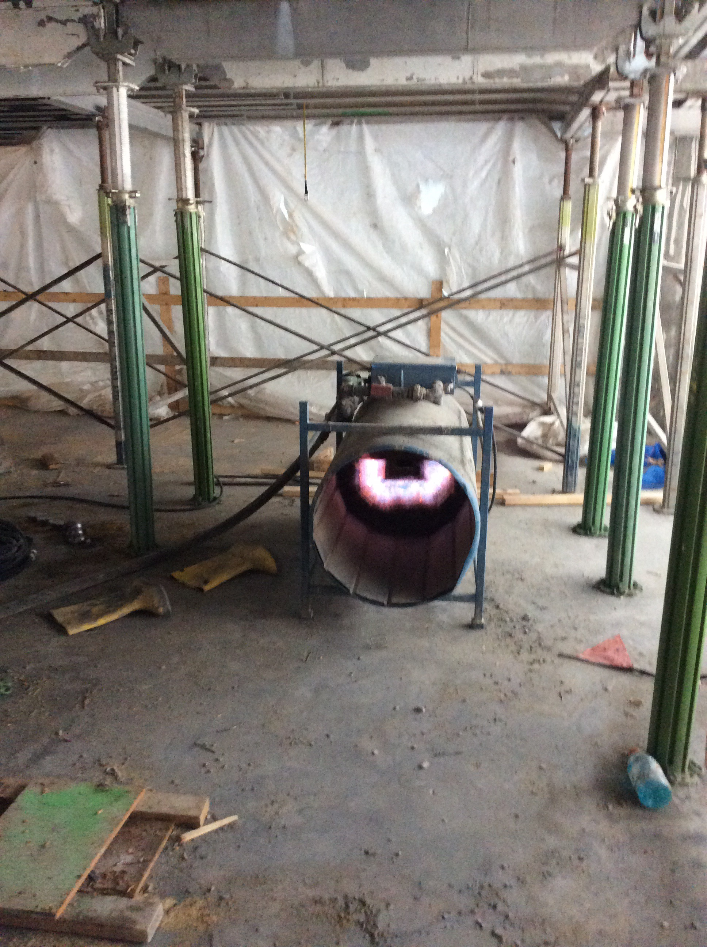
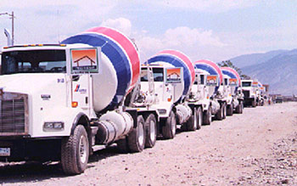
Other Green Concrete Strategies
Efficiencies on the job site
Reduce waiting times on the job site
Utilize NCA accelerator admixtures to reduce heating requirements during cold weather
Electric Vehicles and equipment
Electric Pumps!

Slide 28

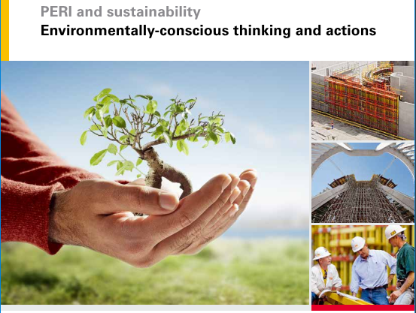
Other Green Concrete Strategies
Work with our formwork partners

Slide 29
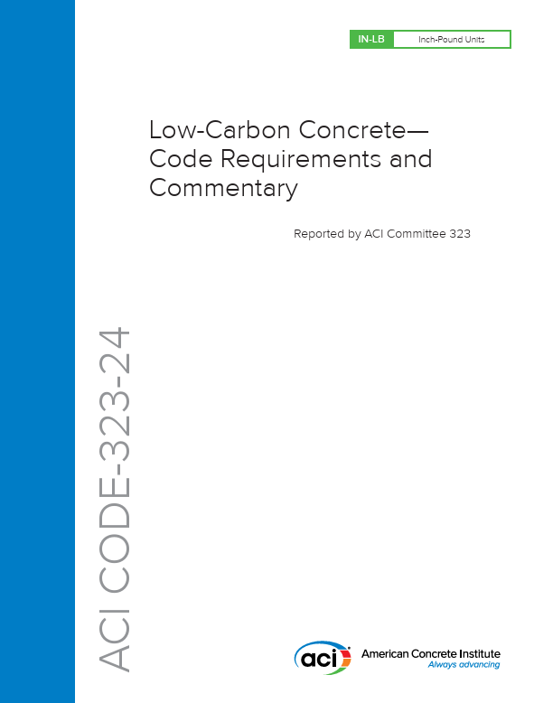
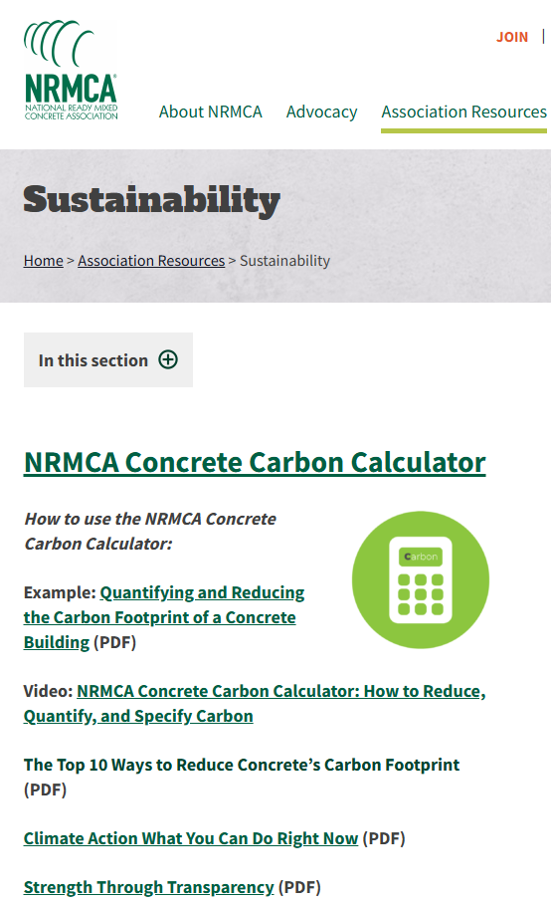
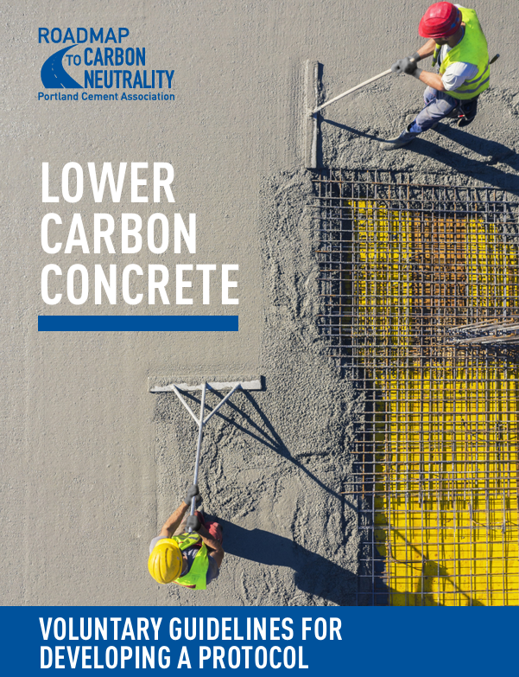
RESOURCES

Slide 30
Conclusions
Concrete can already be green and be made greener!
You can’t manage what you don’t measure
Concrete structures are resilient & long lasting >> 60 YEARS
Significant residual GWP Values beyond 60yrs considered in WBLCA
The best way to get green concrete is to specify it
Use of SCM’s are a current way to significantly reduce GWP

Slide 31
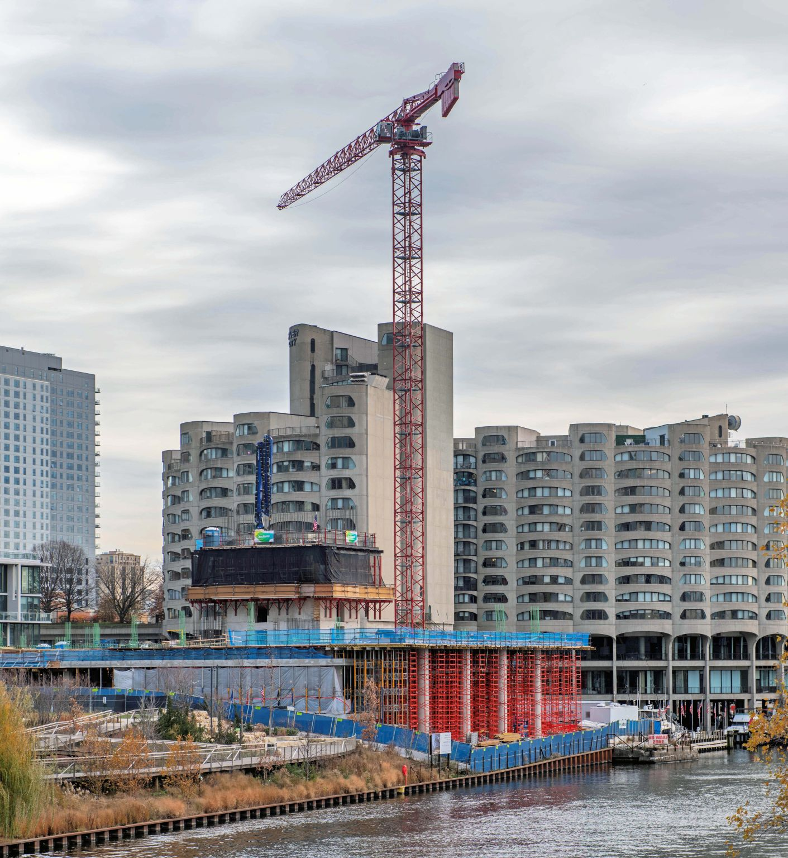
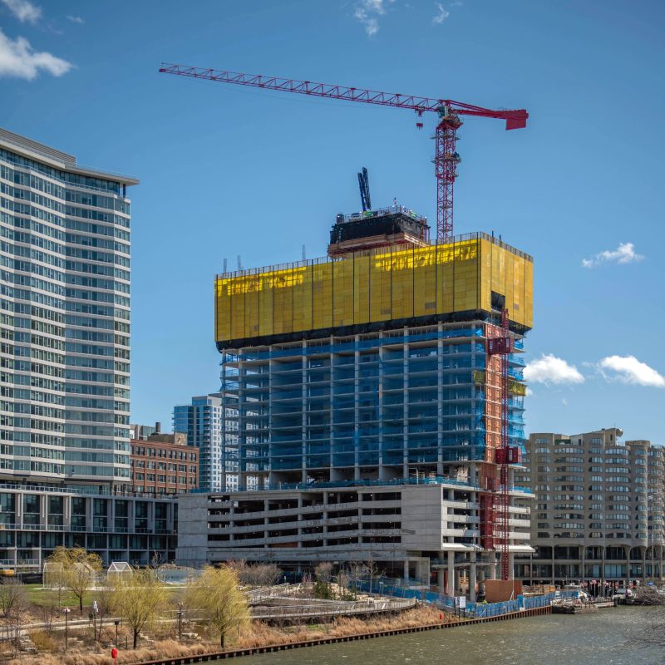
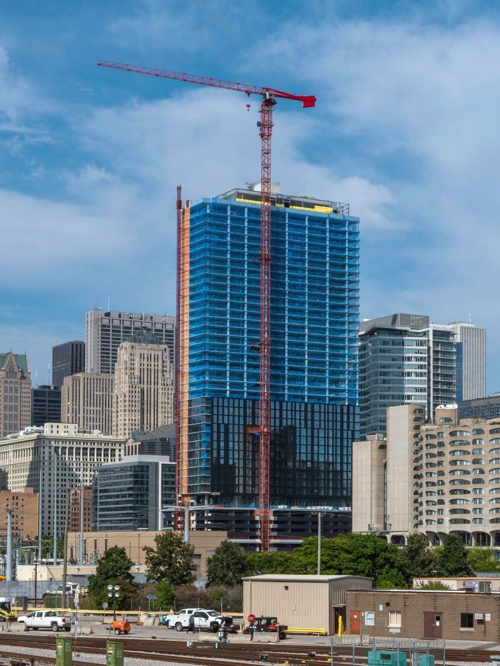



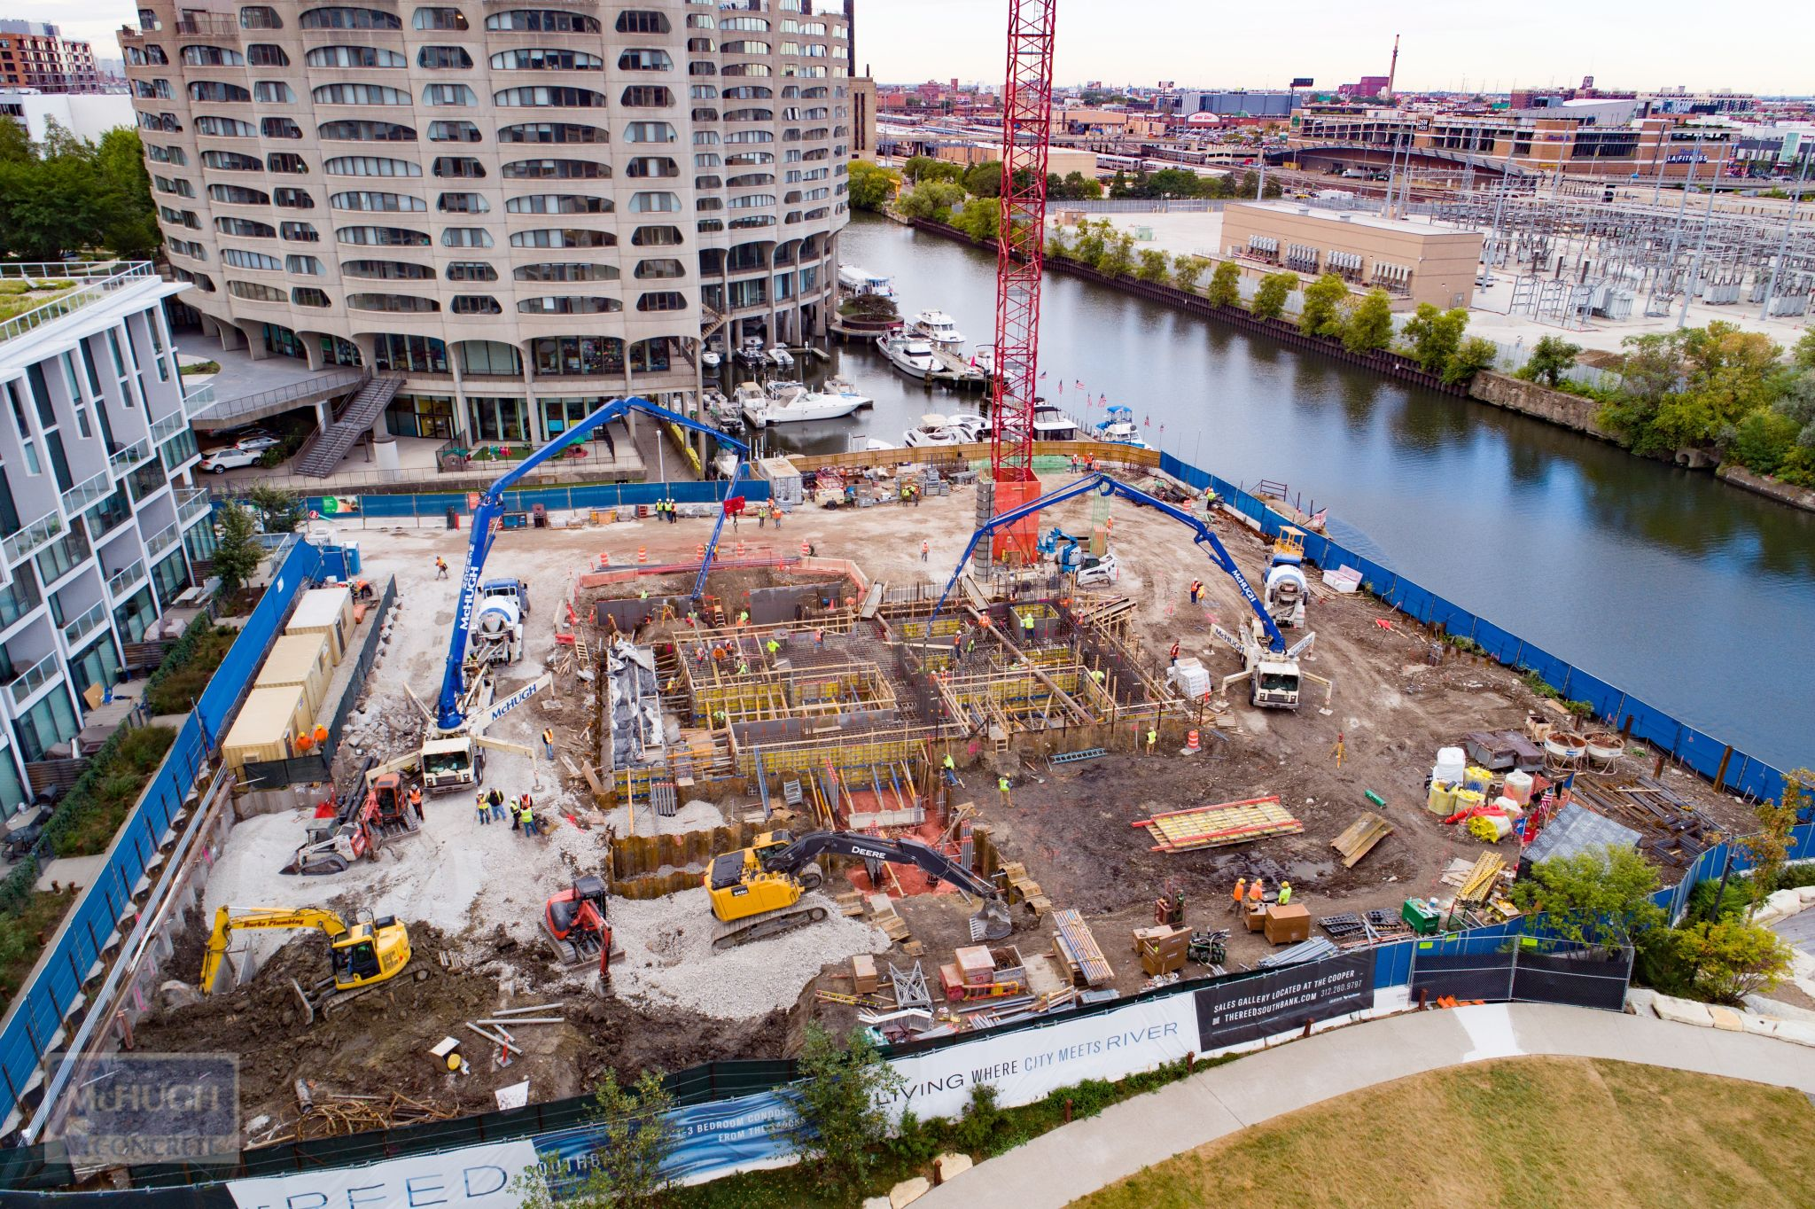
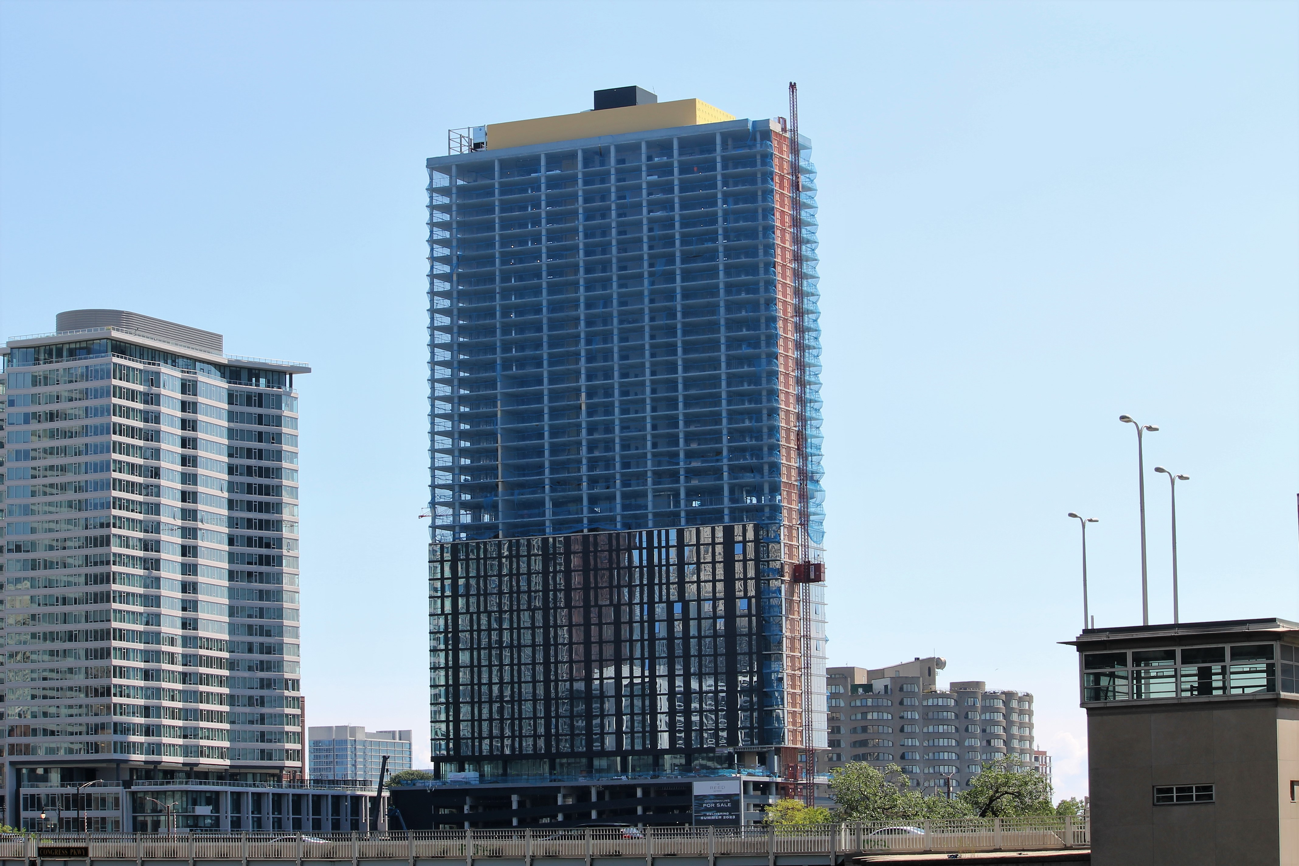


Project Credits

