Slide 1


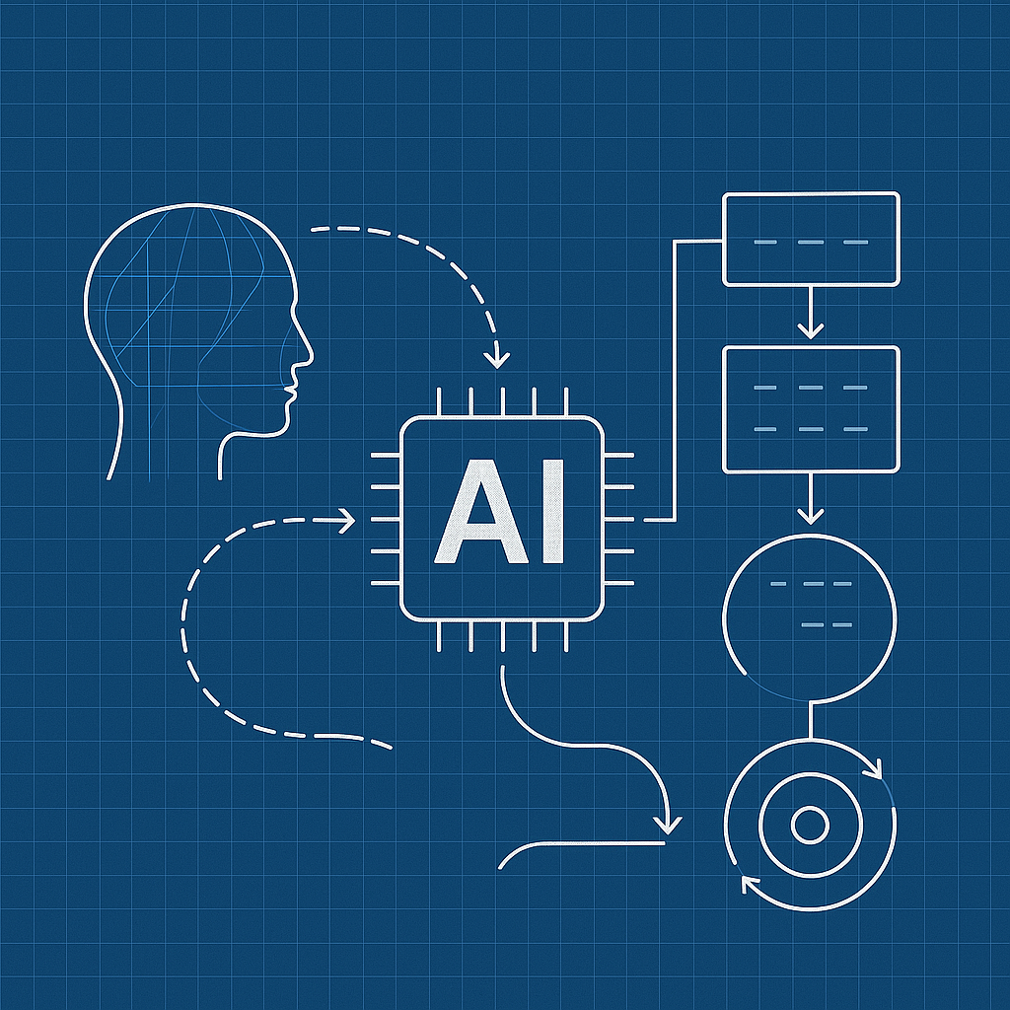

UNCERTAIN
AI FUTURES
WHAT COULD AI MEAN FOR OUR INDUSTRY, OUR PLACES & MY ROLE
October 29, 2025

Slide 2








Jeff Danley
Innovation Development Director
25 years leading innovation
3 patents awarded
Reached over 100M customers

Slide 3
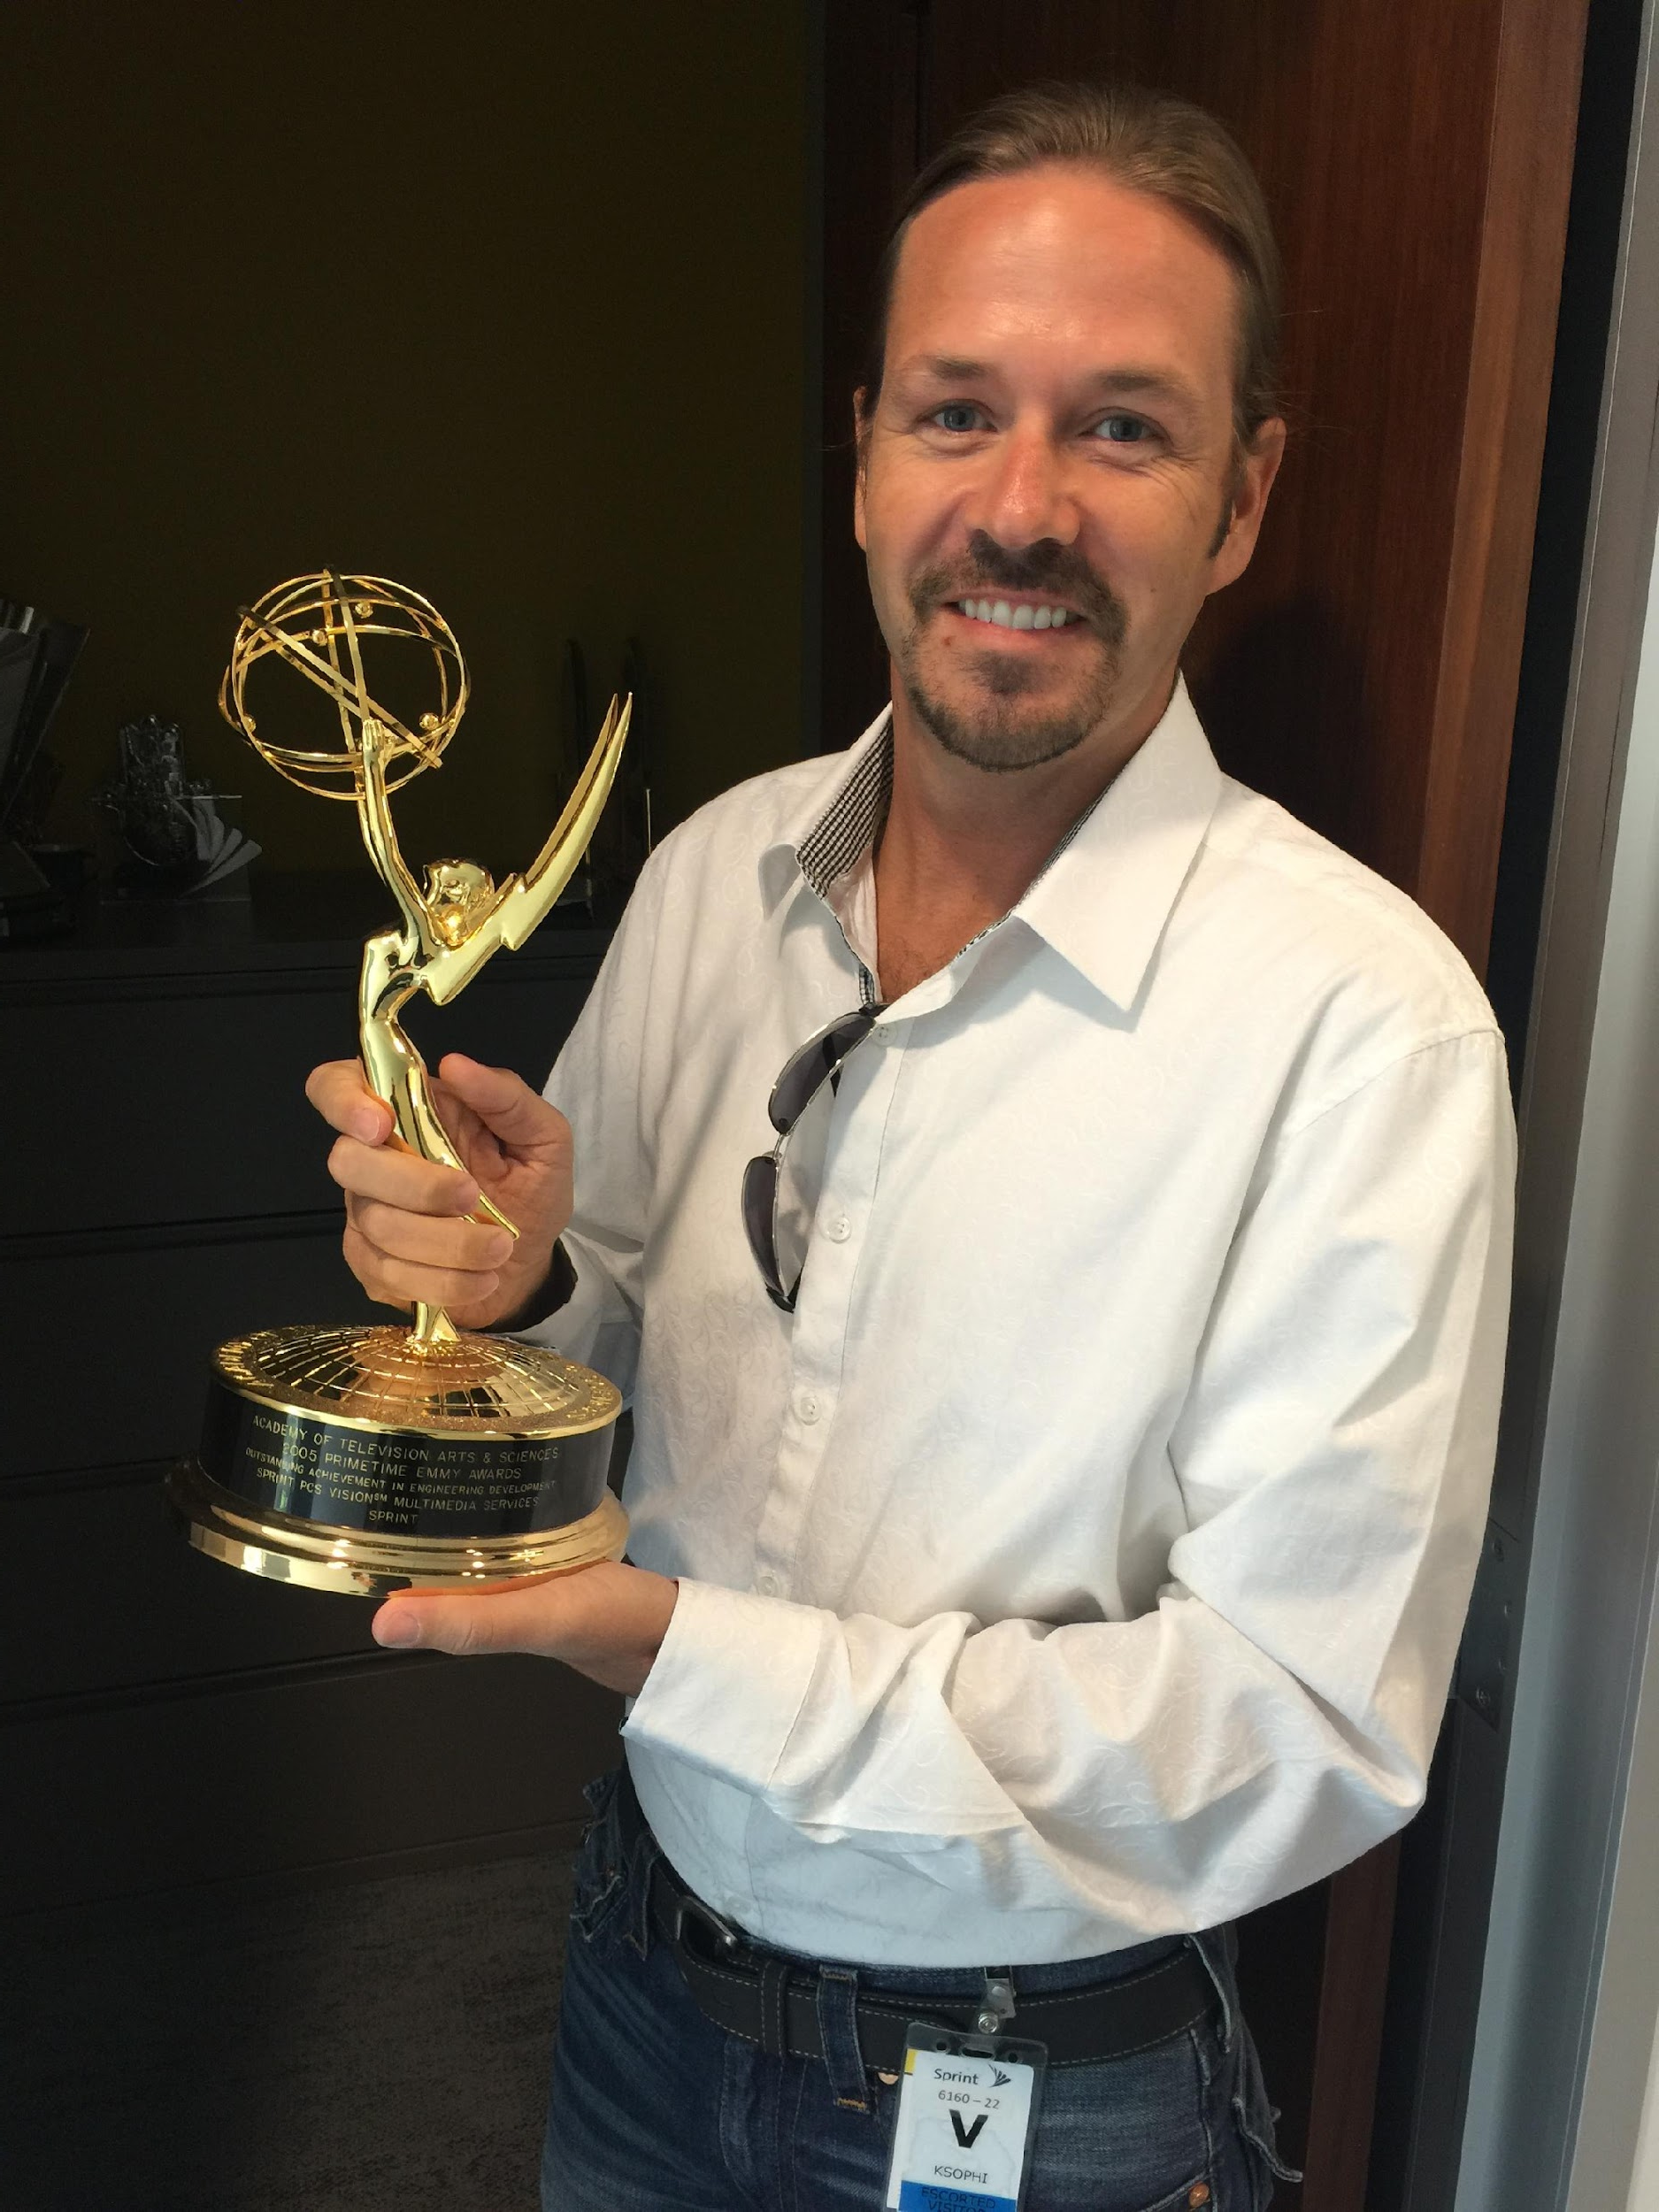

History of Questionable Ideas
2000 - US Patent 7,376,091
2005 - Video on Mobile Phones
Wireless bridge for interfacing an 802.11 Network with a Cellular Network.
Feedback “Why would you ever want to connect WIFI and Cellular networks?”
In 2005 Launched streaming video to mobile phones.
Feedback “No one will ever watch video on a phone.”
2002 - Email on Phones
2006 - Music Genome Project
Began testing email apps on mobile phones.
Feedback “No one will ever check email on a phone.”
Partnered with Pandora to launch the first Pandora mobile app.

Slide 4

You will never experience a slower rate of change
than right now.

Slide 5
The Future Isn’t Written - It’s Designed.
We’re not here to forecast AI, we’re here to shape how we respond to it.

Slide 6
Three Lenses for Today:
Industry – How AI is changing AEC workflows
Place – How AI will reshape our built environments
Role – How each of us can grow and adapt

Slide 7
Industry Lense: The Shift Has Already Begun
Generative design tools reducing design cycles
AI scheduling & estimating improving accuracy
Predictive maintenance redefining asset management
AI agents in project management, documentation, and safety

Slide 8
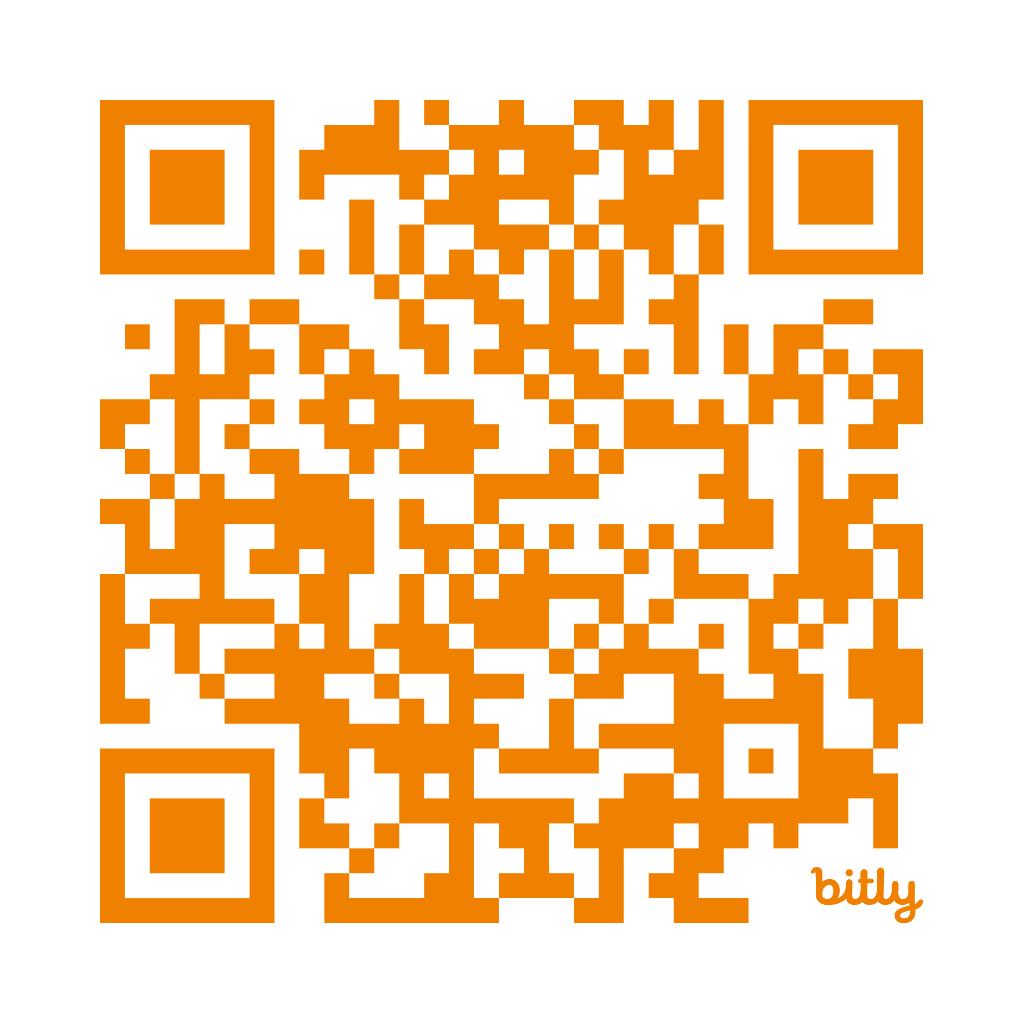
Poll #1: Which AEC Workflow Will AI Disrupt First?
Design Automation
Estimating & Scheduling
Field Operations
Asset Management
None of the above
Notes:
https://forms.gle/sMrbJDiRbnv3hMHM9

Slide 9
Place Lense: AI Will Reshape The World Around Us
Smart cities optimizing energy and traffic in real time
Autonomous job sites with self-directed equipment
Digital twins guiding planning & maintenance
AI-enhanced sustainability modeling

Slide 10
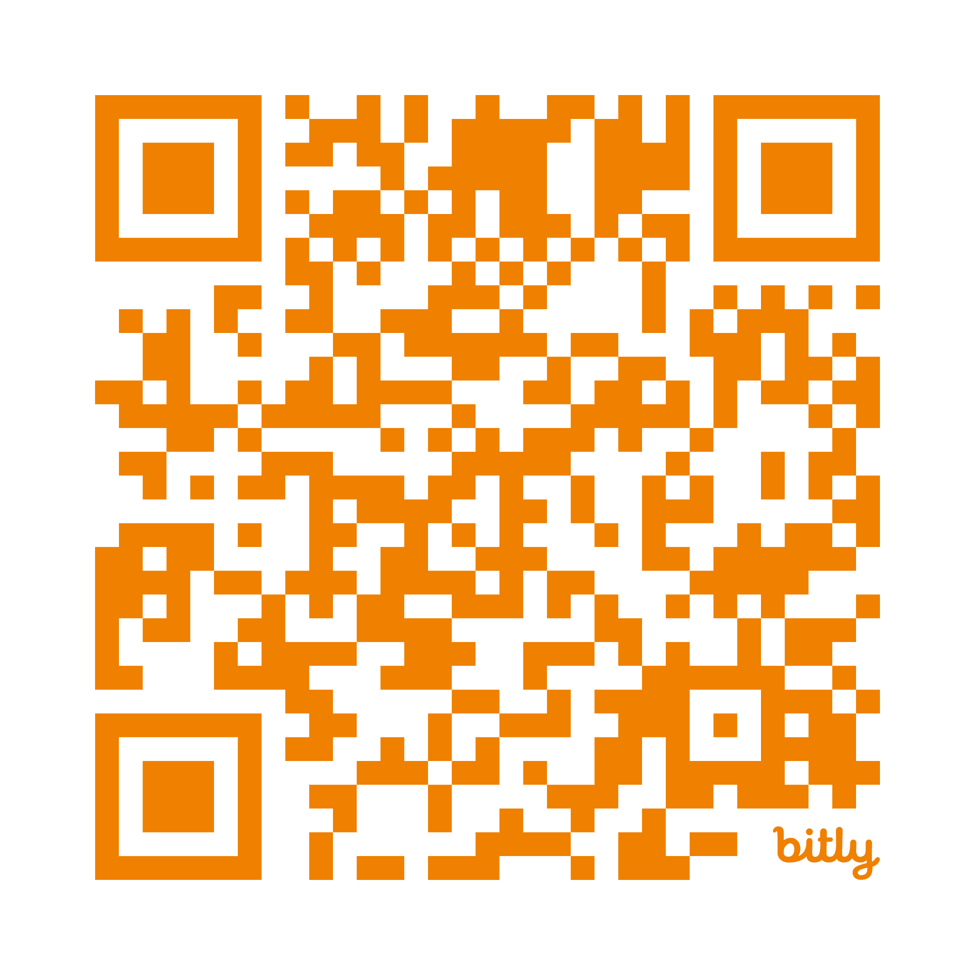
Poll #2: Which AI-Driven City Feels Most Realistic?
Autonomous Construction Sites
AI-Managed Infrastructure
Predictive City Maintenance
Digital Twin Urban Planning
None of the above
Notes:
https://forms.gle/egCz8KFJzdB8CueS9

Slide 11
Your AI Journey
Think about where you are today:
    Curious but cautious
    Experimenting
    Leading adoption

Slide 12
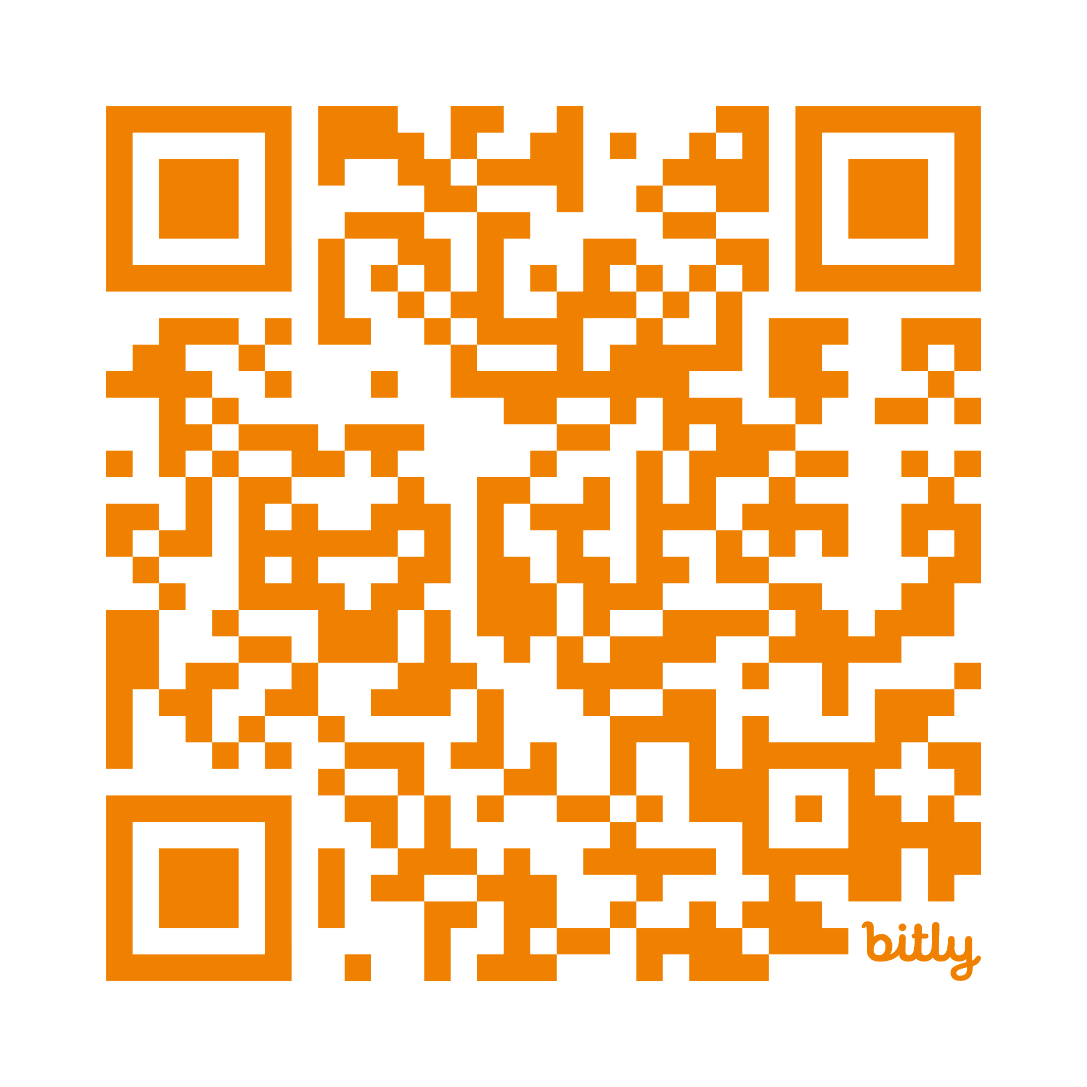
Poll #3: Where Are You on Your AI Journey?
Not Interested
Curious but cautious
Actively Experimenting
Leading Adoption
Notes:
https://forms.gle/rWU7L6Dr1kvqyrAn9

Slide 13
Responsible AI: Opportunity Requires Responsibility
Bias & fairness
Safety & liability
Privacy & data control
Workforce impact

Slide 14
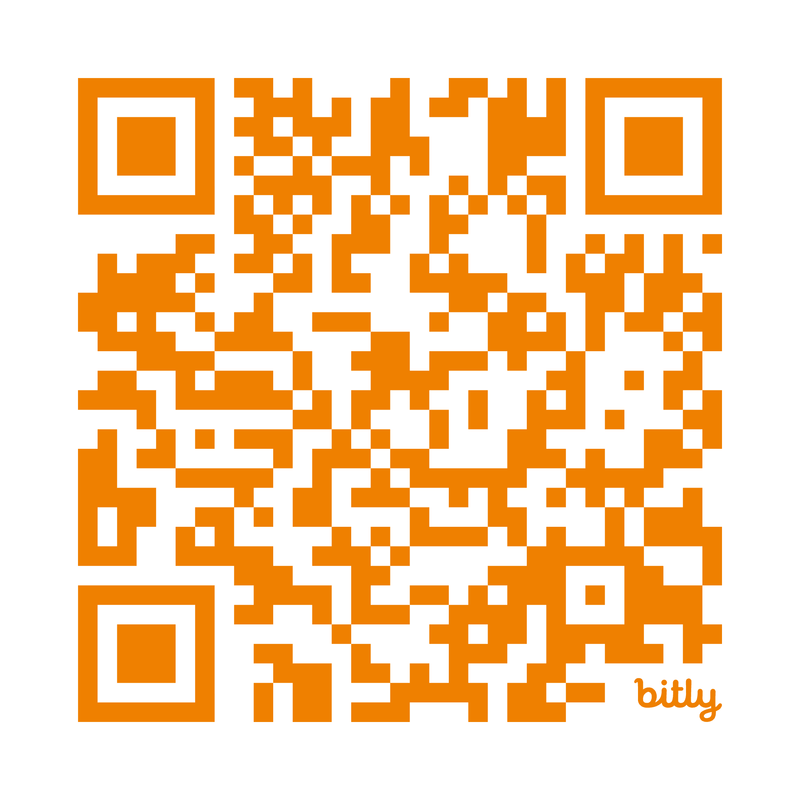
Poll #4: What Worries You Most About AI Adoption?
Bias & Fairness
Job Displacement
Safety & Liability
Data Privacy
Overreliance on Automation
Notes:
https://forms.gle/kVWDRfhnE21STFp6A

Slide 15
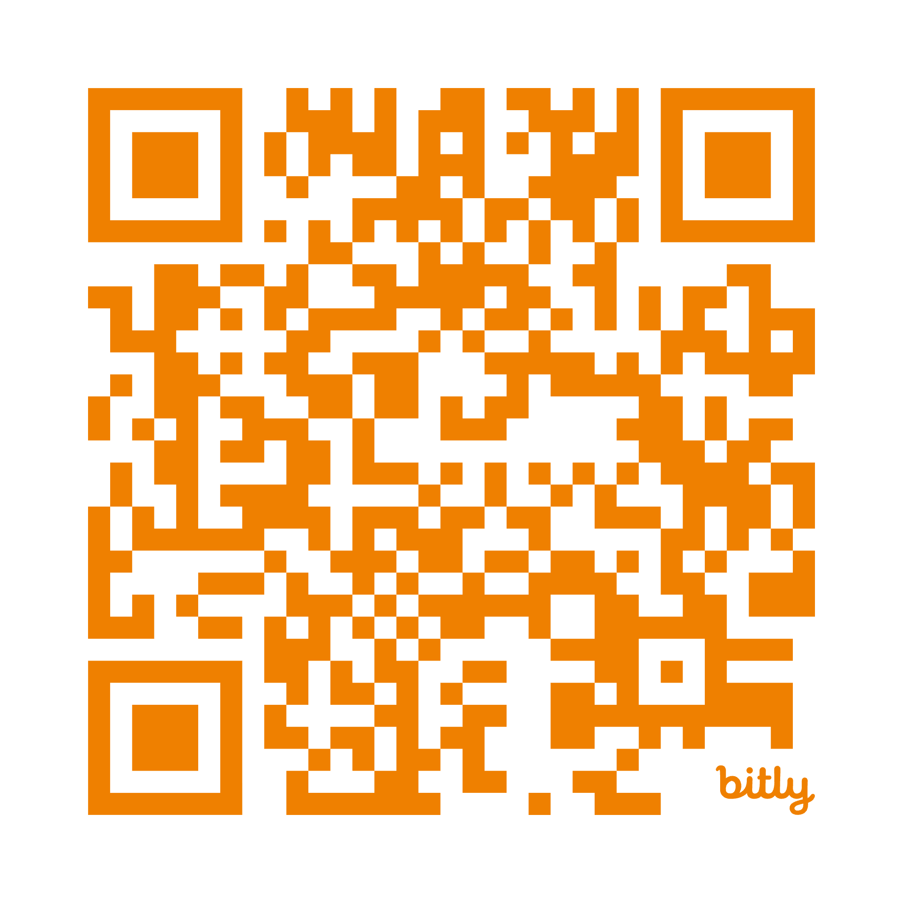
CLOSING REFLECTION
What one word describes the AI future you want to build?
Notes:
https://forms.gle/qUcbCdhnJ97dCrhw6

Slide 16
{ Word Cloud }

Slide 17
NEXT STEPS
Start small – experiment safely
Stay curious – learn how AI actually works
Shape the change – influence how your teams adopt AI
Build literacy – help others around you understand the potential

Slide 18
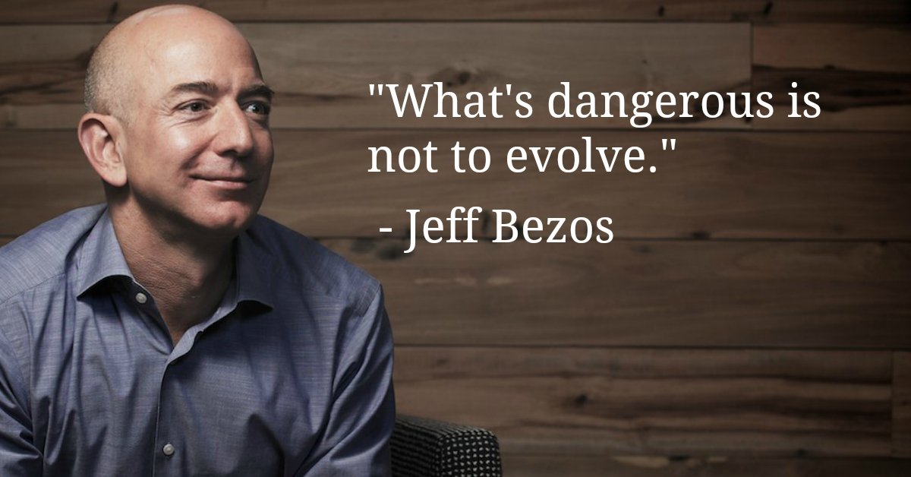


Slide 19
THANK YOU!
Jeff Danley
Innovation Development Director
jdanley@burnsmcd.com
+1 816 718 3801
@jeffdanley
#InnovationByDesign

