Slide 1
STEPPING UP YOUR CONSTRUCTION SAFETY MEASURES
Integrating Human Performance & Construction Resilience
Presented by: Mel Langlais, Senior Safety Director, Mortenson

Slide 2
ICEBREAKER
Raise your hand if you believe your jobsite's best safety measures were put in place after an incident or near-miss occurred, as opposed to being proactively designed beforehand.
Notes:
"Look around. That's a common reality in construction, and it highlights why we need to move from reactive compliance to proactive resilience—designing systems that anticipate error before someone gets hurt. That's what this session is about."

Slide 3
WHY THIS WORKSHOP MATTERS
This session explores how human performance principles and construction resilience can transform safety outcomes, learn how to move beyond compliance and build systems that anticipate error, support workers, and adapt to disruption. We’ll highlight easy to implement best practice leadership safety measures in safety innovation and how you can apply these strategies to your own jobsite.

Slide 4
4 KEY TAKEAWAYS
Understand human performance principles in construction safety
Embed resilience into daily operations
Measure and improve safety-related decision-making
Learn from proactive safety leadership management tools

Slide 5
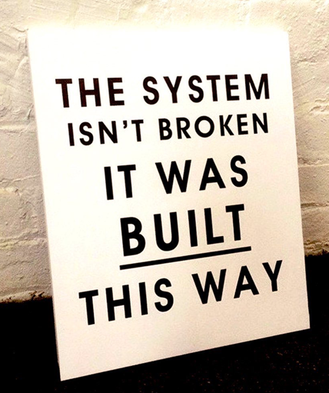
ERROR IS NORMAL & EXPECTED
Expect Mistakes—Design for Them
Human error is inevitable.
Safety systems must anticipate and mitigate it.
Construction Application
Use redundancy and fail-safes.
Normalize reporting and near-miss tracking.

Slide 6
ERROR IS NORMAL & EXPECTED
Error
The unintentional deviation from an expected outcome.
Three main types of errors exist:
Skill-Based (Automatic) | Errors during highly routine activities based on learned skills; very low cognitive commitment. | Low (1 per 1,000 actions)
Rule-Based | Errors associated with the application of rules or procedures that govern a task. | Medium (1 per 100 actions)
Knowledge-Based (Conscious) | Errors resulting from insufficient knowledge, leading to an incorrect solution that is expected to work. | High (20 per 100 actions)
Error Likely Situations (ELS)
A work situation where performance-shaping factors are incompatible with the worker's capabilities, limitations, or needs.
Workers are much more likely to make errors in these situations, especially when under stress.

Slide 7
ERROR LIKELY SITUATION - CONFINED SPACE CASE STUDY
Performance-Shaping Factor | Worker's Capability/Limitation/Need | Incompatibility/Conflict
Physical Environment
Inadequate Lighting (Dim, patchy, or highly localized) | Need for Clear Vision and Visual Acuity to perform precise work (welding, cutting, measuring). | The limited visibility forces the worker to strain, reposition awkwardly, or rely on touch, increasing the likelihood of a measurement error, an incorrect cut, or a welding flaw.
Access/Maneuver Space (Small, confined area) | Limitation of Human Mobility (Need to move tools, position the body comfortably, and maintain balance). | The confined space restricts the workers movement, making it difficult to hold a straight line or keep the tool steady. This increases the chance of accidental contact, a slip, or a tool-handling error.
Individual Worker Factor
Fatigue/Strain (From extended awkward posture) | Limitation of Endurance (The body's requirement for ergonomic posture and rest). | Sustained awkward postures and visual strain from the dim light lead to physical fatigue and reduced concentration over time, directly increasing the probability of a performance error or accident towards the end of the task.

Slide 8
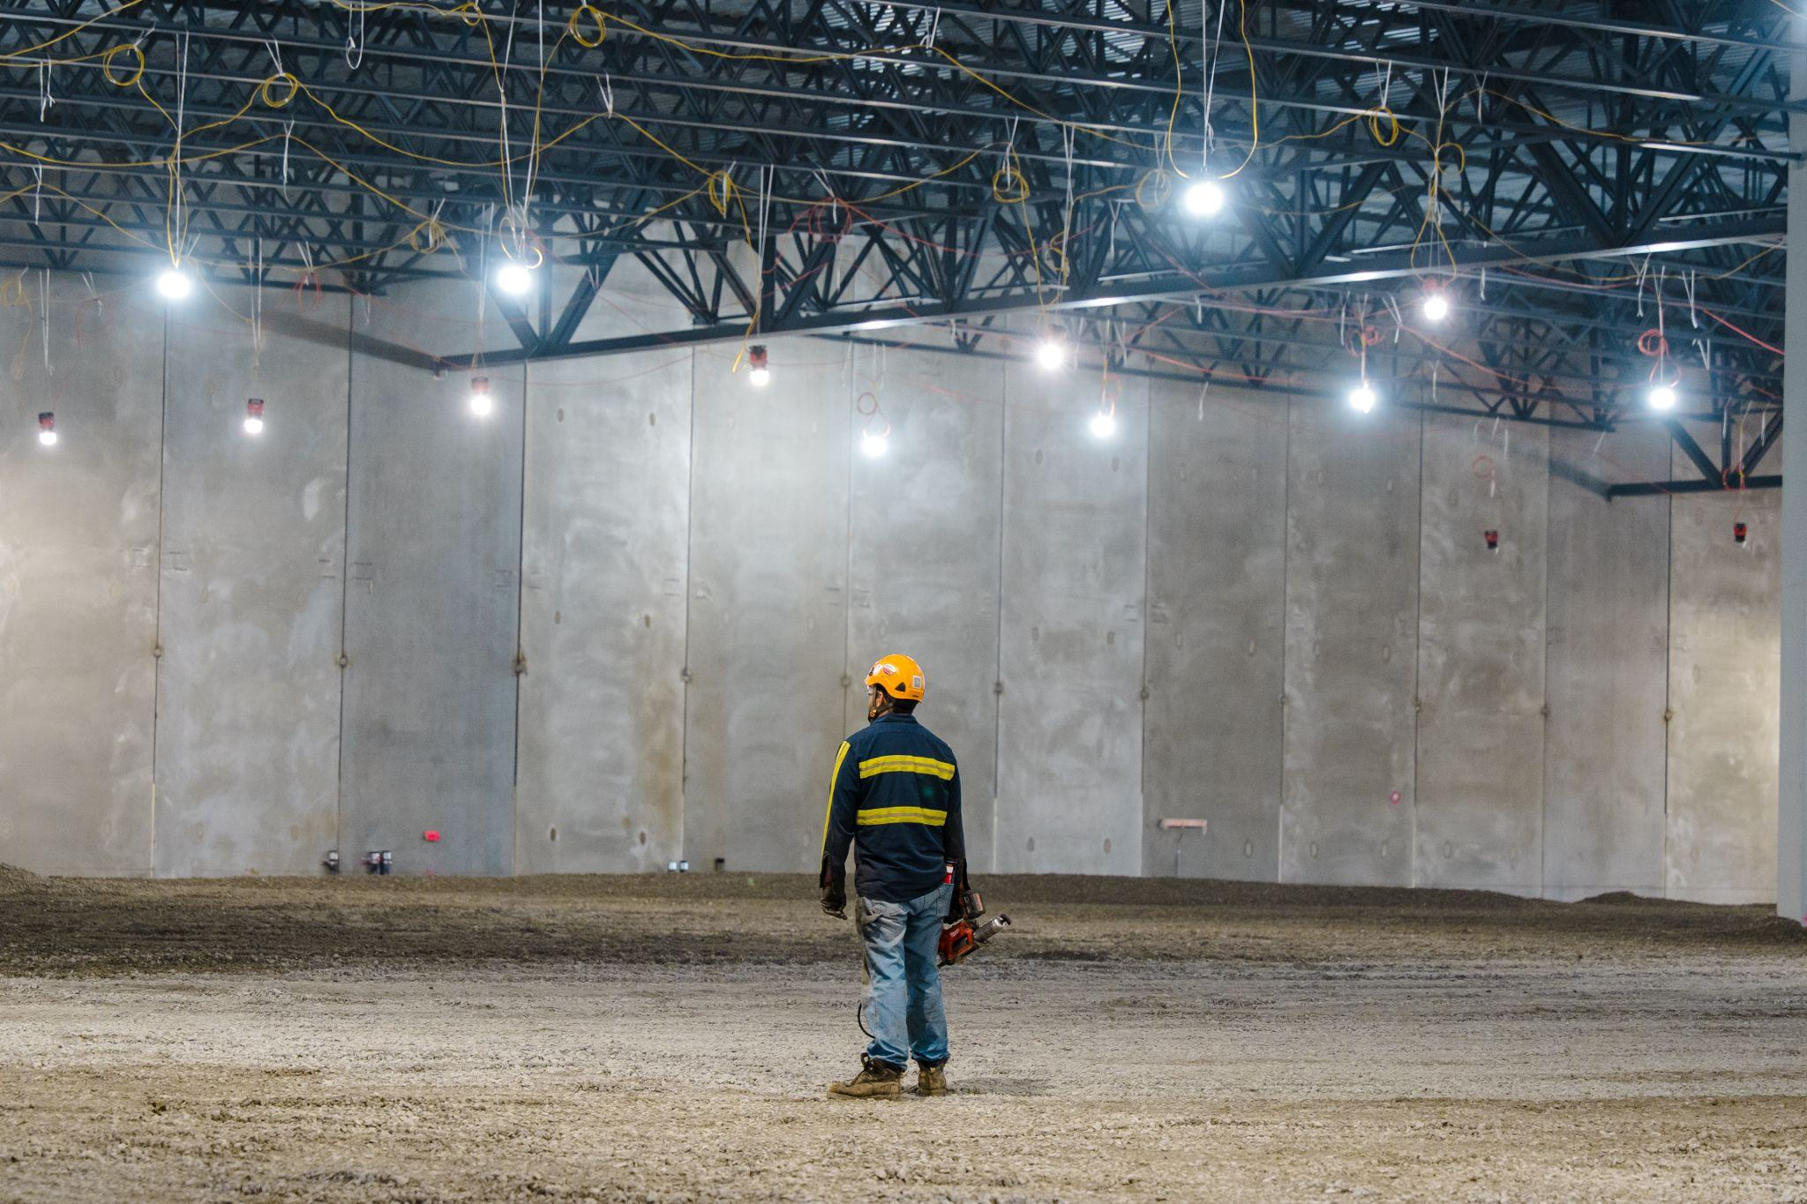
ERROR LIKELY SITUATION - CONFINED SPACE CASE STUDY
Error Outcome
The incompatibility between the need for good visibility/mobility and the poorly lit, confined environment makes it highly likely that the worker will:
Make a measurement error (e.g., cutting a pipe too short).
Misalign the material (e.g., weld a joint crookedly).
Sustain a minor injury (e.g., bump their head or scrape their hand due to restricted movement).

Slide 9

ERROR IS NORMAL & EXPECTED
Error Precursors
Unfavorable conditions embedded in the job site.
They create mismatches between a task and the individual worker.
Failure
The unexpected combination of normal performance variability. According to Erik Hollnagel failure happens for three reasons: (and it’s RARELY because they are unsafe or failed to pre-plan)
The worker believes that what is about to happen to them is simply not possible.
The failure often has nothing to do with the tasks and processes that the worker is currently doing in the field (context).
The worker feels the possibility of getting the intended outcome is well worth whatever risk is present.

Slide 10
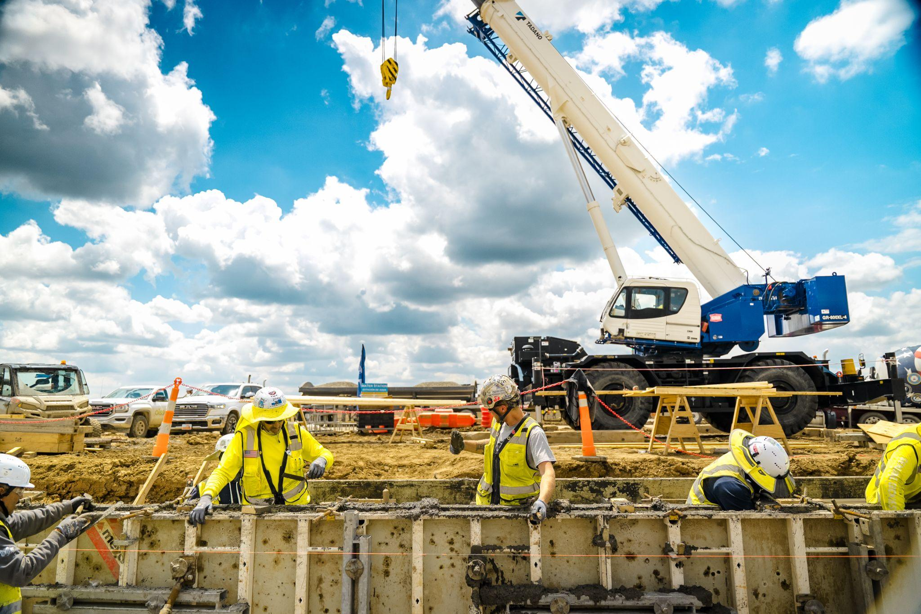
CONTEXT DRIVES BEHAVIOR
Shape the Environment, Shape the Outcome
Workers respond to the conditions around them.
Construction Application
Clear signage, ergonomic tools.
Psychological safety and leadership modeling.

Slide 11
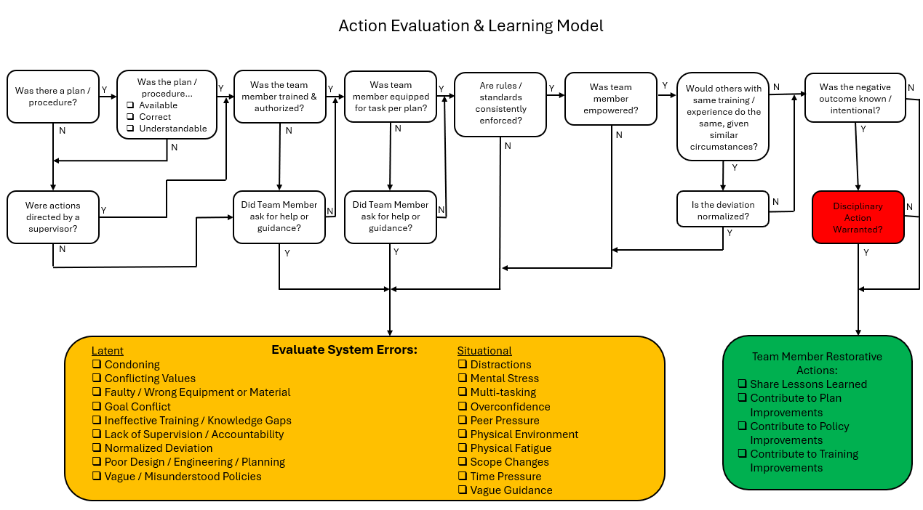
CONTEXT DRIVES BEHAVIOR

Slide 12
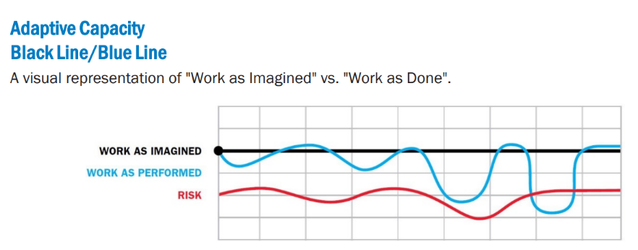
LEARNING IS VITAL
Learn from Every Incident
Safety improves when teams learn from mistakes.
Construction Application
Encourage open reporting.
Conduct debriefs and share lessons learned.
Safety Management Tools
Learning Teams
4Cs

Slide 13
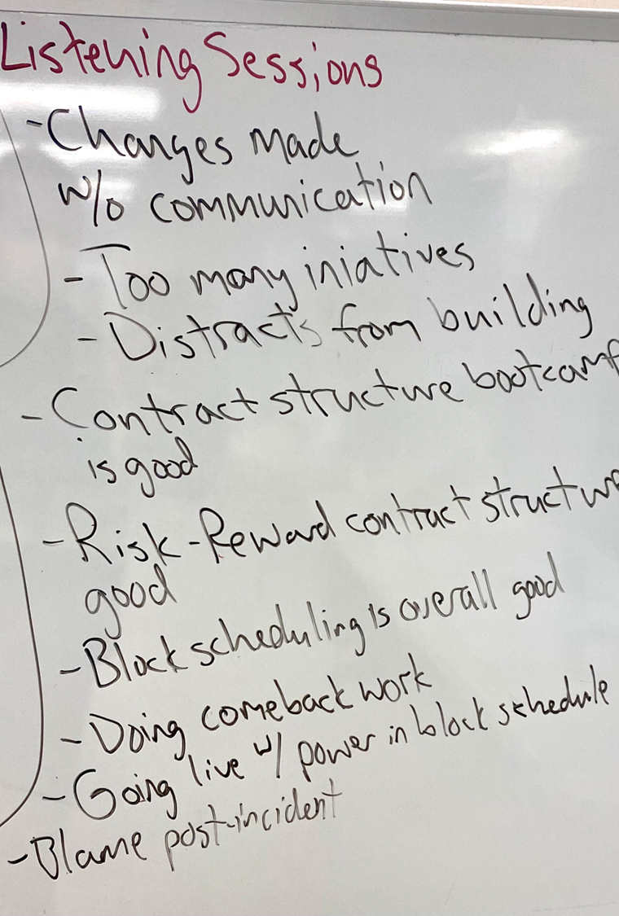
LEARNING IS VITAL
Why We Learn
Adjustment is Key: Performance adjustments are the reason work usually succeeds but also why it sometimes fails.
Focus on Process: Go deep into how the work is performed, not who is to blame.
Involve all workers—ensure everyone has an equal voice.
Focus on what happened and how the system led to it (Take the WHY out of learning).

Slide 14

LEARNING IS VITAL
Learning Team Applications
We deploy Learning Teams to investigate and improve processes:
Reactive: Post-Incident, Near Miss (NM), or following failures (Complements RCA).
Proactive: Specific Process Improvement, Human Reliability Analysis (HRA), New Process Rollouts.
Culture: Following Climate or Engagement Survey results.
Key Insights & Action Areas
Current Reality (Challenges) | Focus for Improvement (Action)
Management creates reactive, temporary solutions based on old findings. | Understand how owner design decisions impact crew efficiency.
Workers must compensate for design flaws or poor housekeeping. | Close training gaps—do not assume competence (e.g., manual handling).

Slide 15
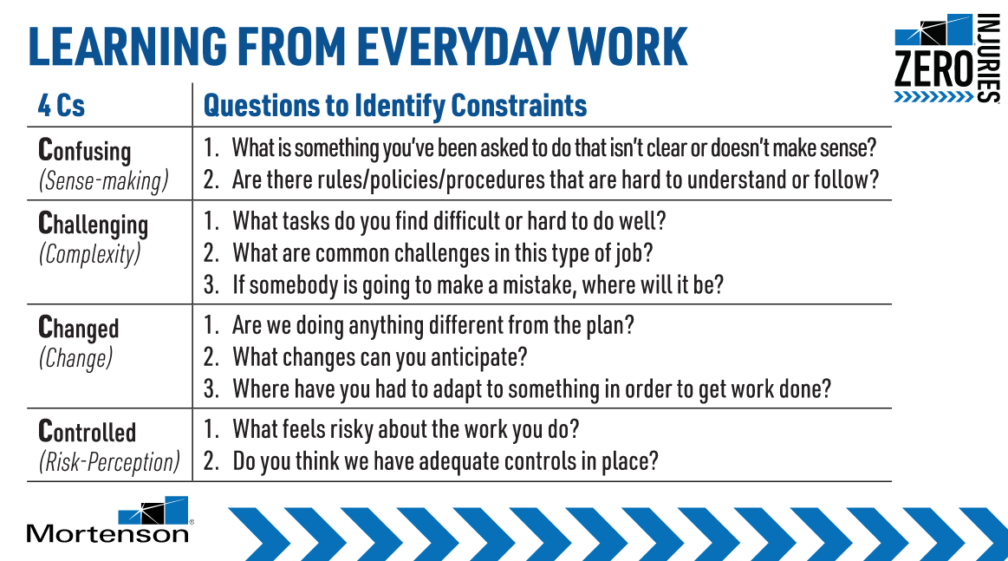
4Cs OF LEARNING FROM EVERYDAY WORK
What are the 4Cs?
The 4Cs represent common constraints in the work that contribute to human error.
They help us look deeper, beyond physical hazards, to support our craft in overcoming things that are:
Confusing or don’t make sense,
Things that make work execution more Challenging than it needs to be,
Changed conditions that disrupt plans requiring unanticipated adjustments,
And understand whether risks are adequately Controlled to mitigate negative consequences.
The questions can unveil specific constraints crews and teams are experiencing, and drive discussion toward solutions before errors lead to negative impacts.

Slide 16
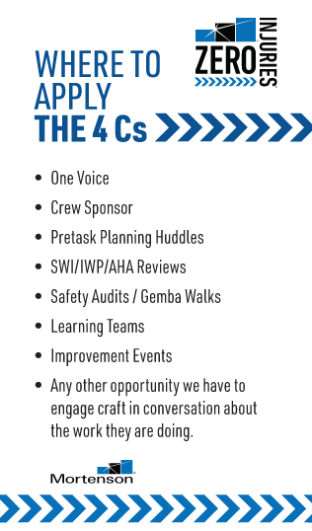
4Cs OF LEARNING FROM EVERYDAY WORK
Why do we need 4Cs?
Learning is Reactive: Our most intentional learning often takes place only during incident investigations.
Incidents are Rare: Significant incidents are infrequent, but small events (close calls, bottlenecks, shortcuts) that make work harder happen every day.
Superficial Conversations: Field interactions are often generic ("How's it going?"), resulting in superficial responses and missed opportunities for meaningful feedback.
The 4Cs Approach
Unlock Daily Learning: We must learn from everyday work—both what makes it hard and what helps it go well.
Ask Better Questions: Equip teams with better, thought-provoking questions (e.g., "What are common challenges in this job?").
Focus on the Experts: Take time to ask these questions of those who know the work best: our craft workforce.
Actionable Response: Our follow-up will formalize best practices and remove constraints, making work:
Safer
Easier
More Sustainable

Slide 17
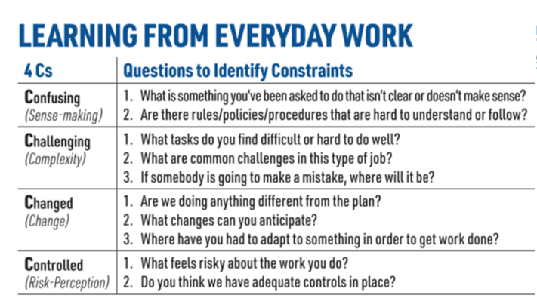
THE 4Cs

Slide 18
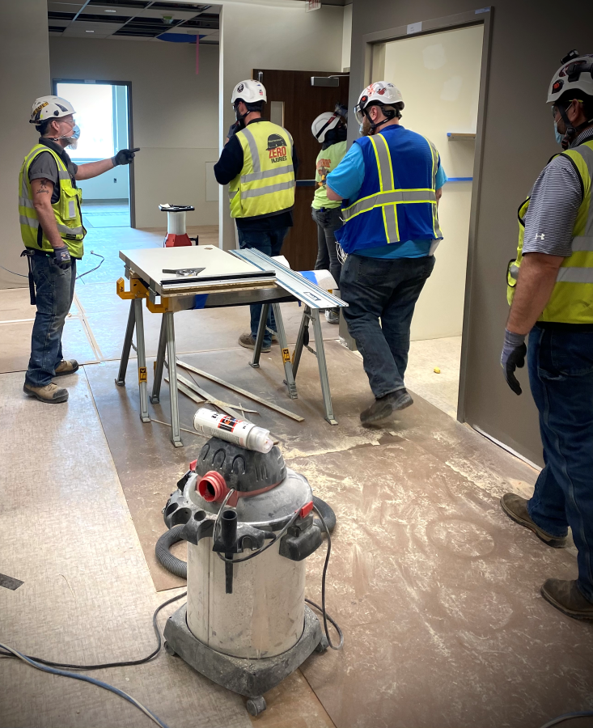
THE 4Cs FUNDAMENTALS
Key Principles
Leadership Engagement (beyond B/S & PTP)
Integrated in our Crew Sponsorship Program
About going where, the work is being performed – Not a safety audit.
(Safe) work is a problem that must be solved every day.
4Cs Walks allow leaders to learn about the realities of everyday work and support workers in dealing with those realities.
Humble inquiry is a skill supported by YOUR Leadership Program
Training & Coaching – 87% Completed

Slide 19
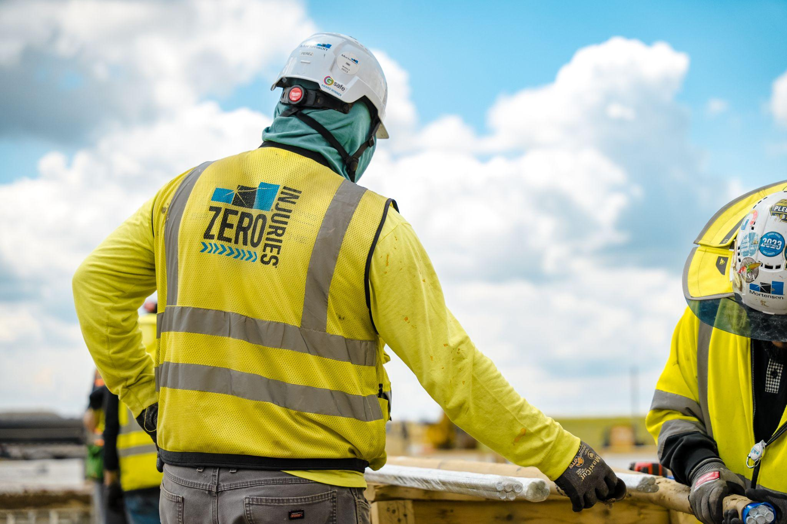
RESPONSE MATTERS
How Leaders React Shapes Culture
Blame discourages reporting. Inquiry builds trust.
Construction Application
Support workers.
Fix systems, not people.
Do You Have a Company Leadership Program?
Mel's Psychological Safety Self Checklist:
Promote Learning over Blame: Do I encourage learning from errors instead of assigning blame and punishment?
Create Safe Space: Am I creating a safe space for my direct reports to share mistakes?
Understand Workflows: Am I investing time to understand how my team's day-to-day work really gets done (for learning/improvement only)?
Focus on Systems: When a failure occurs, do I drive the conversation to focus on systems and processes rather than individual behavior?
Coach for "Safe Day" Learning: Do I coach people to intentionally learn from days where things went well (safe days)?

Slide 20
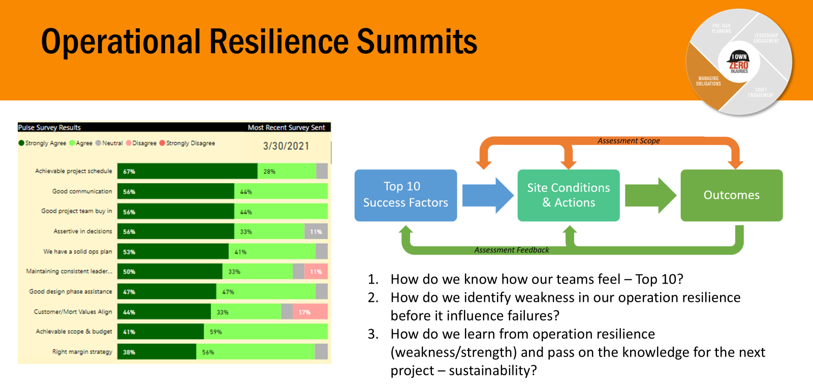
RESPONSE MATTERS - LISTENING SESSIONS VS CLIMATE SURVEYS

Slide 21
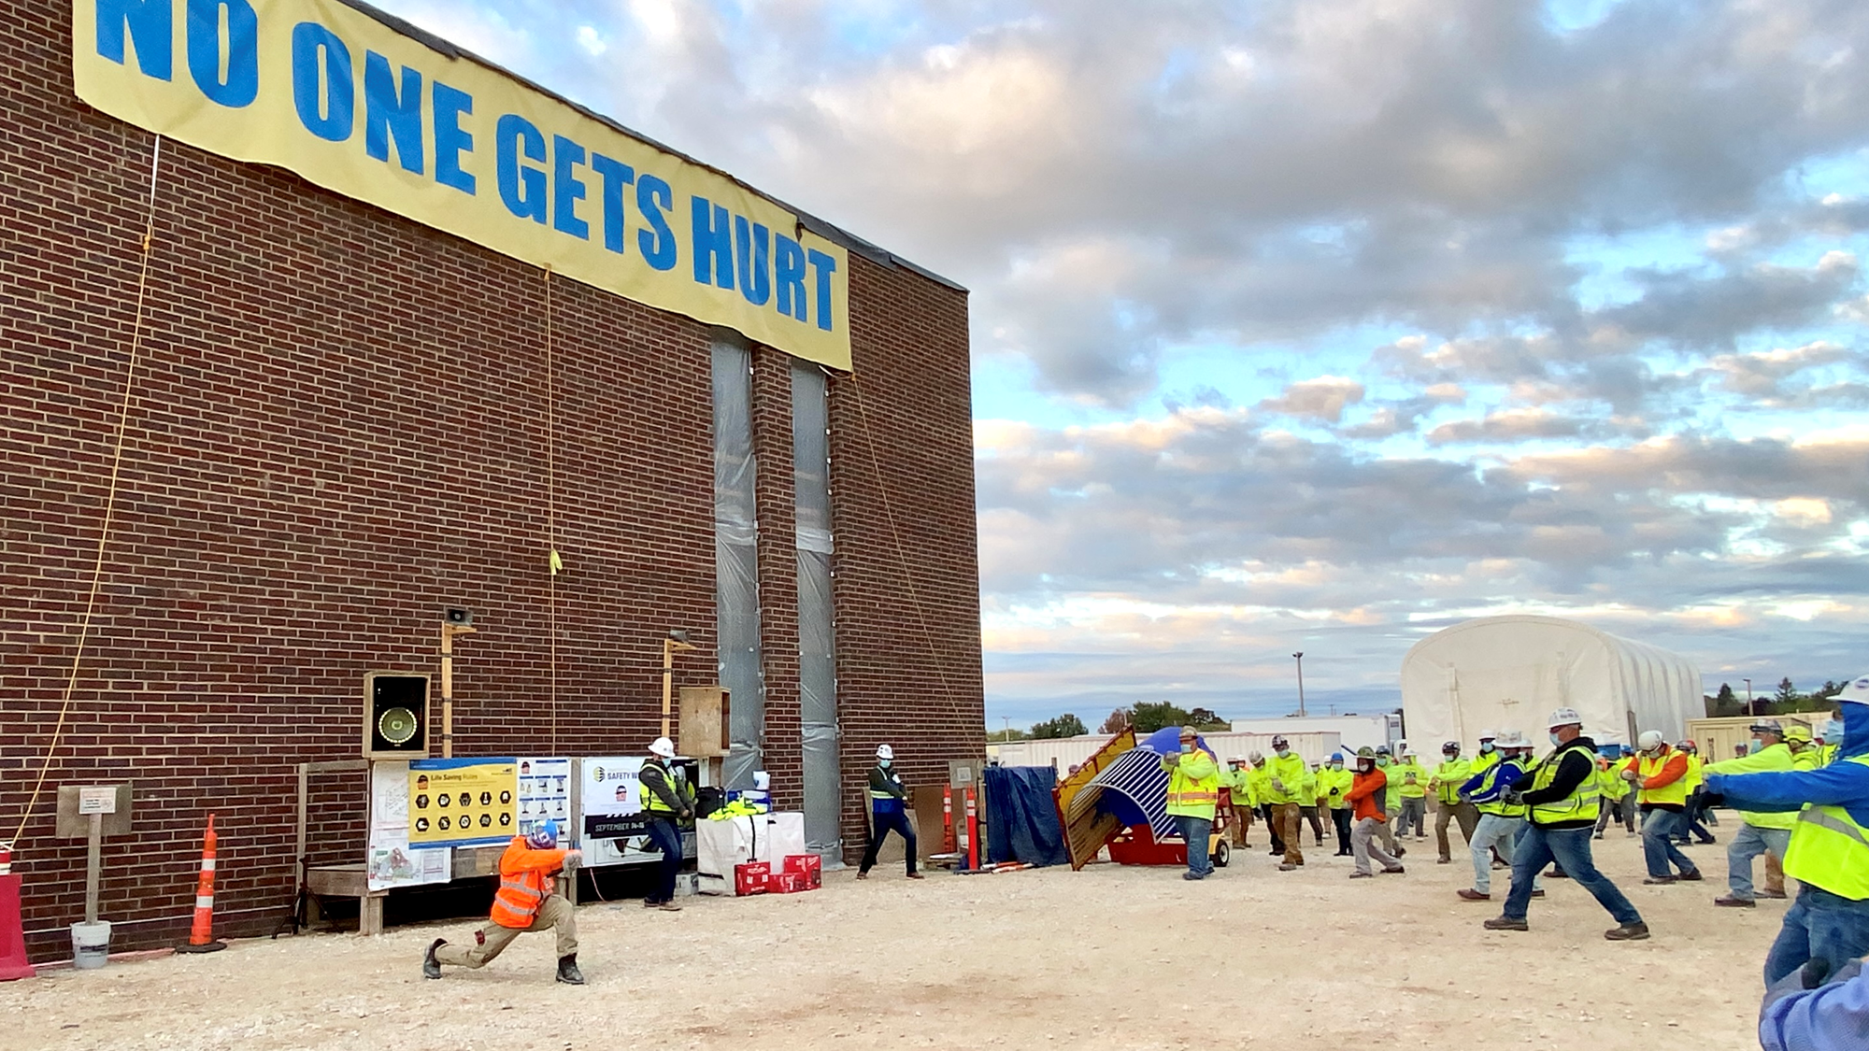
RESPONSE MATTERS - LISTENING SESSIONS VS CLIMATE SURVEYS
Listening sessions are designed to deep-dive on specific areas of our operation to validate resilience:
Climate survey follow-up
Pulse survey follow-up
Post Safety Standdown
Operational Resilience Summits
Post incident
Post scope completion
When it’s just too quiet

Slide 22
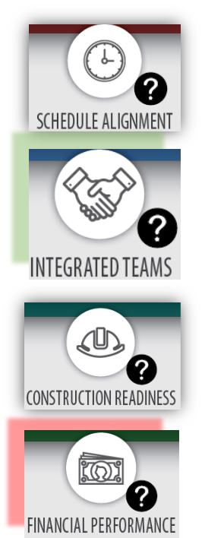
RESPONSE MATTERS - OPERATIONAL RESILIENCE SUMMIT VS SAFETY AUDITING
Customer & Team Focus
Accountable Customer Relations: Build meaningful customer relationships with clear, respectful, and firm accountability.
Communicate the 'Why': Be exceptional at conveying difficult information by focusing on root causes.
Team Foundation: Use high-performing teams as the foundation for our relationship philosophy.
Support Trades: Provide essential support (resources/technology) to our finish trades.
Focused Learning Sessions
Block Schedule: Organize a focused L/L session for OG Superintendents to exchange key organizational learnings.
Shifting Our Approach to Failure
Culture Change: Shift the organizational approach to failure from punitive/blameful to learning and collaborative improvement.
Process Commitment: Commit to the Learning Team process for incident lessons and corrective measures.
Leadership & Focus: Secure OG Leadership Buy-in and ensure the CIA process focuses solely on learning, not anxiety.
Highlighting Operational Strengths
Resilience Summit: Hold a summit to validate the resilience of all operational success factors, moving beyond safety in a silo.
Proactive Team Communication: Leverage our strong team communication as an early warning indicator to find potential problems faster.
Notes:
Customer relationships: Invest significant effort into creating meaningful relationship with the customer with built-in accountability: clear, respectful but firm.
We need to be exceptional at communicating the hard stuff with a focus on why?
High performing teams is an instrumental process to build that relationship philosophy.
Need to help support our finish trades (less resources/technology)
Block Schedule: Organize a focus L/L meeting with the OG Supts. to share learning stories.
As an organization with need to change our approach about how we address failure.
Commit to the learning team process for incident lesson learned and corrective measures - improve the culture from a perceived punitive/blameful perception to learning and collaborative improvement.
OG leadership Buy-in
CIA process - continue focusing the message to be about learning.
This should not create anxiety amongst the team.
What are we doing well?
Summit focused on validating the resilience of all operational success factors – not safety in a silo! (Strength/Potential Weakness Outlined)
We have a good team that communicates well
indicator that we will most likely find out about what could become a problem faster than other teams because people understand why the schedule is build that way and provide input when changes happens about what could be a problem.

Slide 23
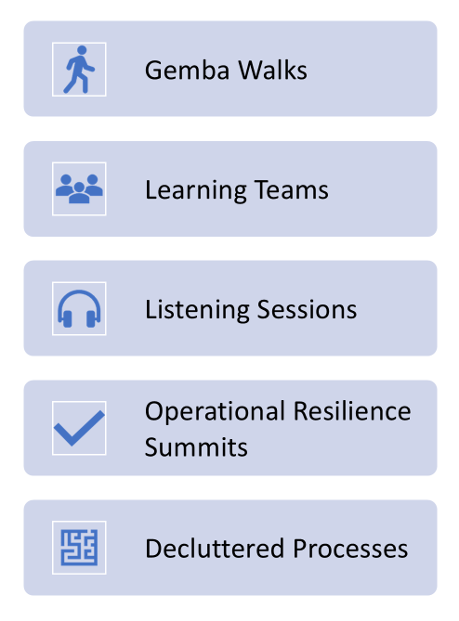
MEASURING CONSTRUCTION OPERATIONAL RESILIENCE
Best Practices for Safety Resilience
Use leading indicators (Schedule delays, procurement issues, design changes, strong project leadership).
Monitor adaptability during disruptions.
Do we fail safely here?
Track team engagement and psychological safety.
Leverage tech: wearables, dashboards, predictive analytics, AI tools.

Slide 24
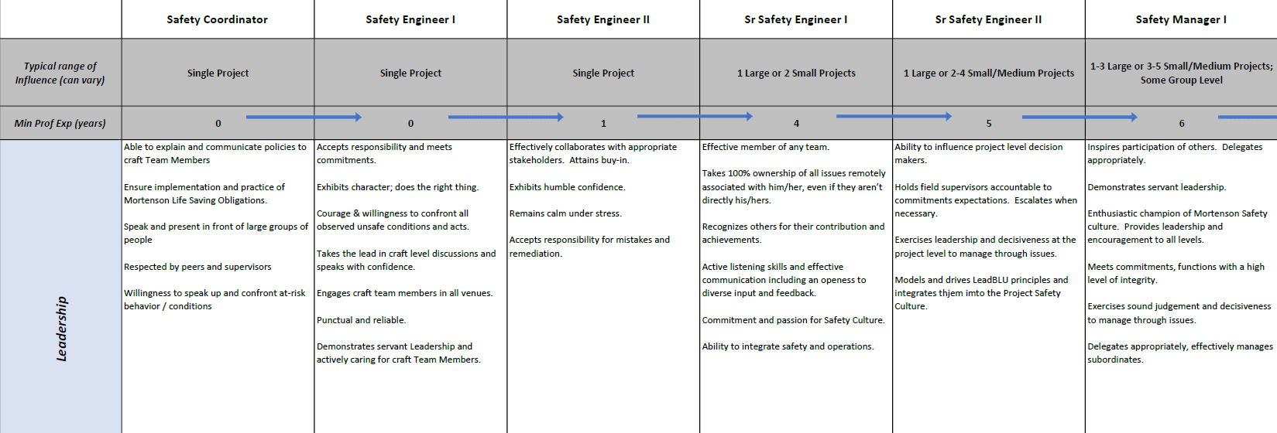
SAFETY STAFFING STRUCTURE - SAFETY POSITION ADVANCEMENT

Slide 25
LET’S BUILD SAFER TOGETHER
Thank you for joining! Questions?

